Slide 1

感恩遇见，相互成就，本课件资料仅供您个人参考、教学使用，严禁自行在网络传播，违者依知识产权法追究法律责任。
更多教学资源请关注
公众号：溯恩高中英语
知识产权声明

Slide 2
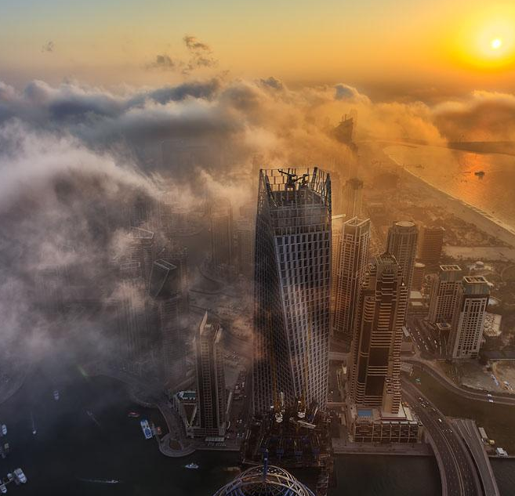
Objectives
学习目标
To know about the format and contents of letters;
To write appropriate Ask-for-help letters, especially pay attention to the tone and language.
To recognize what a good Ask-for-help letter is like.
求助信
Ask-for-help Letters
杭州二中 许丽君 何琰
1

Slide 3

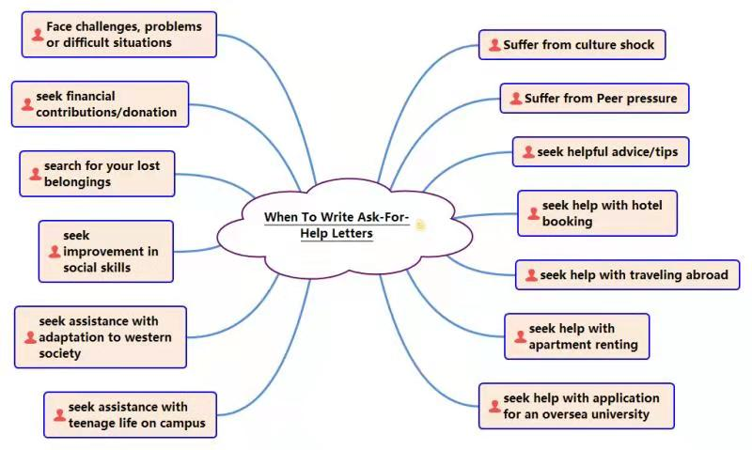
When do you need to write an Ask-for-help letter?
2

Slide 4

When do you need to write an Ask-for-help letter?
helpful advice/tips
improvement in social skills
financial contributions/donation
seek
hotel booking
traveling abroad
apartment renting
application for an oversea university
teenage life on campus
adaptation to western society
lost belongings
seek help with
suffer
from
challenges, problems or difficult situations
culture shock
Peer pressure
3

Slide 5
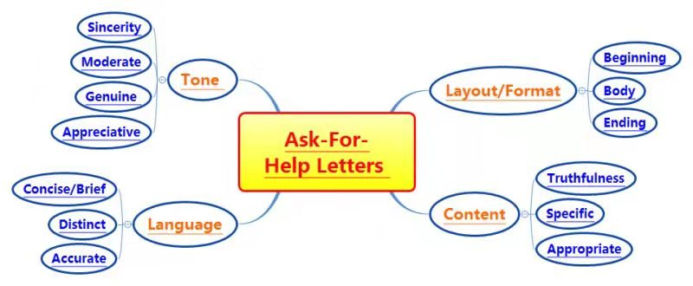
Write Ask-for-help Letters for
Ask-for-help letter
4

Slide 6

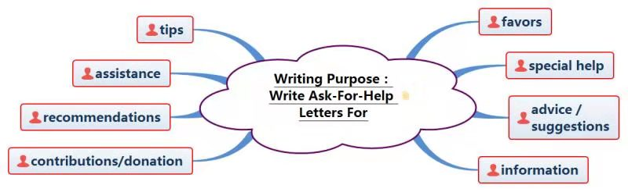
Write Ask-for-help Letters for
favors assistance
special help
advice
suggestions
recommendations
tips
contributions
donation
information
Ask-for-help letter
5

Slide 7
Requirements
• 要点齐全content
• 条理清楚layout
• 语言准确language
• 交际得体tone
Beginning
Main Body
Closing
/Ending
Ask-for-help letter
6

Slide 8
Structure
在学习或日常生活中碰到困难时，向他人寻求帮助。信件需写明请求帮助的理由，求助的具体内容。信文语言表达要准确，措辞要得体。
Beginning
Main Body
Closing
/Ending
自我介绍（收信人非熟人）
交代求助的背景及写信的目的；
Ask-for-help letter
详细描述求助的具体内容
告知联系方式（必要时）；
表达希望得到对方的帮助并致谢。
7

Slide 9
Format
在学习或日常生活中碰到困难时，向他人寻求帮助。信件需写明请求帮助的理由，求助的具体内容。信文语言表达要准确，措辞要得体。
Beginning ----purpose Why are you writing the letter?
Body ----describing the details of assistance or guidance that you seek ----describing about the difficulties you are faced with. What do you ask him/her to do to help you out?
Ending ----Expectation for assistance and expression of your appreciation. Yours faithfully ***
Ask-for-help letter
8

Slide 10
Para.1
Purpose of writing the letter
开头：自我介绍（收信人非熟人），交代求助的背景及写信的目的。
1. I am Li Hua, a …
2. I’m writing to ask you to do me a favor.
3. On behalf of..., I’d like to request your unreserved help.
4. I am sorry/regretful to tell you I’m having trouble with sth/doing sth.
5. I’m glad to tell you that I’m planning a journey to…, but I have difficulty…
6. I’m writing to seek your generous help/ unselfish assistance/patient guidance during...
Writing preparations
9

Slide 11
Para.2
Body Arrangements
正文：详细描述求助的具体内容，告知联系方式（必要时）。
Try as I may, I still find it hard to... .
It worries me that +句子（主语从句）
3. What troubles me most is sth. （主语从句）
4. What worries me most was that+句子（表语从句）
5. 句子，which upsets me a lot.（非限制性定语从句）
6. I’d like to participate in …. However, I find it difficult to …
7. I long to … but I don't know how, which makes me upset.
Writing preparations
10

Slide 12
Para.2
Body Arrangements
正文：详细描述求助的具体内容，告知联系方式（必要时）。
8. Please let me know if…
9. I’m lacking in…, adding to my difficulty in doing…
10. I can be reached at anytime by cellphone at 86754321.
11. You may email or phone me at lihua@136.com or12345678.
12. It’s such a big headache/so big a headache for me to ... that...
13. For lack of..., I have great difficulty/ find myself stumped by(被难倒)...
14. (Doing) sth. is a challenge for me, leading to... /resulting in.../ making it impossible for me to...
Writing preparations
11

Slide 13

To begin with, In addition , Therefore, In short , once, as well, to be honest, what’s more, however, meanwhile…
Natural transitions
The content must be true and concrete, the language be accurate，the attitude and tone be genuine. (态度诚恳，描述准确具体)
Writing preparations
Express your gratitude in an enthusiastic way
Suitable
Details?
Speak in moderation, and in narrative (用语适度，叙事精炼)
12

Slide 14
Para.3
Ending
结尾：表达希望得到对方的帮助并致谢。
● I would appreciate it if you could give me a hand.
● Your help/assistance would be greatly appreciated.
I would be extremely grateful if you do me the favor.
● I would appreciate it if you are kind and generous to do this for me.
I would be more than pleased if you could give me some suggestions.
● I would appreciate it more than I can say if you would like to consider my request.
● I would be grateful if you could do me the favor. Looking forward to your early reply.
● Should you be kind enough to give me any help, I would be grateful to you.
Writing preparations
13

Slide 15
hurt
bother
matter
trouble
wonder
account
interrupt
appreciate
sad
eager
upset
afraid
nervous
worried
grateful
anxious
Writing Tips
Useful words and expressions
14

Slide 16
be at a loss
hard feelings
be trapped in…
be in debt to sb
provide sb with sth
be in great need of sth
puzzle/bother/trouble sb
sb. would appreciate it if…
Writing Tips
Useful phrases
15

Slide 17
1. I feel at a loss whenever…
2. I'd appreciate it if you could …
3. It puzzles/ troubles/bothers me much that …
4. I feel confused/ sad/upset/worried/anxious to…
5.Your genuine help/advice/support means a lot to me.
6. Your genuine help/advice/support is what I need most.
7. It keeps bothering me that I couldn’t think about anything else.
Writing Tips
Useful sentences
16

Slide 18
Dear______,
I am ________ (自我介绍). I’m writing to you to ask for some help. I have met much difficulty in ______ (求助内容). First, I find _________ (困难1). Besides, _________ (困难2). What’s more, ________ (困难3)．
Faced with so much difficulty, I have to ask you for some help. Would you like to ________ (委婉提出请求1)? In the meanwhile, I beg you to ____________ (请求内容2) so that ________ (请求目的). Also, I would like you to ________ (请求内容3)．
I’m sure that I can make great progress in __________ (表达期待)．
Yours Sincerely / Faithfully/ Truly,
________________
Writing
Model
19

Slide 19
Dear __________(写信对象),
My name is __________， I’m writing to ask whether you could do me a favour.
I have had much difficulty/trouble in ___________(交代自己面临的困难). Besides, I’m very upset that ___________（提出令自己苦恼的问题）. What’s more, I don’t know ___________（进一步说明自己的困境） I’m wondering if you could be so kind as to _________ so that ____________（再次请求对方的帮助）.
I’d appreciate it if you could lend me a hand. I’m looking forward to your early reply.
Yours Sincerely / Faithfully/ Truly,
________________
Writing
Model
20

Slide 20
ASSESSMENT
Work in groups of four. Each member read the article and others comment on your classmate’s work. Then choose the best one out to show in the class. When you are discussing, you can pay attention to the following hints.
Purpose | Have you made the purpose clear?
Layout | Does the layout conform to the requirements?
Language | Are the sentences right? Have you used the proper punctuation, words, sentence and paragraphs to express yourself?
Content | Have you included all the points?
Are the details suitable?
Writing
Model
21

Slide 21
Test 1
对象：who (relationship)
文体：what
一、真题再现2018.11
假定你是李华，乘坐FL753航班抵达伦敦后发现钱包遗失。请给航空公司写一封邮件说明情况并寻求帮助。内容包括：
1.行程信息：
2.钱包特征；
3.联系方式。
注意：
1.词数80左右；
2.可以适当增加细节，以使行文连贯。
Writing
Practice
目的：Why
达意
涵盖
要点
22

Slide 22

Test 1
Writing purpose—information of background, asking for favors
Dear Sir or Madam,
I’m Li Hua, an exchange student from China. I took FL753 to London on November 2, 2018, and the moment I stepped off the plane I found my purse gone. It must have been left on the flight. It is a blue leather purse with over $1000, my ID card and my passport in it.
If you find any clue, please phone my host family at 123456789 or email me at lihua@hotmail.com. I would greatly appreciate your timely help.
Yours,
Li Hua
Body: describing the details of special help that you seek /describing about the problem you are faced with.
Writing
Practice
Ending ---- About your wishes for response and your gratefulness
23

Slide 23
对象：who (relationship)
Test 2
文体：what
假定你是李华，下学期要去美国纽约大学留学，请给美国的朋友Mike写一封电子邮件，让他帮你租一间合适的房子，内容包括：
1. 向朋友求助；
2. 对房子的要求及租住时间；
3. 表示感谢。
注意：
1.词数80左右；
2.可以适当增加细节，以使行文连贯。
目的：Why
Writing
Practice
达意
涵盖
要点
24

Slide 24
Test 2
Beginning
Writing purpose: introduction and the background of asking for favor study at New York University rent an apartment
Main Body
describing the details of assistance or guidance that you seek describing about the difficulties you are faced with.
Writing
Practice
Closing
/Ending
Expectation for assistance and expression of your appreciation.
25

Slide 25
Test 2
Beginning
Writing purpose: introduction and the background of asking for favor study at New York University rent an apartment
1. I’m glad to tell you that I’m planning to...
2. I’m writing to ask you to rent an apartment for me.
3. I'm wondering if you could take the trouble to help me with…
4. I’m more than pleased to tell you that I’ll study at New York University next term.
Writing
Practice
26

Slide 26
Test 2
Main Body
describing the details of assistance or guidance that you seek describing about the difficulties you are faced with.
Problem 1: lack of experience
Problem 2: unfamiliar with the native
Assistance: asking a favor to find an apartment
Request 1: location
Request 2: price
Request 3: time
Request 4: condition
Writing
Practice
27

Slide 27
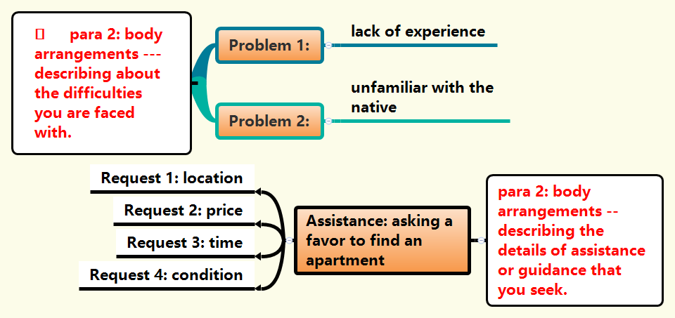
Test 2
Writing
Practice
28

Slide 28
Test 2
Closing
/Ending
Expectation for assistance and expression of your appreciation.
1. I will be very grateful if you could help me...
2. I'm eager to get your timely help.
/I'm eager for your timely help.
3. I would be grateful if you could do me the favor. Looking forward to your early reply
Writing
Practice
29

Slide 29

Test 2
Writing purpose—asking for assistance
Dear Mike,
I’m glad to tell you that I’ll study at New York University next term. I’m writing to ask you to rent an apartment for me.
Hopefully I can live alone in a well-equipped apartment with a bedroom, a living room, a washroom and a kitchen located in a safe community, within 20 minutes’ walk from the campus, so that I can live comfortably. Besides, I hope that the supermarket and public transport can be within easy reach. I will arrive in New York on September 2nd and begin the rent at least for this term. It’s up to you to decide the price.
Thanks for your help and look forward to your early reply.
Yours,
Li Hua
Body: describing the details of assistance that you seek /describing about the problems you are faced with.
Writing
Practice
Ending ---- About your wishes for response and your thanks
30

Slide 30
Model Appreciation
（真题再现:2016全国卷1）假如你是李华，暑假想去一家外资公司兼职，已写好申请和个人简历（resume）。给外教Ms Jenkins写信，请她帮你修改所附的文字和格式（format）。
注意：1. 词数100左右；
2. 可适当增加细节，使行文连贯
Writing
Appreciation
31

Slide 31
Model Appreciation
Beginning
Writing purpose: introduction and the background of asking for favor take a part- time job during the summer vacation write an application letter and my resume
Main Body
describing the details of assistance or guidance that you seek describing about the difficulties you are faced with.
Writing
Practice
Closing
/Ending
Expectation for assistance and expression of your appreciation.
32

Slide 32
Model Appreciation
Beginning
Writing purpose: introduction and the background of asking for favor take a part- time job during the summer vacation write an application letter and my resume
1. I'm eager for your timely help.
2. I’d like to request your unreserved help.
3. I'm writing to ask whether you could do me a favor...
4. Faced with/Facing so many difficulties, I have to turn to you for help.
Writing
Practice
33

Slide 33
Model Appreciation
Main Body
describing the details of assistance or guidance that you seek describing about the difficulties you are faced with.
Problem 1: limited English
Problem 2: English far from satisfaction
Problem 3: grammar mistakes
Problem 4: inappropriate format
Assistance: asking a favor to improve the application format
Request 1: correct the mistakes
Request 2: improve the format
Request 3: gain some social experience
Request 4: improve my work ability
Writing
Practice
34

Slide 34
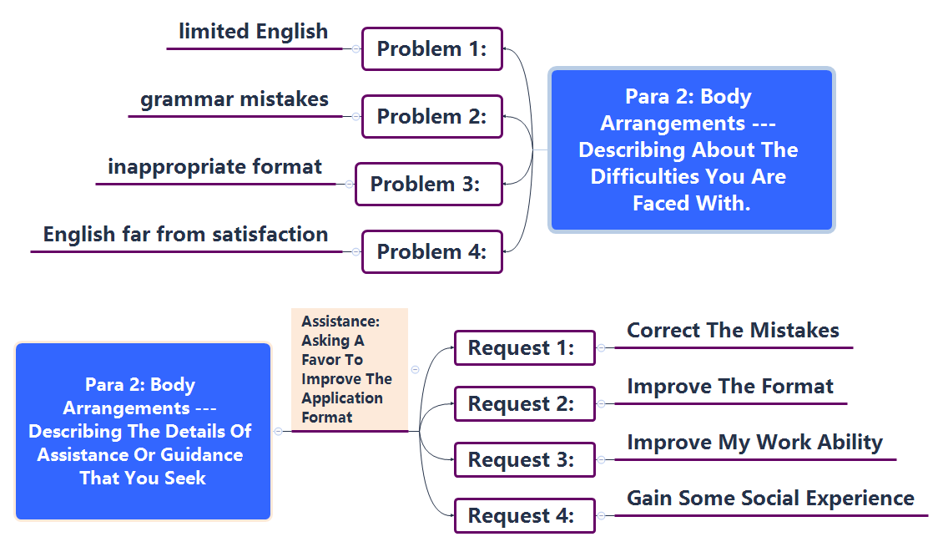
Model Appreciation
Writing
Practice
35

Slide 35
Model Appreciation
Closing
/Ending
Expectation for assistance and expression of your appreciation.
1. I would be grateful if you could really give/lend me a hand.
2. Your assistance really means a lot to me. Good luck and stay well!
3. Words fail to express my deepest gratitude for your assistance. Best wishes to you!
Writing
Practice
36

Slide 36
Model Appreciation
Writing purpose—asking for favors
Dear Ms Jenkins,
I'm writing to ask whether you could do me a favor.
In order to gain some social experience and improve my work ability. I'm going to take a part- time job during the summer vacation. So interested in the position in a foreign-captured company am I that I’ve already written an application letter and my resume all in English. However, I’m afraid that there might be some grammar mistakes or inappropriate format in the materials that I prepared.
Would you be so kind as to correct the mistakes and improve the format of the application and resume for me. I would appreciate it if you could take the trouble to help me. I’m looking forward to your early reply.
Yours,
Li Hua
Body: describing the details of assistance or guidance that you seek /describing about the difficulties you are faced with.
Writing
Practice
Ending ---- About your wishes for response and your gratitude
37

Slide 37

Homework
假定你是李华，暑假打算去英国旅游，请给英国的朋友Jack写一封电子邮件，让他帮忙预订酒店和接机，内容包括：
1. 行程信息；
2. 对酒店要求；
3. 表示感谢。
注意：
1.词数80左右；
2.可以适当增加细节，以使行文连贯。
Writing
Practice
38

Slide 38
Possible Version
Writing purpose—asking for favors
Dear Jack,
This summer I intend to have a trip to England and I’m writing to ask you to book a hotel for me.
My flight is scheduled to arrive at London Heathrow Airport at 3 pm on July 15th. I’ll stay in London for five days. The hotel is hopefully in the center of the city with famous attractions nearby. The room is tidy and clean. By the way, is it convenient for you to meet me at the airport that day?
You help will be highly appreciated and I look forward to your early reply.
Yours,
Li Hua
Body: describing the details of assistance or tips that you seek
Writing
Practice
Ending ---- About your wishes for response and your gratitude
39

Slide 39
THANK YOU

