Slide 1

感恩遇见，相互成就，本课件资料仅供您个人参考、教学使用，严禁自行在网络传播，违者依知识产权法追究法律责任。
更多教学资源请关注
公众号：溯恩高中英语
知识产权声明

Slide 2

Mulan will be on!
Liu Yifei acts the female leading role.

Slide 3

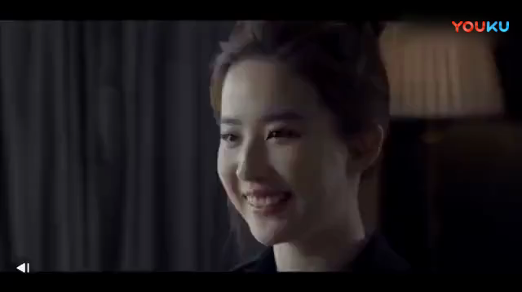
A mini listening test: An interview with Liu Yifei
5
Q1: How many questions did the interviewer ask?
Q2: Which word did Liu Yifei use to define Cannes?
Q3: All the films she's made, what's her favorite movie?
Humanity
Her next movie.

Slide 4

高考英语听力满分突破
李文娟

Slide 5

目 录
CONTENTS
剖析高考听力
体悟高考听力
试炼高考听力
备战高考听力

Slide 6

剖析高考听力
“1234”

Slide 7
听力考查内容《考试大纲》：
理解和处理口头语言材料的能力——信息的获取和处理能力
1览全局
1.1 听力考查内容：《2019年英语考试大纲》
要求考生能听懂所熟悉话题的简短独白和对话。考生应能：
（1）理解主旨要义；
（2）获取具体的事实性信息；
（3）对所听内容做出推断；
（4）理解说话者的意图、观点和态度。
主旨大意题
事实细节题
推理判断题
观点态度题

Slide 8
听力考查内容《考试大纲》：
理解和处理口头语言材料的能力——信息的获取和处理能力
1览全局
以细节题和推理题为主！
1.2 听力题型的考查统计
年份 | 事实细节题 | 推理判断题 | 观点态度题 | 主旨大意题
2017年3月 | 8 | 8 | 3 | 1
2017年9月 | 14 | 4 | 1 | 1
2018年3月 | 12 | 7 | 0 | 1
2018年9月 | 8 | 9 | 3 | 0
2019年3月 | 10 | 10 | 0 | 0
2019年9月 | 11 | 9 | 0 | 0

Slide 9
听力考查内容《考试大纲》：
理解和处理口头语言材料的能力——信息的获取和处理能力
1览全局
美音，≈150字/min ！
1.3 高考听力语音、语速
年份 | 语音 | 总字数 | 语速/分钟
2017年3月 | 美音 | 898 | 142
2017年9月 | 美音 | 894 | 143
2018年3月 | 美音 | 907 | 148
2018年9月 | 美音 | 996 | 150
2019年3月 | 美音 | 858 | 147
2019年9月 | 美音 | 993 | 153

Slide 10
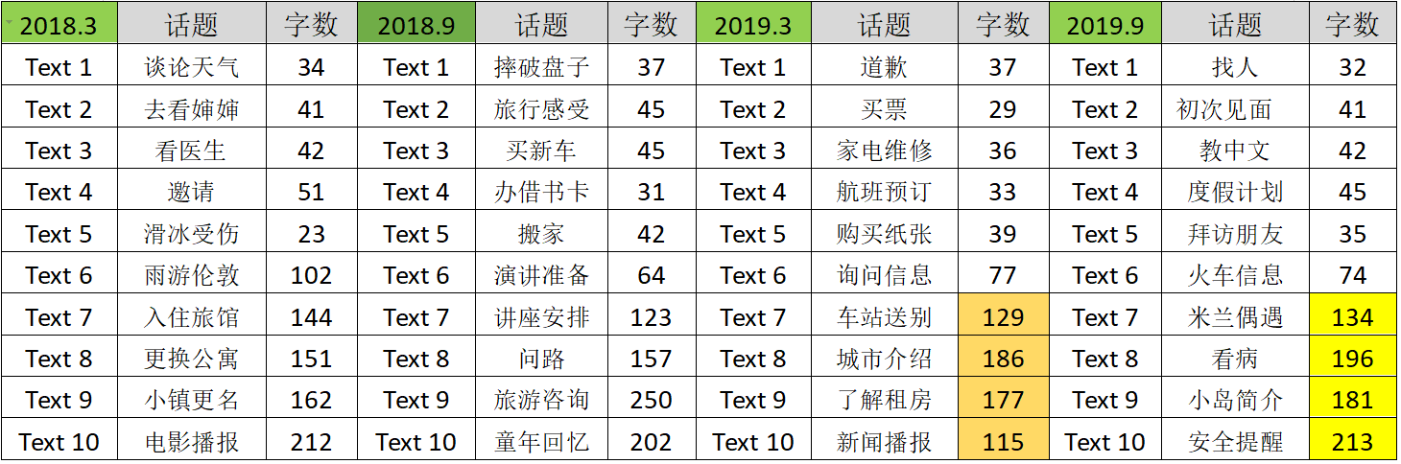
听力考查内容《考试大纲》：
理解和处理口头语言材料的能力——信息的获取和处理能力
1览全局
@学习、工作、生活话题！
1.4 高考听力的话题

Slide 11
听力考查内容《考试大纲》：
理解和处理口头语言材料的能力——信息的获取和处理能力
1览全局
选项分布均匀
6-7 个
1.5 高考听力答案分布对比
年份 | A | B | C
2017年3月 | 6 | 7 | 7
2017年9月 | 7 | 6 | 7
2018年3月 | 7 | 6 | 7
2018年9月 | 7 | 7 | 6
2019年3月 | 7 | 7 | 6
2019年9月 | 7 | 7 | 6

Slide 12
1览全局
分值/题目数量 | 1.5× 20=30分 20%
语速/语音 | ≈150字/min 美音
听力结构 | 短对话+长对话+独白
题目选项 | A/B/C 6-7
题目类型 | 事实细节/推理判断/观点态度/主旨要义
听力场景 | 学习、工作、购物、吃饭、租房、看病、运动、邮寄、天气、文学艺术、交通出行（旅游/出差/驾驶/机场）

Slide 13

题干：
What does the woman think of ……? 听女声；
What does the man imply/ suggest ... ? 听男声。
2抓人物
*根据统计，所提出的问题有90%左右都与speaker 2说话内容有关。

Slide 14
3打基础
1. 语音基础
——略读、辨音（19/90）、升降调
2. 词汇基础
——听力必备词汇（无超纲）地名、人名除外
3. 文化背景
——习语：It's not my cup of tea.
常识: the World Cup， NASA

Slide 15


辨音
——单词发音（同音/近音）、语音现象（吞音）
1. What does Mrs Lamb want William to do? （2019.3 Text 1）
A. Paint the wall. B. Pay for the glass. C. Help cut the grass.
单词：flower /flour
数字：区分-teen和-t-ty及four和five的发音 18/80/8
语音现象：t, d, p, b, s，v 基本听不到

Slide 16
4 练技巧
Predict before you listen. 听前预读
Catch the key words. 抓关键词
Take notes quickly. 快速笔记
Be in a good mood. 心态良好

Slide 17
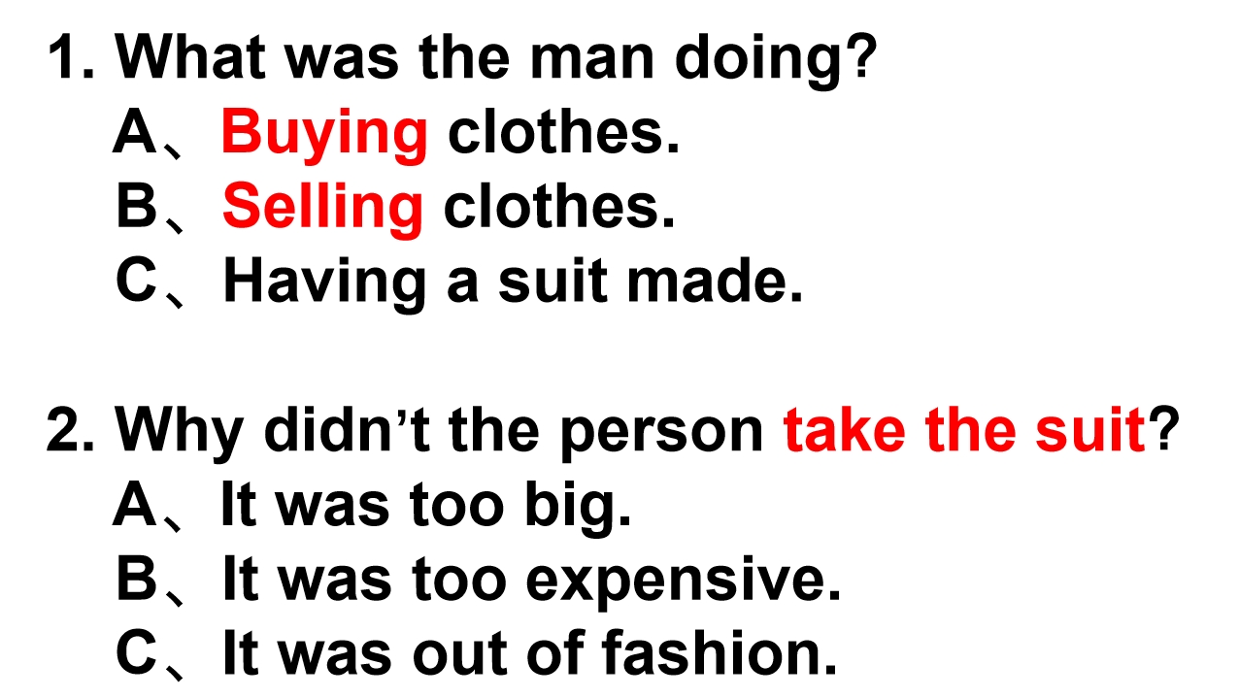
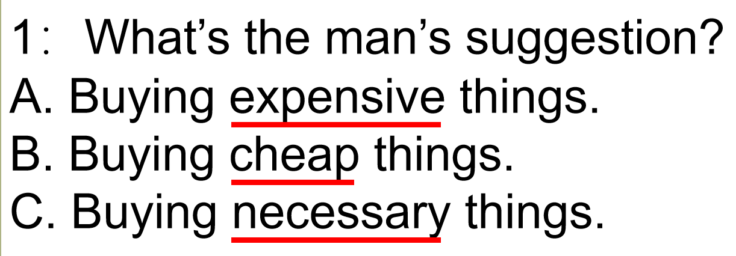
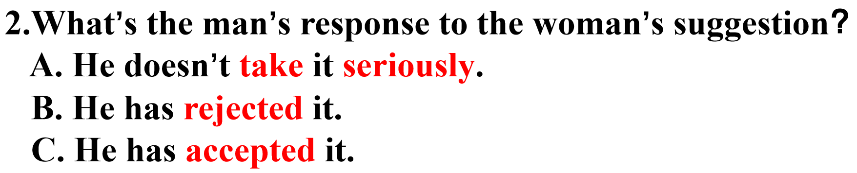
预测判断
化被动为主动！
高考听力有一半的信息靠听，而另一半的信息靠阅读。
迅速浏览题干和所给选项，做到有备而发！
技巧一：忽略相似部分，关注不同部分。
技巧二：2同选1异，1正1反选其一。
技巧三：巧用题目，构建情景。（长对话）

Slide 18
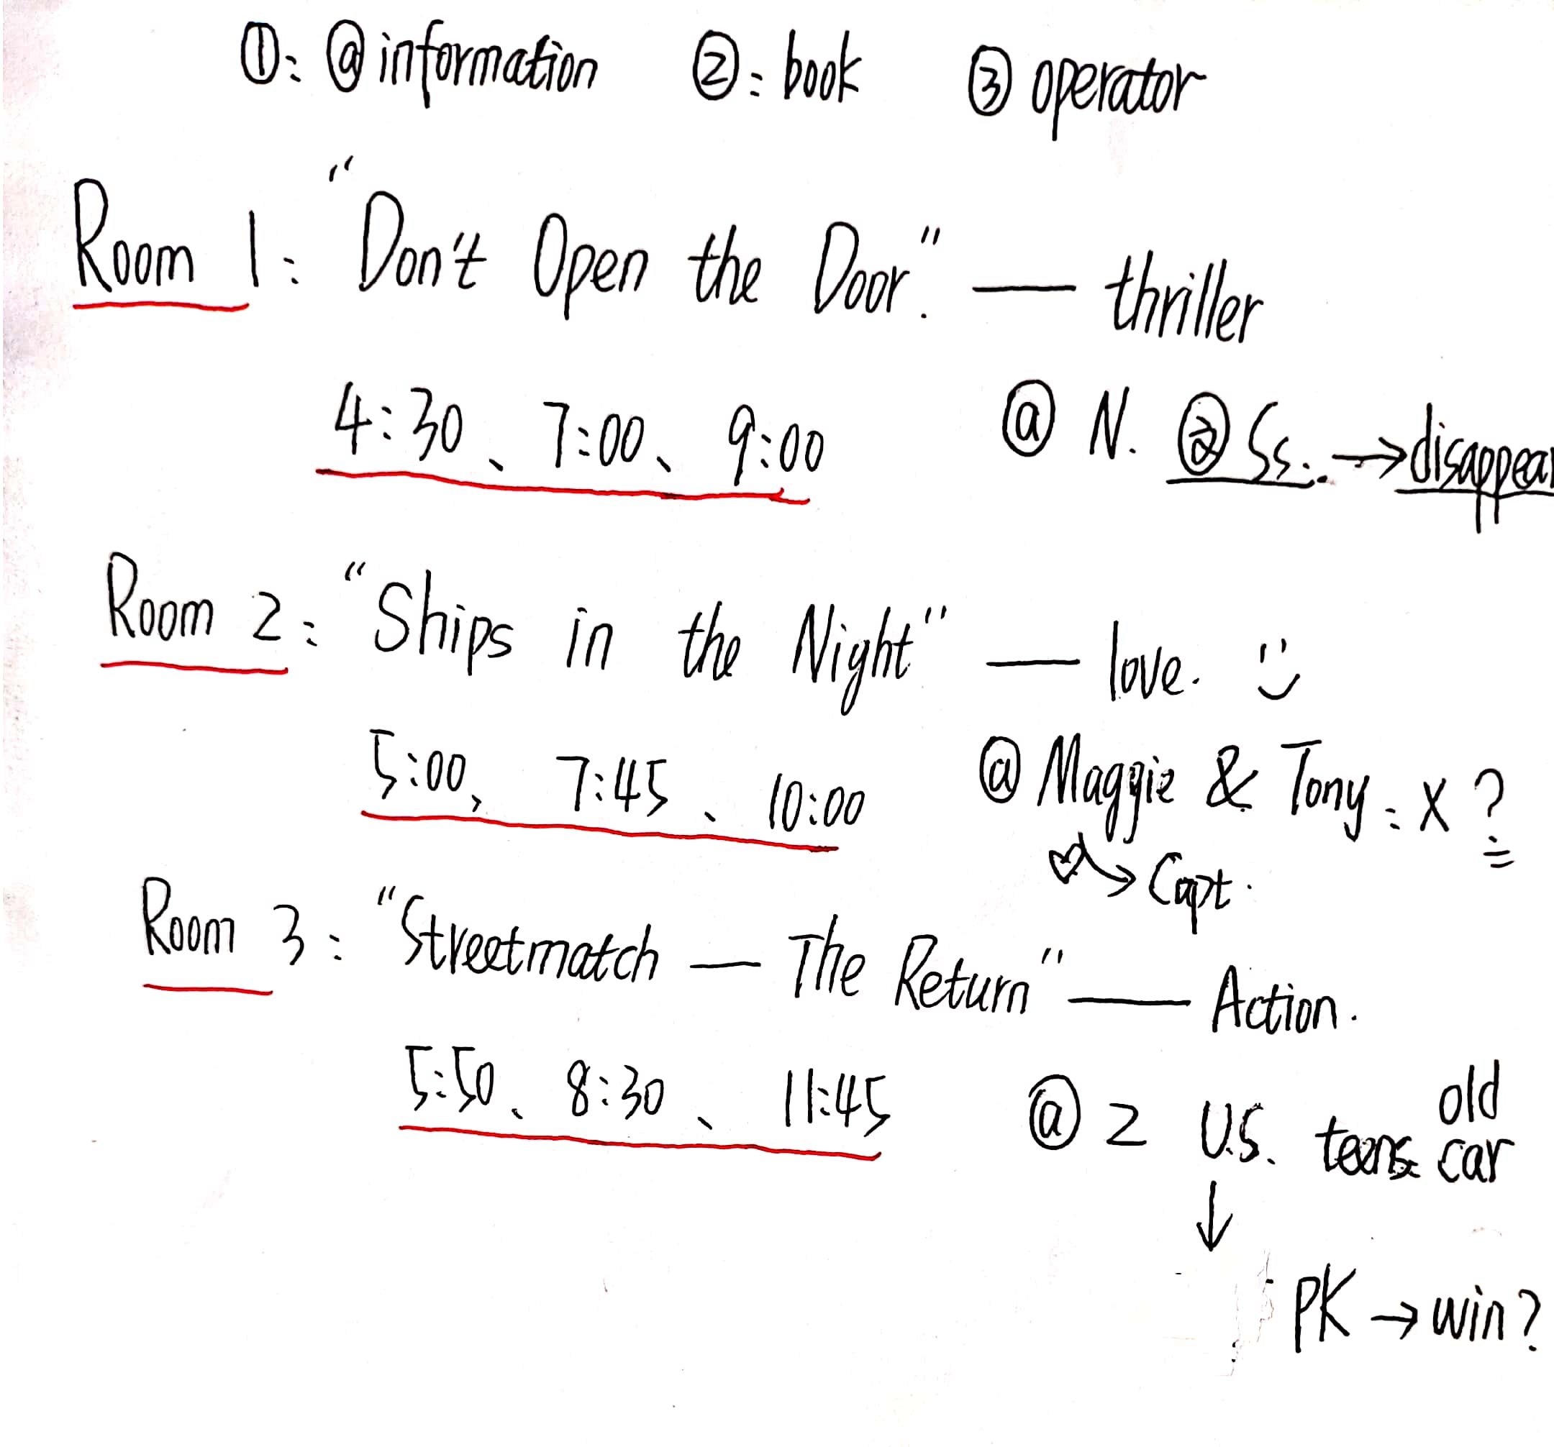
学会速记
——多人、多时间、多事、多数字
18. How does the film in Room 1 seem to be? (2018.3 Text 10)
A. Boring. B. Frightening. C. Relaxing.
19. When is the film in Room 2 showing for the last time today?
A. 9:00. B. 10:00. C. 11:45.
20. Which of the following films is shown in Room 3?
A. Ships In The Night. B. Don’t Open The Door. C. Streetmatch — The Return.
Text 10
Thank you for calling Global Cinema. For film information and times, press 1. To make a booking, press 2. To speak to an operator, press 3.
<<beep>>
These are the films for today, Tuesday the 7th.
In Room 1, Don’t Open The Door. A group of college students decide to rent a house in the mountains for a relaxing weekend break. But they aren’t the only guests on the mountain…one by one, they start to disappear. Who or what is outside the house? Showing at 4:30, 7 o’clock, and 9 o’clock.
In Room 2, Ships In The Night. Maggie breaks up with her boyfriend and decides to take a holiday on a ship to help her forget him. Tony is a waiter on the ship and he is very unhappy when his girlfriend leaves him to marry the captain. Together, they find a way to forget their problems. Showing at 5 o’clock, 7:45, and 10 o’clock.
In Room 3, Streetmatch — The Return, the second film of French director Jean-Luc Ducroix. Two American teenagers buy an old car, and with a lot of hard work and after a lot of problems, they enter their car into the Streetmatch competition. But is their car good enough to win? Showing at 5:50, 8:30, and 11:45.

Slide 19

体悟高考听力

Slide 20
2.1 事实细节题
1. What is David doing this year? （2019.9 第3题）
A. Traveling around the world.
B. Teaching Chinese at school.
C. Learning a foreign language.
2. What time is the train going to arrive in Sydney? （2019.9 第7题）
A. At 2:00. B. At 9:28. C. At 11:34.
3. What is the discount for the man? （2018.3 第9题）
A. 10%. B. 15%. C. 20%.
W: Excuse me, sir. Do I take the train for Sydney there?
M: Uh… when does it leave?
W: At 9:28. Here’s my ticket.
M: Oh, let me have a look. Um… yes. Platform Two.
W: Thank you. By the way, what time does it reach Sydney?
M: You should be there at 11:34.
W: Must I change?
M: No. It’s a through train.
W: Thank you.
M: You’re welcome. Have a nice trip.
错误选项一定能成功干扰到你！
三个选项都听到时，信息要对准！

Slide 21
2.1 事实细节题
4. What did the man do to help the woman? （2019.3 第10题）
A. Book the hotel. B. Look after Alan. C. Play in the concert.
5. What will the weather be like tomorrow? （2019.3 第20题）
A. Sunny. B. Snowy. C. Rainy.
W: Well, I’d better be going. My train is about to leave anytime now.
M: Right.
W: It was nice meeting you. Thanks for coming to see me off.
M: That’s all right. It was nice meeting you, too. I really enjoyed the concert. I think it went really well. All the songs you sang last night were great.
W: Thank you, and thanks for being so helpful — booking the hotel and everything.
M: It was my pleasure. I should thank Alan. If he hadn’t been ill, I wouldn’t have had this chance to help organize the concert and to meet you.
W: Oh, yeah. Give my regards to Alan. I hope he’ll be better soon. Well, I’ll be off, then. I’ll see you around.
M: OK, see you.

Slide 22
2. 1 事实细节题
技巧总结：
1. 听到什么选什么，但要确保题目和答案的一致性；
2. 注意简单的同义替换。

Slide 23
2.2 推理判断题
1. What will the speakers probably do next? （2017.9 第5题）
A. Order some boxes. B. Go home and rest. C. Continue working.
2. Where does the conversation probably take place? （2019.3 第6题）
A. At a bus stop. B. At an activity centre. C. At an information desk.
W: I’m really tired from packing all these boxes for three hours. It’s about time to call it a day. 收工/今天到此为止
M: I know. Maybe we could do it first thing tomorrow morning.
W: Why not? These orders are not urgent. 紧急的
M: Hello. Could you please help us? We’d like a map of this city.
W: Yes, here you are.
M: Oh, could you also give us some information about the film festival?
W: Take this booklet. It has all the information about the activities that will be put on during the festival.
M: Thanks. And one last thing, do you have a bus timetable for East Town?
W: Yes, here you are.
M: Thank you very much.

Slide 24
2.2 推理判断题
3. What is the probable relationship between the speakers? （15.9 第3题）
A. Colleagues. B. Neighbors. C. Strangers.
4. Who suggested the idea of changing the name of the town?（18.3 第16题）
A. A local farmer.
B. A transport company.
C. A government department.
W: Mr. Baker, could I possibly use your phone? Ours doesn’t work. Judy is ill, and I want to call a doctor. M: Sure. Come on in. Hope everything’s well with Judy.
W: What’s so funny, dear?
M: Look here! A small country town in Australia decides to change its name for a month.
W: Really? Just for a month? Why?
M: For road safety. The town is called Speed, in the countryside of Victoria. Now, the people living there want to change it into Speed Kills. They hope the drivers passing the town will slow down a bit when they see the road sign.
W: That sounds like a really good idea, doesn’t it?
M: Mmm. The idea was put forward by the Victoria Transport Accident Office. It soon won over 45 people in Speed. They even made a video which has already become a hit on the Internet!
W: It’s interesting to see what will happen then.
M: A local farmer called Phil Down wants to change his name, too. He’ll be called Phil Slow Down. He wishes the idea would catch on around the world.
W: I hope it works well.

Slide 25
2. 2 推理判断题
技巧总结：
1．捕捉“弦外之音“：降调—赞同肯定；升调—怀疑/惊讶/否定。
2．人物关系和地点推断：捕捉关键词！！！
3．注意一些语法结构的运用：虚拟语气表示与事实相反；否定比较级结构表示最高级；含蓄的表达。

Slide 26
2.3 主旨大意题
1.What are the speakers talking about? （2016.3 第11题）
A. New films. B. Popular cinemas. C. Film-seeing habits.
2. What is the purpose of this speech? （2014.9 第20题）
A. Introduce the best shopping district in London.
B. Encourage people to buy the Christmas trees.
C. Welcome people to visit London in December.
M: Why don’t you like going to the cinema?
W: Well, there are too many problems.
M: Like what?
W: For example, when a film is popular, the cinema is rather crowded. When the traffic is bad, it takes a long time to get there.
M: Are these all the problems?
W: No, the worst is the people --- children running up and down, people chatting endlessly, and so on. So, I’d rather stay home and wait to see the films when they are shown on TV.
M: Then you may see the films a bit later than other people.
W: Yes, but I’ll be more comfortable in the quietness of my living room.
M: Well, I can’t stand others talking about a new film before I see it, so I prefer seeing films at the cinema as soon as they come out.
M: Welcome to London this December! There’s plenty going on this month. For example, on 1 December, London’s West End, the capital’s best shopping district, has its largest ever traffic-free day. More than a million visitors are expected to shop and enjoy various activities while Oxford Street and Regent Street are completely closed to cars and buses. Shoppers will be able to move around the streets, visiting our famous department stores, and having a bite at one of the many cafes and restaurants in the area. Trafalgar Square’s Christmas tree, a gift to London from Norway, will be lit at 6 p.m. on 6 December to the sounds of traditional Christmas songs. Then, every evening from 10 December until 23 December, 5 p.m. to 9 p.m., people will sing Christmas songs in this beautiful setting. Lastly, ring in the New Year with the capital’s largest fireworks show. Although the fireworks will be set off at the British Airways London Eye, they can be enjoyed from across London and will also be broadcast on television at the same time. Then, just a few hours later, come out and see London’s colorful New Year’s Day parade, when marching performers from around the world pass through the capital’s streets. Enjoy your time in our city.
关键词：总结词！
首句很关键！

Slide 27
2.3 主旨大意题
3. What does the speaker talk about? （2017.9 第20题）
A. An exciting lunch party.
B. A well-known short story.
C. An unforgettable experience.
W: Hello, everyone. In today’s program, I’d like to share a true story of mine. One day, my friends and I had just finished lunch at a hotel when it started to rain heavily. When it became lighter, I decided to brave the rain to get my car and go home. It was parked three blocks away. My friends argued I shouldn’t go because at that time, I was due to give birth in three months. I promised I’d be very careful. One of them wanted to come with me, but I insisted she stay with another friend who needed help with her baby. When I walked to the first crossroads, a taxi stopped and a passenger came out with an umbrella. Before I knew what was happening, he walked right beside me and told me he would walk with me to where I would go. I refused, but he insisted. During our walk, he kept telling me to walk slowly. When we got to the car park, I thanked him, and we parted ways. I did not get his name and may not even recognize him now. Did he purposely stop for me? I’ll never know.

Slide 28
2. 3 主旨大意题
技巧总结：
1．首句很关键：文章主题。
2．注意总结词：归纳主旨
3．错误选项：局部代整体、半对半错

Slide 29
2.4 观点态度题
W: Hello, everyone. In today’s program, I’d like to share a true story of mine. One day, my friends and I had just finished lunch at a hotel when it started to rain heavily. When it became lighter, I decided to brave the rain to get my car and go home. It was parked three blocks away. My friends argued I shouldn’t go because at that time, I was due to give birth in three months. I promised I’d be very careful. One of them wanted to come with me, but I insisted she stay with another friend who needed help with her baby. When I walked to the first crossroads, a taxi stopped and a passenger came out with an umbrella. Before I knew what was happening, he walked right beside me and told me he would walk with me to where I would go. I refused, but he insisted. During our walk, he kept telling me to walk slowly. When we got to the car park, I thanked him, and we parted ways. I did not get his name and may not even recognize him now. Did he purposely stop for me? I’ll never know.
1. How does Tony find his experience in China? （2013.3 第10题）
A. Interesting. B. Crazy. C. Disappointing.
2. What did the woman think of Dana's speech? （2014.3 第3题）
A. Boring. B. Important. C. Well-prepared.
W: Tony, can I ask you a personal question?
M: About what?
W: Well, I was wondering about how you are received here in China.
M: What do you mean?
W: Well, since you are Chinese-Canadian and only speak English and French well, how do native Chinese treat you?
M: Oh, well, sometimes it can get pretty difficult. When people find out that I’m a Canadian citizen who can’t speak Chinese well, they usually call me a banana. You know, yellow on the outside and white on the inside.
W: How does that make you feel?
M: Well, I first feel mad. Then I feel sad, for I’m seen as someone who has forgotten his roots. All this is because my parents left to find a better life, and I decided to return in order to find something I lost. Sometimes I’m not sure if I like what I’ve found.
M: What did you think of Dana’s speech today?
W: Well, she must have spent a lot time preparing it. I can’t believe I can sit for that long without feeling bored.

Slide 30
2. 4 观点态度题
技巧总结：
1．Speaker 2回答：肯定——Yes/ Absolutely/ I agree with you
否定——I'm sorry/ I'm afraid I can't…/Well
2．语气、含蓄表述
3．同义转换

Slide 31
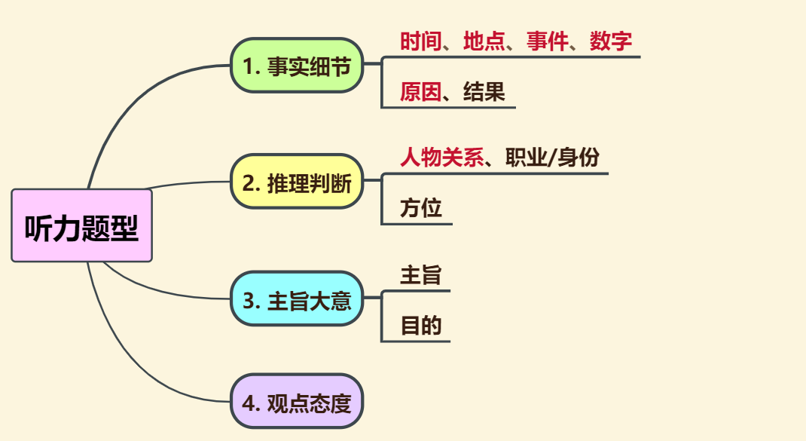
归纳总结：考点

Slide 32

试炼高考听力

Slide 33
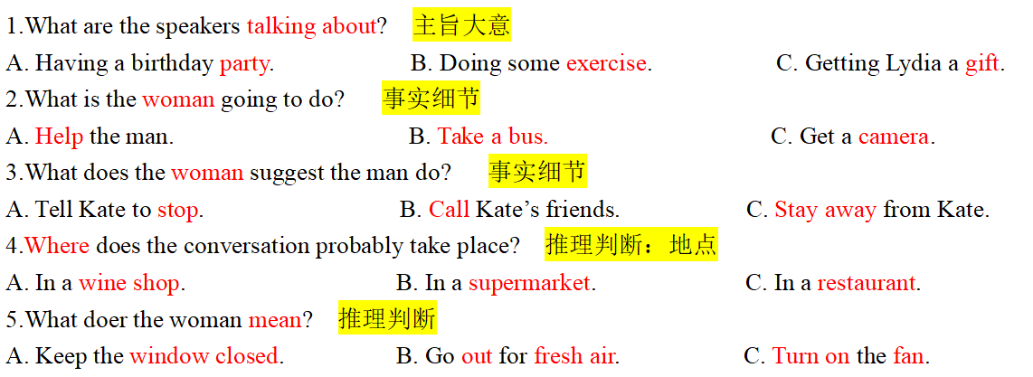
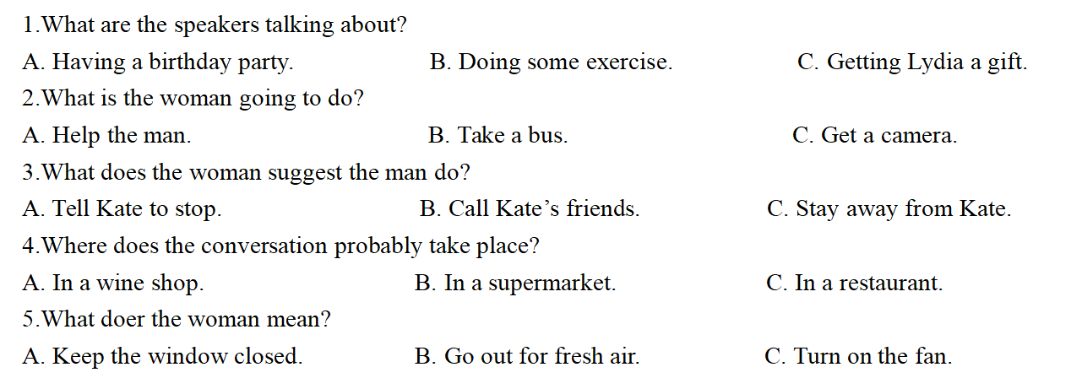
试炼真题：短对话

Slide 34

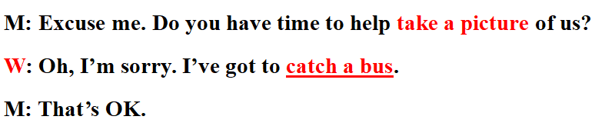

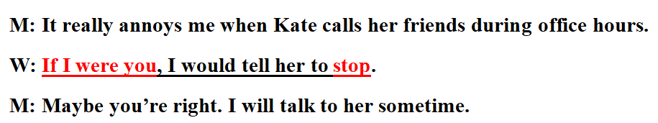
试炼真题：短对话

Slide 35
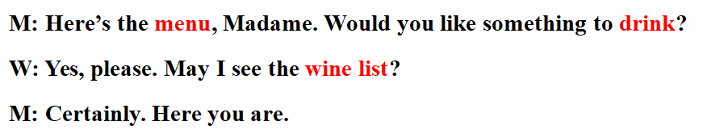
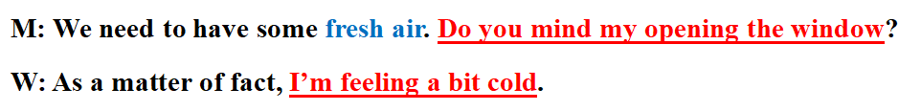
试炼真题：短对话

Slide 36
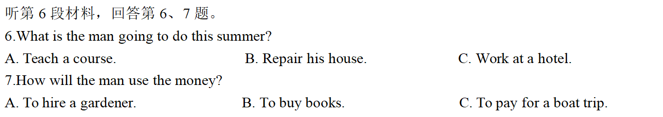
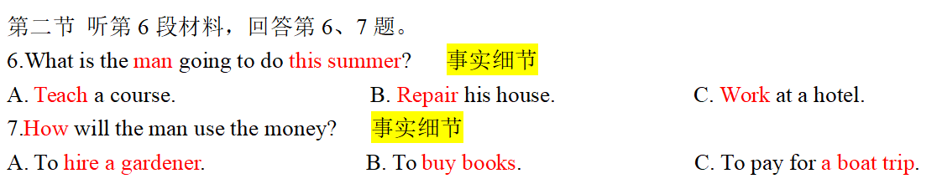
试炼真题：长对话

Slide 37
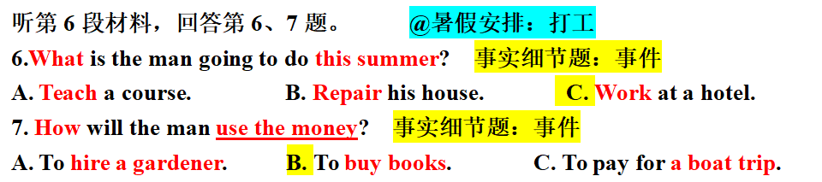
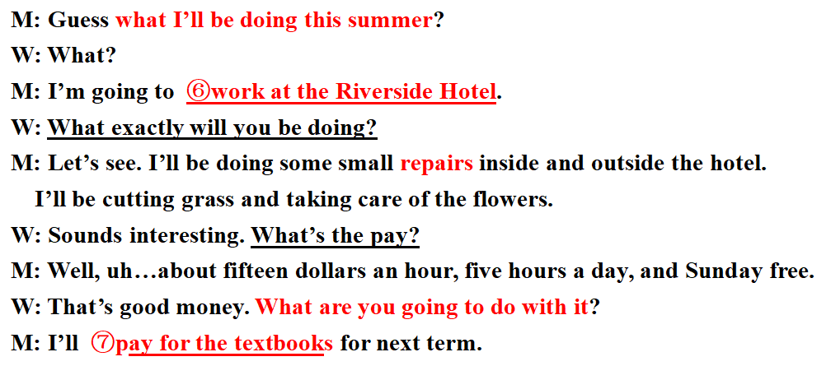
试炼真题：长对话

Slide 38
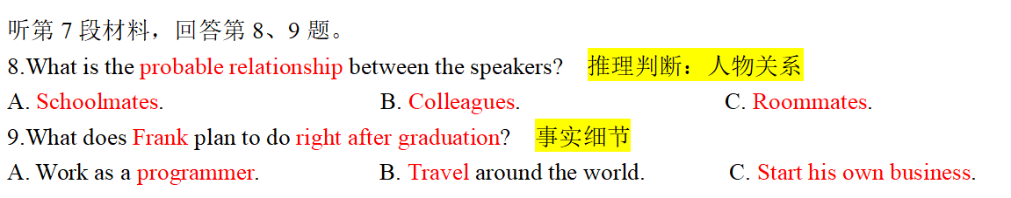
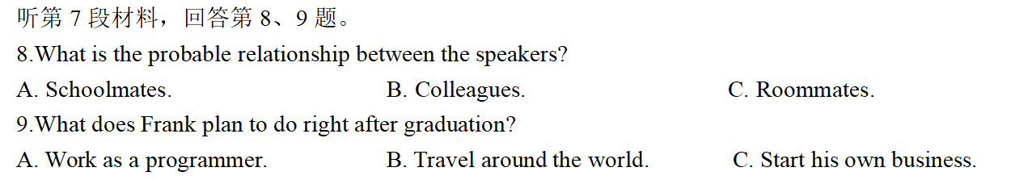
试炼真题：长对话

Slide 39
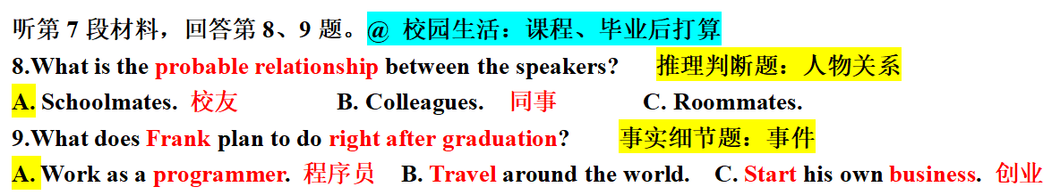
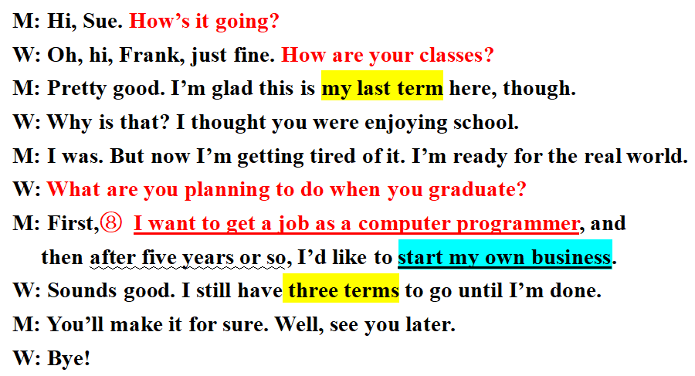
试炼真题：长对话

Slide 40
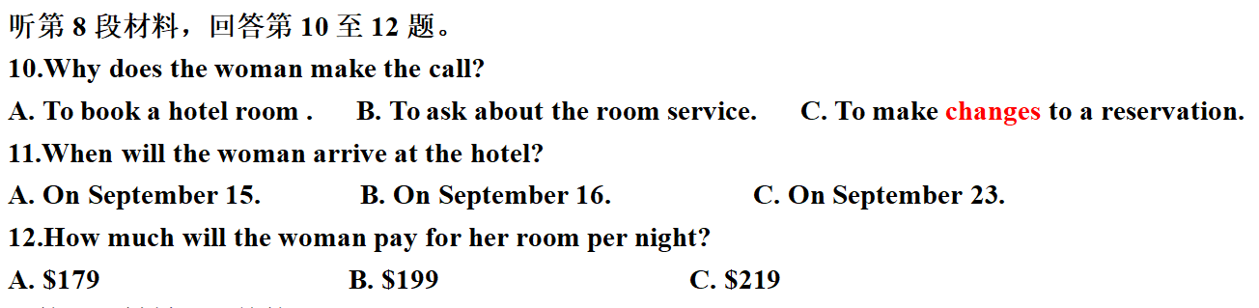
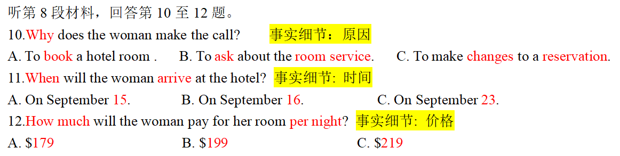
试炼真题：长对话

Slide 41
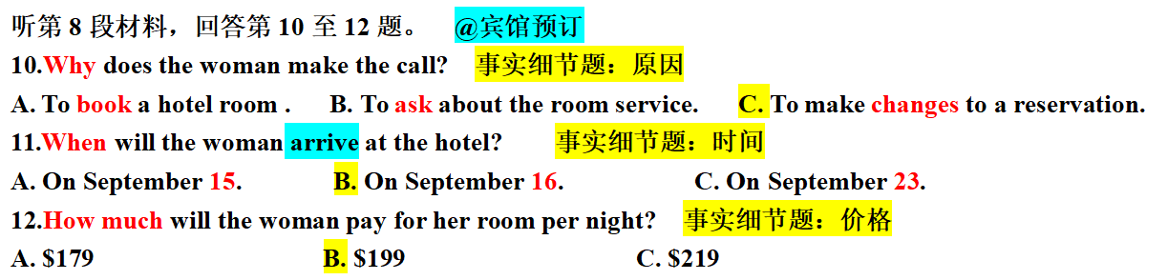
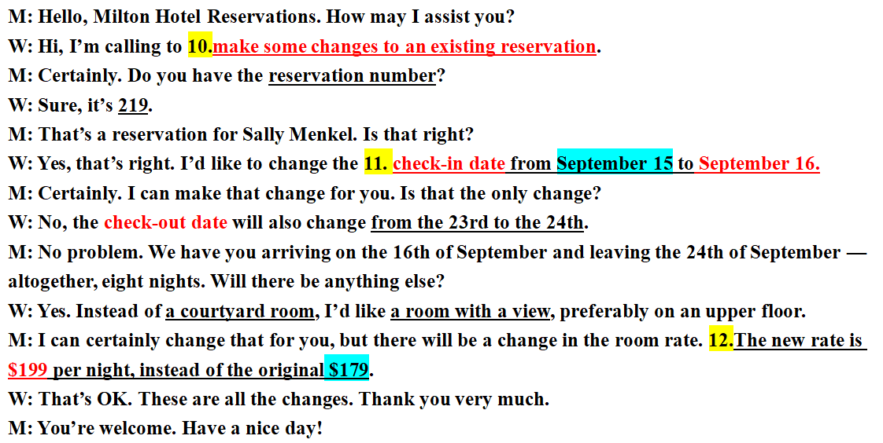
试炼真题：长对话

Slide 42
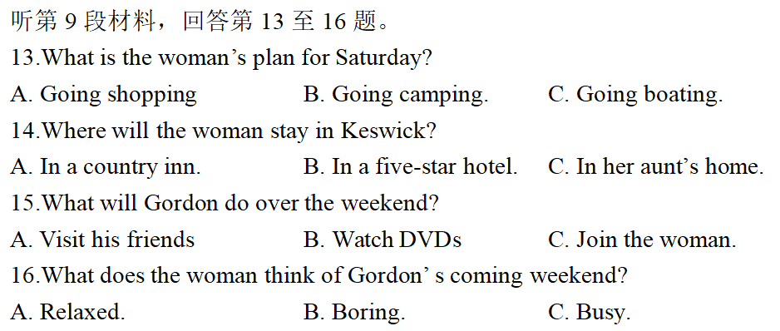
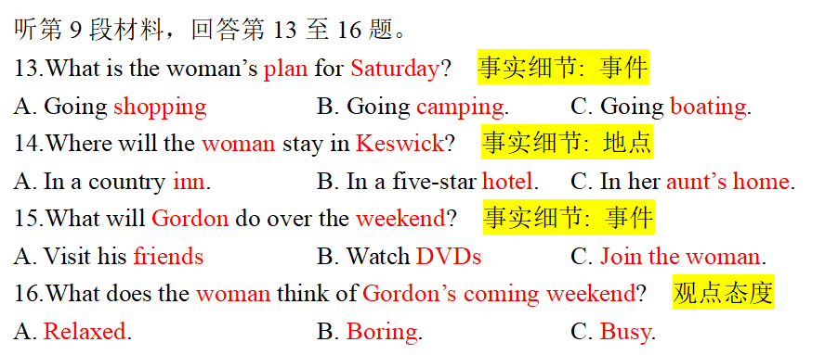
试炼真题：长对话

Slide 43
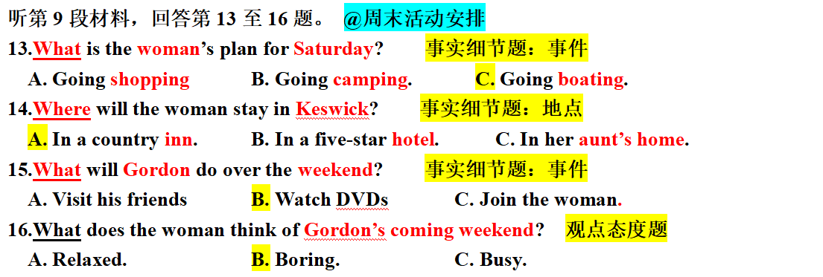
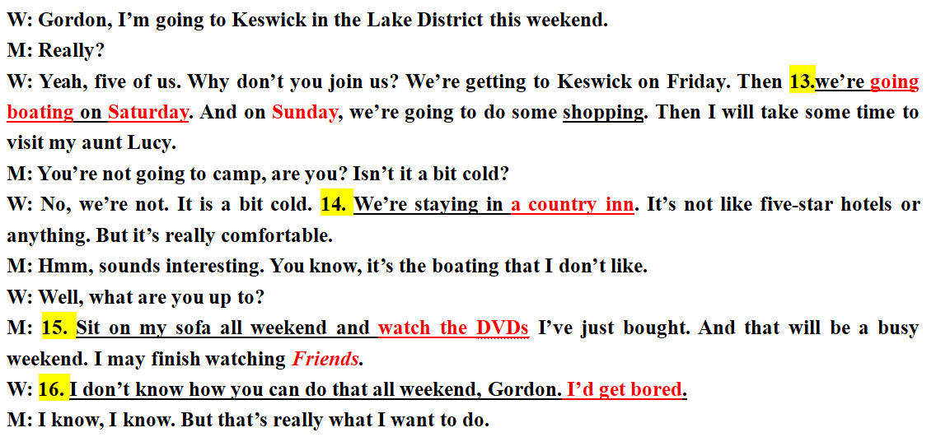
试炼真题：长对话

Slide 44
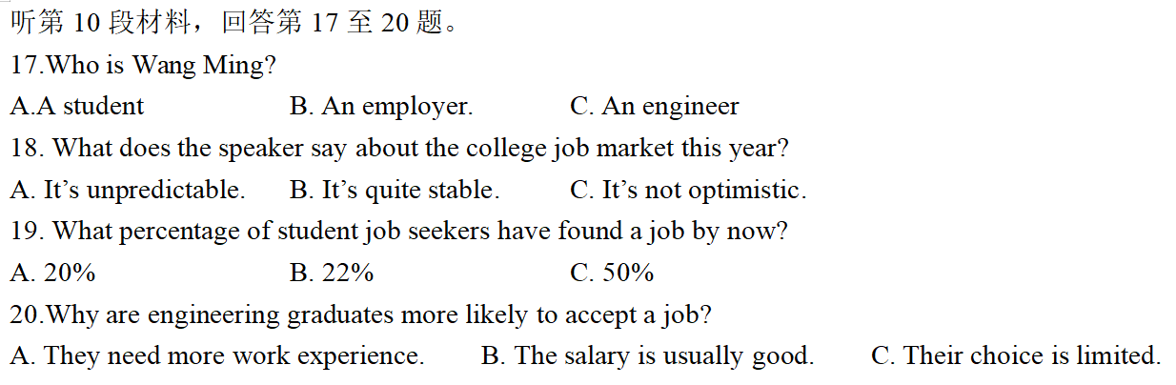
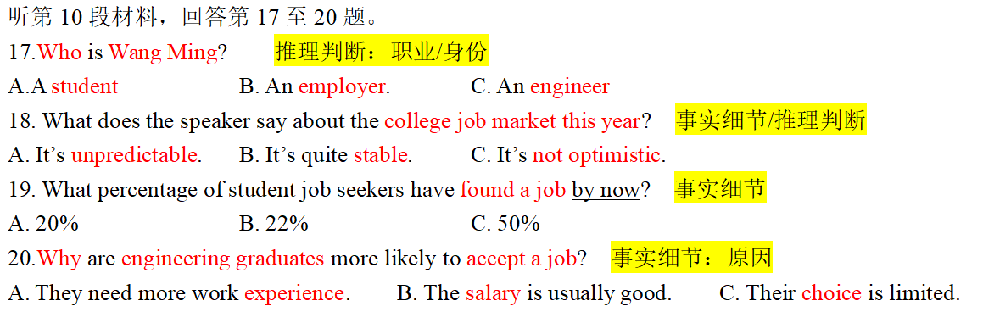
试炼真题：独白

Slide 45
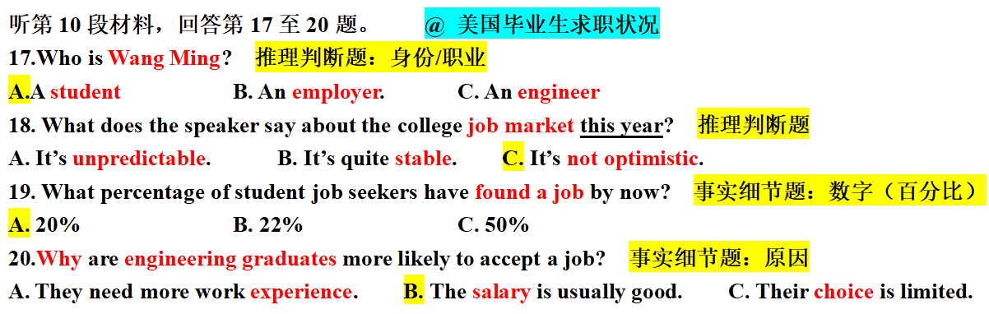
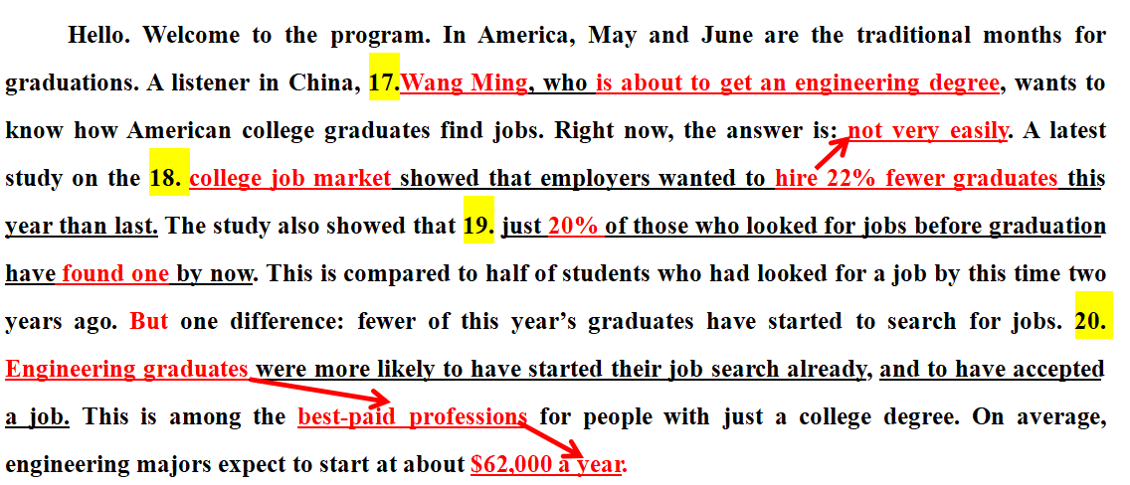
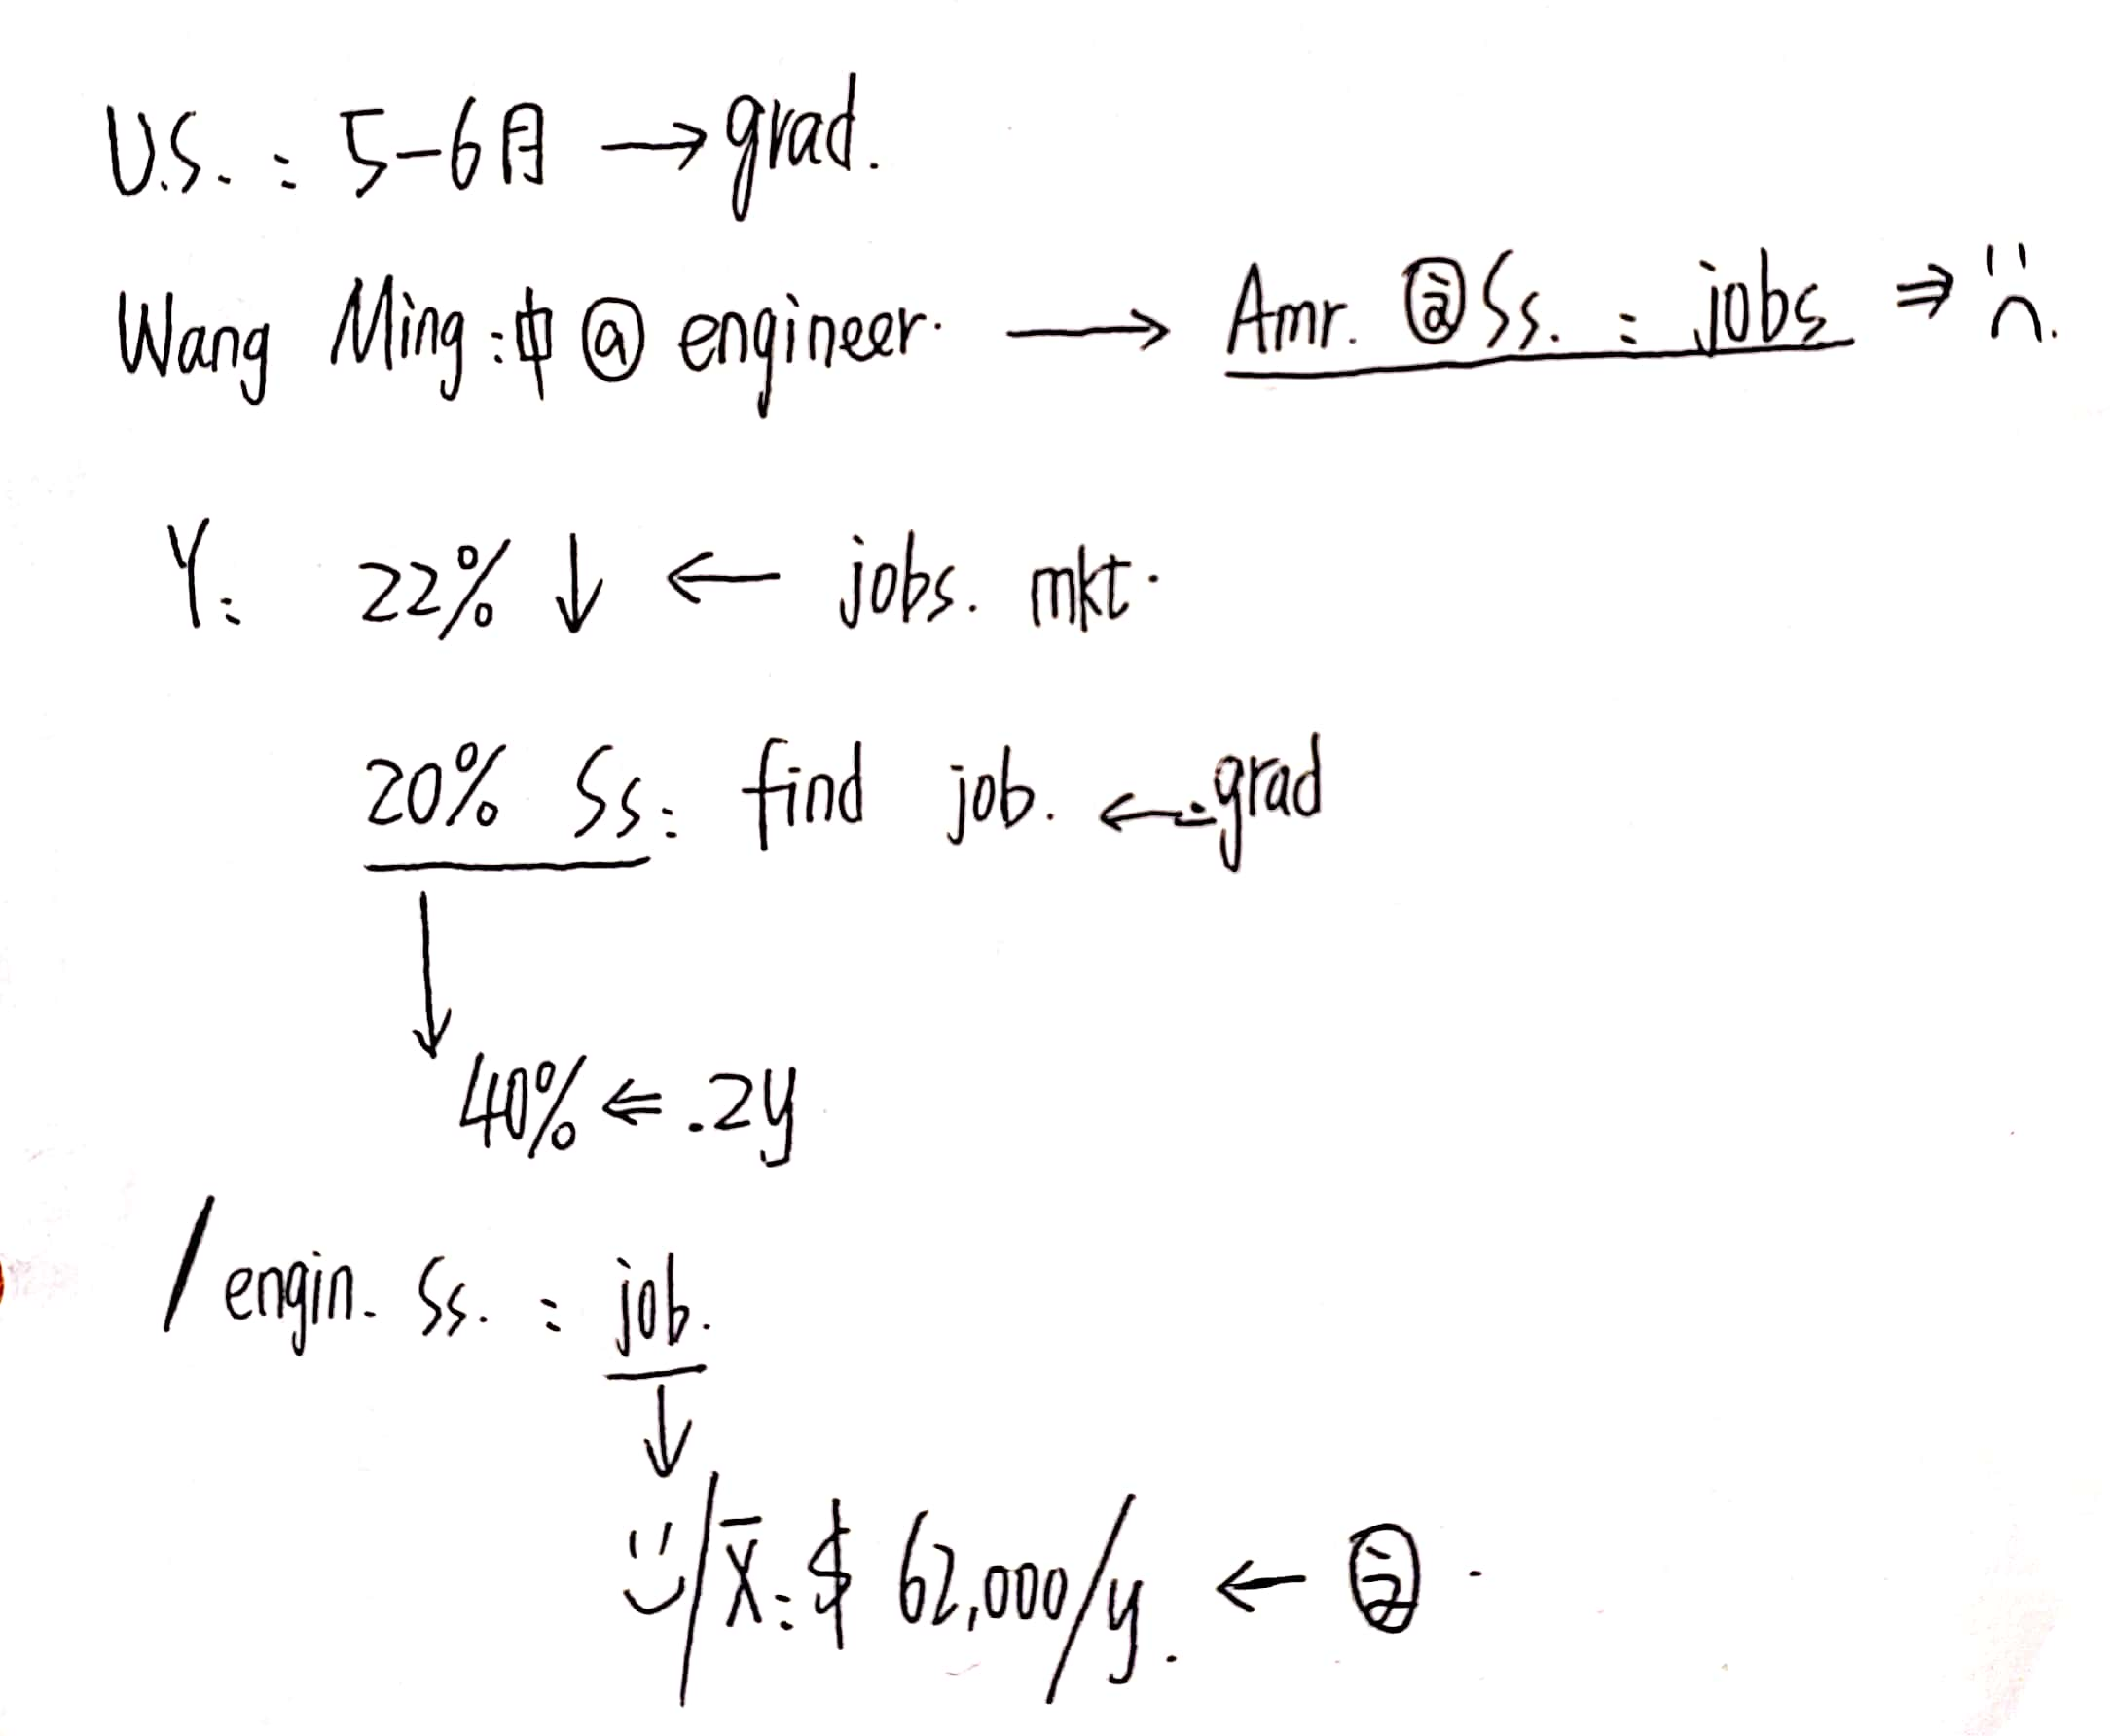
试炼真题：独白

Slide 46

备战高考听力

Slide 47
Summary 知彼
1.留心观察生活，了解生活，熟悉生活场景词汇及表达；
2选材时注意材料语言要地道，话题广泛，设题科学、多样性3.平时的训练中练习快速记笔记，理凊材料中琐碎细节信息的对应关系；
4多用转述( paraphrase)，训练语言灵活转换能力5.博览群书，开拓视野，积累跨文化背景知识，多理解真实生活
中的信息；
6.熟悉不同主播的声音，考场主播轻松应对。
1. 听力常考的话题有哪些？24个
2. 听力常考的题型有哪些？
3. 听力常用的提问方式有哪些？导学案P8
4. 听力的技巧有哪些？

Slide 48

听前、听中、听后
考试小技巧
巧用试音
读题预判
心态平和
有条不紊
把握要点
果断选题
舍前保后
谨慎修改
如果某一句话听不明白，暂时放弃，以免影响后面的答题。
在大多数情况下，改动越多，错误率越高。

Slide 49
百战不殆的Tips
1.留心观察生活，了解生活，熟悉生活场景词汇及表达；
2选材时注意材料语言要地道，话题广泛，设题科学、多样性3.平时的训练中练习快速记笔记，理凊材料中琐碎细节信息的对应关系；
4多用转述( paraphrase)，训练语言灵活转换能力5.博览群书，开拓视野，积累跨文化背景知识，多理解真实生活
中的信息；
6.熟悉不同主播的声音，考场主播轻松应对。
1. 积累主题词汇，文化背景知识；
2. 坚持听力训练，培养耳朵的敏感度；
3. 朗读听力原文，己速≥主播速；
4. 熟悉不同主播的声音，考场时方能轻松应对；
5. 熟练运用本堂课所学的技巧！！！！

Slide 50


彩蛋时刻！
这些年听力告诉我们的道理！
借东西？一般是借不到的
考试？比较难，要熬夜，老师比较严厉
讲座？题目比较有趣，内容一般比较复杂难懂
作文？一般要修改polish或重写rewrite
买票？基本上是买不到的
With AQ，you can bring the unique thing to your life.
有了逆商，你就可以为你的人生增添独一无二的味道。
Adversity Quotient

Slide 51


May you succeed in your first listening exam!
预祝大家在9月份的听力中，首战告捷！

