Slide 1

感恩遇见，相互成就，本课件资料仅供您个人参考、教学使用，严禁自行在网络传播，违者依知识产权法追究法律责任。
更多教学资源请关注
公众号：溯恩高中英语
知识产权声明

Slide 2

Dream
台州市第一中学 周 媚
台州市第一中学 陈泓静
台州市三梅中学 林梦妮

Slide 3
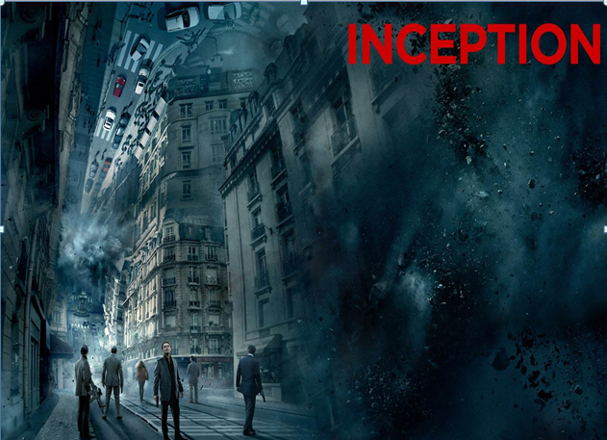
Dreams are reflections of humans’ inner spaces and a connection between human subconsciousness(潜意识) and consciousness(意识).

Slide 4
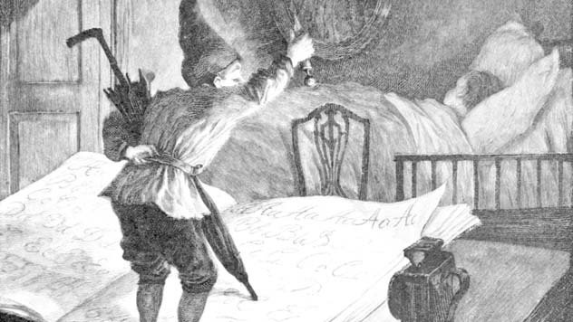
Ancient Stories about Dreams in Western culture
When you wake up with
something solid around your eyes,
it’s because the Sandman(睡魔)
visited you the night before.
In America, every child knows the story of the Sandman, a spirit who sprinkles sand into the eyes of sleeping boys and girls to make them dream.

Slide 5

The dream catcher is an old tradition of American Indians.
It looks like a spider web. A special stone sits near the center and feathers hang from the bottom.
The circles are symbols of unity and strength.
When it is hung over the bed at night, it will catch people’s bad dreams in the web while good dreams will fall through the center, which is said to give people courage.
Dream Catcher

Slide 6

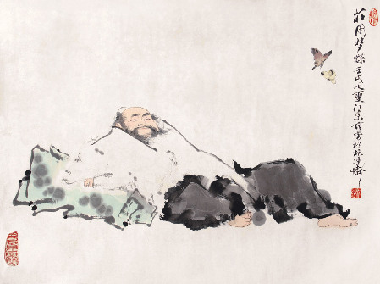
Ancient Stories about Dreams in Chinese culture
In ancient times, there was a man called Zhuangzhou. One day, he dreamt of himself becoming a butterfly. When he woke up, he raised an extremely philosophical(哲学的) question: Was Zhuangzhou dreaming of himself becoming a butterfly, or was a butterfly dreaming of itself becoming Zhuangzhou?
Zhuangzhou Dreamt of A Butterfly

Slide 7
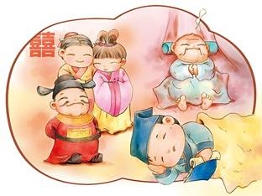
A poor, unhappy scholar who fell asleep while waiting for his lunch. He dreamt he became a high official and enjoyed a life of wealth and comfort, only to wake up and find that the pot of millet was being cooked for him on the fire.
Golden Millet(粟) Dream

Slide 8
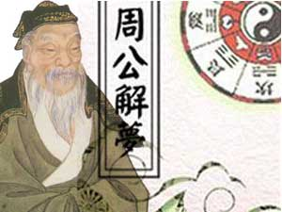
Ancient Chinese people thought that dreams can imply auspicious(吉)and inauspicious things. And they had the idea that different dreams had different meanings. The most famous book for dream interpreting in China is
“Duke of Zhou Interprets Dreams”.
Duke of Zhou
Interprets Dreams

Slide 9

The Meaning of Most Common Dreams
falling
Dreaming about falling is to alarm a situation where you feel out of control or predict your future failure.

Slide 10

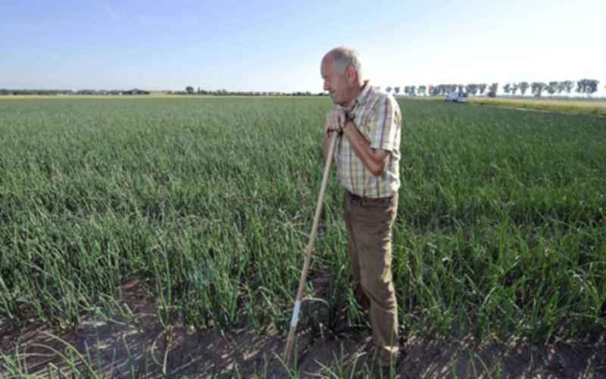
If he dreams of falling, what does the dream mean?
businessman
He may worry about his finance situation or business investments.
peasant
He may worry about the natural weather or the harvest.

Slide 11
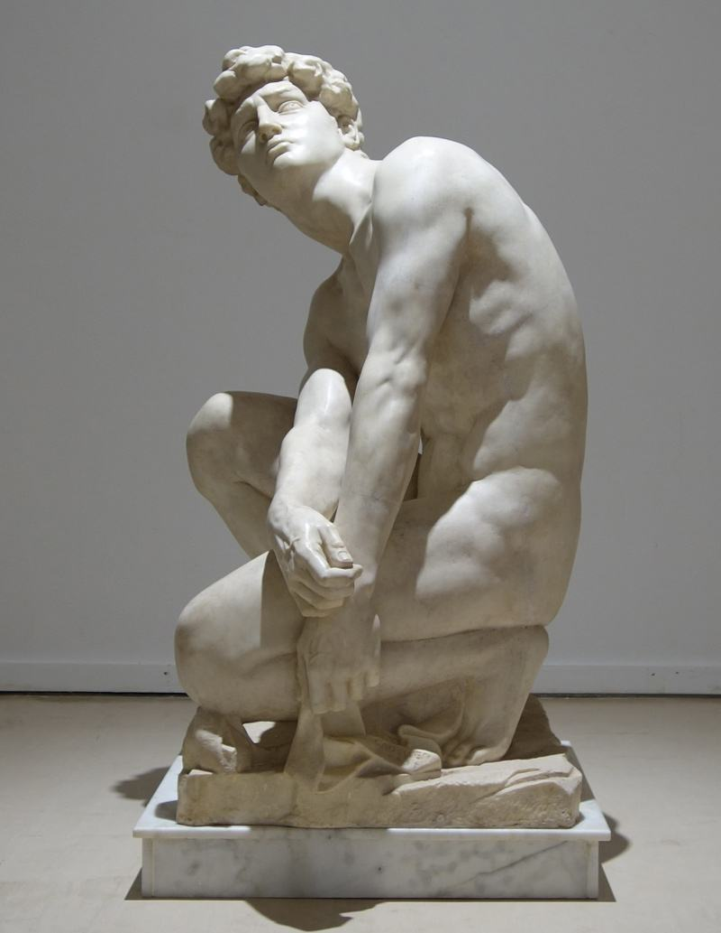
naked

Slide 12
A dream in which you are naked symbolizes weakness. You are most likely worried about the ___________(判断)of others.
To be naked in public in a dream indicates that you are afraid of exposing your inner______(自我) to other people who can see through your usual disguises(伪装).
If you are the only one who is naked, you are afraid of being singled out. You are concerned that you don’t understand the true_______(本质)of those around you.
To be naked proudly indicates that you have great ____________(自信).
judgment
self
nature
confidence

Slide 13
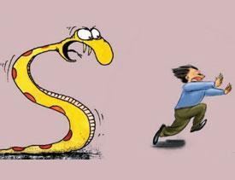
be chased
To dream that you are being chased represents you are avoiding facing problems, or something you may feel impossible to overcome.

Slide 14
A woman dreamed of being chased by a stranger.
She felt unable to find a new job after leaving her old company due to hating her former boss.
A young woman dreamed of being chased by a man with a lion head.
She felt that she was avoiding her ex-boyfriend. She felt the need to avoid him with his constant calls.
She was losing her hair due to an illness and was avoiding telling anyone because she feared they would laugh at her.
A woman dreamed of being chased by monsters.

Slide 15

flying
If you are flying above a city in your dream, it may imply that you will have fun in a long journey.
If you have wings and fly in your dream, it may suggest that you will have an e_________ time in recent days.
njoyable

Slide 16
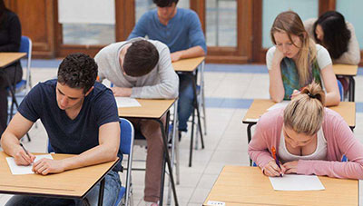
take a test

Slide 17
Generally speaking, the dream about taking an exam or test is echoes of inner anxiety caused by study or work or life. Such a dream suggests that you are under stress, which is similar to the “exam”. In fact, it often appears the day before you show others your strengths or accomplishments in face of risks, or something you have to bear the consequences, such as job interview, delivering a speech, report, important business. But remember, sometimes dreams are opposite to the fact.
Passing an Exam
B.Failing an Exam
Cheating in an Exam
D.Being late for an Exam
E.Being unprepared for an Exam

Slide 18

B
Dreaming about ____ suggests your ideal will come true. For candidates, the dream about getting a bad exam result suggests you will get good marks and handing in a blank paper is a sign of good luck.
D
Dreaming about ____ is an indication of escaping caused by uncertainty. On the other hand, it perhaps shows that you do not want to face some things in your life .Probably you want to make some progress, but in practice you always feel a kind of pressure to slow down.
A
Dreaming about _____ suggests you will have pretty good luck, and a friend may offer you the opportunity to make money. Or you will get more popular and shine in a team activity.
E
Dreaming about ______ presents the real exam. You are worrying about disappointing someone and should be confident about yourself. Also, it indicates you worry about being not prepared enough and you need to rest.
C
Dreaming about _____ shows your anxiety about being unable to fully display your ability. For lack of confidence, it suggests that the results will be dissatisfactory.

Slide 19

Does the “Dream Interpreting” have some scientific basis?
YES!
1.Dreaming is the body’s self-implication(自我暗示).
body’s inner heat is too strong
easily get angry or nervous
roasted by a big fire/too hot to bear
have a liver
(肝) disease
your liver-fire is flaming
experience anger in dreams
2.Dreaming is like overnight therapy(治疗方法).
get rid of the painful emotional experiences during the dreams
have negative
feelings
during the day
focus more on positive things and enhance creativity the next day

Slide 20
3.Dreaming is the expression of wishes
that didn’t come true.
This is why very young men are likely to dream of fairies
(仙女), _________ of higher marks, _________ beggars of food, _________ people of families and prisoners of _________. Then comes another example. A man is asleep and the back of his hand is rubbed with a piece of cotton. He will dream that he is in a hospital and his _____ is visiting him, sitting by the bed and touching his hand gently!
students
hungry
homeless
freedom
?
wife
mother
girlfriend

Slide 21

Dream a dream;
Sometimes fall into daydreaming,
But don’t always;
Actually, you’d better have a dream.
Dream

Slide 22
THANKS
Designed by Sliva

