Slide 1

感恩遇见，相互成就，本课件资料仅供您个人参考、教学使用，严禁自行在网络传播，违者依知识产权法追究法律责任。
更多教学资源请关注
公众号：溯恩高中英语
知识产权声明

Slide 2
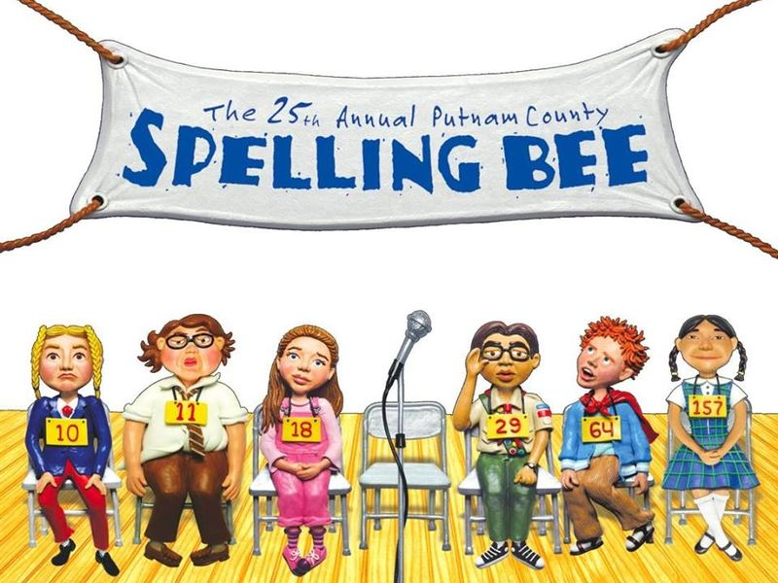
2020年6月浙江省五校联考读后续写讲评
杭州学军中学 乔璐

Slide 3


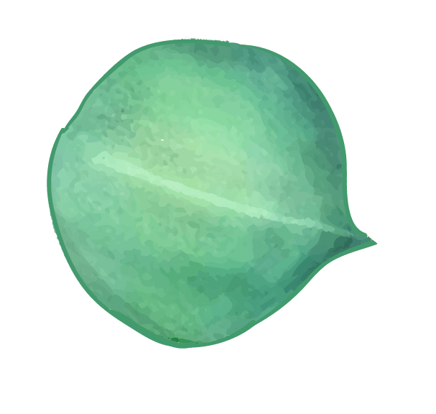



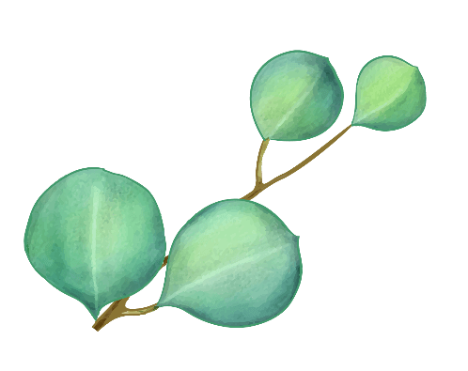



01
Read and analyze the passage
contents
02
Design the plot
03
Write and appreciate your work

Slide 4
①Theo stood at the microphone. Silence settled over the hall. “Your word is onomatopoeia,” said Mr. Ramirez, the announcer. I got this! Theo thought. Spelling was sort of his superpower. He wasn’t a math or science guy, but he had a gift for spelling. ②Theo’s brain fast-forwarded to the spelling bees ahead: first the county championship, then the state championship, and finally the national spelling bee. “Your answer, please, Theo?” He glanced back at Alexa, another fourth-grader, sitting on the edge of her chair. She wanted another chance at winning. If he missed his word, she’d be back in the game. But that wasn’t going to happen. Theo got the right spelling. ③Theo’s sister, Deandra, who had also competed but missed her word, applauded with the rest of the crowd. Mr. Ramirez presented the trophy(奖杯) to Theo. He lifted both arms into the air. “I’m the alpha-best.” Then he raced toward his sister. “Ha!” Theo said, making the trophy dance in front of Deandra’s nose. ④She rolled her eyes. “You’re a terrible winner.” ⑤“What’s wrong with celebrating my victory?”
⑥Deandra crossed her arms and made a sour face. “You know, it wasn’t cool the way you ignored Alexa onstage. She tried to shake your hand.”

Slide 5
⑦Theo shrugged. “I didn’t notice. Anyway, county bee, here I come!” ⑧“You might want to crack open the dictionary before counties. In two weeks, you’ll be facing the best of the best.” ⑨“And they’ll be up against me, the alpha-beast.” ⑩Deandra shook her head. “Well, good luck. I think you’re going to need it.” ⑪Two weeks passed in a blink. At the county bee, students from different schools gathered around onstage, some looking more worried than others. Finally, it was time for the contestants（选手）to take their seats. ⑫After six rounds, the group of more than 100 students decreased to just seven. This was no regular spelling bee. Theo had barely made it through the last round with a lucky guess on conscience. And if he’d had to spell aerospace or conical, he’d be out already. His sister’s advice suddenly made sense.
⑬ Paragraph 1：
When it was his turn again, Theo stood frozen for the longest moment. ⑭ Paragraph 2：
The following Monday at school, Theo found Alexa in the lunchroom.

Slide 6
01
Read and analyze the passage
How is the passage developed?
Para.______:
1/2
Describe main characters and setting
Present conflicts
Relate events that make conflicts complex
Present the solution of the conflicts or
cause characters to change
Para.______:
3-10
Para.______:
11-12
Para.______:
13-14

Slide 7

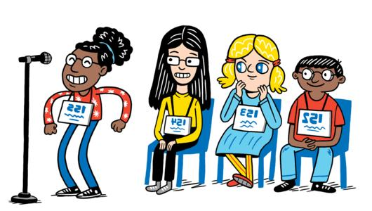
Describe main characters and setting(Para.1/2)
Characters:
Theo,
announcer, Deandra, Alexa, contestants
Setting:
on stage at the school spelling bee
Theo

Slide 8
Present conflicts(Para.3-10)
Plot:
Theo won the school bee and his reaction.
Conflicts:
1.Theo didn’t shake hands with Alexa after the victory.(a terrible winner)
2.Theo wouldn't prepare the spelling bee and believed in his luck.
What kind of person is Theo?
too proud, over-confident
Mr. Ramirez presented the trophy(奖杯) to Theo. He lifted both arms into the air. “I’m the alpha-best.”
“And they’ll be up against me, the alpha-beast.”

Slide 9

Relate events that make conflicts complex(Para.11/12)
Theo had barely made it through the last round with a lucky guess on conscience.
Theo had barely made it through the last round with a lucky guess on conscience.
Would Theo always be lucky and win the county spelling bee?

Slide 10


Present the solution of the conflicts or cause the character to change
Character change
proud，
a terrible winner and learner
didn't respect his rival
wouldn't put efforts,
believed in luck
modest, humble,
respects his rival
determines to work hard
HOW?
to educate people to be modest
Chance favors the prepared mind.
Theme:

Slide 11
02
Design the plot
underlined words:
Theo, Deandra, Alexa, superpower, spelling bee, terrible, victory, ignored, contestants, made it through
【who】 Theo, Deandra, Alexa, contestants
【where】 spelling bee
【theme】 superpower, victory
【adj.】 terrible
【v.】 ignored, made it through

Slide 12
Given sentences:
Paragraph 1：
When it was his turn again, Theo stood frozen for the longest moment.
Why did he stand frozen for the longest moment?
Would he win the game?
Plot
Feelings
Theo racked his brains
nervous, uneasy
but in vain
regretful
lost the game
sad, frustrated, disappointed
guilty
realized sth.

Slide 13
Given sentences:
Paragraph 2：
The following Monday at school, Theo found Alexa in the lunchroom.
Plot
Feelings
Theo apologized to Alexa
nervous, embrrassed, ashamed
Alexa's reaction
smile; comforted him/ surprised
Theo's reaction
surprised, touched, happy,
determined
ending

Slide 14
03
Write and appreciate your work
Language appreciation:
Para. 1:
1. (nervous) His palms were soaked with sweat. 2. His mind was racing, but as seconds ticked past, nothing popped into his mind. 3. Now he was in the similar position like Alexa that day. Unfortunately, the next contestant narrowly made it through, depriving Theo of the chance to win. 4. (lost the game)He had no choice but to make a random guess, and without doubt, he was out. 5. (frustrated) His heart sank. 6. (frustrated)Theo ducked his head, clutched his sleeves tightly and edged back to his seat.

Slide 15
7. (冠军的做法）However, Theo couldn’t believe his eyes when he saw the winner put the trophy aside and went down the stage to shake hands with other contestants. “Wish you good luck, Theo.” It was at that time that he realized that he might have hurt Alexa, which made his heart jolt.
8. (顿悟）Theo came to realize that there was no such thing as superpower and he needed to crack open the dictionary.
9. (顿悟）“He was absolutely a terrible winner, and now, a terrible loser.” He thought to himself.

Slide 16
Para.2:
10. (尴尬）“I’m sorry, Alexa.” uttered Theo in a low voice, his face burning with embarrassment.
11. (道歉）Mustering up his courage, Theo approached her timidly. “Sorry to ignore you that day.” he said in an apologetic tone. “Now I’ve paid the price for my pride. I lost the game.” 12. (ending) In the days to come, they made each other pals to practice spelling, accompanied by the dictionaries, for they both discovered, true superpower lies in endeavor. 13. (ending) That day witnessed Theo’s growth, from being proud to being modest, from believing luck to making down-to-earth efforts. 14. (ending) They enjoyed lunch together, but most importantly, shared the resolution to become the next Alpha-best, with down-to-earth efforts.

Slide 17
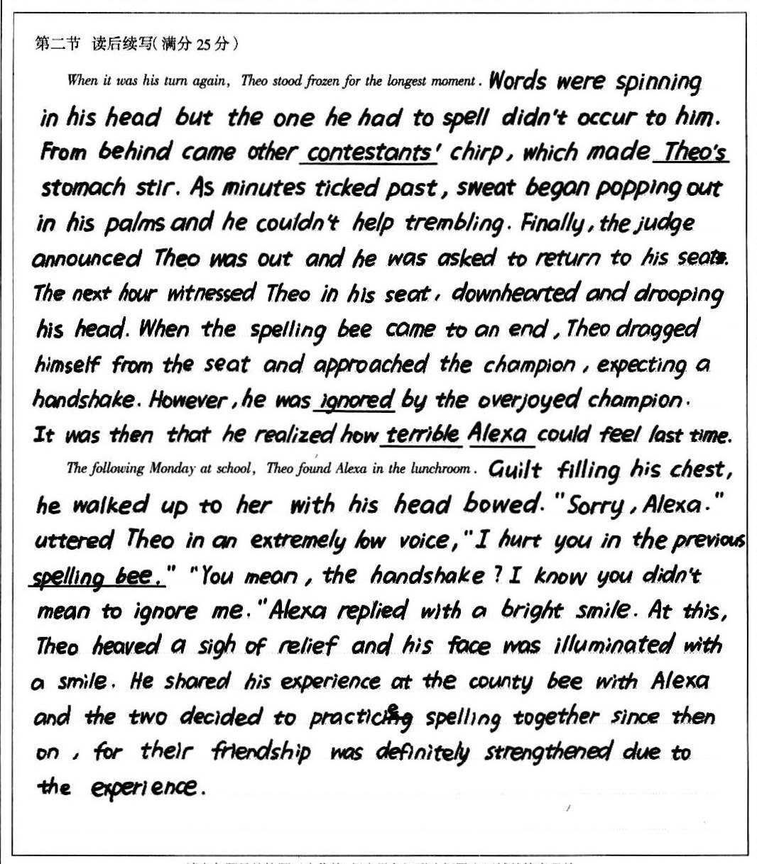

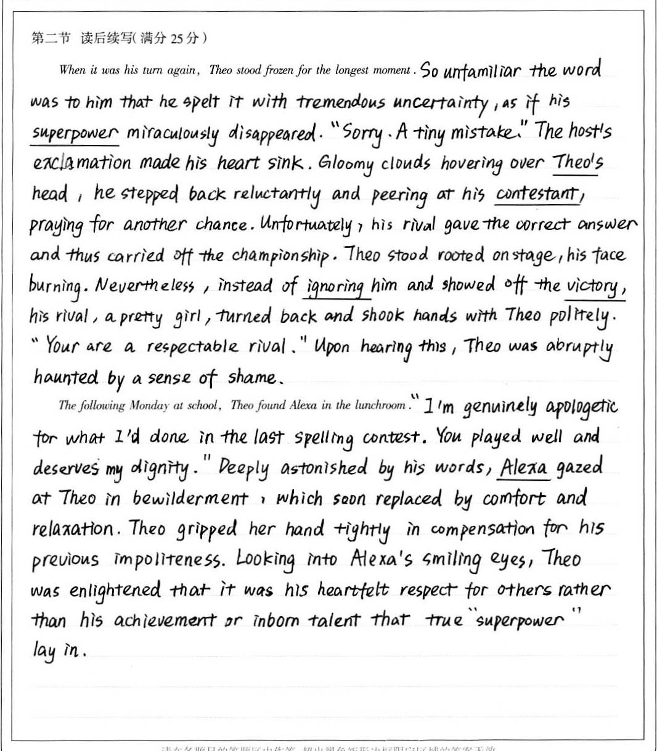
21.5
考场佳作：
22.5

Slide 18
参考范文：
When it was his turn again, Theo stood frozen for the longest moment. He racked his brains, searching for the right word, but this time his superpower seemed to fail him. His mind went totally blank. Other contestants were whispering when the bell rang, announcing he was out. Imagine Theo’s sadness when he walked down the stage, sank heavily into his seat and let out a sigh. It suddenly dawned on him that Alexa must have felt the same. “I was indeed a terrible winner. I must apologize to her.” Theo thought to himself.
The following Monday at school, Theo found Alexa in the lunchroom. Taking a deep breath, Theo went straight to her. “I'm sorry for ignoring you.” He said in a weak voice. “It’s OK. I figured you were just too excited, so how was the county bee? ” Alexa asked with a beam of smile. “It was a disaster.” Theo shrugged his shoulders and started pouring out all the regret for not putting his heart into preparing the competiton. Hearing this, Alexa comforted him and the two decided to study together, determined to become the next Alpha-best.

Slide 19


Thank you!

