Slide 1

感恩遇见，相互成就，本课件资料仅供您个人参考、教学使用，严禁自行在网络传播，违者依知识产权法追究法律责任。
更多教学资源请关注
公众号：溯恩高中英语
知识产权声明

Slide 2






Continuation Writing
素材活用
主题语境下的
浙江省桐乡市高级中学 沈凯慧

Slide 3
历年浙江高考续写
人与自我
人与自然（动物）
Jane与老公吵架，森林中迷路，脱险，醒悟。
Mac狼口脱险。
16年11月
17年6月
人与自然
我骑马遇兔受惊，迷路，最后根据自然的线索安全返回。
人与自我、人与自然
17年11月
我们与粗心的妈妈旅行，忘带东西，迷路，最后却依然享受到了旅途中的美。
18年6月
人与自然（动物）
20年1月
Poppy（狗）、小狗和小主人之间的情感故事

Slide 4
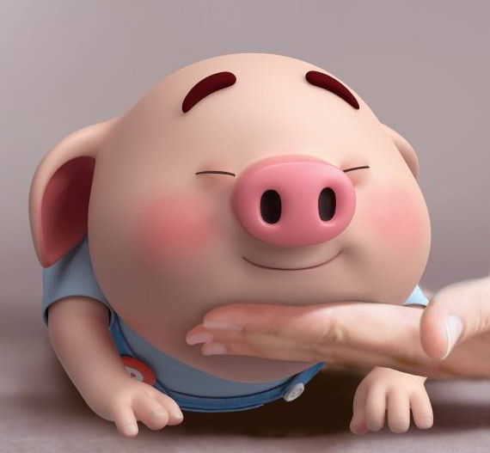
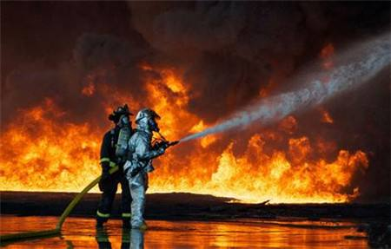
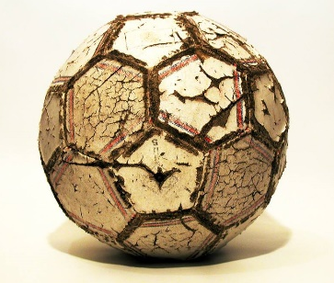
素材活用
人与自然: 动物
人与自然：火灾救人
人与自我：球类比赛

Slide 5
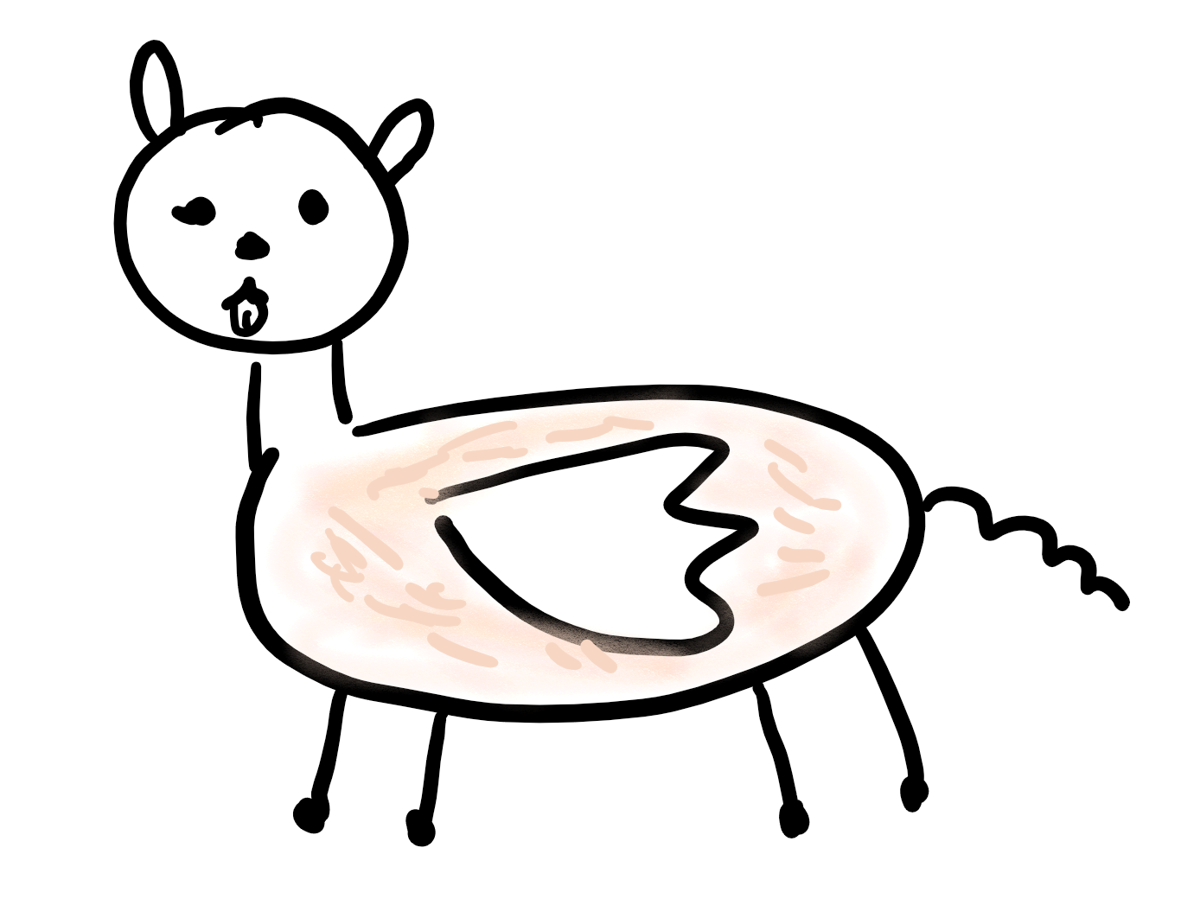
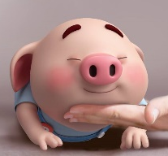
素材活用：人与自然: 动物
ear
eye
wing
CWM
nose
fur
mouth; tongue
tail
leg; paw

Slide 6
素材活用：人与自然: 动物
wing:猛烈扑棱：thrash
拍打翅膀：flap the wings
nose:嗅 sniff; 出声嗅 snuff
fur:
梳理毛发brush the fur
mouth; tongue:
打鼾 snore;
舔我的脸 lick my face
CWM
tail：
摇尾巴 wag the tail
leg:
拖着皮带 tug at his leash
在我身边蹦蹦跳跳 jump about me
跳跃着跑 bound
在我脚边摇晃 cradle against my feet
paw:
摩擦脚掌rub the paws

Slide 7
狗吠：woof
狂吠出尖锐的警告声bark a sharp warning
猫叫：meow
鸟鸣：tweet
鸟尖叫：screech; shriek
马嘶：whinny, neigh
猪哼：oink
牛哞：moo
鸡咯咯：cluck
鸭嘎嘎：quack
狮吼：growl; roar
SOUND

Slide 8
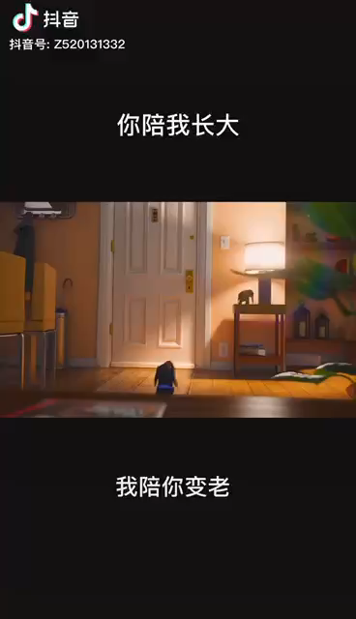
Watch and Practice
Choose one scene that
interests you most
to describe in detail.
(14 scenes)
Notes:
请提供最少一个场景的描写。

Slide 9
Possible Version
【DOG】The puppy was thrilled to expect his master at the door. At the sight of his master, he barked as a greeting, bounced across the room and twirled round and round with exhilaration, bumping against the tea table as well as the armchair. In a flash, he brought in her mouth a pair of slippers, wagging his tails rapidly, eagerly anticipating his master's recognition.
【CAT】The kitten lay idly on the mat as if expecting her owner to hug her. Sure enough, the owner swept her up in her arms, stroked her fur affectionately and beamed at her tenderly. Playful and pettish, the kitten snapped at the finger of her owner and bit it slightly. Soon, she licked the finger tamely to how her friendliness. The kitten and her owner, they both were bathed in an atmosphere of amity.
Notes:
请提供最少一个场景的描写。

Slide 10
素材活用：人与自然: 火灾救人
What can you see or hear before entering the burning house?
What will meet you when you are in the burning house?
How can you save people when you are in the burning house?

Slide 11
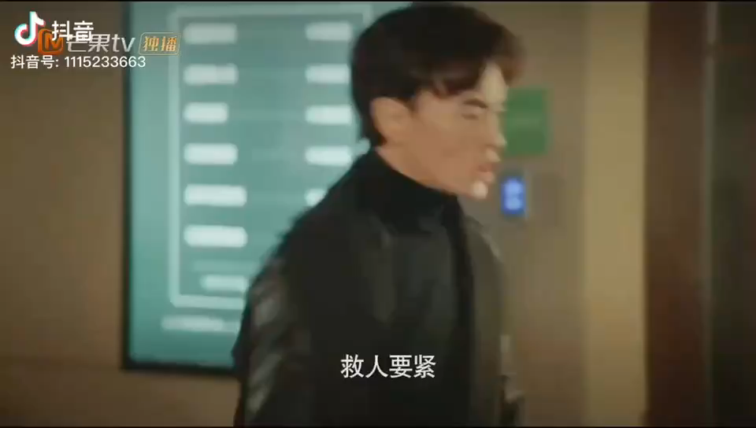
Watch and Discuss
Watch the video and answer the questions.

Slide 12
素材活用：人与自然: 火灾救人
What can you see or hear before entering the burning house?
Smoke billowed from the burning houses.
The house was bathed in an immense stream of flame.
The roaring fire swallowed the whole house.
The air was filled with thick, black smoke, the sounds of sirens, people screaming and glass breaking.

Slide 13
素材活用：人与自然: 火灾救人
What will meet you when you are in the burning house?
Entering the burning house was like “running into a bucket of black paint”.
He was met by intense heat. Blinded by the dense smoke, he stumbled to feel his way.
The thick smoke caused him to stumble blindly around, burned his eyes, and made it impossible to breathe.
His throat and lungs burned as if he’d inhaled fire instead of the smoke and ash in the air. Every blink stung his eyes. All he could hear was the crackling and popping of burning wood.

Slide 14
素材活用：人与自然: 火灾救人
How can you save people when you are in the burning house?
Then a soft but distinct moan emerged. Still unable to see, Surrell fell to his knees on the hot wood floor. He crawled toward the sound, feeling around for any sign of the girl.
He pulled Tiara towards him with full strength. Her body was limp(柔软无力的) and she wasn’t breathing. He scooped (抱起) her into his arms and struggled to feet.

Slide 15
素材活用：人与自我：球类比赛
运动员：player 守门员：goalkeeper
裁判吹哨：The referee blows the whistle.
踢球：kick the ball
拍球：bounce/pat/tap the ball
运球：dribble the ball
扔球：throw/toss the ball
传球：pass the ball
接球：catch the ball
拦球：block the shot
得分：score/score a goal
保持平局：stay tied
以2：1获得比赛胜利 The game ends with 2:1 in our favor.

Slide 16
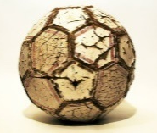
素材活用：人与自我：球类比赛
运动员动作描写：
One of our players burst out of the crowd of players like a piece of overheated popcorn bursting from a pan.
With a speedy kick, she sent the ball through the air and towards the goal.
The goalkeeper reached to block the shot, but the ball soared past her hand.
The team, like a sleeping creature that had been awakened, came quickly to life.
In second half, the opposing player almost scored another goal, but we blocked the net so the ball could not go in.

Slide 17
素材活用：人与自我：球类比赛
观众描写：
The audience let out a thundering cheer.
“Score! Score!” Our cheerleaders roared excitedly. Their storms of cheers refueled us players.

Slide 18
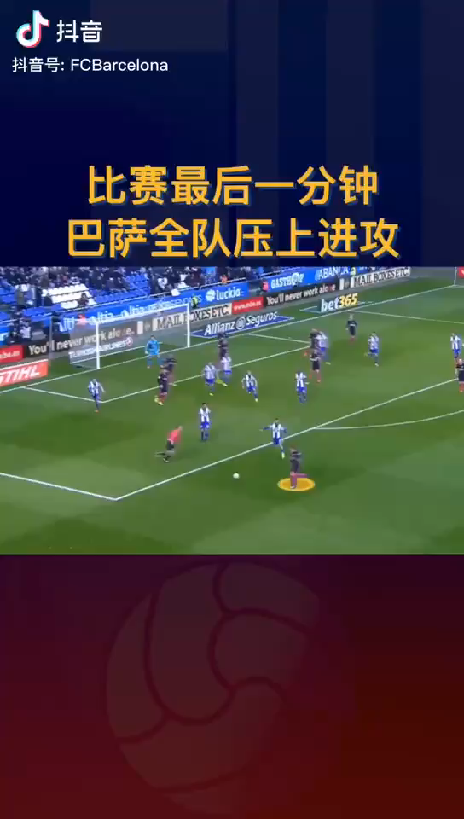
Watch and Practice
Try to describe
this scene.
Notes:
提供写作范文。

Slide 19
Possible Version
The shot was unexpectedly cut off at this critical moment. With the kick from the opponent toward the goal, the footballer dashed across the field like an arrow to save it. He kicked the ball to block the shot, the ball soaring in the opposite, narrowly missing the goal. Again, the opponent launched another attack with a mighty shot. Agile and speedy, the footballer cleared the ball with an impressive kick. There burst a thunderous applause from the spectators in praise of this marvelous moment.
Notes:
请提供最少一个场景的描写。

Slide 20



Final Task
My version
Plot: One day, Mike won the football. When he came home, he found his house was burning, where his pet Peppa dog was, so He bravely rushed into the house and save it.
01
One Story
02
03
Notes:
提供写作范文。

Slide 21
Possible Version
It was definitely an unforgettable day for Mike. Wearing a hearty smile, Mike was heading home after he impressively won his last football match in the season with five nice shots. Far from his expectation, he arrived at his doorstep, only to find smoke billowing from his house. What a disaster! His house had caught on fire! “My Peppa!” Without hesitation, Mike dashed through the door to save his beloved pet dog. Met by a stream of heat, Mike choked fiercely and called out Peppa frantically, fumbling for Peppa in the intense smoke. At the familiar voice, Peppa barked loudly at his master as if asking for help. Seeking the constant barks from Peppa, Mike was shocked to find him trapped under the table. Huddling up in terror, Peppa wagged his tail and licked his own injured paws, expecting the rescue from his master. No sooner had Mike spotted Peppa than he scooped him up, wrapped him tightly in the arms and staggered through the flames, outside the burning house.
Notes:
请提供最少一个场景的描写。

Slide 22





Thank you!

