Slide 1

感恩遇见，相互成就，本课件资料仅供您个人参考、教学使用，严禁自行在网络传播，违者依知识产权法追究法律责任。
更多教学资源请关注
公众号：溯恩高中英语
知识产权声明

Slide 2
续
读
后
写
2020.6温州适应性测试卷讲评
桐乡市高级中学 俞晓炜

Slide 3
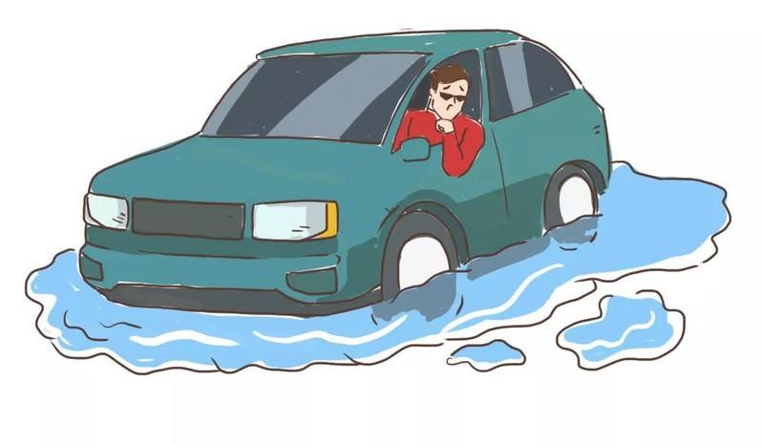
Read for basic information
Elements of a story
Who
When
Where
What
Why
How
I & Joe (a couple)
on a rainy November morning(Rain came down in sheets)
on the way to work (in the shortcut)
my car got stuck in the flood
took the shortcut which was flooded by rain
？

Slide 4
丰富的动作描写推断故事情节的发展，体现人物的心理变化
①It was a rainy November morning. Overcome with anger I knew if I didn‘t leave the house soon I would lose my temper with my husband, Joe. As rain came down in sheets, Joe offered to take me to work. I struggled into my jacket, seized my bag and teaching plans and ignored him.
② He insisted and reached for his boots. I looked at the piles of newspapers and the dirty dishes still on the table. ＂Don’t you have enough to do? I can take care of myself ＂I stormed out，not even kissing him good-bye. Joe shouted after me not to take the shortcut(捷径)
③ Joe and I had been eagerly looking forward to our retirement when a heart attack that past spring forced him to leave his job earlier than we had planned. As the medical bills mounted we realized I would have to continue working full-time while Joe stayed home and took over the housework.
④ The new arrangement was a disaster. Exhausted after a day of full work, all I wanted was a hot home cooked meal and a good night's sleep. However, what greeted me at the table was a microwave package. Sometimes he would serve oatmeal(燕麦)for several nights in a row. One night when I dragged myself to bed, I was terrified to discover Joe had turned our white sheets blue. He told me he had found out how to save on water, soap and electricity. He patted his blue trousers and announced proudly washing everything together was just the secret.
⑤Ten minutes later, ignoring Joes warning I turned off the main route (道路).I thought it hadn’t rained enough to flood the road, but as I rounded the corner water rushed across my path. After a few feet, the car got stuck. I opened the door and water poured in. I hurriedly closed the door. I couldn’t risk walking in this. Almost 20 minutes passed. The car began to shake. I got frightened to death when I heard three long honks (喇叭声).
伏笔： Joe was caring.
他会来救“我 ”。

Slide 5


The development of the given plots
 | I | Joe
Para 1&2 The setting
Para 3&4 The cause
Para 5 The Climax
… to be continued
offered to make me to work;
insisted and reach for his boots ; shouted after me not to take the shortcut
overcome with anger; stormed out
I left home, angry with my husband Joe.
look forward to retirement; continue working full-time; exhausted after work ; wanted a hot homecooked meal and a good night’s sleep
took over the housework; was a disaster; serve oatmeal in a row; turned white sheets blue
I recalled the cause of my anger- Joe did the housework _______.
terribly
/ in a mess
turn off the main route; got stuck; couldn’t risk walking in the water; got frightened ; heard three long honks
My car got stuck in the flood and I was terrified.
How I was saved

Slide 6
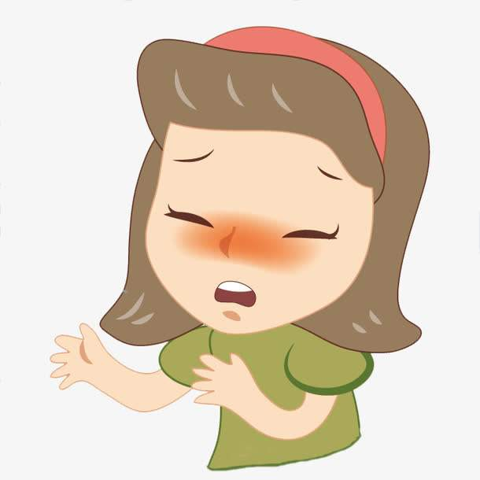

I
The feelings of the main character
Joe
Para 2?
angry / mad
剧情的展开要紧扣主题，Joe来营救是基本方向
disappointed/ upset
Theme: Love
Para 1 ?
frightened

Slide 7
02
Explore the possible plots

Slide 8
Plot planning
①It was a rainy November morning. Overcome with anger I knew if I didn‘t leave the house soon I would lose my temper with my husband, Joe. As rain came down in sheets, Joe offered to take me to work. I struggled into my jacket, seized my bag and teaching plans and ignored him.
② He insisted and reached for his boots. I looked at the piles of newspapers and the dirty dishes still on the table. ＂Don’t you have enough to do? I can take care of myself ＂I stormed out，not even kissing him good-bye. Joe shouted after me not to take the shortcut(捷径)
③ Joe and I had been eagerly looking forward to our retirement when a heart attack that past spring forced him to leave his job earlier than we had planned. As the medical bills mounted we realized I would have to continue working full-time while Joe stayed home and took over the housework.
④ The new arrangement was a disaster. Exhausted after a day of full work, all I wanted was a hot home cooked meal and a good night's sleep. However, what greeted me at the table was a microwave package. Sometimes he would serve oatmeal(燕麦)for several nights in a row. One night when I dragged myself to bed, I was terrified to discover Joe had turned our white sheets blue. He told me he had found out how to save on water, soap and electricity. He patted his blue trousers and announced proudly washing everything together was just the secret.
⑤Ten minutes later, ignoring Joes warning I turned off the main route (道路).I thought it hadn’t rained enough to flood the road, but as I rounded the corner water rushed across my path. After a few feet, the car got stuck. I opened the door and water poured in. I hurriedly closed the door. I couldn’t risk walking in this. Almost 20 minutes passed. The car began to shake. I got frightened to death when I heard three long honks (喇叭声).
What can you infer from the last paragraph?
challenging
It was dangerous and the rescue would be ____________.

Slide 9
Catch hints from the given sentences
Para1 : Looking over my shoulder, I stared into the flashing lights of a truck.
Para2: I screamed that I couldn’t make it.
What did I see?
Who was the driver?
What kind of help did I get?
+ feelings: excited
/ hopeful
/ frightened
I tried, but failed
+ feelings: desperate
/ courageous
/ grateful
/ joyful
What was the difficulty?
How did I solve it?
Did I make up with my husband?

Slide 10
Plots : At the sight of the truck…
Peers’ Sparkling Lines
The hope that had been submerged suddenly resurfaced.
When I realized that he was my husband, I could hardly contain my excitement.
Engulfed by a surge of guilt mingled with being moved, I shouted, “Go back! It is so dangerous!”

Slide 11


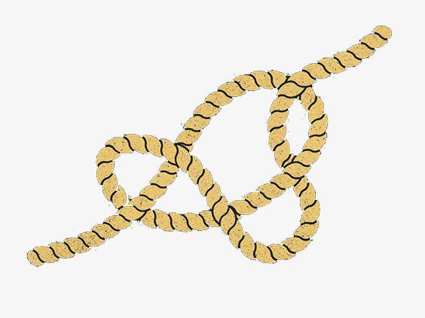

Plots : The way the driver helped me…
a rope
a ladder
a life buoy 救生圈
a kayak 皮艇
扔过来：
抓住绳子 ：
throw / cast
catch (hold of)/ hold
on to/seize/grab /grip
/ capture / clutch …

Slide 12
Plots: The way I was rescued…
拉开门
tug /haul the door : pull （用力） 拖，拉，拽
shove / thrust the door: push 猛推
burst the door open 冲开门
爬窗
wind (wound-wound) down the window 摇下车窗
Joe 紧紧抓住我的手臂
take a firm ________________ of my arm
抓得更紧了 _______（tight） his hold
Joe
I
grip/ grasp/ grab
tighten

Slide 13
Plots : Walk in the flood…
No rush / dash
wade: 跋涉，蹚（水或淤泥等）
Joe leaped out and waded into the flood.
struggle: 艰难地行进；吃力地进行
I struggled up the hill with the heavy bags.
struggle to one’s feet 挣扎着站起来
plod: 艰难地行走；吃力地
Our horses plodded down the muddy track. 我们的马沿着泥泞小路蹒跚而行。
We plodded on through the rain. 我们冒雨艰难地跋涉。
stagger/ totter/ stumble 蹒跚；踉跄

Slide 14
Peers’ Sparkling Lines
With jaws clenched, I resolved to keep edging closer, inch by inch.
Mustering up my courage, I pushed the door open with all my might, seized Joe’s arm tightly, and we waddled （蹒跚而行）to the truck by holding each other up.
I stretched out my arms to embrace him, and he patted me on the back slightly to show comfort.

Slide 15
Plots: After being rescued…
Peers’ Sparkling Lines
I failed to utter a word, with my eyes crammed with tears and my head resting against his chest.
“I’m sorry, and I should have taken your advice,” I murmured, head drooping. Joe chuckled in relief, “You are safe. That’s enough.”
The moment we pulled ourselves out of the water, the car was washed away. What a narrow escape!

Slide 16
03
Share the vivid description

Slide 17
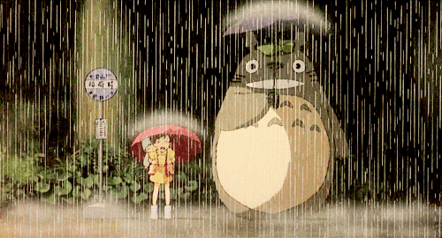
The situation at that moment…（环境描写）
heavy rain : fall / pour / beat / hit
Rain came down in sheets. 大雨倾盆。
pelt 倾泻；下得很大
The rain now was pelting down. 雨这时正哗哗地下。
splash / spatter / splatter 溅落
Rain splashed against the windows. 雨点啪啦啪啦打在窗户上。
Heavy rain splattered on the windshield.
大雨噼里啪啦地打在挡风玻璃上。
wind / thunder / sky / flood

Slide 18
The situation at that moment…（环境描写）
As splashing raindrops hit the windshield frantically and the skies were overhung with a blanket of grey, I could barely make out the figure in the truck.
雨滴疯狂地打在挡风玻璃上，天空笼罩在一片灰色之中，我几乎看不清卡车里的人影。
The fragile little tree cracked and fell in the wild howling wind.
脆弱的小树啪地一下被狂风吹断了，倒在了地上。
The water kept rising, as if it would engulf me alive.
水不停地涨，仿佛要把我活吞下去。

Slide 19
The situation at that moment…（环境描写）
Peers’ Sparkling Lines
The wind howled, whipping the rain against the window.
The rain was pouring and the winds roared.
Hearing the trees creaking in the howling winds and the rain beating against the car window, my palms got sweaty.
With rain frantically spattering down on his body, what I could see was a hero-like figure…
Unfortunately, the water poured in and crept upon my waist.

Slide 20
Feelings of fright / panic / horror
Tears of frustration and horror gushing from my eyes, I felt I had sunk into hopelessness.
Seized by a strong sense of fright, I struggled to shove （猛推）the door again.
A sense of terror sweeping through my body, I shouted in panic, “Help! Help!”
The hairs on the back of my neck prickled with dread and I was drenched in sweat. （汗毛倒竖；湿透）
Swallowed by a wave of despair, I crossed my fingers, closed my eyes and prayed in a shivering voice.
Trembling like a leaf, the car was ready to be flooded away at any time, which refrained me from moving a single inch.

Slide 21
04
佳作欣赏

Slide 22
Looking over my shoulder, I stared into the flashing lights of a truck. Peeking through the mounting rain, I struggled to make out the vague figure over there. It was Joe that shouted and waved violently. “Joe, I’m here!” I wound down the window, tears of horror mixed with rain streaming down my face. My car began to shake increasingly wildly. Picturing the road cracked and the car was flooded away, I felt more frightened and sensed death was waiting for me. “Jump out of the car and ran to me!” Joe yelled and got off the truck, waiting for my action.
I screamed that I couldn’t make it. Yelling at the top of his lung, Joe tried to soothe me and convince me that it was the best way to escape the danger. I opened the door, reached out my foot, trying to find a proper land point. After confirming the safety, I inched forward in the muddy water and eventually rushed frantically towards my husband. Joe also ran in my direction, gathered me into his arms and kept patting my back. Sobbing in relief, I was overwhelmed by waves of guilt and remorse. I murmured sorry, reflecting that I should have taken his warning seriously.
佳作点评：
该习作情节合理、紧扣原文，整个营救过程娓娓道来、扣人心弦。整体行文流畅、过渡自然。人物的心理、动作描写丰富生动，使得人物形象饱满。语言功底强，词汇丰富多样，非谓语动词等高级表达信手拈来。

Slide 23
Possible version
Paragraph 1:
Looking over my shoulder, I stared into the flashing lights of a truck. It was Joe! I couldn’t help bursting into tears. Joe shouted to me not to be frightened. Then he threw a thick rope so that I could hang on to it and walk straight toward him. I opened the door, grabbed it and inched out. However, a sudden fall left me in the rushing water. I struggled to my feet, only to find a branch blocking the way right in front of me.
Paragraph 2:
I screamed that I couldn’t make it. Joe, however, remained calm! He urged me to take one step at a time and assured me I could make it. I moved forward slowly and cautiously before I fell into his arms. Sobbing against his chest, I apologized that I shouldn’t have taken the shortcut. Joe patted me saying his primary concern was my safety. Only then did I realize Joe actually understood how to take care of me despite his trouble with the housework.

Slide 24

What should we do to save ourselves?

Slide 25
Thank you!

