Slide 1

感恩遇见，相互成就，本课件资料仅供您个人参考、教学使用，严禁自行在网络传播，违者依知识产权法追究法律责任。
更多教学资源请关注
公众号：溯恩高中英语
知识产权声明

Slide 2
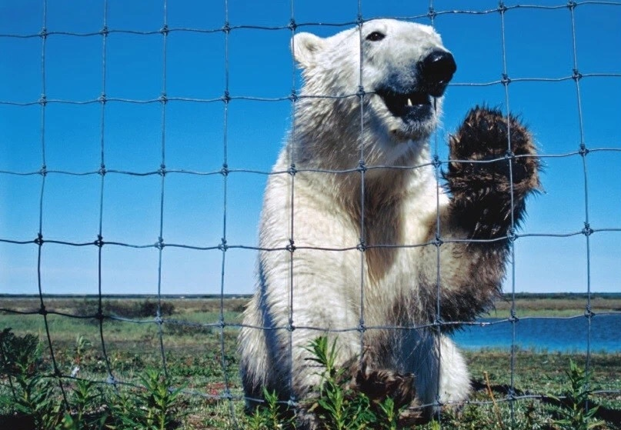
Face to Face with POLAR BEARS
2020.7 浙江卷 读后续写
桐乡市高级中学
冯燕娜

Slide 3
01
Continuation Exercise
真题再现
02
Background Information
背景知识
Contents
03
Understanding the Story
文本精读&情节构思
04
Expressions for Reference
素材参考
05
Possible Version
参考范文

Slide 4
01
Continuation Exercise
真题再现

Slide 5
01
Continuation Exercise
① One fall, my wife Elli and I had a single goal: to photograph polar bears. We were staying at a research camp outside “the polar bear capital of the world”— the town of Churchill in Manitoba, Canada.
② Taking pictures of polar bears is amazing but also dangerous. Polar bears — like all wild animals should be photographed from a safe distance. When I'm face to face with a polar bear, I like it to be through a camera with a telephoto lens. But sometimes, that is easier said than done. This was one of those times.
③ As Elli and I cooked dinner, a young male polar bear who was playing in a nearby lake sniffed, and smelled our garlic bread.
④ The hungry beer followed his nose to our camp, which was surrounded by a high, wire fence. He pulled and bit the wire. He stood on his back legs and pushed at the wooden fence posts.
⑤ Terrified, Elli and I tried all the bear defense actions we knew. We yelled at the bear, hit pots hard, and fired blank shotgun shells into the air. Sometimes loud noises like these will scare bears off. Not this polar bear though — he just kept trying to tear down the fence with his massive paws (爪子).
⑥ I radioed the camp manager for help. He told me a helicopter was on its way, but it would be 30 minutes before it arrived. Making the best of this close encounter (相遇), I took some pictures of the bear.
⑦ Elli and I feared the fence wouldn't last through 30 more minutes of the bear's punishment. The camp manager suggested I use pepper spray. The spray burns the bears eyes, but doesn't hurt them. So I approached our uninvited guest slowly and, through the fence, sprayed him in the face. With an angry roar (吼叫), the bear ran to the lake to wash his eyes.

Slide 6
01
Continuation Exercise
Paragraph 1：
A few minutes later, the bear headed back to our camp.
Paragraph 2：
At that very moment, the helicopter arrived.
注意：
1. 所续写短文的词数应为150左右；
2. 至少使用5个短文中标有下划线的关键词语；
3. 续写部分分为两段, 每段的开头语已为你写好；
4. 续写完成后，请用下划线标出你所使用的关键词语。

Slide 7
02
Background Information
背景知识

Slide 8
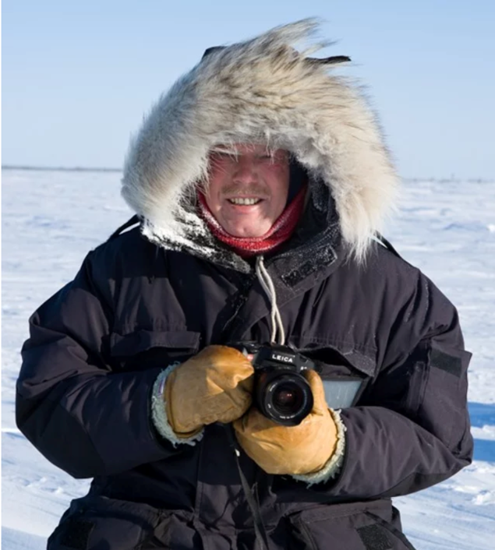
02
Background Information
Norbert Rosing
Norbert Rosing (the author) is a nature and wildlife photographer whose coverage has focused primarily on the Arctic, North American landscapes, and the national parks of Germany.
In 1980, he published his first photograph in a German photo magazine. Since then Norbert has traveled to the Canadian Arctic, the Southwest of the United States, Germany’s national parks, and the African savannas.
He has won several awards for his photography, as well as for books and magazine articles in Germany and the United States. His images have been published in magazines all over the world, including National Geographic, GEO, and BBC Wildlife.

Slide 9
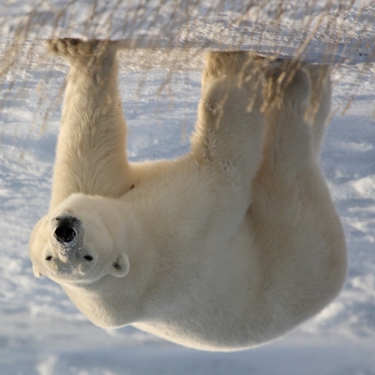
02
Background Information
Polar Bear
Frequently called "Lords of the Arctic”, these spectacular polar bears are huge. Male ones can grow to more than 600 kg and stand 3.05 metres tall. But don't let their massive size fool you – these white bears can move with surprising speed and agility.
With a highly acute sense of smell, they are also skilled hunters that can pick up a scent from over 30 kilometers away, and can detect the presence of seals under three feet of snow and ice. Polar bears have no natural enemies and consequently no fear.
In Churchill, Canada, polar bears come to town in the fall! The bears are hungry, looking for food. Our earth is getting warmer. There is less sea ice now, which is dangerous for polar bears because they need the ice to hunt.

Slide 10
03
Understanding the Story
文本精读&情节构思

Slide 11
03
Understanding the Story
camp
n. (used in compounds 用于构成复合词) a place where people are kept in temporary buildings or tents, especially by a government and often for long periods （尤指政府让人长时间住宿的）营房，营帐
We were staying at a research camp outside “the polar bear capital of the world”— the town of Churchill in Manitoba, Canada.
我们就待在加拿大曼尼托巴丘吉尔镇外的研究营里，这个镇被称为“世界北极熊之都”。

Slide 12
03
Understanding the Story
telephoto lens
n. a camera lens that produces a large image of an object that is far away and allows you to take photographs of it 摄远镜头；远距离照相镜头
When I'm face to face with a polar bear, I like it to be through a camera with a telephoto lens.
我喜欢通过摄像机的长焦镜头和北极熊面对面。

Slide 13
03
Understanding the Story
be easier said than done
(saying) to be much more difficult to do than to talk about
说时容易做时难；谈何容易
But sometimes, that is easier said than done.
但是有时候，这说起来容易做起来难。

Slide 14
03
Understanding the Story
sniff
v. to breathe air in through the nose in order to discover or enjoy the smell of sth （吸着气）嗅，闻 【SYN】smell
As Elli and I cooked dinner, a young male polar bear who was playing in a nearby lake sniffed, and smelled our garlic bread.
我和埃莉做饭的时候，一头在附近湖边玩耍的雄性幼熊闻到了我们做的大蒜面包。

Slide 15
03
Understanding the Story
fence
n. a structure made of wood or wire supported with posts that is put between two areas of land as a boundary, or around a garden/yard, field, etc. to keep animals in, or to keep people and animals out
栅栏；篱笆；围栏
The hungry beer followed his nose to our camp, which was surrounded by a high, wire fence.
这头饥饿的北极熊循着香味来到了我们的营地，营地外围着高高的铁丝栅栏。

Slide 16
03
Understanding the Story
post
n. (often in compounds 常构成复合词) a piece of wood or metal that is set in the ground in a vertical position, especially to support sth or to mark a point 柱；桩；标志杆
He stood on his back legs and pushed at the wooden fence posts.
他后腿站立，用力地推着支起铁丝栅栏的木桩子。

Slide 17
03
Understanding the Story
shell
n. a metal case filled with explosive, to be fired from a large gun 炮弹
shotgun shell 猎枪弹
We yelled at the bear, hit pots hard, and fired blank shotgun shells into the air.
我们对着熊大吼，狠狠敲击锅子，朝着空中发射了空霰弹。

Slide 18
03
Understanding the Story
tear
v. to damage sth by pulling it apart or into pieces or by cutting it on sth sharp; to become damaged in this way 撕裂；撕碎；扯破；戳破 【SYN】 rip
Not this polar bear though — he just kept trying to tear down the fence with his massive paws.
但是对这只熊不管用 —— 他一直用他那巨大的爪子试图拆掉铁丝栅栏。

Slide 19
03
Understanding the Story
radio
v. to send a message to sb by radio （用无线电）发送，传送
I radioed the camp manager for help.
我通过无线电向给营地管理员求救。

Slide 20
03
Understanding the Story
helicopter
n. an aircraft without wings that has large blades on top that go round. It can fly straight up from the ground and can also stay in one position in the air. 直升机
He told me a helicopter was on its way, but it would be 30 minutes before it arrived.
他告诉我直升机正在赶来，但是得30分钟后才能到。

Slide 21
03
Understanding the Story
encounter
n. a meeting, especially one that is sudden, unexpected or violent
（尤指突然、意外或暴力的）相遇，邂逅，遭遇，冲突
Making the best of this close encounter, I took some pictures of the bear.
充分利用这次和北极熊近距离邂逅的机会，我拍了几张他的照片。

Slide 22
03
Understanding the Story
punishment
n. rough treatment 粗暴对待；虐待
Elli and I feared the fence wouldn’t last through 30 more minutes of the bear’s punishment.
埃莉和我担心铁丝栅栏经不起这头熊30几分钟的摧残。

Slide 23
03
Understanding the Story
spray
n. a device or container, for example an aerosol, that you use to apply liquid in fine drops 喷雾器
v. to cover sb/sth with very small drops of a liquid that are forced out of a container or sent through the air 喷；喷洒；向…喷洒
The camp manager suggested I use pepper spray.
营地管理员建议我用胡椒喷雾。

Slide 24
03
Understanding the Story
approach
v. to come near to sb/sth in distance or time
（在距离或时间上）靠近，接近
So I approached our invited guest slowly and, through the fence, sprayed him in the face.
所以我慢慢靠近这个“不速之客”，透过篱笆喷了他一脸辣椒水。

Slide 25
Face to Face with POLAR BEARS
03
Understanding the Story
Setting [when, where, under what circumstances the story take place]
Characters
Plot [important events that take place in the story]
  ①②
  time: one fall
  place: a research camp outside “the polar bear capital of the world”
  background:
  a single goal: to photograph polar bears [amazing but dangerous]
major character: my wife Elli, I, the hungry young male polar bear
minor character: camper manager, helicopter
③ As Elli and I cooked dinner, a young male polar bear smelled our garlic bread.
④ The hungry bear found our camp and attacked the wire fence.
⑤ Terrified, Elli and I tried all the bear defense actions we knew.
⑥ It would be 30 minutes for the rescuing helicopter to arrive and I took some photos of the bear.
⑦ Attacked by the pepper spray, the angry bear ran to the lake to wash his eyes.
Paragraph 1: A few minutes later, the bear headed back to our camp. …
Paragraph 2: At that very moment, the helicopter arrived. …
Paragraph 1: What did the hungry and angry bear do? How did I and Elli feel?
Paragraph 2: Were I and Elli rescued? How did we feel then?

Slide 26
04
Expressions for Reference
素材参考

Slide 27
04
Bear
Hungry & Angry
Expressions for Reference
Then the bear came our way, letting out a rumbling growl.
But then he ceased at the wire fence, stood upright on his hind legs, clawed and bite it ferociously.
There was dead silence except for the sound of his heavy breathing and sniffing.
He agilely rose to his feet and snarled, baring his white fangs.
The bear raised his head so high that he seemed to be standing erect.
Obviously, the hungry bear got furious, rose up on his hind legs and began to growl.
All of a sudden, the bear stood upright and roared loudly with fury, beating its paws madly against the fence.
There must have been a mixture of hunger and anger inside him because he clawed at himself and growled and squealed and banged against the fence frantically. I never saw such a sight!

Slide 28
04
Expressions for Reference
bulky
adj.
(1) (of a thing 东西) large and difficult to move or carry 庞大的；笨重的
    Bulky items will be collected separately.
    大件物品将分开收集。
(2) (of a person 人) tall and heavy 大块头的；高大肥胖的
    The bulky figure of Inspector Jones appeared at the door.
    琼斯督察的壮硕身躯出现在门口。

Slide 29
04
Expressions for Reference
sturdy
adj. (of people and animals, or their bodies 人、动物或身体) physically strong and healthy 强壮的；健壮的
  a man of sturdy build
  体格健壮的男人
  sturdy legs
  强壮有力的腿
  a sturdy breed of cattle
  一种体格强壮的牛

Slide 30
04
Expressions for Reference
chunky
adj. having a short strong body 敦实的；矮胖的 【SYN】stout
  a squat chunky man
  矮胖敦实的男人
  The animal is chunky and short-legged.
  这种动物粗壮而腿短。

Slide 31
04
Expressions for Reference
claw
n. one of the sharp curved nails on the end of an animal's or a bird's foot （动物或禽类的）爪，脚爪，脚趾
v. to scratch or tear sb/sth with claws or with your nails （用爪子或手指甲）抓，撕，挠
  The cat was clawing at the leg of the chair.
  那只猫在抓挠椅子腿。
  She had clawed Stephen across the face.
  她抓过斯蒂芬的脸。
  (figurative)
  His hands clawed the air.
  他的双手在空中乱抓。

Slide 32
04
Expressions for Reference
paw
n. the foot of an animal that has claws or nails （动物的）爪
v. (of an animal 动物) to scratch or touch sth repeatedly with a paw （不断地）挠，抓
  The dog pawed at my sleeve.
  狗一直挠我的衣袖。
  The stallion pawed the ground impatiently.
  种马焦躁地用蹄刨着地面。

Slide 33
04
Expressions for Reference
growl
vi. ~ (at sb/sth) (of animals, especially dogs 动物，尤指狗) to make a low sound in the throat, usually as a sign of anger 低声吼叫
  The wolf growled and bared its sharp fangs.
  那匹狼吼叫着露出锋利的牙齿
  The dog growled at the intruder.
  狗向闯入者狺狺狂吠。

Slide 34
04
Expressions for Reference
roar
vi. to make a very loud, deep sound 吼叫；咆哮
  We heard a lion roar.
  我们听见了狮子的吼声。
  The gun roared deafeningly.
  枪炮轰鸣声震耳欲聋。
  The engine roared to life (= started noisily).
  发动机隆隆启动。

Slide 35
04
Expressions for Reference
snarl
vi. ~ (at sb/sth) (of dogs, etc. 狗等) to show the teeth and make a deep angry noise in the throat 龇牙低吼
  The dog snarled at us.
  狗朝我们低声吼叫。
  The two dogs snarled at each other, and then started fighting.
  两只狗对着狂吠，接着开始厮斗。
  He snarled savagely at her.
  他向她狂吼起来。

Slide 36
04
Expressions for Reference
bang
v. to hit sth in a way that makes a loud noise 猛敲；砸
  She banged on the door angrily.
  她愤怒地砰砰打门。
  The baby was banging the table with his spoon.
  婴孩用调羹敲打着桌子。
  n. a sudden painful blow on a part of the body
  （对身体部位的）猛撞，猛敲，猛击
  a bang on the head
  头被撞击

Slide 37
04
Expressions for Reference
shove
v. to push sb/sth in a rough way 猛推；乱挤；推撞
  The crowd was pushing and shoving to get a better view.
  人们挤来挤去，想看得清楚点儿。
  The door wouldn't open no matter how hard she shoved.
  她怎么使劲推，门都推不开。
  He shoved her down the stairs.
  他把她推下楼梯。

Slide 38
04
Expressions for Reference
smash
v. to move with a lot of force against sth solid; to make sth do this
（使）猛烈撞击，猛烈碰撞
  the sound of waves smashing against the rocks
  浪涛猛烈撞击礁石的声音
  The car smashed into a tree.
  汽车猛地撞到了树上。
  Mark smashed his fist down on the desk.
  马克狠狠地把拳头砸在桌上。

Slide 39
04
Expressions for Reference
thrust
v. to push sth/sb suddenly or violently in a particular direction; to move quickly and suddenly in a particular direction 猛推；冲；搡；挤；塞
  He thrust the baby into my arms and ran off.
  他把婴儿往我怀里一塞就跑了。
  She thrust past him angrily and left.
  她气呼呼地从他身旁挤过去走了。
v. ~ (at sb) (with sth) | ~ (sth at sb) to make a sudden strong forward movement at sb with a weapon, etc. 刺；戳
  He thrust at me with a knife.
  他拿刀向我刺来。
  a thrusting movement
  冲刺动作

Slide 40
04
Expressions for Reference
crush
vt. to press or squeeze sth so hard that it is damaged or injured, or loses its shape 压坏；压伤；挤压变形
  The car was completely crushed under the truck.
  小轿车被卡车压得完全变形了。
  They crush the olives with a heavy wooden press.
  他们用沉重的木制压榨机把橄榄压碎。
  Several people were crushed to death in the accident.
  好几个人在事故中被压死了。

Slide 41
04
Expressions for Reference
slam
v. to put, push or throw sth into a particular place or position with a lot of force用力一放；使劲一推；猛劲一摔
  She slammed down the phone angrily.
  她气呼呼地啪的一声挂上电话。
  He slammed on the brakes (= stopped the car very suddenly).
  他猛地刹住汽车。

Slide 42
04
I&Ellie
Expressions for Reference
Fearful/Scared
Fear tortured my guts, churning my stomach in tense cramps.
Stunned, I made a strenuous effort to compose myself at this enormous creature.
A surge of terror sweeping through her body, Elli exclaimed in panic, “Help! Help!”
Apparently swallowed by a wave of despair, Elli crossed the fingers, closed her eyes and prayed in a shivering voice.
Seized by a strong sense of fright, I struggled to give the bear a full charge of the pepper spray.
Elli crouched, back pressed against me, mouth dry-as-dirt.
I could feel the sweat drenching my skin, the throbbing of my own eyes, the growling of the bear vibrating in my ears, and the thumping of my heart against my chest.
My fingers were curled into a fist, nails digging into my palm. Engulfed by sheer fear, I could hardly hear my rapid breathing, but I could feel the oxygen flooding in and out of my lungs.

Slide 43
04
I&Ellie
Expressions for Reference
Relieved/Thrilled
With a mixture of excitement and relief, I beamed widely at the rescuing helicopter.
Overwhelmed with such sudden relief, we bolted over to the circling helicopter.
At the sight of helicopter, I breathed a deep sigh of relief.
So thrilling was this moment that I could feel the adrenaline flowing around my body.
Extremely overjoyed and relieved, we waved vigorously at the descending helicopter.
A sudden surge of relief sweeping over me, I exclaimed at Elli, “We're safe now!”
As I grabbed the rope lowered from the helicopter above, a flush of relief welled up inside me.
So ecstatic was Elli that she wrapped her arms around my neck tightly.

Slide 44
04
Expressions for Reference
crouch
vi. to put your body close to the ground by bending your legs under you
蹲；蹲下；蹲伏 【SYN】 squat
  He crouched down beside her.
  他在她的旁边蹲了下来。
  Doyle crouched behind a hedge.
  多伊尔蹲在篱笆后面。

Slide 45
04
Expressions for Reference
flinch
vi. to make a sudden movement with your face or body as a result of pain, fear, surprise, etc. （突然）退缩；畏缩
  He met my gaze without flinching.
  他毫不畏缩，跟我对视着。
  He flinched at the sight of the blood.
  他一见到血就往后退。
  She flinched away from the dog.
  她一下子避开了那条狗。

Slide 46
04
Expressions for Reference
squeal
vi. to make a long, high sound 尖声长叫；发出长而尖的声音
  The pigs were squealing.
  猪尖叫着。
  The car squealed to a halt.
  汽车嘎的一声停了下来。
  Children were running around squealing with excitement.
  孩子们跑来跑去，兴奋地尖叫着。

Slide 47
04
Expressions for Reference
gasp
n. a quick deep breath, usually caused by a strong emotion
（常指由强烈情感引起的）深吸气，喘息，倒抽气
  to give a gasp of horror/surprise/relief
  惊恐得／吃惊得倒抽一口气；如释重负地松一口气
  His breath came in short gasps.
  他急促地喘着气。
v. to take a quick deep breath with your mouth open, especially because you are surprised or in pain （尤指由于惊讶或疼痛而）喘气，喘息，倒抽气
  She gasped at the wonderful view.
  如此美景使她惊讶得倒吸了一口气。
  They gasped in astonishment at the news.
  他们听到这消息惊讶得倒吸了一口气。

Slide 48
04
Expressions for Reference
huddle
vi. ~ (up/together) (+ adv./prep.) (of people or animals 人或动物) to gather closely together, usually because of cold or fear （通常因寒冷或害怕）挤在一起
  We huddled together for warmth.
  我们挤在一块取暖。
  They all huddled around the fire.
  他们都聚集在火堆周围。
vi. ~ (up) (+ adv./prep.) to hold your arms and legs close to your body, usually because you are cold or frightened （通常因寒冷或害怕）蜷缩，缩成一团
  I huddled under a blanket on the floor.
  我在地板上盖着毯子缩成一团。

Slide 49
05
Possible Version
参考范文

Slide 50
05
Possible Version
Paragraph 1：
A few minutes later, the bear headed back to our camp. Mounting anger mingled with hunger overwhelming him, he smashed his paws frantically against the wire fence, thrusting his sharp claws at us. Panicked as we were, I and Elli squealed at the top of our lungs, waved our fists at him and stamped heavily on the ground in an attempt to intimidate and scare him away. To our dismay, all these efforts were in vain. This sturdy bear relentlessly banged and shoved the wooden posts which were evidently on the verge of collapsing! This bulky and furious beast within a stone's throw, I flinched back and huddled with Elli tightly. Chilly winds whipping our faces, I could hear nothing but the sound of our hearts throbbing violently in our chests.
Paragraph 2：
At that very moment, the helicopter arrived. The gusting wind from the hovering vehicle swept away our choking fear immediately. Out of the helicopter descended a rope to haul us up. Thrilled yet relieved, we clutched the rope and eventually landed on the helicopter safe and sound. While overlooking the chunky bear from high above, I was amazed to spot this stubborn guy had crushed the fence and headed toward our camp for the inviting garlic bread. At this once-in-a-lifetime moment, I reached into my backpack and pulled out the camera, photographing that impressive scene. Gazing at his broad back in the melting ice field, I wondered if it was the warmer planet that had forced the bear to hunt for food from the human regions.

Slide 51
Good Luck!

