Slide 1


感恩遇见，相互成就，本课件资料仅供您个人参考、教学使用，严禁自行在网络传播，违者依知识产权法追究法律责任。
更多教学资源请关注
公众号：溯恩高中英语
知识产权声明

Slide 2

2020年7月浙江高考英语客观题分析1
· 阅读理解
· 任务型阅读
· 完型填空
· 语法填空
鲁周焕
杭州市余杭高级中学

Slide 3
一、试卷总体印象
1. 总体难度:感觉与2020年1月卷持平，但感觉题目更加灵活。
2. 阅读理解:中规中矩，三个语篇与1月卷类型相似：序言——自传；现象类
说明文——新闻报道；科研报告——科研报告。考查的点都非常具有语篇
特色，比如科研报告考标题选择，序言考文本类型。
3. 任务型阅读:难度有所上升，类似于记叙文，不像1月份的说明文语篇特征
非常明显，技巧性比较强。该语篇设空前后逻辑关系比较隐晦。
4. 完型填空:单纯的记叙文，动作描写非常多，几处理解起来有一定难度。
5. 语法填空:考查谓语动词增多（有三处），其中一处考了had done，以前
高考真题中极少出现，对学生语法知识的要求提高了。
6. 应用文:李华还在，但这次的内容明显要难，要写好不容易！
7. 读后续写：（概要写作：终究是我错付了o(╥﹏╥)o）又又又是野外求生！
考了那么多次了，求换个主题（卑微），写出来的全是套路！
1

Slide 4
第一节
阅读理解

Slide 5
一、阅读理解A篇
A篇概览
1
词数 | 主题语境 | 语篇类型 | 文章来源
299 | 人与自我 （生活与学习） | 介绍说明类 | 404 not found
阅读理解A篇节选自某本书的序言(preface)，主要讲述了身为主编，作者在编撰该书时的一些初衷和想法，比如为什么不直接呈现每部戏剧的主旨，以及对读者阅读戏剧时的一些指导，比如运用想象力沉浸其中、感同身受。
今年全国英语I和II卷中也有两篇阅读理解是关于rereading和love for the library的，本篇是作者对戏剧的喜爱，2020年1月高考中A篇是love for reading，相信关注“阅读”主题的文章今后会在高考中越来越常见。

Slide 6
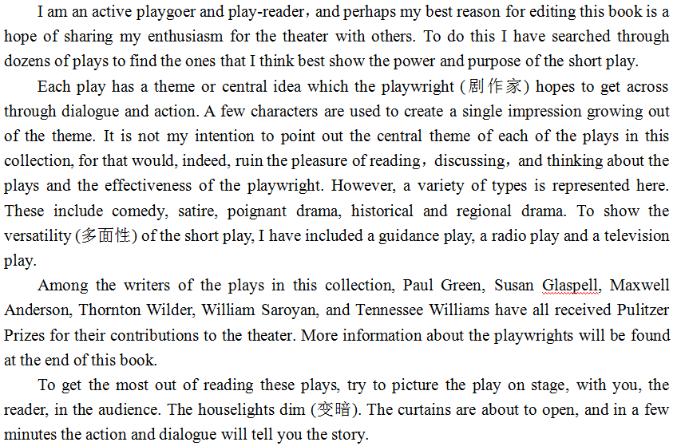
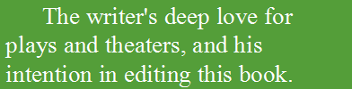
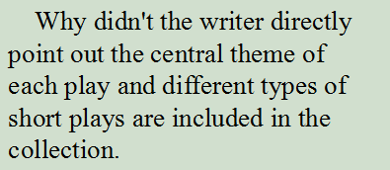

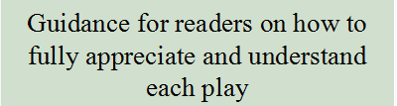
2. 语篇分析

Slide 7
3.“题目分析
I am an active playgoer and play-reader, and perhaps my best reason for editing this book is a hope of sharing my enthusiasm for the theater with others. To do this I have searched through dozens of plays to find the ones that I think best show the power and purpose of the short play.
对具体细节的推断
21. What do we know about the author from the first paragraph?
A. He has written dozens of plays.
B. He has a deep love for the theater.
C. He is a professional stage actor.
D. He likes reading short plays to others.
Tips：1. 找到推断对象；
2. 定位推断内容；
3. 找到同义改写；
27. What can we infer about the writer from the first paragraph?[2018.11月真题]
A. He has a cottage in New England. B. He shows talents for literature.
C. He enjoys reading when traveling. D. He admires a lot of great writers.
似曾相识

Slide 8
3.“题目分析
Each play has a theme or central idea which the playwright (剧作家) hopes to get across through dialogue and action. A few characters are used to create a single impression growing out of the theme. It is not my intention to point out the central theme of each of the plays in this collection, for that would, indeed, ruin the pleasure of reading, discussing, and thinking about the plays and the effectiveness of the playwright...
对具体细节的理解
22. What does the author avoid doing in his work?
A. Stating the plays' central ideas.
B. Selecting works by famous playwrights.
C. Including various types of plays.
D. Offering information on the playwrights.
Tips：
找到题干关键词；
对应文章关键句；
找到同义改写
1. avoid≈not my intention to
2. point out=state; central theme=central ideas

Slide 9
3.“题目分析
If you picture sth. in your mind, you think of it and have such a clear memory or idea of it that you seem to be able to see it.
To get the most out of reading these plays, try to picture the play on stage, with you, the reader, in the audience. The houselights dim (变暗). The curtains are about to open, and in a few minutes the action and dialogue will tell you the story.
对具体细节的理解
23. What does the author suggest readers do while reading the plays?
A. Control their feelings. B. Apply their acting skills.
C. Use their imagination. D. Keep their audience in mind.
1. readers do≈to get...
2. picture=imgaination
Tips：平时要积累一些常见单词的“熟词生义”，以及赏析部分单词在句子中的活用妙用。

Slide 10
3.“题目分析
I am an active playgoer and play-reader, and perhaps my best reason for editing this book is a hope of sharing my enthusiasm for the theater with others. To do this I have searched through dozens of plays to find the ones that I think best show the power and purpose of the short play.
推断文本类型
24. What is this text?
A. A short story. B. An introduction to a book.
C. A play review. D. An advertisement for a theater.
preface
▪play review: a piece of article that goes through the content and form of a
play, usually with the author's own opinions.
▪preface: an introduction at the beginning of a book that explains what the book
is about or why it was written.
23. Where is the text probably from?[2020.1真题]
A. A guidebook. B. An autobiography. C. A news report. D. A book review.

Slide 11
4. 语篇知识
记叙类文本
说明类文本
应用类文本
autobiography a science report a guidebook
science fiction a research plan an advertisement
a novel a science magazine an announcement
a diary a health magazine an exhibition guide
children’s literature a research paper a travel brochure
a business report
a book review
an official report
a biology textbook
《课程标准》在“语篇知识”中要求学生掌握：
1. 记叙文和说明文语篇的主要语篇结构特征（如：该类语篇的必要组
成部分和可选组成部分、各组成部分的顺序等）；
2. 散文、诗歌、广告、访谈等语篇的语篇结构特征；
3. 议论文语篇的主要语篇结构特征和论证方法；
4. 公文、社论、书评等语篇的语篇结构特征。
阅读教学中除了解读文本信息、学习语言点之外，更应重视整个语篇的
分析，比如写作目的、结构特征、写作风格等。语篇知识在新高考中的
比例会越来越大。

Slide 12
二、阅读理解A篇
B篇概览
1
词数 | 主题语境 | 语篇类型 | 文章来源
323 | 人与社会 （科学与技术） | 现象说明类说明文 | https://time.com/3845445/commuting-times-adaptive-traffic-lights/
阅读理解B篇节选自外刊新闻，主要介绍了美国西雅图贝尔维尤市采用了智能信号灯后，在一定程度上改善了交通状况，但在更拥挤的城市不一定适用。
该篇阅读理解与2020年1月B篇（用奶酪盐水方法除冬天道路上的冰）在非常类似，都涉及用新方法解决生活中的问题。这符合《课标》中要求发展学生的思维品质，提升学生的思维在逻辑性、批判性、创新性等方面的能力和水平。

Slide 13
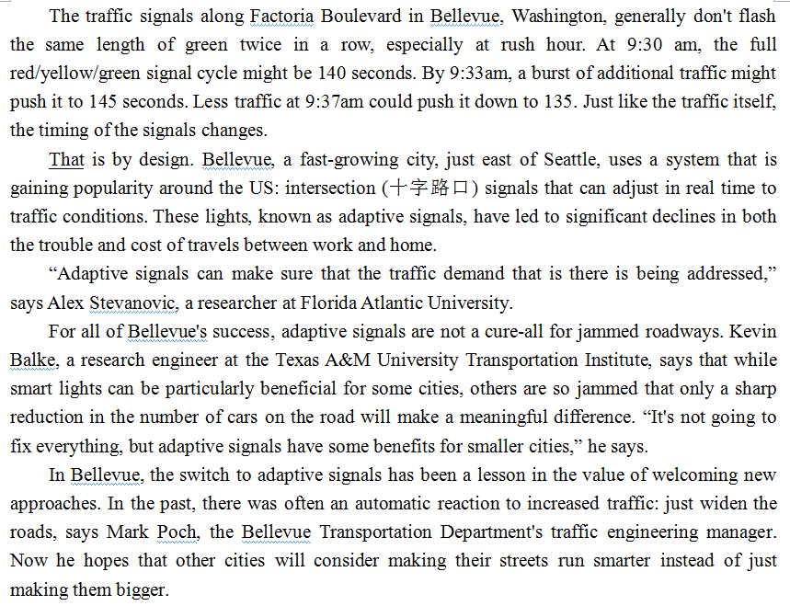
2. 语篇分析
A general introduction to the adaptive signals
The benefits brought to the city by the adaptive signals
The shortcoming of the adaptive signals for more jammed cities
The lesson learned from applying the adaptive signals

Slide 14
3.“题目分析
How is Paragraph 1 organized?
Topic sentence
The traffic signals along Factoria Boulevard in Bellevue, Washington, generally don't flash the same length of green twice in a row, especially at rush hour. At 9:30 am, the full red/yellow/green signal cycle might be 140 seconds. By 9:33am, a burst of additional traffic might push it to 145 seconds. Less traffic at 9:37am could push it down to 135. Just like the traffic itself, the timing of the signals changes.
That is by design. Bellevue, a fast-growing city, just east of Seattle...
The traffic signals along Factoria Boulevard in Bellevue, Washington, generally don't flash the same length of green twice in a row, especially at rush hour. At 9:30 am, the full red/yellow/green signal cycle might be 140 seconds. By 9:33am, a burst of additional traffic might push it to 145 seconds. Less traffic at 9:37am could push it down to 135. Just like the traffic itself, the timing of the signals changes.
That is by design. Bellevue, a fast-growing city, just east of Seattle...
supporting details
Conclusion
考查代词指代
25. What does the underlined word “that” in paragraph 2 refer to?
A. Increased length of green lights. B. Shortened traffic signal cycle.
C. Flexible timing of traffic signals. D. Smooth traffic flow on the road.
Tips：段落首句的代词指代，往往要去上一段最后一句找。

Slide 15
3.“题目分析
How is Paragraph 4 organized?
Topic sentence
For all of Bellevue's success, adaptive signals are not a cure-all for jammed roadways. Kevin Balke, a research engineer at the Texas A&M University Transportation Institute, says that while smart lights can be particularly beneficial for some cities, others are so jammed that only a sharp reduction in the number of cars on the road will make a meaningful difference. “It's not going to fix everything, but adaptive signals have some benefits for smaller cities,” he says.
For all of Bellevue's success, adaptive signals are not a cure-all for jammed roadways. Kevin Balke, a research engineer at the Texas A&M University Transportation Institute, says that while smart lights can be particularly beneficial for some cities, others are so jammed that only a sharp reduction in the number of cars on the road will make a meaningful difference. “It's not going to fix everything, but adaptive signals have some benefits for smaller cities,” he says.
supporting details
What does “others” refer to?
对具体细节的理解
26. What does Kevin Balke say about adaptive signals?
A. They work better on broad roads.
B. They should be used in other cities.
C. They have greatly reduced traffic on the road.
D. They are less helpful in cities seriously jammed.
该题答案既可以从支撑性细节中来，也可以从主旨句中看出（多训练学生找topic sentence）

Slide 16
3.“题目分析
In Bellevue, the switch to adaptive signals has been a lesson in the value of welcoming new approaches. In the past, there was often an automatic reaction to increased traffic: just widen the roads, says Mark Poch, the Bellevue Transportation Department's traffic engineering manager. Now he hopes that other cities will consider making their streets run smarter instead of just making them bigger.
考查推理判断和信息归纳
27. What can we learn from Bellevue's success?
A. It is rewarding to try new things. B. The old methods still work today.
C. I pays to put theory into practice. D. The simplest way is the best way.
26. Milwaukee’s new way to de-ice streets may be an
example of ______. [2020.1真题]
♦谚语是对《课标》中文化意识的直接考查，平时
教学要渗透并积累。
Tips：
理解每个选项的含义；
对应文中具体事例；

Slide 17
三、阅读理解C篇
C篇概览
1
词数 | 主题语境 | 语篇类型 | 文章来源
336 | 人与自我 （生活与学习） | 科研报告 | https://www.npr.org/sections/health-shots/2015/04/29/403030347/your-tough-job-might-help-keep-you-sharp
阅读理解C篇节选自外刊新闻，主要介绍了一项科学研究：德国的科学家通过实验发现，挑战性工作有助于提升大脑明锐度。
该篇阅读理解与2020年1月C篇（父亲在孩子的成长中极大地影响孩子毅力的养成）非常类似，都属于科学研究报告。这类文本在近几年全国卷和浙江卷中经常出现，非常能考查学生思维的严谨性，有助于培养学生的科学素养。

Slide 18
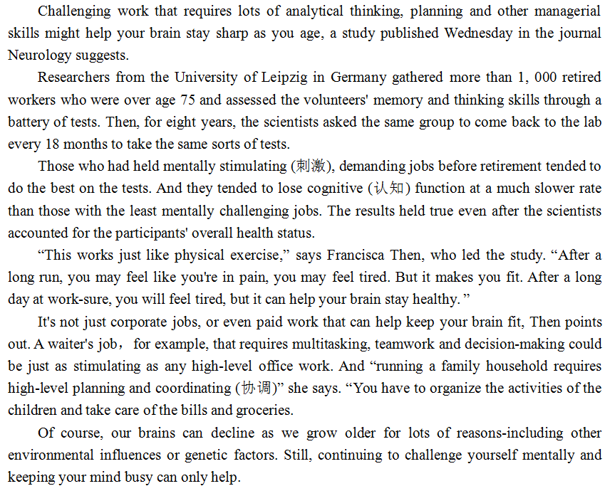
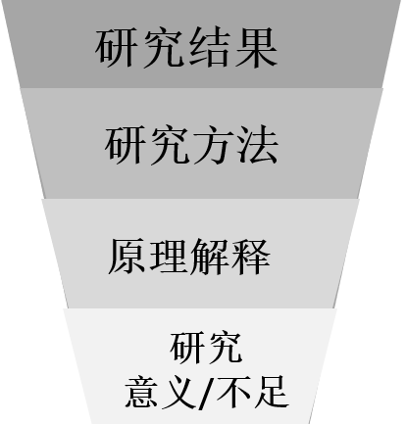
2. 语篇分析
A new study/research suggests/ discovers/reveals/finds…
研究结论
（首段）
…by
·experiment
·observation
·survey
·case study
研究方法
原理解释:
（中间）
研究意义/不足:
（结尾）

Slide 19
3.“题目分析
Researchers from the University of Leipzig in Germany gathered more than 1, 000 retired workers who were over age 75 and assessed the volunteers' memory and thinking skills through a battery of tests. Then, for eight years, the scientists asked the same group to come back to the lab every 18 months to take the same sorts of tests.
对具体细节的理解
28. Why did the scientists ask the volunteers to take the tests?
A. To assess their health status. B. To evaluate their work habits.
C. To analyze their personality. D. To measure their mental ability.
1. the volunteers≈volunteers
2. assess=measure;
mental ability=memory and thinking skills
Tips：
找到题干关键词；
对应文章关键句；
找到同义改写

Slide 20
3.“题目分析
“This works just like physical exercise,” says Francisca Then, who led the study. “After a long run, you may feel like you're in pain, you may feel tired. But it makes you fit. After a long day at work-sure, you will feel tired, but it can help your brain stay healthy. ”
对写作手法的考查
29. How does Francisca Then explain her findings in paragraph 4?
A. By using an expert's words. B. By making a comparison.
C. By referring to another study. D. By introducing a concept.
comparasion: When you make a comparison, you say that one thing is like another in some way.
平时阅读教学需要关注文章写作手法，尤其是最基本的example, cause-effect等

Slide 21
3.“题目分析
Challenging work that requires lots of analytical thinking, planning and other managerial skills might help your brain stay sharp as you age, a study published Wednesday in the journal Neurology suggests.
对主旨大意的考查
30. Which of the following is the best title for the text?
A. Retired Workers Can Pick Up New Skills
B. Old People Should Take Challenging Jobs
C. Your Tough Job Might Help Keep You Sharp
D. Cognitive Function May Decline As You Age
1. 找到“研究结果”
2. 定位“关键词”
3. 对应选项
Researchers from Brigham Young University discovered that fathers are in a unique position to help their adolescent children learn persistence.
30. Which of the following is the best title for the text?
A. Three Characteristics of Authoritative Fathers
B. Key Skills for Young Adults to Succeed in Future
C. Children Tend to Learn Determination from Father
D. Family Relationship Influences School Performance.

Slide 22
第二节
任务型阅读

Slide 23
二、任务型阅读
任务型阅读概览
1
词数 | 主题语境 | 语篇类型 | 文章来源
338 | 人与自我 （生活与学习） | 记叙文 | https://psychcentral.com/lib/how-to-help-your-child-combat-loneliness/
任务型阅读选自有关心理学的外刊，原文是一篇how-to类型说明文，经剪裁后有点像记叙文了，主要讲了我小时候怕孤单，我妈妈用培养了我三个习惯让我觉得不再孤单：看书，做手工和出门活动。
任务型阅读的语篇由由单一的How-to模式说明文向多元化语篇模式发展，像事理阐释类说明文、记叙文等。万变不离其中，宏观语篇知识（篇章模式）和微观语篇知识（过度、转折手法）等在解题中尤为重要。

Slide 24
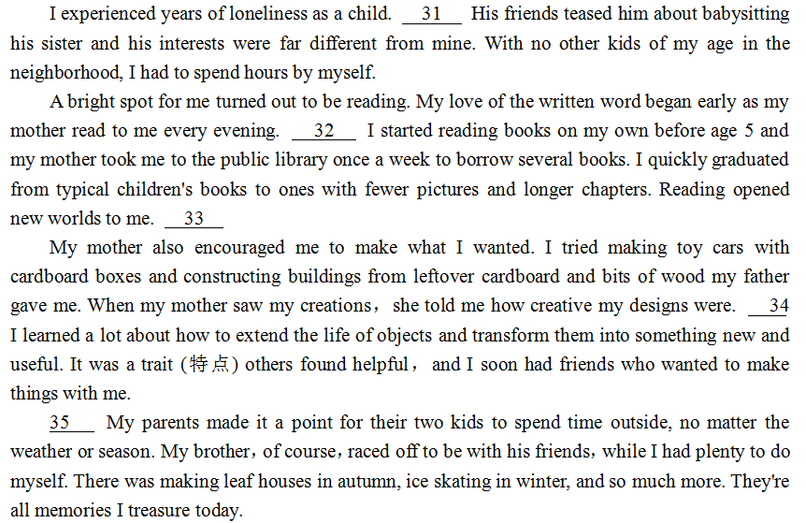
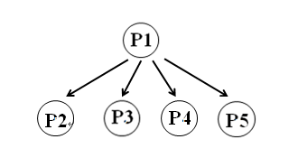
2. 语篇分析
problem
solution
Topic sentence
supporting details
(examples)

Slide 25
3.“题目分析
考查指代
I experienced years of loneliness as a child. 31 His friends teased him about babysitting his sister and his interests were far different from mine. With no other kids of my age in the neighborhood, I had to spend hours by myself.
G
A. I wasn't alone any longer.
B. I enjoyed reading stories aloud.
C. I was invited to play with another kid.
D. I loved the colorful photographs in the books.
E. Another habit I formed early was being outdoors.
F. Thus, I began my lifelong interest in making things.
G. My older brother couldn't be bothered to play with me.

Slide 26
3.“题目分析
考查因果关系
A bright spot for me turned out to be reading. My love of the written word began early as my mother read to me every evening. 32 I started reading books on my own before age 5 and my mother took me to the public library once a week to borrow several books. I quickly graduated from typical children's books to ones with fewer pictures and longer chapters. Reading opened new worlds to me. 33
D
A
solution
考查因果关系
A. I wasn't alone any longer.
B. I enjoyed reading stories aloud.
C. I was invited to play with another kid.
D. I loved the colorful photographs in the books.
E. Another habit I formed early was being outdoors.
F. Thus, I began my lifelong interest in making things.
G. My older brother couldn't be bothered to play with me.

Slide 27
3.“题目分析
My mother also encouraged me to make what I wanted. I tried making toy cars with cardboard boxes and constructing buildings from leftover cardboard and bits of wood my father gave me. When my mother saw my creations, she told me how creative my designs were. 34 I learned a lot about how to extend the life of objects and transform them into something new and useful. It was a trait (特点) others found helpful，and I soon had friends who wanted to make things with me.
考查因果关系
F
A. I wasn't alone any longer.
B. I enjoyed reading stories aloud.
C. I was invited to play with another kid.
D. I loved the colorful photographs in the books.
E. Another habit I formed early was being outdoors.
F. Thus, I began my lifelong interest in making things.
G. My older brother couldn't be bothered to play with me.

Slide 28
3.“题目分析
考查段落主旨句（复现）
35 My parents made it a point for their two kids to spend time outside, no matter the weather or season. My brother, of course, raced off to be with his friends，while I had plenty to do myself. There was making leaf houses in autumn, ice skating in winter, and so much more. They're all memories I treasure today.
E
A. I wasn't alone any longer.
B. I enjoyed reading stories aloud.
C. I was invited to play with another kid.
D. I loved the colorful photographs in the books.
E. Another habit I formed early was being outdoors.
F. Thus, I began my lifelong interest in making things.
G. My older brother couldn't be bothered to play with me.

Slide 29
第三节
完型填空

Slide 30
三、完型填空
任务型阅读概览
1
词数 | 主题语境 | 语篇类型 | 文章来源
275 | 人与社会 | 记叙文 | https://www.theguardian.com/lifeandstyle/2015/jun/12/experience-my-dog-stole-my-tractor
完型填空是一个活生生的历险故事，情节丰富，语言生动，画面感强。讲述了作者牧羊期间可能由于狗的原因使得拖拉机溜坡，差点酿成恶性事故的一次经历。
今年的完型填空既非感人落泪的暖心故事，也不是讲述道理的学习故事，而是一篇纯粹的记叙文。阅读起来有点难度，几个选项的词汇用法非常灵活，需要结合语境。但万变不离其中，每个答案文章都有提示。

Slide 31
3.“题目分析
I’ve been farming sheep on a hillside for 54 years. I use a small tractor to get about. My dog Don always sits beside me in the passenger scat.
One morning I 36 a lost lamb when I was in the top field, near where a motorway cuts through my land. The lamb had become separated from its 37 , so I jumped out of the tractor to 38 it while Don stayed in his seat.
Lamb and mother 39 , I turned back to the tractor only to see it move suddenly away from me. This was so 40 because I had put the handbrake on when I jumped out. 41 Don had somehow made the 42 move.
What does “only to” imply?
36. A. dropped B. spotted C. carried D. returned
37. A. kids B. friends C. owner D. mother
38. A. ask about B. play with C. tend to D. run into
39. A. freed B. switched C. reunited D. examined
40. A. unexpected B. dangerous C. embarrassing D. difficult
41. A. Fortunately B. Generally C. Immediately D. Obviously
42. A. lamb B. vehicle C. seat D. fence
care for

Slide 32
3.“题目分析
How does the writer feel?
...the mortorway ran normally again...
My heart froze in my chest as I 43 the tractor heading towards the 44 . I ran desperately but failed to 45 . It crashed through a wooden fence and disappeared. The 46 thing I saw was Don's face, looking calmly back at me.
Heart in mouth, I 47 the fence and looked over. The tractor was 48 against the crash barrier in the central reservation, having miraculously (奇迹般地) crossed the 49 road with fast-flowing traffic. I couldn't see Don, but as I 50 the tractor he jumped out onto the road, apparently 51 , and dashed back to me.
43. A. saw B. stopped C. remembered D. drove
44. A. crowd B. motorway C. field D. hill
45. A. take off B. catch up C. hold back D. get out
46. A. real B. best C. basic D. last
47. A. fixed B. noticed C. reached D. closed
48. A. resting B. running C. parking D. turning
49. A. sleep B. long C. rough D. busy
50. A. abandoned B. approached C. recognized D. repaired
51. A. unclean B. uncertain C. unhurt D. unhappy
If something is resting somewhere, or if you are resting it there, it is in a position where its weight is supported.

Slide 33
3.“题目分析
The police 52 and the motorway ran normally again. I couldn't quite believe my 53 it turned out no one got badly hurt, but the outcome could have been 54 . Don was given a special 55 that night—I didn't want him thinking I was angry with him.
52. A. arrived B. replied C. survived D. waited
53. A. ability B. dream C. luck D. idea
54. A. common B. confusing C. desirable D. awful
55. A. meal B. test C. job D. lesson
词性 | 名词 | 动词 | 形容词副词
个数 | 5 | 9 | 6

Slide 34
第四节
语法填空

Slide 35
四、语法填空
语法填空概览
1
词数 | 主题语境 | 语篇类型 | 文章来源
234 | 人与社会 （生活与学习） | 说明文 | 原版书籍 1000 Inventions and Discoveries
语法填空介绍了从史前时代开始，农业发展演变的过程。
动词的时态与语态 | 非谓语动词 | 连词 | 冠词 | 介词 | 名词单复数 | 固定搭配
3 | 2 | 1 | 1 | 1 | 1 | 1

Slide 36
2.“题目分析
Some time after 10,000 BC, people made the first real attempt to control the world they lived 56 , through agriculture. Over thousands of years,, they began to depend less on 57 could be hunted or gathered from the wild, and more on animals they had raised and crops they had sown.
Farming produced more food per person 58 hunting and gathering, so people were able to raise more children. And, as more children were born, more food 59 (need). Agriculture gave people their first experience of the power of technology 60 (change) lives.
By about 6000 BC, people 61 (discover) the best crops to grow and animals to raise. Later, they learned to work with the 62 (season), planting at the right time and, in dry areas, 63 (make) use of annual floods to irrigate (灌溉) their fields.
This style of farming lasted for quite a long time. Then, with 64 rise of science, changes began. New methods 65 (mean) that fewer people worked in farming. In the last century or so, these changes have accelerated. New power machinery and artificial fertilizers (化肥) have now totally transformed a way of life that started in the Stone Age.
in
what
than
was needed
to change
had discovered
seasons
making
the
meant

