Slide 1

感恩遇见，相互成就，本课件资料仅供您个人参考、教学使用，严禁自行在网络传播，违者依知识产权法追究法律责任。
更多教学资源请关注
公众号：溯恩高中英语
知识产权声明

Slide 2

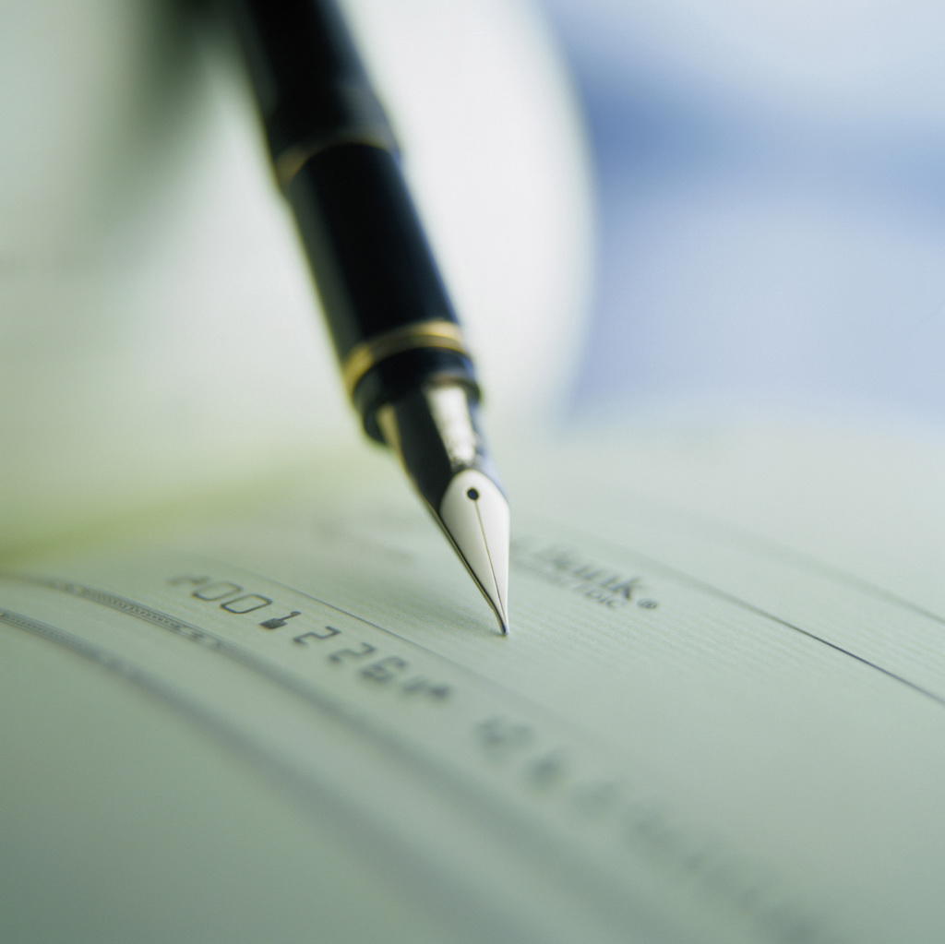
新教材B1U1 Reading for writing
A Letter of Advice
衢州二中 徐飞(Fish)

Slide 3

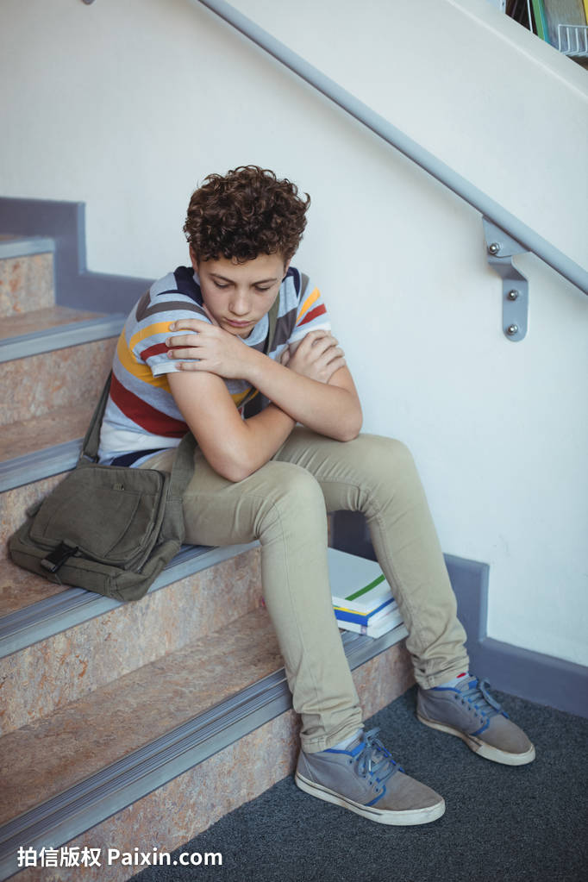
Why is the boy so sad?

Slide 4
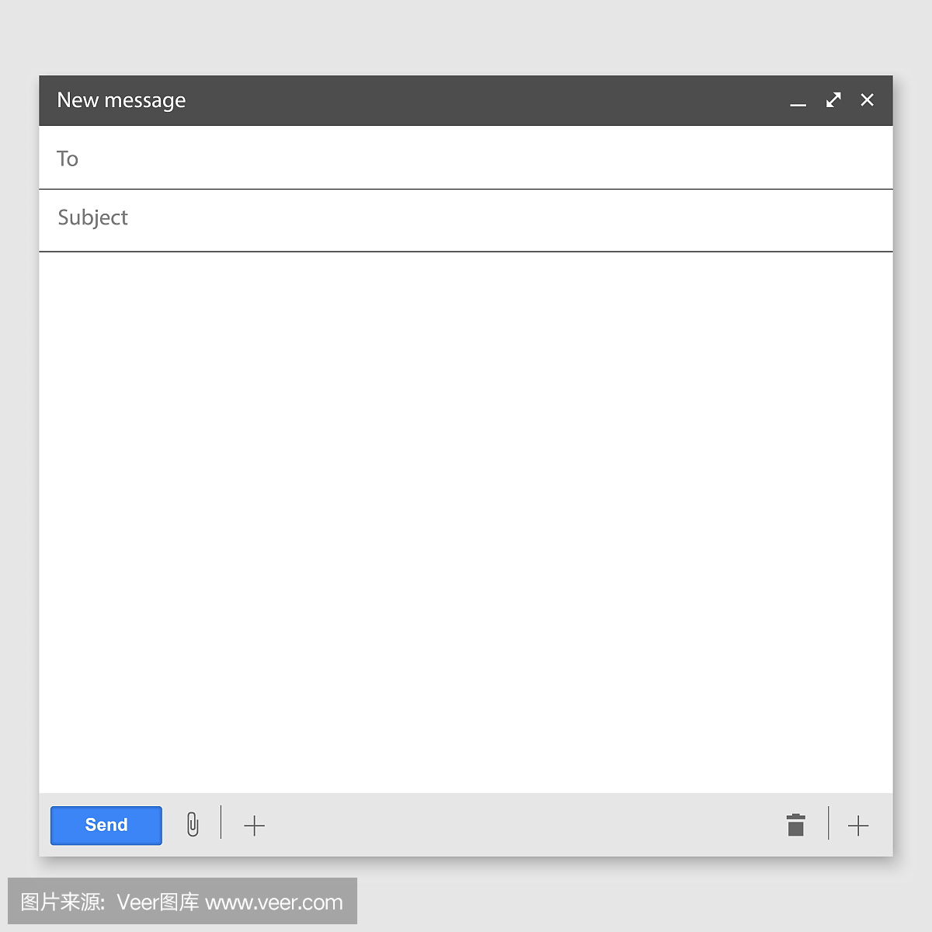
What advice would you give to Min Ho?
My name is Min Ho from Seoul. I am 15 years old. I have a problem. There is a girl I like in my class, but I'm too shy to tell her. Please help me!

Slide 5
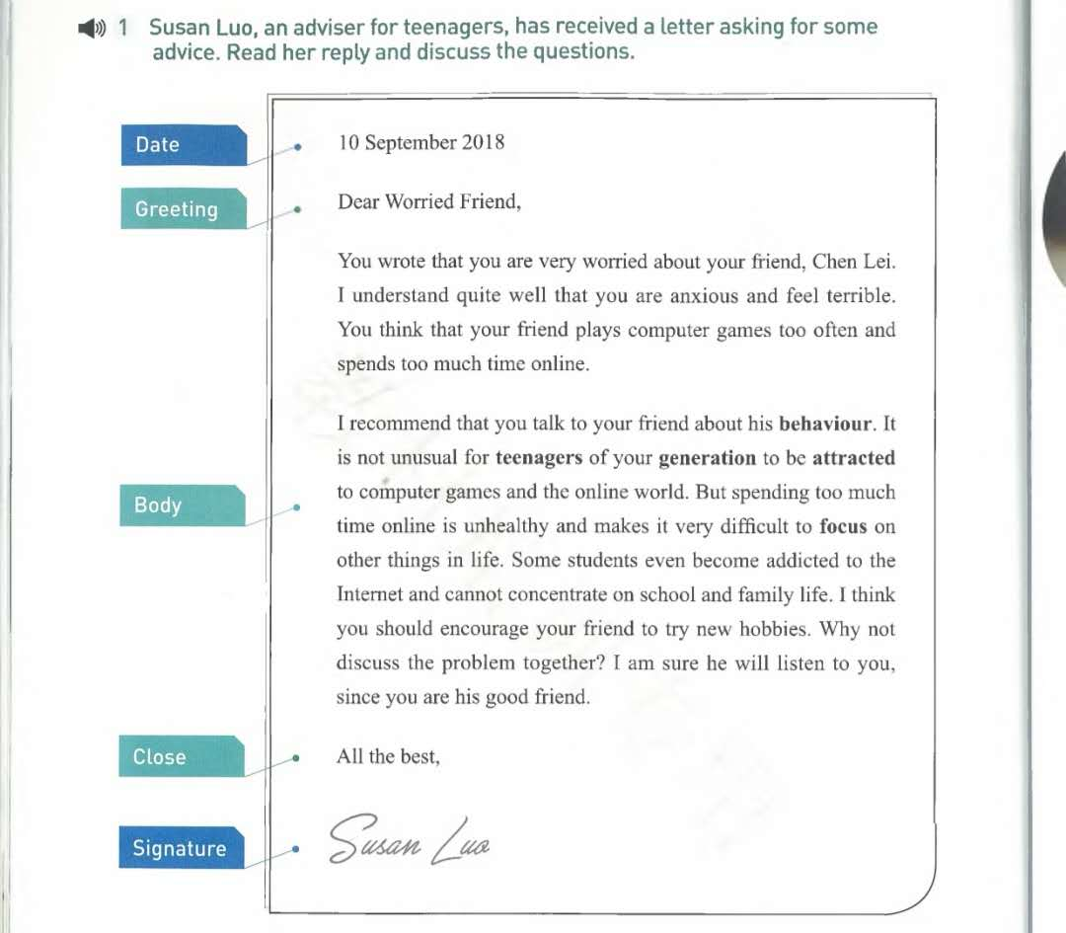


Slide 6
Read the letter and answer the following questions.
Q 1: What is the purpose of paragraph 1?
Q 2: What is the worried friend's problem?
Q 3: Can the sentence “I understand quite well that you are anxious and feel terrible” be deleted（删除）?
Q 4: What advice does Susan Luo give?
Q 5: Do you think her advice is useful? Why or why not?
Q 6: What expressions（表达）does Susan Luo use?
Q 7: What other advice would you give?

Slide 7
Tips on how to write a letter of advice.
Beginning: describe the problem clearly and briefly.
(offer comfort and understanding)
Body: give advice and its supporting details.
(Don't give advice that's not related to the problem. )
give comfort and encouragement.
Ending: offer your good wishes.

Slide 8
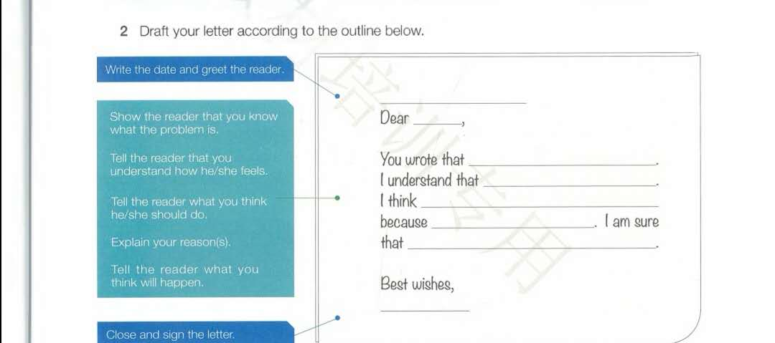
Work in groups and write a letter of advice to help Min Ho.

Slide 9
Use the the checklist and decide whether it is a good writing.
Are all the parts of a letter included and organized in a good order?
Does the writer give reasons for the advice?
Does the writer give the proper expressions to give suggetions?\
Does the writer use commas and stops correctly?
Is the handwriting easy to read?

Slide 10
Assignment:
Write a letter of advice to help Lisa. Here is her problem.
Dear Miss Wang,
I am having some trouble with my classmates at the moment. I’m getting along well with a boy in my class. We often do homework together and we enjoy helping each other. We have become really good friends. But other students have started gossiping. They say that this boy and I have fallen in love. This has made me angry. I don't want to end the friendship, but I hate others gossiping. What should I do?
Yours,
Lisa

Slide 11
Thank you for your listening.

