Slide 1
Book 5 Unit1
Great Scientists
John Snow Defeats "King Cholera"
第二课时
Reading for Writing
Notes:
本课是在课文的阅读课之后，故很多细节，包括约翰斯诺的科研过程，已经在阅读课讨论过

Slide 2

在全球抗疫的大背景下，全世界均见证了中国抗疫的成效。其中，钟南山院士功不可没。近日，《科学美国人》（Scientific American）杂志拟刊登钟南山院士抗疫科研过程，故面向全体中国人征稿，要求如下：
1. 自拟题目；
2. 凸显其科研过程和其科研精神；
3. 字数不限，用词严谨；
4. 截止日期：2020年6月15日。
Notes:
情境导学，创设学习的真实情境

Slide 3
Learning objectives
Analyze the passage thoroughly
Learn the language, contents, structure, and title of the passage
Write a similar passage about another scientist—Zhong Nanshan and his scientific research stages
Notes:
学生读

Slide 4
Reading-Input
Step1—Language & Contents

Slide 5
Precise use of words
convincing&persuasive
This was the deadly disease of its day.
？
Neither its cause nor its cure was understood. So many thousands of terrified people died every time there was an outbreak.Cholera would never be controlled until its cause was found.
Notes:
分析第一段

Slide 6
Punctuation
John Snow was a famous doctor in London - so expert, indeed, that he attended Queen Victoria as her personal physician.
famous
dash
dash: to explain, to illustrate
Notes:
the punctuation in red is a ?
老师问：此处的破折号是为了解释？

Slide 7
Sentence patterns
John Snow was a famous doctor in London - so expert, indeed, that he attended Queen Victoria as her personal physician.
expert
he attended Queen
Victoria as her personal physician.
so...that...
giving examples
Zhong Nanshan is so expert that he played a vital role in defeating SARS in 2003 and even at the age of 84, he took an active part in fighting COVID-19.
Notes:
how did the author emphasize expert? look at here.
that后面给了例子

Slide 8
Description of characters
John Snow wanted to
face the challenge and solve this problem.
brave/courageous
Show，don't tell.

Slide 9
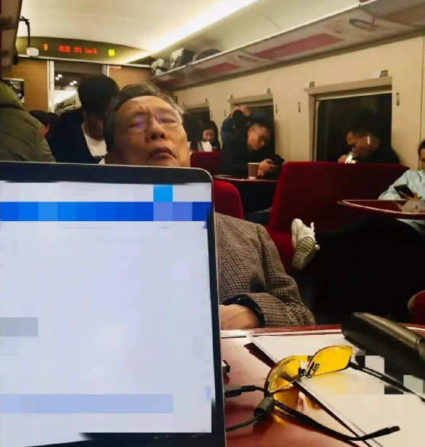
Description of Zhong Nanshan
Zhong Nanshan went to Wuhan at night by high-speed train instead of during day time to conduct investigation immediately.
responsibility&love for the public
Notes:
开始仿写。举一例

Slide 10
Group Discussion
Notes:
和学生说：now， I want to challenge you
（由于文章共有7段，所以老师就把同学们分成了7个小组group1-7；而第一段老师已经领大家分析了，所以学生任务只剩下2-6段，故得有两个小组来分析同一段，
又由于第四段相对重要和复杂，故1.4组都负责分析第四段；其他小组，为了任务清晰，每组就分析和自己组号相同号码的段落就可以了）

Slide 11
Reading-Input
Step1—Language & Contents
Notes:
让学生们对照着这个框架，来分析这几个方面

Slide 12
Show time

Slide 13
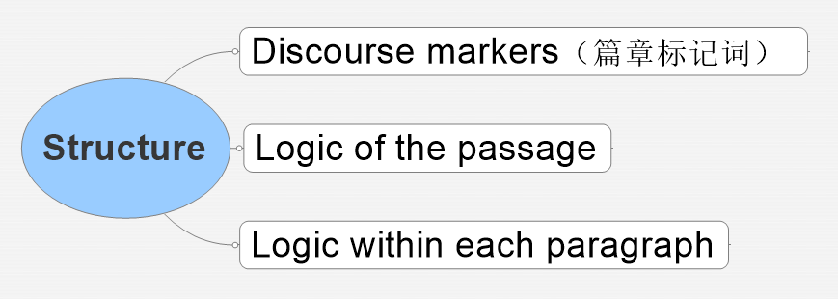
Reading-Input
Step2—Structure
Notes:
recall logic of the passage

Slide 14
Discourse markers（篇章标记词）
4. First he marked on a map the exact places where all the dead people had lived. ……
5. Next, John Snow looked into the source of the water for these two streets. ……
7. Finally "King Cholera" was defeated.
  discourse markers
logical & organized
Notes:
请同学们看第4/5/7三段

Slide 15
Logic of the passage
Suspecting
Draw a conclusion
Find supporting evidence
Think of a method
Analyze the results
Find a problem
Make a question
Collect results
Find a problem
Make a question
Think of a method
time order
chronological order
the scientific research stages
Proving
Collect results
Analyse the results
Find supporting evidence
Draw a conclusion
Concluding
Notes:
这是阅读课后的读写课，科研过程在阅读课上已经分析过了，
所以上课时，教师会说：Let's recall the logic of the passage we discussed yesterday.
然后接着问，we divided the whole process into 3 parts? what are they?

Slide 16
Outline of Zhong Nanshan's research
Suspecting
the origin of the virus
SARS? Bats?
Notes:
回顾完约翰斯诺的科研过程，继而立刻探讨钟南山的科研过程。
此处老师没有给材料铺垫，是基于自己学生的学情：
1.线上学习期间，老师和学生一起进行了项目化学习，期间已经让学生们仔细查找过钟南山此次疫情期间的所作所为；
2.另外，在上课之前的周末，老师再次布置任务，让大家再次查找或重温钟南山的抗疫科研过程，故此处，学生已经有了一定的内容输入，
老师在此以问题导学的形式，领学生们将所知进行分阶段梳理

Slide 17
Outline of Zhong Nanshan's research
Proving
go to the seafood market to investigate
analyze the confirmed cases

Slide 18
Outline of Zhong Nanshan's research
Concluding
The virus originated in bats or pangolins.
It can spread from person to person.
People had better stay at home and wear masks when going outside.

Slide 19
Logic within each paragraph
He immediately told the astonished people in Broad Street to remove the handle from the pump so that it could not be used. Soon afterwards the disease slowed down.
remove the handle
it could not be used
the disease slowed down.
result
reasons
cause and effect
Notes:
know how each paragraph is generally developed by cause and effect
这是老师领着学生一起分析第5段因果关系，接下来让同学们自己分析其他段落内部的因果关系，老师以问题驱动，让学生通过回答问题来
理解各个段落内部的因果关系

Slide 20
P1
Why did John Snow become inspired?
(What are the causes of his inspiration?)
What was the effect of his inspiration?

Slide 21

P1
Why did John Snow become inspired?
(What are the causes of his inspiration?)
① Helping ordinary people.
② The deadly disease of its day.
a.Neither its cause nor its cure was understood.
b.many terrified people died every time.
③ A famous & expert doctor
④ Cholera would never be controlled until its cause was found.

Slide 22
P1
What was the effect of his inspiration?
Face the challenge and solve the problem.

Slide 23
P3
Why was he determined?
John Snow suspected that the second theory was correct but he needed evidence.
the disease spread quickly through poor neighbourhoods.
In two particular streets, the cholera outbreak was so severe that more than 500 people died in ten days.
Why was he determined?

Slide 24
P4
How did John come to the conclusion that “It seemed that the water was to blame”? (use your own words)

Slide 25
P4
How did John come to the conclusion that “It seemed that the water was to blame”? (use your own words)
First he marked on a map the exact places where all the dead people had lived.
Many of the deaths were near the water pump in Broad Street.
He also noticed that some houses had had no deaths.
He discovered that these people worked in the pub at 7 Cambridge Street. They had been given free beer and so had not drunk the water from the pump.

Slide 26
P7
Why did John give suggestions?
To prevent cholera from happening again.
Why did John give suggestions?

Slide 27
Reading-Input
Step3—Title
tense
figure of speech

Slide 28
To emphasize the fact
John Snow Defeats “King Cholera”
King
Finally "King Cholera" was defeated.
powerful
deadly/severe
Personification
vivid, arouse reader's interest/attention
Notes:
问，为什么题目是一般现在，文章最后一句是一般过去？为什么作者用不同时态，表达同一意思？在标题用一般现在是为了？
King用了什么figure of speech？ King本身是什么样的？ 说明霍乱是怎样的？
此处构成问题链，让学生思维得以持续锻炼

Slide 29
Zhong Nanshan &
his scientific research stages?
Notes:
请同学们结合本课提供信息+疫情期间对于钟南山和其科研过程了解+之前老师让学生专门查找的相关信息，individual free talk钟南山的科研过程

Slide 30
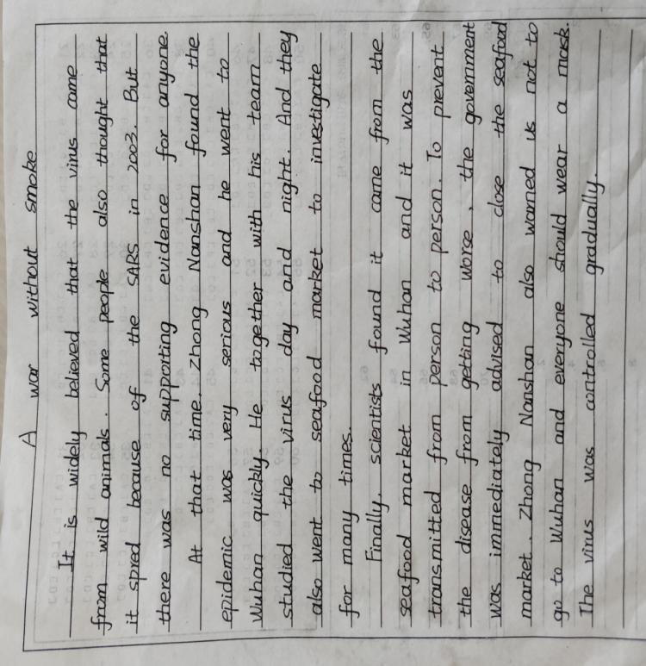
Notes:
此处，找一名同学站起来说一说自己脑海中的钟南山的抗疫科研过程

Slide 31
在全球抗疫的大背景下，全世界均见证了中国抗疫的成效。其中，钟南山院士功不可没。近日，《科学美国人》（Scientific American）杂志拟刊登钟南山院士抗疫科研过程，故面向全体中国人征稿，要求如下：
1. 自拟题目；
2. 凸显其科研过程和其科研精神；
3. 字数不限，用词严谨；
4. 截止日期：2020年6月15日。

Slide 32
Jigsaw Writing—Output
Concluding
Suspecting
Proving
Notes:
由于课上时间有限，故让学生拼图写作，不同同学分别负责不同部分，这样便在一堂课，将三个部分完全呈现。
课下，同学们再分别完成自己的全篇书写任务。下一堂课，再展示同学们作品，互相学习。

Slide 33
Jigsaw Writing—Output
Write one part of Zhong Nanshan’s scientific research stages.
Give your passage a title first.
No word limit.
Combine your own ideas with what
we have discussed.
Discuss with your group members
if necessary.
Notes:
学生读

Slide 34
Show time
Notes:
此处要说：当同学读自己part的时候，大家一定要认真听，认真看，老师要请同学们生生互评，看能从不同同学的写作里，学习到哪些方面

Slide 35
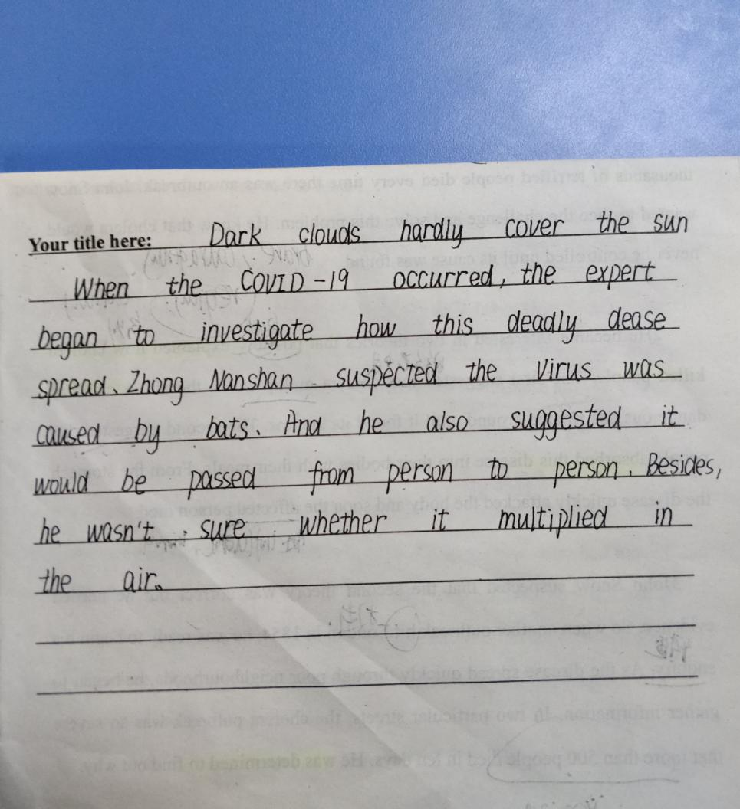
Suspecting

Slide 36
Suspecting
rigorous/cautious
Notes:
标横线处，是教师根据点评学生的观点，进行整理的

Slide 37
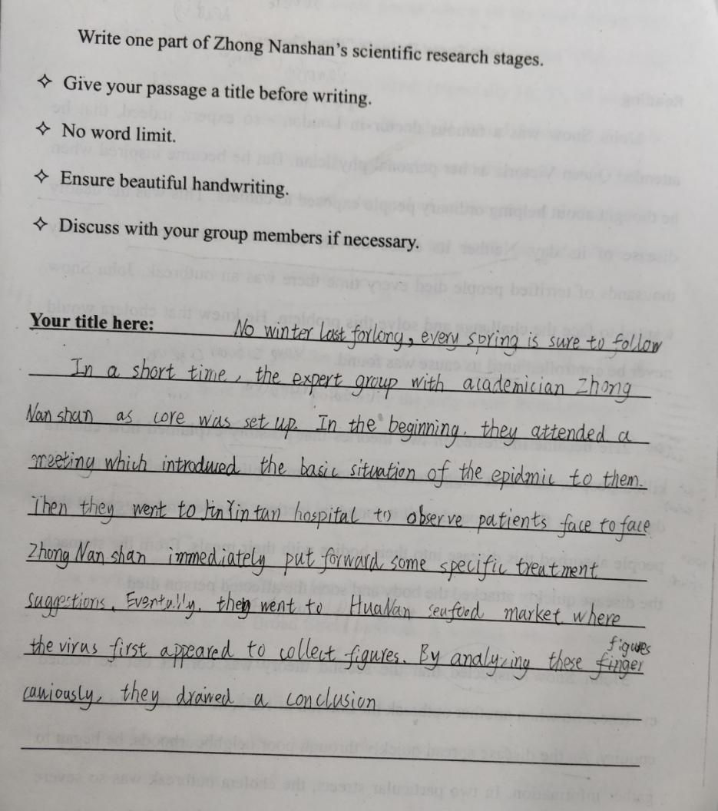
Proving

Slide 38
Proving
essential/vital/crutial
care for the public
responsible for the public

Slide 39
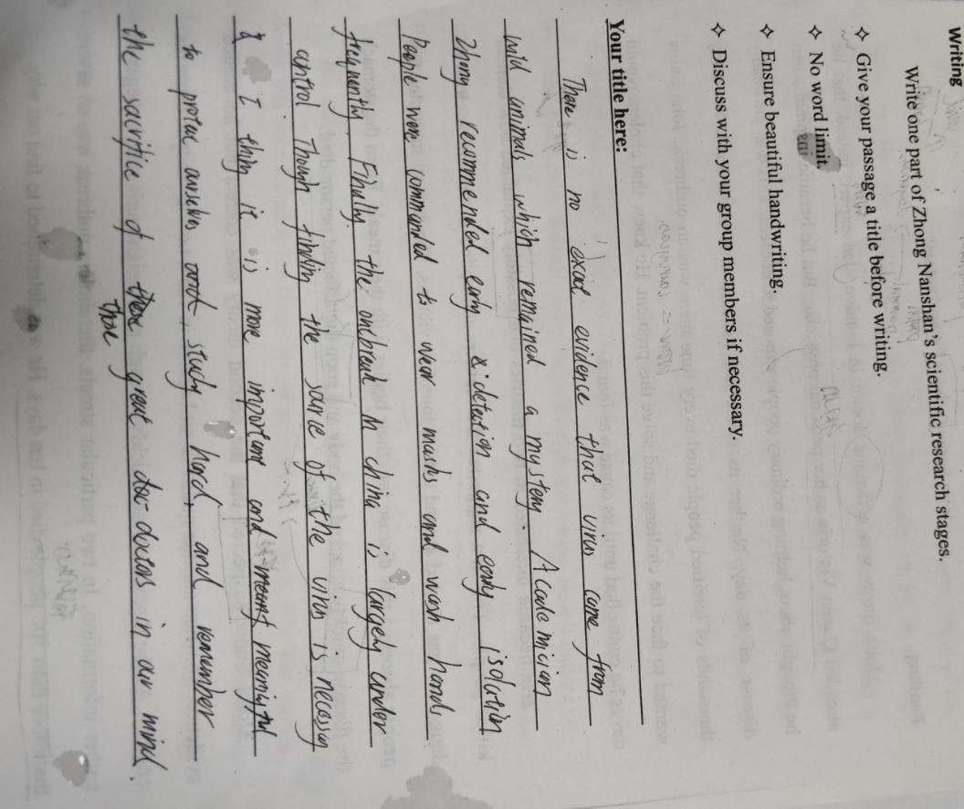
Concluding

Slide 40
Concluding
adv: to make the information more impressive

Slide 41
The fabulous titles given by ss
The Sunshine Brightens the Clouds
The Mountain that Guards People
Articles with good titles are half written.
The Lighthouse Old Man
Hope in Pandora's Box
题好一半文。
The War without Smog
The Way of Exploring
Angel Defeats Devil
Guardian of Life
Load Ahead...
Notes:
老师在同学们书写的时候，收集了大家的好题目，拿出来给同学们分享，
老师先请写某个题目的同学讲一讲为什么取这个题目？
例如第二个题目，学生说，山指：火神山、雷神三和钟南山，三山齐聚济苍生！ 多么有想法的题目！
再让同学们分析，每个题目好在哪里？
例如用到了比喻metaphor，拟人personification，引用了常用的比喻等

Slide 42
Assignment
Everyone complete your own passage.
Do self- assessment & peer-assessment within your own group.
You're invited to email your passage to the editor's official email.
No word limit.
Ensure beautiful handwriting.
Pay attention to the scientific research stages.
Notes:
布置作业，完成个人习作的基础上，教师再次强调自评和同伴互评！

Slide 43

editors@sciam.com

Slide 44
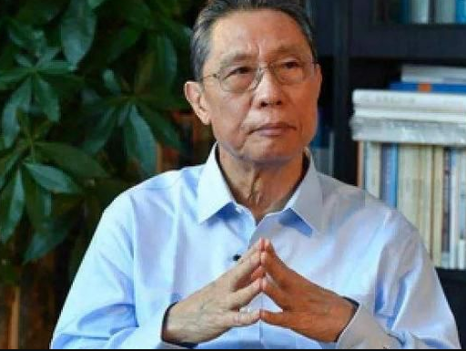
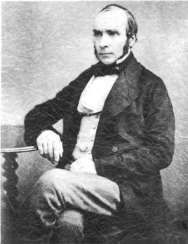
If we want to be a good writer,
be a good reader first.
Notes:
此处结尾，老师总结，升华主题：next time, when embracing an article, learn sth from it please. Of course we can also
learn a lot from the main characters in the articla, for example, we can learn a lot from John Snow and
Zhong Nanshan. With the joint efforts of great scientists like them, the world is sure to defeat COVID-19.

Slide 45


