Slide 1


感恩遇见，相互成就，本课件资料仅供您个人参考、教学使用，严禁自行在网络传播，违者依知识产权法追究法律责任。
更多教学资源请关注
公众号：溯恩高中英语
知识产权声明

Slide 2
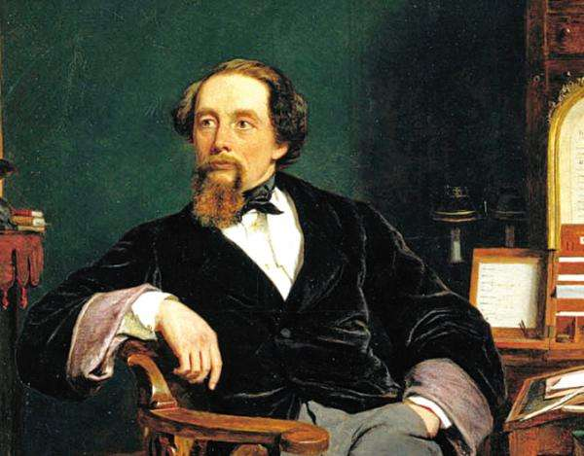
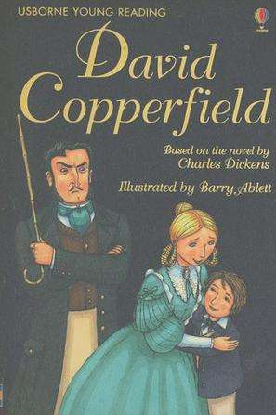
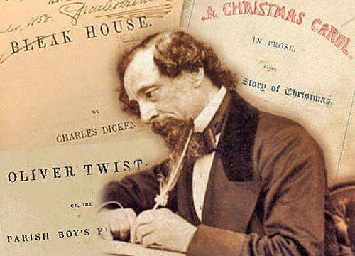
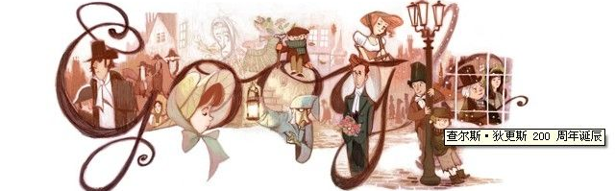
David Copperfield

Slide 3
Chapter 6
A Fresh Life and Old Friends

Slide 4


VI. Chapter 6: A Fresh Life and Old Friends
1
1
1
1.What did Aunt Betsey decide to do with me?
“From this moment,” she said, “your name will be Trotwood Copperfield. My house is now your home!”
I spent the next few days with my head in the clouds, overjoyed at my new life with Aunt Betsey and Mr. Dick. Then one morning, Aunt Betsey said, “Trotwood, we are off to Canterbury today to visit your new school. We will stop on the way at my solicitor’s. Mr. Wickfield is someone whose opinion I greatly value.”
2. How was the new school
different from Salem House?
She decided to send me to a new school.

Slide 5







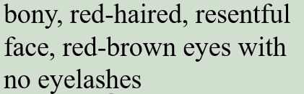


3. Who did I meet at Mr. Wickfield’s house?
Name | What | Appearance | character
 |  | /
？
4. How did I feel toward the present life?
I was content and happy with the Wickfields, but I disliked Uriah Heep.
5. Why did I dislike Uriah Heep?

Slide 6
“Are you aiming to be Mr. Wickfield’s partner in law, when you’ve qualified?” I asked him one evening.
Uriah rubbed his pale hands together and his body writhed in a most horrible way. “Oh no,” he oozed, “I’m much too’umble for a job like that. But you, Master Copperfield, are a gentleman. Maybe it will be you who becomes his legal partner.”
I shook my head. The thought hadn’t even crossed my mind.
“I would be honored if you would come to have tea with my mother and I at our most ‘umble home,’” he went on, bowing low.
5. How did Uriah feel when hearing my question?
anxious, worried and restless.
7. Why do you think Uriah
invite me to his home?
6. Why did Uriah react that way?
Maybe he didn’t want me to regard him as a competitor and hide his real intention.

Slide 7
[ˈwiːdl] v. to try to persuade sb. to give you sth. by saying nice things
His mother seemed to writhe as she spoke, just like Uriah.
“We are so delighted you are sitting in our ’umble home,” she wheedled.
Before I could speak, the two of them started firing questions at me.
“How long are you going to stay with the Wickfields?”
“What do you know about Mr. Wickfield’s law business?”
“What do you think of his daughter, Agnes?”
They were like a pair of dentists pulling out a painful tooth. They managed to squeeze information out of me, and I told them a lot more than I meant to…
8. What was Uriah’s real intention by
inviting me for a tea?
To “steal” Mr. Wickfield's information and investigate me.
9. How does the writer show their
eagerness for the information?
10. What kind of person is Uriah?
ambitious
disloyal
greedy
shrewd
hypocritical
sly/foxy
11. Who saved me from the miserable talk?
Mr. Micawber

Slide 8
V
12. How do you understand the title “A Fresh Life and Old Friends”?
I totally broke away from the Murdstones’ rule.
A Fresh Life and Old Friends
I started to live with Aunt Betsey.
I started a new school.
I met the Micawbers.
I started to meet new people.
I started to…

Slide 9
Chapter 7
Agnes’s Warnings

Slide 10
VII. Chapter 7: Agnes’s Warnings
1. What did Aunt Betsey suggest doing?
My time at Doctor Strong’s school passed very quickly and soon I was facing a new future out in the world. The only problem was I didn’t know what I wanted to do.
Having a break and figuring out what I wanted to do in the future.
2. How did I feel towards Salem House?
Can you find some supporting details in the text?
Both terrified and furious.
3. Who did I meet in London unexpectedly? How did we?
Steerforth.
They felt it unbelievable but meanwhile overjoyed.

Slide 11
“Emily is very beautiful,” said Steerforth thoughtfully.
“I agree,” I grinned. “She and Ham will make an excellent couple.”
Steerforth frowned. “I’m not sure about that,” he said. “I don’t think Ham is good enough for Emily.”
I stopped and eyed Steerforth with shock. “That’s a pretty harsh thing to say!” I protested.
A twinkle of laughter appeared in Steerforth’s eyes and I thought he was joking. But later, I realized how stupid I had been not to realize what was happening.
4. What were the Peggotty’s celebrating?
5. What did Steerforth think about the
engagement? Why would you say that?
Ham and Emily have just engaged.
6. Why do you think Stterforth behave
that way?
7. Why did Steerforth refuse to visit my
childhood with me?
Because claimed he wanted to go sailing.
8. What kind of people is Steerforth?
arrogant
shrewd
sophisticated

Slide 12
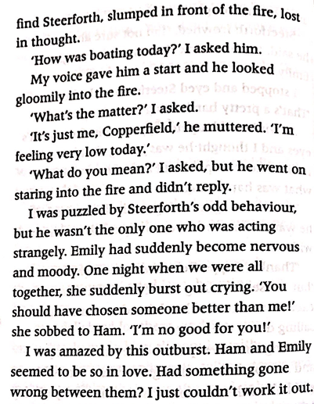
8. How did Steerforth behave strangely one
evening?
He had a lot in his mind and maybe met something frustrating.
9. What can you infer about him from his odd behavior?
9. How did Emily behave?
as odd/strange as Steerforth
10. Why do you think Emily said these words?
She felt sorry for Ham.
She felt regretful.
10. What do you think happened between
Steerforth and Emily?
11. Why would that happen?

Slide 13
v
12. What kind of profession did I decide to take on?
Lawyer.
13. What kind of difficulty did I meet? Who solved it?
Financial difficulty.
Aunty Betsey helped me pay the training costs.
14. Up to now, can you compare the life track of David’s with Dicken’s?
Father dead when David born
Father in prison for debt
Can you understand why Dicken regard the novel as his “favorite child”?
Working in a filthy warehouse
Working in a factory
Adopted by Aunt Betsey and life starting to change
Inheriting money from uncle and life starting to change
Starting to work as a lawyer
Starting to work as a reporter

Slide 14
What kind of people is David?
bull-headed
arrogant
“I’m very worried about one of your friends,” she told me.
I pulled a face. “And who’s that?” I asked.
“Steerforth,” she replied.
“Steerforth!” I cried. “What’s the matter with him?”
“All I’m saying is that I know he’s kind and charming, but he’s also rich and used to having everything he wants…”
“I won’t hear of it!” I protested. “Steerforth’s one of my oldest friends!”
Absurd/
ridiculous
How did I feel toward her warning?
She came to warn me of Steerforth.
15. Why did Agnes visit me?
She came to tell me his father’s difficult situation (for help).
“The worm!” I declared with outrage, as I remembered Uriah’s insistence that he was too ‘’umble’ ever to be Mr. Wickfield’s partner. “You must stop this happening, Agnes!”
…
“I’ll deal with Uriah!” I seethed (control your anger).
…
I had to admit that Agnes was right. Uriah was a powerful enemy and if…
How did I feel toward Uriah?
Furious
I resented him.
impulsive/rash
a man of integrity
What kind of people is David?

Slide 15
v
16. How did Uriah react when I spoke to Agnes during the party?
He hovered nearby, listening in to our conversation.
[ˈhɒvə(r)] to wait somewhere, near sb.
e.g. Judith was hovering in the doorway.
17. Why did I invite Uriah for a coffee after the party?
I wanted to “steal” some information and then deal with him.
18. What’s Uriah’s plan on Agnes?
“Liar!” I thought…
He wanted to marry her.
I felt my blood boil.
19. How did my feeling change during the
conversation?
…that made me shudder.
angry
furious
afraid
worried
sleepless…tossed and turned…

Slide 16
20. Find sentences that describe Uriah.
His slimy behavior was almost unbearable…Whenever I spoke to Agnes, he hovered nearby, listening in to our conversation.
He leaped at the chance. “Oh what an honor it is for an ‘umble person…”
“It’s a shame about Mr. Wickfield,” he said, pretending to sigh…
“But it’s not Mr. Wickfield I have my eyes on,” Uriah said, leaning forward and rubbing his clammy hands together…
“…Let’s keep it as our little secret.” And he smile in a slimy, unpleasant way that made me shudder.
greedy
sly/foxy
hypocritical
evil
selfish
power-addicted

Slide 17
13. Try to find the sentence describing the following feelings.
happy
“Ham and Emily…” cried Dan, beaming with happiness.
disappointed
My heart sank.
surprised
I turned to her in astonishment.
unhappy
I pulled a face.
I felt my blood boil.
angry
“The worm!” I declared with outrage.

Slide 18
17. Try to find the words indicating “say sth”.
continue
“You could…”, continued Aunt Betsey. “See the sights.”
exclaim
“Little Copperfield!” he exclaimed, with surprise.
mutter
“It’s just me, Copperfield,” he muttered.
declare
“The worm!” I declared with outrage.

Slide 19
Chapter 8
Bad News from the Peggottys

Slide 20
VII. Chapter 8: Bad News from the Peggottys
1. What does “something” refer to?
But something was about to happen that would send all thoughts of Agnes and Uriah out of my mind—at least for a while.
To me, Dora was the most beautiful creature in the world and I would walk right across London from north to south, just for the chance to see the light at her window.
I would stand for hours, waiting for a glimpse of my beloved, as she set out on an errand with her little dog Jip. I could imagine no greater joy than to sit in the same room with her and to hear her voice.
I fell in love with Dora, Mr. Spenlow’s daughter.
How does the writer show David’s love for Dora?
2. How did I feel when I found we
both loved each other?
[ɪkˈstætɪk] adj.
extremely happy
over the moon; ecstatic

Slide 21
3. How did Mr. Spenlow react to my secret
engagement with Dora?
One day after my meeting with Mr. Spenlow, he asked to see me. “What are the meaning of these letters you’ve been sending to my daughter?” he demanded.
“I love your daughter and we are engaged,” I declared.
“Nonsense!” exploded Mr. Spenlow. “You will not talk of engagement.”
“But…but,” I stammered.
“No!” raged Mr. Spenlow. “We will throw these letters in the fire and forget all about them!”
He got furious and refused it decidedly.
Why do you think Mr. Spenlow reacted this way?
My poor Aunt Betsey
lost all her money.
4. What kind of people is Mr. Spenlow?
shrewd
sophisticated
sly/foxy
5. What happened to Mr. Spenlow finally?
He died unexpectedly.

Slide 22
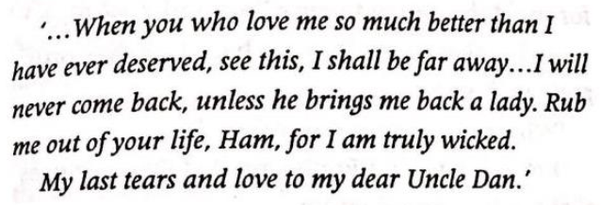
6. Why was I surprised to see Emily?
When we got down to Yarmonth, I dropped in to see Dan in his barge house. He was just the same as ever. But I was shocked when I set my eyes on Emily. She was so changed. Gone was the beautiful, passionate young woman I’d always know, to be replaced by a silent, trembling figure who clung to her Uncle Dan all the time.
She has totally changed.
Why do you think she changed so much?
7. Why did Emily leave a letter?
To show her sorry for Ham.
What kind of people is Ham according to your understanding?
8. How did I feel toward Emily’s leaving?
astonished
confused
angry
regretful

Slide 23
9. Try to find the sentence describing the following feelings.
desperate
I was thrown into the depth of despair.
unhappy
Dan’s face clouded over with a dark sheen of fury
astonished
I sank down into a chair, completely shattered.
10. Try to find the words indicating “say sth”.
stammer
“But…but,” I stammered.
groan
“Of course it’s my fault,!” I groaned.

Slide 24
Chapter 9
Uriah Heep’s Scheme

Slide 25
VII. Chapter 9: Uriah Heep’s Schemes
1. How did I feel toward Steerforth’s running away with Emily?
In the days after that terrible discovery, I went over and over everything that had happened. Agnes had been right yet again. Steerforth had behaved very badly and I was ashamed of him—but I still could not believe that he was wholly evil. He had betrayed his friends through selfishness, but he had not meant to do them harm.
angry
I was ashamed of him. He betrayed his friends.
regretful
Agnes had been right all the time.
Why would David have this kind of mixed feelings?
I still couldn’t believe that he was wholly evil.
astonished

Slide 26
2. Why did Agnes visit me again?
“That man is my torturer!” he said falteringly, pointing a finger at Uriah. “He has taken every drop of peace and quiet from my life!”
…
“You have ruined me!” wailed Mr. Wickfield.
…
This was too much for Mr. Wickfield. He moaned in horror, started pulling his hair out, and beating his head with his own fists.
To tell me the bad situation his father was in
What kind of situation is his father in?
He was totally controlled by Uriah both physically and financially.
3. What can you infer from Mr.
Wickfield’s words and actions?
He’s both furious
and regretful.
Why would he feel that way?
4. How did I react?
What do you think David would do to deal with Uriah?
I fought with him.

Slide 27
Chapter 10
The Shipwreck

Slide 28
IX. Chapter 10: The Shipwreck
1. Why do you think I didn’t raise my hopes too high?
Then, at last, I had a stroke of luck. Mr. Micawber wrote to me from Mr. Wickfield’s suggesting that my aunt and I should come down to Canterbury. Mysteriously, he hinted that he had some very important news for us.
I tried not to raise my hopes too high…
Because Mr. Micawber isn’t reliable enough for me to trust.
2. How did Mr. Micawber behave when
seeing my aunt and me?
Why do you think Mr. Micawber behave that way?
He pretended to be very surprised.

Slide 29
3. Why didn’t Mr. Micawber leave as ordered?
Uriah spluttered with fury. “So this is a plot!” he shrieked, glaring at me. I’ll get even with you and then you’ll be sorry!”
…
He lunged at Mr. Micawber, trying to snatch the letter…
As the list of his crimes grew longer, Uriah’s face twisted with rage. Gone was any pretence of ’umbleness.
…
“I’ve always hated you, Copperfield,” he burst out…
“But I’m not going to tell you anything more,” snarled Uriah.
He wanted to reveal Uriah’s scheme and accuse Uriah of crime.
4. How did Uriah react to Mr. Micawber’s
accusation?
He instantly flew into a rage and tried to defend himself.
Why do you think Uriah reacted this way?
He thought Mr. Micawber wouldn’t betray him.
He blamed all these on David.
The dream to climb to higher social class was shattered.

Slide 30
v
5. How was my marriage with Dora?
It wasn’t happy and successful as expected.
Why would the marriage become such unsuccessful?
Dora wasn’t god at household affairs.
Our first baby died and Dora fell ill.
6. Who helped me through the difficult time?
Agnes
What kind of people is Ham based on these chapters?
7. How did Ham lose his life?
He sailed into the storm to save the last sailor.
kind
warm-hearted
8. Who was the last sailor?
simple
a man of integrity
Steerforth

Slide 31
Chapter 11
New Beginnings
and Happy Endings

Slide 32
X. Chapter 11: New Beginnings and Happy Endings
Steerforth had left Emily abroad with no money, and so she came to London where Dan Peggotty finally tracked her down. Dan decided that there was nothing to hold him in Yarmouth and he and Emily began a new life in Australia.
And in search of yet another fresh start, the Micawbers decided that they would also go to Australia. “Something will turn up there,” said Mr. Micawber, as cheerful as ever.
I went travelling abroad as I’d planned, taking pleasure only in the letters from Agnes Wickfield, urging me to come home and continue my writing career. I listened to her encouragement and picked up my pen once more.
1. Why did Ham, Emily and the Micawbers went to Australia?
To seek for a new life.
2. Why did I travel abroad for a long time?
To forget about the miserable things that happened before.

Slide 33
v
3. How was Mr. Wickfield?
He was contented, free forever from Uriah Heep.
When I finally plucked up the courage to ask her to marry me, she told me that she’d secretly loved me for years. I could hardly believe my happiness and we were married within a fortnight. Aunt Betsey, who had always liked Agnes, was almost as pleased as I was.
As I sit here now I have the two women at my side, who mean everything to me—Agnes, my wife, and Aunt Betsey, who looked after me when I was all alone in the world.
4. How did I feel toward my life at present?
Why do you think I could have such a happy ending?
contented and happy

