Slide 1

感恩遇见，相互成就，本课件资料仅供您个人参考、教学使用，严禁自行在网络传播，违者依知识产权法追究法律责任。
更多教学资源请关注
公众号：溯恩高中英语
知识产权声明

Slide 2

人教版选修7 Unit1
Living Well
Reading and Writing
东北师大附中朝阳学校 李秋爽

Slide 3

Unit 1 Living Well
Using Language Reading & Writing

Slide 4


What possible problems will there be if our school life comes back to normal?

Slide 5
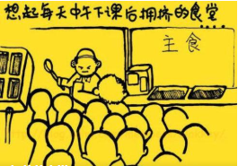
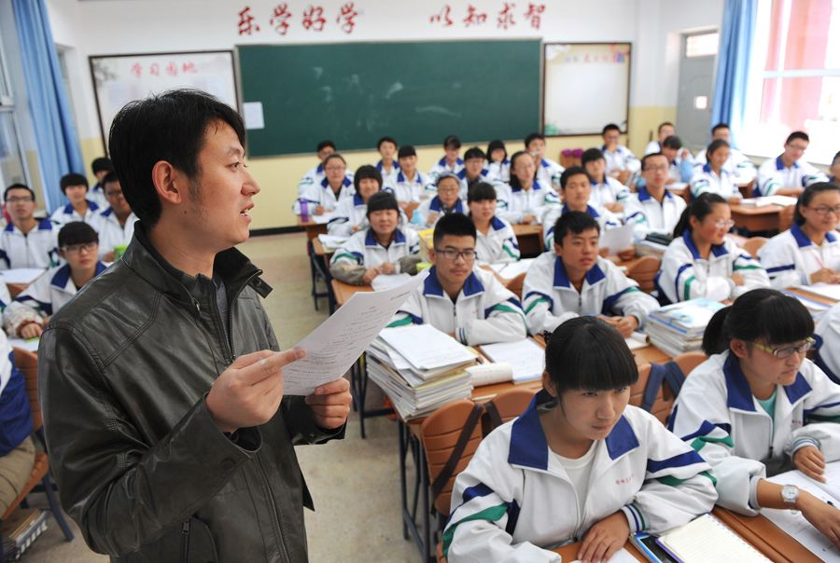
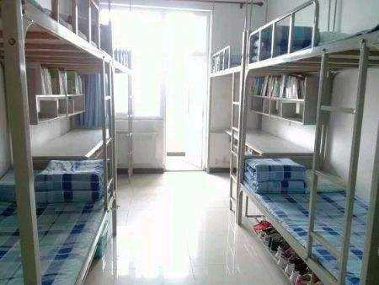
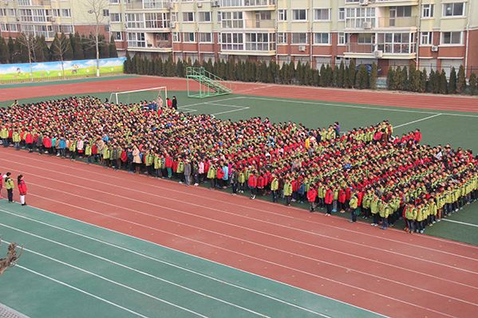
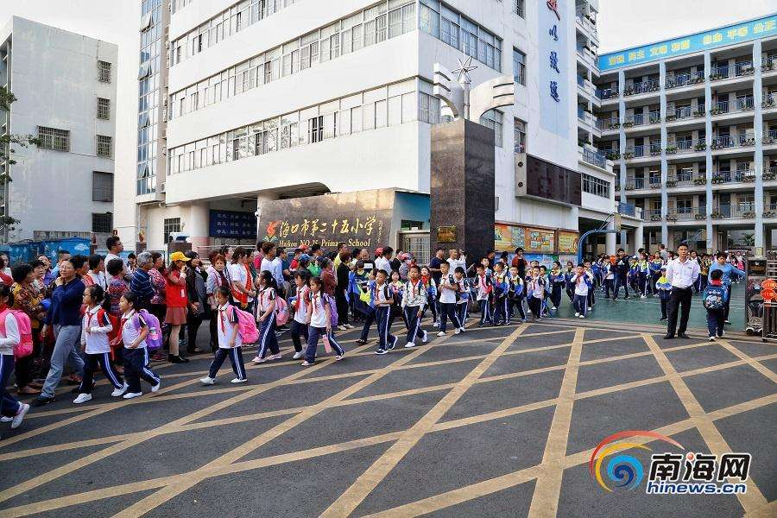
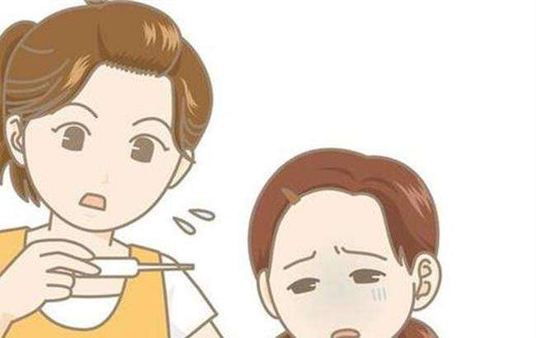
having meals in a packed dining hall
having classes side by side with a crowd
sleeping in a fully occupied dormitory
attending group
activities like the flag-raising ceremony
the intense parents and students flow at the school gate
fever caused by other viruses or germs

Slide 6
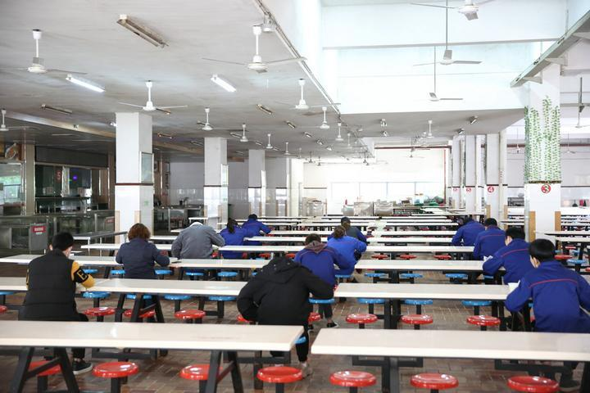
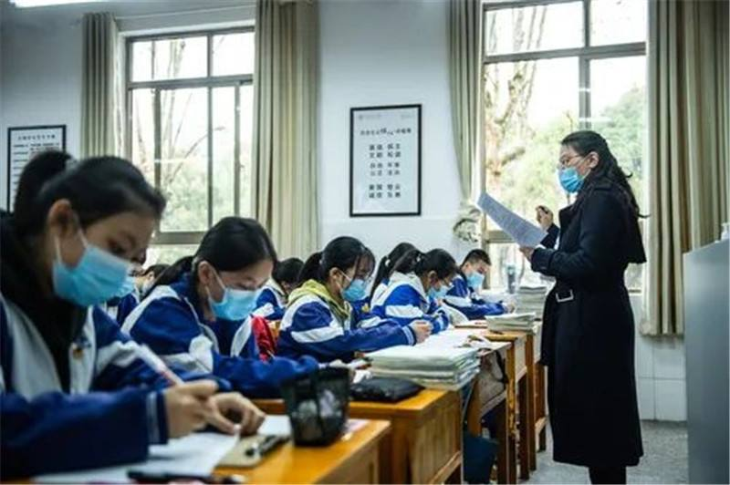
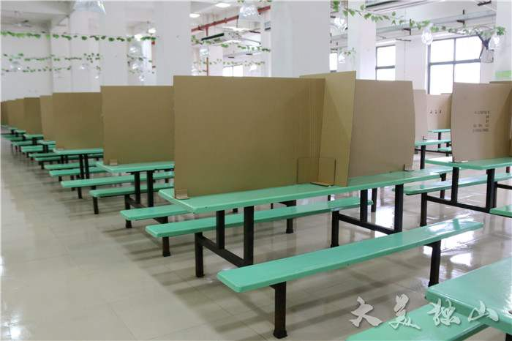
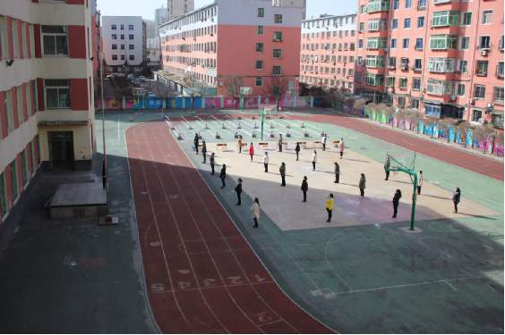
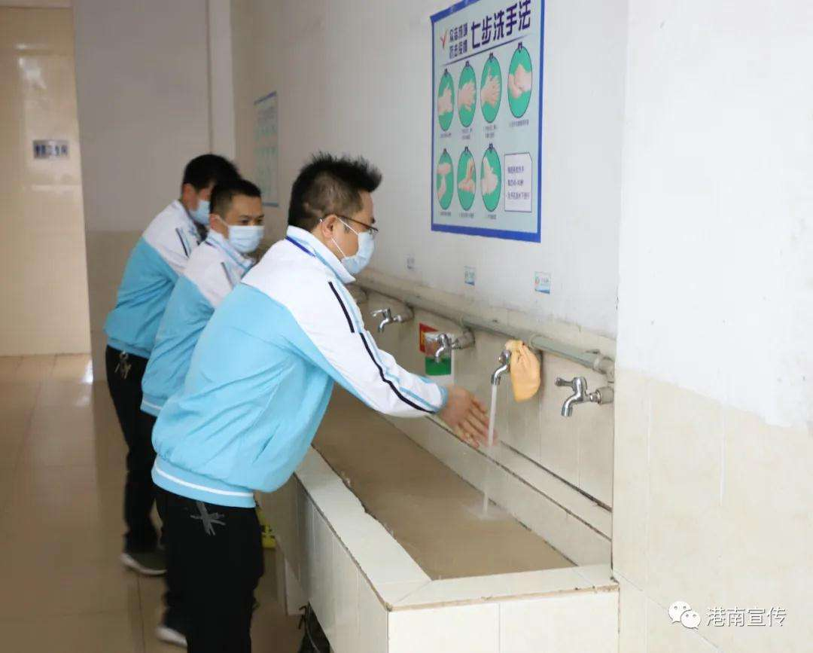
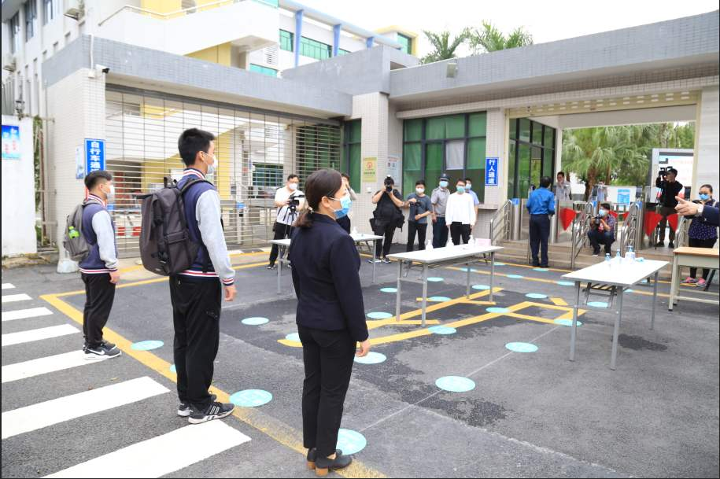
Considering such problems, what are the possible solutions?
having classes with certain distance from each other, wearing masks
fencing the tables or desks into different areas
dining at different periods on separate tables
washing hands and airing rooms constantly
checking temperatures at entrances
avoiding public gathering
Notes:
Wonderful ideas, but I’m afraid your answers are far from a good letter of suggestion.

Slide 7
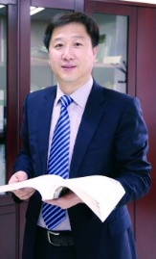
Let’s share our wonderful solutions with our headteacher.
formal, polite, clear, logical, convincing
How ?

Slide 8
A letter to an architect
Prediction
How many parts do you expect to read in a letter of suggestion?
What does each part talk about?
Notes:
Who is the letter from? (追：What kind of person is he?)
What’s the name of the architect?(追: what does an architect do?)
Why does Alice Major write the letter?
How many suggestions are given here?
What do you think of her letter? (polite and formal)

Slide 9
Reading for structure
Go over the passage as quickly as possible and check your prediction.
A letter of suggestion
Beginning
Body
Ending
Purpose
Suggestions
Appreciation and Expectation

Slide 10
Reading for information
请按下暂停键，思考并在学案上写出答案。
Alice Major
Who is the letter from?
What’s the name of the architect?
Why does the writer write the letter?
How many suggestions are given here?
Ms Sanders
To offer some advice about the needs of the disabled for the cinema to be built.
5
Tip 1. State your writing purpose clearly in the beginning paragraph.
Tip 2. Make your suggestions clear and easy to get by numbering them.
Notes:
Q1 disabled able-bodied
Q2 architecture
Q3 in dignity
Q4 adequate
Q5 Clear, polite, reasonable

Slide 11
Reading for writing strategies
Para. 1
I read in the newspaper today that you are to be the architect for the new Bankstown cinema. I hope you will not mind me writing to ask if you have thought about the needs of disabled customers. In particular I wonder if you have considered the following things:
Writing background
Writing purpose
+

Slide 12
Reading for writing strategies
Para. 2
1 Adequate access for wheelchairs. It would be handy to have lifts to all parts of the cinema. The buttons in the lifts should be easy for a person in a wheelchair to reach, and the doors be wide enough to enter. In some cinemas, the lifts are at the back of the cinema in cold, unattractive places. As disabled people have to use the lifts, this makes them feel they are not as important as other customers.
suggestion
Problem/Reason
+

Slide 13
Reading for writing strategies
Para. 3
2 Earphones for people who have trouble hearing. It would help to fit sets of earphones to all seats, not just to some of them. This would allow hearing-impaired customers to enjoy the company of their hearing friends rather than having to sit in a special area.
suggestion
benefit
+

Slide 14
Reading for writing strategies
Para. 4
3 Raised seating. People who are short cannot always see the screen. So I'd like to suggest that the seats at the back be placed higher than those at the front so that everyone can see the screen easily. Perhaps there could be a space at the end of each row for people in wheelchairs to sit next to their friends.
further
suggestion
problem/reason
benefit
suggestion
+
+
+

Slide 15
Reading for writing strategies
Para. 5
4 Toilets. For disabled customers it would be more convenient to place the toilets near the entrance to the cinema. It can be difficult if the only disabled toilet is in the basement a long way from where the film is showing. And if the doors could be opened outwards, disabled customers would be very happy.
problem/reason
further suggestion
suggestion
+
+

Slide 16
Reading for writing strategies
Para. 5
5 Car parking. Of course, there are usually spaces specially reserved for disabled and elderly drivers. If they are close to the cinema entrance and/or exit, it is easier for disabled people to get to film in comfort.
present situation
suggestion
benefit
+
+

Slide 17
Reading for writing strategies
Para. 6
Thank you for reading my letter. I hope my suggestions will meet with your approval. Disabled people should have the same opportunities as able-bodied people to enjoy the cinema and to do so with dignity. I am sure many people will praise your cinema if you design it with good access for disabled people. It will also make the cinema owners happy if more people go as they will make higher profits!
appreciation
hope
reason
+
+
benefits
(for the reader)
+

Slide 18
Tip 3. To achieve persuasiveness, give your suggestions by presenting problems, providing suggestions or talking about the benefits, especially the benefit to the reader.

Slide 19
Reading for proper wording
请按下暂停键，请在学案上画出自己归纳的结构+关键语言导图。
Draw a mind map to include the key aspects of each paragraph and the according key expressions.
e.g.
Para.1
background
I read in …that…
purpose
I hope you will not mind me writing to ask if…
I wonder if you have considered the following things.

Slide 20
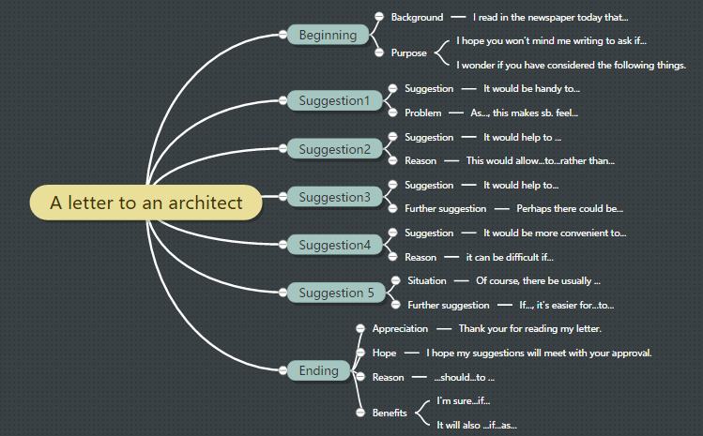
Notes:
这页需要重新做 也许我需要画图

Slide 21
Tip 4. To achieve politeness and show respect to a superior, use polite language.

Slide 22
In groups, brainstorm as many relevant expressions as you can.
Brainstorming
background
benefit
reason
hope
suggestion
problem
appreciation
purpose
Transition

Slide 23
background
Knowing that…, I…
I read in the newspaper that…
purpose
I’m writing to ask if you mind …
I’m writing this letter to provide you with some suggestions/advice
problem
As you know, …has been a great concern.
There is no doubt that …has been considered an urgent issue calling for immediate addressing.
In your last letter, you mentioned that…
Notes:
此页建议用板书

Slide 24
benefit
If…, it’s likely that the situation will look up.
reason
It’s universally acknowledged that…
appreciation
It would be highly appreciated if…
Thanks for doing…
This would allow...to...(Only in this way, can…)
…so that…
because, as, since, in that…

Slide 25
suggestion
It is suggested that (should) do…
It would be convenient to…
transition
As a result; hence; thus
what’s more; in addition; last but not least
hope
I hope my suggestions will meet with your approval.
Hopefully, my suggestions will inspire you in some way.
It is a good idea to…
all in all; generally speaking; in a word

Slide 26
针对即将到来的复课，学校正在广泛征求各位同学的建议，请以一名高二学生的身份，就校园复课的潜在隐患给校长写一封建议信。信中应包含以下内容：
Writing Task
1. 写信目的
2. 对校园复课可能潜在的问题简要评述。
3. 针对问提题出建议。

Slide 27
针对即将到来的复课，学校正在广泛征求各位同学的建议，请以一名高二学生的身份，就校园复课的潜在隐患给校长写一封建议信。信中应包含以下内容：
Writing Task
将来时+现在时
the resuming of class
asking/calling for students advice
potential risks/problems
第一人称
a letter of advice
1. 写信目的
2. 对校园复课可能潜在的问题简要评述。
3. 针对问提题出建议。
I’m writing to
It is suggested that…等

Slide 28
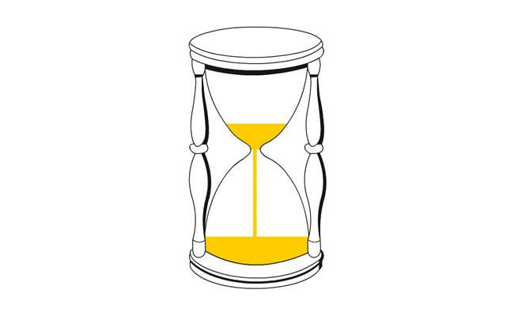
Write a structure
Draw a mind map to include the main topic for each paragraph. the key aspects of each paragraph and the according key expressions.

Slide 29

Write the first draft
Marking Angles | Structure | Paragraph Organization | Wording | Politeness | Accuracy | Coherence & Logic
Full score | 5 | 5 | 5 | 5 | 5 | 5
Self
Peer 1
Peer 2

Slide 30
Peer Marking and Sharing
After making your own work, exchange your works. Mark each others’, wave three highlights and underline three mistakes.
Marking Angles | Structure | Paragraph Organization | Wording | Politeness | Accuracy | Coherence & Logic
Full score | 5 | 5 | 5 | 5 | 5 | 5
Self
Peer 1
Peer 2

Slide 31
Dear Sir,
I read on the school website that you are calling for some suggestions about the measures for resuming the class, I hope you won’t mind me writing to ask if you considered the following things.
It would help to maintain certain distance between people. So, I’d like to suggest we study and dine on separate tables, wearing masks and only taking them off when necessary. It would be wise to broadcast all public gatherings online rather than having them as usual. On occasions like entering or leaving school or dining, when public gathering is a must, make sure students and parents are separated into different groups showing up at different times with enough space in between.
Besides, it would be safe to check the body temperatures constantly so that the infected can be detected. Of course, it’s natural for everyone to have a common fever. If an immediate check is provided to inform everyone of the real cause, it’s easier for everyone to ease anxiety.
Last but not least, it would be nice if the school cuts students from rumors and provides some psychological lessons. I’m sure students will praise the school for such kind deeds.
Thank you for reading my letter. I do hope my suggestions can meet with your approval. (218 words)
Yours, …

Slide 32
Dear Sir,
Learning you are calling for some suggestions at this critical moment of resuming the class, I hope you won’t mind me writing to ask if you considered the following aspects.
As Covid-19 is spread through droplet, it’s crucial to maintain certain distance between individuals. Hence, it’s recommended that we study and dine on separate tables, wearing masks and only taking them off when necessary. If possible, cancel all the public gatherings. Instead, broadcast them online. On occasions like entering or leaving school or dining, when public gathering is a must, make sure students and parents are separated into different groups showing up at different times with enough space in between.
Besides, check the body temperatures constantly. Only in this way, can the infected be detected timely and the risk be cut to the lowest level. Undoubtedly, it’s natural for everyone to have a common fever. To ease anxiety, provide an immediate check to inform everyone of the real cause.
Finally, the school is supposed to show concern for students’ psychological well-being, which means cutting students from rumors and providing some psychological lessons are essential as well.
Simple as my suggestions are, they may inspire you in some way. I’d appreciate it if they can meet your approval. (209 words)
Yours, …

Slide 33

Assignment
Perfect your Draft 1 and complete your Draft 2.

Slide 34

谢谢您的观看
北京市朝阳区教育研究中心 制作

Slide 35
Assignment
Polish your draft according to what you learned today.

Slide 36
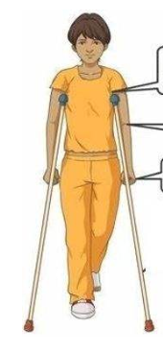
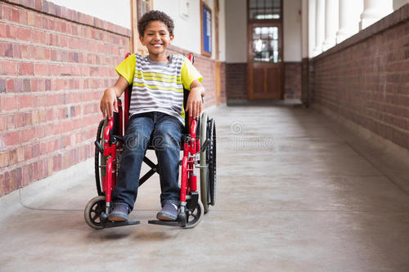
What possible problems will there be for a disabled students on the campus?
Plan B
problems
solutions

Slide 37
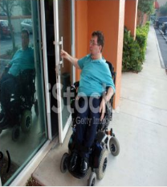
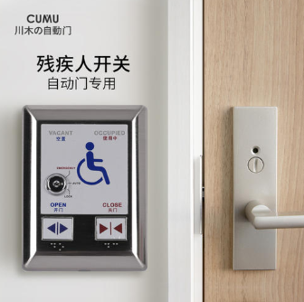
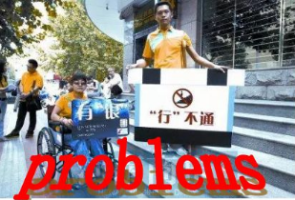
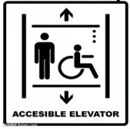
The classroom is not accessible.
Solutions
Doors wide enough to enter
(adequate access for wheelchairs)
Buttons within easy reach
Doors open outwards
Lifts (free access)
Plan B

Slide 38

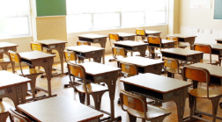
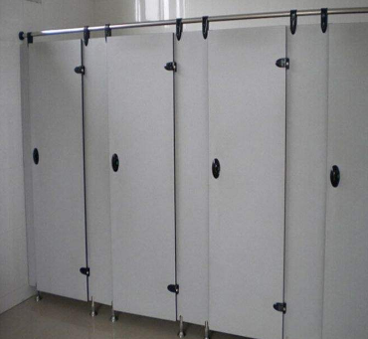
Problems
No obstacle facilities for the blind
Desks and toilets are to narrow for a wheelchair
Solutions
Remove all the obstacles in the way
Put obstacle facilities where necessary
Set special toilets and desks for the disabled
Plan B

Slide 39
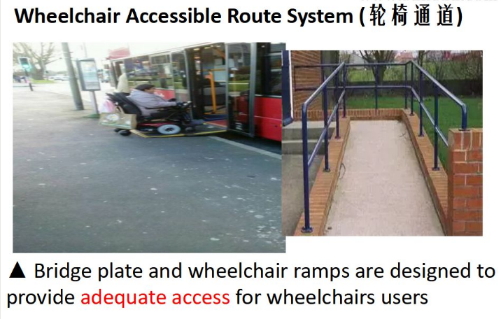
Plan B

Slide 40
On behalf of the disabled students, let’s share our wonderful solutions with our headteacher.
Formal, polite, clear, logical, convincing
How ?

Slide 41
针对学校的基础设施改造，学校正在广泛征求各位同学的建议，请以一名高二学生的身份，替残疾学生发声，就目前学校设施给残疾学生带来的不便给校长写一封建议信。信中应包含以下内容：
Writing Task
1. 写信目的
2. 残疾学生在校园可能遇到的问题进行简要评述。
3. 针对问题提出建议。

