Slide 1

感恩遇见，相互成就，本课件资料仅供您个人参考、教学使用，严禁自行在网络传播，违者依知识产权法追究法律责任。
更多教学资源请关注
公众号：溯恩高中英语
知识产权声明

Slide 2
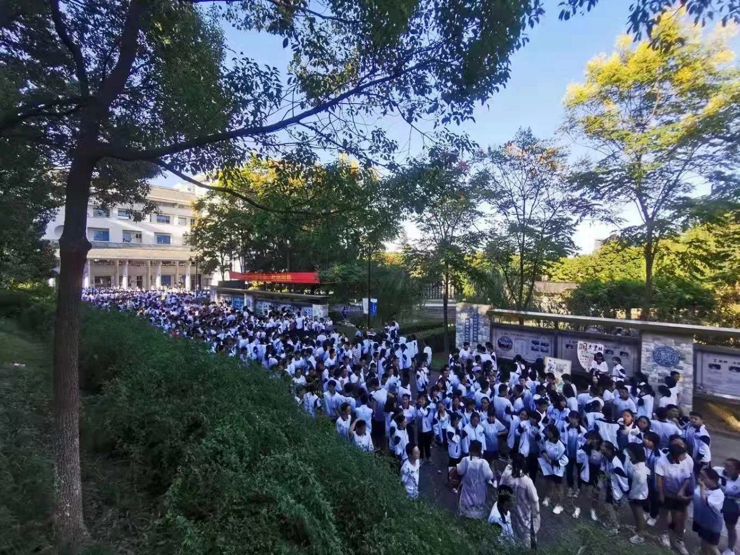
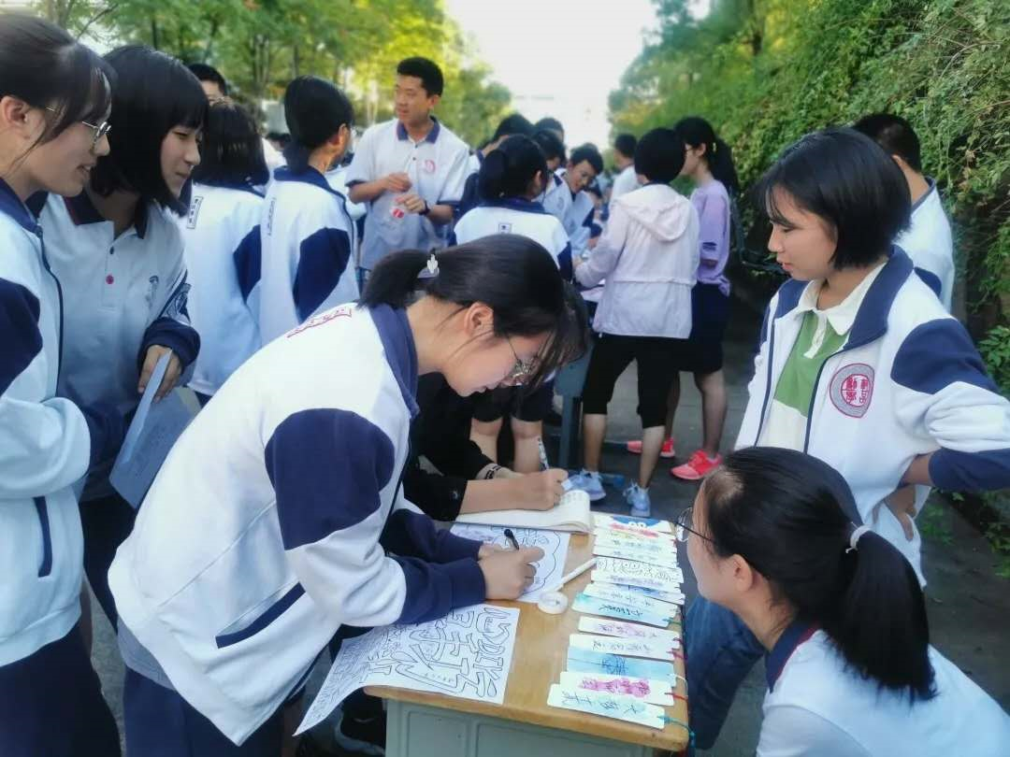
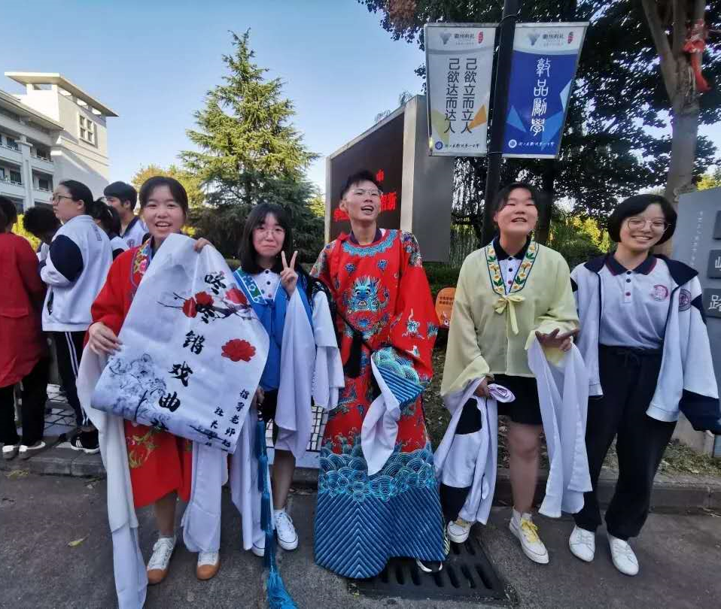
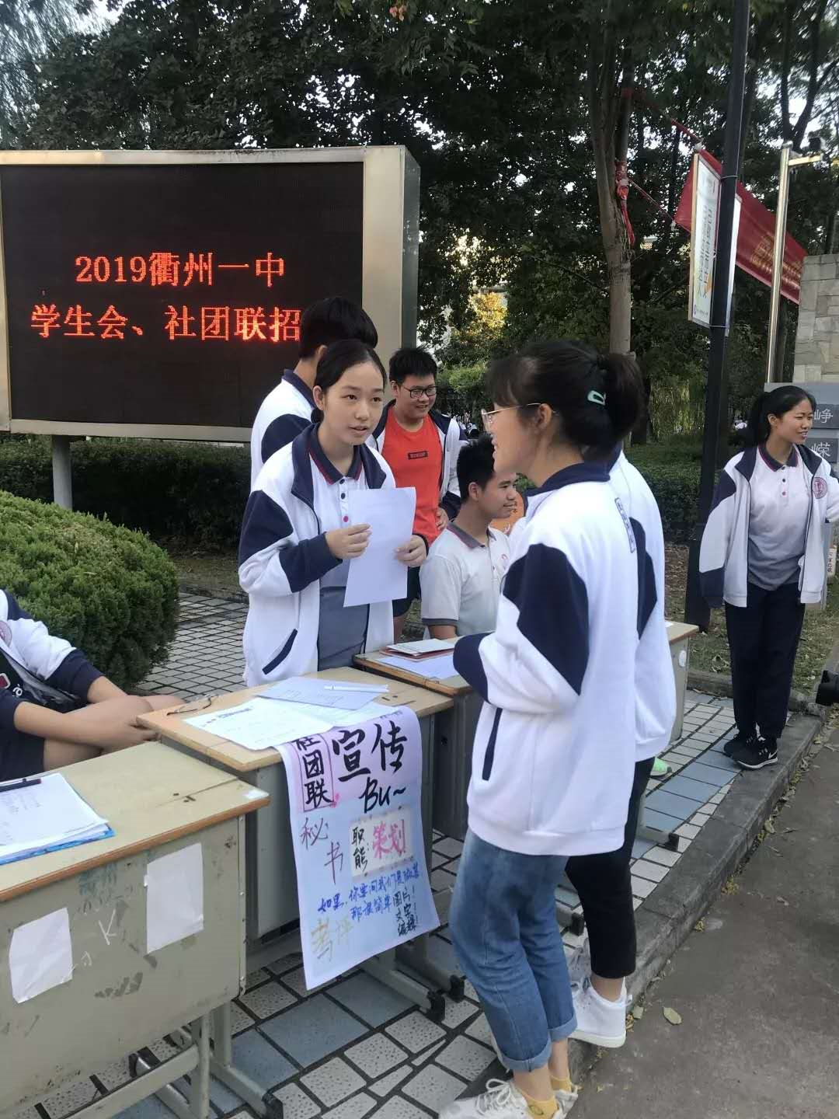
Choose a School Club

Slide 3
Talk about likes:
I like/love/enjoy/prefer/am fond of doing sth.
I'm interested in sth/doing sth.
I'm usually satisfied/happy/pleased with...
I'm keen on/passionate about...
...would be one of my best choices.
...sounds interesting/exciting to me.
...attract/appeal to me...
It will be thrilling/fun to do sth.
There is always plenty of fun for me to...

Slide 4

Predict based on the questions and choices:
Try to predict what the conversations may be about.
Conclude: This conversation happens between/among____________ (who) and they are ____________(doing what) and they do this probably in _________(where).
Infer according to “5W1H”:
who, what, when, where, why, how

Slide 5
Listen for difficult points:
If you _________ hear the first one, it means you're not a dog! Dogs ______ hear very high frequency sounds, but people _______. And if you _______ hear the second one, you're younger than 25.
couldn't
can
can't
could

Slide 6
Reflect on the answers:
They are learning about hearing.
Students are discussing dating.
Hearing and dating are the __________ of the conversations.
These two conversations happened in Science Club and Debate Club.
______________________can help us understand the whole conversation.
topics
Places/Settings

Slide 7



Focus on the bigger picture first!
Topics/Settings first, details second.

Slide 8
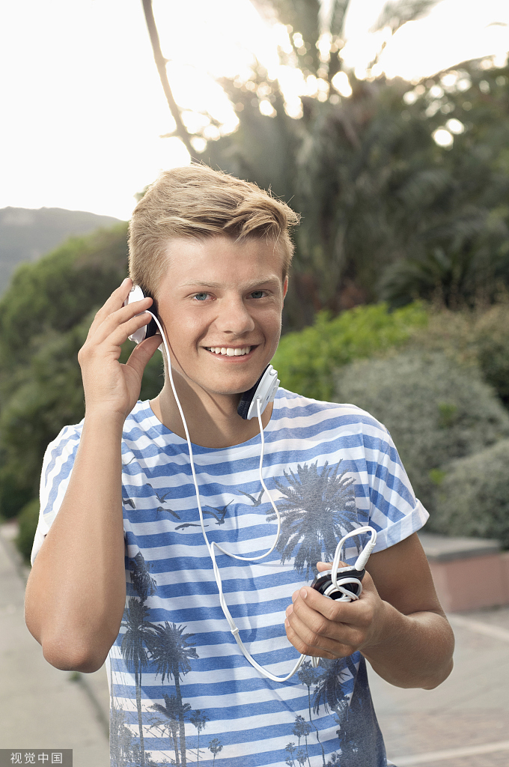
Adam
Predict the content of conversation 3:

Slide 9
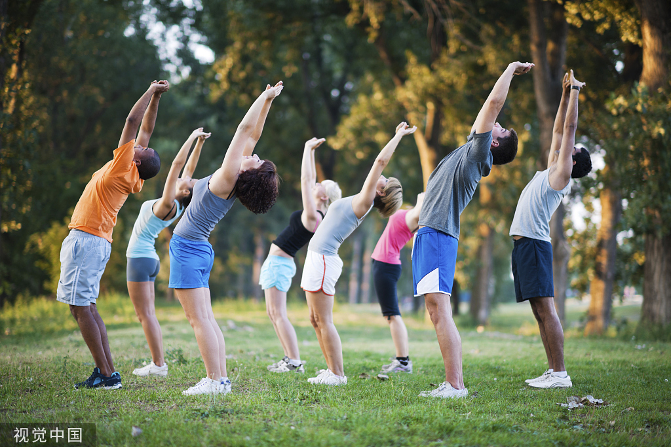
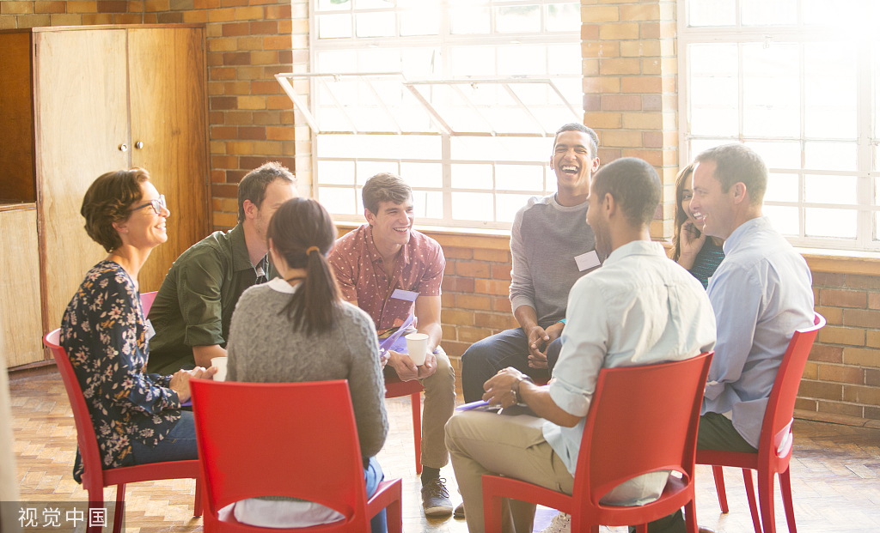
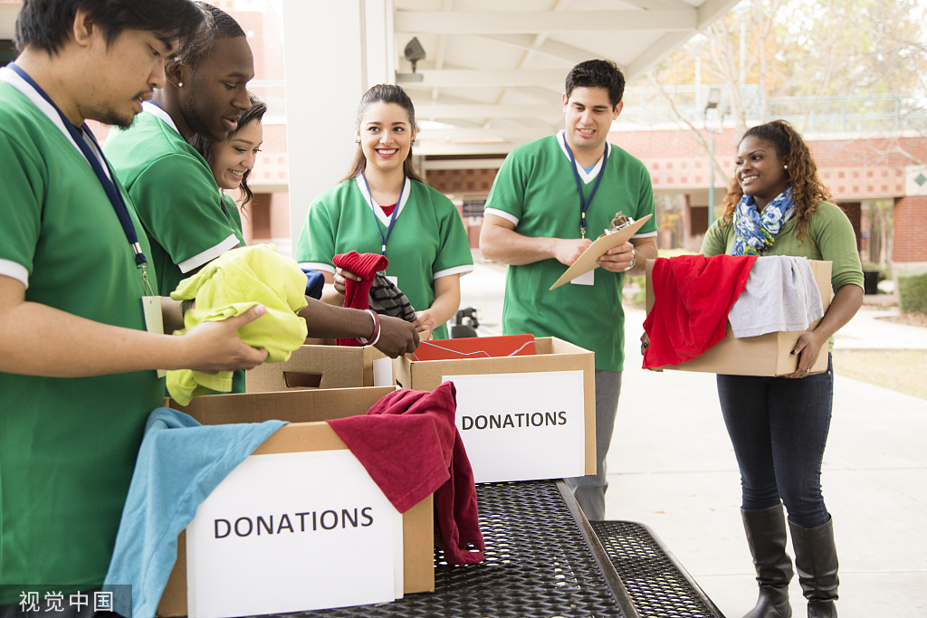
Think: What else should be considered when deciding on a school club?

Slide 10
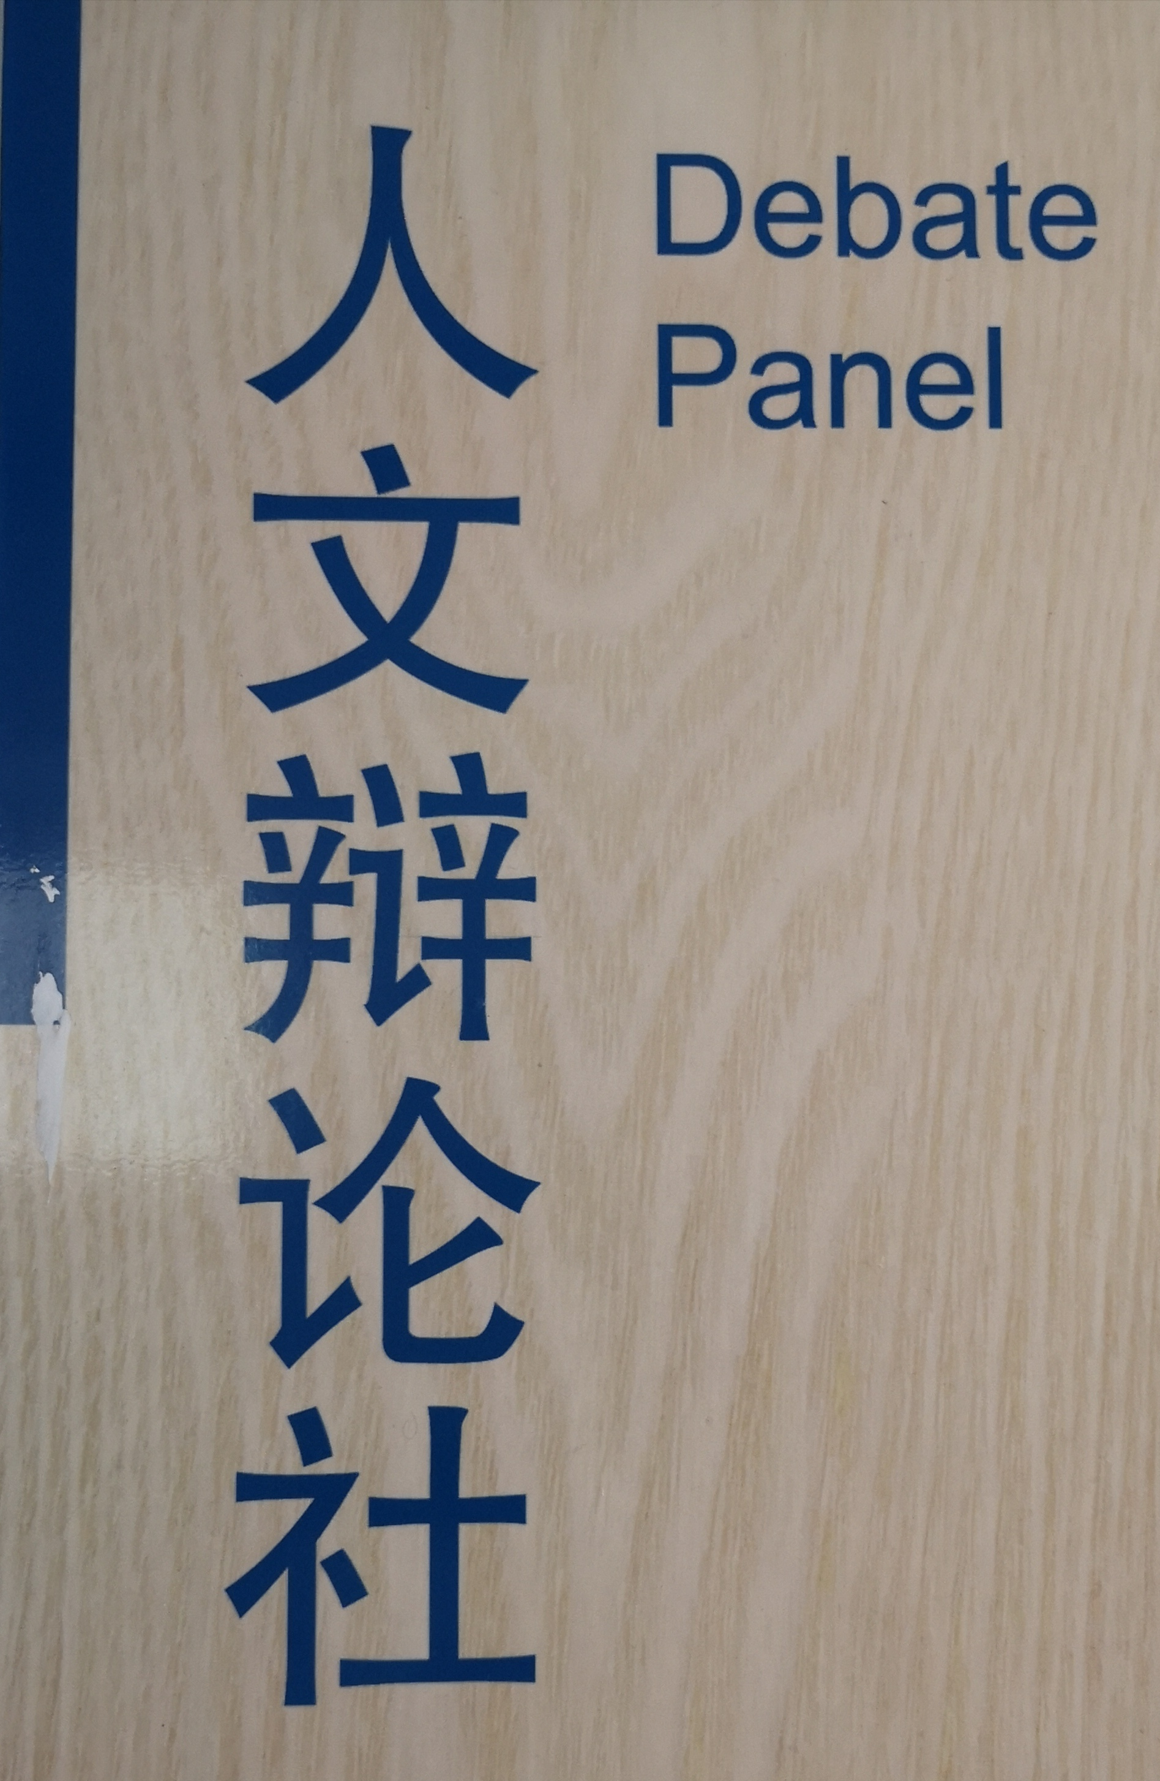
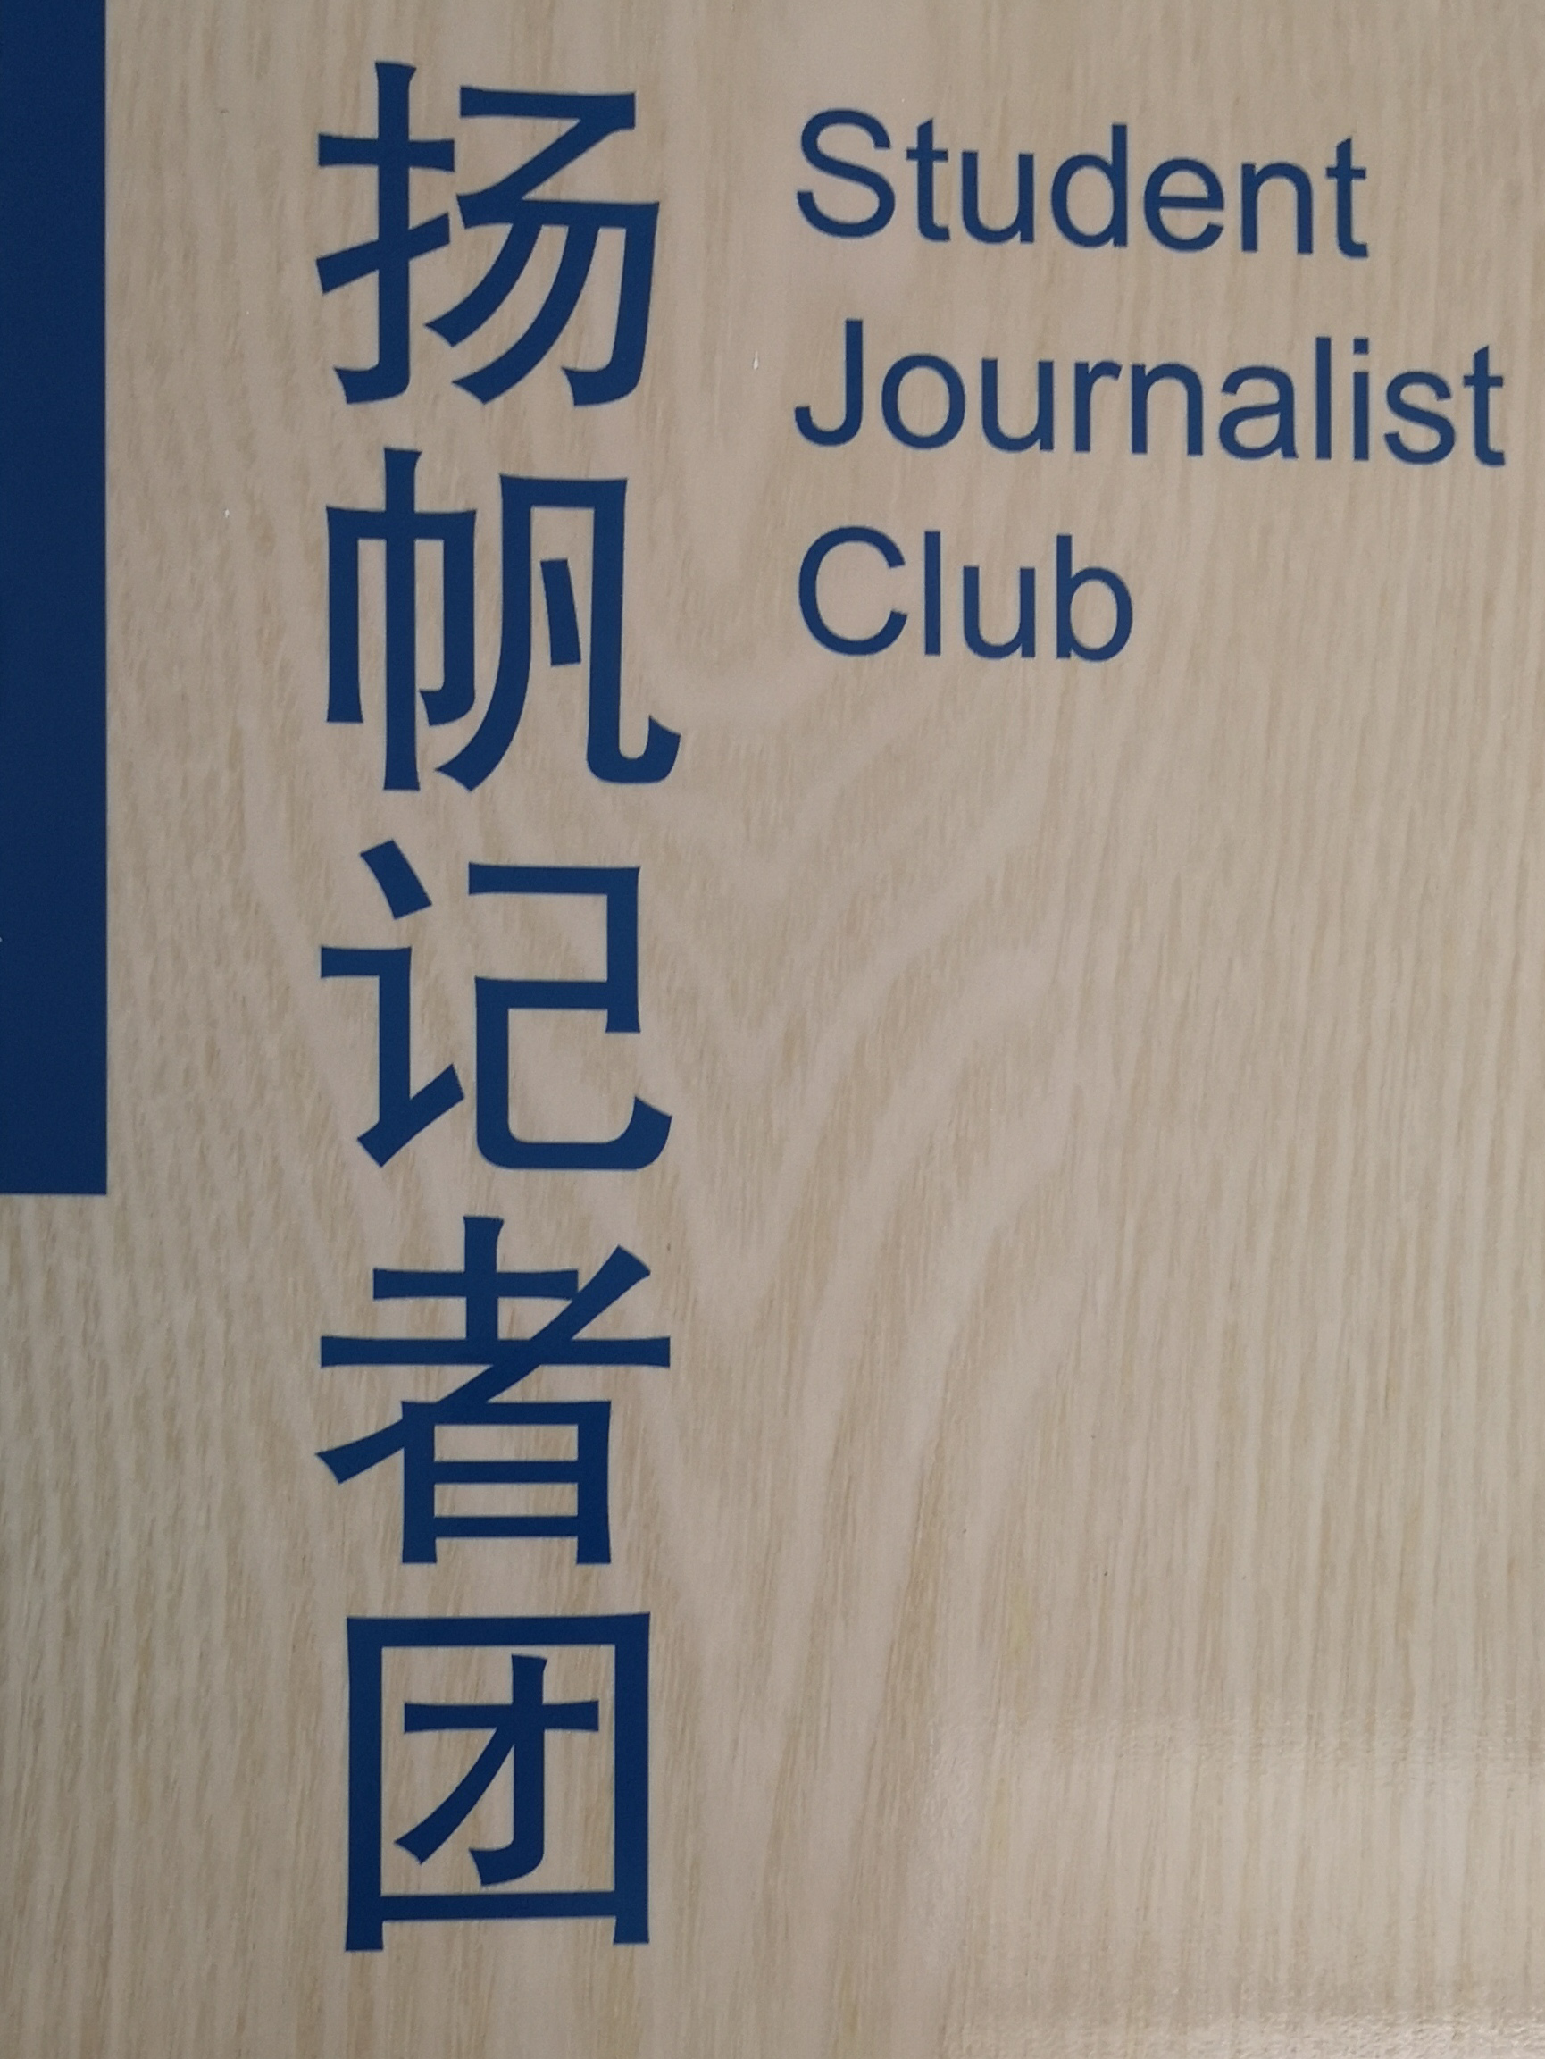
Susan：
I am an outgoing girl. I love meeting new people and learning new ideas, so I choose ...
Tom：
My obvious strength lies in expressing myself well. I am passionate about conveying my ideas to others, so ...
personality（性格）
strength/ advantage

Slide 11


Andy：
I am so fond of Guo Jingming. It's always been my dream to take up such a career like him, so I choose...
Chris：
I am keen on mastering the skill of playing a musical instrument.
Career goals
Ability
goals

Slide 12

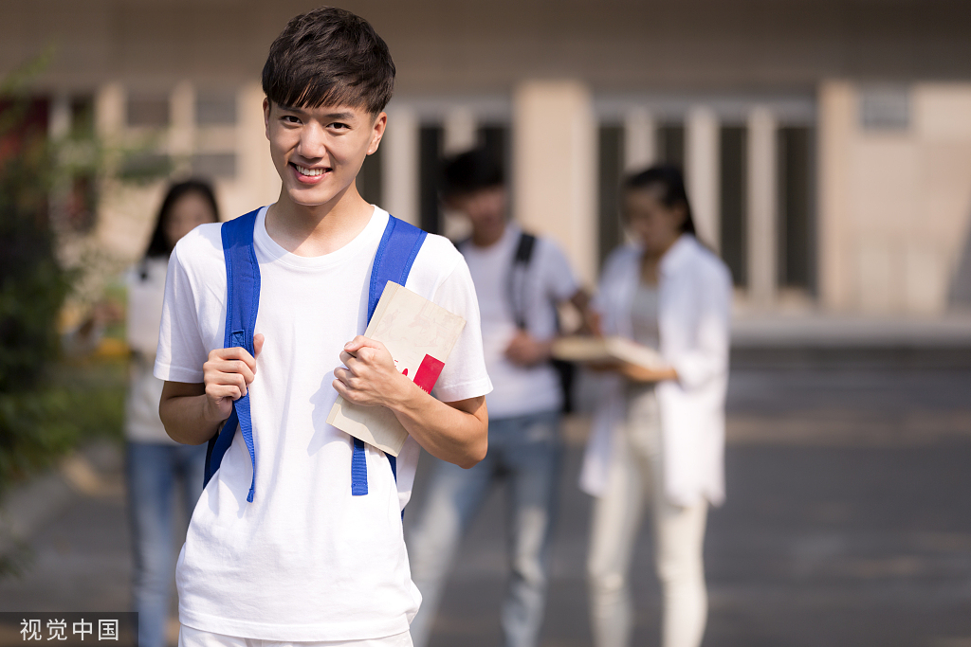
Talk: Help two teenagers from our sister schools choose a school club, who would come and stay in our school for weeks and join some clubs.
I'm Li Hua, from Hongkong. I used to give invitations or advice to others, but now I'm confused about what to choose.
I'm Kate, from your sister school in the Netherlands(荷兰) .

Slide 13
Talk: Help him/her choose a school club
Kate
Li Hua
talk about personal interests, strengths, personalities, career goals or ability goals;
help him/her choose a school club of Quzhou NO.1 Middle School

Slide 14
Sample:
Kate: I am amazed at the variety of school clubs in your school.
S: It does offer many clubs. Actually I am a member of the Debate Club because I'm fond of expressing ideas.
Kate: Good decision!
S: How about you? What do you like?
Kate: I'm wondering which one I should choose, Zhouxun Film Viewing Club or Jin Yong Literary Club?
S: I guess the question is ... Do you like watching films better than reading novels?
Kate: Actually, I like both, but maybe watching films is easier for me in this case.
S: I think you're right. Zhou Xun is an excellent actress. We can talk about her films after you watch some.
Kate: I'm looking forward!
give responses
encourage thoughts

Slide 15
Assess: Use the checklist to give feedback
Do the speakers mention some school clubs?
Do the speakers talk about personal interests, strengths, personalities, career goals or ability goals?
Do the speakers use expressions to show likes?
Do the speakers include some expressions to give responses or encourage thoughts?

Slide 16

Homework:
High school musical
《歌舞青春》
It's a Boy Girl Thing
《女男变错身》
Drumline
《乐鼓热线》
Mean Girls
《贱女孩》
Each group watches a teenage film and find out clips related to school clubs.
What a Girl
Wants
《水瓶座女孩》
The Princess
Diaries
《公主日记》
Bring it on
《美少女啦啦队》
17 Again
《回到17岁》

Slide 17


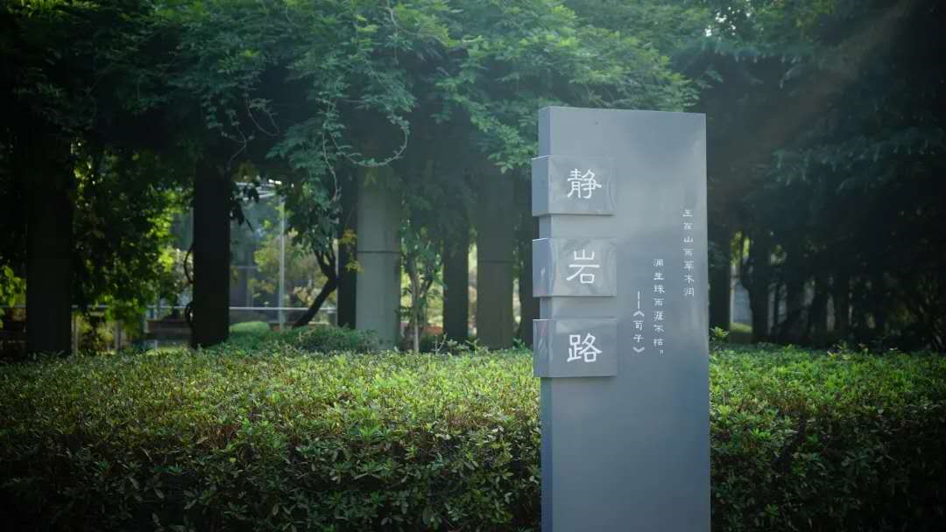
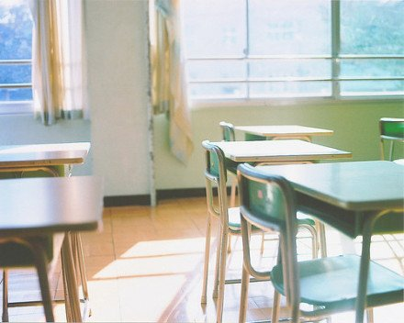
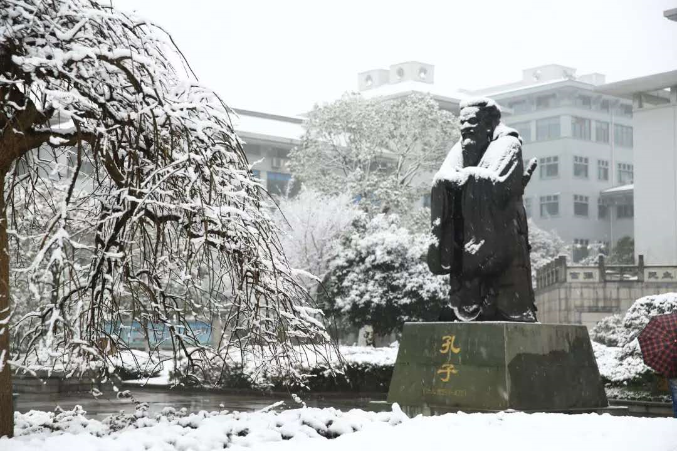

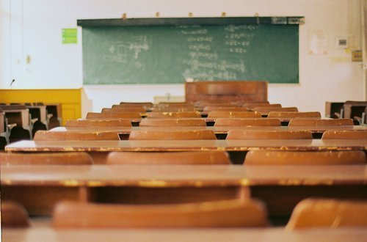

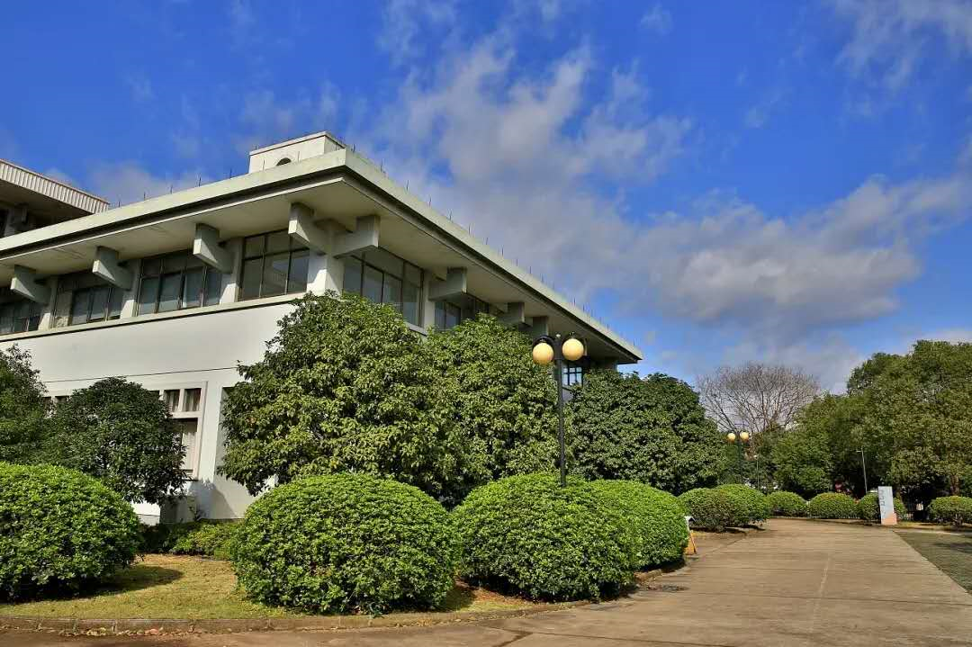
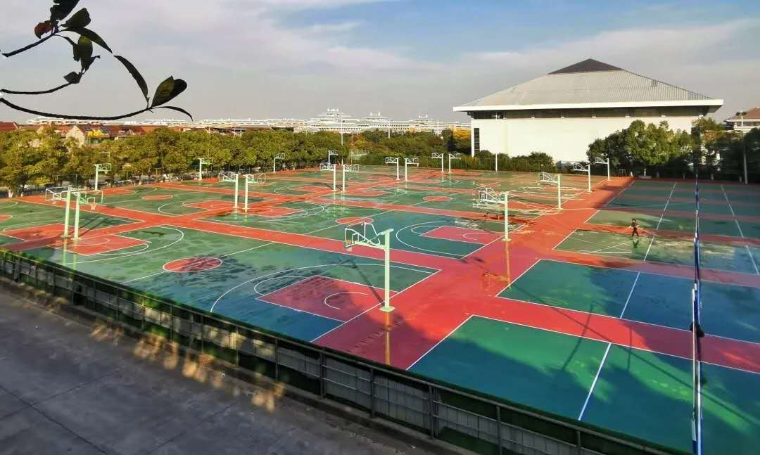

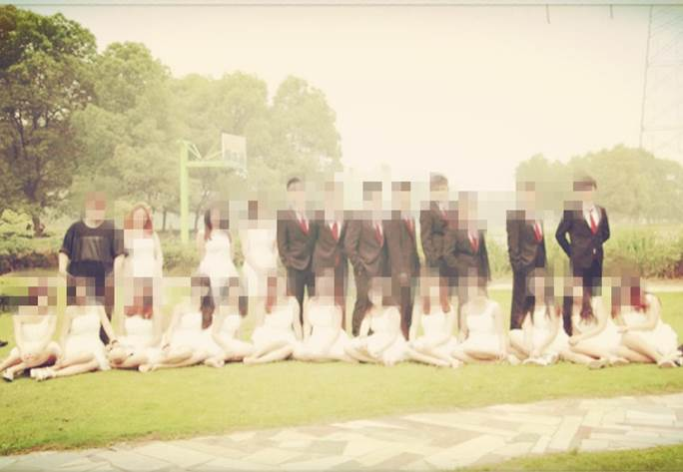
THANKS

