Slide 1

感恩遇见，相互成就，本课件资料仅供您个人参考、教学使用，严禁自行在网络传播，违者依知识产权法追究法律责任。
更多教学资源请关注
公众号：溯恩高中英语
知识产权声明

Slide 2
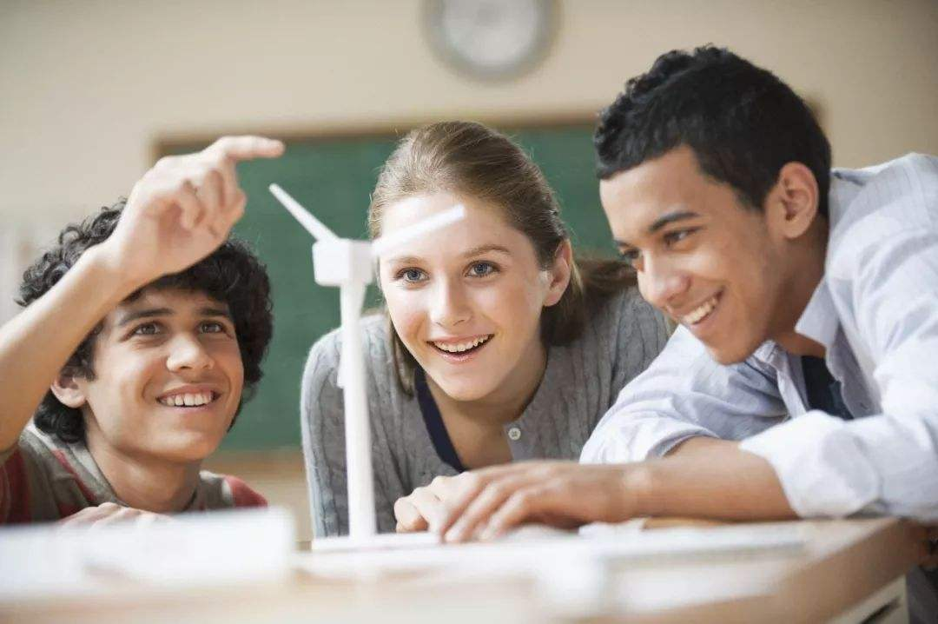
Teenage life
Bella

Slide 3
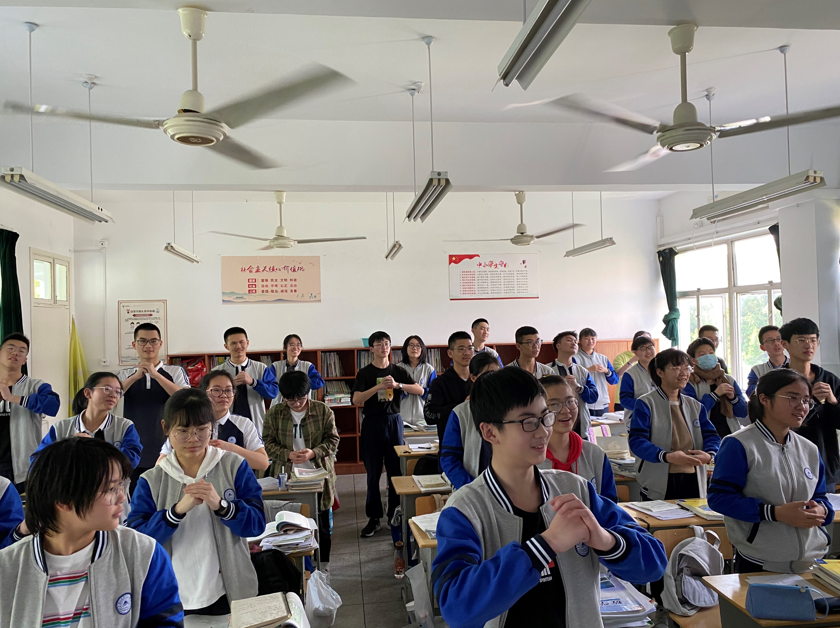
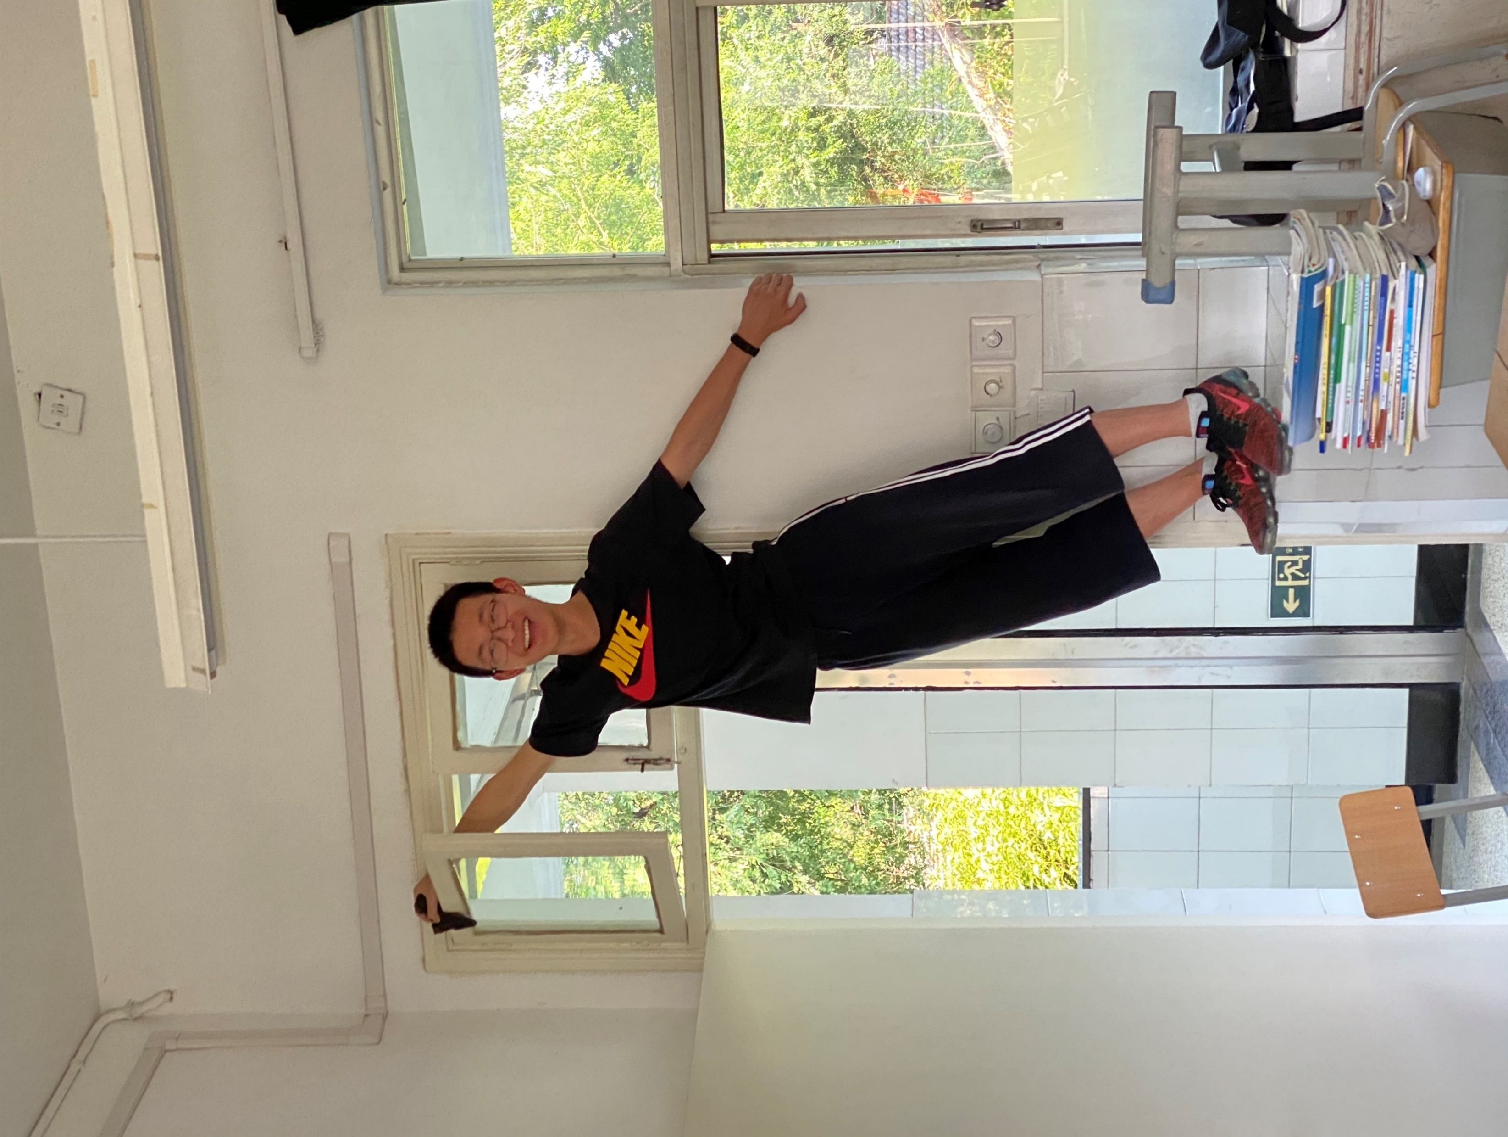
What do you know about school life in other countries?
What do you think of your freshman life?

Slide 4
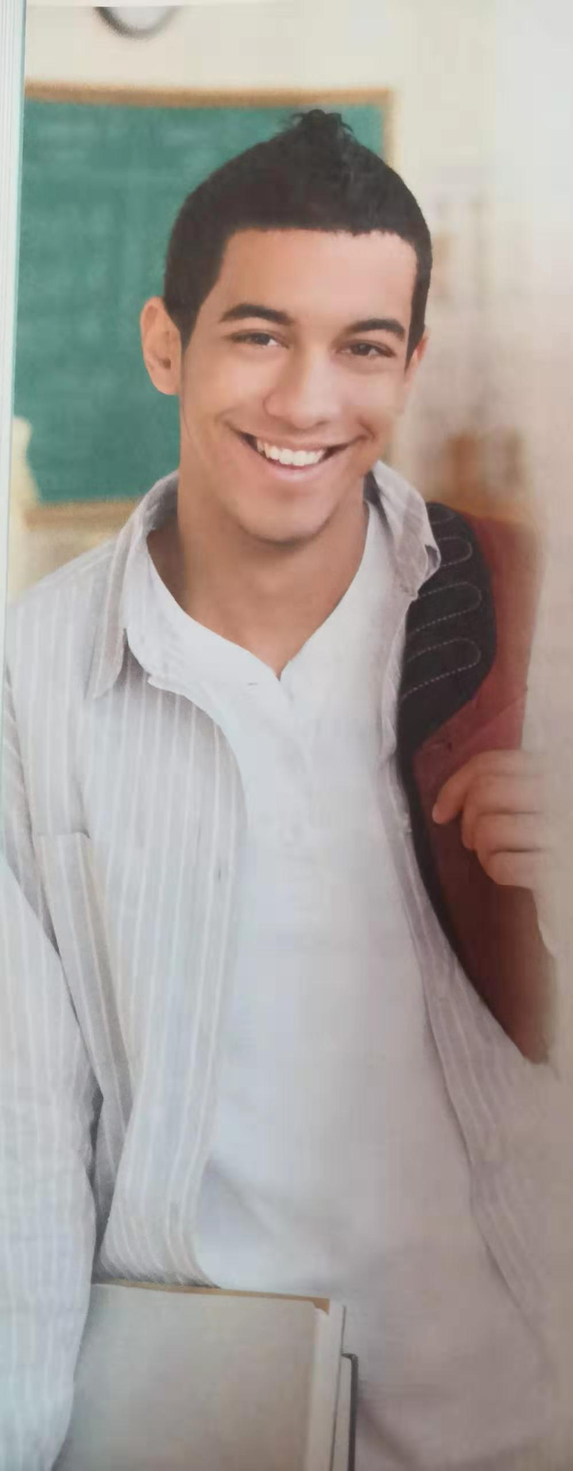
The freshman challenge
What do you want to know from the text?
Adam

Slide 5
What’s the main idea of each paragraph?
Skim the text and complete the form.
Paragraph | Main idea | How do you know?
Paragraph 1
Paragraph 2
Paragraph 3
Paragraph 4

Slide 6
How do you know?
Paragraph | Main idea
Paragraph 1
Paragraph 2
Paragraph 3
Paragraph 4
Senior high school is a challenge.
Adam had to think very carefully about taking suitable courses.
Adam had to choose extra-curricular activities.
Adam will have to study harder in the future and get used to being responsible for a lot more.

Slide 7
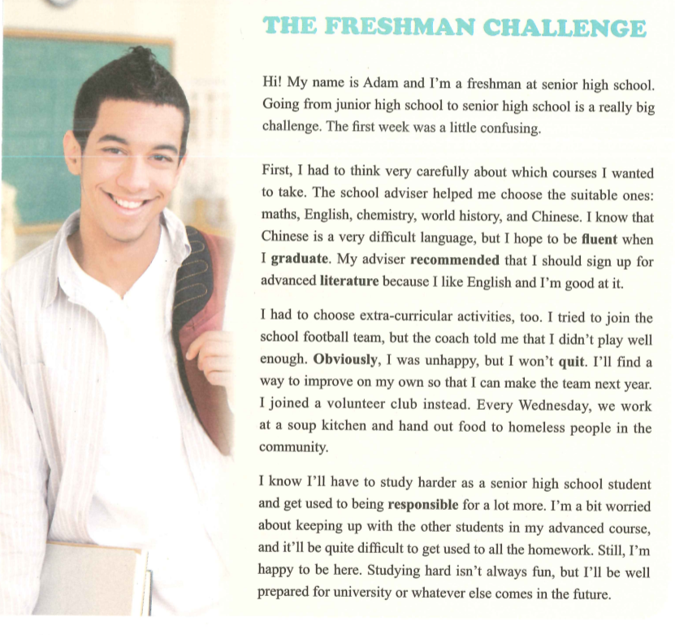
topic sentence
linking words
key phrases

Slide 8

Reading skill: Skimming
You can quickly find main ideas and the whole structure by first taking a quick look at the title, picture(s), key words and phrases, and topic sentences.

Slide 9

share your answers to the questions you raised

Slide 10
share your answers to the questions you raised
What: challenge | How: feeling | How: solution
difficult subjects | difficult but hopeful | school adviser; recommended; sign up for
make the school football team | unhappy but determined | improve himself; joined … instead
study | worried and stressed but happy and confident | study harder; be responsible; be well prepared

Slide 11
How does Adam organize every challenge?
Hi! My name is Adam and Fm a freshman at senior high school. Going from junior high school to senior high school is a really big challenge. The first week was a little confusing.
First, I had to think very carefully about which courses I wanted to take. The school adviser helped me choose the suitable ones: maths, English, chemistry, world history, and Chinese. I know that Chinese is a very difficult language, but I hope to be fluent when I graduate. My adviser recommended that I should sign up for advanced literature because I like English and I’m good at it.
I had to choose extra-curricular activities, too. I tried to join the school football team, but the coach told me that I didn’t play well enough. Obviously, I was unhappy, but I won’t quit. I’ll find a way to improve on my own so that I can make the team next year. I joined a volunteer club instead. Every Wednesday, we work at a soup kitchen and hand out food to homeless people in the community.
I know l’ll have to study harder as a senior high school student and get used to being responsible for a lot more. I’m a bit worried about keeping up with the other students in my advanced course, and it’ll be quite difficult to get used to all the homework. Still, I’m happy to be here. Studying hard isn’t always fun, but I’ll be well prepared for university or whatever else comes in the future.
Hi! My name is Adam and Fm a freshman at senior high school. Going from junior high school to senior high school is a really big challenge. The first week was a little confusing.
First, I had to think very carefully about which courses I wanted to take. The school adviser helped me choose the suitable ones: maths, English, chemistry, world history, and Chinese. I know that Chinese is a very difficult language, but I hope to be fluent when I graduate. My adviser recommended that I should sign up for advanced literature because I like English and I’m good at it.
I had to choose extra-curricular activities, too. I tried to join the school football team, but the coach told me that I didn’t play well enough. Obviously, I was unhappy, but I won’t quit. I’ll find a way to improve on my own so that I can make the team next year. I joined a volunteer club instead. Every Wednesday, we work at a soup kitchen and hand out food to homeless people in the community.
I know l’ll have to study harder as a senior high school student and get used to being responsible for a lot more. I’m a bit worried about keeping up with the other students in my advanced course, and it’ll be quite difficult to get used to all the homework. Still, I’m happy to be here. Studying hard isn’t always fun, but I’ll be well prepared for university or whatever else comes in the future.
Hi! My name is Adam and Fm a freshman at senior high school. Going from junior high school to senior high school is a really big challenge. The first week was a little confusing.
First, I had to think very carefully about which courses I wanted to take. The school adviser helped me choose the suitable ones: maths, English, chemistry, world history, and Chinese. I know that Chinese is a very difficult language, but I hope to be fluent when I graduate. My adviser recommended that I should sign up for advanced literature because I like English and I’m good at it.
I had to choose extra-curricular activities, too. I tried to join the school football team, but the coach told me that I didn’t play well enough. Obviously, I was unhappy, but I won’t quit. I’ll find a way to improve on my own so that I can make the team next year. I joined a volunteer club instead. Every Wednesday, we work at a soup kitchen and hand out food to homeless people in the community.
I know l’ll have to study harder as a senior high school student and get used to being responsible for a lot more. I’m a bit worried about keeping up with the other students in my advanced course, and it’ll be quite difficult to get used to all the homework. Still, I’m happy to be here. Studying hard isn’t always fun, but I’ll be well prepared for university or whatever else comes in the future.
specific example
clear feelings

Slide 12

Which paragraph/sentence/phrase/word do you like most? Why?
What’s your favorite part? | Why do you like it?

Slide 13
Which paragraph/sentence/phrase word do you like most?
I know … is difficult, but I hope to be fluent ...
…, but I won’t quit. I’ll find a way to improve …
Contrast
?
Still, I’m happy to be here.
…isn’t always fun, but I’ll be well prepared for…
His positive attitude towards challenges in senior high school

Slide 14


How do you think Adam’s story can help you in your future senior high school life?
Life in senior high school is full of challenges.
We should explore and experience it in a positive way to get prepared for whatever comes in our future.

Slide 15

Think
What are some differences between Adam's school life and your school life?

Slide 16
Discussion
Do you face the same challenges as Adam? What other challenges are you facing? How do you deal with them?
Like Adam, I also have to…
Unlike Adam, I don’t have to…
My solution to this challenge is to…

Slide 17
Assignment
Please write a short passage to share your own challenges as a freshman at senior high school. And add your attitude towards the challenges as a conclusion. You’re expected to use the words and expressions in the passage.
Hi! My name is _______ and I’m a freshman at XXXX School. Going from junior high school to senior high school is a really big challenge. The first week was _______.
Requirements:
logical structure: linking words; topic sentence
detailed description: examples for specific challenge and solution
clear feelings: feeling words

Slide 18
One Possible Version
Hi, my name is Jane and I’m a freshman at Quzhou No.2 High School in ZheJiang Province. Going from junior high school to senior high school is a really big challenge. The first week was difficult to adapt but exciting.
First, I had to adjust myself to the routine here, which was totally different from that in the junior high school. The time of classes has significantly changed from 5 hours to nearly 9 hours and at first the 4 extra hours of learning nearly freaked me out. But as time went by I gradually got used to the new schedule and really devoted myself to studying harder. Another big shift lay in the increased time of autonomous learning. At the beginning it was difficult to have my time well-organized. However, our head teacher recommended us that we should arrange our schedules in advance by writing a to-do list everyday, which truly helped me keep up with the new routine in senior high school.

Slide 19
Also, every day I had to face mountainous homework assigned by different teachers and some of them were exactly hard to complete. The increase in variety of the class and its complexity really made me at a loss. Therefore, piles of assignment usually took up most of my time, leaving me with little time to review and preview lessons. Later, under the guidance of teachers, I redesigned my learning methods--- I would always review lessons learned before doing homework and it obviously turned out to be an effective method as my understanding of the knowledge and efficiency greatly improved.
Furthermore, I had to get familiar with new classmates and teachers. Though it took much effort and time, that still gave me a hint of excitement. What further excited me was that I was selected to be the monitor of the class and I know it means I must be responsible for all classmates and be obliged to give them a hand whenever they need help.
The first week is not that easy and pleasant, but I know I have to embrace all the challenges. I’m sure I will get better prepared for my new journey and that nothing will ever pull me down if I face difficulties positively.

Slide 20
