Slide 1

感恩遇见，相互成就，本课件资料仅供您个人参考、教学使用，严禁自行在网络传播，违者依知识产权法追究法律责任。
更多教学资源请关注
公众号：溯恩高中英语
知识产权声明

Slide 2

2020年7月高考浙江卷英语试题精听
语音分析
佳诚高级中学
焦海滨老师制作

Slide 3


影响听力的因素
心理因素学生在进行听力练习或考试时往往表现为听音时感到紧张、焦虑因而导致无法正常听音。
缺乏背景知识由于没有语言环境，学生很少了解听力材料中的背景知识，无法做出正确的判断、推理、猜测。
学生缺乏听力解题技巧研究发现，很多情况下由于听者未能掌握相关的听力技巧，因而不能很好地理解听力材料。
词汇储备不足一个学生的听、说、读、写要达到一定的水平，必须拥有相应数量的必备词汇。

Slide 4

语音知识对听力的影响
在听力理解的过程中，语音是第一位的，听者首先接受的是语音信息，大脑接受了因素，音节，中音等因素构成的单词，短语和句子后使他们在自己的语言图式中“对号入座”，根据已有的知识结构( 图式 ),开始对该信息进行建构，以理解其意义。

Slide 5
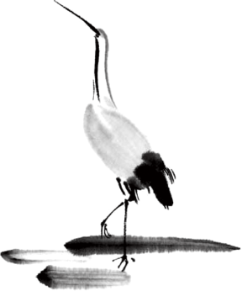
2020年元月的听力试题163词/分( 比2019年6月每分钟快12词）
语速的加快主要有一下三种原因
壹
贰
叁
连读
（ 以下用红色标记 )
省音
（ 以下用蓝色标记 ）
音变
（以下用绿色标记 ）

Slide 6



一，连读 （ 以下用红色标记 )
1，“辅音+元音”型连读（异性相吸）
如：I’d like another bowl of rice.
2、“辅音+半元音”型连读英语语音中的/j/和/w/是半元音，如果前一个词是以辅音结尾，后一个词是以半元音，特别是/j/开头，此时也要连读。Thank you .

Slide 7

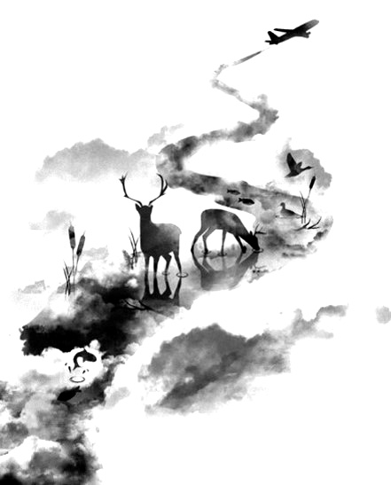

二，省音 （以下用蓝色标记）
01
壹
一、爆破音/b/ /p/ /d/ /t/ /g/ /k/
1.以上任何一个爆破音后面如果紧接着是一个辅音或者半元音，那么这个爆破音将不再发音，仅空半拍就行。如：Good morning!可以发为/gu_'mɔ:niŋ/。
2.以上任何一个爆破音在句尾时，这个爆破音不再发音。如：Good night!最后的/t/音便不再发，整句话可读作/gu_nai_/。

Slide 8
省音 （以下用蓝色标记）
01
二、不完全爆破
① 爆破音中的任何两个爆破音相邻时，前一爆破音失去爆破。如：a big car等。
② 爆破音中的任何一个后接摩擦音f,h,x,sh,s,r时，前面的爆破音失去爆破。
如：I didn't say so.
③ 爆破音后接/t/， /d/， /tr/， /dr /时，前面的爆破音失去爆破。如：a great change等。
④ 爆破音后接/m/, /n/, /l/, /s/时，前面的爆破音失去爆破。如：a bit more expensive等。

Slide 9
省音 （以下用蓝色标记）
01
三、/s/-/z/ /ts/-/dz/ /∫/-/ ʒ / /t∫/-/ dʒ / /θ/-/ ð / ds发/dz以上任何两个音相遇，只读后面的那个音，而前面的音则省略不发。
如：Who is Stone?可把前面一个/z/省掉，只读作/hu i stəun /。

Slide 10
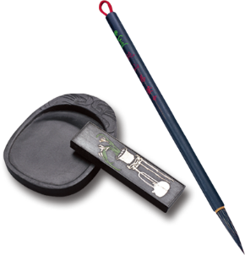
音的变化也是一种连读现象，两个词之间非常平滑的
过渡，导致一个音受临音影响而变化。
主要是以下两种方式：
1、 辅音[d]与[j]相邻时，被同化为[dʒ]：
Would you....?
2、 辅音[t]与[j]相邻时，被同化为[t∫]：
Can’t you？
三，音变
（以下用黄色标记 ）

Slide 11
听力试音材料
M:Hello ! International Friends Club , can I help you ?
W: Oh , hello ! I read about your club in the paper today . And I thought I’d phone to find out a bit more .
M:Yes , certainly . well , we’re a sort of social club for people from different countries . It’s quite a new club .we have about 50 members at the moment but we’re growing all the time .

Slide 12
听力试音材料
W: That sounds interesting .I’m British actually ,and I came to Washington about three months ago ,I’m looking for ways to meet people . . Er ,what kinds of events do you organize ?
M: well , we have social get-togethers ,and sports events ,and we also have language evenings
W: Could you tell me something about the language evenings ?

Slide 13
听力试音材料
M: Yes , every day except Thursday , we have a language evening. People can come and practice their languages .you know , over a drink or something .we have different languages on different evenings . Monday -Spanish; Tuesday- Italian ;Wednesday- German and Friday- French .On Thursday we usually have a meal in a restaurant for everyone who wants to come .

Slide 14
听力试音材料
W:well,that sounds Great , I really need to practice my French .
M: Ok , well if you can just give me your name and address I’ll send you the form and some more
and 的d省掉之后，字母n和后面的字母a连读了。Name and address其实是这样拆分的（ na mea na ddress )
information .If you join now ,you can have first month free .

Slide 15


例题
M:Excuse me ,can you tell me how much the shirt is ?
W：Yes, it’s nine-fifteen.
例：How much is the shirt?
A. ￡19.15. B. ￡9.18. C. ￡9.15.

Slide 16


Text 1 举办晚宴
M: Who will join us for dinner tonight?
W: Bob and Candy. I also invited Mary, but she is out of town.
M: What a pity! I was hoping she would come.
1. What will the speakers do tonight?
Visit Mary.
Go out of town.
C. Host a dinner.

Slide 17


Text 2 送孩子上学
——————————
M: If I were you, I’d just walk to work. It would take you about 20 minutes.
Riding a bike is a good choice, too.
W: I agree. But this week my husband is away on business, so I have to drive my kids to school before I go to work, and pressed for time, you know.
2. How does the woman go to work this week?
By car.
B. By bike.
C. On foot.

Slide 18

Text 3开会迟到
W: It’s 8:30, Dave, and you’re going to be late for the meeting.
M: Oh, my! I just have half an hour left. I can’t believe I slept for 10 hours.
3. What time does Dave's meeting start?
At 8：30.
B. At 9：00.
C. At 10：00.
天人合一
天 下 皆 知 美 之 为 美 ， 斯 恶 已
皆 知 善 之 为 善 ， 斯 不 善 已
有 无 相 生 ， 难 易 相 成 ， 长 短 相 形
高 下 相 盈 ， 音 声 相 和 ， 前 后 相 随
恒 也

Slide 19

Text 4 去图书馆学习
M: Hi, Helen. Where are you off to?
W: To the library. I’ve got a history paper due next week, and need to do some reading.
4. What is Helen going to do?
Buy some books.
B. Study in the library.
C. Attend a history class.

Slide 20
Text 5 签署文件
W: Thank goodness! You’re still here.
M: What’s up?
W: I need your signature for this document. It’s urgent.
5. What is the woman's feeling now?
Relief.
B. Regret.
C. Embarrassment.

Slide 21
Text 6 参加旅游节
W: Are you all alone, Tom? Why not ask Mike to help you collect money for the Children’s Centre?
M: Well, he’s working on his lab report. Could you come?
W: I’d love to, but I won’t be available until next week. I think Kathy will have some free time this week. Do you want me to pass on a message?
M: That would be nice. Thanks, Jane.
6. What is Tom busy doing?
A. Raising money. B. Writing a lab report. C. Giving classes to children.
7. Who might be able to help Tom this week?
A. Mike. B. Cathy. C. Jane.

Slide 22
Text 7候车期间做的事
W: Are you leaving for the railway station now, Jack? It’s so early.
M: Just avoiding the rush hour traffic. I don’t want to be late.
W: So you have to wait for about two hours? I don’t think there’s scenery to
look at.
M: Don’t worry! I’ll take a book with me .
W: It’s too noisy to read in the railway station. I would usually look around the shops while waiting for the train.
M: But I’ve already got all the gifts for my parents and sisters. I don’t need to buy anything. If I really can’t focus on the book, I may phone up some friends I haven’t talked to in a while.

Slide 23
——————————
W: That’s a nice idea. Betty told me last time that she often spends the waiting time writing a to-do list so that she’ll not miss anything in the days to come.
M: That’s an awesome idea. I’ll surely do that. Thank you, Judy. See you next year, bye!
8. Why is Jack leaving early?
A. To avoid getting stuck in traffic.
B. To enjoy the scenery on the way.
C. To buy some gifts for his family.

Slide 24
9. What does Judy often do at the railway station?
Read books.
B. Call some friends.
C. Look around the shops.
10. What are the speakers mainly talking about?
A. What to do next year.
B. Where to go for vacations.
C. How to pass the waiting time.
天人合一
天 下 皆 知 美 之 为 美 ， 斯 恶 已
皆 知 善 之 为 善 ， 斯 不 善 已
有 无 相 生 ， 难 易 相 成 ， 长 短 相 形
高 下 相 盈 ， 音 声 相 和 ， 前 后 相 随
恒 也

Slide 25
Text 8艰难的决择
Text 8 W: Hi, Bill. You look troubled. What’s the matter?
M: Hi, Grace. I have a big decision to make. My uncle offered me a job as the lead engineer at a service station and with good pay.
W: That’s wonderful, but are you going to quit college?
M: That’s exactly the problem. One side of me says, “Oh, go ahead! You can go back to college anytime. What job could you get after college that would pay you $15 an hour? That’s $30,000 a year!”
W: And then?

Slide 26
M: And then, the other side says, “Hold it, not so fast! For all those years you were in the army, you planned to go to college so that you would have many job possibilities to choose from. You’ve planned your whole life around going to college. And now…
W: I can see it. It’s true that with your experience in the army, you could do excellent work repairing cars if you accept the job. But you are doing very well now. Just think of the future. You will get better jobs.

Slide 27

11. Why does Bill look troubled?
He is short of money.
B. He has made a big mistake.
C. He is facing a tough choice.
12. What is Bill now?
A college student.
B. An army officer.
C. A computer engineer.
13. What does the woman seem to suggest Bill do?
Learn to repair cars.
B. Decline the job offer.
C. Ask his uncle for advice.

Slide 28
Text Text 9读书俱乐部
W: Hey, John. Can I talk to you for a minute?
M: Sure, what’s up?
W: I want to let you know about a book club I joined a few months ago. I know you do a lot of reading, so I thought you might want to come with me next month.
M: Oh, that sounds like fun. When does the group meet?
W: Usually the last Saturday of the month at 7:30 in the evening. Is that too late for you?
M: No, I think that’s OK. What do you talk about in the group?
W: Well, every month we choose a new book, and then during the next meeting, we discuss it.

Slide 29
M: What books have you read?
W: Quite a lot. Recently we have read The Beautiful Mind and The Great Gatsby. Now we’re reading The Kite Runner.
M: The Kite Runner? I’ve heard that’s a good book. What’s it about?
W: It’s about a boy who grows up in Afghanistan during the 1980s.
M: That sounds interesting. I’d love to come.
W: Great! The next meeting will be held in two weeks, so you still have time to read the book.

Slide 30
14. What is the woman recommending to the man?
A writer.
B. A club.
C. A course.
15. What is the woman reading now?
The Beautiful Mind.
B. The Great Gatsby.
C. The Kite Runner.
16. How much time does the man have to read the book?
Two weeks.
B. Three weeks.
C. Four weeks.
——————————

Slide 31
Text 10 记笔记技巧
W: Today, let’s begin with note-taking techniques. Note-taking is an important skill not only for taking classes, but also for doing your job in the future. I’d like to draw your attention to certain points about taking notes. First, remember that note-taking should be 75% listening and only 25% writing, so don’t try to write down every single word the teacher says. Ignore what is unimportant and write in phrases not complete sentences. Second, leave spaces and lines between main ideas. You may want to add some information later. I find that some of you are very good at making use of color, mapping web and symbols such as arrows, circles and boxes. I highly recommend these tools to all of you, because the use of them makes the outline more easily readable and interesting than the blocks of text. It also makes sure that important words stand out. Here are some examples.

Slide 32
17. What is the speaker doing?
Reporting a study. B. Chairing a meeting.
C. Teaching a class.
18. What should you pay most attention to when taking notes?
Listening. B. Reading. C. Writing.
19. What is an advantage of using symbols in note-taking?
A. It keeps information secret.
B. It leaves space for future use.
C. It makes key words noticeable.
20. What will the speaker do next?
Ask a few questions.
B. Show some notes.
C. Make a summary.

Slide 33
欢迎指导
祝各位考生金榜题名！

