Slide 1

感恩遇见，相互成就，本课件资料仅供您个人参考、教学使用，严禁自行在网络传播，违者依知识产权法追究法律责任。
更多教学资源请关注
公众号：溯恩高中英语
知识产权声明

Slide 2
Unit 1 Teenage Life
网
Discovering Useful Structures
Noun Phrases Adjective Phrases Adverb phrases
衢州三中 孙玲
学

Slide 3
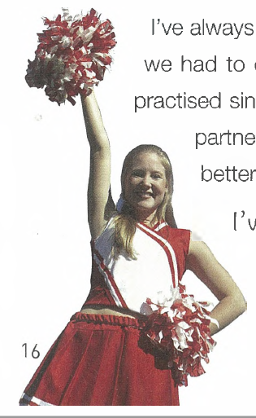
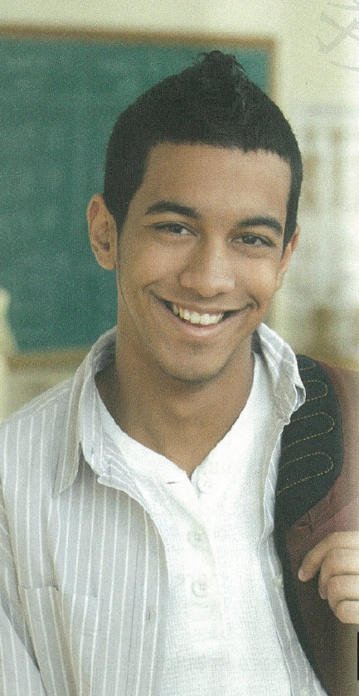
Hi, my name is Joyce.
I’m a student.
My school is beautiful.
I like it.
Hi, my name is Adam.
I’m a senior high school student of America.
My school is really beautiful with a lot of trees.
I like it very much
more informative
more detailed
more vivid（生动的）

Slide 4
What are phrases?
How are these phrases formed?

Slide 5
I’m a senior high school student of America
Noun Phrase(NP)
word group with a noun as its head word
名词短语：（限定词）+（形容词）+（描述性名词）+名词+（介词短语）
My English teacher is very helpful
I have joined some school clubs
teacher
clubs

Slide 6
My school is really beautiful with a lot of trees
Adjective Phrase (AdjP)
word group with an adjective as its head word
形容词短语：
（副词）+形容词+（介词短语）
The question is really very confusing
This lesson is so interesting
confusing
interesting

Slide 7
I like it very much
Adverb Phrase (NP)
word group with an adverb as its head word
副词短语：
（副词）+副词
He finished his homework very quickly
You did it quite well
quickly
well

Slide 8
Combine the following words to form noun/adjective/adverb phrases.
a/an difficult really test very teacher well much kind quite quickly so interesting lesson
Noun phrases（名词短语）: ____________________________________________________________________________________________
Adjective phrases（形容词短语）: ____________________________________________________________________________________________
Adverb phrases（副词短语）: ____________________________________________________________________________________________
a difficult test; an interesting test; a difficult lesson; an interesting lesson; a kind teacher
really/very/quite/so difficult; really/very/quite/so kind; really/very/quite/ so interesting
so/very/quite/really well; so/very/quite/really quickly; very/so much

Slide 9
Can you give me more examples of using noun/adjective/adverb phrases in sentences?

Slide 10
Find out noun /adjective /adverb phrases in Adam’s writing
Being a freshman at senior high school is a really big challenge.
2. It’s a little confusing to choose suitable courses and
extra-curricular activities.
3. To choose suitable courses, I have to think very carefully and ask the school adviser for help.
NP
AdjP
NP
AdjP
NP
NP
NP
AdvP
NP

Slide 11
4. My adviser recommended that I should sign up for advanced literature.
5. I have to study harder and be responsible for a lot more.
6. I’m a bit worried about keeping up with the other students in my advanced course.
NP
AdvP
AdjP
NP
NP

Slide 12
classmate
diet
teacher
school life
sports
homework
….
test
club
Joyce: Have you joined any club?
Adam: I have joined a volunteer club.
Joyce: Do you play football well?
Adam: I don’t play well enough.
…

Slide 13
I have just written a draft. Please help me to improve it by using noun/ adjective /adverb phrases to add more information.

Slide 14
Cheerleader Try-outs
I’ve always wanted to be a cheerleader. Yesterday, I tried out for the team. It was hard. First, we had to dance. The teacher showed us how to move, and then we tried. Second, we practiced singing a song about the school basketball team. Finally, some girls had to lift their partners. The other girls jumped and cheered. I think I did well, but the other girls were better. I'm not sure if I will make the team or not.

Slide 15
I’ve always wanted to be a cheerleader.
I’ve always wanted to be a high school cheerleader.
It was hard.
It was really hard.
We had to dance.
We had to dance very energetically and beautifully.
Tip1: Pay attention to nouns and add adj./n./prep. to make them into noun phrases.
Tip2: Pay attention to adjectives and add adv./prep. to make them into adjective phrases.
Tip3: Pay attention to verbs and add adverb phrases.

Slide 16
Suggested Answer:
I've always wanted to be a high schoolcheerleader. Yesterday, I tried out for my school's cheerleading team. It was really hard. First, we had to dance up and down around the basketball court for 20 minutes. The teacher showed us how to move, and then we tried very hard. Second, we practised singing a short fight song about the school basketball team. Finally, some of the stronger girls had to lift their partners. The other girls jumped very high and cheered so loudly. I think I did quite well in the try-out, but many of the other girls were even better. I'm not sure whether I'll make the cheerleading team this year or not.
more informative
more detailed
more vivid

Slide 17
Assignment
Write a passage about your school life and use as many noun/ adjective /adverb phrases as possible

Slide 18
Thank you!

