Slide 1
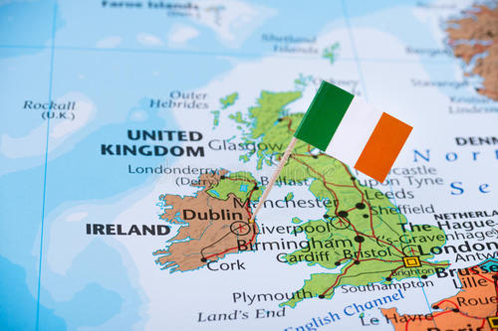
Beautiful Ireland and Its Traditions
----青田中学 叶新新

Slide 2
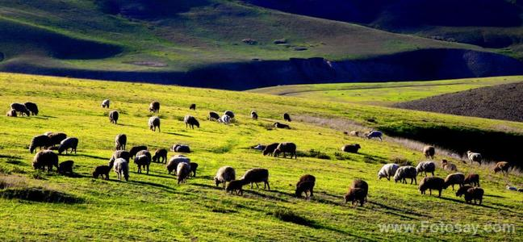
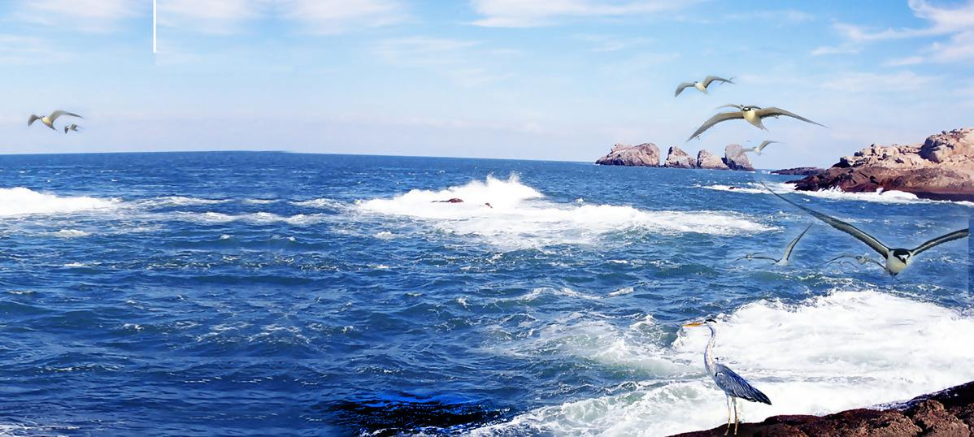
Look at the pictures of Ireland’s countryside and describe your first impression of the country.
beautiful

Slide 3
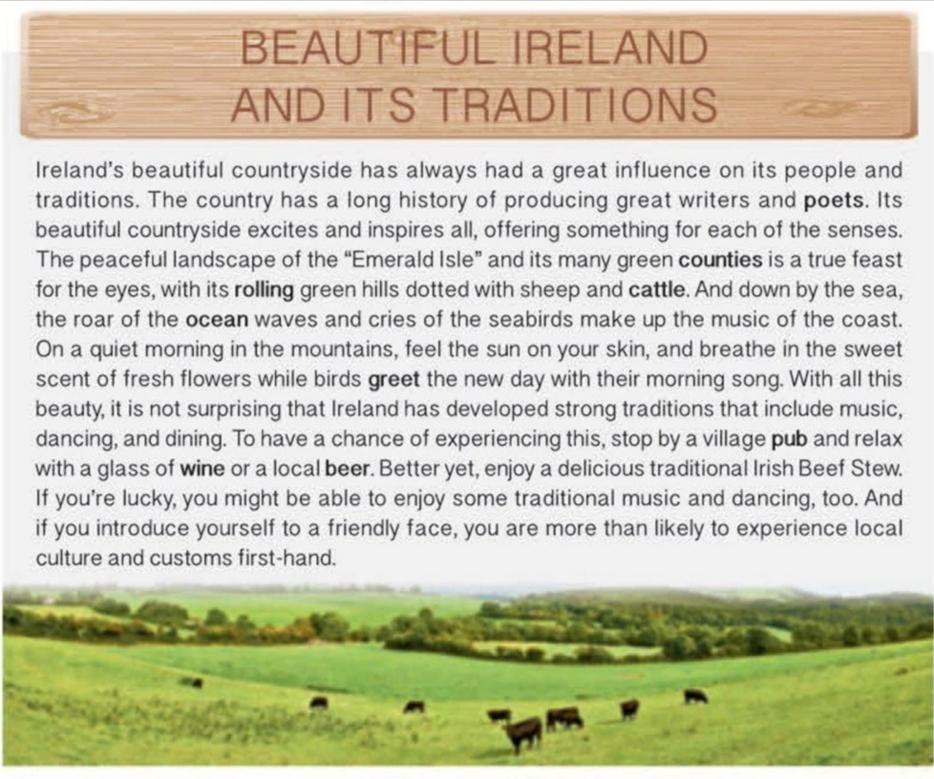
Fast reading
What's the topic sentence of the passage?

Slide 4
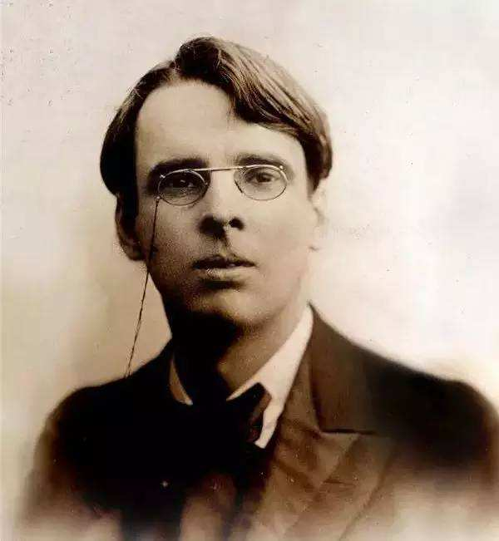
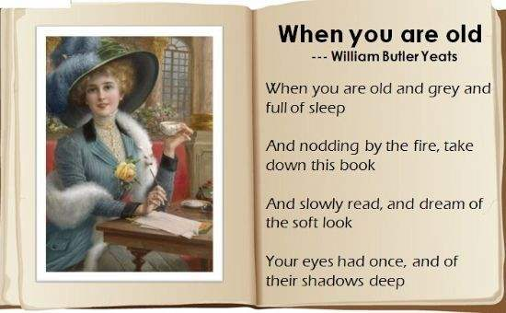
William Butler Yeats (叶芝）

Slide 5
Ireland’s beautiful countryside has always had a great influence on its people and traditions. The country has a long history of producing great writers and poets. Its beautiful countryside excites and inspires all, offering something for each of the senses. The peaceful landscape of the “Emerald Isle” and its many green counties is a true feast for the eyes, with its rolling green hills dotted with sheep and cattle. And down by the sea, the roar of the ocean waves and cries of the seabirds make up the music of the coast. On a quiet morning in the mountains, feel the sun on your skin, and breathe in the sweet scent of fresh flowers while birds greet the new day with their morning song. With all this beauty, it is not surprising that Ireland has developed strong traditions that include music, dancing, and dining. To have a chance of experiencing this, stop by a village pub and relax with a glass of wine or a local beer. Better yet, enjoy a delicious traditional Irish Beef Stew. If you are lucky, you might be able to enjoy some traditional music and the dancing, too. And if you introduce yourself to a friendly face, you are more than likely to experience local culture and customs first-hand.
Ireland’s beautiful countryside has always had a great influence on its people and traditions. The country has a long history of producing great writers and poets. Its beautiful countryside excites and inspires all, offering something for each of the senses. The peaceful landscape of the “Emerald Isle” and its many green counties is a true feast for the eyes, with its rolling green hills dotted with sheep and cattle. And down by the sea, the roar of the ocean waves and cries of the seabirds make up the music of the coast. On a quiet morning in the mountains, feel the sun on your skin, and breathe in the sweet scent of fresh flowers while birds greet the new day with their morning song. With all this beauty, it is not surprising that Ireland has developed strong traditions that include music, dancing, and dining. To have a chance of experiencing this, stop by a village pub and relax with a glass of wine or a local beer. Better yet, enjoy a delicious traditional Irish Beef Stew. If you are lucky, you might be able to enjoy some traditional music and the dancing, too. And if you introduce yourself to a friendly face, you are more than likely to experience local culture and customs first-hand.
Its beautiful countryside excites and inspires all, offering something for
each of the senses
If a country produces sb with a special quality, the person comes from that country 栽培，培养
Why are there so many great writers and poets in Ireland?

Slide 6
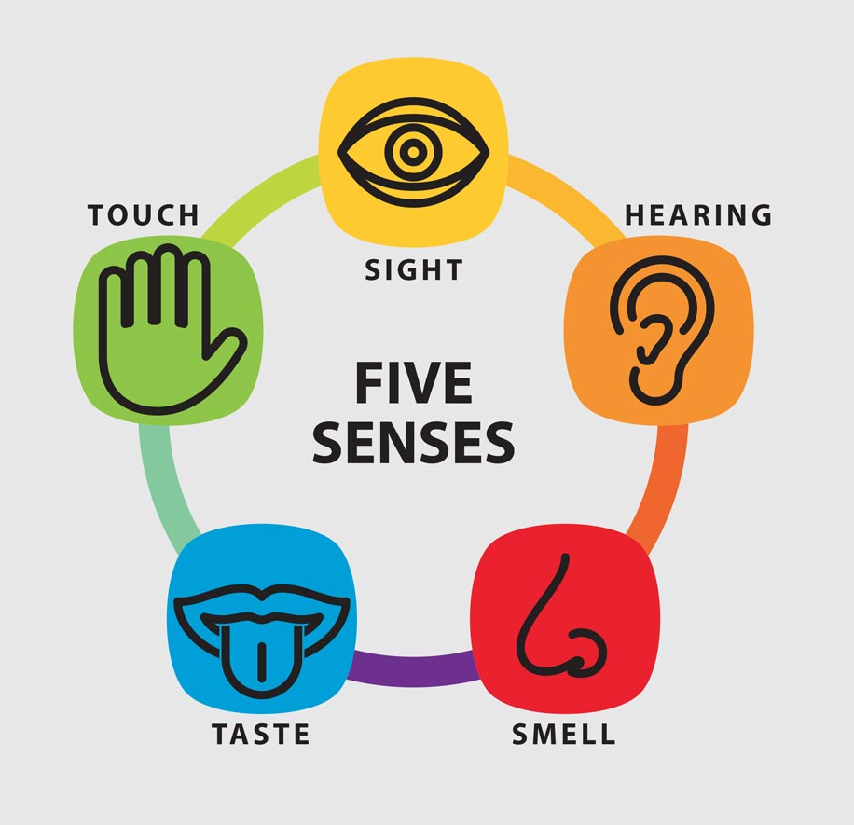
Task One:
The paragraph talks about different senses in different places. Write the senses and places in the order that they appear.
in the green counties and hills
Senses: 1____________ | Places: 1____________
2____________ | 2____________
3____________ | 3____________
4____________ | 4____________
sight
hearing
down by the sea
touch
in the mountains
smell
in the mountains

Slide 7
Ireland’s beautiful countryside has always had a great influence on its people and traditions. The country has a long history of producing great writers and poets. Its beautiful countryside excites and inspires all, offering something for each of the senses. The peaceful landscape of the “Emerald Isle” and its many green counties is a true feast for the eyes, with its rolling green hills dotted with sheep and cattle. And down by the sea, the roar of the ocean waves and cries of the seabirds make up the music of the coast. On a quiet morning in the mountains, feel the sun on your skin, and breathe in the sweet scent of fresh flowers while birds greet the new day with their morning song. With all this beauty, it is not surprising that Ireland has developed strong traditions that include music, dancing, and dining. To have a chance of experiencing this, stop by a village pub and relax with a glass of wine or a local beer. Better yet, enjoy a delicious traditional Irish Beef Stew. If you are lucky, you might be able to enjoy some traditional music and the dancing, too. And if you introduce yourself to a friendly face, you are more than likely to experience local culture and customs first-hand.
Ireland’s beautiful countryside has always had a great influence on its people and traditions. The country has a long history of producing great writers and poets. Its beautiful countryside excites and inspires all, offering something for each of the senses. The peaceful landscape of the “Emerald Isle” and its many green counties is a true feast for the eyes, with its rolling green hills dotted with sheep and cattle. And down by the sea, the roar of the ocean waves and cries of the seabirds make up the music of the coast. On a quiet morning in the mountains, feel the sun on your skin, and breathe in the sweet scent of fresh flowers while birds greet the new day with their morning song. With all this beauty, it is not surprising that Ireland has developed strong traditions that include music, dancing, and dining. To have a chance of experiencing this, stop by a village pub and relax with a glass of wine or a local beer. Better yet, enjoy a delicious traditional Irish Beef Stew. If you are lucky, you might be able to enjoy some traditional music and the dancing, too. And if you introduce yourself to a friendly face, you are more than likely to experience local culture and customs first-hand.
Ireland’s beautiful countryside has always had a great influence on its people and traditions. The country has a long history of producing great writers and poets. Its beautiful countryside excites and inspires all, offering something for each of the senses. The peaceful landscape of the “Emerald Isle” and its many green counties is a true feast for the eyes, with its rolling green hills dotted with sheep and cattle. And down by the sea, the roar of the ocean waves and cries of the seabirds make up the music of the coast. On a quiet morning in the mountains, feel the sun on your skin, and breathe in the sweet scent of fresh flowers while birds greet the new day with their morning song. With all this beauty, it is not surprising that Ireland has developed strong traditions that include music, dancing, and dining. To have a chance of experiencing this, stop by a village pub and relax with a glass of wine or a local beer. Better yet, enjoy a delicious traditional Irish Beef Stew. If you are lucky, you might be able to enjoy some traditional music and the dancing, too. And if you introduce yourself to a friendly face, you are more than likely to experience local culture and customs first-hand.
Ireland’s beautiful countryside has always had a great influence on its people and traditions. The country has a long history of producing great writers and poets. Its beautiful countryside excites and inspires all, offering something for each of the senses. The peaceful landscape of the “Emerald Isle” and its many green counties is a true feast for the eyes, with its rolling green hills dotted with sheep and cattle. And down by the sea, the roar of the ocean waves and cries of the seabirds make up the music of the coast. On a quiet morning in the mountains, feel the sun on your skin, and breathe in the sweet scent of fresh flowers while birds greet the new day with their morning song. With all this beauty, it is not surprising that Ireland has developed strong traditions that include music, dancing, and dining. To have a chance of experiencing this, stop by a village pub and relax with a glass of wine or a local beer. Better yet, enjoy a delicious traditional Irish Beef Stew. If you are lucky, you might be able to enjoy some traditional music and the dancing, too. And if you introduce yourself to a friendly face, you are more than likely to experience local culture and customs first-hand.
Ireland’s beautiful countryside has always had a great influence on its people and traditions. The country has a long history of producing great writers and poets. Its beautiful countryside excites and inspires all, offering something for each of the senses. The peaceful landscape of the “Emerald Isle” and its many green counties is a true feast for the eyes, with its rolling green hills dotted with sheep and cattle. And down by the sea, the roar of the ocean waves and cries of the seabirds make up the music of the coast. On a quiet morning in the mountains, feel the sun on your skin, and breathe in the sweet scent of fresh flowers while birds greet the new day with their morning song. With all this beauty, it is not surprising that Ireland has developed strong traditions that include music, dancing, and dining. To have a chance of experiencing this, stop by a village pub and relax with a glass of wine or a local beer. Better yet, enjoy a delicious traditional Irish Beef Stew. If you are lucky, you might be able to enjoy some traditional music and the dancing, too. And if you introduce yourself to a friendly face, you are more than likely to experience local culture and customs first-hand.
What words does the writer use to describe sensory details?
sight
hearing
touch
smell
Tip1: Good writers use personification to make the description more vivid.
What is the rhetorical device?
Tip2：Good writers use sensory details which describe something according to one or more of the five senses: taste, smell, touch, hearing, and sight.

Slide 8
Ireland’s beautiful countryside has always had a great influence on its people and traditions. The country has a long history of producing great writers and poets. Its beautiful countryside excites and inspires all, offering something for each of the senses. The peaceful landscape of the “Emerald Isle” and its many green counties is a true feast for the eyes, with its rolling green hills dotted with sheep and cattle. And down by the sea, the roar of the ocean waves and cries of the seabirds make up the music of the coast. On a quiet morning in the mountains, feel the sun on your skin, and breathe in the sweet scent of fresh flowers while birds greet the new day with their morning song. With all this beauty, it is not surprising that Ireland has developed strong traditions that include music, dancing, and dining. To have a chance of experiencing this, stop by a village pub and relax with a glass of wine or a local beer. Better yet, enjoy a delicious traditional Irish Beef Stew. If you are lucky, you might be able to enjoy some traditional music and the dancing, too. And if you introduce yourself to a friendly face, you are more than likely to experience local culture and customs first-hand.
The beautiful countryside is a true feast for all senses.
transitional sentence
Tip3：Good writers use transitional sentence to make the passage more coherent.

Slide 9
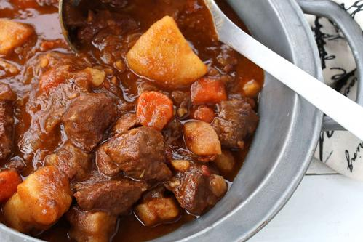
What are the best ways to experience some Irish traditions and culture?
1) stop by a ___________and relax with ______________or ___________.
village pub
a glass of wine
a local beer
2) enjoy a delicious _______________________
traditional Irish Beef Stew
3) enjoy some _______________and the________
traditional music
dancing
4) introduce yourself to _______________
a friendly face
The local culture and customs are something that needs to be ___________ first-hand.
experienced

Slide 10
Task two:
Sort each sensory words according to the sense that is related to.
bitter bright buzzing(昆虫嗡嗡声) murmuring cloudy fruity shining fragrant(芳香的) salty rough
wet cry earthly smell(泥土般气味) rolling roar
scented sweet humming(嗡嗡声) glistening howling rustling(沙沙声) stroke through the hair kiss on the cheek
smell
hearing
taste
touch
sight
Notes:
Related to 单词有个小错误。然后这里可以归类一下，把这些expressions放到各自的类别里去。

Slide 11
Ireland’s beautiful countryside has always had a great influence on its people and traditions. The country has a long history of producing great writers and poets.
Its beautiful countryside excites and inspires all, offering something for each of the senses. The peaceful landscape of the “Emerald Isle” and its many green counties(视觉) is a true feast for the eyes, with its rolling green hills dotted with sheep and cattle(视觉). And down by the sea, the roar of the ocean waves and cries of the seabirds make up the music of the coast(听觉). On a quiet morning in the mountains, feel the sun on your skin(触觉), and breathe in the sweet scent（嗅觉） of fresh flowers while birds greet the new day with their morning song. With all this beauty, it is not surprising that Ireland has developed stron
Imitative writing 仿写

Slide 12
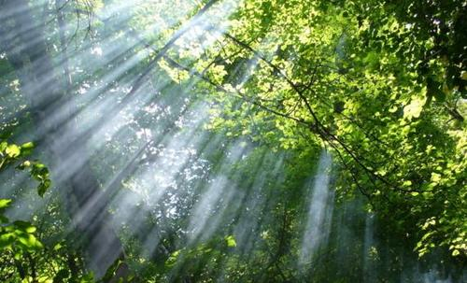
Imitating writing 模仿写作
[Tell] Nature was calm and peaceful
[Show]
It was a cool(触觉) and fresh(嗅觉) morning. The sky is clear and clean(视觉). A gentle breeze whistled(听觉) through the bushes and trees, mixed with scents(嗅觉) of the wild flowers.

Slide 13

Assignment：
[Tell]: The West Lake is beautiful.
[Show] When the night falls, the West Lake is really fascinating. High above the sky are a lot of bright shiny stars , and the glistening moon is specially clear.(视觉) The water in the lake is as even as a mirror with reflections of hills and trees alongside the lakeshore. Branches of the willows are singing a soft song in the evening breeze.(听觉) Walking for a short distance, with the wind stroking through your hair (触觉)and the faint sweet smell(嗅觉) wafted along, you can be fully immersed in this charming peace.

