Slide 1

感恩遇见，相互成就，本课件资料仅供您个人参考、教学使用，严禁自行在网络传播，违者依知识产权法追究法律责任。
更多教学资源请关注
公众号：溯恩高中英语
知识产权声明

Slide 2
Welcome Unit
Listening & Speaking
2020/08/05
浙师大附中 Lynn

Slide 3
We're expected to
01
listen for key words and detailed information;
02
listen to make reasonable inferences;
03
introduce ourselves and greet others properly.

Slide 4
Warming Up
Part 1

Slide 5

✿Where do you think these students are?
✿How do you think they feel?
✿How do you feel on the first day of school?
What make you feel so？
I feel excited because I will start a new life.
I feel uncertain because I am not sure what to expect.
I feel nervous because I will get to know new people.
......

Slide 6
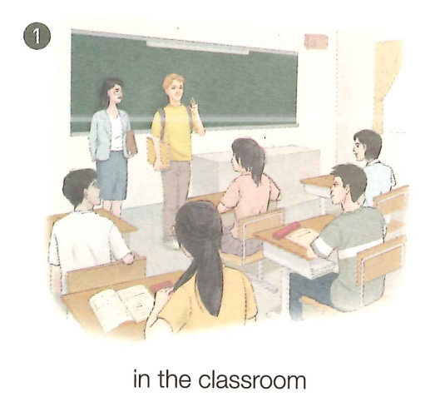
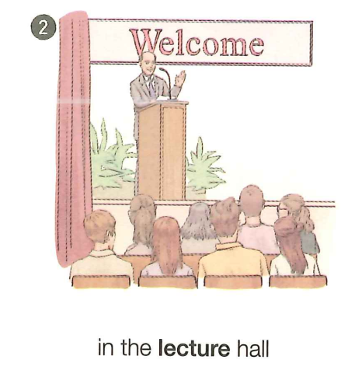
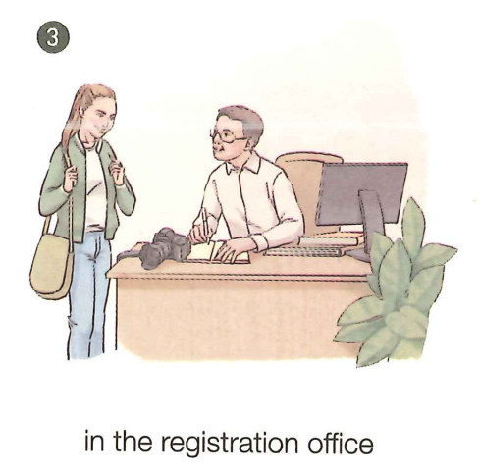
✿What kinds of new people will you meet on the first day of school?
The headmaster. /The teachers. /The classmates...
✿Describe what the people in the pictures are doing.
Match the pictures with sentences.
A boy is in the front of a classroom with a woman teacher standing by. Some students are sitting by their desks. Maybe the boy is introducing himself. B
In a lecture hall, a formally dressed man is standing on the stage behind a microphone. Some people are sitting in chairs and listening to him. Maybe he is giving a welcome speech. C
It is in the registration office. A man is sitting by his desk and a girl is talking with him. A

Slide 7
Listening
Part 2
So in picture 3, Amy is applying for a student ID card from the man. What will they say? Let's come to Conversation 1.

Slide 8
✿Listen to Conversation 1 and complete the table.
1 | REGISTRATION
2 | Student No. | Name |  | Sex | Nationality | Grade | Email
3 |  | Amy |  | Female
170143
Jones
the USA
1/One
amyj16@
pep.com.cn
✿What are they doing at the end of the conversation?
How do you know?
Now, stand over here, please. Smile!
There is a sound of flash as a photo is taken.
There is a camera on the desk in picture 3.

Slide 9
Then Amy meets Max, an exchange student, in the dining hall. What will they talk about? Let's come to Conversation 2.
✿Can you guess what they will talk about?
✿ Listen to Conversation 2 and tick their favorite subjects.
Subject | Chinese | Maths | English | Chemistry | Physics
Max’s favorite
Amy’s favorite
√
√
✿How does Max think of Maths?
How does Amy think of Chemistry?
✿What's your favorite subject and why?
more difficult but really interesting
fun

Slide 10
✿ Listen to Conversation 3 to make out Amy's dream job and the
advice she has got from the school adviser.
When it comes to choosing courses, western senior high students will turn to a school adviser for advice.
1. What does Amy want to be in the future?
A. An engineer. B. A designer. C. A writer.
2. What course will Amy probably choose?
A. English. B. IT. C. Art.
√
√
✿What other courses do you think Ms Li will advise Amy to choose?
Why?
e.g. The theory of designing, for theory is the basis for practice.

Slide 11
Speak in a more polite way in formal situations.
Getting to know new people
conversation | topic | introduction | greetings & responses | relationship | language style
1
2
3
My name is...
I'm...
registration
Good morning.
Nice to meet you.
teacher &
student
more
polite
/
favorite
subjects
Hi, Amy. How's it going?
Great. How about you?
more
casual
classmates
/
courses to
choose
Good morning.
Morning.
teacher &
student
more
polite

Slide 12
Speaking
Part 3
Come up with more ways of introductions, greetings and responses.

Slide 13
Brainstorming
Introductions
Greetings
Responses
1. Morning!
2. Nice/Glad to meet you, too.
3. Hi/Hey!
4. Great!
5. Not much.
6. I'm fine, and you?
7. Very well, thank you.
8. Fine, thanks.
1. My name is...
2. I'm...
3. This is...
4. Have you met...?
5. Do you know...?
6. May I introduce...?
7. I'd like to meet...
8. I don't believe
you know...
1. Good morning!
2. Nice/Glad to meet you.
3. Hi/Hello!
4. How's it going?
5. What's up?
6. How are things going?
7. How are you?
8. How are you doing?

Slide 14
Situation 1
A boy meets a girl during a break.
1. Choose one situation;
2. Make a conversation
with partners;
3. Use proper introductions
and greetings.
Situation 2
An exchange student is talking to a teacher on campus.
Situation 3
A boy and a girl are at the airport to meet a visiting group of teachers and students from England.
Pair Work

Slide 15
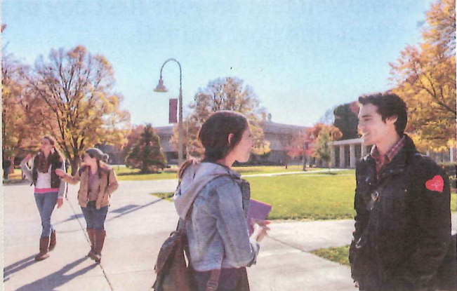
Sharing Time

Slide 16
In this class, we...
01
learned to listen for key words and detailed information;
02
learned to make reasonable inferences after listening;
03
learned to introduce ourselves and greet others properly.

Slide 17
Assignment
1.Think of another situation on your first senior
high school day and make a conversation to
introduce yourselves and greet others properly.
2. Finish the “Pronunciation” part on Page 3.

Slide 18
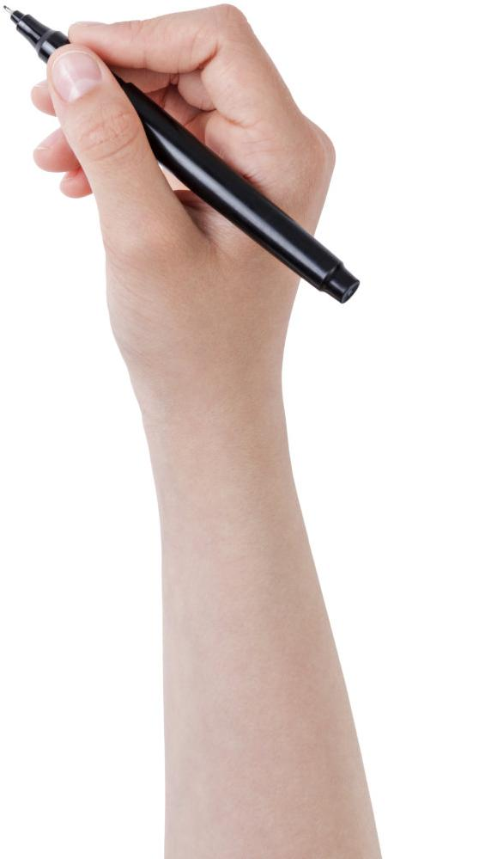
Thanks！

