Slide 1


感恩遇见，相互成就，本课件资料仅供您个人参考、教学使用，严禁自行在网络传播，违者依知识产权法追究法律责任。
更多教学资源请关注
公众号：溯恩高中英语
知识产权声明

Slide 2


约 稿 信

Slide 3
文体概述
article
约稿信是向某作者发出为某杂志、报刊等撰写稿件的请求信件。包括四个部分：
（1）栏目介绍；
（2）稿件内容；
（3）稿件长度；
（4）交稿日期。
约稿信属于书信的一种，考生应把握好书信的固定格式和得体的寒暄用语。
column
be about XX; be related to ;
be connected with
concern;cover; involve; contain;include
字数
Deadline; before XX;be supposed to submit
To whom
tone
Get to points
A proper ending

Slide 4
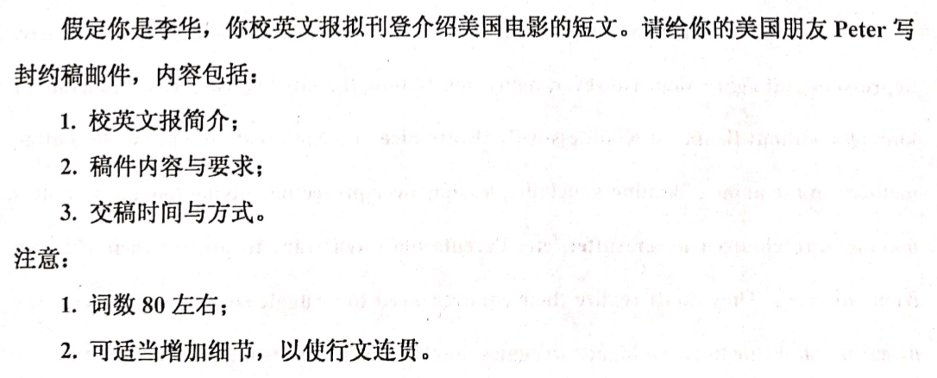

实例示范
tone
formal
informal
I would appreciate it if you submit your article.
It would be appreciated that…
Would you please write something about XXX？
It would be better if we have your article before June 1st .

Slide 5
内容操练
1.校英文报简介
开 头
On hearing the news that…, I can’t wait to tell you about sth.
I would like to invite you to write an article for our school’s English newspaper.
I wonder If you could write something about Chinese poems.
Would/could you please write something about/concerning the culture in your part of America?
eg:I would like to invite you to write an article in our School’s English newspaper. It is very popular among students.
Be related to
Be linked to in regard to be connected with in the way of concerning regarding in connection with

Slide 6
内容操练
2.稿件内容与要求
主 体
The Foreign Culture section where you are expected to contribute articles on our newspaper is very popular among us students.
We would especially welcome articles about how Americans spend their holidays ,festivals and the everyday life of American senior high students.
翻译：任何与此相关的文章都可以
eg: Would/could you please write something concerning American films and the film industry. It will help us understand how the industry has developed into big business.
Add the detail
the importance
You can write anything relevant to XXX.
Anything relevant to XXX is welcomed.

Slide 7
内容操练
3.交稿时间与方式
主 体
4.翻译：字数三百字就可以
4.About 300 words is ok.
Within 300 words would be fine.
You are supposed to write the article within 300 words.
Your article is supposed to be written about 300 words.
5.翻译：截至日期为6月1号
The deadline is due on June 1st .
It would be better if we have your article before June 1st .
We will extend the deadline if you consider the time is not enough.

Slide 8

内容整合
I would like to invite you to write an article in our School’s English newspaper. It is very popular among students.
I would like to invite you to write an article in our School’s English newspaper , which is very popular among students.
Use attributive clause
The politeness should be expressed throughout the text.
Would/could you please write something concerning American films and the film industry. It will help us understand how the industry has developed into big business.
Would/could you please write something concerning American films and the film industry. It will help us understand how the industry has developed into big business as it is today.
Make it more specific
It would be better if we have your article before Dec. 10 . About 400 words would be fine.
Use inanimate subject

Slide 9
结 尾
I’m looking forward to hearing from you soon!
I would appreciate it if you could give me a reply as soon as possible.
开 头
朋 友 之 间
Knowing that…., I’m writing to…
I’m writing the letter to invite you to…
How is everything going (with you)?

Slide 10
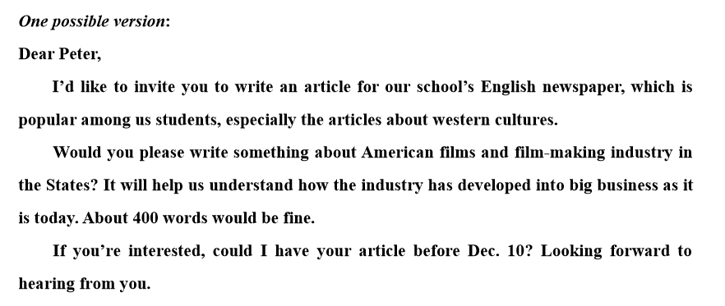
polite

Slide 11
模板背诵 仅供参考
Dear 被约稿人，
I’d like to ask/invite you to write an article for 某媒体某栏目，which provides a nice platform for 某媒体受众 to do sth. It carries articles written by XXX concerning Chinese cultures.
Would you please write something about XXX？You can write anything relevant so long as it’s interesting and informative. 400 words would be fine.
结尾1：If you are interested, you are supposed to subscribe your article by Sep.10. 结尾2：Could we have your article before Sep.10? I’m looking forward to your reply at your earliest convenience.

Slide 12
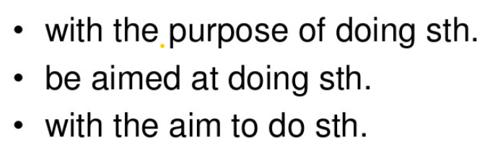
短语补充
Carry/publish articles written by XXX about/concerning …. 登载着由XXX写的关于…的文章
Anything relevant； some relevant details about the articles we need.
Write an article with the theme of …
Especially welcome articles about…
The column/section in our newspaper
Make/help sb know sth about; introduce sth to sb
Interesting and informative 寓教于乐 broaden one’s horizons
Be expected/ required to do
Hand in the article; sb contribute to; sb submit the article
Be due on…; the deadline is…;no later than… 截止到…

Slide 13
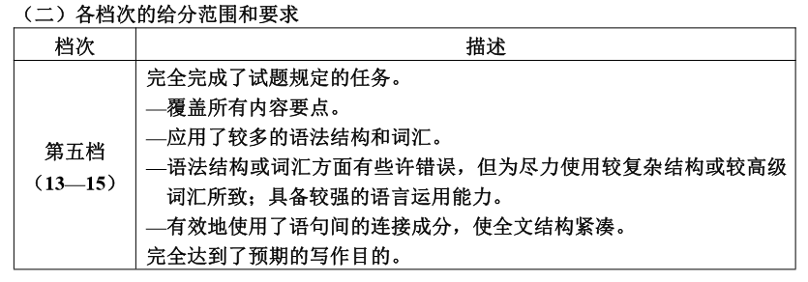



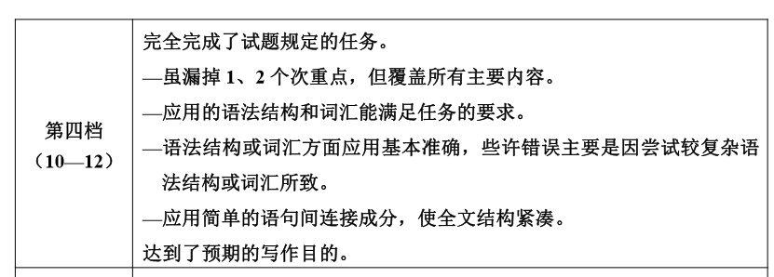



（10-12）

Slide 14
polite

Slide 15
实战演练 2015全国卷1
假定你是李华，你校英文报“外国文化”栏目拟刊登美国节日风俗和学生生活的短文。请你给美国朋友彼得写信约稿，要点如下：
1.栏目介绍
2.稿件内容
3.稿件长度：约400词汇
4.交稿日期

Slide 16
A possible version
Dear Peter,
I’d like to ask you to write an article for our school’s English newspaper. The “Foreign Culture” section in our newspaper is very popular among us students. It carries articles written by foreign friends about the cultures of their home countries. Would you please write something about the culture in your part of the the United States? And we would specially welcome articles about how Americans spend their holidays and festivals, and the life of American high school students. You can write anything relevant so long as it’s interesting and informative. 400 words would be fine. Could we have your articles before June 28?
I’m looking forward to hearing from you.

Slide 17


