Slide 1

感恩遇见，相互成就，本课件资料仅供您个人参考、教学使用，严禁自行在网络传播，违者依知识产权法追究法律责任。
更多教学资源请关注
公众号：溯恩高中英语
知识产权声明

Slide 2
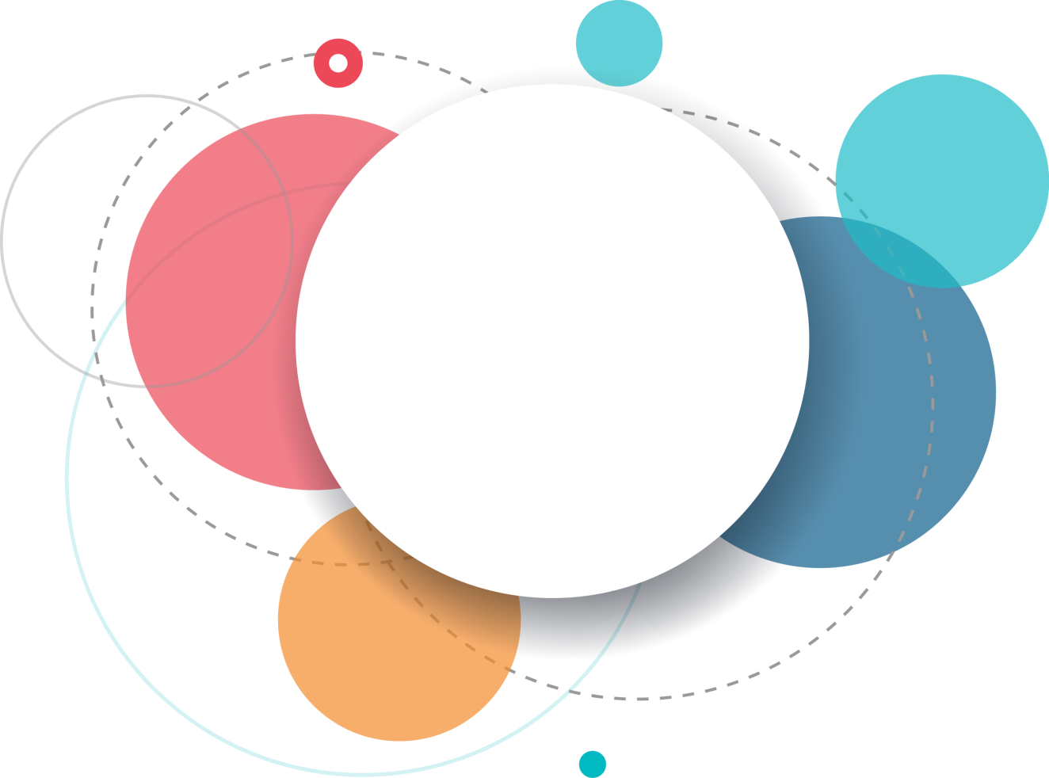
We-talk
Summary writing
BY：桐乡市高级中学 翁雨昕Ivy

Slide 3
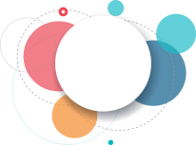
Evaluation criteria
Correct&
diversified
Content
logic
Clear&neat
Complete; objective;
concise&
independent
points
coherent
language
&grammar
handwriting

Slide 4
Students’ difficulties in writing
Content
Language
Logic
踩不中点，既怕不完整，又怕太繁琐
找不到替换词和句式
段与段关系不明，不会用连接词

Slide 5

Solution: three steps
Step1
Read for theme & main ideas.
Step2
Read for key points and rewrite them correctly and concisely.
Step3
Read for structure and organize your
writing coherently.

Slide 6
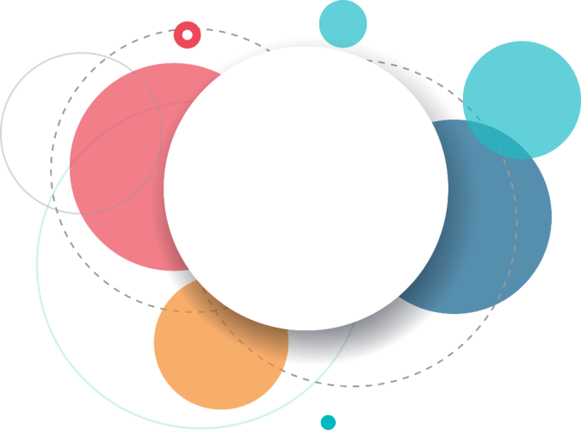
Step1
Read for theme and main ideas

Slide 7

Read for theme and main ideas
“we-talk”
We all know that friends are special people who we share our lives with, and who share their lives with us in return. But seeking friends and keeping the friendship going are never easy. According to research recently published in the Journal of Social and Personal Relationships, the key is to use
“we-talk”.
Led by University of California psychologist Megan Robbins and her colleagues, the researchers reviewed and analyzed 30 different studies involving over 5,000 participants. This largest-ever analysis of “we-talk” suggested that the frequent use of “we” and “us” is linked to happier and healthier relationships. The word “we” move people from an individual position into a partnership, which makes us more interdependent. “The pronouns offer an insight into whether people see themselves as individuals or as part of a whole,” Robbins told Science Daily.
Their research also found that “we-talk” is helpful for solving conflicts. “The primary point is that interdependence may bring about supportive behaviors and positive ideas of the partner– especially important in times of stress and conflict,” according to a statement released by Robbins’ lab.
Contrary to “we-talk”, there is “I-talk”, which refers to the frequent use of first-person singular pronouns, such as “I”, “me”, and “mine”, when writing or speaking. Earlier this year, researchers from the University of Arizona, US, analyzed a set of data that came from 4,700 people in Germany and the US. They found that too much “I-talk” was an accurate linguistic marker（语言标记）that someone is likely to feel stressed or experiencing negative emotions.
As you can see from the two studies, too much “I-talk” can make you feel depressed. But “we-talk” can encourage you to become more positive and create a ripple effect of healthy interdependence with others. So next time you’re talking to a friend, try using more “we-talk”. You may find yourself feeling more positive—and the effect it will have on your friend will have on your friend will be positive as well.
importance
The of“we-talk”
“we-talk”
“we-talk”
advantage
One of“we-talk”
“we-talk”
advantage
Another of“we-talk”
“we-talk”
disadvantage
The of“I-talk”
“we-talk”
suggestion
The

Slide 8
Step2
Read for key points and rewrite them

Slide 9

Para.1The importance of “we-talk”
Tip1 抓住信号词，定位要点。
We all know that friends are special people who we share our lives with, and who share their lives with us in return. But seeking friends and keeping the friendship going are never easy. According to research recently published in the Journal of Social and Personal Relationships, the key is to use “we-talk”.
We all know that friends are special people who we share our lives with, and who share their lives with us in return. But seeking friends and keeping the friendship going are never easy. According to research recently published in the Journal of Social and Personal Relationships, the key is to use “we-talk”.
seek friends:
make friends;build\establish friendship
maintain friendship
Tip2 抓住关键词，同义替换。
keep friendship:
sth.is important\essential\crucial\vital; sth. plays an important role in; sth. is of importance
key:

Slide 10
Learn from peers
Tip3 巧用句型，整合关键信息。
correct &concise
Which version is the best one? Why?
1.Using “we-talk” is vital to making friends and maintaining friendship.
(v-ing作主语）
2.“We-talk” can play a crucial role in building and maintaining the friendship. (句型sth. plays a crucial role in doing sth.）
3.Despite the obstacles in establishing and maintaining friendship, “we-talk” may be of assistance. (despite引导的让步状语从句）
Possible version
“We-talk” plays a crucial role in establishing and maintaining friendship.

Slide 11




Tip4 逐句分析复杂段落，提取主要点和次要点，去除冗余信息。
Para.2 One advantage of “we-talk”
研究介绍(冗余信息)
Led by University of California psychologist Megan Robbins and her colleagues, the researchers reviewed and analyzed 30 different studies involving over 5,000 participants. This largest-ever analysis of “we-talk” suggested that the frequent use of “we” and “us” is linked to happier and healthier relationships. The word “we” move people from an individual position into a partnership, which makes us more interdependent. “The pronouns offer an insight into whether people see themselves as individuals or as part of a whole,” Robbins told Science Daily.
Led by University of California psychologist Megan Robbins and her colleagues, the researchers reviewed and analyzed 30 different studies involving over 5,000 participants.
研究结果(主要点)
“The pronouns offer an insight into whether people see themselves as individuals or as part of a whole,” Robbins told Science Daily.
解释“relationship”(次要点)
举例说明(冗余信息)
What’s “happier and healthier relationships” in para.2?

Slide 12


What’s “happier and healthier relationships” in para.2?
(Draw a mind map to illustrate the concepts like “individual”; “partnership”; “interdependent” and “happier and healthier relationship”. )
interdependent
Tip5 借助思维导图，
厘清抽象概念。
“We”
I
individual
partnership

Slide 13

主次要点逻辑清晰
Which version is the best one? Why?
Learn from peers
1. According to their study, the more you use “we” and “us”, the happier
and healthier you will be. (句型 “the+比较级…,the+比较级…”)
2. Frequently using “we” is associated with healthier relationship and
motivates individuals into a group. (将is linked to改写为is associated with; move改写为motivate)
3. The research demonstrates “we-talk”,with plenty of “we” and “us”, promotes harmonious relationships by mingling people to a community. (将happier and healthier改写为harmonious; move改写为mingle;借助v-ing连接主次要点)
Possible version
As a study reveals, “we-talk” contributes to healthier relationships, motivating individuals into a group and to rely on each other.

Slide 14
Para.3 Another advantage of “we-talk”
研究结果(主要点)
Their research also found that “we-talk” is helpful for solving conflicts. “The primary point is that interdependence may bring about supportive behaviors and positive ideas of the partner– especially important in times of stress and conflict,” according to a statement released by Robbins’ lab.
“we-talk” is helpful for solving conflicts.
解释说明(次要点)
benefit\be beneficial to\be conducive to\contribute to
be helpful for:
solve:
settle\address\tackle\deal with
conflict:
collision\disagreement\argument\dispute
Possible version
Support from such interdependence is beneficial to address collisions.
Tip6 巧用限定词，省略重复信息。

Slide 15

Thinking：The following version combines the points in para.2 and para.3 into one sentence. Do you think it proper? Why?
要点2
Some researches show that “we-talk” not only can make relationship happier and healthier, but also can help us to deal with some conflicts between friends.
要点3
点评：此生虽能借助“not only…but also”句型体现para.2和para.3两段的并列关系，且能抓住两段的主要点，但合并处理不利于次要点的整合。
Tip7 概括较长段落时，各要点独立成句，以免丢失次要点。

Slide 16
Para.4 The disadvantage of “I-talk”
Contrary to “we-talk”, there is “I-talk”, which refers to the frequent use of first-person singular pronouns, such as “I”, “me”, and “mine”, when writing or speaking. Earlier this year, researchers from the University of Arizona, US, analyzed a set of data that came from 4,700 people in Germany and the US. They found that too much “I-talk” was an accurate linguistic marker（语言标记）that someone is likely to feel stressed or experiencing negative emotions.
Contrary to “we-talk”, there is “I-talk”, which refers to the frequent use of first-person singular pronouns, such as “I”, “me”, and “mine”, when writing or speaking. Earlier this year, researchers from the University of Arizona, US, analyzed a set of data that came from 4,700 people in Germany and the US. They found that too much “I-talk” was an accurate linguistic marker(语言标记)that someone is likely to feel stressed or experiencing negative emotions.
研究结果(主要点)
indicate;symbolize;demonstrate;show
an accurate linguistic marker:
tense;anxious;strained;under the pressure
stressed:
Possible version
“I-talk” indicates pressure or negative feelings.

Slide 17
Para.5 The suggestion
As you can see from the two studies, too much “I-talk” can make you feel depressed. But “we-talk” can encourage you to become more positive and create a ripple effect of healthy interdependence with others. So next time you’re talking to a friend, try using more “we-talk”. You may find yourself feeling more positive—and the effect it will have on your friend will have on your friend will be positive as well.
As you can see from the two studies, too much “I-talk” can make you feel depressed. But “we-talk” can encourage you to become more positive and create a ripple effect of healthy interdependence with others. So next time you’re talking to a friend, try using more “we-talk”. You may find yourself feeling more positive—and the effect it will have on your friend will have on your friend will be positive as well.
建议内容(主要点)
建议效果(次要点)
表建议:it’s necessary\recommended\suggested\advised\proposed\a must to do sth.
It’s advisable to use “we-talk” in the benefit of you and your friends.
Possible version
Tip8 巧用介词短语、非谓语动词、定语从句等语法，连接主次要点。

Slide 18
Step3
Read for structure and organize your writing

Slide 19
Read for the structure and draw a mind map
Introduction
(Para.1)
Advantage 1
(Para.2)
并列
Advantage 2
(Para.3)
转折
Disadvantage
(Para.4)
因果
Suggestion
(Para.5)

Slide 20
Fill in the blanks with proper logical words
Possible version
“we-talk” plays a crucial role in establishing and maintaining friendship. As a study reveals, “we-talk” contributes to healthier relationships, motivating individuals into a group and to rely on each other. , support from such interdependence is beneficial to address collisions. “I-talk”, , indicates pressure or negative feelings. , it’s advisable to use “we-talk” in the benefit of you and your friends.
Additionally
by contrast
Thus
并列:also; additionally;
besides; what’s more; furthermore; moreover; in addition to…
转折:however; on the contrary; contrarily; by(in) contrast; whereas; conversely;nevertheless…
结果: so; therefore; thus;
hence; consequently; in consequence; as a result\consequence…

Slide 21

Conclusion
Step1: Read for theme & main idea
Three
steps
Step2: Read for key points and rewrite
them correctly and concisely.
Step3: Read for structure and organize
your writing coherently.

Slide 22


Assignments
1. Polish your writing with the 8 tips you’ve learnt.
2. Review the newly-learnt words and sentence patterns.

Slide 23
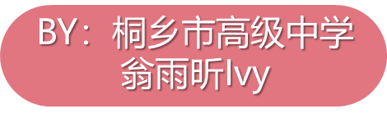
Thank you

