Slide 1

感恩遇见，相互成就，本课件资料仅供您个人参考、教学使用，严禁自行在网络传播，违者依知识产权法追究法律责任。
更多教学资源请关注
公众号：溯恩高中英语
知识产权声明

Slide 2
Unit1 Book1
人教版新教材 词汇导学练

Slide 3
1. teenage [ˈtiːneɪdʒə(r)]a. teenager [ˈtiːneɪdʒə(r)] n.
2.ballet [ˈbæleɪ] n.
3.volunteer [vɔlənˈtɪə(r)] n. vi.
voluntary a.
十几岁的; 青少年的
青少年, 十几岁的少年
teen(十几)+age(年龄)+er(人)：十几岁的人——青少年
芭蕾舞
志愿者, 义工
自愿
音意互通：我能替 助记：我能替你做志愿者。
自愿的; 自发的

Slide 4
练：
______________ gives you a chance to change lives, including your own.(2013 北京)
Mark ____________ to ride the bus with Susan each morning and evening until she could manage it by herself. (2012 天津)
3.Today, over thirty companies regularly donate food and other goods to the cause and __________ help to deliver them to the homeless.(2012 山东)
Volunteering
volunteered
volunteers

Slide 5
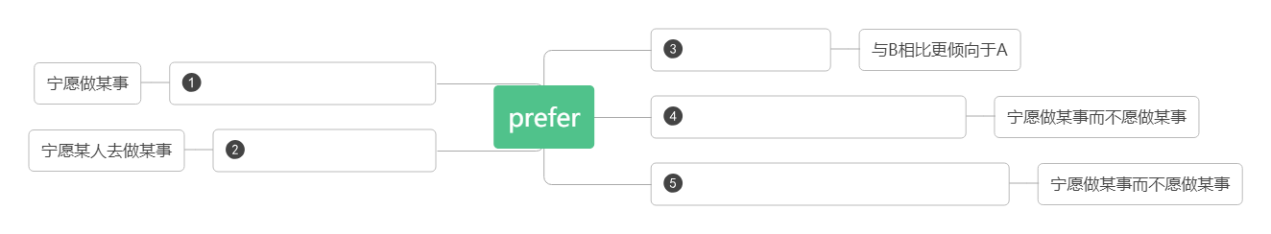
4.prefer [prɪˈfɜː(r)] vt.
宁愿,偏爱,更喜欢
A to B
doing/to do sth.
doing sth. to doing sth.
sb. to do sth.
to do sth.rather than do sth.
练：
Some people prefer ____________________(做所有的事) over the internet.
I'd prefer________________________(你早点开始).
I prefer the red dress______the green one because it fits me better.
I prefer ________________to______________(读书而不是看电视).
I prefer to go there by bike _____________(而不是) by car.
to do everything
you to start early
to
reading books
watching TV
rather than

Slide 6
preference [ˈprefərəns] n.
give preference to
in preference to
练：
Many people expressed a strong ____________(对……的偏爱) the original plan.
Preference should ___________(被给予) graduates of this university.
She was chosen _______________(优先于) her sister.
偏爱，倾向
给….以优惠或优待
优先于，而不是
preference for
be given to
in preference to

Slide 7
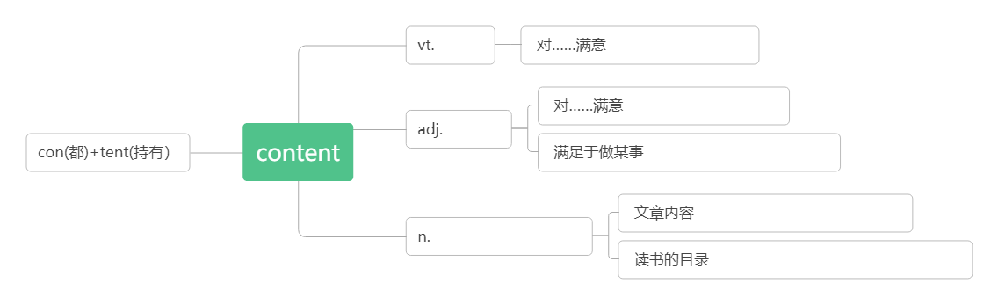
5.content[kənˈtent] a. ['kɒntent]n.
练：
People who are truly content________ life are enthusiastic about what they do.
The couple are very contented ________the life in the countryside, where everything goes quietly and comfortably.
Stricter controls were placed on the ________ of video films.
满足的,满意的
内容;目录[pl]
使满足
be contented with
be content with
满足的
be content to do sth.
the content of the article
内容; 目录[pl]
read the contents of the book
with
with
content

Slide 8
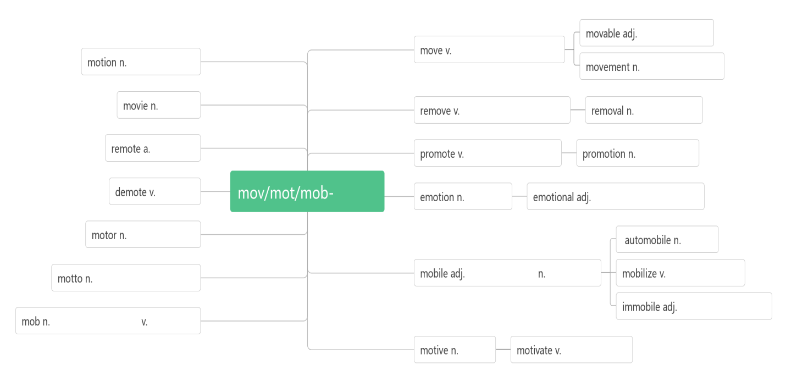
6.movement ['mu:vmənt] n.
移动, 动作
可移动的
移动
移动,动作
移动
电影
移走, 去除
移除;免职
遥远的
提升; 促进
升职;促进
使降级
动
感情
感人的；易激动的
马达,发动机
汽车
机动的,
可移动的
手机
动员,调动,组织
座右铭,格言
固定的,不动的
乌合之众,暴徒
一拥而上
动机
驱动;激发

Slide 9
7.greenhouse ['griːnhaʊs] n.
8.clean [kliːn] vt. a.
A clean hand wants no washing.
clean up
cleaner n.
9.suit [suːt, sjuːt] vt. n.
a suit of
a business suit
follow suit
suitable [ˈsjuːtəb(ə)l] a.
a suitable place for a picnic
be suitable for
suitcase [ˈsjuːtkeɪs] n.
温室，暖房
打扫；弄干净
清洁的，干净的
身正不怕影子斜。
打扫/清除干净
清洁工,清洁器,清洁剂
适合
一套(衣服); 诉讼; 恳求
一套
商务套装
学样子;跟着做
合适的,适宜的
一个适合野餐的地方
适合于
(旅行用)小提箱,衣箱

Slide 10
练：
If we met at 2 o'clock , would that _____ you?
The hot weather doesn't _____ me.
Short sight can be fixed by the use of ________ glasses.
Soon they came to a very long room full of pictures and there they found __________(一套) armour(盔甲).
10.actually [ˈæktʃʊəl] ad.
suit
suit
suitable
a suit of
事实上；的确
词根词缀：act-(做)+-ual(形容词后缀)+-ly(副词后缀)：已经做出来了——事实上，实际上
actually=in fact=in reality=as a matter of fact 事实上

Slide 11
挑战
质疑；向……挑战
10.challenge [ˈtʃælɪndʒ] n. vt.
_____________a challenge 面对/接受挑战
音意相通：才难治 助记：这种有挑战的疾病才难治呢。
face/take up
智美例句：
When happy people face a challenge in life, they don’t beat themselves up and fall into a depressive state. Instead, they face up to the challenge and channel their energies toward finding a creative solution.
在生活中遇到挑战的时候，开心的人不会自虐，然后变得很消沉。他们会直面挑战，调动全身力量寻找解决办法。
Everything negative - pressure, challenges - is all an opportunity for me to rise.
压力、挑战，这一切消极的东西都是我能够取得成功的催化剂。(科比)
challenging a.
一个具有挑战性的工作
具有挑战性的
a challenging job

Slide 12
11.title['taitl]n.
12.topic ['topik]n.
（书、诗歌等的）名称；标题；称呼；头衔
话题;主题;论题
 | "标题,名称",指书，绘画，剧作等创作作品的名称；还可作"头衔，称呼"讲
 | "话题,主题,论题",可指演讲或整篇作品的主旨,也可指某个章节,段落乃至单句包含的要点
 | "主题,主旋律",指文学,艺术或建筑等创作所围绕的主题,如诗的思想,乐曲的主旋律或绘画的基调
 | "题目,主题,科目",在这组词中词义最广,泛指某范围内的主题,涉及面广,概括性强,一般包括若干topic
title
topic
theme
subject

Slide 13
练：
It was the book's eye-catching_______that helped me make up my mind to buy it.
正是这醒目的书名才使我下决心买下这本书。
The _______ of your article is very good, but your spelling and style must be improved.
你文章的主题很好，但拼写及风格必须改进。
I cannot remember in the very long conversation what _______ has been touched upon .
我不记得在漫长的谈话中涉及到了那些话题。
The graduates wrote a number of essays whose ________ was man's will-power.
研究生们写了以人类的意志力为主题的一系列论文。
He chose "A Reform in Teaching Methods" as the _________ of his lecture.
他选择"教学方法的改革"作为讲话的题目。
title
topic
topic
theme
subject

Slide 14
高一新生；大一新生
13.freshman ['freshmən]n.
14.confuse [kənˈfjuːz] v. 使迷惑;使混乱;混淆
confusing adj.
(现在分词表示 内涵，意为“ ”)
confused adj.
(过去分词表示 内涵，意为“ ”)
confuse sth. sth. 把……与……弄混淆
be confused 对……感到困惑
confusion [kən'fju:ʒ(ə)n]n.
fresh(新鲜的)+man(人): 新人——新生
con-(共同,都)+fuse(融合,混合)：都混合在了一起——混淆，使迷惑
令人困惑的
主动
令人……的
感到困惑的
被动
感到……的
with
at/about
混乱;混淆

Slide 15
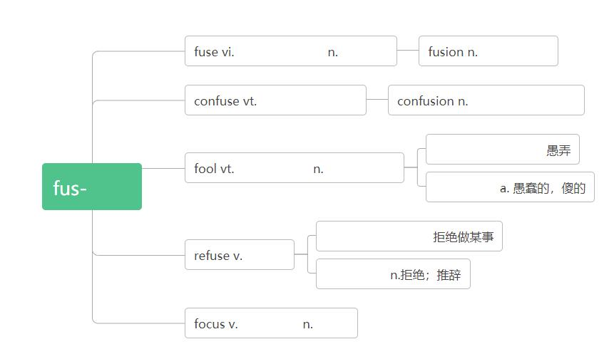
融合；融化 保险丝
融合；融化
使混乱，使困惑
困惑，混乱，混淆
make a fool of
捉弄，愚弄
傻瓜，蠢货
熔流
foolish
refuse to do sth.
拒绝
refusal
聚焦;集中
焦点
练：
We decided to cut short the meeting, but her unexpected arrival ___________ all our plans.
The uncertainty created by this situation must be _____________ for you.
His answers to my questions have only added to my _____________.
The driver was _____________________ the road signs.
confused
confusing
confusion
confused at/about

Slide 16
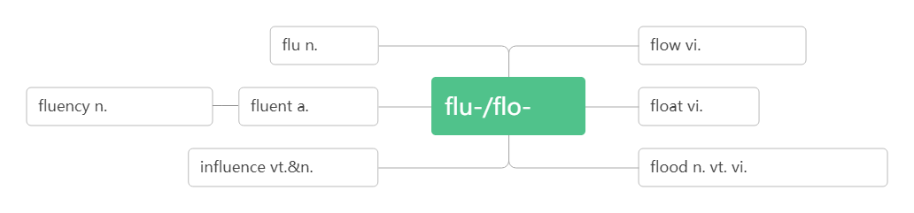
15. fluent [ˈfluːənt]
流利的,流畅的
流感
流淌,流动
流利; 流畅
流利的
流
漂浮
影响
洪水;
淹没;
泛滥

Slide 17
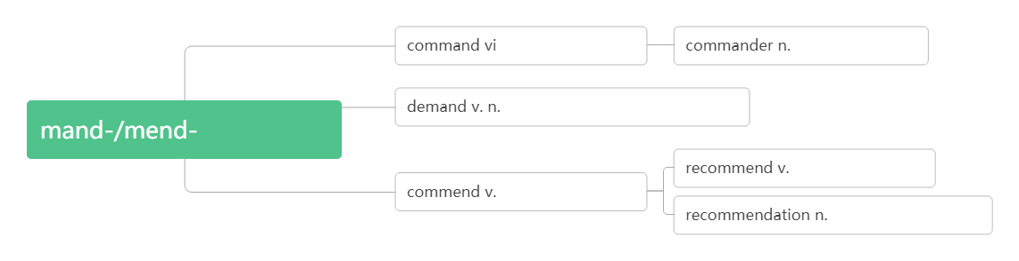
毕业
研究生;毕业生
16.graduate [ˈɡrædjʊət] vi. n. adj.
graduate_______从……毕业
graduation [ɡrædjʊˈeɪʃ(ə)n] n.
17.recommend [rekəˈmend] vt.
recommend 建议做某事
recommend 建议某人做某事
recommend 建议（宾语从句）
毕业的;研究生的
grad-(级别)+u+ate(做)：达到级别——毕业
from
毕业;毕业典礼
推荐;建议
doing sth.
sb. to do sth.
(that) sb. (should) do sth.
命令; 指挥; 控制
指挥官; 司令官
要求; 需要
委托/指派
推荐,介绍;委托
推荐;称赞;委托
推荐; 建议; 推荐信

Slide 18
练：
Can you_____________ a good hotel?
I recommend he ____________(see) a lawyer.
We'd recommend you _________________(book) your flight early.
He recommended ________(read) the book before seeing the movie.
It is strongly recommended that the machines ___________ ________ (check) every year.
recommend
(should) see
to see/(should) see
reading
(should) be
checked

Slide 19
记号,符号;手势;迹象;指示牌
18.sign[saɪn] n. vi. vt.
sign up for
traffic sign
sign an agreement/contract/treaty etc
A long tongue is a sign of a short hand.
19.advance [ədˈvɑːns; (US) ədˈvæns] vt. vi.
in advance
advanced [ədˈvɑːnsd; (US) ədˈvænsd]adj.
练：
Confidence and ability usually ____________ side by side.
信心与能力通常是齐头并进的。
A person’s soul is like the torch made of hay. If taking action ,it must burn itself ______ advance.人的心灵好比干草扎成的火把，要发生作用，它必须自身先燃烧。
Those who are content with their present situations will surely make no more _____________ in life. 满足于现状者止步于当下。
签名
签署；示意
注册；报名参加
交通标志
签署协议书/合同/条约等
夸夸其谈，眼高手低。
推进,促进
前进
提前
高级的,高等的,先进的
advance
in
advances

Slide 20
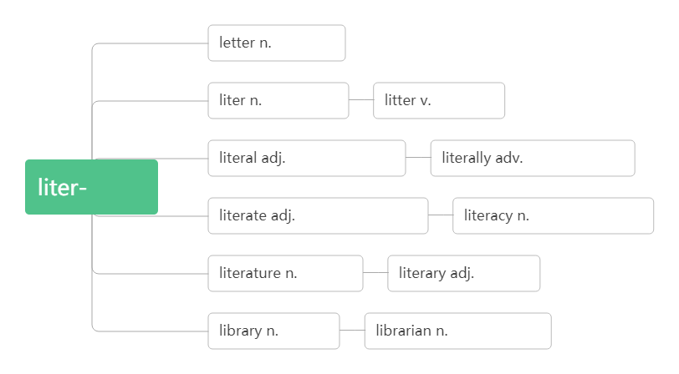
20.literature [ˈlɪtərətʃə(r); (US) ˈlɪtrətʃʊər] n.
文学
音意相通：离开猥琐 助记：文学是我们离开猥琐的净土。
字母；信
升, 公升
乱丢杂物
文字的；字母的
逐字地；字面的
文字
识字的；会读写的
识字；读写能力
文学
文学的
图书馆
图书管理员

Slide 21
21.extra-curricular [ekstrə'kərikjələ] a.
extra ['ekstrə] adj.
curricular [kə'rɪkjəlɚ]adj.
22.obvious [ˈɔbvɪəs] a.
课外的
额外的；附加的
课程的
显然的；明显的
ob(对面)+vi(看)+ous(形容词后缀)：站在对面就能看到——明显的

Slide 22
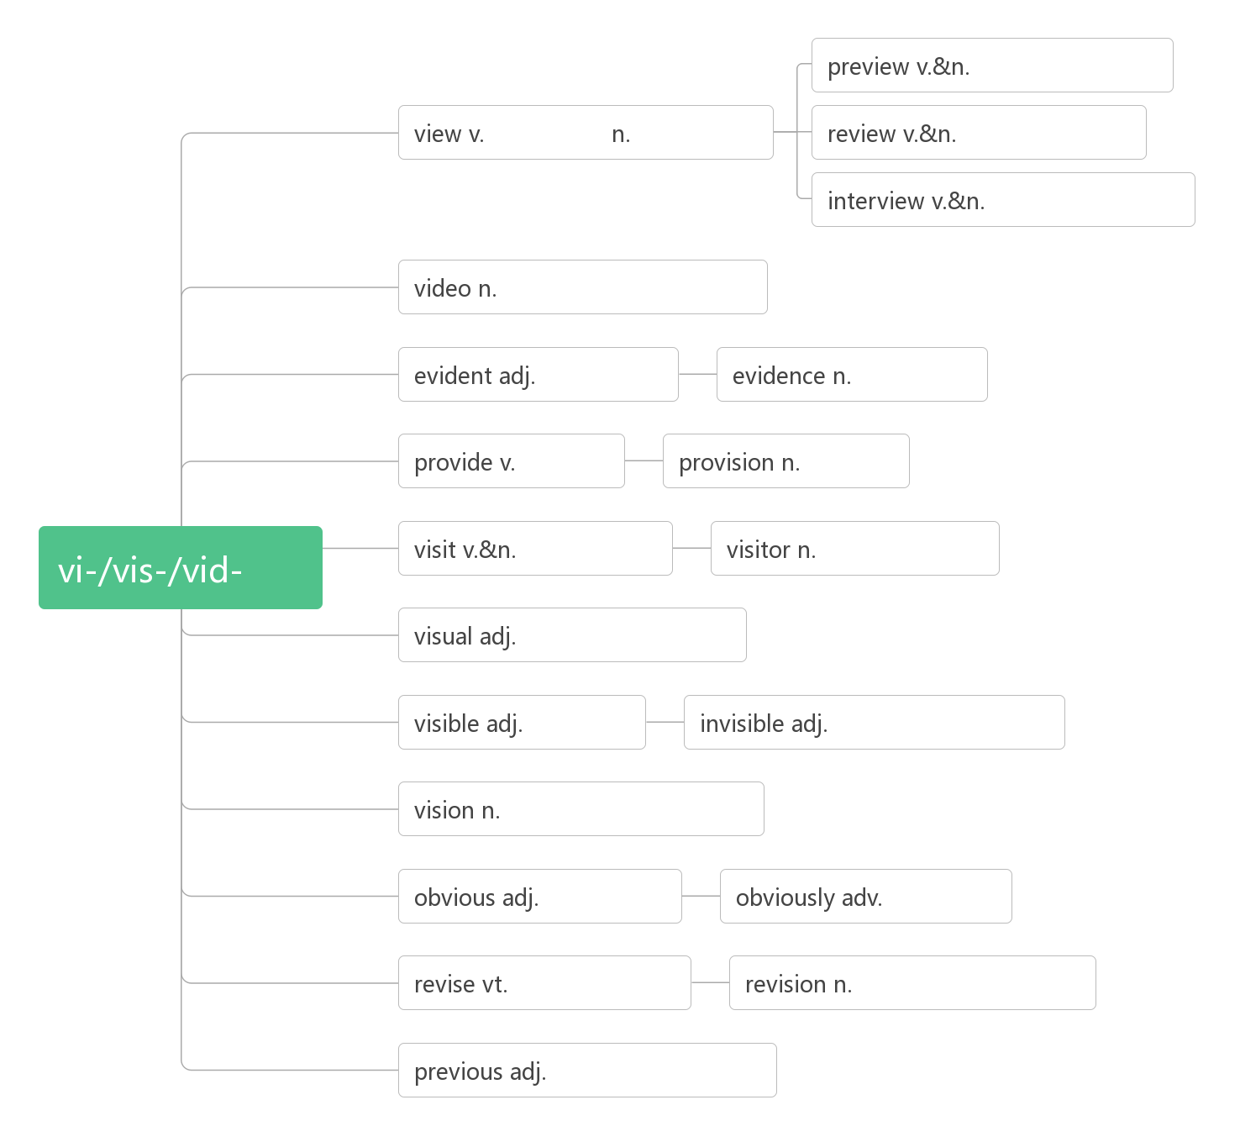
预习；预览
看，看待 观点，景象
回顾；复习；评论
采访；面试
视频,录像
明显的
证据
提供
提供
看
参观,访问
游客,访客
视觉的；视力的
可见的
看不见的
视力;洞察力;幻觉
明显的
明显地
修订,校正;复习
修订,校正;复习
先前的, 前面的

Slide 23
23.quit [kwit] vi. & vt. (quit, quit)
24.responsible [rɪspɔnsɪˈbl]adj.
be responsible for
responsibility [rɪspɔnsɪˈbɪlɪtɪ] n.
have responsibility for
take responsibility for
练：
With great power, comes great _______________.(Spider Man)
Children must learn just a few basic roles——being safe, being considerate to others and being _______________ to themselves.
The project is delayed. Someone must be responsible _____ this.
退出;戒掉;离开(职位/学校等)
负责的；有责任的
对……负责
责任，负责
对……有责任
承担……的责任
responsibility
responsible
for

Slide 24
25.solve [sɔlv]vt. vi.
solve/settle a problem
solve a puzzle/riddle/case
solution [sə'luʃən]n.
练：
I have tried very hard to find a ________to the problem, but in vain.(2010江苏)
The committee is discussing the problem right now. It will hopefully _________ by the end of next week.
解决;解答
溶解
解决问题
解谜/猜谜/破案
解决办法;溶液
solution
be solved

Slide 25
26.schedule [ˈskedʒʊl] n. v.
work to a very tight schedule
____ schedule按时; 按照预定时间
______ of schedule 提前
be scheduled ___ June/Monday 被安排在六月/周一
_________ flight/service 预定的航班/服务
练：
We have ____________ the meeting for Monday.
The speaker is ___________ to make a speech tomorrow.
Thanks to your help, we finished the job _______of schedule.
We have to prepare for the possibility that we might not finish it _____ schedule.
工作计划; 日程安排
安排时间;预定
音意相通：撕开就 助记：这份工作计划撕开就无效了。
工作安排非常紧
on
ahead
for
scheduled
scheduled
scheduled
ahead
on

Slide 26
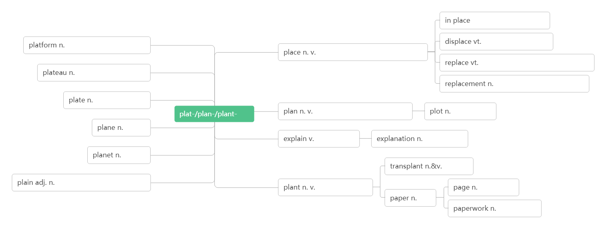
编辑; 编者
27.editor [ˈedɪtə(r)] n.
edition [ɪˈdɪʃ(ə)n]n.
28.plate [pleit] n.
(发行物的)版; 版本
盘子; 碟子
就位;在适当的位置
平台;站台;讲台
取代;置换;转移
地方,位置;
摆放,放置
代替,替换;偿还;放回原处
高原;稳定期;托盘
顶替;更换;复位;替代品
盘子;金属板
平
计划;平面图;
计划;打算
情节;阴谋
飞机
说明,解释
说明,解释
行星
移植
平的;简单的;朴素的n.平原
植物 v.种植
纸
页,页码
文书工作

Slide 27
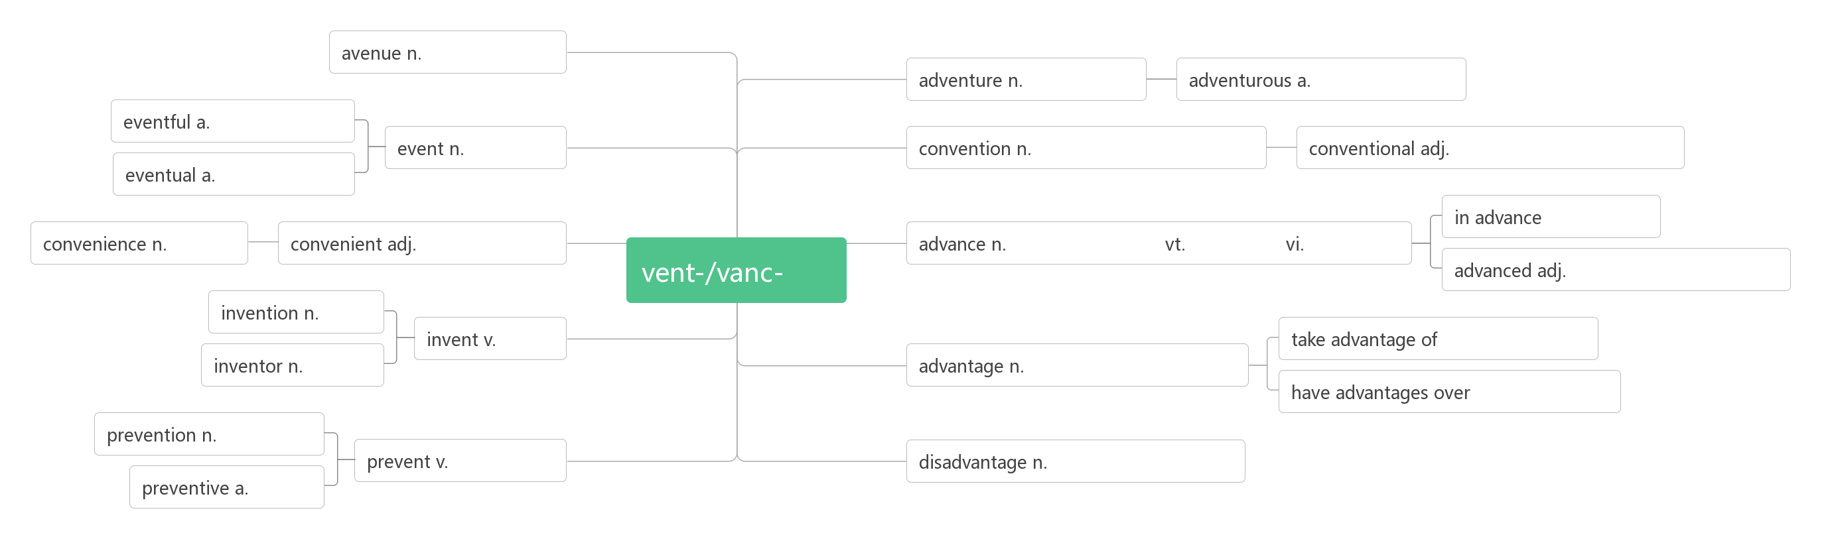
29.adventure [ədˈventʃə(r)] n.
冒险; 奇遇
大道;林荫道
奇遇,冒险
冒险的;大胆的
多事的;重大的
大会；惯例；公约；习俗
事件,盛事
常规的;传统的;惯例的
最终的;最后的
提前;预先
便利
方便的,便利的
前进;事先
推进,促进
前进
来
先进的,高级的
发明
发明
利用;占便宜
优点,优势,
有利条件
发明者
比……有优势
预防,防止
预防,防止
缺点,劣势,不利条件
预防的

Slide 28
30.youth [juːθ] n.
young [jʌŋ] a.
练：
A lazy _________, a lousy(极坏的) age. 少壮不努力，老大徒伤悲。
He who will not learn when he is _______ will regret it when he is old. 少壮不努力，老大徒伤悲。
A plant may produce new flowers; man is _______but once.
花有重开日，人无再少年。
What sowed in _______, what harvested when old.
年青时种下了什么因，年老时就收获什么果。
Learning keeps us _______ and dreams keep us alive.
学习让我们保持年轻，梦想让我们充满活力。青年时种下了什么，老年时就收获什么。
青春; 青年
年轻的, 年少的
youth
young
young
youth
young

Slide 29
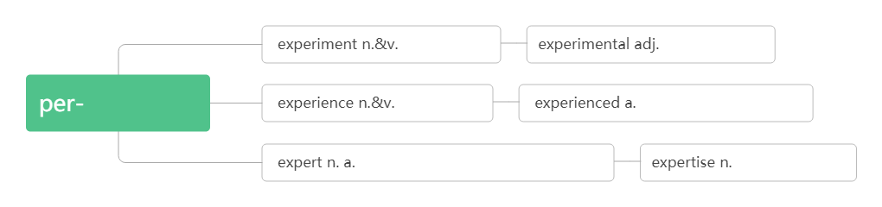
专家，行家
专业的，内行的
31.expert [ˈekspɜːt]n. adj.
实验;试验
实验的;试验的
体验,尝试
经历;经验
有经验的;熟练的
专家; 行家
a.专业的，内行的
专业知识/技能
助记:做完实验experiment, 就有经验experience, 有了经验, 就成专家expert。
练：
He is expert ______playing the piano. Success is doing the same right thing over and over again until you become ____ expert in your field. Every teacher once was a student. Every winner once was a loser. Every _________ once was a beginner. But all of them have crossed the bridge called “Learning”.
at/in
an
expert

Slide 30
32.behave [bɪˈheɪv] vi.
behave oneself
behavior[bɪ`heɪvjər ] n.
练：
Believe there is a great power silently working all things for good, ________ yourself and never mind the rest.
相信举头三尺有神明，谨言慎行，豁达待人。
A beautiful form is better than a beautiful face; a beautiful __________ than a beautiful form.——Emerson
美丽的形体胜于漂亮的脸蛋，优雅的举止胜于美丽的形体。
—— 爱默生
举止，表现
举止得体，守规矩
行为，举止
behave
behavior

Slide 31
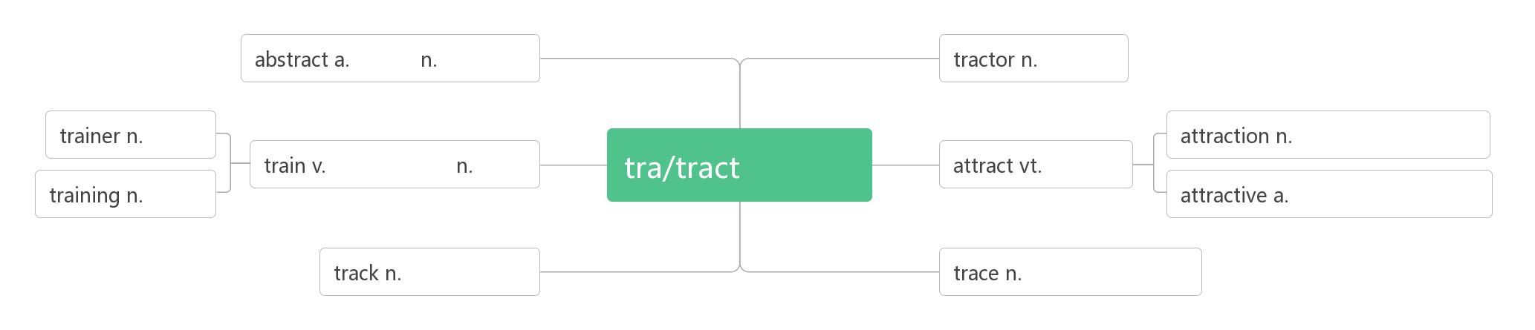
33.generation [dʒenəˈreɪʃ(ə)n] n.
from generation to generation
generation gap
练：
Life is for one____________ , a good name is forever.
生命只有一代之久, 而美名永存于世。
One generation ________ the trees in whose shade another generation rests.
前人栽树，后人乘凉。
34.attract [əˈtrækt] vt.
世代，一代
gene(基因)+rat(动词后缀:产生)+ion(名词后缀):产生的下一代基因——世代,一代
代代相传
代沟
generation
plants
吸引
抽象的
摘要
拖拉机
教练
牵引
吸引；景点
训练, 培训
火车
吸引
训练, 培训
有吸引力的
轨道,车辙,痕迹
足迹,痕迹,行踪

Slide 32
练：
The man who _________ luck carries with him the magnet(磁铁) of preparation.(Clifton Fadiman)
吸引好运的人，总是在时刻准备着。——克利夫顿·费迪曼
Nowadays TV as well as other media have __________ the attention of many audiences.
I was entirely____________by the beautiful music while listening.
Unwilling to leave out any _____________, my cousin arranged his enjoyable journey carefully.
Rainbow Valley is a great tourist ___________, drawing many visitors every year.
attracts
attracted
attracted
attractions
attraction

Slide 33
35.focus [ˈfəʊkəs] vi.&vt. n.
focused a.
focus on
练：
The secret of change is to ___________ all of your energy, not on fighting the old, but on building the new. (Socrates)
做出改变的秘诀不是多么努力地和过去做斗争，而是全力以赴地去打造全新的自己。
——苏格拉底
Life never stops pushing forward. Stay___________ and never slow down with regrets.
生活从来都不会停止向前，保持专注，别因为后悔而放慢脚步。
Control your _________, control your life.
掌控你的注意力，你就能掌控你的生活。
As long as I can focus _____ enjoying what I’m doing, having fun, I know I’ll play well. (Steffi Graf 施特菲·葛拉芙(网球明星) )
聚焦;集中
焦点;注意力
专注的
专注于
focus
focused
focus
on

Slide 34
36.addicted [əˈdɪktɪd] a.
be addicted to
addict [əˈdɪkt]n. vt.
37.adult [ˈædʌlt] n. a.
38.Chicago [ʃɪˈkɑːɡəʊ] （美国城市）
39.Seoul[səʊl] （韩国首都）
上瘾的,成瘾的,入迷的
ad(=to)+dict(说)+ed:赞不绝口的——上瘾的,入迷的
对…上瘾，沉溺于
成瘾者,沉迷者
使成瘾, 使入迷
成年人
成年的
芝加哥
首尔

