Slide 1

感恩遇见，相互成就，本课件资料仅供您个人参考、教学使用，严禁自行在网络传播，违者依知识产权法追究法律责任。
更多教学资源请关注
公众号：溯恩高中英语
知识产权声明

Slide 2
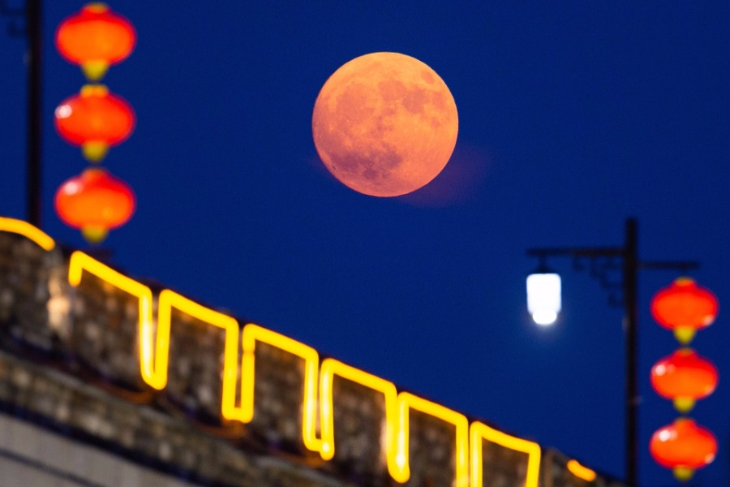

Mid-Autumn Festival for harvest
“Festivals have a wide range of origins, such as the seasons of the year, religions, famous figures, and important events.”
FROM Why Do We Celebrate Festivals?

Slide 3
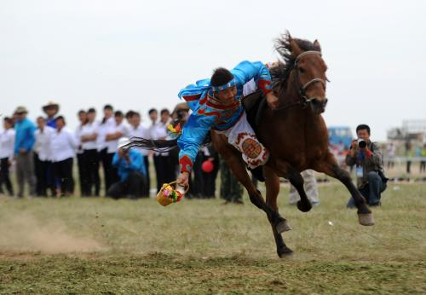
Naadam Festival for ?
“Festivals have a wide range of origins, such as the seasons of the year, religions, famous figures, and important events.”
FROM Why Do We Celebrate Festivals?

Slide 4
Predict text type and its features
My amazing Naadam experience
Predictions
Text type?
Text features?
Content?
How will you record a festival experience with the power of words?

Slide 5
Check predictions and explore the gist
My amazing Naadam experience
It’s a narrative about the writer’s Naadam experience.
Text type
Main idea
Time order
Past tense
Opinions and feelings
…
Diary
Typical textual features

Slide 6
Read for the key points and structure
Draw a mind map to show the structure of the diary.
Experience and feelings
Atmosphere
Activities
Feelings
Introduction
Body
Summary

Slide 7
Introduction: learn some knowledge about Naadam
Aspects | Facts | Useful language
Reign (where)
Date (when)
Meanings (why)
Representative activities
Inner Mongolia Autonomous reign
I experienced…in…
4th day of the 6th of the lunar calendar
The festival falls on…
Play games for happiness
It means…
It is represented by…, which are so exciting to watch.
It features sth…(Reading P4)
Horse racing, wrestling and archery
Writing tip: collect useful sentence patterns under a certain theme.

Slide 8
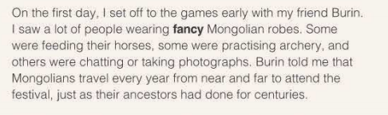
Body (Para.2): explore the festival atmosphere
Show, not tell!
What do people do to prepare for the festival?
amazing/exciting
lively/cheerful
busy/bustling
It is during the Naadam Festival.
Writing tip: use verbs to show the atmosphere rather than tell directly.

Slide 9
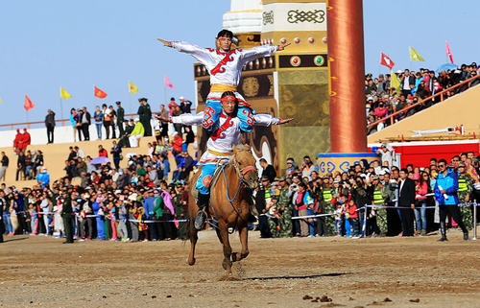
Body (Para.3&4): explore the festival activities
What’s special about Naadam activities?
The wrestling competition is exciting/amazing.
Wrestling
Horse racing
No rounds/Mixed weight
The competitors danced onto the green field, waving their arms in the air as if they were eagles.
Writing tip: use simile to show the scene vividly.

Slide 10
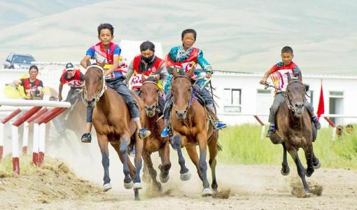
Body (Para.3&4): explore the festival activities
Underline the description of feelings and emotions.
Wrestling
Feeling expressions
be moved by
absolutely enjoy sth
be surprised to see
be a little worried about sth,
That was the moment I started to understand…
Horse racing
Riders are boys and girls who are experienced in riding horses.
Writing tip: add inner feelings to show the scene vividly.

Slide 11
Summary (Para.5) : appreciate the ending
Read comparatively and decide which one you prefer? Why?
My amazing Naadam experience
I’m tired back home, but I think everything is worthwhile. I’m looking forward to having another stay in winter.
I’m finally back home new, feeling really tired, but celebrating Naadam with my friend was totally worth it. He invited me back for the winter to stay in a traditional Mongolian tent and eat hot pot. I can’t wait it.
Echo the title
Writing tip: use adverbials to emphasize the feeling.

Slide 12
Summary: appreciate the title
My AMAZING Naadam experience
I saw sb doing.
Some were…others were…
the bustling atmosphere
Echo the title
exciting wrestling competition
I was quite moved by…
I was amazed at
absolutely enjoyed…
was surprised to see
That was the moment …
thrilling horse races
Be totally worth it
I can't wait.
the hospitality of Burin.

Slide 13
Imitating writing: make an outline
Theme
Structure/content
Language
I experienced…in…
The festival falls on…
It means…
It is represented by…
Experience and impressions
Writing activity:
Suppose you’re going to write a diary to record one of your impressive festival experiences, how will you write it?
My
Amazing
Lantern Experience
Activities
Viewing lanterns
Guessing riddles
Eating yuanxiao
Feelings and thoughts
really, totally, I can’t wait

Slide 14
Imitating writing: evaluate your work
Aspects | ITEM | Peer-assessment
Textual features | Past tense; first narrator; time order; opinions and feelings.
Textual structures | IBE-introduction, body, conclusion; topic sentences; linking words
Textual language | Generally correct in grammar, spelling and punctuation. Vivid expressions about feelings and movements

Slide 15
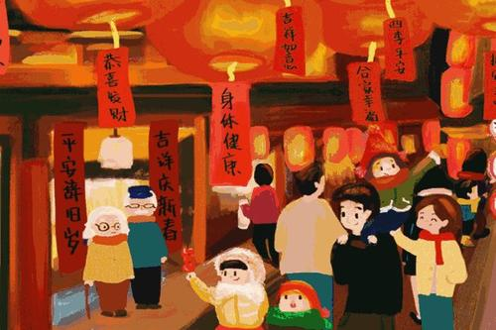
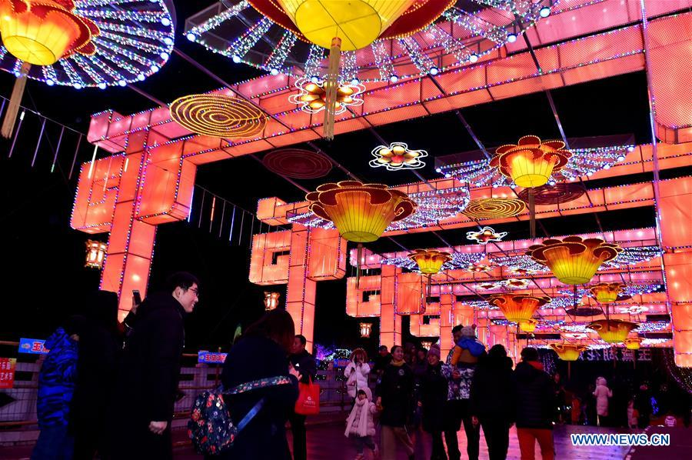
One possible version
My joyful Lantern Festival
Lantern festival, one of the most significant Chinese traditional festivals, falls on the fifteenth day of the first lunar month, usually in February or March. It features oceans of lanterns for people to appreciate and riddles on lanterns for people to solve. I still remember my most joyful Lantern festival when I was 10.
On that Lantern festival night, I set off to the local plaza to join the riddle-guessing contest. All along the way, I saw people from near and far packing the street in a buzz of excitement. Some were stretching themselves on their tiptoes to see the lantern parade including lion dancing and lanterns in numerous fancy shapes. Others were chatting or taking photos to record this unforgettable moment.

Slide 16
One possible version
My joyful Lantern Festival
As for me, the riddle-guessing contest is the most thrilling part. Riddles are written down and posted on each lantern by the owners. If anyone has the solution to the riddle, they are given the opportunity to present their answer to the lantern owner to see if it is right. If correct, the person is given a gift for his or her hard work. My journey there was totally worth it because I solved 6 riddles that night and won a delicate toy car for myself.
On back home, my mother feasted me with a bowl of mouthwatering Yuanxiao, which represented unity, happiness and harmony among family members. It was amazing to have such a joyful Lantern Festival experience with my family and I will recommend anyone travelling to China to experience it!

Slide 17
Homework
Continue to complete and polish the narrative writing about a festival experience after class.
Search on the Internet for more information about the Naadam Festival.

