Slide 1

感恩遇见，相互成就，本课件资料仅供您个人参考、教学使用，严禁自行在网络传播，违者依知识产权法追究法律责任。
更多教学资源请关注
公众号：溯恩高中英语
知识产权声明

Slide 2
人教版新教材 词汇导学练
Unit3 Book1

Slide 3
健康; 适合
1. fitness /ˈfɪtnəs/ n.
Sports and Fitness 运动与健康
a fitness center 健身中心
fit vt.
adj.
be fit for
They're doing exercise to improve their ______.
他们为增强体质而做体操。
I hired a ______ coach, and I began to eat small and healthy meals. (2017天津) 我雇了一个健身教练，开始了量少而健康的饮食。
安装;适合;与……相符
健康的;适合的;胜任的
胜任
fitness
fitness

Slide 4
Working out in the morning provides additional benefits beyond being physically____.(2018全国I)
晨练提供了除了身体健康以外额外的好处。
Thus, these well－equipped people survived because they were the _____.(2016北京卷)
这些准备充分的人们胜出因为他们是最适应的。
She and her family bicycle to work, which helps them keep ___.(2018北京卷）
她和家人们骑自行车去上班，这有助于他们保持健康。
fit
fittest
fit

Slide 5
词语辨析
This coat ____ me very well.这件外套我穿起来很合身。
These shoes don’t ___ me. Have you got a larger size?
这鞋我穿不合适。你们有大点的吗？
That haircut ______ you.那种发型很适合你。
It’s a small house but it ______ our needs.
这是一栋小房子，但它符合我们的需要。
The carpets should ________ the curtains.地毯应该和窗帘相配。
Do these shoes ________ my dress?这鞋子与我的衣服配吗？
fit | 强调尺寸、大小或形状上的吻合。
suit | 侧重于强调颜色、款式、品味等适合某人
match | 多指两个物体相互之间很匹配，显得很协调。
fits
fit
suits
suits
match
match

Slide 6
足球
2.soccer /ˈsɒkə(r)/ n.
a soccer game/match /team 足球比赛/队
soccer players 足球运动员
e.g.
Would you like to go to the soccer game?你想去看足球赛吗？
I like watching soccer games.我喜欢看足球赛。
I play soccer in my free time.我空闲时会踢足球.
补充知识:
soccer是美国人对足球的叫法,在美国football通常指的是橄榄球,而英国人把足球叫做football,英国人很少使用soccer这种叫法。

Slide 7
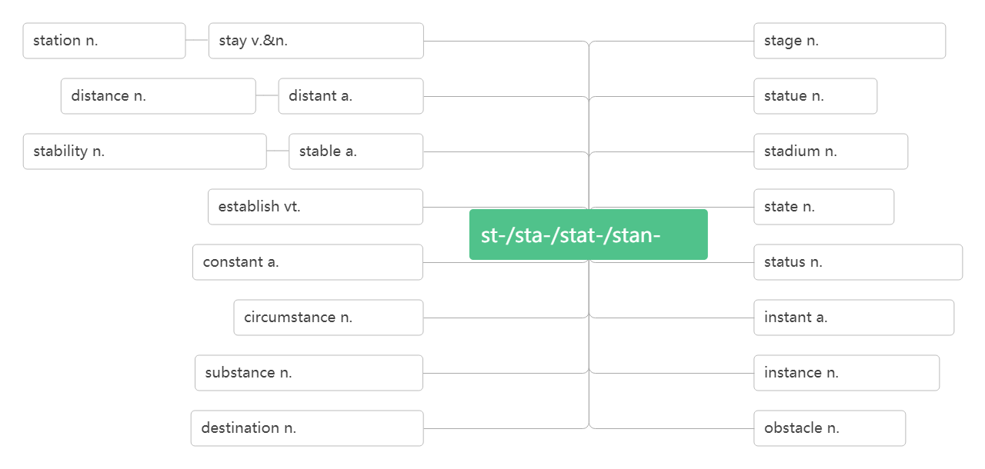
体育场; 运动场
3.stadium /ˈsteɪdiəm/ n.
a football/sports stadium 足球/运动场
To hold the Olympic Games, several stadiums have been built for competitions.为了举办奥运会，建了好几个供比赛用的体育场。
车站;驻地
停留;待着
舞台;阶段,时期
距离;远处
遥远的
雕像
稳定性;恒心
稳定的
体育场
建立;创立
状态;州
站
连续的,不断的
地位;状况
环境
立即的;紧急的
物质;本质
情况;例子
目的地; 终点
障碍

Slide 8
拳击
4.boxing /ˈbɒksɪŋ / n.
a boxing match 拳击比赛
heavyweight boxing 重量级拳击
Do you want to watch the boxing match? 你想看拳击比赛吗？
Boxing matches were very popular in England two hundred years ago. 两百年前拳击比赛在英国就很盛行。
羽毛球
5.badminton /ˈbædmɪntən/ n.
How about watching badminton this afternoon?
今天下午去看羽毛球比赛怎么样？
Let's go to the badminton match.咱们去看羽毛球比赛吧。
He can play badminton quite well now.他羽毛球打得很好。
破拆法：bad(不好)+min(民众)+ton(疼)
助记：腿不好的民众打羽毛球会腿疼。

Slide 9
马拉松赛跑
6.marathon /ˈmærəθən/ n.
Beijing International Marathon Day 北京国际马拉松日
Full Marathon and Half Marathon 全程和半程马拉松赛
He set up a new national record in the marathon race.
他创造了马拉松赛跑的全国新记录。
大事; 盛事; 赛事
7.event/ɪˈvent/ n.
Badminton is traditional advantage event in China.
我国羽毛球是传统优势运动项目。
The 800 metres is the fourth event of the afternoon.
800 米赛是下午的第四项比赛。
Holding the Olympic Games is a big event for China.
举办奥运会对中国是一件大事。

Slide 10
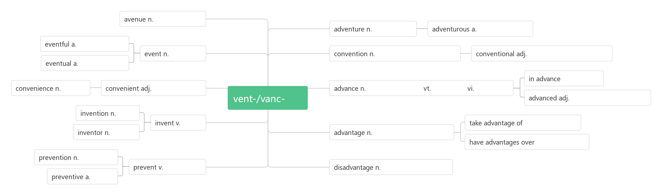
大道;林荫道
奇遇,冒险
冒险的;大胆的
多事的;重大的
大会；惯例；公约；习俗
事件,盛事
常规的;传统的;惯例的
最终的,最后的
提前,预先
便利
方便的,便利的
前进;事先
促进
前进
来
先进的,高级的
发明
发明
利用;占便宜
优点,优势,
有利条件
发明者
比……有优势
预防,防止
预防,防止
缺点,劣势,不利条件
预防的

Slide 11
8.come along
Would you like to come along? 你一起来吗？
There's a big party tonight .Would you like to come along?今晚有一个大型的聚会，你一起来吗？
Come along with me, boys, don’t keep everybody waiting.孩子们跟我来, 大家都在等你俩呢。
When the right opportunity comes along, you must take it. 适当的机会来临时，你要抓住它。
Your English has come along a lot recently.
你的英语最近进步很大。
Come along or we'll miss the train.
快点,不然就会赶不上火车。
过来；到来；进步；赶快

Slide 12
滑雪
9.ski /ski:/ vi.&n.
ski race滑雪比赛
ski boots 滑雪靴
He went on a ski trip with some friends.
他和一些朋友滑雪去了。
I like to ski on the snow. 我喜欢在雪上滑雪。
He skied down the mountains. 他从山坡上滑了下来。
去滑雪
They go skiing in Switzerland every winter.
他们每年冬天去瑞士滑雪。
The students often go skiing during winter vacation.
学生们在寒假期间经常去滑雪。
go skiing

Slide 13
主办;主持
主人;东道主;节目主持人
10.host /həʊst/vt. n.
Zhangjiakou will host the Youth Ski Race in December.
十二月份张家口要举办青年滑雪比赛。
Does anyone want to host the Olympic Games?
会有人想承办奥运会吗？
He has dreamed of hosting a pop music programmer.
他梦想着主持一个流行音乐节目。
Our host introduced us to the other guests.
主人把我们介绍给了其他客人。
I am the host of a live radio programme.
我是一个电台直播节目的主持人。
Most people think being a television host is exciting.
很多人认为当电视节目主持人是一件刺激的事情。

Slide 14
host family
寄宿家庭（人们出国时所借宿的人家）
Do you want to learn to speak English well? Why not go to England and stay with a host family?
你想学说一口好的英语吗？为什么不去英国与房东一家人住在一起呢？
/ˈhəʊstəs/ n.女主人; 女主持人
Mary was always the perfect hostess.
玛丽总是最殷勤的女主人。
11.track /træk/ n. vt.& vi.
track and field 田径
track-and-field lover 田径爱好者
hostess
跑道;足迹;轨道
跟踪; 追踪

Slide 15
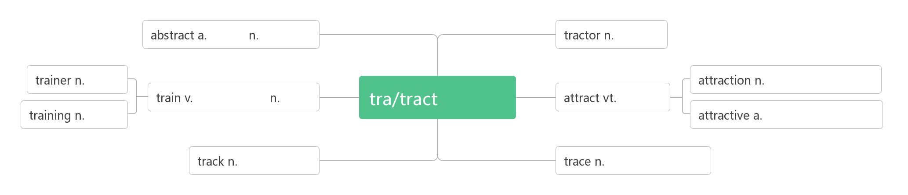
抽象的
摘要
拖拉机
教练
吸引,景点
训练
火车
拖拽
吸引
训练
有吸引力的
轨道,车辙,痕迹
足迹,痕迹
What are the most important competitions in_____________? 最重要的田径比赛有哪些?
Are you also taking part in the ____________ events today?你今天也要去参加田径比赛吗 ?
Suddenly an athlete fell on to the running _____.
突然一名运动员摔倒在赛跑跑道上。
track and field
track-and-field
track

Slide 16
After the earthquake, the railway ______ were useless pieces of steel. 地震之后，铁轨成了一条条废钢。
Neither a wise man nor a brave man lies down on the ______ of history to wait for the train of the future to run over them.
智者和勇者都不会躺在历史的轨道上等待未来列车碾压他们。
The hunter _______ this wolf and killed it.
猎人跟踪这只狼，并杀死了它。
Our radar began ________ the planes .
我们的雷达开始追踪飞机的动向。
tracks
tracks
tracked
tracking

Slide 17
12.gym/dʒɪm/ n.
Come and work out at a gym! 来健身房锻炼吧！
I usually go to the gym during my lunch hour.
我通常在午休时间去健身房。
Our school has recently built a new gym.
我们学校最近新建了一个体育馆。
We played basketball in the gym because of rain.
由于天气下雨, 我们在体育馆打篮球。
健身房; 体育馆

Slide 18
体操(训练)
gymnastics/dʒɪmˈnæstɪks /n.
Gymnastics is his favourite sport. 体操是他最喜爱的运动。
She does gymnastics at school every day.
她在学校每天做体操训练。
I love gymnastics. I think it's more exciting than badminton.
我更喜欢体操, 我认为体操比羽毛球更让人激动。
破拆法：gym(健身房)+na(那)+st(stand站)+ics(科目)：站在健身房表演的科目——体操

Slide 19
锻炼；计算出；解决
13.work out
Come and work out at a gym! 来健身房锻炼吧！
I work out at a gym twice a week. 我一周去健身房锻炼两次。
You are fat, so you must work out regularly.
你太胖了，应该定期锻炼。
Work out how much all these things will cost.
算算买这么东西要多少钱。
She find it difficult to work out the problem.
她发现解决这问题有困难。
I can't work out how to do it.
我无法解答如何做这个。

Slide 20
获得成功；准时到达
15.make it
You can make it! 你会成功的！
Work hard and you can make it. 努力学习，你会成功的。
I believe anyone can make it if he tries hard.
我相信只要努力任何人都能获得成功。
I don't know whether I can make it in science.
我不知道我能否在科学上获得成功。
The flight leaves in twenty minutes─we'll make it.
再过二十分钟飞机就起飞了，我们会准时到达的。
I think we'll just make it if we hurry up!
如果抓点紧，我想我们能及时到达。

Slide 21
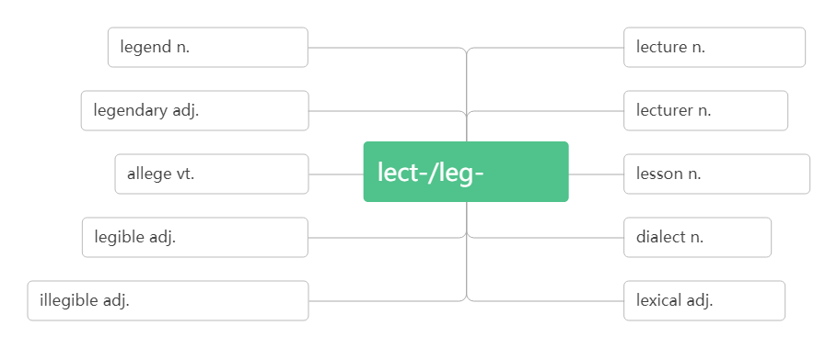
传奇; 传说
16.legend /ˈledʒənd / n.
英雄联盟
当今体育传奇人物
Yao Ming is a basketball legend. 姚明是一个篮球传奇人物。
He enjoys reading ancient Greek legends. 他喜欢读古代希腊传说。
词根词缀：leg-(说)+end(最后）：被人传颂到最后——传奇
传奇,传说
讲座;课程
传奇般的
演讲者
断言,宣称
说/读
课程;教训
易读的,清晰的
方言
潦草的,字迹模糊的
词汇的
League of Legends
living legends of sports

Slide 22
运动员；运动健儿
17.athlete /ˈæθli:t/ n.
Long Ping is not only a great athlete but also an outstanding coach.
郎平不但是一位伟大的运动员而且是杰出的教练。
She is a natural athlete. 她是个天生的运动健儿。
破拆法：ath(Athens雅典)+let(让)+e(enter)
助记：让来自雅典的运动员入场。

Slide 23
高手; 大师; 主人
精通; 掌握
18.master/ˈmɑ:stə(r)/n. vt.
Deng Yaping is a master of pingpang.邓亚萍是一个乒乓球高手。
He was named a "great master of language". 他被誉为“语言大师”。
The dog was running behind its master. 狗跟在它主人后面跑着。
She should be the master of her own future. 她应该把握自己的未来。
To the basketballers, the most important things is to master the skills of basketball.对篮球队员来说，最重要的事是精通篮球技术。
Students are expected to master a second language.
学生应该掌握一门第二语言。
I want to travel all over the world, so I need to master English first. 我想周游世界，因此，首先我得精通英语才行。

Slide 24
树立榜样
19.set an example
They must be athletes who are masters in their sports and also set good examples for others.
他们一定是一些远动员, 是他们领域的高手, 并且给别人树立好榜样。
Famous people should set a good example for others.
名人应该为别人树立好榜样。
Parents should set a good example for their children.
父母亲应该为孩子树立好榜样.
She arrived at the office early to set an example for the others.
她很早就来到办公室,作为他人的表率。

Slide 25
荣誉;荣幸;敬意
尊敬;授予荣誉
20.honour /'ɒnə(r)/n. vt.
We won the game and brought ______ to our school.
我们赢得了比赛，为学校赢得了荣誉。
We compete against each other just for the ______ of winning.
我们为了赢得荣誉而彼此竞争。
It was ___ honour to be invited here today.
今天承蒙邀请到此,深感荣幸。
India ________ him as the Father of the Nation and his birth anniversary is a national holiday.
印度人将他敬为国父，并以他的生日为国庆日。
Virginia Hamilton is America's most ________ writer of children's literature.弗吉尼亚·汉密尔顿是美国最受尊敬的儿童文学作家。
音意互通：傲呢 助记：荣誉的事情值得骄傲呢。
honour
honour
an
honours
honoured

Slide 26
为了纪念; 向……表示敬意
in honour of
The Duanwu Festival is held in honour of the famous ancient poet, Qu Yuan . 端午节是为了纪念古代著名的诗人—屈原。
We celebrate Mother's Day in honour of our mothers.
我们庆祝母亲节是为了向母亲表示敬意。
They held a party in honour of the foreign visitors.
他们为国外来访者举办了晚会。

Slide 27
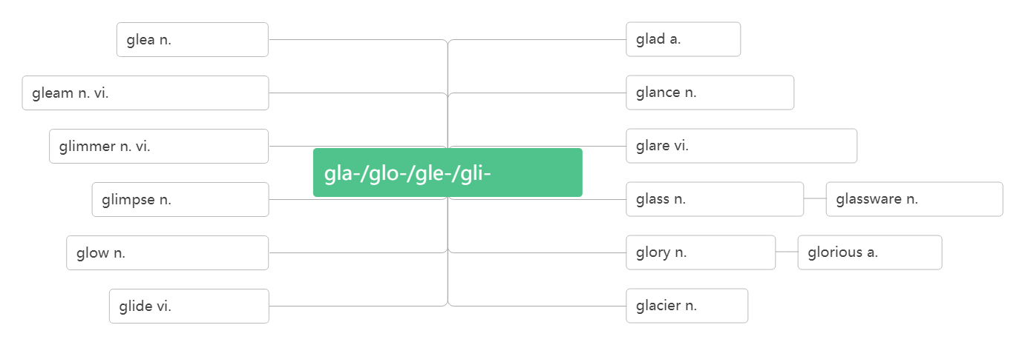
光荣；荣誉；赞美
21. glory /ˈglɔ:ri /n.
As a player, Lang Ping brought honour and glory to her country.
作为一个运动员，郎平为国家带来了无限荣光。
She won the game and was enjoying her moment of glory.
她赢得了比赛，享受着自己的光荣时刻。
Glory belongs to the great motherland. 光荣归于伟大的祖国。
高兴, 欢乐
高兴的
微光;反光
隐约闪烁
闪光; 一瞥
微光
发出微光
耀眼; 怒视
光/光滑
一瞥;一闪
玻璃(杯)
玻璃器皿
炽热;光辉;热情
光荣;荣耀
光荣的
滑动,滑过
冰川

Slide 28
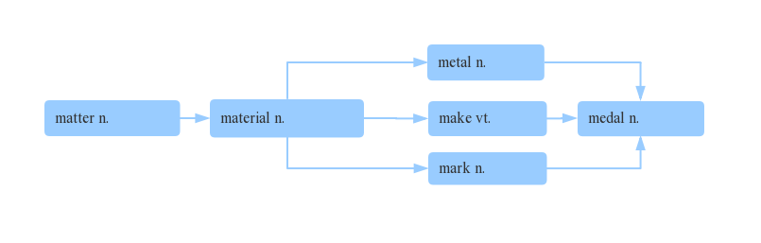
奖章; 勋章
22.medal/ˈmedl/n.
e.g.
She won a gold medal in the Olympics.
她在奥林匹克运动会上赢得一枚金牌。
She is an Olympic gold medal winner. 她是奥运会金牌得主。
The young man was awarded a medal for bravery.
这个年轻人被授予一枚英勇勋章。
金属
物质
材料
制作
奖章
标记

Slide 29
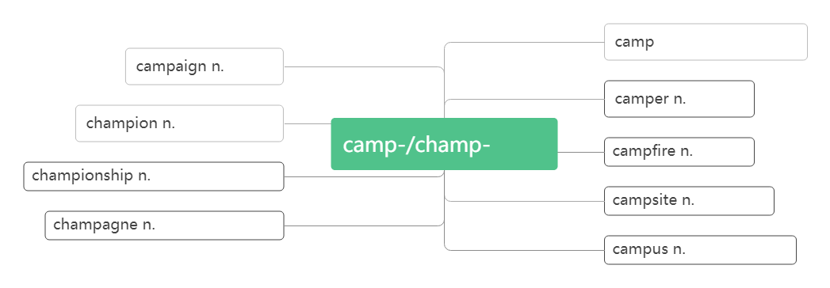
冠军; 优胜者
23.champion /ˈtʃæmpiən/ n.
Two weeks later they were world champions!
两周后她们成了世界冠军。
At the age of eighteen, Ali was the world champion in boxing.
18岁时，阿里已经是世界拳击冠军。
n.营地
vi.宿营
战役
宿营者
冠军;胜利者
营地
营火
锦标赛; 冠军称号
宿营地
香槟酒;香槟色
校园;校区

Slide 30
锦标赛; 冠军称号
championship/ˈtʃæmpiənʃɪp/ n.
As a coach, she led the China women's volleyball team to medal at world championships and the Olympics. 作为一名教练，她带领中国女排在世界锦标赛和奥林匹克运动会上赢得了奖牌。
This year's national college football championship was won by Princeton. 今年全国高校足球锦标赛普林斯顿队获胜。
They've held the championship for the past two years.
他们在过去的两年里一直保持着冠军地位。

Slide 31
决定; 确定; 下决心;
24.determine/dɪ'tɜ:mɪn/vt.
/dɪtɜ:mɪˈneɪʃn/ n.决心；决定
/dɪ'tɜ:mɪnd/adj.坚决的，有决心的
决心做某事
练：
They_________ to start early. 他们决定早点出发。
A date for the meeting has not been __________. 会议日期尚待确定。
Shall we _________ what we are going to do next?
我们来确定一下下一步该做什么吧?
词根词缀：de-(强调)+termin-(界限)+e：界定——决定；确定
determination
determined
be determined to do sth.
determined
determined
determine

Slide 32
When the Chinese team was preparing for the 2015 World Cup, her ____________ was tested.
当中国队正在备战2015年世界杯时，她的决心受到了考验。
He fought the illness with courage and ____________.
他勇敢顽强地与疾病作斗争。
A __________ person always tries to finish the job, no matter how hard it is.
无论工作有多困难，一个有决心的人总是会设法完成它。
She was __________ to become a doctor and her hard work paid off.她决心成为医生，她的努力取得了成功。
determination
determination
determined
determined

Slide 33
分离地；分开地
25.apart/əˈpɑ:t / adv.
把……区别开
把……拆开
破裂；破碎；崩溃
We're living______now. 我们现在不住在一起。
I can't ___ the twins apart. 我分不出这一对双胞胎中谁是谁。
I needed to ____ apart my computer.我得把我的电脑拆开。
The team that Lang Ping had built was ______apart.
郎平组建的队伍正在分崩离析。
The house is so old and it's ______ apart.
那座房子太破旧，都开始坍塌了。
tell...apart
take apart
take apart
apart
tell
take
falling
falling

Slide 34
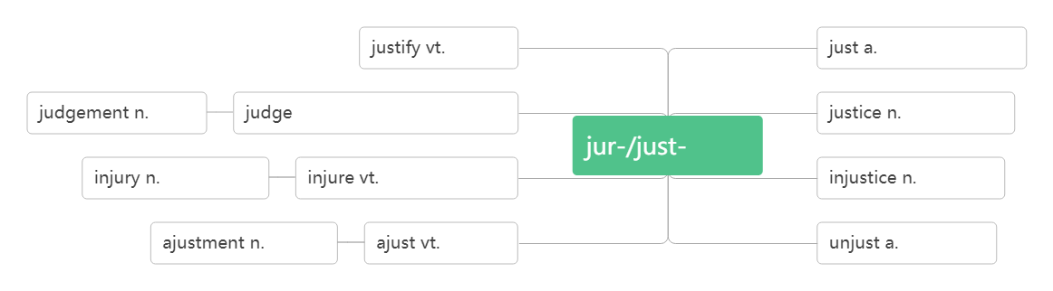
伤害；损害
26. injure/ˈɪndʒə(r)/ vt.
/ˈɪndʒəd/ adj. 受伤的；有伤的
/ˈɪnd ʒəri / n. 伤害；损伤
使公正
公正的, 正义的
判断
vt.判断,评判n.法官,裁判
公正, 正义
公正
伤害, 损害
伤害, 损害
不公正
调整
调整
不公正的
injured
injury

Slide 35
练：
He _______ his left foot playing football.他踢足球时伤到了左脚。
Three people were killed and five ____________ in the crash.
撞车事故中有三人死亡，五人受伤。
One of the best players had ___________. 最好的球员之一受伤了。
Luckily, she isn't ________.幸运的是，她没受伤。
Many of them died because they were so badly _______.
他们中很多人因伤势过重而死亡。
Two players are out of the team because of ______ .
两名队员因伤退出了比赛。
A racing _______ made him in hospital for two weeks.
一次比赛中的受伤使他住院两周。
injured
were injured
been injured
injured
injured
injury
injury

Slide 36
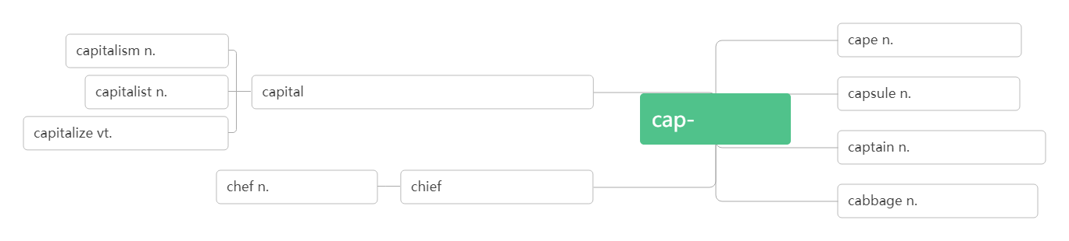
队长；船长；上尉
27. captain /ˈkæptɪn / n.
One of the best players had been injured, and the team captain had to leave because of heart problem.
最好的球员之一受伤了，并且队长因心脏问题不得不离开。
She was captain of the football team at school.
她过去是学校足球队的队长。
The captain ordered all the passengers into lifeboats.
船长命令所有乘客进入救生艇。
词根词缀：cap(头)+tain(握/拿)：当头拿主意的人——队长；船长
资本主义
斗篷;海角
资本家
n.首都;省会;资本
a.首要的;大写的
胶囊;密封舱
头/帽子
资本化
队长;上尉;船长
大厨,主厨
n.领袖,首领
a.主要的
卷心菜;大头菜

Slide 37
丧失信心；灰心
28.lose heart
lose one's heart to
Losing two important players was a big challenge, but Lang Ping did not lose heart. 失去两名重要球员是一个巨大的挑战，但郎平没有灰心。
The scientist never lost heart when he was in trouble.
那位科学家遇到困难时从不灰心。
We shouldn't lose heart. We may have another try.
我们不应该灰心,我们可以再试一次.
Although he failed in this entrance examination, he didn't lose heart.
这次入学考试他虽名落孙山, 但他并不气馁.
When he was a child, he lost his heart to poems.
他是个孩子时就喜欢上诗歌。
The first time he saw the girl he lost his heart to her.
他第一次看到这个女孩就爱上了她。
爱上

Slide 38
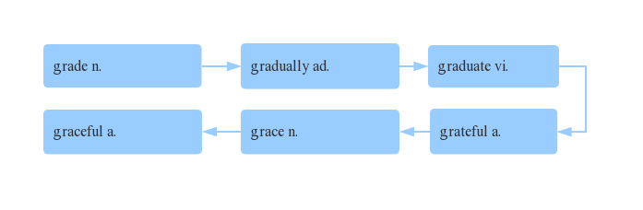
优美的；优雅的
29.graceful /ˈgreɪsfl / adj.
词群：You need to ________ achieve the _____ to ________, and be _______ to hold your _____ to live a ________ life.
The player who became known as “Air Jordan” changed basketball with his _______ moves and jump.
这个被称为“飞人乔丹”的球员以他优雅的动作和跳跃改变了篮球。
等级; 年级
逐渐地
毕业
优雅的
优雅; 恩惠
感激的
gradually
grade
graduate
grateful
grace
graceful
graceful

Slide 39
grace
The ballet dancers were all tall and _____.
这些芭蕾舞演员都个子高高的，动作十分优雅。
His handwriting is flowing and _______.
他的字写得流畅优美。
Courage is _____ under pressure. 勇气就是压力下的优雅。
She lived a life of activism, but also a life of dignity and _______. 她的一生积极向上，充满尊严与优雅。
30.strength /streŋθ/ n.
/ˈstreŋθn/vt.加强；巩固；使坚强 vi.变强
/strɒŋ/adj. 强壮的; 坚强的
graceful
grace
grace
力量；力气；强项
strengthen
strong

Slide 40
Jordan's skills were impressive, but the mental _______ that he showed made him unique.
乔丹的技能令人印象深刻，但他表现出来的精神力量使他与众不同。
Take into account your own ________ and weaknesses.
考虑一下你自己的长处和弱点。
I think you have to find an inner _______ in order to feel good about yourself. 我觉得只有找到内心的力量才能有自信。
The exercises are designed to _________ your stomach muscles.
这些活动目的在于增强你的腹部肌肉。
Our bodies are ____________ by taking exercise.
参加锻炼可以增强我们的体质。
strength
strengths
strength
strengthen
strengthened

Slide 41
strengthen
Repairs are necessary to _________ the bridge. 这座桥需要加固。
The wind __________ overnight. 夜里，风更大了。
Courage is like a muscle. We __________ it with use.—Ruth Gordon
勇气就像肌肉，我们经由使用它来加强它。 —露丝‧戈登
To avoid knee pain, you can run on soft surfaces, do exercises to__________ your leg muscles (肌肉).（2018 全国卷I）
为了避免膝盖疼痛，你可以在柔软的表面跑步, 做运动来增强腿部肌肉。
He's ______ enough to lift a car! 他力气大得能抬起一辆汽车！
We should be ______ enough to deal with any difficulty.
我们应该足够坚强，能够处理任何困难。
strengthened
strengthen
strengthen
strong
strong

Slide 42
失败；失败的人/事物
31. failure / ˈfeɪljə(r) / n.
fail /feɪl/ vi. & vt.
Jordan says that the secret to his success is learning from his ______.
乔丹说他成功的秘诀是从失败中吸取教训。
The success or _______ of the plan depends on your determination.
这项计划的成败取决于你的决心。
I can accept _______, but I can't accept not trying.
我可以接受失败，但我不能接受从不去尝试。(迈克·乔丹)
Success is the ability to go from one _______ to another with no loss of enthusiasm. 成功是，你一次又一次失败，却仍没有失去热情。
Winners are not those who never ____ but those who never quit.
成功者不是从不失败，而是从不放弃。
Happiness will never come to those who ____ to appreciate what they already have. 幸福不会降临在那些不懂感激自己所拥有的人的身上。
失败; 未通过; 未能(做到)
failure
failure
failure
failure
fail
fail

Slide 43
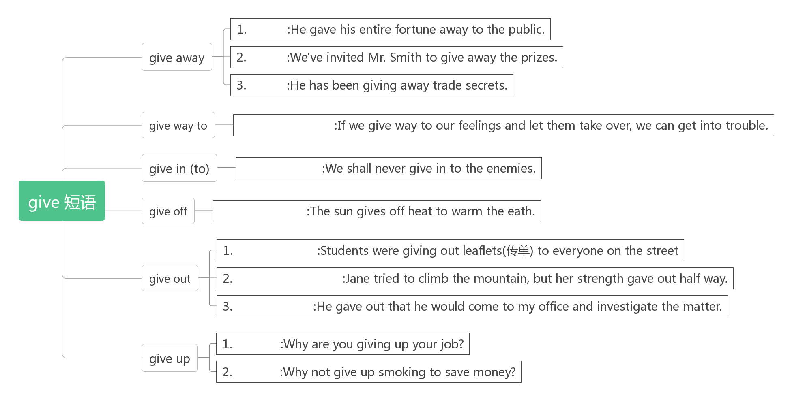
放弃；认输
32.give up
赠送
分发
泄露
让步于,屈服于
屈服,投降
散发,发出
散发,分发
被用光,耗尽
公布,公开
放弃
戒除

Slide 44
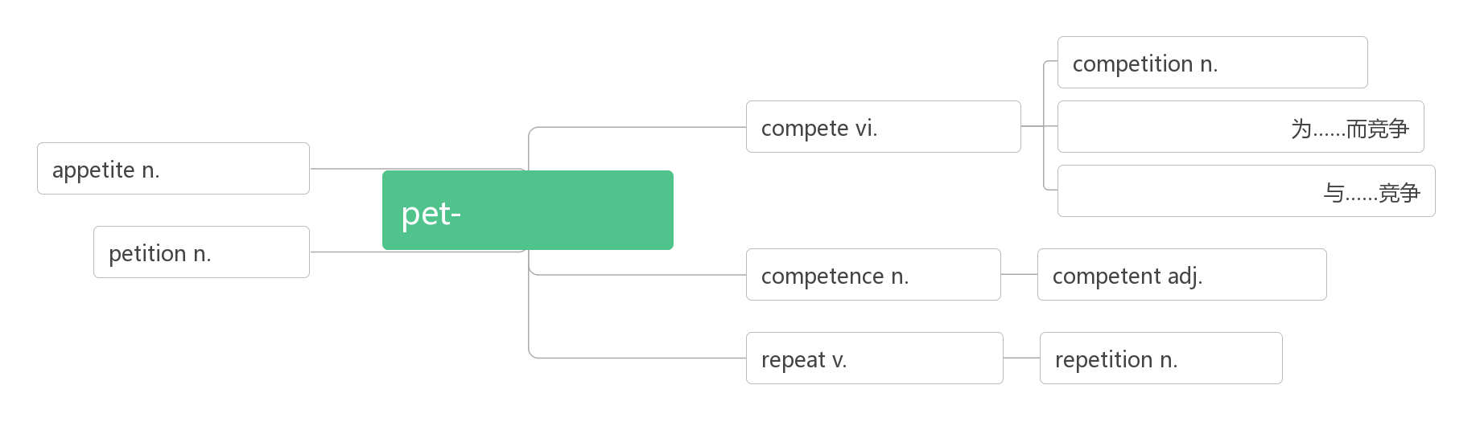
竞争；比赛
33.compete /kəmˈpi:t/ vi.
为……而竞争
参加……比赛
同某人比赛/竞争
/ˌkɒmpəˈtɪʃn/ n. 比赛；竞赛
与……处于竞争中
/kəmˈpetɪtə(r) / n. 竞争者
/kəmˈpetə t ɪv/ adj. 竞争的；有竞争力的
词根词缀：com-(共同)+pete-(追求):大家都来追求——竞争
compete for sth.
compete in sth.
compete with/against sb.
competition
in competition with
competitor
competitive
竞争;比赛
比赛;竞争
compete for
胃口;食欲
追求,追寻
compete with/against
请愿
能力
有能力的
重复；重做
重复

Slide 45
An athlete should think about honour and his/her fan if he/she is _________for his/her country.
如果为国家参赛，运动员应该考虑荣誉和他的球迷。
How many countries competed ___the ancient Olympic Games?有多少个国家参加古代奥林匹克运动会？
He's hoping to compete ___ the London marathon.
他期盼着参加伦敦马拉松比赛。
Our Greek cities used to compete __________ each other just for the honour of winning.
我们希腊各个城市之间曾经为了赢得荣誉而彼此竞争。
They competed ___________ each other to attract more customers.
他们互相竞争以吸引更多的顾客。
Instead there are ___________ like skiing and ice skating which need snow and ice.相反却有像滑冰和滑雪这类需要冰雪的比赛项目。
competing
in
in
with/against
with/against
competitions

Slide 46
with
We are in competition ____ four other companies for the contract.我们在与其他四家公司竞争这项合同。
When they were free from work, they invited us to local events and let us know of an interesting ___________(compete) to watch，together with the story behind it.（2019 全国卷III）
当我们不工作时，他们邀请我们去看当地的赛事，让我们了解一项值得一看的有趣的比赛，以及其背后的故事。
More than 10,000 __________ from different countries came to Beijing to compete with each other in the Olympic Games for medals. 来自不同国家的一万多名参赛选手来到北京参加奥运动会为了奖牌而相互竞争。
We need to work harder to remain __________ with other companies.我们必须更加努力工作以保持对其他公司的竞争力。
competition
competitors
competitive

Slide 47
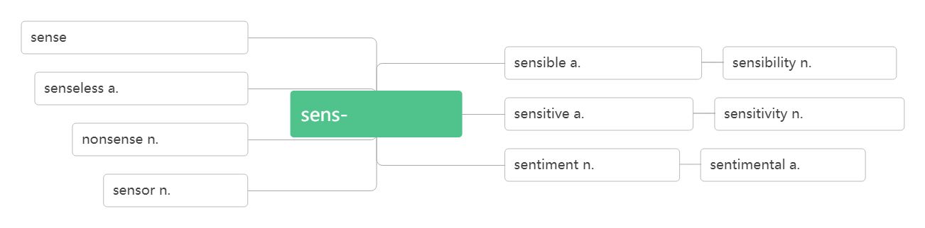
感到
感觉;意义;理智
34.sense /sens/vt. n.
make sense
make sense of
做某事毫无意义。
n.感觉;意义;理智
vt.感到
有意义的
感性,情感
没感觉的,没意义的
感觉/意义
敏感的;灵敏的
敏感;灵敏度
胡说;荒唐
感情;感伤
感伤的
传感器
有道理；讲得通
弄懂；领会
There is no sense (in) doing sth.

Slide 48
练：
That doesn't make any _____! 这个行不通/没有意义。
It doesn't make sense ________(argue) with him.
和他争论没有任何意义。
Her advice doesn’t make sense __ me.
她的建议对我来说没有意义。
John wasn't _______ much sense on the phone.
约翰在电话上说得不大清楚。
I can't make sense ___ this poem. 我弄不懂这首诗的意义。
There is no sense __ doing nothing but complaining.
不做事只抱怨没有任何意义。
sense
to argue
to
making
of
in

Slide 49
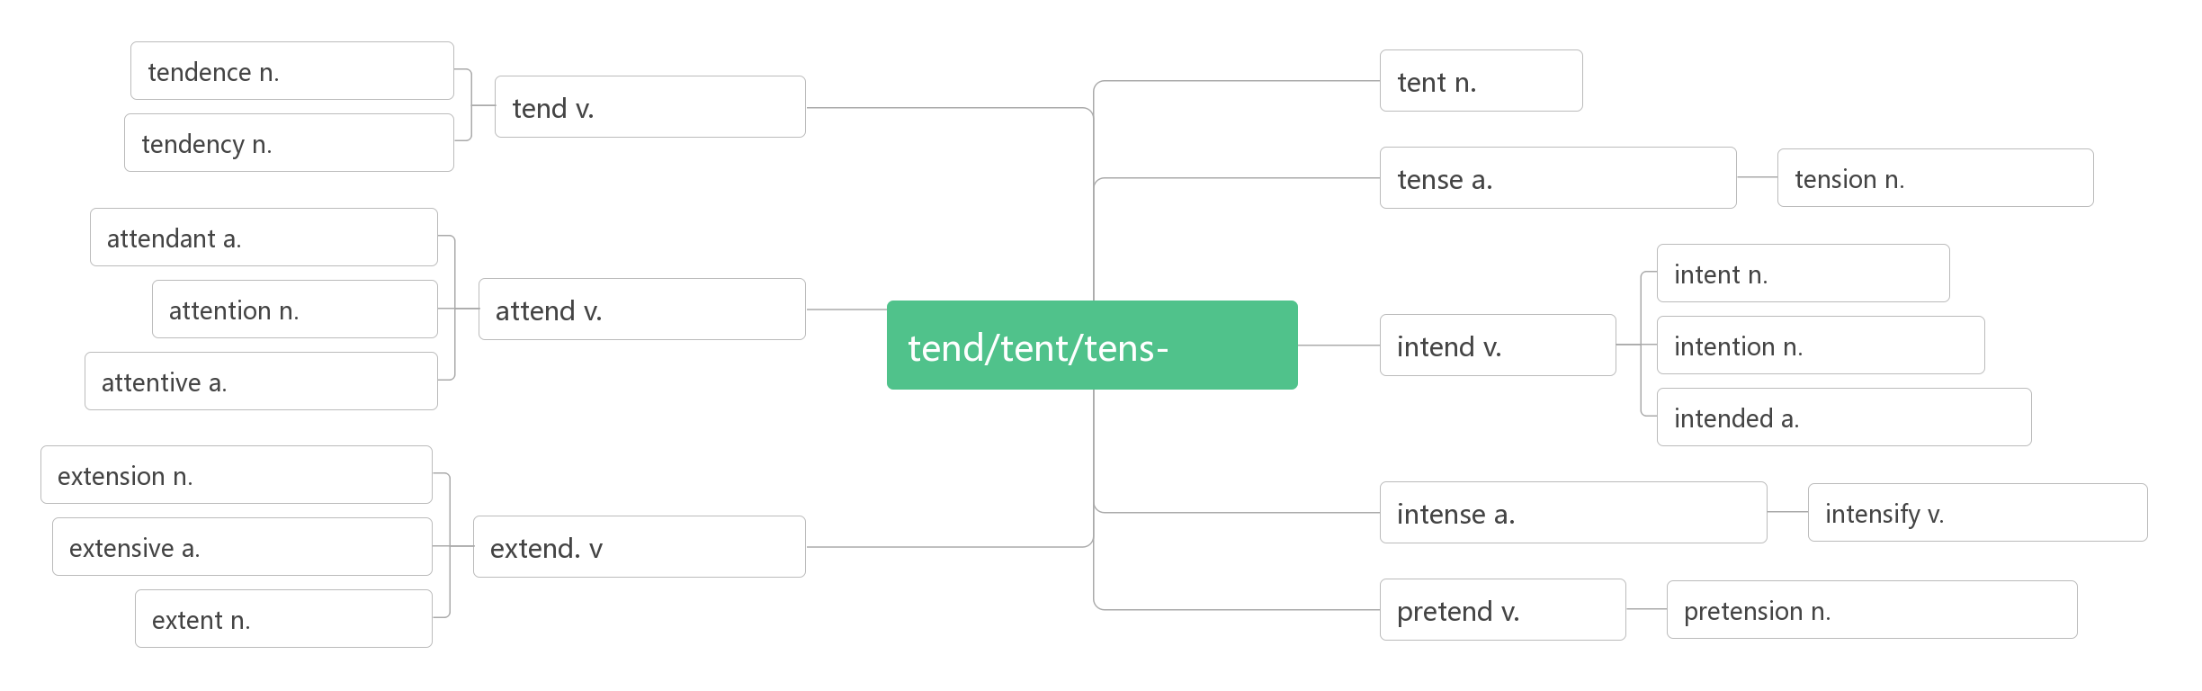
假装
35.pretend/prɪˈtend/vi.& vt.
词根词缀：pre(向前)+tend(伸展)：把肢体向前伸——假装在做某事
趋势;倾向
帐篷
照料;倾向于
趋势;倾向
紧张的;拉紧的
紧张;张力
出席的
n.随从
意图,目的
注意力
出席;照料
伸展
打算
意图,打算
体贴的,留心的
故意的;筹划中的
延伸,扩张,延期
激烈的,剧烈的
加强,加剧
广泛的,广阔的
延伸,扩展
范围;程度
假装
装腔作势

Slide 50
Do you sing karaoke and ________ you are a famous singer like Song Zuying or Liu Huan?
你是否唱卡拉OK，并假装自己是像宋祖英或刘欢一样著名的歌唱家？
He pretended to his family ____ everything was fine.他对家人佯称一切都好。
A soccer player should not pretend _______(fall) down even if it helps his/her team.足球运动员即使是帮助自己的球队也不能假摔。
If you pretend _________(know) what you don't know, you'll only make a fool of yourself. 不懂装懂就会闹笑话。
The boy pretended to _________(do) his homework when his mother came in．当他妈妈进来的时候，这个男孩假装正在做作业。
He pretended to ______________(forget) his promise.他假装忘记了他的承诺。
pretend
that
to fall
to know
be doing
have forgotten

Slide 51
即使；尽管
36.even if/though
WeChat Pay(微信支付) makes our life convenient. We can buy things even if/though we don’t take any money.
微信支付使我们的生活很便利。即使我们没带钱也可以买东西。
You will miss the flight even if/though you catch a Didi car.
即使你打滴滴车，你也赶不上航班了。
Even even if/though it should rain tomorrow, they will go for an outing.即使明天下雨，他们也要去游览。
Even if/though the forest park is far away, a lot of people visit it every year.
尽管那个森林公园很遥远，但是每年都有很多游客到那里参观。

Slide 52
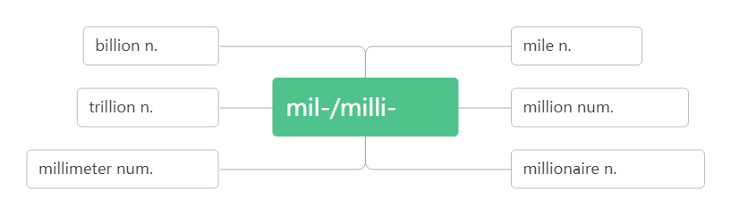
百万
37.million/ˈmɪljən/ num.
They sold their house for about 1.4 million pounds.
他们把的房子卖了140 万英镑。
millions of 数百万的
It is wrong to pay people millions of yuan to play sport.
给人们几百万元来参加体育运动是不对的。
Millions of people all over the world watched the football game on TV.
全世界数百万的人通过电视观看这场足球赛。
十亿
英里
万亿
千
百万
毫米
百万富翁

Slide 53
作弊;舞弊
欺骗;蒙骗
欺骗;骗子
38.cheat/ tʃi:t / vi. vt. n.
骗取某人某物
You should never _______in an exam.
你永远不应该在考试中作弊。
John ________ in the exam, and the teacher kicked him out of the class. 约翰考试作弊，结果被老师赶出了教室。
Although people may _____ you, be honest anyway.
虽然人们可能会欺骗你，但不管怎样，你都要诚实。
He looks honest, but actually he is __ cheat.
他看上去挺厚道，可实际上他是个骗子。
He cheated the old lady ___ her money. 他骗取了老太太的钱。
cheat sb. of sth.
cheat
cheated
cheat
a
of

Slide 54
观众；听众
39. audience/ˈɔːdiəns / n.
I see what you mean, but the audience wants fair play.
我明白你的意思，但观众希望公平竞争。
The audience were greatly moved by his performance.
观众们被他的表演深深打动。
His speech made a strong impression on the audience.
他的演说给听众留下了深刻的印象。
词根词缀：audi-(听)+-ence(名词后缀)：听的人——听众;观众

Slide 55
积极的;正面的;乐观的;肯定的
40.positive /ˈpɒzətɪv / adj.
By being positive about myself and my body, I became both happier and healthier.
通过对自己和身体保持积极的态度，我变得更快乐、更健康。
She tried to be more positive about her new job.
她力求对新工作更有信心。
Keep a positive attitude and good things will happen.
保持乐观的心态，好事自然会发生。
I was positive that things were going to turn out fine.
我确信事情最终会好起来的。
音义互通：跑着起舞 助记：积极乐观的人会随风奔跑着起舞。

Slide 56
苗条的;纤细的
41. slim /slɪm/ adj.
I always wanted to look like the slim girls on TV even though I knew that it was impossible.
我一直想看起来像电视上的苗条女孩即使我知道这是不可能的。
She was tall and slim. 她是个瘦高个儿。
How do you manage to stay so slim?
你是怎样把身材保持得这么苗条的？
42. diet/ˈdaɪət /n. vi.
均衡的饮食
节食
日常饮食; 节食
节食
音义互通：得饿他 助记：他要想节食就得饿他。
a balanced diet
go/be on a diet diet

Slide 57
练：
I worried about my weight and tried every new _____ I read about online.
我担心我的体重，尝试了我在网上看到的每一种新的饮食。
Everybody has to eat, but do you eat ___ healthy diet?
人人都得吃饭，但是你有健康的饮食吗？
I decided to go ____ a diet before my holiday. 我决定在休假前节食。
She's always ________ but she never seems to lose any weight.
她总是在节食，但体重好像并未减少。
diet
a
on
dieting

Slide 58
(对……)有影响, 起作用
43. make a difference (to)
I had no idea a letter could make such a difference!
我不知道一封信会有这么大影响！
It shows that a knowledge of first aid can make a real difference.这表明懂得急救知识的确能发挥重要作用。
The dog makes a big difference to my life.
小狗对我的生活产生了很大的影响。
Whether he is here or not will make no difference to our work.
他在不在对我们的工作没有影响。
I have to make an effort if I want to make a difference.
如果我想有所改变，我一定会尽我所能。

Slide 59
相当, 很
44.rather /ˈrɑ:ð ə(r)/ adv.
She fell and hurt her leg rather badly. 她跌倒了，腿伤得相当重。
I didn't fail the exam; in fact I did rather well!
我没有考不及格，事实上，我考得不错！
It was a rather difficult question. 这是个相当难的问题。
rather than
Once I started thinking about fitness rather than weight, things began to change.一旦我开始考虑健康而不是体重时，情况开始发生变化。
Rather than cutting out the foods I enjoyed, I added healthy foods to my meal.没有停止吃我喜欢的食物，我在饮食上加了健康的食品。
I think I'll have a cold drink rather than coffee. 我想要冷饮，不要咖啡。
I'd stay at home rather than go out. 我宁可呆在家里也不出去.
而不是

Slide 60
俯卧撑
45.push-up /'pʊʃʌp / n.
I want to be able to do 30 push-ups. 我想做30个俯卧撑。
How many push-ups can you do in a minute ?
你一分钟能做多少个俯卧撑？
46.cut out
Rather than cutting out the foods I enjoyed, I added healthy foods to my meal. 没有停止吃我喜欢的食物，我在饮食上加了健康的食物。
Cut out your stupid joke! Nobody wants to hear that.
停止你那愚蠢的笑话！没有人想听。
He cut out the picture from the newspaper.他从报上剪下这图片。
停止做；裁剪出；删去

Slide 61
有时；偶尔
47.now and then
I could still have a burger now and then, but I would add a salad or an apple. 我偶尔还会吃汉堡，但是我要加沙拉或苹果。
I like to go to the cinema now and then. 我喜欢偶尔去看电影。
We haven't seen each other for years, but we chat online now and then. 我们已有很多年没见过面了，但是我们有时会上网聊一聊。
I meet him every now and then on the campus. 我不时在校园里见到他。

Slide 62
比较; 比作
48.compare /kəmˈpeə(r)/ vt.
把……与……作比较
把……比作……
与……相比（做方式状语）
Finally, I stopped__________ myself with actresses and models and looking for things that were wrong with my face or body. 最后，我不再拿自己跟女演员和模特比较, 也不再挑剔我的脸上或身体上的毛病了。
Please compare your answer with ____ on the blackboard.
请把你们的答案和黑板上的比较。
Don’t compare your life ____ others’. You have no idea what their journeys are all about.不要把你的生活跟别人比较。你不知道其他人走过什么样的路。
Enjoy your own life without comparing it with ____ of another.
享受自己的生活，不要和别人比较。
词根词缀：com-(一起)+pare(排列)：把东西排列在一起——比较。
compare… with
compare… to
compared… to
comparing
that
with
that

Slide 63
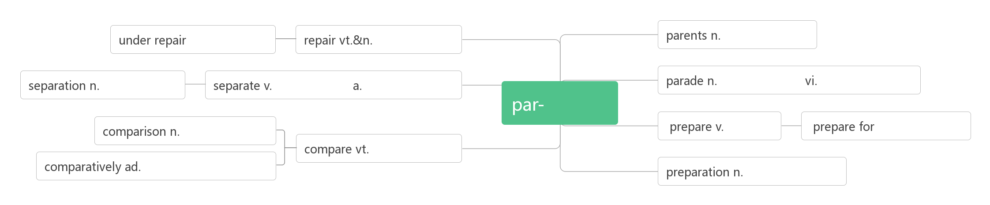
We often compare a teacher ___ a candle．我们常把老师比喻成蜡烛。
Books can ____________ to friends.书可以比喻为朋友。
_________ to/with our parents, we have greater opportunities to have a good time. 和我们的父母比起来，我们有更多机会享受生活。
to
be compared
Compared
在修理中
修理,修补
父母,双亲
分离,
脱离
分离;分开
分开的,
单独的
游行;
阅兵
游行;
列队前进
安排/排列
比较,
对照
为…作
准备
准备
比较;
比作
比较地,
相对而言
准备,预备

