Slide 1

感恩遇见，相互成就，本课件资料仅供您个人参考、教学使用，严禁自行在网络传播，违者依知识产权法追究法律责任。
更多教学资源请关注
公众号：溯恩高中英语
知识产权声明

Slide 2



2020年7月新高考全国卷Ⅰ （山东卷）
应用文讲评——新闻报道
浙江省 常山一中 吴俊峰

Slide 3
1
How to write a news report
CONTENTS
2
Three principles of writing
Comparison
between Shandong and Zhejiang
3

Slide 4
01
How to write a news report
Ask around for story ideas, especially government officials and public relations representatives.
Write down everything you see and everything that takes place. Record and take notes of any speeches that occur at events. Make sure to get the names of the speakers.
Make sure to get the full names (spelled correctly) of anyone you interviewed.
Make sure you review your transcriptions to make sure they're accurate. You don't want to misquote someone.
It is good to do basic research on the subject. Research any companies, people, or programs that you are reporting on to make sure you have your facts straight.
Double check spelling of names, dates, and any information you have gathered to make sure it is correct.

Slide 5
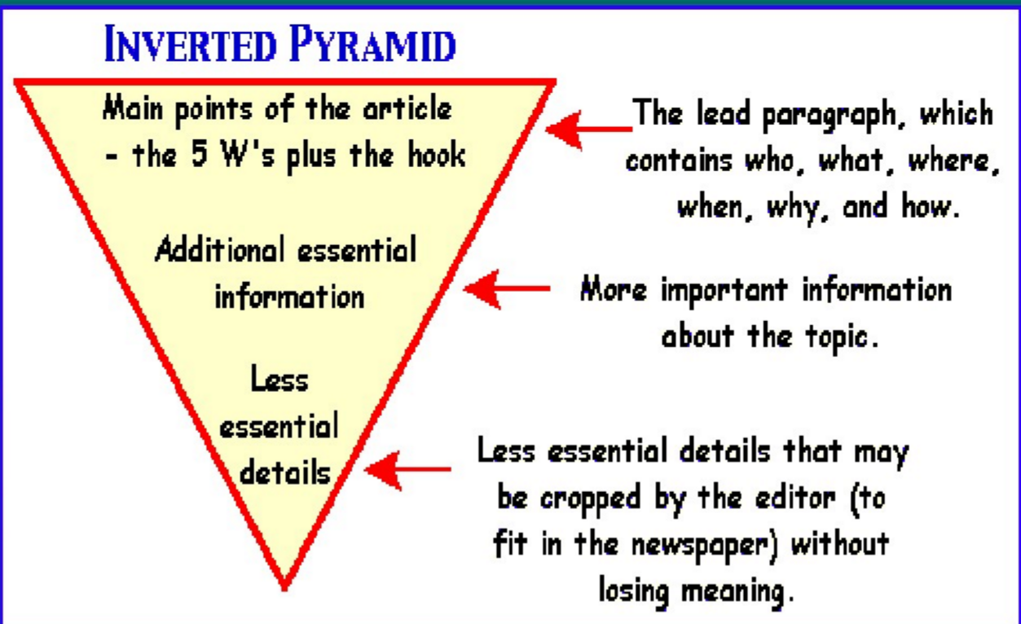
How to write a news report
A news report is similar to a news article. It is the basic facts of a story that is currently happening or that just happened.
1.
current
Report on the subject clearly, conduct good interviews, and write in a style that is clear, concise, and active. Don't use overly descriptive language. And peak in past tense.
2.
clear, concise, and active
3.
Information's Inverted Pyramid

Slide 6
How to write a news report- the structure
Part1 | 标题 headline | The headline should be accurate, clear, and easy to understand. Use key words from the story and keep it straight and plain. Use active and short action verbs in your headline. The headline should be attention grabbing, but not exaggerate or mislead.
Part2 | 导语 lead | A news lead (or introduction) is the opening paragraph of a report and is often considered the most important part. A news report is not the time for a verbose and artful lead. Keep your lead to the point. A lead is only one or maybe two sentences and summarizes the news story: the who, what, when, where, why, and how of you story should be emphasized in the lead.
Part3 | 主体 body | The body consists of the facts, but more detailed and specific than in your lead. Use the information you collected and gathered at the scene and in interviews. Write your report in third person and from a neutral perspective. Make sure your story conveys information and not an opinion.
Part4 | 结语 end | Response, summary, prediction, or thematic significance of the events.

Slide 7
How to write a news report- the lead
Part1 | 标题 headline
Part2 | 导语 lead | 假定你是李华, 上周日你校举办了5公里越野赛跑活动。请你为校英文报写一篇报道, 内容包括: 1. 参加人员；2. 跑步路线:从校门口到南山脚下；3. 活动反响。
A Cross-Country Running Race
To encourage sports on campus, a 5-km cross-country running race was held by our school last Sunday.
In order to enrich our campus life,our school organized a 5km cross-country running race last Sunday.
Last Sunday, our school held a 5km cross-country race, the route of which started from our school gate to the South Mountain.
Last Sunday, our school held a 5km cross-country running race, which attracted many enthusiastic participants, including both students and teachers.
what
who
when
where
why

Slide 8
02
Three principles of writing
Character (角色代入)-the status of identification
Completeness（要点齐全）-cover all the key points
Coherence（行文连贯）-article is well organized and clear

Slide 9

Character (角色代入)-the status of identification
假定你是李华, 上周日你校举办了5公里越野赛跑活动。请你为校英文报写一篇报道, 内容包括:
1. 参加人员；
2. 跑步路线:从校门口到南山脚下；
3. 活动反响。
注意:
1. 写作词数应为80左右；
2. 请按如下格式在答题卡的相应位置作答。
A Cross-Country Running Race
____________________________________________________________________________________________________________________________________________________________________________________________________________________________________________________________
Who are you?
Do you learn something about the 5-km Cross-Country Running Race?
I'm Li Hua, a reporter for the school newspaper.
Who are the readers of the news report?
All the school's teachers and students.

Slide 10

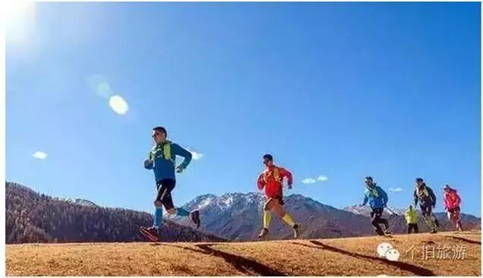
Character (角色代入)-the status of identification
As a reporter, do you know what is the Cross-Country Running Race?
Cross country running is a sport in which teams and individuals run a race on open-air courses, which may include surfaces of grass, and earth, passing through woodlands, open country, hills, flat ground and sometimes gravel road. Cross country running is a natural long-distance track and road running.
越野跑是一项团队和个人在露天球场上进行比赛的运动，其中可能包括草地和泥土表面，通过林地，开阔的乡村，小山，平坦的地面，有时还有砾石路。越野跑是一种天然的长距离田径和公路跑步。

Slide 11
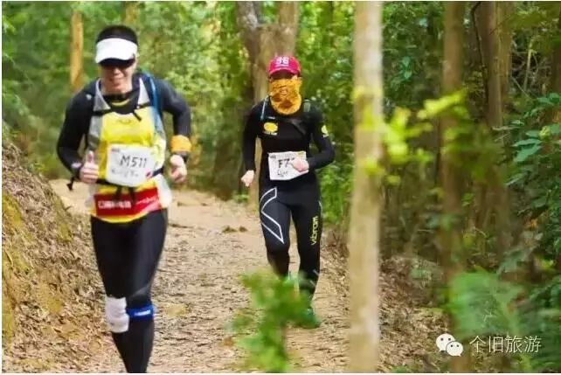
Character (角色代入)-the status of identification
As a reporter, do you know why cross country running is getting more and more popular?
That is because it shows the true spirit of athletics—It's not important to get the first prize or beat others. Instead, it is to overcome yourself, your own body, your limitations and horrors. And the victory is to go beyond yourself and get your dreams come true.
这是因为它展示了真正的体育精神——获得第一名或击败别人并不重要。相反，它是要克服你自己，你自己的身体，你的局限和恐惧。胜利就是超越自己，实现梦想。

Slide 12
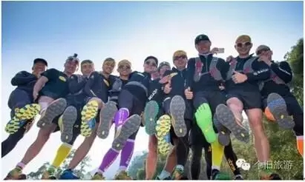
Character (角色代入)-the status of identification
As a reporter, do you know what equipment is needed for the cross country running?
Cross- country shoes, comfortable socks, backpacks, raincoats or jackets, lighting equipment, maps and a compass, timekeeping equipment, carry the mobile phone with yourself, energy gels and water, emergency equipments, a kettle bag and the route map, a scarf, a hat, and gloves. They all depend on the weather and personal hobbies.
越野鞋、舒适的袜子、背包、雨衣或夹克、照明设备、地图和指南针、计时设备、随身携带手机、能量凝胶和水、应急设备、水壶袋和路线图、围巾、帽子和手套。它们都取决于天气和个人爱好。

Slide 13
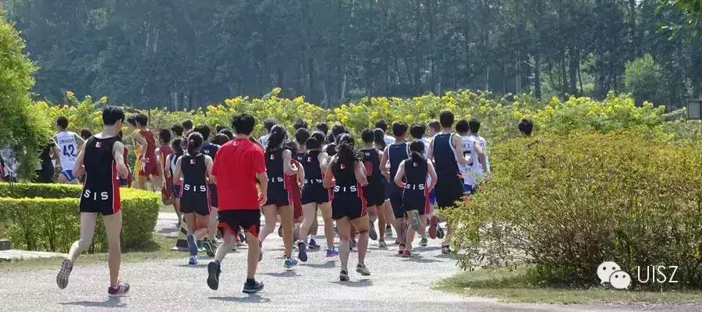
Completeness（要点齐全）-cover all the key points
1
参加人员
Approximately 300 participants from our
school competed in this running event.
This annual event with the theme of “Brace
yourself, Embrace nature” attracted about 500 faculty and students to compete in.
Finishers received a medal and certificate which was an online version in order to save paper and be more environmentally friendly.

Slide 14
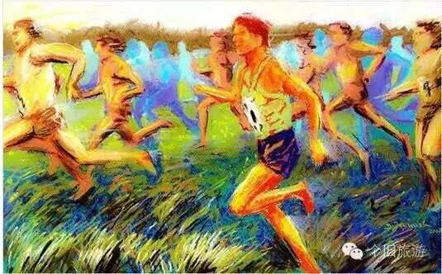
Completeness（要点齐全）-cover all the key points
1
参加人员
The race consisted of two groups: student and school staff.
Ninety students from twenty classes participated in the race, among whom thirty were girls.
At 8:30 am, the referee announced the rules of the race and the teacher gave us some instructions on how to protect ourselves from injury during the race. Then, the race began at 9:00 am and it lasted about an hour. Most of the racers finished the whole course.

Slide 15
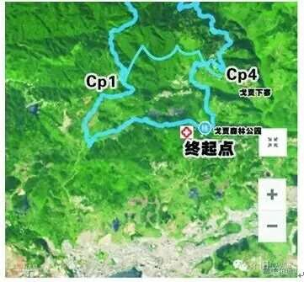
Completeness（要点齐全）-cover all the key points
2
跑步路线: 从校门口到南山脚下
This cross country race spanned from the
school gate to the foot of the South Mountain.
Most of the participants managed to finish
the running route from the school gate to the foot of the South Mountain.
Participants set out at 9am from the gate of
the school, through the Renmin Park, and finally arrived at the foot of Nanshan Mountain.
The route went from our school gate to the foot of the South Mountain.
The whole course was extremely difficult, especially the part near the mountain, narrow and rough. However difficult it was, no participants gave up halfway. All the racers held on to the finish line.

Slide 16
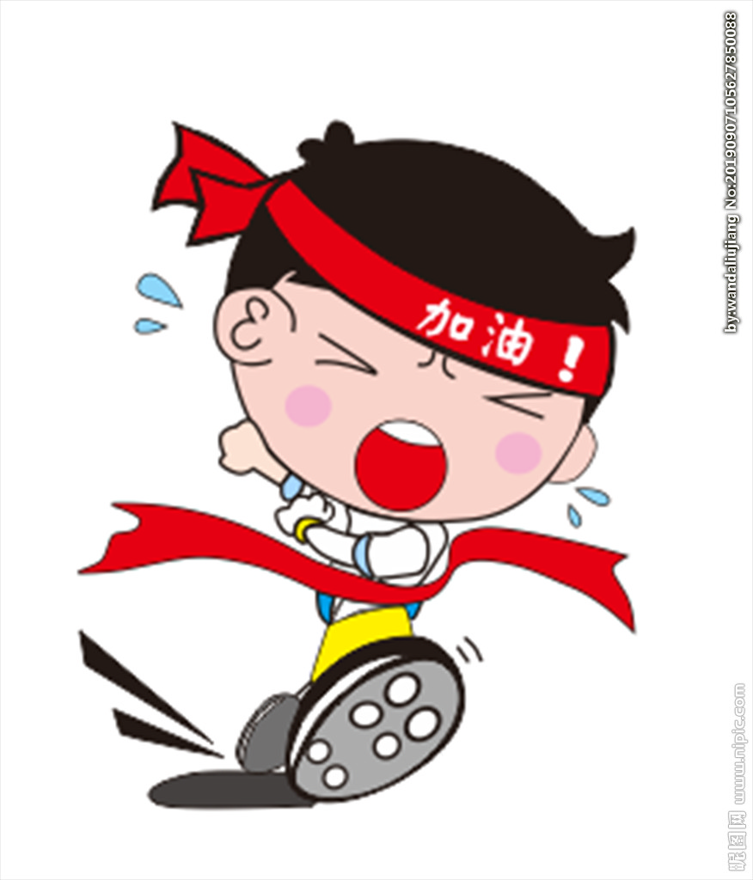
Completeness（要点齐全）-cover all the key points
3
活动反响
The magnificient scenes along the route erased our agitation for the approaching College Entrance Examination and brought us enormous gaiety.
We exposed and explored ourselves to splendid nature, which erased our fatigue and pressure caused by heavy study.
Challenging as the activity was, everyone enjoyed it and all the participants benefited a lot from it.

Slide 17
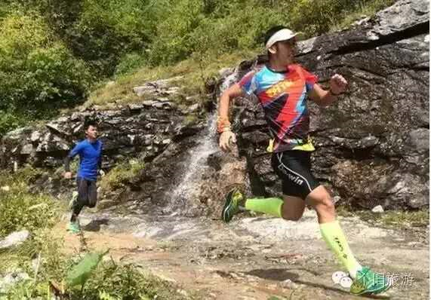
Completeness（要点齐全）-cover all the key points
3
活动反响
By joining the event, we had the opportunity to meet friends and live unforgettable adventures in a safe and trustworthy environment.
The race was of great benefit to the
participants, physically and mentally. Therefore, we all think highly of it, and expect more activities like this in the future.
Aimed to fight against pollution while enjoying the great outdoors,the
Cross-Country Eco-Race Carry is designed to pick up food packaging and other such trash while running, and contribute to environmental protection along the route!

Slide 18

Completeness（要点齐全）-cover all the key points
3
活动反响
Considered as a beginning of the comprehensive education, this activity emphasized students’ overall development, especially in physical health and mental endurance. It also boosted morale of the teaching staff, awaking them to the importance of regular workout.
After the race, we felt that not only did the event improve our physical and psychological quality, but it also helped us build a positive attitude towards life. We do hope that the school will carry out more similar activities in the future.

Slide 19
Coherence（行文连贯）-article is well organized and clear
A Cross-Country Running Race
On Sunday June 11th our school held an annual cross-country running race, which turned out to be a huge success.
Participating in this activity were energetic and dynamic participants from every class who started from the school gate and ran all the way to the foot of Nanshan Mountain, covering 5 kilometers altogether. Challenging as the race was, all the runners gave full play to their willpower, most of whom strove to cross the finishing line, enjoying the enthusiastic cheers and applause from the audience.
After the race, we felt that not only did the event improve our physical and psychological quality, but it also erased our fatigue and pressure caused by heavy study.
这篇习作格式正确，覆盖所有内容要点，条理清晰，语言优美，行文连贯，结构紧凑，简明扼要，而且应用较多的复杂结构或较高级词汇词组，表现出很强的语言运用能力和严密的逻辑思维能力。
尤其是对参赛者状态，活动的场面，越野赛的意义，描写生动有趣，报道真实可信，是一篇不可多得的优秀作品。

Slide 20
03
Comparison
between Shandong and Zhejiang

Slide 21
2020年7月山东与浙江新高考对比 —— 共同点
山东卷
共同点
浙江卷
假定你是李华, 上周日你校举办了5公里越野赛跑活动。请你为校英文报写一篇报道, 内容包括:
1. 参加人员；
2. 跑步路线:从校门口到南山脚下；
3. 活动反响。
注意:
1. 写作词数应为80左右；
2. 请按如下格式在答题卡的相应位置作答。
1.中学生李华
3.三个要点提示
3.词数80左右
4.语篇和任务情境贴近学生的校园生活实际。如：关注体育运动，倡导健康生活理念；外教生病，表达慰问感恩、鼓励祝愿之情。
5. 话题均紧扣《普通高中英语课程标准(2017年版)》的理念要求“发展英语学科核心素养，落实立德树人根本任务。”
假定你是李华，你校来自爱尔兰的外教Peter因病回国休假。请给他写一封电子邮件，内容包括：
1.询问近况；
2.分享班级最新消息；
3.表达祝愿。
注意：
1.词数80左右；
2.可适当增加细节，以使行文连贯。

Slide 22
2020年7月山东与浙江新高考对比 —— 不同点
山东卷
不同点
浙江卷
假定你是李华, 上周日你校举办了5公里越野赛跑活动。请你为校英文报写一篇报道, 内容包括:
1. 参加人员；
2. 跑步路线:从校门口到南山脚下；
3. 活动反响。
注意:
1. 写作词数应为80左右；
2. 请按如下格式在答题卡的相应位置作答。
1.新闻报道
2.面向全校和全社会的交际活动
3.给出英语标题
1.书信邮件：慰问并告知（浙江新高考8次都是此形式）
2.与外国友人的交际活动（浙江新高考8次都是与跨文化交际或交流活动相关）
3. 无英语提示
假定你是李华，你校来自爱尔兰的外教Peter因病回国休假。请给他写一封电子邮件，内容包括：
1.询问近况；
2.分享班级最新消息；
3.表达祝愿。
注意：
1.词数80左右；
2.可适当增加细节，以使行文连贯。

Slide 23

THANKS

