Slide 1

感恩遇见，相互成就，本课件资料仅供您个人参考、教学使用，严禁自行在网络传播，违者依知识产权法追究法律责任。
更多教学资源请关注
公众号：溯恩高中英语
知识产权声明

Slide 2
Welcome Unit Reading
2020/08/14
浙师大附中 Lynn

Slide 3
We're expected to
01
grasp the expressions showing feelings;
02
learn about what Han Jing experiences and her feelings on the first senior high school day;
03
talk about our first senior high school day.

Slide 4
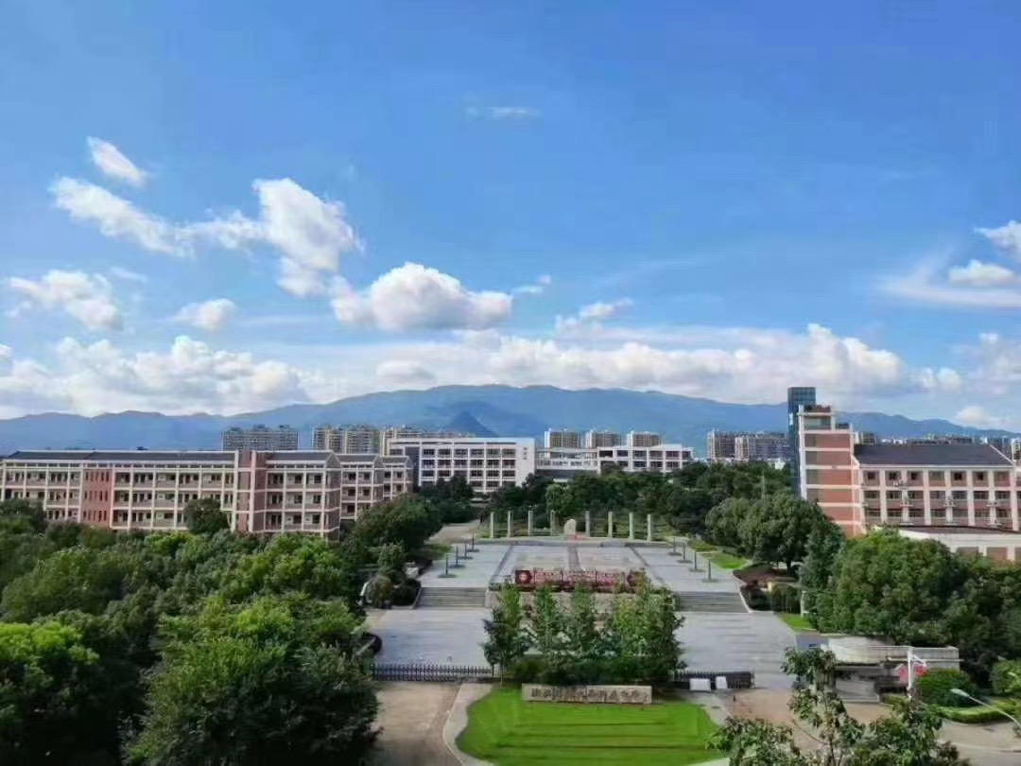
✿How do you feel on your first day of senior high school? Why?
I feel ... because/for the reason that...
I ..., so I feel ...

Slide 5
Expressions showing feelings
happy/
excited
comfortable/
relaxed
anxious
A
B
C
D
E
F
frightened/
scared
angry/
annoyed
awkward/
embarrassed

Slide 6

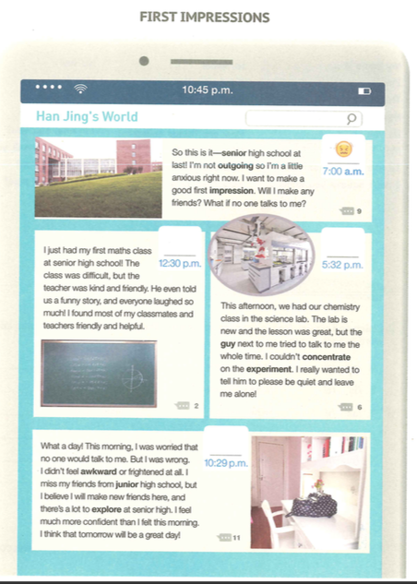
Go through the passage quickly to find out:
✿Where is the text taken from? How do you know?
✿In what order is the text organized?
When facing a brand-new start, one can have mixed feelings. So does Han Jing, a senior high school freshman. Shall we read her story?
1. It is a text taken from a social
networking website.
2. It is organized in the order of
time and space.

Slide 7
Individual Work
Read the text and finish the table.
Time | Place/Occasion | Feeling
7:00 a.m.
the campus
12:30 p.m.
the maths class
5:32 p.m.
the chemistry class
10:29 p.m.
the dormitory/ home

Slide 8
Pair Work
Try to infer her feelings based on the experiences.
Time | Place/Occasion | Feeling
7:00 a.m.
the campus
a little anxious
12:30 p.m.
the maths class
5:32 p.m.
the chemistry class
10:29 p.m.
the dormitory/ home
e.g. Han Jing was not an _______ girl. She wondered
whether she would ______________ and what she
should do if ________________. So she was __.
outgoing
make any friends
no one talked to her
?

Slide 9
Time | Place/Occasion | Feeling
7:00 a.m.
the campus
a little anxious
12:30 p.m.
the maths class
happy
5:32 p.m.
the chemistry class
10:29 p.m.
the dormitory/ home
The maths class was difficult, but the funny story told by my kind and friendly teacher made them laugh so much. Most classmates and teachers were friendly and helpful. So Han Jing felt happy.

Slide 10
Time | Place/Occasion | Feeling
7:00 a.m.
the campus
a little anxious
12:30 p.m.
the maths class
happy
5:32 p.m.
the chemistry class
annoyed
10:29 p.m.
the dormitory/ home
The chemistry lesson in the new science club was great, but the guy next to her tried to talk to her all the time, which made her unable to concentrate on the experiement. So Han Jing felt annyed.
Think: If you were in her situation, what would you do?

Slide 11
Time | Place/Occasion | Feeling
7:00 a.m.
the campus
a little anxious
12:30 p.m.
the maths class
happy
5:32 p.m.
the chemistry class
annoyed
confident+ happy+excited
10:29 p.m.
the dormitory/ home
Before going to bed, she believed that she would make new friends and that there was a lot to explore. So Han Jing felt confident, happy and excited, expecting the next day would be a great day!

Slide 12
Pair Work
What did Han Jing learn from her first day at senior high shcool?
She learned that she would make new friends there.
She learned that there would be a lot to explore at senior high.
She learned that tomorrow would be a great day.
What have you learned from her story?
Starting a new life can be challenging at first, but it can
also be interesting, exciting and even rewarding. So, be
brave to welcome the new school life!

Slide 13
Talk about your own first day of senior high school by referring to the structure of the text.
Group Work
Time | Place/Occasion | Feeling
Sample:
I am not an outgoing girl. On the first day, I wondered whether I would make any friends and what I should do if no one would talk to me. So I felt anxious and worried.

Slide 14
In this class, we...
01
learned the expressions showing feelings;
02
learned how to show feelings by telling one's experiences;
03
learned to tell our own first day of senior
high school.

Slide 15
Assignment
1. Write down your first day of senior high school.
2. Finish the “Word Study” part on Page 5.

Slide 16

Thanks！

