Slide 1

感恩遇见，相互成就，本课件资料仅供您个人参考、教学使用，严禁自行在网络传播，违者依知识产权法追究法律责任。
更多教学资源请关注
公众号：溯恩高中英语
知识产权声明

Slide 2
人教版新教材 词汇导学练
Unit4 Book1

Slide 3
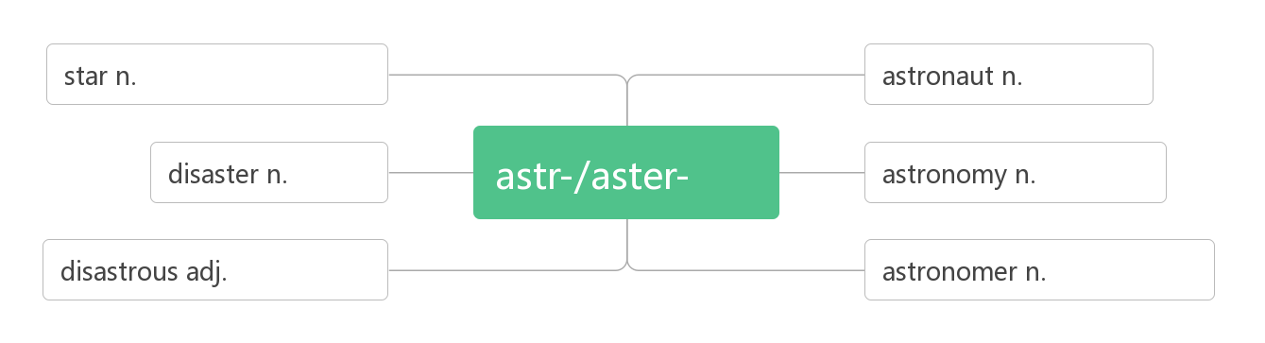
1.disaster / dɪ'zɑ:stə(r) / n.
灾难；灾害
词根词缀：dis-(远离,偏离)+aster-(star星星)：
星星偏离了原来的位置——灾难。
natural disasters 自然灾害
an air disaster 空难
It was the second air disaster in less than two months.
这是不到两个月内的第二次空难了。
Thousands of people died in the disaster. 数千人在这场灾难中丧生。
星星;恒星;明星
宇航员
灾难
星
天文学
灾难性的
天文学家

Slide 4
2.tornado /tɔ:ˈneɪdəʊ/ n.
龙卷风；旋风
破拆法：torn(tear撕扯)+a+do(door门)
助记：龙卷风撕扯着一扇门。。
The tornado killed dozens of lives.
那场龙卷风夺去了几十条人命。
3.drought / draʊt / n.
旱灾;干旱
dry a.干燥的——
high a.高的——
see vt.看见——
think vi.想——
drought n.干旱
height n.高度
sight n.视野
thought n.想法

Slide 5
The ground is as hard as stone after the drought.
长期干旱后土地硬得就像石头一样。
In fact many food crops failed because of the drought.
实际上，因为干旱，很多粮食作物歉收。
4.slide / slaɪd / vi. & vt. ( )
slid, slid
(使)滑行；滑动
We slid on the ice. 我们在冰上滑行。
The door slid open. 门慢慢开了。
She slid the door open 她滑开了门。
(使)滑入; 溜进
slide into
It seemed possible that the US and China could slide into some form of trade war.
有可能中国和美国会陷入某种形式的贸易战。
The thief slid into the room. 小偷悄悄溜进房间。

Slide 6
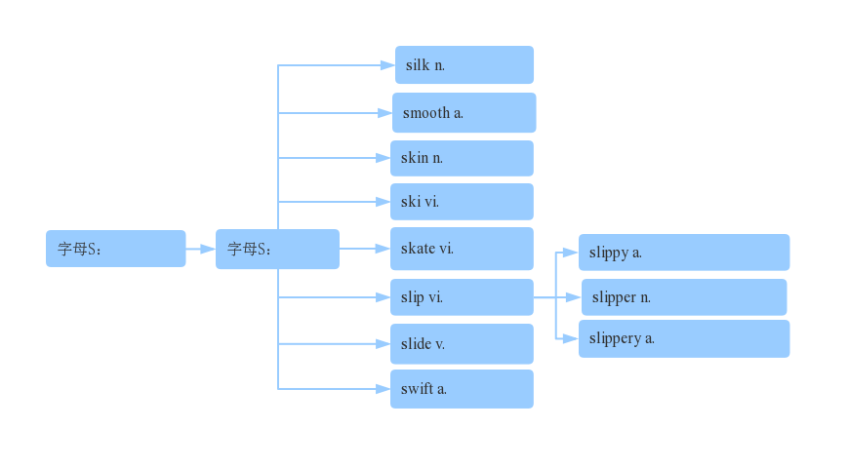
山体垮塌；滑坡
landslide /'lændslaɪd/n. (landfall)
The village was destroyed by a landslide. 滑坡摧毀了村庄。
The heavy rain caused the landslide. 大雨引起山体滑坡
丝绸
光滑的
皮肤
滑雪
曲线
丝滑
滑冰
光滑的;敏捷的
滑倒
拖鞋
滑动
滑的;狡猾的
敏捷的

Slide 7
海啸
5.tsunami /tsu:'nɑ:mi / n.
破拆法：t(turn转变)+sun(太阳)+a+mi(米粒)
助记：在海啸中，太阳变成米粒般大小。
Large earthquakes can cause powerful tsunamis.
大地震可以引起强烈的海啸。
6.flood / flʌd /n.
洪水；大量
The heavy rain has caused floods in many parts of the country. 大雨使全国许多地方泛滥成灾。
The river is in flood. 河水泛滥。
More than 70 people were killed in the flood.
70 多人因洪灾丧生。

Slide 8
大量的
a flood of
He received a flood of thank-you letters.
他收到大量感谢信件。。
flood /flʌd /vt.
淹没；灌满
The heavy rain flood the village. 大雨淹没了这个村庄。
The afternoon light flooded the little rooms
午后的阳光洒满一间间小屋。
flood /flʌd/vi.
泛滥；大量涌入
大量涌入
flood in
Water flooded in through the back door. 水从后门涌了进来。
Telephone calls flooded in from all over the country.
全国各地的电话像潮水般打来。

Slide 9
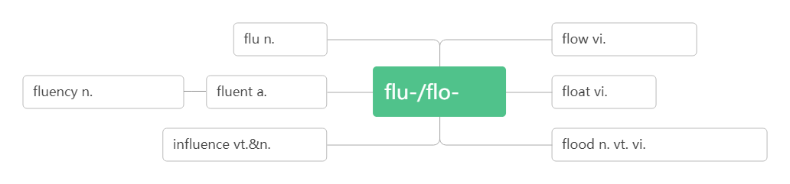
流感
流动,流淌
流利,流畅
流利的
流
漂浮
影响
洪水
淹没
泛滥
7.erupt /ɪˈrʌpt / vi.& vt.
爆发; 喷出
The couple volunteered to help after the volcano erupted.
火山爆发后这对夫妇自愿帮忙。
An active volcano may erupt at any time. 活火山会随时喷发。
A fight has erupted outside the restaurant. 饭馆外发生了斗殴。
/ɪ'rʌpʃn/ n.爆发
The eruption of the volcano destroyed many villages.
火山爆发破坏了很多村庄。
Volcanic eruption is the most terrible natural disasters on earth.
火山喷发是地球上最可怕的自然灾害之一。
eruption

Slide 10
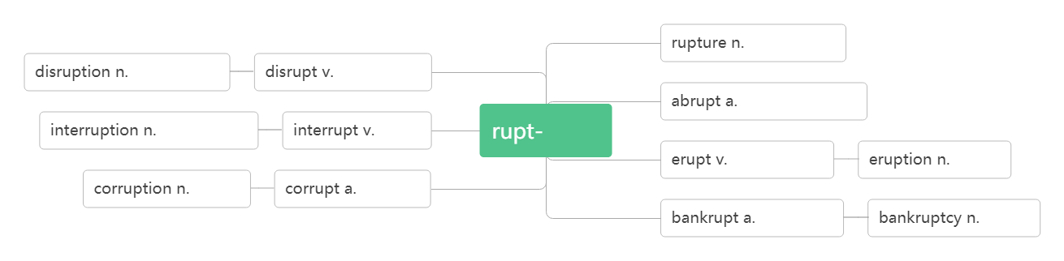
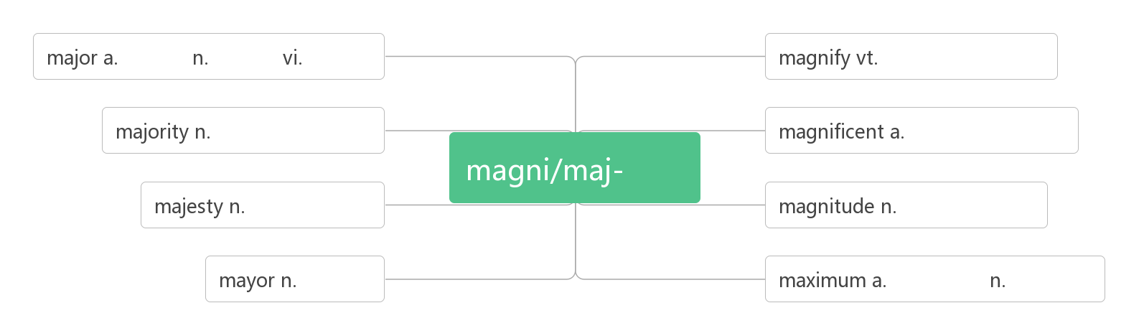
破裂,断绝
分裂,瓦解
分裂,瓦解
突然的,突兀的
打断,插嘴
打断
断裂
爆发,喷出
爆发
腐败
腐败的
破产的
破产
8.magnitude /ˈmæ gnɪtju:d / n.
震级；量级
词根词缀：magni-(大)+-tude(名词后缀，表状态)：大的程度——震级，量级
主要的 专业 主修
放大, 扩大
大部分,大多数
宏伟的, 壮观的
大
威严, 雄伟
大小, 量级
市长
最大的 最大值

Slide 11
The Wenchuan earthquake had a magnitude of 8.0. 汶川地震的震级为8.0 级。
We did not realize the magnitude of the problem.
我们没有意识到这个问题的重要性。
营救；救援
9.rescue /'reskju:/n.& vt.
音意相通：来施救
rescue workers/boats 救援人员/船只
What are the rescue workers and soldiers doing in the flood-hit area?
在受灾地区，救援人员和士兵在做什么？
Internet rescue camps in South Korea and China try to save kids addicted to the screen.韩国和中国的网络救援营试图拯救沉溺于手机的小孩。
Ten fishermen were saved in a sea rescue.
在一次海上营救行动中，十名渔民获救。
They were rescued by helicopter.他们被直升机救走了。

Slide 12
rescue sb./ sth. from…
从……中营救某人/某物
Firefighters rescued a child from a burning building.
消防队员从着火的大楼里救出了一个孩子。
/'reskju:ə(r)/ n. 救援者；救助者
rescuer
Many people burst into tears when a rescuer carried a girl out of the ruins.
当一名救援者从废墟里抱出一个女孩时,在场的许多人不禁潸然泪下。
损害；损坏
10. damage /ˈdæ mɪdʒ / vt. &.n.
破拆法：dam(大坝)+age(年纪) 助记：上了年纪的大坝一般都有所损坏。
Which buildings were damaged in Seoul？ 首尔哪些建筑物受损？
The fire badly damaged the town hall. 火灾使市政厅遭到严重破坏。
Smoking seriously damages your health. 吸烟严重损害健康。
The earthquake caused serious damage to the house.地震给这所房子造成了严重的损坏。
do damage to sb/sth.
对……造成损害
The storm didn't do much damage to crops. 暴风雨并未对庄稼造成严重损失。

Slide 13
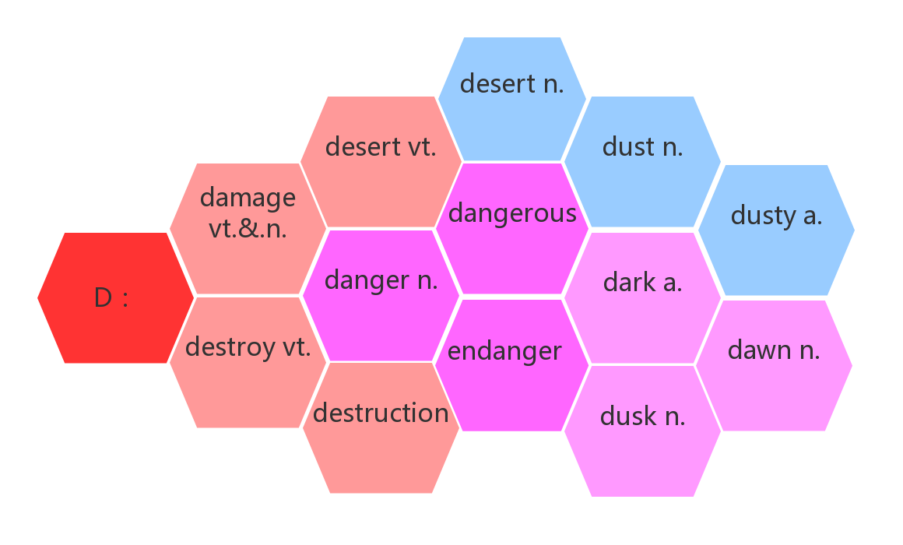
词群：
沙漠
遗弃
灰尘
a.危险的
布满灰尘的
损坏
损毁
危险
黑暗的
摧毁
vt.使危险
黎明
n.毁灭
黄昏

Slide 14
摧毁 ；毁灭
11.destroy/dɪ'strɔɪ/ vt.
破拆法：des-(毁掉)+troy(特洛伊，被希腊联军毁掉的名城)
Nearly everything in the city was destroyed.
城里几乎所有的东西都被毁了。
They've destroyed all the evidence.
他们销毁了一切证据。
Heat gradually destroys vitamin C.
加热会逐渐破坏维生素C。
You have destroyed my hopes of happiness.
你毁掉了我得到幸福的希望。
A man can be destroyed but not defeated.
人可以被毁灭，但无法被打败。
destruction/dɪ'strʌkʃ(ə)n/ n.
摧毁；毁灭
Those already sold are to be recalled for repair, replacement or destruction.
已经销售的要召回修理、替换或销毁。

Slide 15
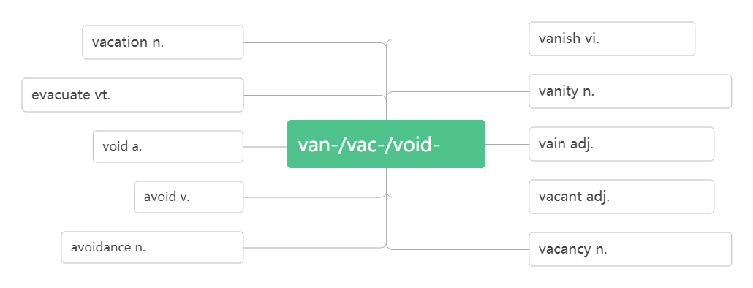
撤离
12. evacuate /ɪˈvækjueɪt / vt. vi.
疏散；撤出
词根词缀:e-(外)+vacu-(空)+-ate(动词后缀):都到外面, 使里面变空——撤出
Almost 88,000 people have been evacuated from the area. 近88, 000人撤离了该地区。
The building is on fire. Evacuate all the people immediately.
这座楼着火了，立即疏散人群。
When the forest fires broke out, we were told to evacuate.
当森林大火爆发时，我们被通知撤离。
假期;度假
消失; 绝迹
撤空;疏散;排泄
自负; 自满; 虚荣
消失; 绝迹
空
无用的, 徒劳的
避免
空的; 空缺的
避免;无效
空职; 空虚; 空闲

Slide 16
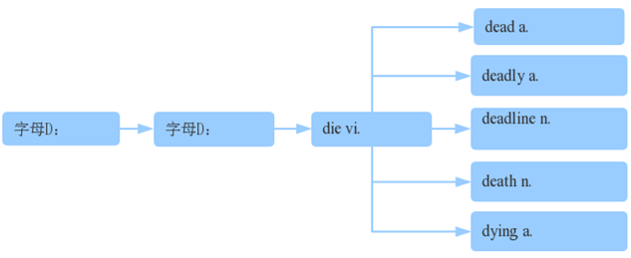
直升机
13.helicopter /ˈhelɪkɒptə(r)/ n.
破拆法：he(他)+li(离)+cop(警察)+ter(特)
助记：他离警察特远，需要调动直升机去帮助。
Helicopters were used to fight the fire. 直升机被用来灭火。
The injured were sent to the hospital by helicopter. 伤员由直升机送到医院。
死, 死亡
14. death/ deθ/ n.
死亡的
致命的
坠落
损毁
死亡
最后期限
死亡
垂死的

Slide 17
练：
Before modern medicine changed the laws of nature, many children _____of common childhood diseases. (2015广东)
在现代医学改变自然法则之前，许多儿童死于常见的儿童疾病。
You may drink, smoke,be overweight and still reduce your risk of ______ early by running.(2018全国) 你可以喝酒，吸烟，肥胖，但通过跑步你仍然可以降低死亡率。
Mr. Holden returned home from his holiday upset and convinced his pet was____ .(2015 陕西) 当Holdern先生度假回到家时，他很伤心，因为他确信的自己的宠物已经死了。
He thought that Joe must be _____, but he didn't want to leave immediately.(2014 全国I）
他认为Joe一定死了，但他不想立刻离开。
It should not cause _______ traffic accidents.(2017天津) 这不应该导致致命的交通事故。
The ________ and what you need to apply depend on the program.(2019全国卷I)
最后期限以及你需要申请些什么取决于项目。
I knew it was the difference between life and ______.(2017北京卷)
我知道这是生与死之间的差别。
Only five years after Steve Jobs' ______, smart－phones defeated conventional PCs in sales.(2017江苏) 仅在 Steve Jobs去世五年后，智能手机就在销售量上击败了传统电脑。
died
dying
dead
dead
deadly
deadline
death
death

Slide 18
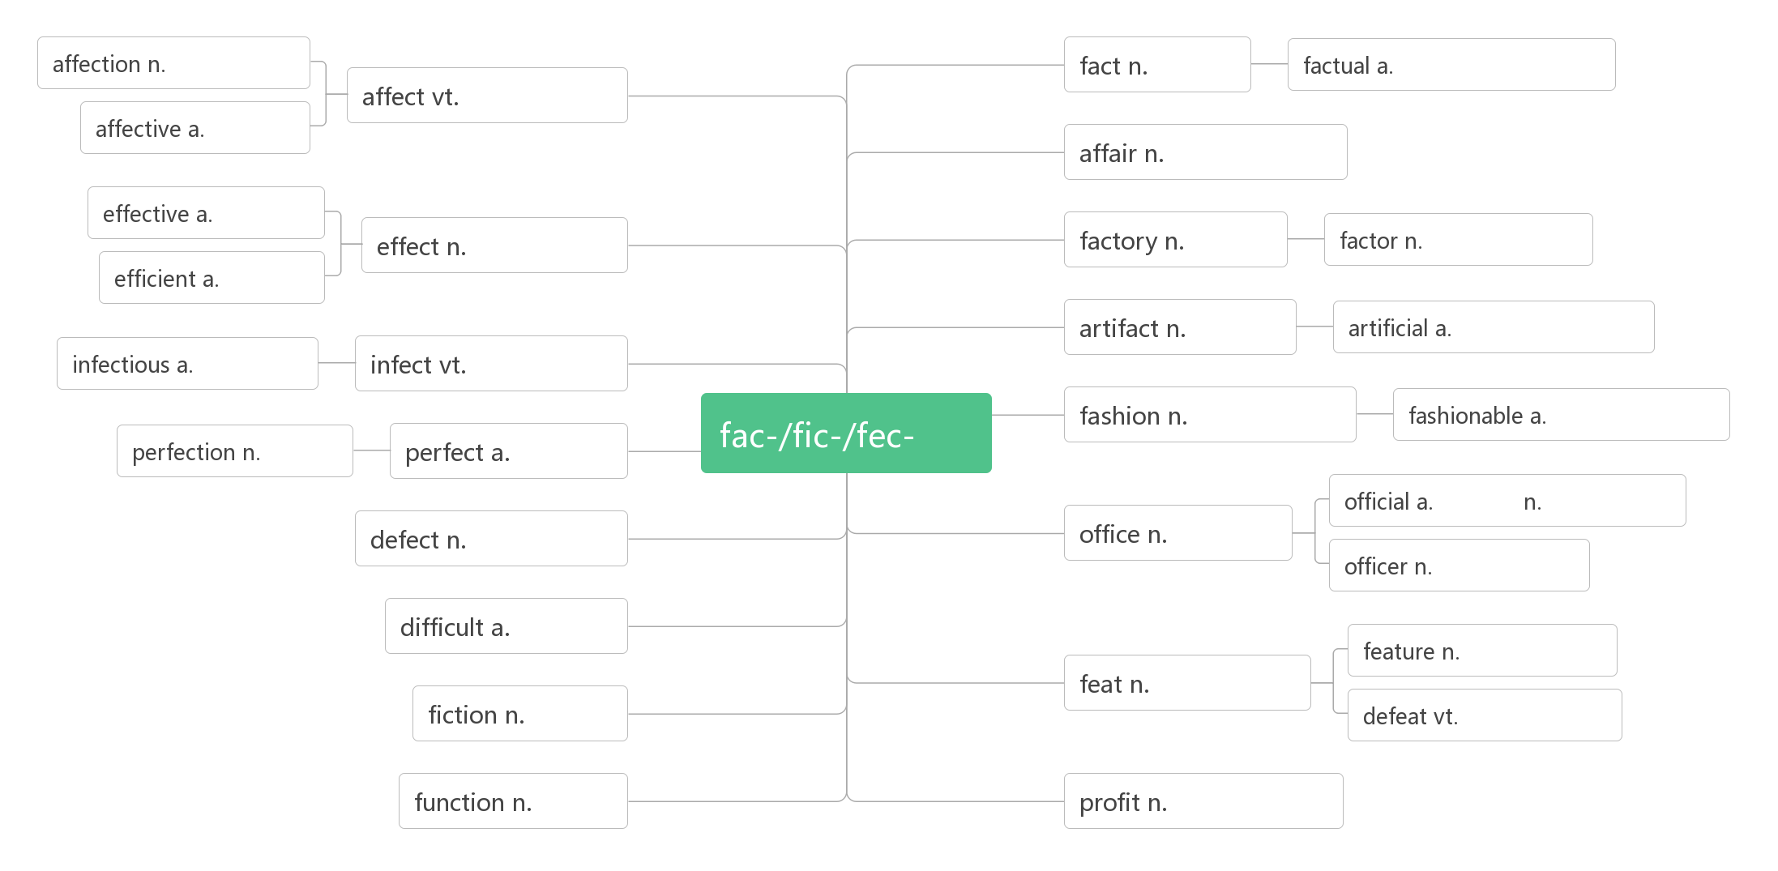
影响；感染；感动
15. affect /ə'fekt/ vt.
情感;爱
事实
实际的,事实的
影响;感动
感人的
事物,事情
有效的
效果;影响
工厂
因素
高效的
人造品
人造的
传染的
传染
做
时尚
时尚的
完美
完美的
官方的 政府官员
缺陷
办公室
军官;警官
困难的
特征
功绩
小说
打败
功能
利润

Slide 19
对……有影响
副作用
have an effect on
side effect
练：
A bad home environment can_______a child's healthy growth.
不良的家庭环境能影响儿童的健康成长。
The thoughts and behaviors of a teacher will ______ those of his pupils.
教师的思想和言行将影响到其学生的品质。
The illness has ________ both her mental and physical health.
这种疾病损害了她的身心健康。
They were deeply ________ by the news of her death. 她死亡的消息使他们悲伤不已。
You might also begin to notice the ______ not only on your health but in your pocket.(2018浙江卷)
你可能也会开始注意到，它不仅对你的健康，而且对你的经济都有影响
The weather ________, both good and bad, are felt in many places.(2016江苏卷)
天气的影响，无论好的还是坏的，在很多地方都能察觉到。
Your house may have an effect ____ your figure.(2015全国II)
你的住处可能对你的身材有影响。
affect
affect
affected
affected
effects
effects
on

Slide 20
Headaches are one of the ____ effects of the drug. 头痛是这种药物的副作用之一。
They have reduced pollution through ________ measures.(2014全国卷)
他们通过有效的措施减少了污染。
So far there is no _________ way to get rid of it..(2018北京卷)
到目前为止还没有有效的方法摆脱它。
There are actually healthier ways that can work just as ________.(2015重庆卷)
实际上有更加健康而且同样有效的方法。
Regardless of your choice of course, you'll develop your language ability both quickly and ___________.(2016 天津卷)
无论你选的那一门课，你都能迅速而有效地培养你的语言能力。
When communication becomes more _________, people are able to contact one another no matter where they are and at whatever time they wish to.(2014江西卷)
当交流变得更加高效时，人们就可以随时随地彼此联系。
Now that Chicago's waste water was draining __________ into the Chicago River, the city’s next step was to clean the polluted river. (2015湖南卷)
既然芝加哥市的废水更高效地排入了芝加哥河，该市的下一步举措就是治理这条被污染的河流。
side
effective
effective
effective
effectively
efficient
efficiently

Slide 21
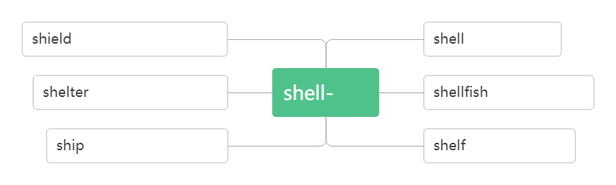
Understanding your own needs and styles of communication is as important as learning to convey your___________ and emotions.(2014湖南卷)
理解你自己的需求与交流风格就像学会表达你的喜爱与感情一样重要。
affection
n.避难处;居所;庇护vt.保护;庇护
16. shelter/'ʃeltə/
n.盾, 护盾
vt.保护
n.壳
vt.剥壳
n.避难所
vt.保护
壳
n.甲壳类动物
n.船只
vt.用船运载
n.架子, 搁架
shelter sb/sth from sb./sth.
保护……免受……

Slide 22
Workers built ________ for survivors whose homes had been destroyed.
救援人员为那些家园被毁的幸存者盖起了避难所。
People were running for the shelter ______ the storm. 人们跑着找地方躲避暴风雨。
Many are sleeping in the open because they have no ________.
很多人因为没有栖身之所，只好露宿在外。
Perhaps I _________ my daughter too much. 也许我对女儿保护过度了。
Some parents want to shelter their children _____ any harm.。
shelters
from
shelters
sheltered
from
n. 裂纹；裂缝 vi. & vt. (使) 裂开
17. crack /kræk/
音意相通：拟声词，咔嚓 助记：咔嚓一声墙壁裂开了。
There were deep cracks that appeared in the well walls. 井壁上出现了深深的裂缝。
This cup has a crack in it. 这杯子有一道裂痕。
The glass will crack if you pour hot water into it. 别往玻璃杯里倒热水, 不然会烫裂杯子。
The ice cracked as I stepped onto it. 我一踩冰就裂了。
The little boy failed to crack the walnut. 小男孩没能砸开核桃。
She dropped a plate and cracked it this morning.
今天早上她把一个盘子掉在地上打破了。

Slide 23
18. as if
似乎；好像；仿佛
It seemed as if the world ______(be) coming to an end. 世界似乎要到末日！！
It seems as if our team ___(be) going to win. 看来我们队要胜了。
She stood at the gate as if she ____(be) waiting for someone. 她站在门口好像在等人。
Some people like to talk about film stars' personal life as if they _____(be) close friends. 一些人喜欢谈论影星的私生活，好像他们是亲密朋友。
She loves the boy as if she _____(be) his mother. 这男孩，就好像她是他的母亲一样。
It was John who broke the window. Why are you talking to me as if I _________(do) it?
打破窗子的是约翰，为什么你和我说话，好像是我打破的。
He walked in as if he___________(buy) the school.（2012 广东）
were
is
was
were
were
had done
had bought
19. ruin /'ru:ɪn/
vt. 毁掉；毁坏n. 毁灭；废墟(pl)
in ruins
严重受损；破败不堪
ruined
The bad weather _______ our trip. 坏天气毁了我们的旅行.
My new shoes got ________ in the mud. 我的新鞋被泥浆毁了。
The crops ____________ by the heavy rain. 农作物被大雨全毁了。
ruined
were ruined

Slide 24
Everywhere survivors looked, there was nothing but ______.
幸存者无论朝哪里看，除了废墟什么也没有。
The house has fallen _____ ruins. 房子倒坍成了废墟。
Drinking was the _____ of him. 酗酒毁了他。
In less than one minute, a large city lay ________.
在不到一分钟内，一座大城市就沉沦在一片废墟之中。
The castle now lies ________. 这个城堡现在已成为一片废墟。
ruins
into
ruin
in ruins
in ruins
辨析：
 | 只用作动词，指强调用某种摧毁性的力彻底破坏，以致不可能修复，常作"破坏"、"毁灭"解,也可以指希望、计划等破灭。
 | 可以用作动词，也可以用作名词，用作名词时常与 to sb/sth 连用。指部分"损坏"、"损害"或指价值有所降低。一般被破坏的物品可以重新修复。
 | 可以用作动词，也可以用作名词，用作动词时, 作“毁掉；毁灭；弄糟"解；强调缓慢但无法逆转的毁灭。；用作名词时, 表示"毁灭；毁坏；废墟"等抽象概念。
destroy
damage
ruin

Slide 25
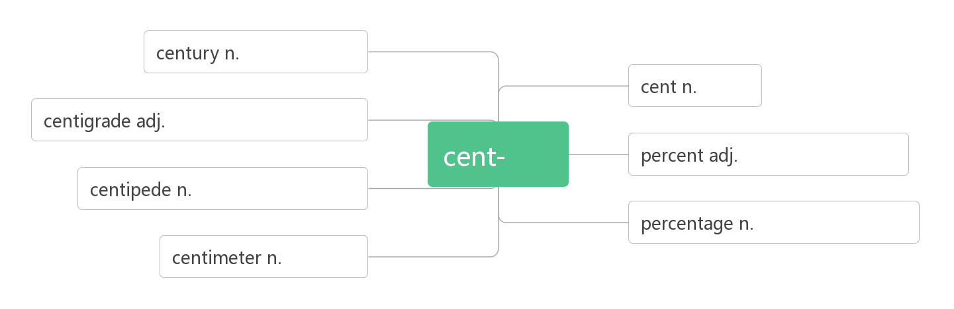
The earthquake __________ almost the whole town. 地震几乎毁灭了整个城镇。
His hope of being a writer was _________. 他想成为一个作家的希望破灭了。
Hundreds of houses in the area were _________ by the storm.
暴风雨毁坏了这个地区数以百计的房屋。
The accident did a lot of ________ to his car. 这次车祸使他的车受到很大的损坏。
The floods _______ many precious paintings. 这次水灾毁坏了很多珍贵的画。
You'll _____ your health if you go on like this. 这样下去你会毁了你的身体的。
destroyed
destroyed
damaged
damage
ruined
ruin
百分之....
20. percent /pə'sent/n.
世纪,百年
美分
摄氏度的,百分度的
百
百分之...
蜈蚣,百足虫
百分比,百分率
厘米

Slide 26
About 75 percent of the city’s factories and buildings, 90 percent of its homes, and all of its hospitals were gone.
大约75%的工厂和建筑物、90%的家园所有的医院都消失了。
We found that only fifteen percent of our students exercise every day.
我们发现仅有15%的学生每天锻炼。
The price of the house has risen by ten percent. 房价上升了10%。
砖；砖块
21. brick /brɪk/n.
词源：break——>brick(原指碎石块)
联想记忆：b(Brazil)+r(Russia)+i(India)+c(China)：金砖四国——brick
Bricks covered the ground like red autumn leaves. 残砖就像秋天的红叶覆盖着大地。
The house is built of brick. 那座房子是用砖建造的。
This garden is surrounded by high brick walls. 花园四周有高高的砖墙环绕。

Slide 27
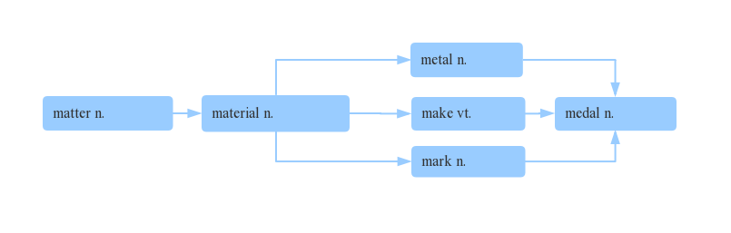
金属
22. metal /'metl/n.
金属
物质
材料
制作
奖章
标记
a piece of metal 一块金属
The railway tracks were now useless pieces of metal.
铁轨如今成了一块块废金属。
The box is made of metal.
盒子是用金属做的。

Slide 28
n.震惊;令人震惊的事;休克 vt.(使) 震惊;电击
23. shock /ʃɒk/
in shock 处于震惊/休克中
shocking /ˈʃɒkɪŋ/ adj.
(现在分词表示______内涵，意为“ ”)
shocked / ʃɔkt/ adj.
(过去分词表示______内涵，意为“ ”)
令人震惊的
主动
令人……的
感到震惊的
被动
感到……的
电；电能
24. electricity /ɪˌlekˈtrɪsəti/ n.
拆破法：e(电子)+lect(收集)+tri(去)+city(城市)
助记：收集电子去给城市供电。
electric [ɪˈlektrɪk] adj.
electrical [ɪˈlektrɪk(ə)l] adj.
electronic [ɪlekˈtrɔnɪk] a.
电动的
与电相关的
电子的

Slide 29
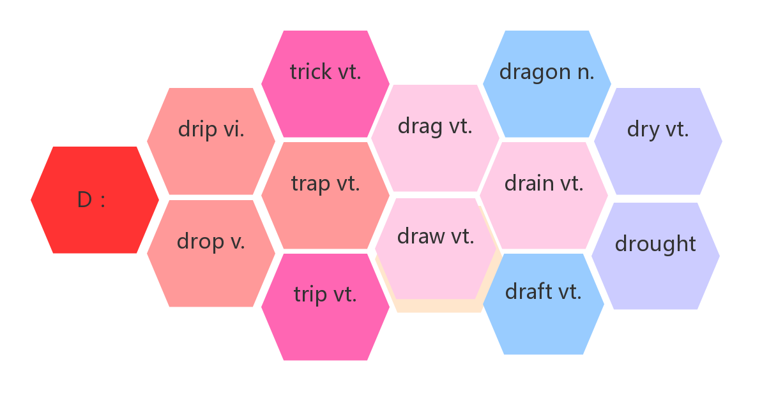
Water, food, and electricity were hard to get. 水、食物，和电都很难弄到。
The electricity had been cut off. 停电了。
We can use the power of the wind to make electricity．我们可以使用风力来发电。
困境；陷阱
25. trap/træp/ vt. n.
困住；使陷入
诱骗
龙
滴落
拖拽
使…脱水
坠落
使陷入
抽干
掉落
牵拽
n.干旱
绊倒
起草

Slide 30
受困于
诱使某人（做）某事
be trapped in…
trap sb into (doing) sth.
The thick smoke and flames trapped people upstairs.
浓烟和火焰把人们困在了楼上。
The children trapped in the burning building were saved at last.
被困在燃烧着的楼房里的孩子们最后得救了。
A fox was caught in a trap. 一只狐狸掉进了陷阱里。
Some women see marriage as a trap. 有些妇女把婚姻视作围城。
Soon after the quakes, the army sent 150,000 soldiers to Tangshan to dig out those who were trapped and to bury the dead. 地震后不久，部队派了15 万名战士到唐山将受困的人们挖出来，并将死者掩埋。
Some of the workers were trapped in the ruins. 有些工人被困在废墟中。
They trapped her into marrying their son. 他们诱使她嫁给他们的儿子。

Slide 31
掩埋；埋葬
26. bury/ˈberi/vt.
破拆法：bu(不)+r(让)+y(养) 助记：既然不让养，就把它埋了吧。
= 埋头于，专心致志于
bury one's head/oneself in…
be buried in…
He died at the age of 80 and was ______in his homeland.
他80岁去世了，被安葬在他的家乡。
I was looking for my handbag, which__________under a pile of old newspapers. 我正在找被埋在一堆旧报纸下面的手提包。
He_______his face in his hands and wept. 他双手掩面而泣。
She had learnt _______her feelings. 她已经学会了感情不外露。
My father_______his head / himself___ his newspaper.
= My father _____________his newspaper. 我父亲专心致志地看他的报纸。
________ my book, I didn't realize it was raining.
我专心致志地看书，没注意到下雨了。
buried
was buried
buried
to bury
buried
in
was buried in
Buried in

Slide 32
呼吸
27. breathe/bri:ð/vi.&vt.
breathe in/out
breath /ˈbreθ/ n.
take a deep breath
hold one's breath
out of breath
catch one's breath
吸入/呼出
气息；呼吸；一口气
深吸一口气
屏住呼吸
上气不接下气
恢复呼吸
练：
Slowly, the city began to _________ again. 慢慢地，这座城市又开始出现了生机。
It's good for the health ____________ deeply. 做深呼吸对身体有益。
Most people don't realize that they are ___________ polluted air.
大多数人没有意识到自己正呼吸着污染了的空气。
You can see people's________ on a cold day. 冷天能看到人们呼出的空气。
She ______ a deep breath. 她做了一次深呼吸。
breathe
to breathe
breathing
breath
took

Slide 33
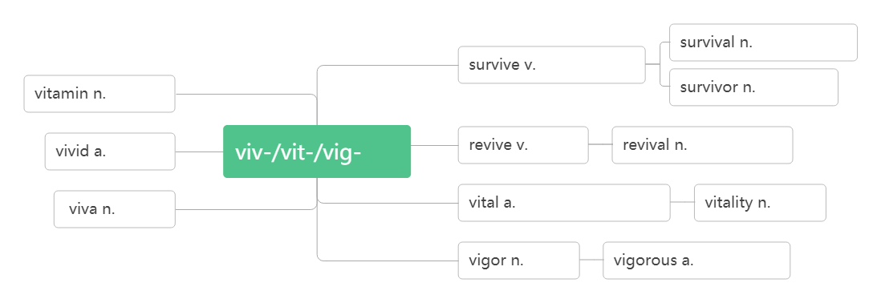
By mile 17, I became out of ________ and the once injured ankle hurt badly. (2018北京)
跑到17英里的时候，我变得上气不接下气，受伤的脚踝疼的要命。
I paused to ________ my breath and then positioned myself to take the best photo of this panorama(全景).(2017天津) 我停下来恢复呼吸,并找好位置去拍一幅最佳的全景照。
breath
catch
复活;(使)复苏
28. revive/rɪ'vaɪv/vt.&vi.
生存;幸存
生存;幸存
维生素
幸存者
生动的
生活
复活
复活; 复兴
万岁
有活力的;重要的
活力
精力
精力旺盛的

Slide 34
Tangshan began to revive itself and get up on its feet again.
唐山开始恢复元气，重新站起来。
They managed to revive the injured driver at last. 他们最终使受伤的司机苏醒了过来。
The flowers soon revived in water. 这些花见了水很快就活过来了。
The economy is beginning to revive. 经济开始复苏。
复活；复兴
revival /rɪ'vaɪvl/n.
What do you think helped in the revival of Tangshan city?
你认为是什么帮助唐山市的复兴？
World trade is showing signs of revival. 世界贸易正显示出复苏的征兆。
Jazz is enjoying a revival.爵士音乐再度盛行。
努力
29. effort /'efət/ n.
词根词缀：ef(向外)+fort(力量)：向外用的力量——努力。
努力做某事
竭尽全力做某事
不遗余力做某事
make an effort to do sth.
make every effort to do sth.
spare no effort to do sth.

Slide 35
With strong support from the government and the tireless _______ of the city, a new Tangshan was built upon the earthquake ruins.
在政府的大力支持和全市人民的不懈努力下，一个新的唐山在地震废墟上建成了。
You should put more ________ into your work. 你应该更加努力地工作。
All my ________ ended in failure . 我的一切努力最后都无济于事。
A winner is one with ____ great effort of will. (2018北京)
成功者是有着强大努力意志的人。
So I_______ an effort to be on time when I meet my friends.
所以当我与朋友见面时，我努力做到守时。
efforts
efforts
efforts
a
make
He was_________ an effort to control himself. 他努力控制自己的情绪。
These flowers, with or without human care, whether or not some people appreciate, always _______every effort to open their flowers. 这些花儿，不管有没有人在意，不管是不是有人欣赏，总是要竭尽全力开出自己的花朵。
Dear fellow students, let's start right now and _____ no effort to do a little bit every day, every hour, and every minute! 亲爱的同学们，让我们从现在起，每一天，每一小时，每一分钟，都不遗余力地做一点贡献！
making
make
spare

Slide 36
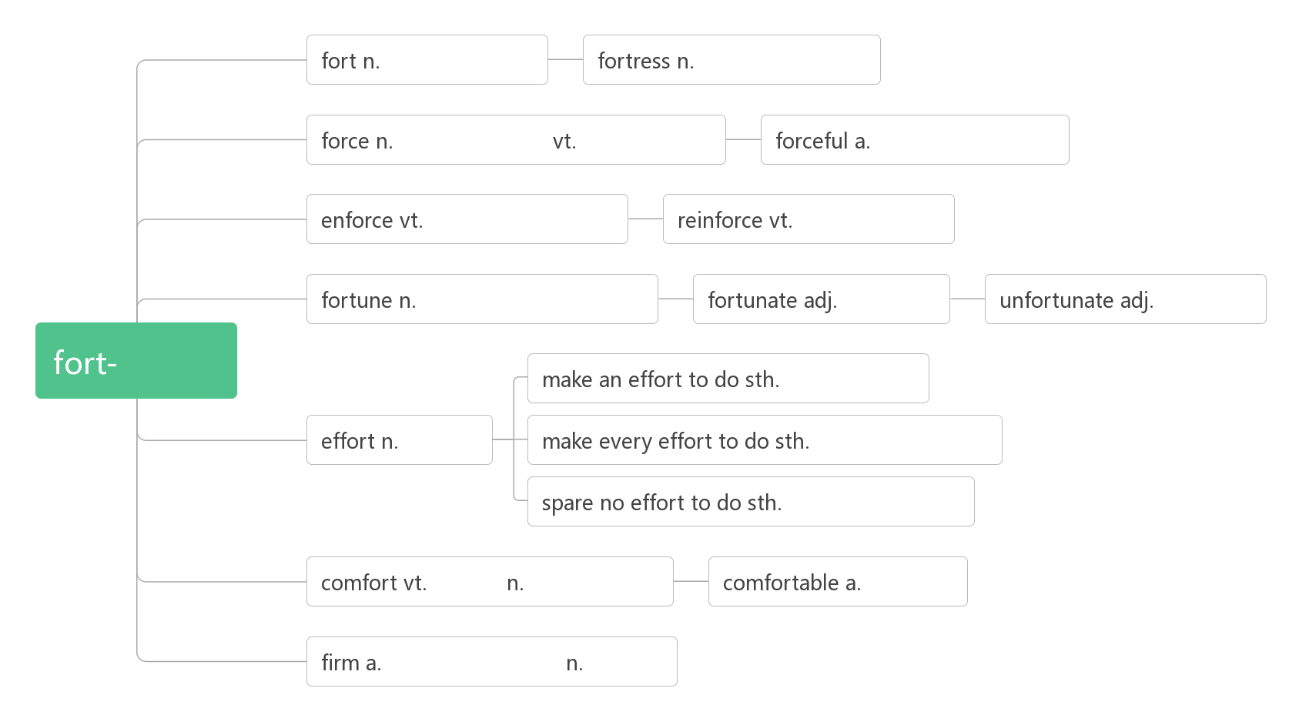
堡垒,要塞
堡垒,要塞
武力, 强力
强迫,迫使
强大的,有力的
实施,执行,强制
加强,巩固
财富;命运;运气
幸运的
不幸的
力量
努力做某事
努力
全力以赴做某事
不遗余力做某事
安慰
安慰,舒适
舒适的
坚定的,牢固的
公司

Slide 37
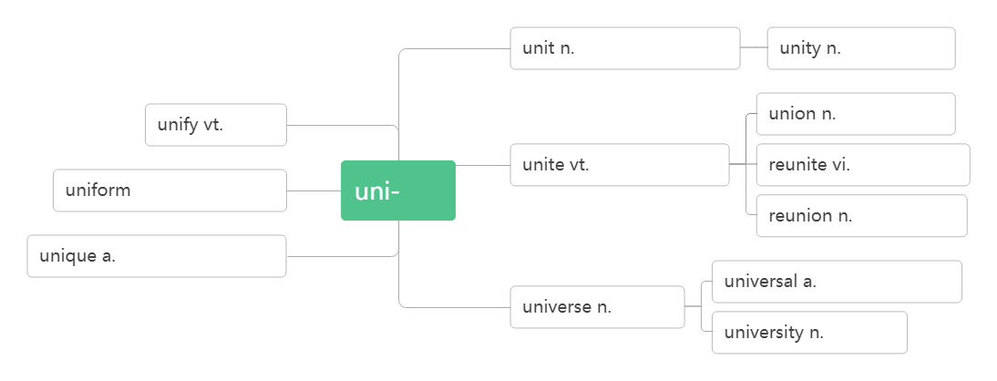
30. unify/'ju:nɪfaɪ/vi.&vt.
统一;(使)成一体
单元;小节;个体
一致,统一
统一
联盟;联合
联合;团结
团聚,重聚
n.制服
a.一致的
一
团聚,重聚
唯一的,独一无二的
普遍的;通用的
宇宙
大学
Germany unified officially in 1990 ; Will the two Koreas unify?
德国在1990年正式统一了；两个朝鲜能统一吗？
The new leader hopes to unify the country. 新领袖希望把国家统一起来。

Slide 38
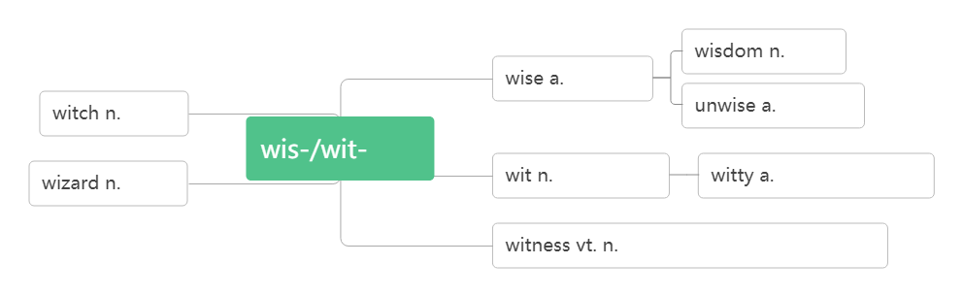
31.wisdom /'wɪzdəm/ n.
智慧;才智
智慧
明智的
女巫
不智的
知
智慧,才智
机智的,诙谐的
巫师
见证;目击
目击者;证人
Tangshan city has proved to China and the rest of the world that in times of disaster, people must unify and show the wisdom to stay positive and rebuild for a brighter future. 唐山市已向中国和世界其他地区证明：在灾难时期，人们必须团结一致, 展现智慧，保持积极的心态，重建更光明的未来。

Slide 39
A man of great wisdom often appears slow . 大智若愚。
Experience is the mother of wisdom. 经验为智慧之母。
/waɪz/ adj. 明智的;有智慧的
wise
She is a wise woman. 她是一个智慧的女性。
She made a very wise decision. 她作了一个非常明智的决定。
I'm wiser after ten years in the business.
在商界混了十年之后，我变得聪明了。
32. suffer/'sʌfə(r)/
vt.遭受;蒙受vi.(因疾病,痛苦,悲伤等)受苦
因……而痛苦；患有（疾病等）
suffer from
sufferer
/'sʌfərə(r)/n. 受苦者；受难者；患病者
suffering
/'sʌfərɪŋ/n. 痛苦；苦难

Slide 40
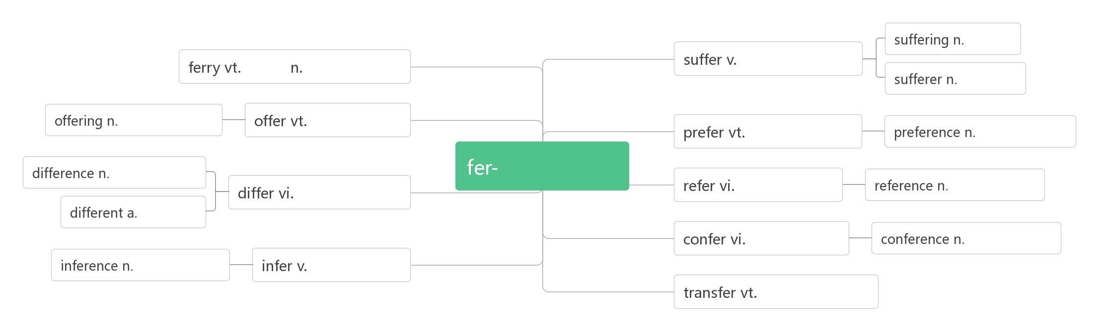
痛苦
渡运
渡口;渡船
受苦; 承受
受难者
提供物,祭品
提供;提出
偏爱, 更喜欢
偏爱,优先权
拿取/承受
不同,差异
提到;参考
参考;引证
不同,有差异
不同的
协商,谈判
商量;会议
推理,推断
推理,推断
传送;转移
Within a few days she had become seriously ill and _________ great pain.
几天的时间，她就病得很严重了，疼痛难忍。
The company _________ heavy losses last year. 公司去年出现巨额亏损。
They _________ terribly when their son was killed. 儿子遇难之后，他们悲痛欲绝。
At least he died suddenly and didn't _________. 起码他死得很突然，没遭受痛苦。
suffered
suffered
suffered
suffered

Slide 41
He suffered ______ poor eyesight and could no longer read properly.
他视力不好，再也不能正常阅读了。
Some were found alive, though they were __________ from terrible injuries.
有些人被发现还活着，尽管他们受到了严重的伤。
He appears to be strong and healthy , but he suffers ______ heart disease.
他看上去强健, 其实他患有心脏病。
This new cancer treatment offers hope to many _________.
这新的癌症治疗法给许多病人带来希望。
We must bring _________ and hunger to an end in the world.
我们必须结束世界上的苦难和饥饿。
A man who fears __________ is already suffering from what he fears.
害怕承受痛苦的人，他已经在承受害怕本身所带来的痛苦了。
from
suffering
from
sufferer
suffering
suffering
33. volcano/vɒlˈkeɪnəʊ/n.
火山
破拆法：vol-(大声)+cano(加农炮)：发出加农炮一般的大声——火山(喷发)
Etna is Europe's most active volcano. 埃特纳山是欧洲最活跃的火山。 There are more than 100 volcanoes in Japan. 日本有100 多处火山。

Slide 42
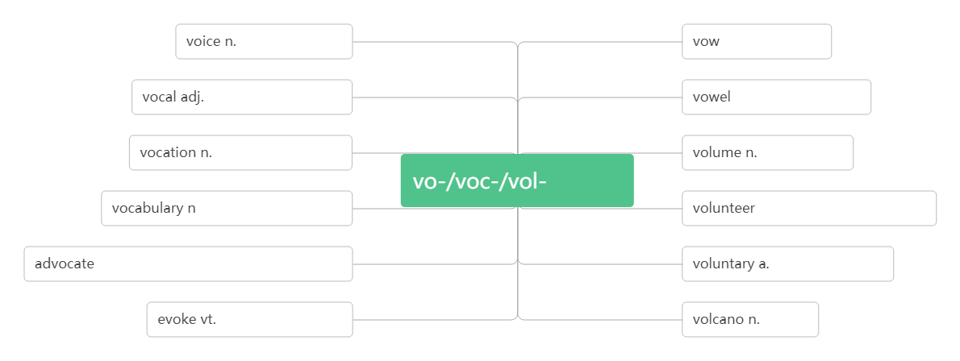
说话声,嗓音
v.发誓
n.誓言
有声的,声音的
n.元音a.元音的
职业;使命;天职
音量,体积
大声说
词汇;词汇表
n. 志愿者 v.自愿做
vt.提倡,主张,拥护 n.提倡者
自愿的,主动的
引起;唤起;召来
火山
vt.供应,供给n.供应;补给;[pl.]补给品
34. supply/səˈplaɪ/
supply sb. ____ sth. = supply sth.___ sb. 向某人提供某物
with
to
Russia supplies the European countries ______ natural gas.
= Russia supplies natural gas ___ the European countries.
俄罗斯向欧盟国家输送天然气。
with
to

Slide 43
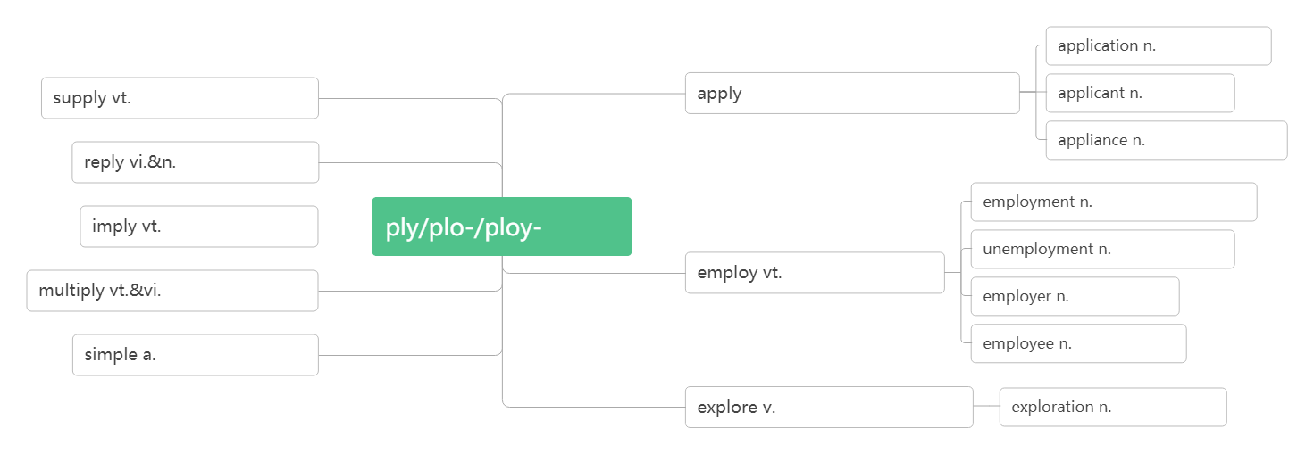
The supplies which ________________ to the disaster area were collected from around the country. 向灾区提供的物资是从全国各地收集的。
Our water ________ has been cut off. 我们断水了。
Books were ____ short supply.书籍供应短缺。
were supplied
supply
in
申请;应用
供应,提供
vt.应用,涂抹
vi.申请
申请人
器具,装置
回答;回应
应用
雇用;就业
暗示;意味着
失业
增加;繁殖
雇用;利用
雇主
简单的
雇员
探索;探测
探索;探险
台风
35. typhoon/taɪ'fu:n/n.
音意相通：音译自汉语：台风
Many homes were destroyed by the typhoon. 许多房屋被台风摧毁。

Slide 44
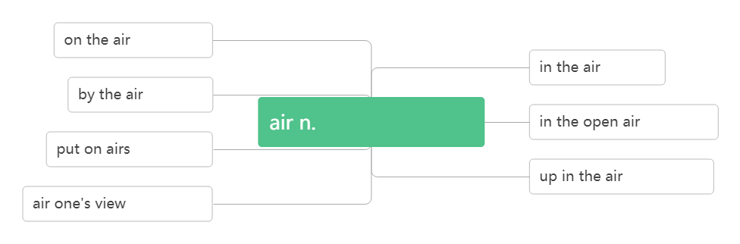
露天；在户外
36. in the open air
正在播报
在空中
坐飞机
空气;天空;样子
在露天
装腔作势
悬而未决
发表观点
People put up shelters in the open air. 人们在户外搭建庇护所。
The film will be shown in the open air tonight. 今晚电影在露天演。

Slide 45
37. hurricane /ˈhʌrɪkən / n .
飓风
破拆法：hurri(迅速)+cane(棍杖)
助记：飓风来袭，像迅疾的棍杖肆虐着这个小镇。
After the hurricane, many people's homes were destroyed.
飓风过后许多人的房屋被毁。
vt.幸存于vi.生存；存活
38. survive /sə'vaɪv/
词根词缀：sur(下)+vive(活)：活下去——生存，幸存
___________ 依靠……生存
_________ /sə'vaɪvə/ n. 幸存者；生还者
_________ /səˈvaɪvl/ n.存活；幸存
survive on
survivor
survival
练：
She's feeding the baby who __________ the earthquake她正在喂养地震中幸存的婴儿。
Many birds didn't _________ the cold winter. 很多鸟死于这次严冬。
She survived her husband _____ ten years. 丈夫死后她又活了十年。
survived
survive
by

Slide 46
Of the six people injured in the crash, only two __________.
因这次撞车事故受伤的六人中，只有两人活了下来。
Companies must be able ____________ in the marketplace.
公司必须有能力在市场竞争中生存下去。
Some strange customs have survived ______ earlier times.
有些奇怪的风俗是从早年留存下来的。
I can't survive ____ £40 a week. 一星期40 英镑，我无法维持生活。
Everywhere ___________ looked, there was nothing but ruins.
幸存者们无论朝哪里看，除了废墟什么也没有。
Many firms will die, but the ___________ will get stronger than before.
许多公司将会倒闭，但是幸存下来的会更强大。
I think life is a struggle for __________.
我认为生活就是一场奋力求生的斗争。
If cancers are found early there's a high chance of _________.
如果癌症在早期发现的话，存活的几率会很高。
survived
to survive
from
on
survivors
survivors
survival
survival

Slide 47
39. power /'paʊə(r) / n.
力量；电力；权力
音意相通：怕我
助记：我以前幼稚地以为，当我拥有权力后别人都会怕我。
________________ 断电/停电
______________ 上台执政
____________ 丧失权力，在野
_________/'paʊəfl/ adj.有权势的;有影响力的;强有力的
power cut/failure
come to power
out of power
powerful
There was no power at school last night. It was so dark. 昨天晚上学校停电了，漆黑一片。
As is known to us, knowledge is power. 众所周知，知识就是力量。
I think it's important for China to raise its soft power. 我认为中国增加软实力是很重要的。
The Republican Party came to power in 2016. 美国共和党是在2016 年上台执政的。
His grandfather once was a rich and powerful man. 他的爷爷曾经是一个有钱有势的人。
China is wealthier and more powerful than ever before.
中国比以往任何时候更加富有和强大。

Slide 48
40. tap /tæp/
vi.& vt. 轻叩；轻敲；轻拍n. 水龙头;轻叩
音意相通：拟声词，模拟轻拍、轻敲的声音
the hot/cold tap 热水/冷水龙头
He never drinks tap water. 他从不喝自来水。
Turn the tap on/off . 打开/关上龙头。
Don't leave the tap running. 别把水龙头开着白白流水。
He felt a tap on his shoulder and turned round. 他觉得有人轻轻拍他的肩膀便转过身来。
管子；管道；烟斗
41. pipe/paɪp/ n.
piper/ˈpaɪpə/ n.
管道工
hot and cold water pipes 冷、热水管
The pipes are made of plastic . 这些管子是用塑料制作的。
Super Mario is a famous piper. 超级马里奥是一个著名的管道工。
In the city, the water pipes in some buildings cracked and burst.
在市内，有些建筑物里的水管爆裂开来。。

Slide 49
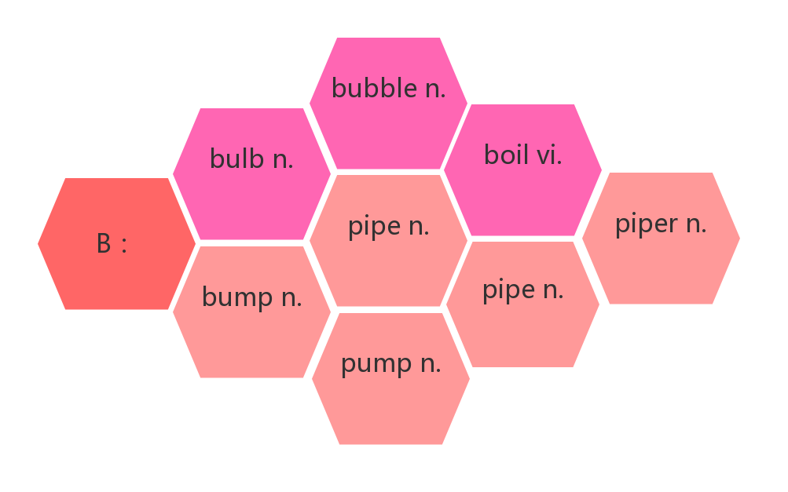
词群：
气泡
灯泡
沸腾
凸起
烟斗
管道工
肿块
管道
水泵
42. whistle /ˈwɪsl/
vi.吹口哨；发出笛声n. 哨子(声)；呼啸声
音意相通：拟声词，模拟口哨声。
The crowd whistled as the player came onto the field. 那队员上场时，人群吹起了口哨。
The kettle began to whistle. 烧水壶呜呜地响了起来。
He listened to the whistle of a train.他听着火车呼啸而过。
He scored the winning goal just before the final whistle.
他就在终场哨声前打进了制胜的一球。

Slide 50
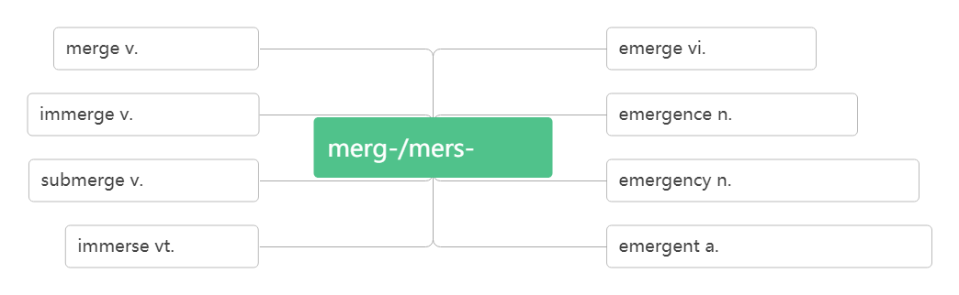
43. emergency/iˈmɜ:dʒənsi / n.
突发事件；紧急情况
词根词缀：e(出)+merg(沉)+ency(名词后缀):
从沉没中突然浮出来——突发事件。
合并, 融合
浮现,出现
沉入,浸入
浮现,出现
沉/浸
沉入,浸入
突发事件;紧急情况
使浸入
紧急的;突发的;新兴的
emergency room/exit 急诊室/紧急出口
Call an emergency number. 拨打紧急电话
We must keep as cool as a cucumber in an emergency.我们要在危急时刻保持镇定自若。
This door should only be used in an emergency. 这道门只能在紧急情况下使用。

Slide 51
44. calm /kɑ:m/
a.镇定的,沉着的vt.使平静,使镇定vi.平静,镇定
保持镇定
使……平静或镇定下来
keep/stay/remain calm
calm sb./sth. down
We should __________________calm in the face of danger.我们在危险面前要保持镇定.
You will go somewhere quiet to calm your friend _______.
去个安静的地方让你的朋友平静下来。
He took a deep breath to calm __________ down．他深吸了一口气使自己平静下来。
Gradually I ________ down and lost my anxiety.我渐渐平静了下来，忘掉了焦虑。
keep/stay/remain
down
yourself
calmed
辨析：
 | (人)情绪镇定冷静的;(天气，海洋等)平静的
 | 强调客观环境很安静或人性格文静
 | 强调人主观上不愿意说话
 | 强调没有动作，静止不动
calm
quiet
silent
still

Slide 52
It's a hot and _______ day. I'd rather stay at home than go out.
天气炎热无风，我宁可待在家里也不想出门。
In an emergency, she is always ______. 在紧急关头，她通常很冷静。
The street is ______ at midnight. 深夜的街道非常安静。
The girl is ______ and popular. 这个女孩很文静，很受欢迎。
The man is very strange and _______. 这个男人非常奇怪，而且少言寡语。
When asked about the accident, he stayed ______.
当被问起这起事故时，他保持了沉默。
The _____ butterflies look like flowers. 那些静止的蝴蝶看起来像花朵。
I like to sit in front of the door and overlook the __________ lake.
我喜欢坐在门前，远眺平静的湖面。
calmed
calm
quiet
quiet
silent
silent
still
still/calm
45. aid /eɪd/
n.援助;帮助;救援物资 vi.&vt. (formal) 帮助;援助
急救
在…的帮助下
first aid
with the aid of
economic/emergency aid 经济/紧急援助

Slide 53
He succeeded with the aid of a new method he discovered.
借助于自己发现的一种新的方法，他获得了成功。
To aid the poor farmers, the government provided them with a lot of money.
为了帮助贫穷的农民，政府给他们提供了很多钱。
46. sweep /swi:p/ vt.&vi. ( )
打扫; 清扫
swept, swept
音意相通：四围扑 助记：用扫帚在四围扑打，清扫灰尘。
sweep away
消灭；彻底消除
Could you please sweep the floor? 你扫扫地好吗？
Sweep the leaves into the corner where they won't be noticed.
把落叶扫到墙角去,那儿不会被人注意。
Fishermen, tourists, hotels, homes, and cars were swept away by huge wave.
渔民、游客、旅馆、住宅和汽车都被巨浪冲走了。
The boy helped Mother sweep the dirt away. 男孩帮助母亲清除尘土。
Let's sweep away the broken glass. 让我们把这些碎玻璃扫走。

Slide 54
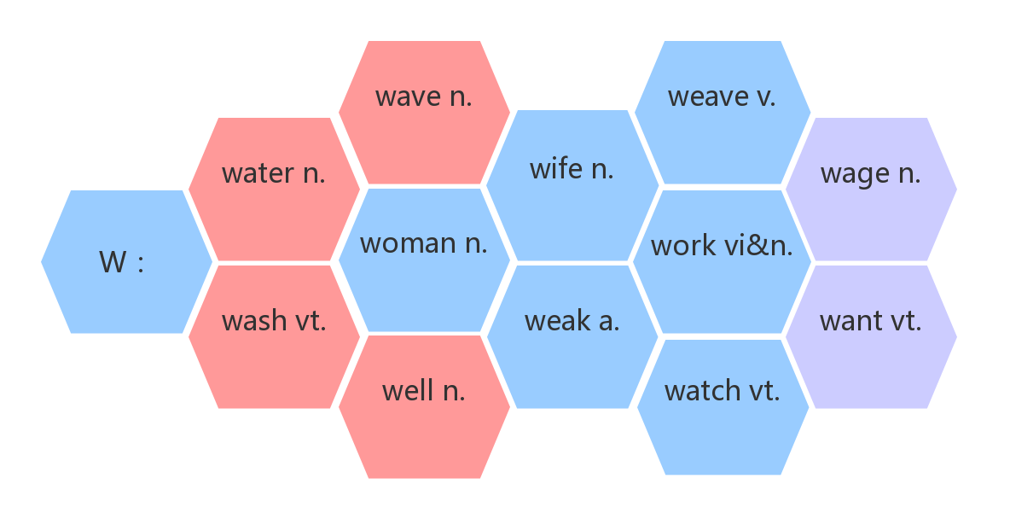
47. wave /weɪv/
n.海浪;波浪vi.&vt. 挥手;招手
Cars were swept away by huge waves caused by the strong earthquake.
汽车被强烈地震引起的巨浪冲走了。
Children were playing in the waves. 孩子们在海浪中嬉戏。
The people on the bus waved and we waved back.
公共汽车上的人挥手致意，我们也向他们挥手。
They came to the front door to wave goodbye. 他们来到前门挥手告别。
词群：
波浪
纺织
水
妻子
薪水
水
妇女
工作
洗
弱的
想要
井
看护

Slide 55
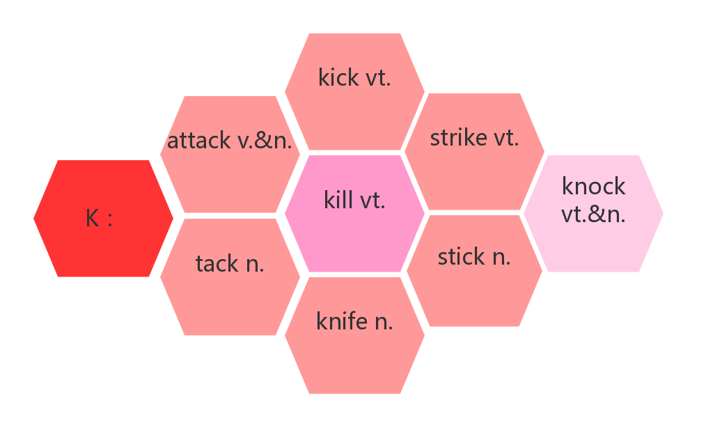
48. strike/straɪk/
v.&n.击打;突击 ( ) n.罢工
struck, struck/stricken
词群：
踢
攻击
击打
攻击
杀死
敲击
棍棒
大头钉
刀
on strike
罢工
某人突然想到……
It strikes sb. that...

Slide 56
The undersea quake ________ around 7:00. 海底地震发生在 7 点左右。
The ship _______ a rock. 船触礁了。
The child ran into the road and ____________ by a car. 孩子跑到公路上给车撞了。
_______while the iron is hot. 趁热打铁。
They went __________for more money. 他们为了得到更多的钱而罢工。
The workers __________were all fired. 罢工工人都被解雇了。
It suddenly ________ me how we could improve the situation.
我一下子明白我们如何能改善局面了。
struck
struck
was struck
Strike
on strike
on strike
struck
49. deliver/dɪ'lɪvə(r)/
vt.&vi.递送；传达；发表；接生
音意相通：递礼物
助记：为了感谢她为我接生，我在她发表演讲的时候给她递送了礼物。
be delivered of a baby 分娩；生孩子
However, dangerous conditions and damaged roads will make it difficult to ________ food and supplies. 然而，危险的状况和被毁坏的道路将使运送食物和供应品变得困难。
Do you have your milk ____________? 你的牛奶是让别人送吗？
We promise___________ within 48 hours. 我们承诺在48 小时内送到。
deliver
delivered
to deliver

Slide 57
The president will ________ a speech about the economic development.
总统将就经济发展发表讲话。
Lin Qiaozhi often went late at night __________ a baby for a poor family.
林巧稚经常在深夜去为贫苦家庭的产妇接生。
She was delivered ____ a healthy boy. 她生下一个健康的男孩儿。
deliver
to deliver
of
50. summary /'sʌməri/
n.总结；概括；概要
词根词缀：sum(总结，概括)+(m)ary(名词后缀)：概要，总结
总的来说
in summary
A summary is a short statement of main point. 摘要是对要点的简短陈述。
Here's a summary of the day's news. 下面是今日新闻简报。
In summary, this was a disappointing performance. 总的来说，这场演出令人失望。
In summary the two universities have some things in common.
总之，那两所大学有一些共同之处。

Slide 58
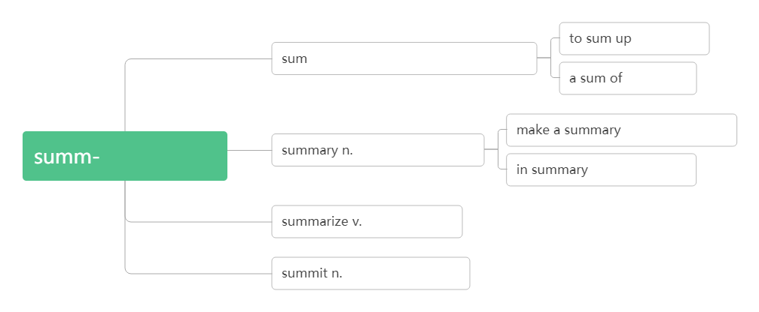
作为总结
n.金额;总数v.概括;总结;合计
一笔(钱)
做总结,做摘要
总的/高的
概要,摘要,总结
总地来说
总结;概括
顶点;顶峰;峰会
51. length/ leŋθ/
n. 长；长度
类比：long a.长的—— strong a.强壮的——
dead a.死亡的—— wide a.宽的——
length n.长度
strength n.力量；长处
death n.死亡
width n.宽度
Is the summary the proper length? 摘要的长度合适吗？
This room is twice the length of the kitchen. 这个房间的长度是厨房的两倍。
The river is 300 miles in length .这条河长 300 英里。
The snake reaches a length of 100 cm. 蛇长达100厘米。
She had always kept his family at arm's length. 她一直与他的家人保持一定距离。

