Slide 1

感恩遇见，相互成就，本课件资料仅供您个人参考、教学使用，严禁自行在网络传播，违者依知识产权法追究法律责任。
更多教学资源请关注
公众号：溯恩高中英语
知识产权声明

Slide 2
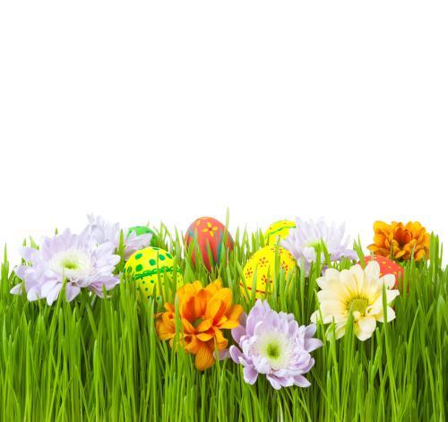
让人物在你的笔端鲜活
神态描写

Slide 3

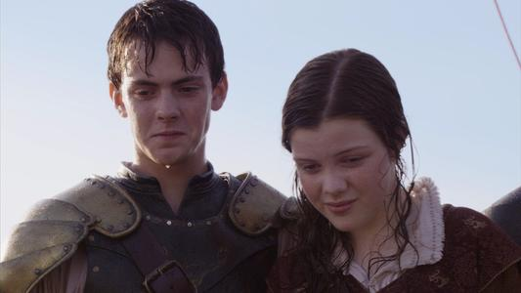
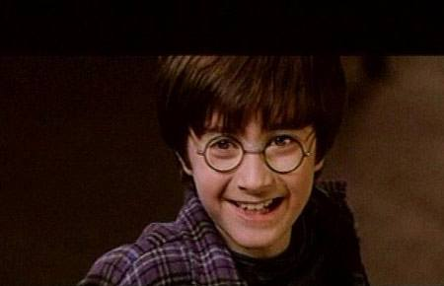
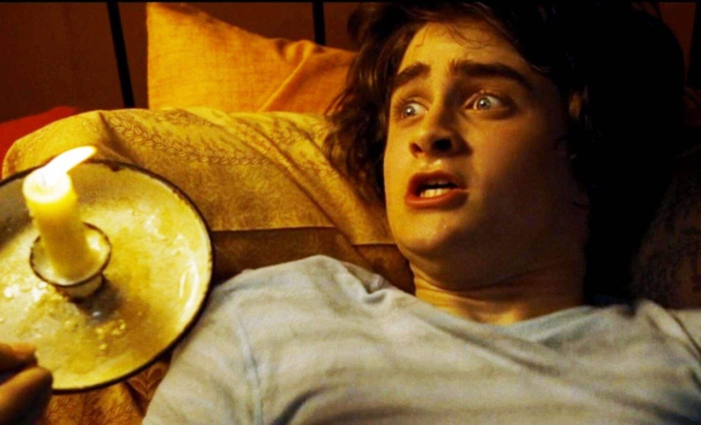
神态描写
神态描写专指对人物脸部表情的刻画。描写时要注意脸部的细微的表情和变化，适当运用表示表情、神态的词语。

Slide 4
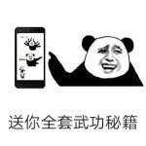

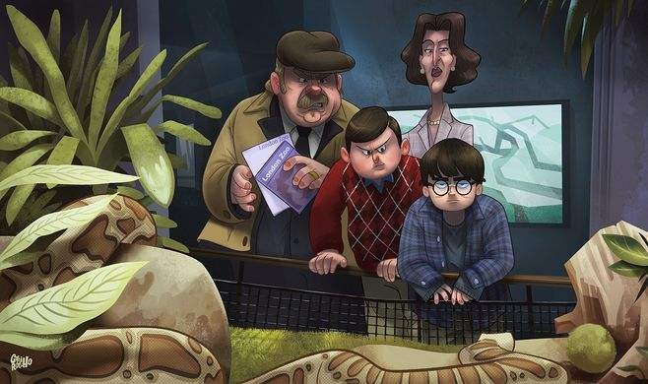
取胜第一招：神态描写要抓住人物脸部的细微变化
素材摘录：“Who’d be writing to you?” sneered Uncle Vernon, shaking the letter open with one hand and glancing at it. His face went from red to green faster than a set of traffic lights. And it didn’t stop there. Within seconds it was the grayish white of old porridge.
“谁会写信给你呢？”弗农姨父冷笑着说，用一只手把信甩开。只看了一眼，他的脸色便由红转绿，比交通灯变得还快。而且还没停呢。不久，他的脸色变得像放久了的粥的灰白色。
Mrs. Durley,
Aunt Petunia
Mr. Durley,
Uncle Vernon
Dudley Durley
Harry Potter

Slide 5
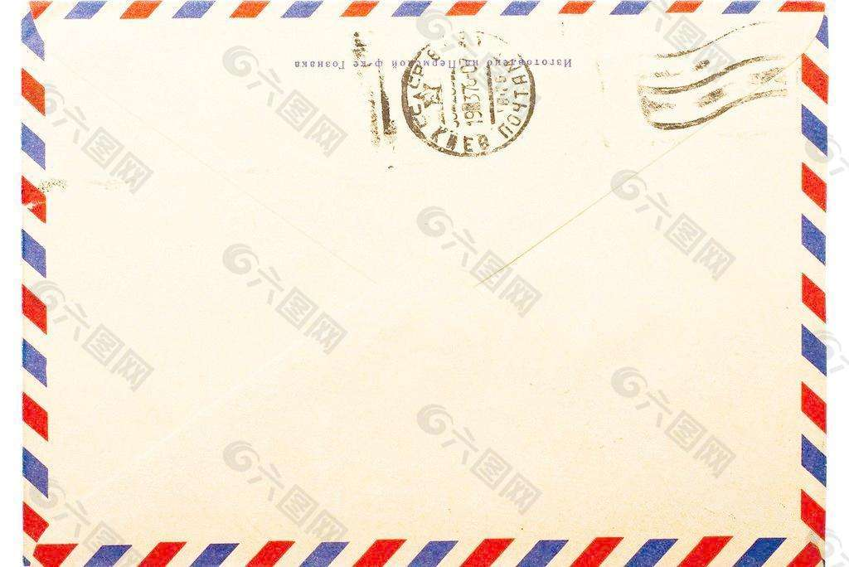

素材背景：Harry Potter has been living with the Dursleys since his parents were killed. Mrs. Potter was Mrs. Durley’s sister, but Mrs. Dursley pretended she didn’t have a sister, because the Potters were sorcerers. They didn’t and don’t want to have anything to do with the sorcerers. Nearly ten years passed and no one wrote to Harry. Now he received a letter from Hogwarts.
This is exactly where Harry lives.

Slide 6
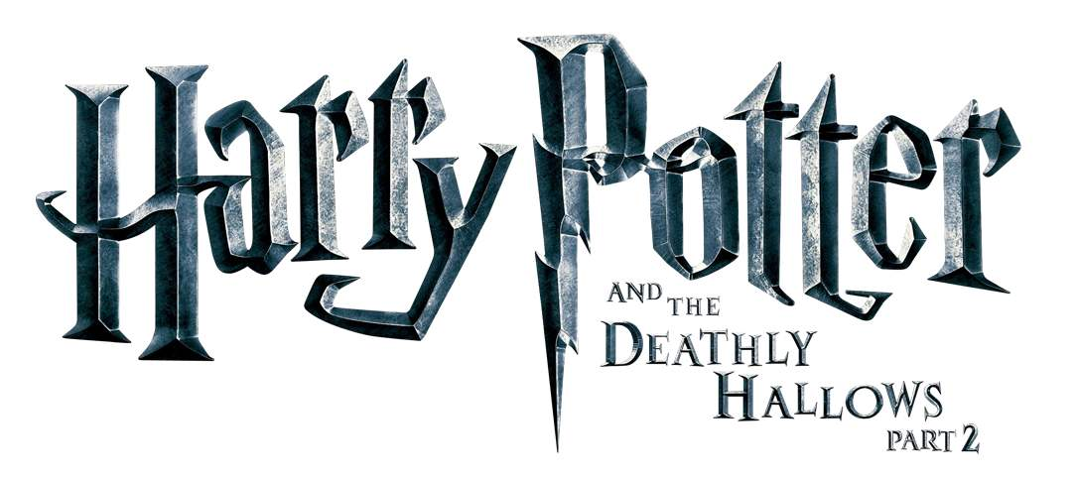
脸色变化
sneer(v.)嘲笑,鄙视
“Who’d be writing to you?” sneered Uncle Vernon, shaking the letter open with one hand and glancing at it. His face went from red to green faster than a set of traffic lights. And it didn’t stop there. Within seconds it was the grayish white of old porridge.
grayish white灰白色
grayish white
green
red
sneer
glance
脸色变化
画面感强
动作
and the
Sorcerer’s Stone

Slide 7
取胜第二招：神态描写要反映人物的思想感情
素材摘录：On Sunday morning, Uncle Vernon sat down at the breakfast table looking tired and rather ill, but happy.星期天早上，弗农姨父终于可以坐在桌旁吃早餐了。他看上去疲惫不堪，但是非常开心。
“No post on Sundays,” he reminded them cheerfully as he spread marmalade on his newspapers. “今天没有信件。”他开心得把橙子酱往报纸上涂。
素材背景： Uncle Vernon burned all the letters to Harry, for he didn’t want Harry to be a sorcerer. But more and more letters poured in.

Slide 8
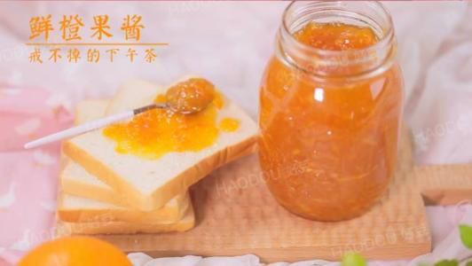
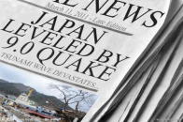
anxiety
On Sunday morning, Uncle Vernon sat down at the breakfast table looking tired and rather ill, but happy.
“No post on Sundays,” he reminded them cheerfully as he spread marmalade on his newspapers.
橙子酱涂错地方的这一动作体现了他真实的内心。
焦虑，分心
先扬后抑
happy, cheerful
tired, ill
marmalade(n.)橙子酱
and the
Sorcerer’s Stone

Slide 9
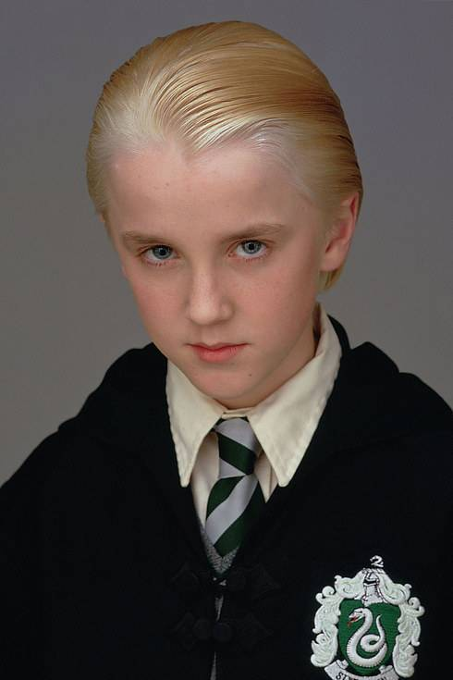
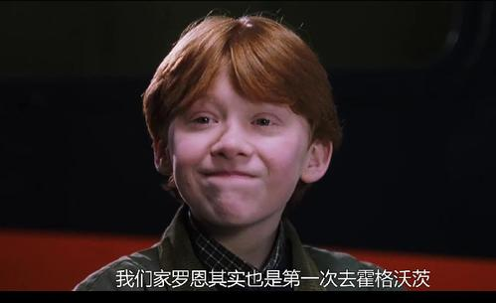
素材摘录：Ron gave a slight cough, which might have been hiding a snigger.
Ron
罗恩轻轻咳了一声,免得笑出声来。
Draco Malfoy
素材背景：On the train to Hogwarts, Draco Malfoy introduced himself to Harry and Ron. Ron found the name funny.

Slide 10
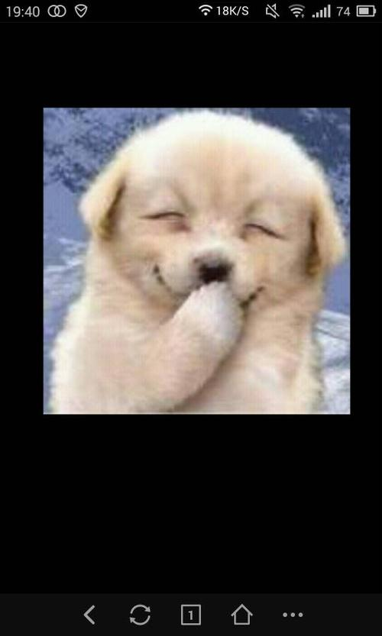
snigger
Ron gave a slight cough, which might have been hiding a snigger.
snigger(n.&v.)窃笑;半忍住的笑
Ron
to show politeness
and the
Sorcerer’s Stone

Slide 11
取胜第三招：神态描写与动作描写相结合
素材摘录：More silence followed this little speech. Harry and Ron exchanged looks with raised eyebrows. Hermione Granger was on the edge of her seat and looked desperate to start proving that she wasn’t a dunderhead. 他讲完短短的开场白之后，全班寂静无声。哈利和罗恩扬了扬眉，交换了一下眼色。赫敏·格兰杰几乎挪到椅子边上，看来是急于证明自己不是笨蛋傻瓜。

Slide 12
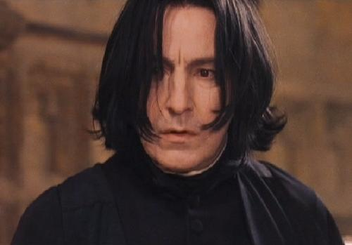
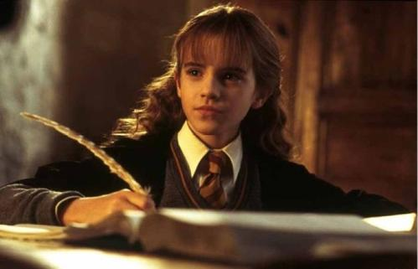

素材背景：Before he began his class, Professor Snape delivered a little speech: “I can teach you how to bottle fame, brew glory, even stopped death——if you aren’t as big a bunch of dunderheads as I usually have to teach.”我可以教会你们如何获取声望，酿造荣耀，甚至阻止死亡——但有一点，那就是你们不是我经常遇到的那种笨蛋傻瓜才行。
bright
diligent
Professor Snape
intelligent
strict
Hermione Granger

Slide 13
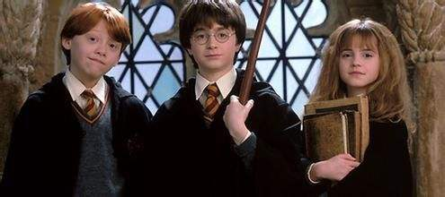
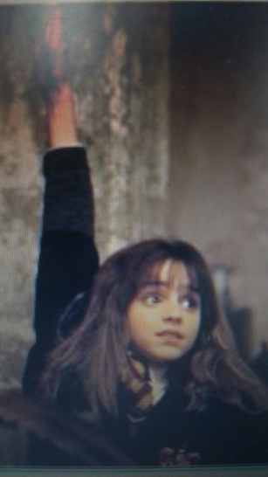
surprise&eagerness
笨蛋
More silence followed this little speech. Harry and Ron exchanged looks with raised eyebrows. Hermione Granger was on the edge of her seat and looked desperate to start proving that she wasn’t a dunderhead.
exchange looks交换眼神
raised eyebrows扬起眉毛
on the edge of her seat在她座位边缘处
desperate(adj.)急切的
and the
Sorcerer’s Stone

Slide 14
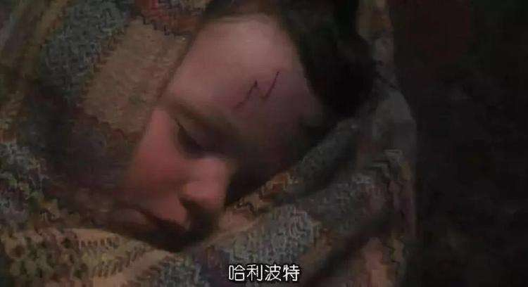
素材摘录：Hagrid’s shoulders shook, Professor McGonagall blinked furiously, and the twinkling light that usually shone from Dumbledore’s eyes seemed to have gone out. 海格的肩头不停地抖动着，麦格教授拼命地眨眼，邓布利多眼中通常闪烁的亮光好像消失不见了。
素材背景：Nearly ten years ago, Hagrid,
Professor McGonagall and Dumbledore put Harry on the front step of the Dursleys. For a full minute the three of them stood and looked at the little bundle.

Slide 15
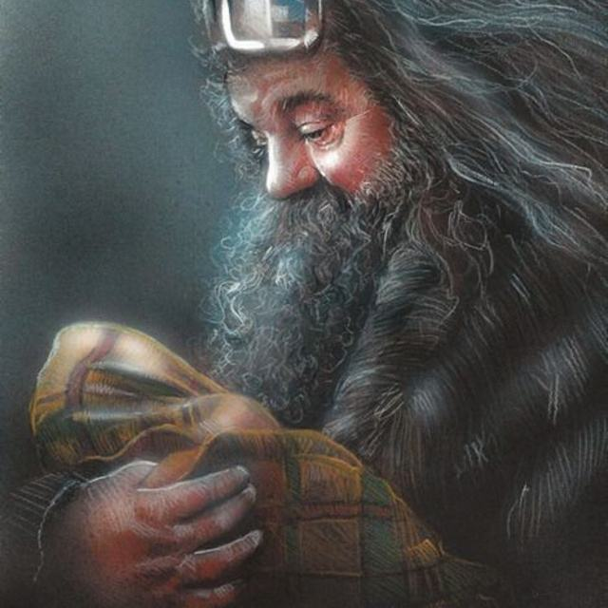
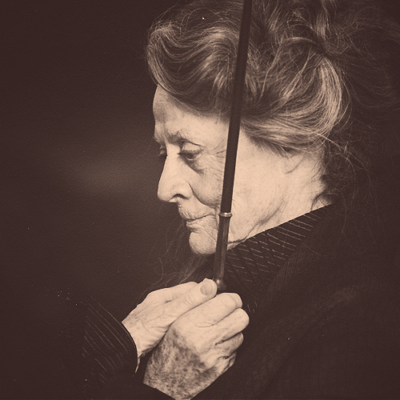
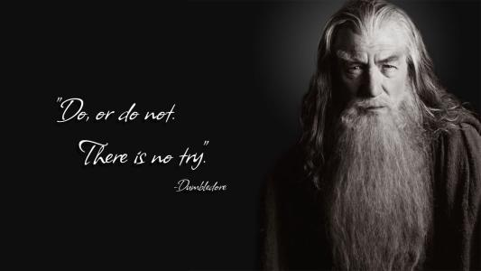

sorrow
Hagrid’s shoulders shook, Professor McGonagall blinked furiously, and the twinkling light that usually shone from Dumbledore’s eyes seemed to have gone out.
light ….have gone out
动作&神情:伤感
shoulders shook
blinked furiously
and the
Sorcerer’s Stone

Slide 16
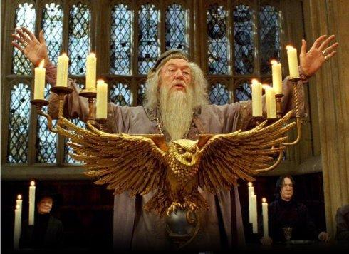
素材摘录：Albus Dumbledore had gotten to his feet. He was beaming at the students, his arms opened wide, as if nothing could have pleased him more than to see them all there.艾伯斯·邓布利多站起来，注视着台下的学生，张开双臂，仿佛在说没有什么能比见到他所有的学生济济一堂更高兴的了。
素材背景： Albus Dumbledore welcomed the new students.
Albus Dumbledore

Slide 17
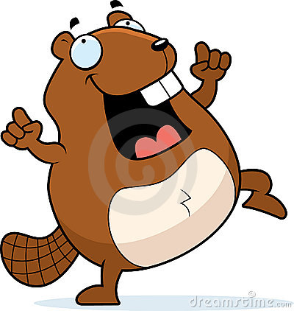
pleasure & welcome
Albus Dumbledore had gotten to his feet. He was beaming at the students, his arms opened wide, as if nothing could have pleased him more than to see them all there.
get to his feet
open his arms
pleased
beam
and the
Sorcerer’s Stone

Slide 18
取胜第四招：神态描写与语言描写相结合
素材摘录：“That’s a broomstick,” he said, throwing it back to Harry with a mixture of jealousy and spite on his face. “You’ll be in for it this time, Potter, first years aren’t allowed them.” “是把飞天扫帚。”他一边说,一边把包裹扔还给哈利,脸上混杂着嫉妒和怨恨的表情,“你等着挨罚吧,波特,一年级学生是不许玩这个的。”
素材背景：Harry received a parcel containing a broomstick from Professor McGonagall.

Slide 19
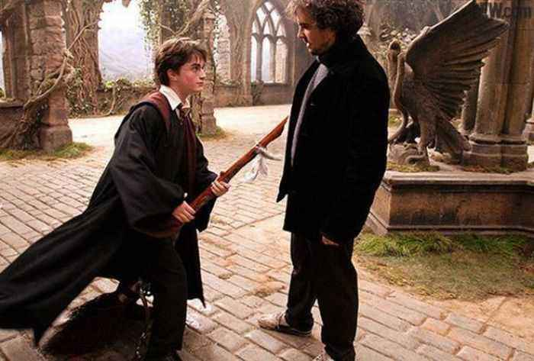
动作
jealousy & spite
“That’s a broomstick,” he said, throwing it back to Harry with a mixture of jealousy and spite on his face. “You’ll be in for it this time, Potter, first years aren’t allowed them.”
语言
jealousy
spite

Slide 20
取胜第五招：神态描写与修辞手法相结合
素材摘录：Snape’s face was twisted with fury as he dropped his robes quickly to hide his leg. 斯内普赶紧放下长袍挡住伤腿。他气得脸都歪了。
素材背景：Harry Potter went to Professor Snape’s room to take back the book that was taken from him earlier that day. When Harry came, Filch was handling Snape bandages for his bloody leg.

Slide 21

夸张
twist v.扭曲变形
anger
Snape’s face was twisted with fury as he dropped his robes quickly to hide his leg.
这里运用的修辞手法是夸张。因为生气,脸上的表情与正常不同,但也不至于脸变歪。这里却说脸都歪了,就是一种夸张。
这里形容Snape教授很生气。由于太生气,面目狰狞。

Slide 22
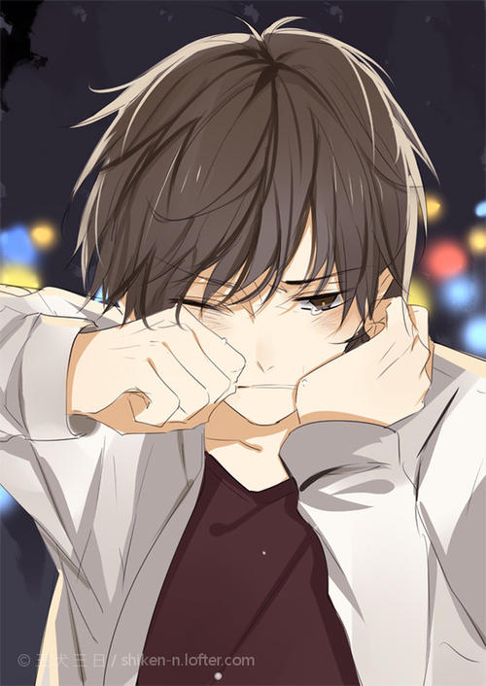
se the boy... Use the boy..."
Part 4
Harry felt as if Devil's Snare was rooting him to the spot. He couldn't move a muscle. Petrified, he watched as Quirrell reached up and began to unwrap his turban. What was going on? The turban fell away. Quirrell's head looked strangely small without it. Then he turned slowly on the spot.
Harry would have screamed, but he couldn't make a sound. Where there should have been a back to Quirrell's head, there was a face, the most terrible face Harry had ever seen.
译文：
哈利觉得自己仿佛被魔鬼网牢牢缠住了，浑身上下丝毫也动弹不得。他呆呆地站在那里，看着奇洛举 起手解下他头上的围巾。这是怎么回事?大围巾落了下来，奇洛裸露的脑袋看上去小得出奇。然后，他慢慢 地原地转过身去。
哈利想放声尖叫，但发不出一点儿声音。在原本该是奇洛后脑勺的地方，长着一张脸，哈利还从来没有看见过这样狰狞恐怖的脸。
讲解：
chalk white 像粉笔一样白的
名词+形容词 像...一样...的
素材摘录： Wiping his streaming eyes on his jacket sleeve, Hagrid swung himself onto the motorcycle and kicked the engine into life. 海格用外衣衣袖揩了揩流泪的眼睛，跨上摩托，踩着了发动机。
素材背景： Nearly ten years ago, Hagrid brought baby Harry from Harry’s home to the Dursleys. After Dumbledore put baby Harry on the front step of the Dursleys, Hagrid said goodbye to Harry and left.

Slide 23

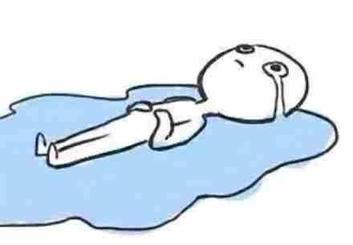
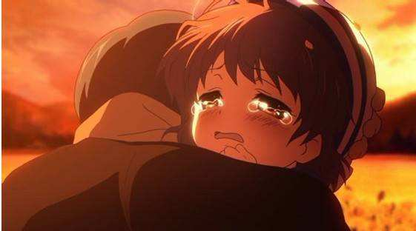
se the boy... Use the boy..."
Part 4
Harry felt as if Devil's Snare was rooting him to the spot. He couldn't move a muscle. Petrified, he watched as Quirrell reached up and began to unwrap his turban. What was going on? The turban fell away. Quirrell's head looked strangely small without it. Then he turned slowly on the spot.
Harry would have screamed, but he couldn't make a sound. Where there should have been a back to Quirrell's head, there was a face, the most terrible face Harry had ever seen.
译文：
哈利觉得自己仿佛被魔鬼网牢牢缠住了，浑身上下丝毫也动弹不得。他呆呆地站在那里，看着奇洛举 起手解下他头上的围巾。这是怎么回事?大围巾落了下来，奇洛裸露的脑袋看上去小得出奇。然后，他慢慢 地原地转过身去。
哈利想放声尖叫，但发不出一点儿声音。在原本该是奇洛后脑勺的地方，长着一张脸，哈利还从来没有看见过这样狰狞恐怖的脸。
讲解：
chalk white 像粉笔一样白的
名词+形容词 像...一样...的
n. 小河;溪
v. 流
sadness
Wiping his streaming eyes on his jacket sleeve, Hagrid swung himself onto the motorcycle and kicked the engine into life.
夸张

Slide 24
se the boy... Use the boy..."
Part 4
Harry felt as if Devil's Snare was rooting him to the spot. He couldn't move a muscle. Petrified, he watched as Quirrell reached up and began to unwrap his turban. What was going on? The turban fell away. Quirrell's head looked strangely small without it. Then he turned slowly on the spot.
Harry would have screamed, but he couldn't make a sound. Where there should have been a back to Quirrell's head, there was a face, the most terrible face Harry had ever seen.
译文：
哈利觉得自己仿佛被魔鬼网牢牢缠住了，浑身上下丝毫也动弹不得。他呆呆地站在那里，看着奇洛举 起手解下他头上的围巾。这是怎么回事?大围巾落了下来，奇洛裸露的脑袋看上去小得出奇。然后，他慢慢 地原地转过身去。
哈利想放声尖叫，但发不出一点儿声音。在原本该是奇洛后脑勺的地方，长着一张脸，哈利还从来没有看见过这样狰狞恐怖的脸。
讲解：
chalk white 像粉笔一样白的
名词+形容词 像...一样...的
取胜第四招：神态描写与环境描写相结合
素材摘录： They walked in silence, their eyes on the ground. Every now and then a ray of moonlight through the branches above lit a spot of silver-blue blood on the fallen leaves. 他们静静地走着，眼睛盯着地面看。不时地，月光透过头上的树枝，照亮留在落叶上的一道银蓝色的血痕。
素材背景： As punishment for breaking the school rules, Hagrid took Harry, Hermione, Neville and Draco Malfoy to the Forbidden Forest to look for the wounded unicorn.

Slide 25

se the boy... Use the boy..."
Part 4
Harry felt as if Devil's Snare was rooting him to the spot. He couldn't move a muscle. Petrified, he watched as Quirrell reached up and began to unwrap his turban. What was going on? The turban fell away. Quirrell's head looked strangely small without it. Then he turned slowly on the spot.
Harry would have screamed, but he couldn't make a sound. Where there should have been a back to Quirrell's head, there was a face, the most terrible face Harry had ever seen.
译文：
哈利觉得自己仿佛被魔鬼网牢牢缠住了，浑身上下丝毫也动弹不得。他呆呆地站在那里，看着奇洛举 起手解下他头上的围巾。这是怎么回事?大围巾落了下来，奇洛裸露的脑袋看上去小得出奇。然后，他慢慢 地原地转过身去。
哈利想放声尖叫，但发不出一点儿声音。在原本该是奇洛后脑勺的地方，长着一张脸，哈利还从来没有看见过这样狰狞恐怖的脸。
讲解：
chalk white 像粉笔一样白的
名词+形容词 像...一样...的
fear
with great care & fear
They walked in silence, their eyes on the ground. Every now and then a ray of moonlight through the branches above lit a spot of silver-blue blood on the fallen leaves.
silence
环境静得吓人
fear
moonlight
泛着幽光的月亮
now and then
隔一会就吓一次
blood
银蓝色的血

Slide 26
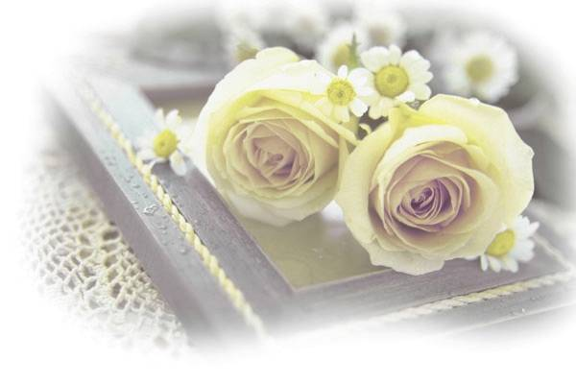
Goodbye!

