Slide 1


感恩遇见，相互成就，本课件资料仅供您个人参考、教学使用，严禁自行在网络传播，违者依知识产权法追究法律责任。
更多教学资源请关注
公众号：溯恩高中英语
知识产权声明

Slide 2


Application Letters
• 高中英语应用文写作---申请求职信(2)
杭州二中：许丽君

Slide 3

目录 / CONTENTS
01/objectives
02/Lead in
03/Format
04/ The template
05/Assessment
06/Writing Sample

Slide 4
Lead in
申请求职信 （2）
Lead in
When do you need to write Application letters?
apply for a position in clubs
apply for a position in a company
apply for an internship
apply to be a volunteer
apply to get a chance of being a host family
apply to get a chance of taking part in camps
apply to get a chance of being a service provider

Slide 5





申请求职信：在申请工作职位、入学资格、奖学金、签证或参加活动的机会时，向校方或聘方发出的信件，信件需写明申请的理由、职位和具体内容，概述个人情况。信文语言表达要准确，言简意赅，语气应诚恳，措辞要得体。
信件格式
称呼：Dear Sir or Madame/editor/Tom,
署名：Yours 或者Sincerely yours 换行Li Hua
客套话：开头How are you? How is everything going? / I am pleased/delighted to receive your letter…
结尾Best wishes./Best regards./Have a good day!/ I’d appreciate it if you write me soon./ Look forward to your early reply…

Slide 6
Part 1: Purpose of writing the letter
Writing preparations
（1）开篇常用句式：自我介绍（收信人非熟人），交代消息来源和写信的目的；。
I would like to work as a volunteer for the Winter Asian Games.
I am writing to express my interest in the post/position that you …
I am more than glad to get the information about the summer Camp.
I’m writing to apply for becoming one of the host families to accommodate our friends.
I have learnt from the advertisement that you need a …. I am writing to apply for this post.
Learning from… that you are looking for a …, I am writing to tell you that I’m suitable for the job.
I am writing to you to apply for the post that you advertised in the newspaper yesterday.
如果是非朋友，也可先简单介绍自己：
I am Li Hua, a student from No. 2 High School/ Chairman of the Student Union.

Slide 7
Part 2: Body Arrangements
Part 2: Body Arrangements
（2）篇中介绍能胜任申请的个人特长：知识、经验、性格等
communicate with
I have been …since…
get along well with sb
I once worked as a …for two years.
be rich in experience/ have much experience in

Slide 8



Part 2: Body Arrangements
Natural transitions
to begin with, besides, In addition , Therefore, In brief, once, as well, to be frank, what’s more, meanwhile…
The content must be correct and concrete, the language be accurate, the attitude and tone be genuine. (描述准确精炼，言简意赅，语气诚恳)
Suitable Details?
Speak in moderation, and in persuasive (用语适度，有说服力)
Express your gratitude in an enthusiastic way

Slide 9




Part 3: Ending
（3）篇尾表达对申请结果的期待
It will be highly appreciated if I can have this opportunity.
I sincerely hope you will enjoy the time you spend in my family.
I do hope that I can be lucky enough to be admitted to your camp.
I would appreciate it if you could take my application into consideration.
I am looking forward to your favorable reply at your earliest convenience.

Slide 10
Useful words and expressions
acted
ability
achieved
adapted
advanced
addressed
adjusted
adopted
advocated
ambitious
announce
anticipated
applied
approved
appointed
approached
arranged
assisted
assigned
attached
attended
balanced
boosted
background
combined
clarified
confirmed
cultivated
Delivered
designed
developed
diagnosed
determined
effective
experienced
education
exchanged
evaluated
enhanced
energetic

Slide 11
Writing help: Useful phrases
Writing help: Useful phrases
specialized in
good sense of
good candidate
responsible for
well suited for
technical skills
willing to travel
at your request
match for the job
I am sending you
meet your criteria
keep an interest in
take pride in my work

Slide 12





Writing help: sentences
Writing help: sentences
1. I am responding to your advertisement in Sunday’s paper for...
2. Sb. has informed me that you are currently looking for a part-time...
3. In response to your ad for a website producer/editor, I’m enclosing....
_
4. I was pleased to see your advertisement in this morning’s paper for...
__
5. My eight years as a..., make me suitable for the responsibilities of the position you are advertising.

Slide 13
Writing Template
申请求职信写作模板2：
Dear ______, (写信对象)
Writing Purpose：
My name is ____, from _______ (自我介绍). I would like to apply for (写信目的).I firmly believe that I have the qualification as a/an _____(申请的职位).
Body --- describing your viewpoint on why you feel you are qualified for the job
--- describing how you think they will fit the position you are applying for
Why do you feel you are qualified for the job?
Being a _____, I have been working in ____for___ years and I have a good command of _____. What’s the most important is that I was brought up to respect others and share happiness and sorrow with others. (申请的主要原因至少两个优点). I think that it will be beneficial to my ______.
Ending ---About your wishes for response and your gratitude.
I believe I have what the job takes. I hope you can offer me the opportunity. Looking forward to your earliest reply.
Sincerely yours Li Hua

Slide 14
Assessment
Work in groups of four. Each student read the article and others comment on your partner’s work. Then select the best one out to show in the class. When you are discussing, you can pay attention to the following hints.
Purpose | Have you made the purpose obvious?
Format | Does the format conform to the requirements?
Language | Are the sentences correct? Have you used the proper punctuation, words, sentence and paragraphs to convey yourself?
Content | Have you included all the points of view?
Are the details suitable?

Slide 15
（2018年6月浙江高考真题）
招聘志愿者
范文1：（2018年6月浙江高考真题）
第一节 应用文写作（满分15分）
假定你是李华，你校英语协会招聘志愿者，接待来访的国外中学生。请你写信应聘，内容包括：
1. 口语能力：
2. 相关经验；
3. 应聘目的。
注意：
1. 词数80左右；
2. 可以适当增加细节，以使行文连贯。

Slide 16
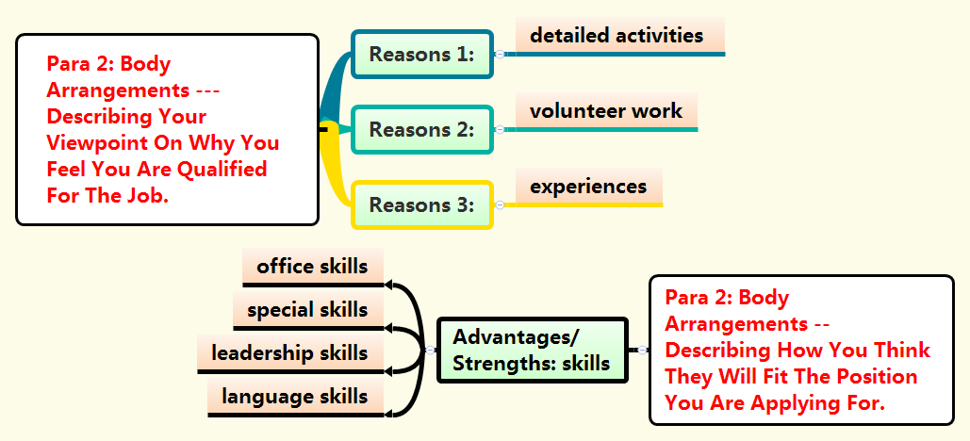
（2018年6月浙江高考真题）
招聘志愿者

Slide 17
（2018年6月浙江高考真题）
招聘志愿者
Writing Sample：
Dear sir,
I am writing to apply for a position as a volunteer for the reception job of some foreign students.
I think I’m qualified for the position. To begin with, I can speak English fluently as I have been learning it for 8 years or so, which can greatly benefit my work. What’s more, as a volunteer I once participated in lots of activities in society, during which I was well-equipped with plenty of experience. What’s the most important is that I can do my utmost for the English Association of School.
I would be much obliged if you can take my request into account. Your prompt attention to this letter would be highly appreciated.
Yours faithfully, Li Hua

Slide 18
申请肯德基（KFC）当服务生
范文2：假定你是李华，正在Columbia University求学，想利用暑假时间在肯德基(KFC)当一名服务生。请你给店长Steven写一封申请信，内容包括：
1. 自我介绍；
2. 申请的理由；
3. 联系方式。
注意：1．词数80左右；
2．可适当增加细节，以使行为连贯。

Slide 19
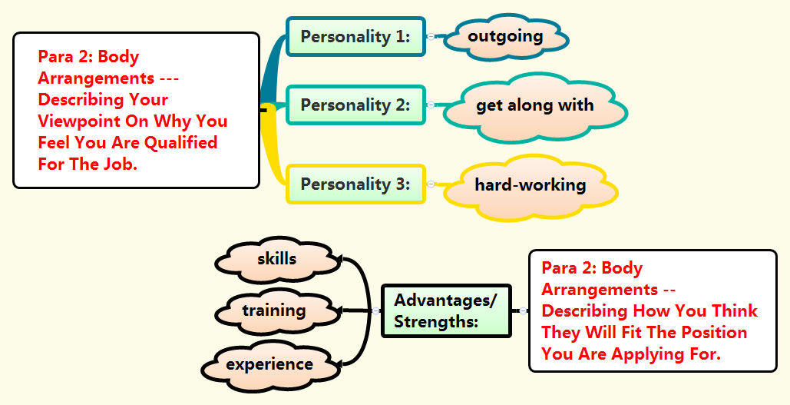
申请肯德基（KFC）当服务生

Slide 20
申请肯德基（KFC）当服务生
Writing Sample：
Dear Steven,
I am Li Hua, a student from Columbia University. I am writing to apply to be a waiter in your KFC to earn some pocket money during this summer vacation.
I am outgoing and can get along well with my colleagues and customers. I worked in a restaurant last summer and earned much related experience. Above all, I am a quick learner, which can enable me to adapt to my job as soon as possible.
It will be highly appreciated if my application is taken into account. Please contact me by 123456@gmail.com.
Yours faithfully,
Li Hua

Slide 21

Thanks
Thanks for your attention!

