Slide 1

感恩遇见，相互成就，本课件资料仅供您个人参考、教学使用，严禁自行在网络传播，违者依知识产权法追究法律责任。
更多教学资源请关注
公众号：溯恩高中英语
知识产权声明

Slide 2
Unit3
Sports and Fitness
By Lily

Slide 3
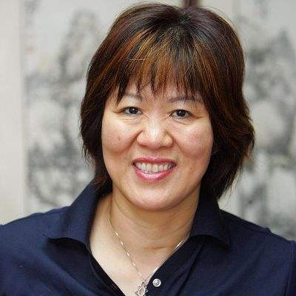
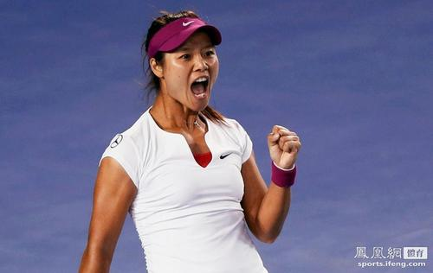
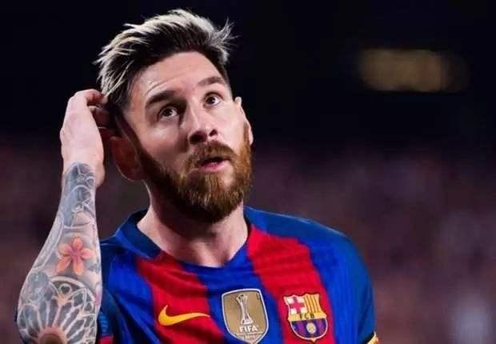
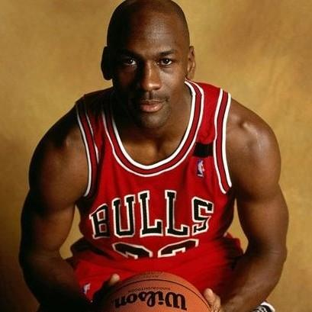
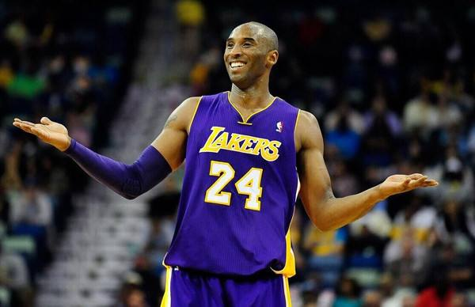


WWW. LLSport. com
Athletes
News
Discussion
Choose your favorite athletes
page
1
2
3
...
Comments:
Anna: Lina is the best, anyway.
Mike: James, My hero!@Jackson
Cindy1: Kobe, my forever dream!

Slide 4
Living Legends
Living Legends
Living Legends
Living Legends
“ legend”:
someone who is famous and admired for being extremely good at doing something. ———Longman Dictionary

Slide 5
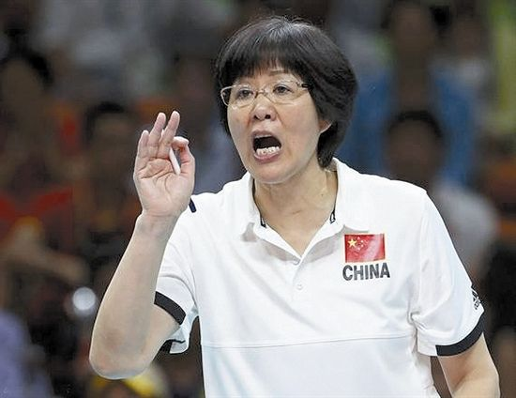
Lang Ping

Slide 6
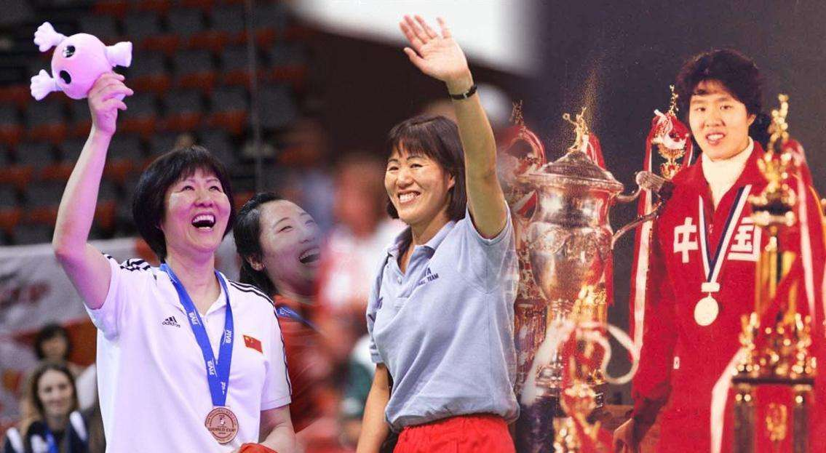
Find the descriptions of Lang ping
As a player, Lang Ping brought honour and glory to her country.
As a coach, she led the China women's volleyball team to medals at world championships and the Olympics.
As a person, Lang Ping is loved by fans at home and abroad.
Q1: Why did the writer say so?
Q2: What example did the writer use ?
Q3: Why is Lang ping still loved by people ?

Slide 7
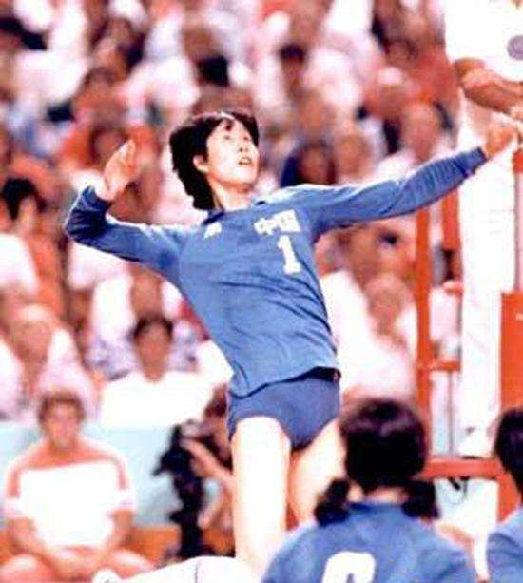
Lang Ping's career as a Player:
As a player, Lang Ping brought honour and glory to her country.
1960
Lang Ping was born.
1981
The 3rd World Cup
Q1: Why did the writer say so?
1982
9th World Women's Championship
Lang Ping won many championships and medals for China.
1984
The LA Olympics
1985
4th World Cup
1986
10th World Cup
1986
Lang Ping retired.

Slide 8
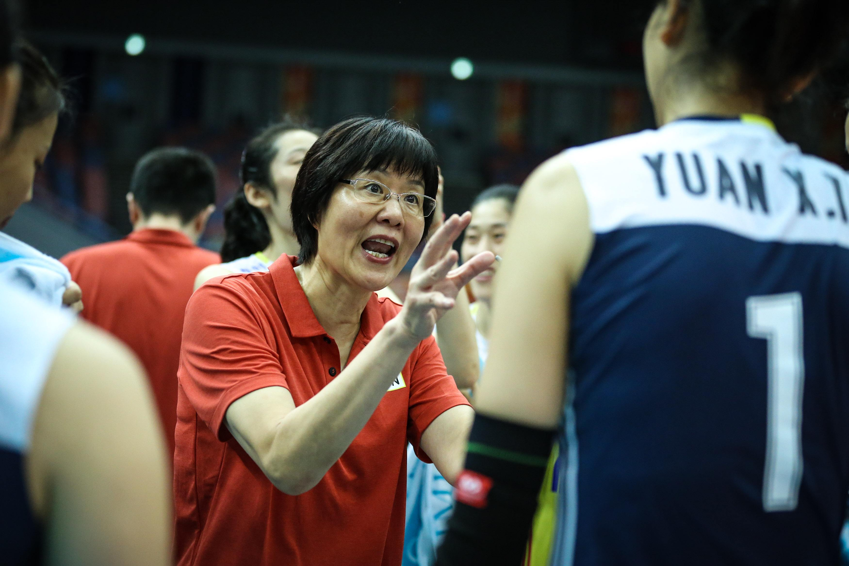
As a coach, she led the China women's volleyball team to medals at world championships and the Olympics.
Q2: What example did the writer use ?
the 2015 World Cup
Her determination was tested
a big challenge
Losing two important players
The team that Lang Ping had built was falling apart.
崩塌，分解
Lang Ping's attitude:
Not lose heart; confident; calm

Slide 9
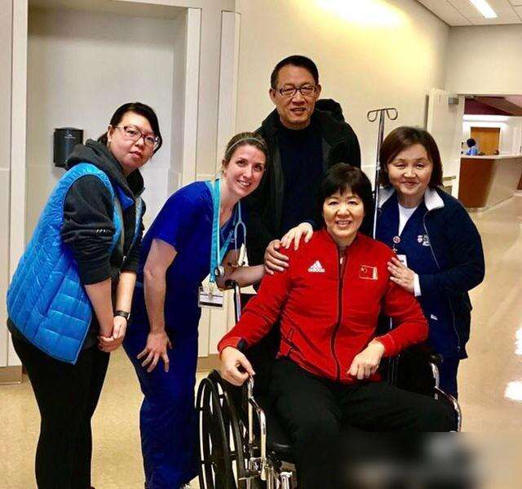
As a person, Lang Ping is loved by fans at home and abroad.
Q3: Why is Lang Ping still loved by people ?
Lang Ping's Charm
her capability
her personal qualities
as a player
determined,
brave, devoted, inspiring
as a coach
A Legend

Slide 10
Michael
Jordan

Slide 11
Jordan as a legend
his skills
his mental strength
[...] Jordan's skills were impressive, but the mental strength that he showed made him unique. [...]
Transitional sentence （过渡句）
1. How impressive were Jordan's skills?
2. What kind of mental strength does Jordan have?

Slide 12
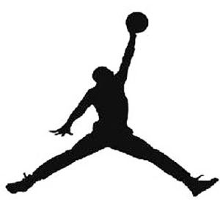
1. How impressive were Jordan's skills?
stop moving
“ When Michael Jordan's feet left the ground, time seemed to stand still.”
What rhetorical device （修辞手法） is used here?
hyperbole 夸张
his graceful moves and jumps in seconds
“Air Jordan”
“ In the final seconds of a game, Jordan always seemed to find a way to win. ”
Q:How did the Jordan make it?
Learn from failures and Practice harder.
Q: What mental strength does he have?
positive mind
strong will
determination

Slide 13
2. What kind of mental strength does Jordan have?
Jordan is positive, strong-willed and determined.
devoted
Supporting Evidence
Jordan says, “I can accept failure; everyone fails at something. But I can't accept not trying.”
What Jordan says
generous/ kind
In life, Jordan has learnt to share his success with others.
What Jordan does
inspiring
激励人的

Slide 14

Summary and Comparison
Two legends | Lang Ping | Jordan
descriptions of capability
Rhetorical Device (修辞)
supporting Evidence （支撑材料）
Personal qualities
As a player,..As a coach,...
As a person,...
When..., time seemed to stand still.
In the..., he always seemed to...
parallelism (排比)
hyperbole (夸张)
An example:
2015 world cup
Jordan's words and his actions
determined; brave; devoted; generous
determined; devoted; generous; inspiring
Thinking: What can we learn from these two living legends?

Slide 15
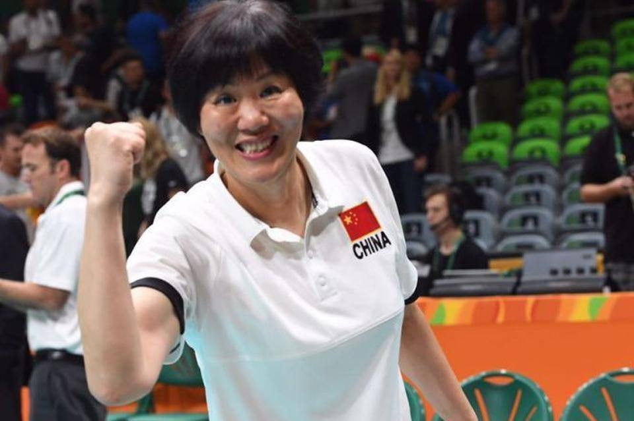
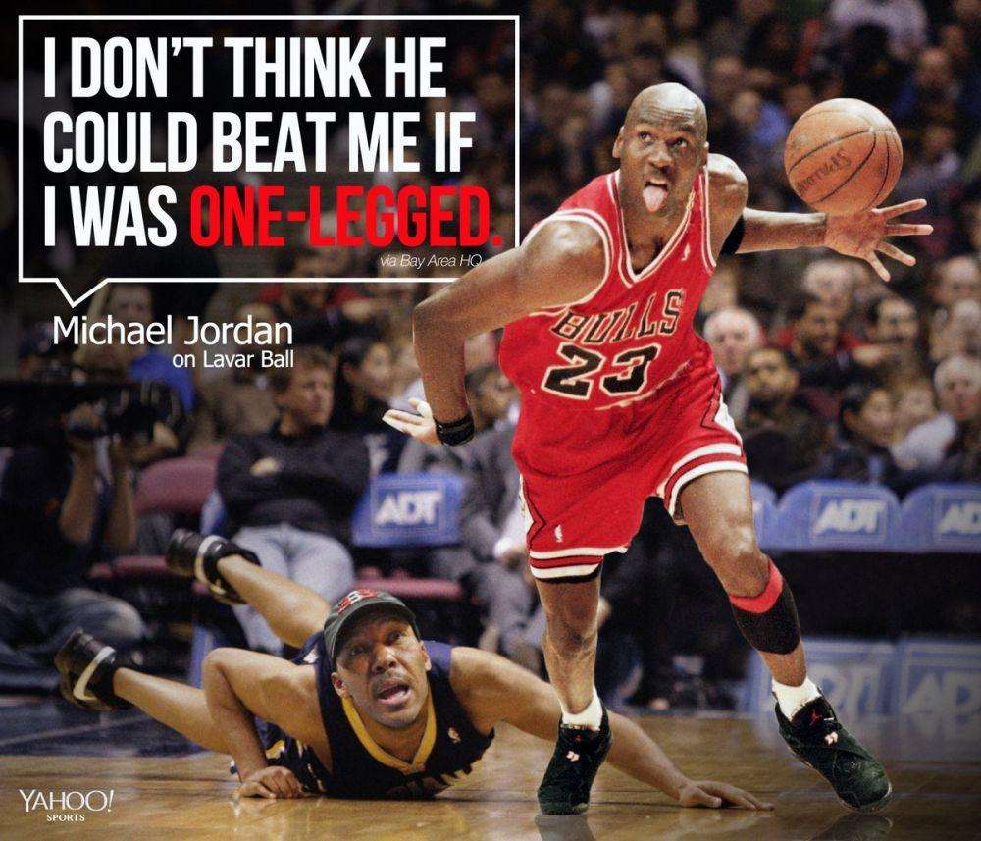
Thinking: What can we learn from these two living legends?
“ As an ace, you have to face all the challenges.”
---Lang Ping, 2015 World Cup.
“ The spirit of women volleyball team is not to win the championship but to make every effort to it even though you have known that you will lose.”
----Lang Ping, 2015
“I can accept failure; everyone fails at something.
But I can't accept not trying.”
-----Jordan

Slide 16
WWW. LLSport. com
Athletes
News
Discussion
Introduce Your Legend of Sports
What's the legend of sports in your heart?
Write an introduction of your legend and send to us.
The Living legend
Who:
His or Her capability:
His or Her personal qualities:
Supporting Evidence:

Slide 17
Homework:
1. To polish the draft.
2. To search for more supporting evidence about the legend you choose and polish the writing.

Slide 18
One possible example:
hyperbole (夸张)
The Living legend—__Kobe Bryant______
“Have you seen the LA at the 4:oo am?”Kobe Bryant did it for many times in his basketball training. When Kobe threw the ball, the ball seemed like a bullet, sharp and precise. His perfect and graceful skills made him the rising NBA star after Jordan. In his career, he brought honour and glory to his team with lots of achievements, such as 15 times of all-NBA teams, once MVP in regular season,4 times of all-star MVP, 2 times of final MVP,5 times of NBA championship and Two Olympic champions. Kobe’s skills were impressive but the mental strength he showed made him unique and loved by so many fans. Every match with Kobe was a wonderful and exciting performance. In the match, all the audience could feel his aggressiveness and the eager of victory. Failures made him improve himself to win every game. As the leader of Lakers, Kobe never let people down. He was always calm and got the key score for the team at last just like what he said," We do not retreat, we do not shrink, we do not run away, we insist, and then conquer our opponents?" It was famous Mamba Mentality. Unfortunately, on January 27, 2020, Kobe Bryant died in a plane crash, but his Mamba Mentality will make him a legend forever.
Kobe's capability
Supporting Evidence:
Kobe's traits
Content: Rich and Persuasive
Stucture:Clear and logic
Language:Correct and Colourful

Slide 19
Thank You!

