Slide 1


感恩遇见，相互成就，本课件资料仅供您个人参考、教学使用，严禁自行在网络传播，违者依知识产权法追究法律责任。
更多教学资源请关注
公众号：溯恩高中英语
知识产权声明

Slide 2

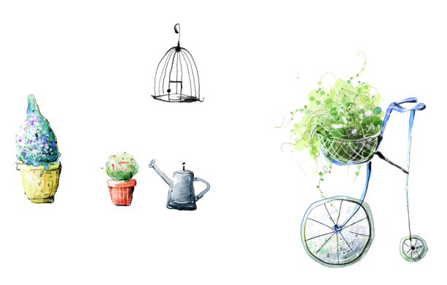


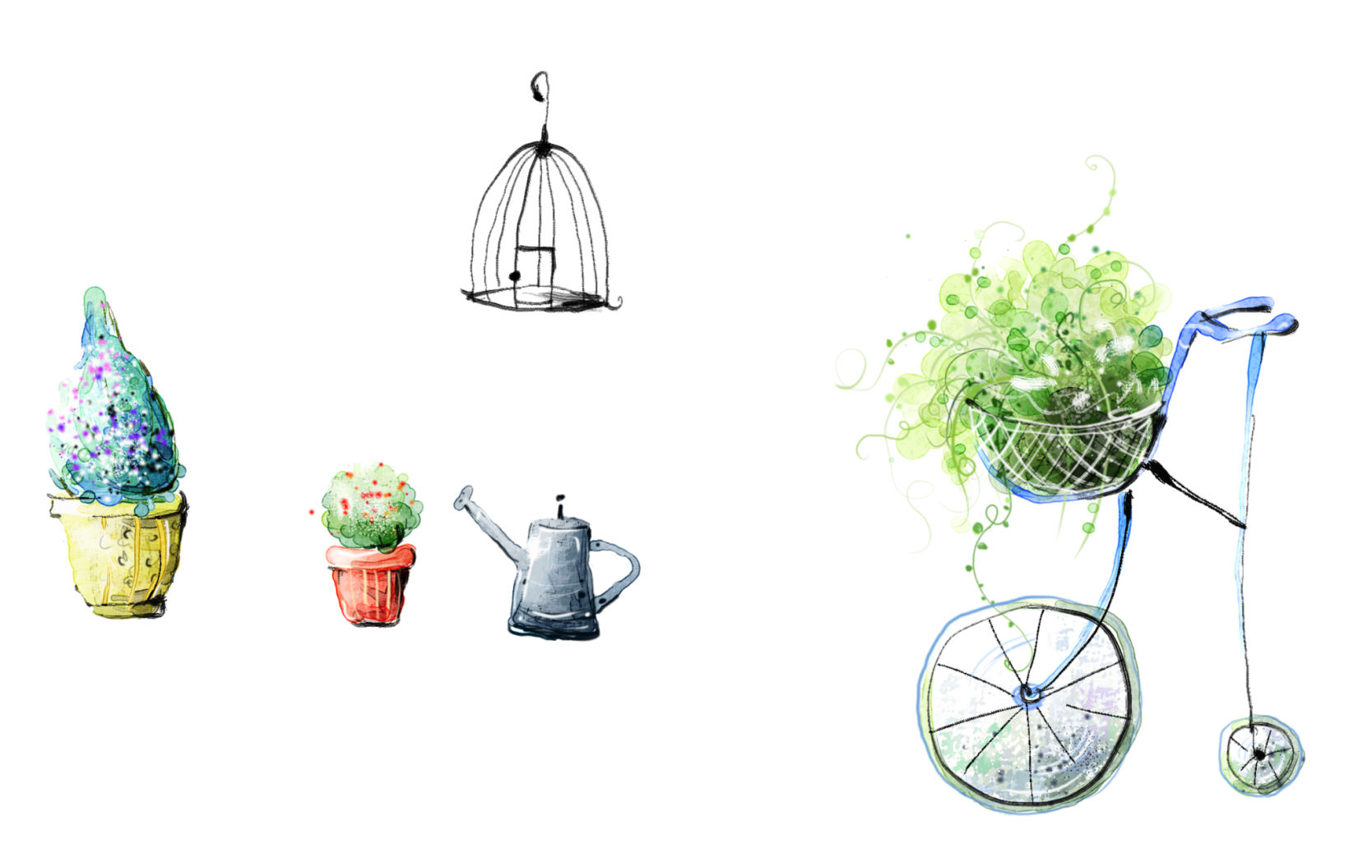
Summary Writing
Sabrina

Slide 3
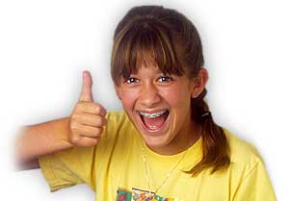

a________
pproval

Slide 4
Who is in control of your life? Who is pulling your strings? (操控)For the majority of us, it’s other people – society, colleagues, friends, or our family. We learned this way of operating when we were very young, of course. We were brainwashed. We discovered that feeling important and feeling accepted was a nice experience and so we learned to do everything we could to make other people like us. As Oscar Wilde puts it, “Most people are other people. Their thoughts are someone else’s opinions, their lives a mimicry (模仿), their passions a quotation.”
When people tell us how wonderful we are, it makes us feel good. We long for this good feeling like a drug – we are addicted to it and seek it out wherever we can. Therefore, we are so eager for the approval of others that we live unhappy and limited lives, failing to do the things we really want to. Just as drug addicts and alcoholics live worsened lives to keep getting their drug, we worsen our own existence to get our own constant drug of approval.
But, just as with any drug, there is a price to pay. The price of the approval drug is freedom – the freedom to be ourselves. The truth is that we cannot control what other people think. Everyone has a different way of thinking, and people change their opinions all the time. Moreover, people have their own business, and in the end, they’re more interested in themselves than in you. The person who tries to please everyone will only end up getting exhausted and probably pleasing no one in the process.
So how can we take back control? I think there's only one way -- make a conscious decision to stop caring what other people think. We should guide ourselves by means of a set of values -- not values imposed (强加) from the outside by others, but values which come from within. If we are driven by these values and not by the changing opinions and value systems of others, we will live a more authentic, effective, purposeful and happy life.

Slide 5
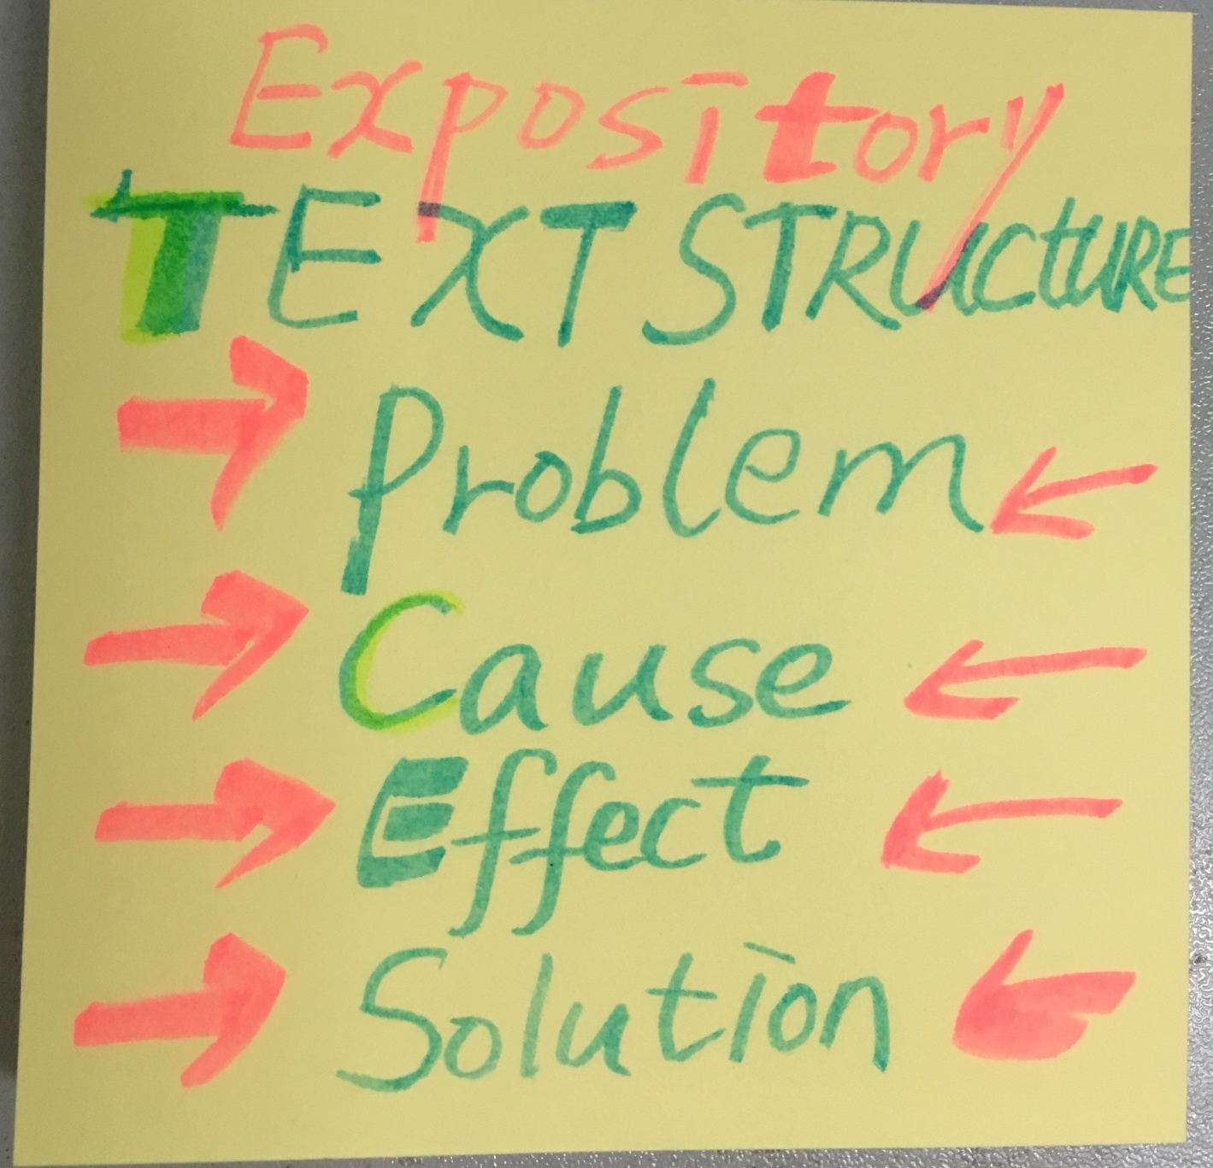
To be a focused reader
Step 1: Get a general idea
Q1: What is the writing style of the passage?
A Argumentation B Narration C Exposition
Q2: How is the passage organized?
Exposition: a type of writing to introduce,inform or explain…
Argumentation: a type of writing to convince or persuade…

Slide 6
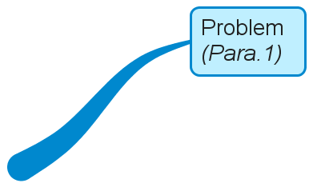
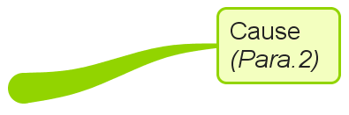
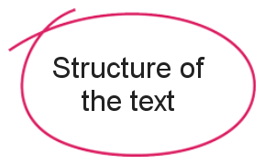
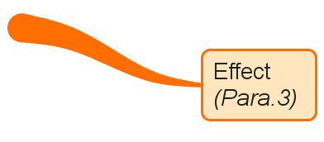
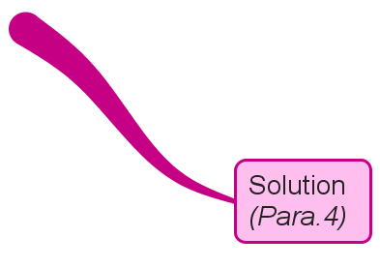

Slide 7
Step 2: Analyse the main points
Para 1: Introduction--Problem
For the majority of us, it’s other people – society, colleagues, friends, or our family that control our life.
topic
supporting details
as sb says/puts it
such as
for example
?
Writing tip 1: Delete unnecessary information, such as details, examples or quotations.

Slide 8
Other people are in control of our life.

Slide 9
Para 2: Cause
Therefore, we are so eager for the approval of others that we live unhappy and limited lives.

Slide 10
Other people are in control of our life.
because/
as / that's because
We are eager for the approval of others.

Slide 11
Para 3: Effect
Can we control others?
Why or why not?
Price?
The price of the approval drug is freedom.
We cannot control what other people think.
People change their opinions all the time.
Moreover, they are more interested in themselves.
Writing tip 2:Combine two different opinions if necessary.

Slide 12
Other people are in control of our life.
that's because
We are eager for the approval of others.
however
Their approval costs us our freedom to be ourselves, because they change their opinions all the time and are more interested in themselves.

Slide 13
Para 4: Solution
So how can we take back control?
stop caring what other people think. We sguide ourselves by means
values which come from within. Ifdriven by
how
what
authentic, effective, purposeful and happy life.

Slide 14
Other people are in control of our life.
that's because
We are eager for the approval of others.
however
Their approval costs us our freedom to be ourselves, because they change their opinions all the time and are more interested in themselves.
therefore/ consequently
We should stop caring what other people think and guide ourselves by values which come from within, so we will live a more enjoyful life.

Slide 15
Step 3: Paraphrase the points
Paraphrasing methods:
(1) change the speech of words
(2) use synonyms
(3) change the voice
(4)transform sentence patterns
Point1
Other people are in control of our life.
A
control
Other people ________ our life.
in charge of
B
Other people are ____________ our life.
C
is controlled
Our life ___________ by other people.
that
D
It is other people _____ control our life.

Slide 16
Paraphrasing methods:
(1) use synonyms
(2) change the voice
Point2
We are eager for the approval of others.
have a desire for/ have an appetite for/ long for
A
The main reason is that we __________________ getting approval.
anxious/ thirsty/ hungry/
B
We are ___________________ for getting others' _________________.
recognition/ acceptance
C
That's because we attach great importance to ________________ by them.
being approved of
being accepted
being recognized

Slide 17
Paraphrasing methods:
(3)Use a single word to cover the whole sentence's meaning.
point 3
The price of the approval drug is freedom.
We cannot control what other people think.
People change their opinions all the time. and are more interested in themselves.
changeable
uninterested
Their __________ and ____________thoughts,
are beyond our control.
Their recognition costs us our freedom to be who we are,
________their changeable and uninterested thoughts are
uncontrollable.
because
Writing tip 3:Use signal words to make your writing logical and clear.

Slide 18



Micro-writing practice
point4
We should stop caring what other people think
and guide ourselves by values which come from
within, so we will live a more authentic, effective,
purposeful and happy life.

Slide 19
Paraphrasing methods:
(4)Transform sentence patterns.
We should stop caring what other people think and
guide ourselves by values which come from within, so we
will live a more enjoyful life.
point4
Only by _______________________ others' opinion and
sticking to our inner values _______live a more enjoyable life.
A
ignoring/ taking no notice of
can we
（倒装）
B
Ignoring opinions of others and sticking to our inner values are good ways to be ourselves, ______makes our life cheerful and meaningful.
which
（定语从句）
c
One advisable solution is to ignore other people's opinion
and to be ourselves, thus ______ our life more enjoyable.
making
（用doing做结果状语）

Slide 20
Step 4: Check for possible mistakes
Check for improvement
01
Cover all the key points
02
Write in correct language
Assessment
Criteria
03
Use proper conjunctions
04
Avoid copying the original sentences
05
Count the words (60±20)

Slide 21

Summary writing
Good
One possible version
Our life is controlled by other people around us. That's because we attach great importance to being approved of by them. Sadly, their recognition costs us our freedom to be who we are, because their changeable and uninterested thoughts are uncontrollable. Therefore, we should ignore opinions of others and stick to our inner values, thus making our life cheerful and meaningful. (67)
请输入标题

Slide 22
Summary
Writing tips:
1. Delete unnecessary information, such as details,examples and quotations.
2. Combine two different opinions if necessary.
3.Use signal words to make your writing logical and clear.
Paraphrasing methods:
(1) Use synonyms
(2) Change the speech of words
(3) Change the voice
(4)Transform sentence structures(inversion etc.)
(5)Use a single word to cover a sentence’s meaning.

Slide 23



Assignment
Please apply what we learn in this period to make a summary of a new passage .

Slide 24
Many of us invest valuable time, energy and money planning our vacations. We do this because we know for sure that going on vacations must be good for us. Research proves this feeling without a doubt. Vacations help us perform better at work, improve our sleep quality and cushion us against depression.
Yet, despite these benefits, many of us return home with a feeling that our last vacation was OK - but not great. In order to change this, some mistakes should be avoided. A typical one for vacation planners is attempting to maximize value for money by planning trips that have too many things. Perhaps you're planning a trip to Europe, seven cities in 10 days, and you realize it will cost only a little more to add two more destinations to the list. Sounds fine in theory, but hopping from one place to the next hardly gives an opportunity to experience what psychologists call mindfulness -- time to take in our new surroundings, time to be present and absorb our travel experiences. Another mistake is that we worry too much about strategic issues such as how to find a good flight deal, how to get from A to B, or which destinations to add or subtract from our journey. These issues may seem important, but our psychological state of mind is far more important.
Actually, vacation happiness is based on the following top rules. First, choose your travel companions wisely, because nothing contributes more significantly to a trip than the right companions. Second，don't spend your vacation time in a place where everything is too expensive so as to maintain a positive mood. Third, shop wisely, for meaningful experiences provide more long-term happiness than physical possessions.

Slide 25
Summary
One possible version:
Vacations benefit everyone, but many people come back from vacations not feeling very great. To make our vacations happy, we should avoid two mistakes-trying to achieve the fullest value for what we invest into vacations and worrying too much about vacation arrangements. Besides, we should follow some rules such as choosing the right companions and destinations and being wise in doing shopping.

Slide 26
