Slide 1


感恩遇见，相互成就，本课件资料仅供您个人参考、教学使用，严禁自行在网络传播，违者依知识产权法追究法律责任。
更多教学资源请关注
公众号：溯恩高中英语
知识产权声明

Slide 2
M2U5 Music
嵊州市高级中学 尹 娟

Slide 3
Reading for Writing

Slide 4
Revise & Warm up
How can music help us and change our life?
make us relaxed and peaceful
release our pressure
give us courage and power
offer us comfort
keep us company

Slide 5
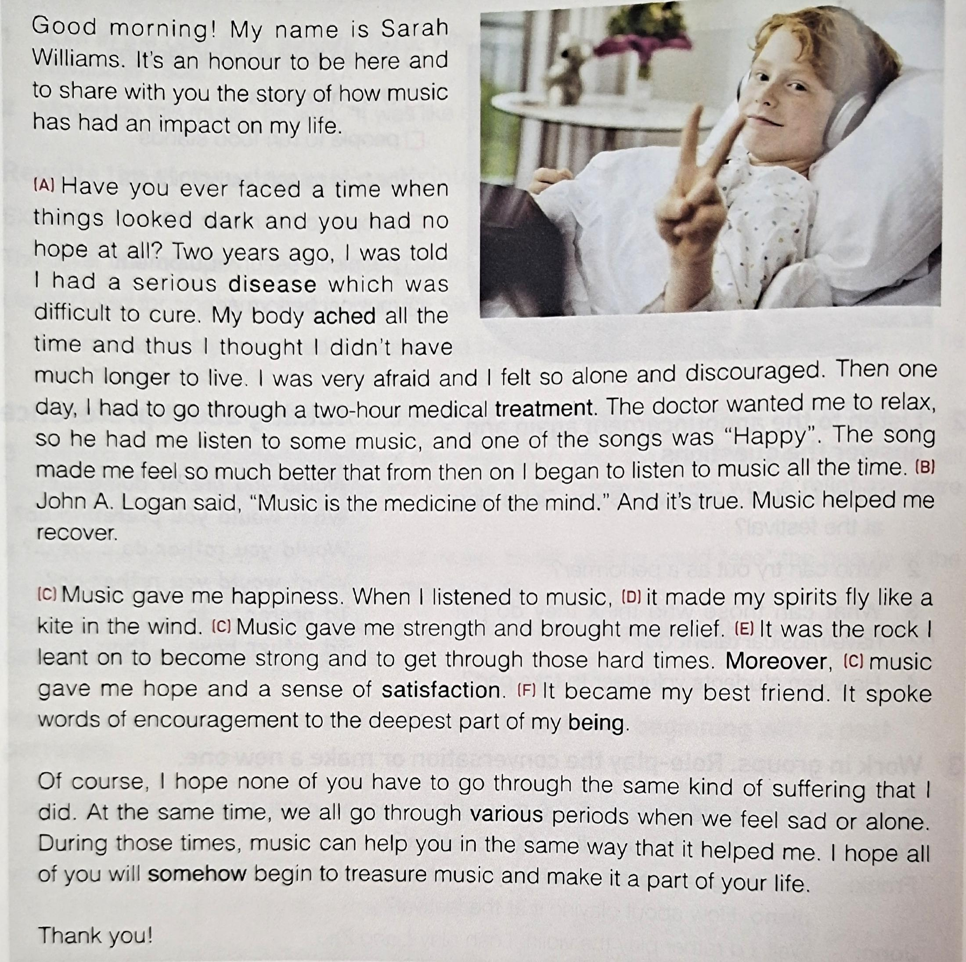
Read for the structure of a speech
Welcome the audience
Introduce oneself
Start
Propose the topic
Sarah's personal anecdote（story/experience）about the topic(music)
Body
Sarah's personal feeling about the topic(music)
Appropriate structure makes the speech smooth, logical and coherent.
Sarah's advice to the audience
Ending
Thank the audience at the end

Slide 6
Read for the information of the speech
(A) Have you ever faced a time when things looked dark and you had no hope at all? Two years ago, I was told I had a serious disease which was difficult to cure. My body ached all the time and thus I thought I didn't have much longer to live. I was very afraid and I felt so alone and discouraged. Then one day, I had to go through a two-hour medical treatment. The doctor wanted me to relax, so he had me listen to some music, and one of the songs was “Happy”. The song made me feel so much better that from then on I began to listen to music all the time. (B)John A. Logan said, “Music is the medicine of the mind.” And it's true. Music helped me recover.
1.What was Sarah's problem ?
Sarah had a serious disease which was difficult to cure, and she was very afraid and felt so alone and discouraged.
Sarah’s Problem:the disease
John A. Logan said, “Music is the medicine of the mind.”
2.How did music help her during her difficult time ?
The songs“Happy”made her feel so much better and helped her recover.
Sarah’s solution:the music

Slide 7
Read for the information of the speech
(C) Music gave me happiness. When I listened to music, (D)it made my spirits fly like a kite in the wind. (C) Music gave me strength and brought me relief. (E) It was the rock I leant on to become strong and to get through those hard times. Moreover, (C) music gave me hope and a sense of satisfaction. (F) It became my best friend. It spoke words of encouragement to the deepest part of my being.
3.What did music bring to Sarah?
Happiness.
Strength and relief.
Hope and satisfaction.
Friendship and Encouragement.
The impact of music on Sarah's life
Sarah's personal feeling about music
4.What is Sarah's advice to others?
Of course, I hope none of you have to go through the same kind of suffering that I did. At the same time,we all go through various periods when we feel sad or alone. During those times, music can help you in the same way that it helped me. I hope all of you will somehow begin to treasure music and make it a part of your life.
Treasure music and make it a part of one's life.
Sarah's advice to others about music
Suitable personal experience/anecdote makes the speech sincere, touching and impressive.
5. What kind of person is Sarah?
Considerate
Helpful
Convincing

Slide 8
Read for the language features of the speech
Hints for making a successful speech
1. When planning your speech, remember to organize your ideas as you
would for any other piece of writing. 2. Add the strategies that make a speech different from a piece of writing
such as: metaphors, personification, repetition, quotations, rhetorical
question, similes and so on.
3. Write the speech and then practise it with a partner. Exchange
suggestions on improving your speeches.
4. Finally be ready to give your speech to the class with expression and
emotion. Before your speech, ask the students for their opinions on
your topic.
5. Give your speech. Remember you want to change someone else’s point of
view, so you must sound sincere and convinced of your own arguments.
Rhetorical devices（修辞手法）

Slide 9

Read for the language features of the speech
I have once faced a time when things looked dark and I had no hope at all. Two years ago, I was told ...
(A) Have you ever faced a time when things looked dark and you had no hope at all? Two years ago, I was told ...
V.S.
A rhetorical question
（设问）
A statement
Arouse the audience's interest and build a connection between speaker and audience, thus making the audience involved in the speech
Just state the story of speaker and have little connection with the audience.
Involvement of readers
Involvement of readers
Involvement of readers
Involvement of readers
Setting up a connection
Setting up a connection
Setting up a connection
Setting up a connection

Slide 10
Read for the language features of the speech
(B)John A. Logan said, “Music is the medicine of the mind.”
As Longfellow says, “Music is the universal language of Mankind.”
In my opinion, I think music is the medicine of the mind.
I think music is the universal language of Mankind.
V.S.
A quote
（引用）
A personal
point of view
It's more convincing from a famous person. It can add weight to the point you present.
It's not authentic and persuasive.

Slide 11
Read for the language features of the speech
(D)...it made my spirits fly like a kite in the wind.
(C) Music gave me happiness.
(C) Music gave me strength
and brought me relief.
(C) ...music gave me hope and
a sense of satisfaction.
simile
(明喻)
A v. like/as B.
(E)It (music) was the rock I leant on to become strong and to get through those hard times.
Repitition
( 重复)
It can emphasize a particular point of view, draw the audience's attention and make the speech powerful and convincing.
Metaphor (隐喻)
A is B.
They make the speech vivid, lifelike and expressive.

Slide 12
Read for the language features of the speech
It can help the audience develop a connection between an abstact object or idea and feel empathy or sympathy for that idea or object. It can also help the audience relate to the concept being presented, and to give a more complete understanding of a difficult concept to comprehend.
(F) It became my best friend. It spoke words of encouragement to the deepest part of my being.
Personification
(拟人)
A rhetorical question（设问）
A quote（引用）
Repitition( 重复)
simile(明喻)
Metaphor (隐喻)
Personification(拟人)
All these rhetorical devices make a successful speech draft.

Slide 13
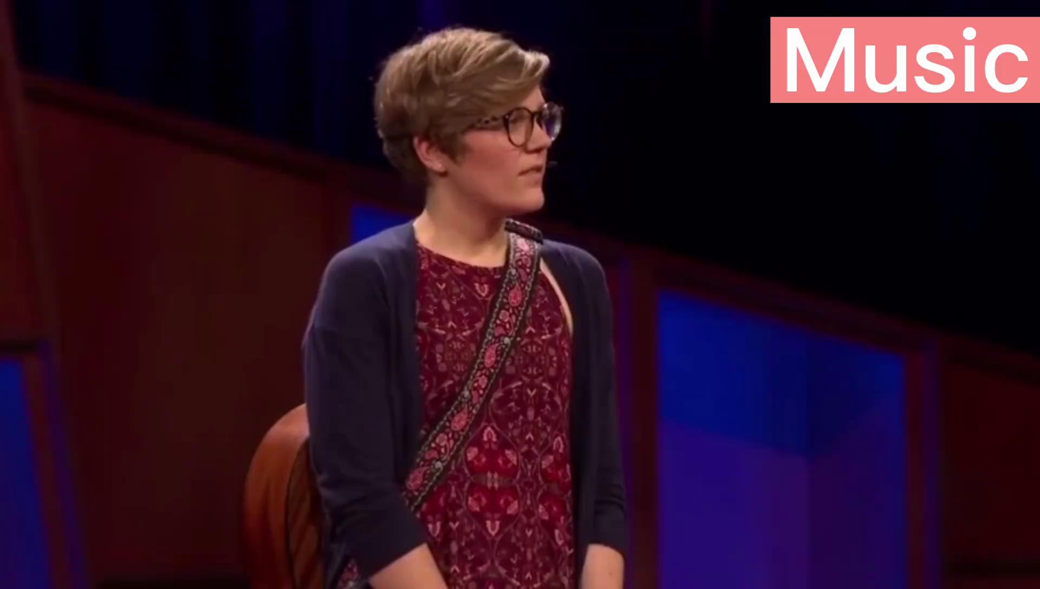

Slide 14
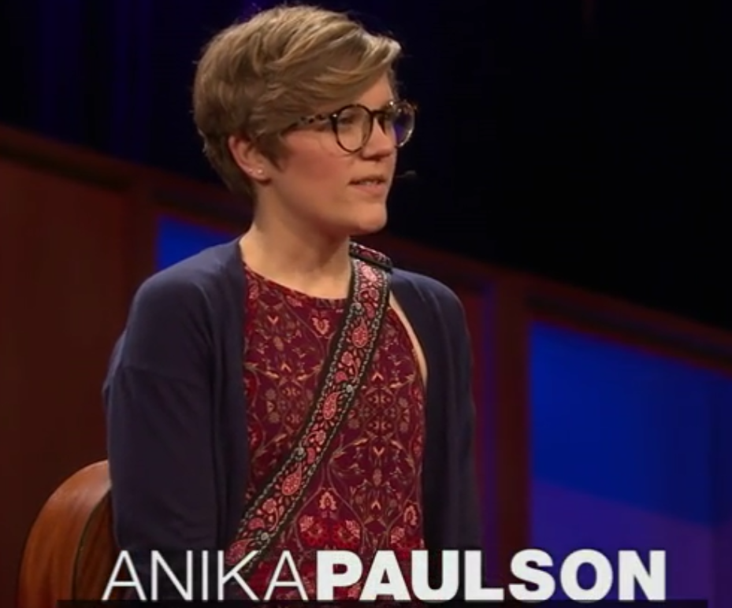
Appreciate the language features in the speech
What kind of rhetorical devices does Anika Paulson use in her speech?
The philosopher Plato once said, “Music gives a soul to the universe, wings to the mind, flight to the imagination and life to everything.”
A quote
When I’m happy, when I’m sad, when I’m bored, when I’m stressed, I listen to and I create music.
Repitition
Music surrounded me. It made me who I was, and it gave me a place to belong.
Personification
Proper rhetorical devices make the speech powerful, convincing and successful.
Now, music has these parts--rhythm, melody and harmony --just like our lives.
simile
Metaphor
Music has rhythm, which is routines and habits we have.

Slide 15
Write a speech about music
Write a speech about how music can change a person's life by using the structure and the rhetorical devices.
Think of ways that people experience music, and how music can help people.
Group work
Ways people experience music
singing,
How music can help people
give encouragement,
listening to music,
joining in the virtual choir
dancing freely ,
humming softly to oneself,
playing the piano/guitar...
give hope/strength/confidence,
make ... strong/confident/brave, bring ... relief/a sense of satisfaction,
offer comfort, release our pressure,
have a positive influence...

Slide 16
Write a speech about music
Useful expressions in the “Start” part of the speech
1. Good morning, ladies and gentlemen. I’m... Today I'm greatly honored to speak here
to talk about...
2. Good morning, everyone. My name is ... Thank you for giving me the opportunity to
make a speech about... 3. Hello, my dearest fellow schoolmates. I'd like to start by introducing myself. My name
is …. I feel very much honored to have a chance here to make a speech on the subject...
4. Good afternoon, everybody. My name is ... It’s my great honor to have the opportunity
to share with you my opinion on ... 5. Hello, ladies and gentlemen. Let me introduce myself. My name is…Today I’d like to
deliver a lecture on ... 6. Good morning, ladies and gentlemen. I’m...It’s my great honor to stand here on behalf of
all the students, and share with you my point of view on...

Slide 17
Write a speech about music
Useful expressions in the “Body” part of the speech
1. Have you ever faced a time when things looked dark and you had no hope at all?
2. Have you ever experienced the ups and downs of life and felt frustrated or discouraged?
3. Two years ago, when I entered the new school, I felt lost and depressed.
4. It’s like I had been taken out of my natural environment, and put somewhere new. And
slowly I began to lose myself, like I was being washed away.
5. There’s a beautiful connection between music and life. It can bind us to reality at the
same time it allows us to escape it.
6. Music is something that lives inside of you. You create it and you’re created by it.
Our lives are not only conducted by music, they’re also composed of it.
7. Music has always been a big part of my life. To create and to perform music connects
you to people countries and lifetimes away.
8. The philosopher Plato once said, “Music gives a soul to the universe, wings to the mind,
flight to the imagination and life to everything.”
9. Henry Wadsworth Longfellow once said, “Music is the universal language of mankind.”

Slide 18
Write a speech about music
Useful expressions in the “Ending” part of the speech
1. Of course, I hope none of you have to go through/experience the suffering and difficulties.
2. No one can deny the fact that music can .../It can be said with certainty that music can...
Undoubtedly, music is supposed to a strong support to you.
3. I hope everyone finds your comfort in your life and experience an enjoyable experience ...
4. If you are faced with difficulties, you can turn to music for help. It will surely help you out.
5. I sincerely hope all of you will somehow begin to treasure music and make it a part of
your life.
6. But music is always there, supporting us, connecting us to each other and showing us the
beauty of the universe. So if you ever feel lost, stop and listen for your song.
7. That’s all I want to say about this point. Thank you.
8. That’s all. Thank you for your listening/attention.
9. Thank you from the bottom of my heart for giving me this chance to speak to you today.
10. Finally, I hope I have made myself understood about music. Thank you so much.

Slide 19
Hello, ladies and gentlemen. My name is Kathy, and I'm here to talk about how music has changed my life.
Welcome the audience
Start
Introduce oneself
Have you ever experienced the ups and downs of life and felt frustrated or discouraged? Two years ago, when I entered the new school, I felt lost and depressed. It’s like I had been taken out of my natural environment, and put somewhere new. And slowly I began to lose myself, like I was being washed away. But then the next moment, I felt the melody, the song “Count on me”---soft and calming, comforting and powerful. It gave me strength and hope, like my old friend. It gave me company and comfort. And also it gave me courage to face all the difficulties. Gradually, I adapted to the new school. The philosopher Plato once said, “Music gives a soul to the universe, wings to the mind, flight to the imagination and life to everything.” I do benefit a lot from mysic.
Propose the topic
Share personal anecdote about the topic
Body
Share personal feeling
Using proper rhetorical devices
Supply advice to the audience
Thank the audience at the end
Ending
So next time, if you are faced with difficulties, you can turn to music for help. It will surely help you out. Thanks!
Close the speech

Slide 20
Write a speech about music
Writing task
Make use of what we talk about the speech---the structure, the rhetorical devices and useful expressions, combine them with your own experiences, and thenfinish your speech about how music changes our life.
Does the writer explain how music has changed his/her/someone else's life?
Are some of the rhetorical devices inctuded and used properly?
Checklist to polish the speech draft
Does the writer talk about how music makes him/her/someone feel?
Is the first word in each sentence capitalised?
Does the writer use correct punctuation?

Slide 21
Homework
Polish the speech and then practise it with a partner. Exchange suggestions on improving your speeches.
Be ready to give your speech to the class with expression and emotion. Before your speech, ask the students for their opinions on your topic.
Give your speech. Remember you want to change someone else’s point of view, so you must sound sincere and convinced of your own arguments.

Slide 22
Thank you!

