Slide 1


感恩遇见，相互成就，本课件资料仅供您个人参考、教学使用，严禁自行在网络传播，违者依知识产权法追究法律责任。
更多教学资源请关注
公众号：溯恩高中英语
知识产权声明

Slide 2
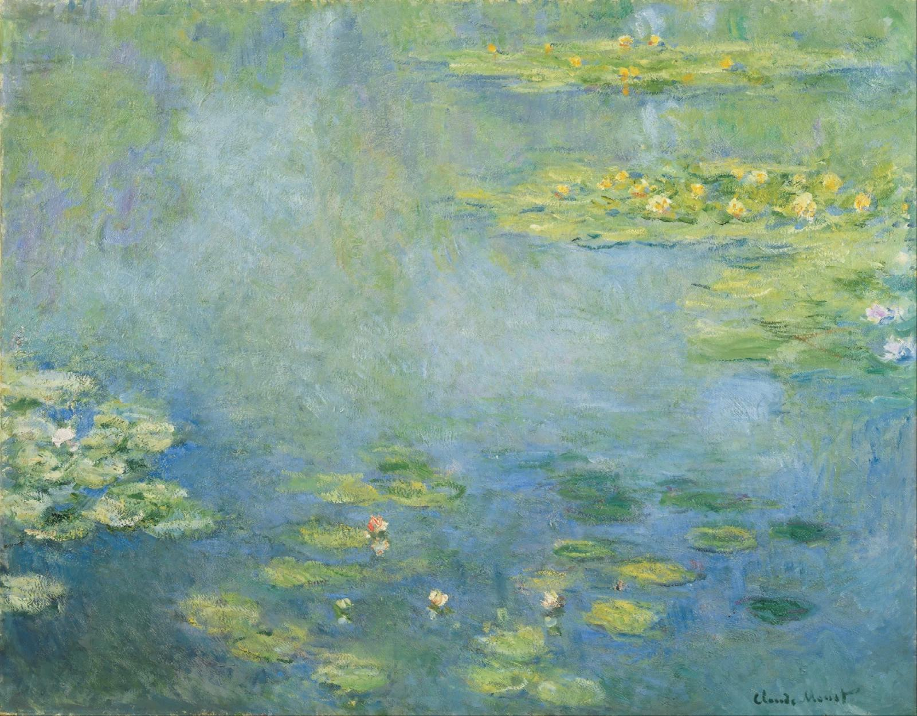
Discussion
If Laura had finished her question at the end of the story - Isn't it, darling? -, what would it say?
“Everyone is made out of the same dough
but not baked in the same oven”
——Jewish Proverb

Slide 3
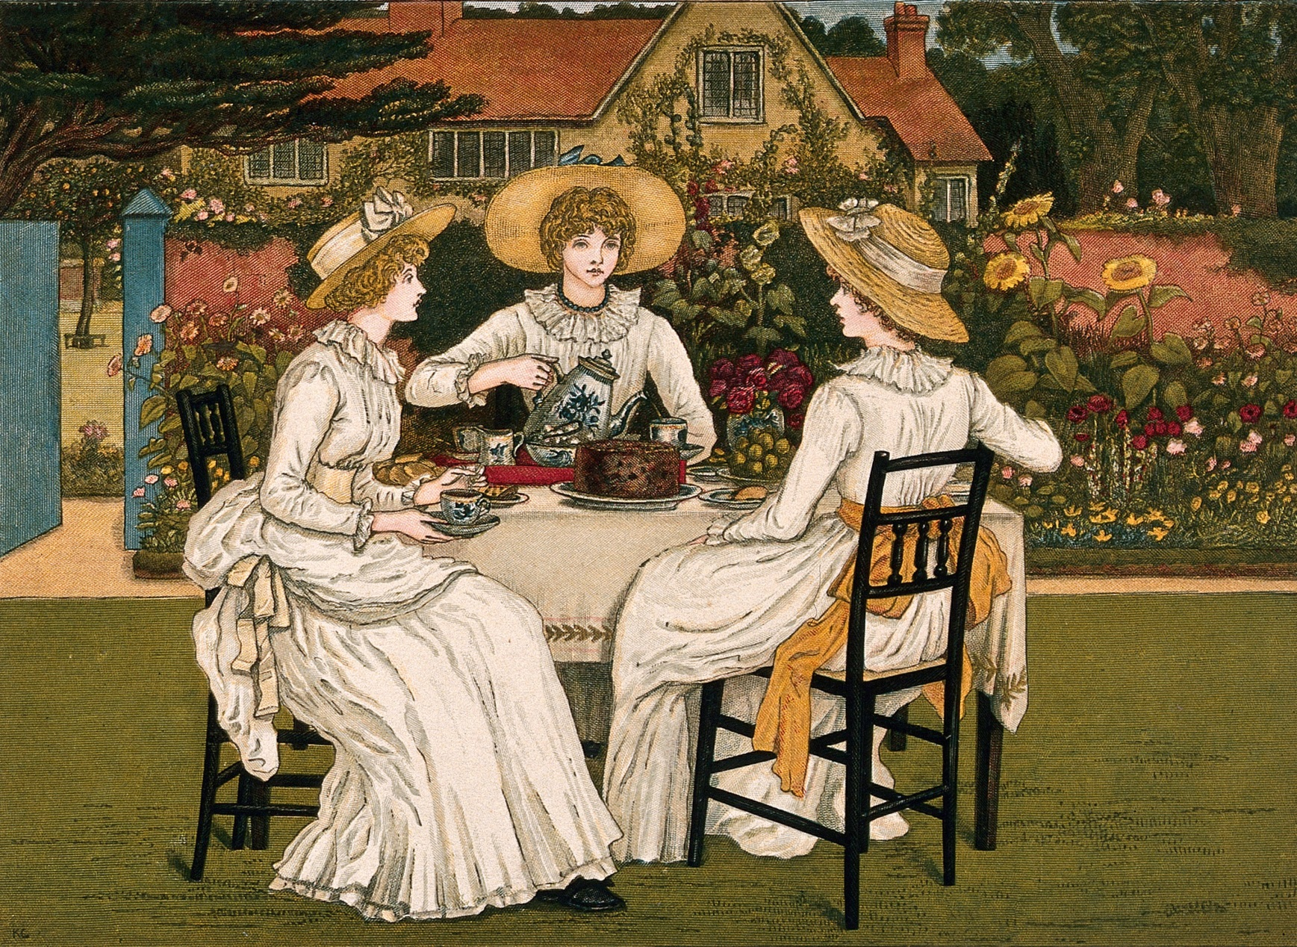
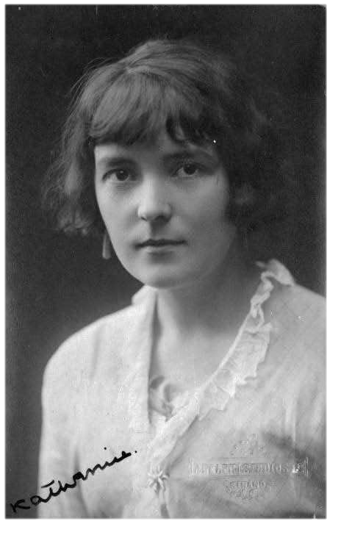
The Garden Party
Katherine Mansfield
1888~1923

Slide 4
Review:
Character Map
Mrs. Sheridan Class-conscious matriarch
Godber's deliveryman Bakery worker; gleeful bearer of terrible news
Laurie Sheridan Beloved brother
Mother
Siblings
Laura Sheridan Idealistic teenager on the brink of adulthood
Tell bad news
Siblings
Siblings
Jose Sheridan Attention-seeking young socialite
Neighbors
Scott
Poor laborer from the bottom of the hill; deceased

Slide 5

Thinking
Draw a Plot Map
Draw a plot map of the Garden Party. Retell the story with your plot map.

Slide 6


Thinking
Plot Diagram
5
4
6
3
2
7
1
Introduction
1. Laura oversees the workmen in the garden.
Rising Action
2. Godber's deliveryman shares news of Scott's death.
3. Laura's pleas to cancel the party are rebuffed.
4. Laura brings a basket of leftovers to the Scotts.
Climax
5. Laura views Scott's corpse.
Falling Action
6. Laura is overcome by the peace and beauty of the dead man.
Resolution
7. Laura tries to explain her feelings to Laurie.

Slide 7
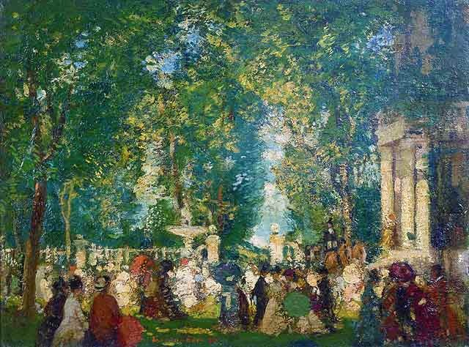
Thinking
Theme
Analyse the following dialogues and descriptions, and try to figure out the theme.

Slide 8
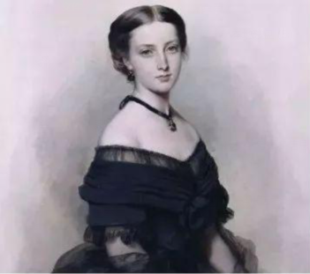
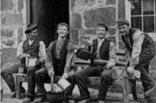
Before: “ Good Morning,’’ she said, copying her mother’s voice.
“Oh—er—have you come—is it about the marquee?”
After: How very nice workmen were!
Why wouldn’t she have workmen for friends rather than the silly boys she danced with and who came to Sunday night supper? She would get on much better with men like these. It’s all the fault, she decided, of these absurd class distinctions.
Laura
Foil Characters: someone who contrasts with another character – usually the main character – to highlight their qualities.

Slide 9
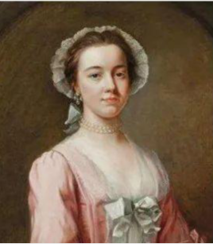
“Stop the garden party, of course.”
“But we can’t possibly have a garden party with a man dead just outside the front gate.”
Laura
“Stop the garden party? My dear Laura, don’t be so absurd. Of course we can’t do anything of the kind. Nobody expects us to. Don’t be extravagant.”
Jose

Slide 10
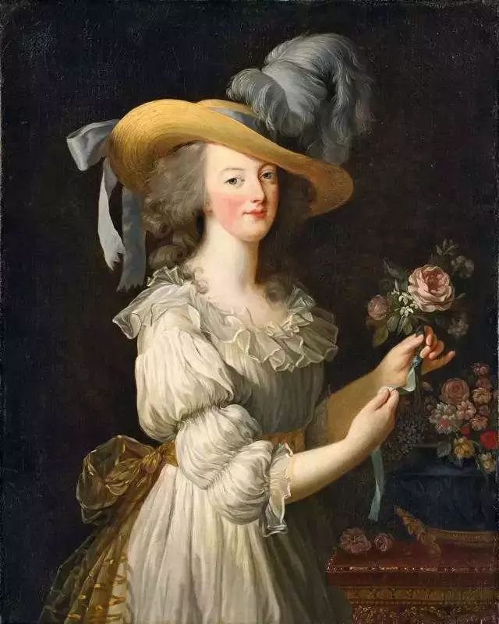
“But listen, mother,” said Laura. Breathless, half choking, she told the dreadful story. “Of course, we can’t have our party, can we?” she pleaded.
Laura
“But, my dear child, use your common sense. It’s only by accident that we’ve heard of it. If someone had died there normally – and I can’t understand how they alive in those tiny little holes – we would still have our party, wouldn’t we?’’
Mrs. Sheridan

Slide 11
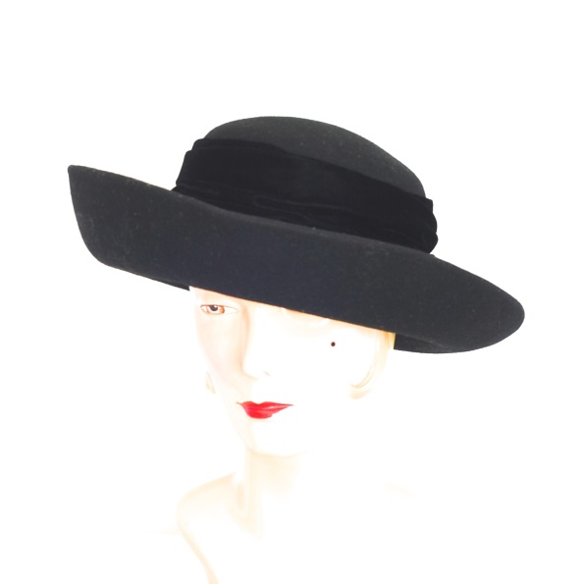
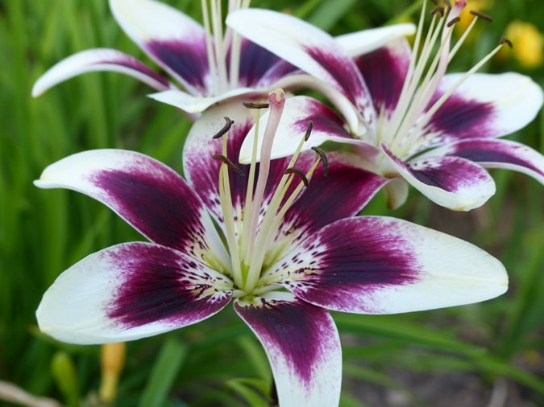
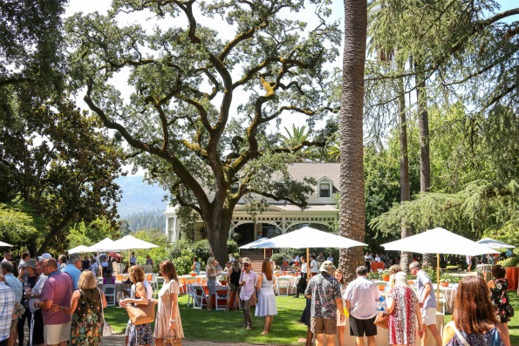
Black Hat
Black hat trimmed with daisies and a long black velvet ribbon
Lilies
There, just inside the door, stood a wide, shallow tray full of pink lilies. No other kind. Nothing but lilies – canna lilies, big pink flowers, wide open, radiant, almost frighteningly alive on bright crimson stems.
Symbolism: the practice or art of using an object or a word to represent an abstract idea.
Garden
The grass seemed to shine.
The karaka trees were so lovely, with their broad, gleaming leaves, and their clusters of yellow fruits.

Slide 12
Light:
Windless, warm, the sky without a cloud.
The blue was thinly covered with a haze of light gold.
The green bushes bowed down as though they had been visited by angels.
Imagery: language used by poets, novelists and other writers to create images in the mind of the reader.
Darkness:
They were little mean dwellings painted a chocolate brown..
The very smoke coming out of their chimneys was poverty-stricken. Little rags and shreds of smoke, so unlike the great silvery plumes that uncurled from the Sheridans' chimneys.

Slide 13
Theme
Laura’s idea
Internal
Society’s expectations
Conflict
Laura
External
Her family

Slide 14
Social Implications
Conflict
Adolescent Confusion
Psychological and Moral Growth
“Everyone is made out of the same dough but not baked in the same oven”
Mature Perception to Reality

