Slide 1

感恩遇见，相互成就，本课件资料仅供您个人参考、教学使用，严禁自行在网络传播，违者依知识产权法追究法律责任。
更多教学资源请关注
公众号：溯恩高中英语
知识产权声明

Slide 2

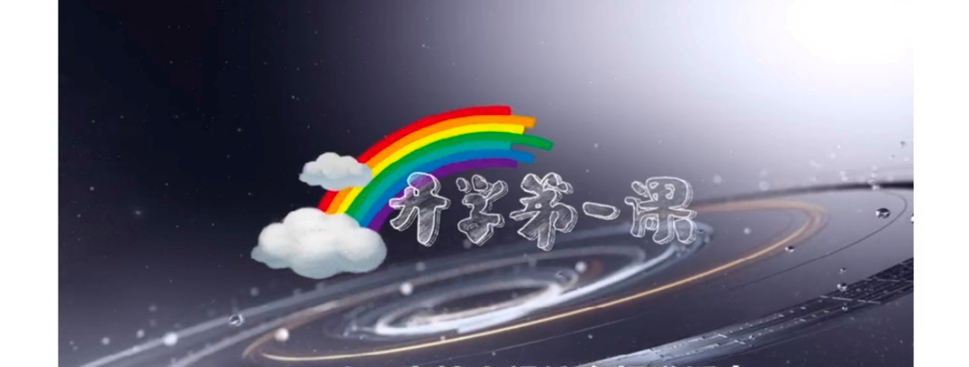
2020秋季开学季
Hey Jude,
remember to let her into your heart!
comfort, courage, conquer
change, choice, challenge
confidence, country, CHINA
浙江省常山一中 吴俊峰

Slide 3

1. Hey Jude
—— comfort, courage and change
Contents目录
2. The Snail on the Wall
—— confidence, challenge and conquer
3. How to choose
—— choice, country and China

Slide 4
1. Hey Jude —— comfort, courage and change
1、Hey Jude, don't make it bad. 嘿 Jude 不要沮丧。
Take a sad song and make it better. 找一首哀伤的歌，把它唱得欢乐些。
Remember to let her into your heart, 记得将它唱入你的心田，
Then you can start to make it better. 生活才会更美好。
Hey Jude, don't be afraid. 嘿Jude！不要害怕。
You were made to go out and get her. 你天生就要勇于克服恐惧。
The minute you let her under your skin, 当你将它身埋于心底那一刻，
Then you begin to make it better. 你已经开始过的更好。
The minute you let her under your skin, then you begin to make it better.
“ the minute” 是由名词转化过来的连词。
1.the moment, the instant, the minute这几个词(前面一般都有定冠词)都可做连词，意为“一…就，马上,立刻”；引导时间状语从句。
2.every time(每次)，each time(每次)，(the) next time(下次)，any time(随时)，(the) last time(上次)，the first time(第一次)。注意：every time, each time, any time前不用冠词，(the) next time, (the) last time中的冠词可省略，而the first time中的冠词通常不能省略。

Slide 5
1. Hey Jude —— comfort, courage and change
1、Hey Jude, don't make it bad. 嘿 Jude 不要沮丧。
Take a sad song and make it better. 找一首哀伤的歌，把它唱得欢乐些。
Remember to let her into your heart, 记得将它唱入你的心田，
Then you can start to make it better. 生活才会更美好。
Hey Jude, don't be afraid. 嘿Jude！不要害怕。
You were made to go out and get her. 你天生就要勇于克服恐惧。
The minute you let her under your skin, 当你将它身埋于心底那一刻，
Then you begin to make it better. 你已经开始过的更好。
Find out the object complement in this section (找出本节中的宾语补足语)
don't make it bad
make it better
let her into your heart
let her under your skin
You were made to go out and get her (Subject complement主语补足语).

Slide 6
1. Hey Jude —— comfort, courage and change
2、And anytime you feel the pain, 无论何时，当你感受痛苦的滋味
hey Jude, refrain, 嘿 Jude，要学会忍耐，
Don't carry the world upon your shoulders. 不要去担负太多自己能力以外的事。
For well you know that it's a fool who plays it cool 要知道傻瓜才会假装坚强，
By making his world a little colder. 才会把自己的世界变得冷漠。
anytime you feel the pain, hey Jude, refrain
“ anytime” 是由名词转化过来的连词。
refrain /rɪˈfreɪn/ vi. 忍住; 克制；避免；制止
I made a terrific effort to refrain from tears. 我狠着心把泪止住。
She couldn't refrain from smiling through tears. 她不禁破涕为笑。
For¹ you know well that² it's a fool who³ plays it cool by making his world a little colder.
1. for连词，“因为”
2. that引导宾语从句
3. who plays it cool by making his world a little colder，who引导定语从句

Slide 7
1. Hey Jude —— comfort, courage and change
3、Hey Jude, don't let me down. Hey Jude 不要让我伤心
You have found her, now go and get her. 既然找到真爱就要勇敢追求
Remember to let her into your heart, 记住要将真爱揽入你的心房
Then you can start to make it better. 那样世界就能开始好转
4、Better better better better better better, Oh. 会更美好 会更幸福
Na na na, na na na na, na na na
Find out the object complement in this section2-5 (找出2-5节中的宾语补足语)
making his world a little colder
don't let me down
let her into your heart
make it better
let it out and let it in
You're waiting for someone to perform with
let sb down 使某人失望或沮丧

Slide 8
1. Hey Jude —— comfort, courage and change
5、So let it out and let it in 所以啊，让你的爱自由来去
Hey Jude, begin 嘿朱迪，开始
You're waiting for someone to perform with 你期待有个人与你同台表演
And don't you know that it's just you 你不知道那个人就是你自已吗
Hey Jude, you'll do 嘿朱迪，你会办到
The movement you need is on your shoulder 下一步该怎麼做就全看你自己
Na na na na na na na na na 啦啦啦啦
on one's shoulders 由某人负责;由某人承担
be looking over your ˈshoulder惴惴不安；小心提防
shoulder to ˈshoulder (with sb)肩并肩地；紧挨着；齐心协力
a shoulder to ˈcry on 倾诉的对象
The movement you need is on your shoulder
the moment为先行词，you need 为定语从句，省略关系代词that

Slide 9
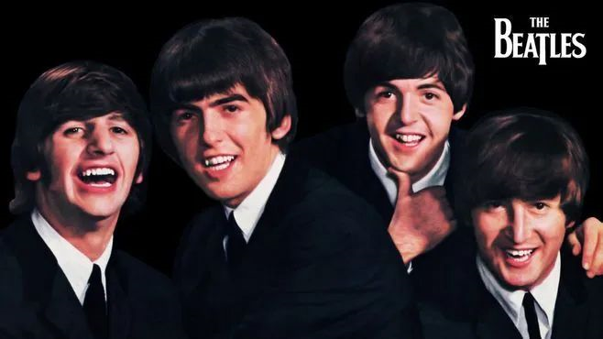
1. Hey Jude —— comfort, courage and change
The Beatles，英国摇滚乐队，由约翰·列侬、保罗·麦卡特尼、乔治·哈里森和林戈·斯塔尔四名成员组成。The Beatles的音乐呈现了多元风格，其中有主流摇滚、交响摇滚、民谣摇滚、先锋摇滚、迷幻摇滚等等。他们不仅在音乐中运用各种不同元素，而且还吸收了其他艺术种类的风格特点，我们可以从中听到各种乐器的美妙旋律，他们的音乐还具备轻松、愉快的特点。

Slide 10

1. Hey Jude —— comfort, courage and change
据说《Hey Jude》是Paul为一个五岁孩子写的歌。他叫Julian，是披头士成员John Lennon与前妻Cynthia的儿子。
Paul很喜欢好友的儿子Julian，他在驱车看望Cynthia和Julian时，想到父母离异可能带给Julian的心理打击，便在车中创作了这首Hey Jude来安慰Julian，虽然Julian在很多年之后才意识到这首歌实际上是写给自己的。
这首歌没有前奏，在歌曲一开头，作为主音的Paul便直奔主题，他不带矫饰的声音充满了宽慰，就好像亦师亦友的Paul正轻轻拍着小Julian的头，“别怕，一切都会好”。

Slide 11
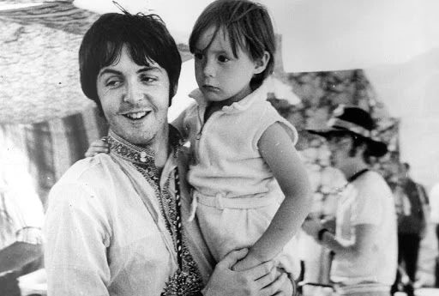
1. Hey Jude —— comfort, courage and change
Paul让这首歌自始至终都富于感染力，振奋人心。它的歌词太容易引起共鸣了。无论遭遇怎样的挫折，先哼上一首歌让自己好过一些，前面还有新的生活，足够我们去追寻自我的价值，那么，勇敢的起程吧。
歌词结尾部分，那一串渐强的Better不给我们留下任何怀疑，一切都会好起来，只要我们敢于Start to make it better，只要我们学会坚强，只要我们起程追寻自我价值。
乐评人蒂姆·利雷（Tim Riley）写道“如果这首歌是关于在困难面前的自我价值和自我慰藉，那人声本身的表现传达了这一旅程。他从安慰他人的歌唱开始，然后随着歌曲的进程感情加深，最后在反复的副歌中他自己渐渐坚定，开始相信自己。”
保罗·麦卡特尼和小时候的朱利安

Slide 12
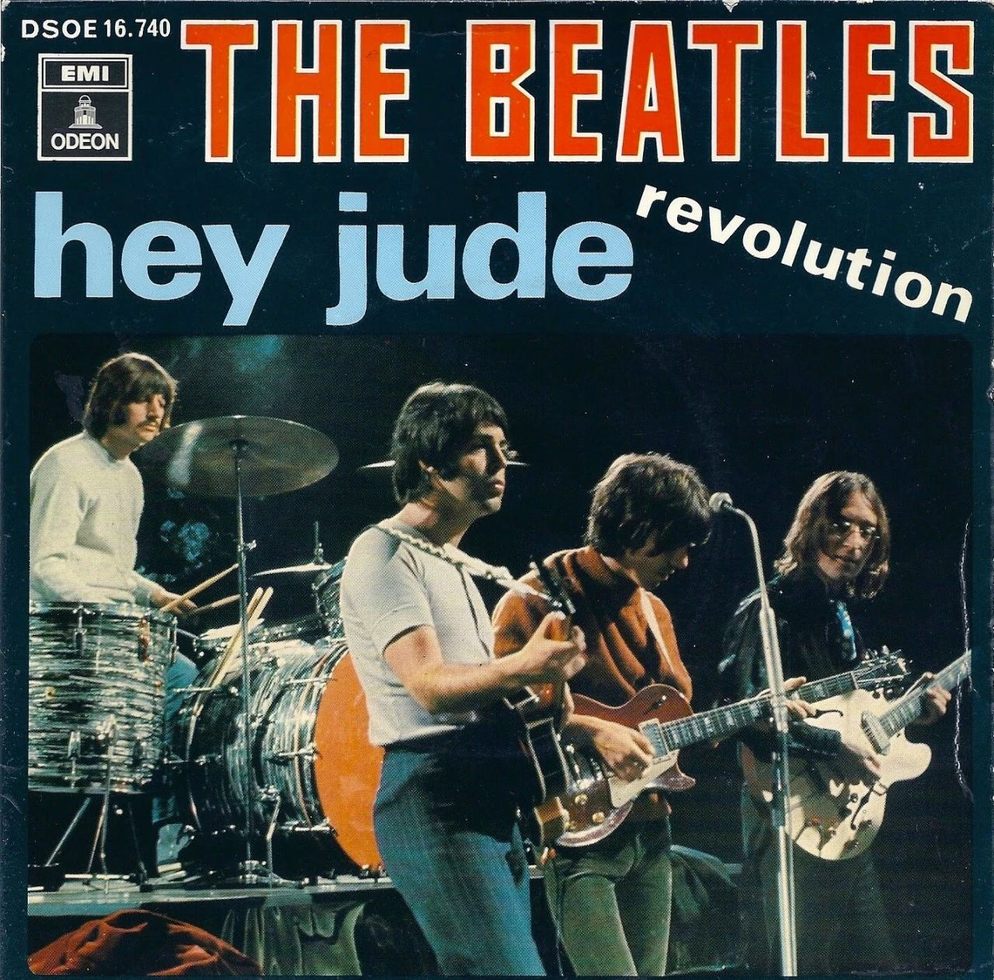
1. Hey Jude —— comfort, courage and change
《Hey Jude》以其简单通俗而又内涵丰富的歌词，轻易打破英美两种文化间的隔阂，同时又在两种文化间激起了迥异的想象。歌曲《Hey Jules》于1968年8月作为单曲发行（B面为列侬的《Revolution》），是披头士在苹果唱片旗下发行的第一首单曲。这首歌是当时在英国排行榜登顶过的单曲中有史以来最长的，也在美国排行榜第一的位置上停留了9个星期，是所有披头士冠军歌曲中占据第一时间最长的。这首歌已售出近八百万张，经常出现在专业乐评人的史上最伟大歌曲名单中。
歌曲《Hey Jules》有“英国第二国歌”之称。2012年7月27日的伦敦奥运会开幕式上，奥运圣火点燃后，70岁的保罗· 麦卡特尼率领全体观众钢琴弹唱此歌作为典礼压轴曲，把伦敦碗推到又一个高潮，大约8万人合唱《Hey Jude》的场面感染了全世界。

Slide 13
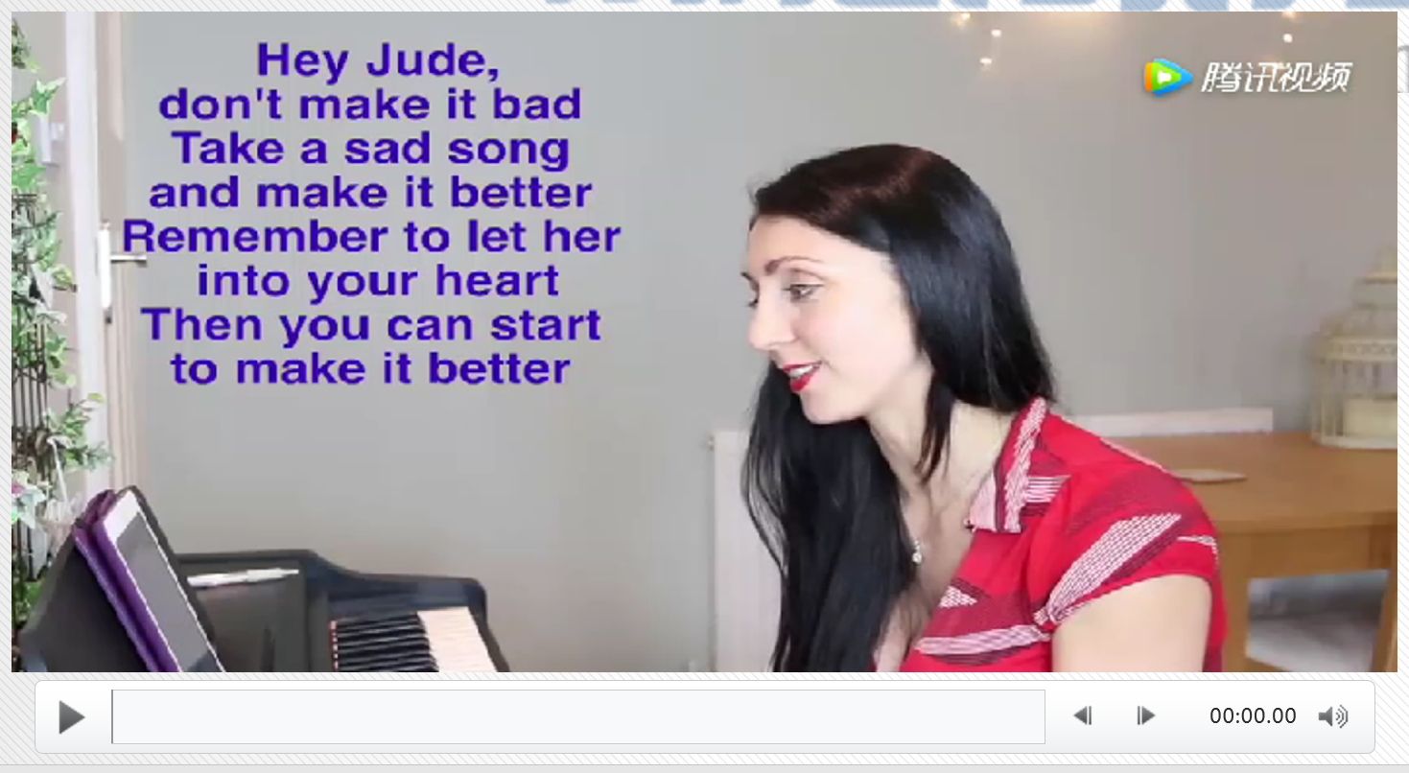
1. Hey Jude —— comfort, courage and change
Allen teaches you sing this song “Hey Jude ”

Slide 14
2. The Snail on the Wall —— confidence, challenge and conquer
读后续写: 阅读下面短文，根据所给情节进行续写，使之构成一个完整的故事。
The Snail(蜗牛)on the Wall
“What’s wrong with you, dear?” said Granny Bell to a little boy, who sat near a wall at the back of her house. He had a book in his hand, and tears were in his eyes.
“We have all got a poem called Little Jim to learn,” said the boy, whose name was Tom Blair; “and the one who says it best is to get a prize from the master. But I don't think I can learn it.”
“Why not?” said Granny Bell.
“The boys say that I can't, and that I need not try,” said Tom in a sad tone.
“Don't mind what the boys say. Let them see that you can learn it,” said his friend.
“But I don't think I can,” said Tom, “it is so long, and some of the words are so hard. I know I need not try for the prize. But I should like to learn the poem as well as I can; for the boys laugh at me, and call me ‘Slow Tom’.”

Slide 15
2. The Snail on the Wall —— confidence, challenge and conquer
“Well, dear,” said the dame, in a kind voice, “if you are slow, and can't help it, try to be ‘slow and sure’, as they say. Look at the snail on the wall; how slow it is! And yet, if you watch it, you will see it will get to the top in time. So just try to learn a few lines each day, and you may gain the prize in the end. And when you feel like losing heart, think of the snail on the wall.”
When Granny Bell had said this, she went on her way. And Tom thought that (though he could not keep up with the boys) he might run a race with the snail. So he determined to try to learn his task, by the time the snail got to the top of the wall.
At last, the day came on which the master was to give the prize.
Paragraph 1: And after he called up five or six boys to repeat the poem, it came to Tom's turn.____________ _________________
Paragraph 2: “Well done. Tom. Well done. Tell us how you made it!” said the master with great joy. __________ _____________________

Slide 16

2. The Snail on the Wall —— confidence, challenge and conquer
Act it out
Tom Blair
Granny Bell
tears were in his eyes
What’s wrong with you, dear?
“I don't think I can learn it.”
“The boys say that I can't, and
that I need not try,” said Tom in a sad tone.
“Don't mind what the boys say. Let them see that you can learn it”
try to be ‘slow and sure’
Look at the snail on the wall; how
slow it is! And yet, if you watch it, you will see it will get to the top in time.
just try to learn a few lines each
day, and you may gain the prize in the end
when you feel like losing heart,
think of the snail on the wall.
it is so long, and some of the
words are so hard.
for the boys laugh at me, and
call me ‘Slow Tom’.
he might run a race with the snail
he determined to try to learn his
task, by the time the snail got to the top of the wall.

Slide 17
2. The Snail on the Wall —— confidence, challenge and conquer
Analyze characters
Tom Blair
Granny Bell
What’s wrong with you, dear?
tears were in his eyes
caring/ sympathetic/ affectionate
sad/ in low spirits
“I don't think I can learn it.”
“The boys say that I can't, and
that I need not try,” said Tom in a sad tone.
encouraging
unconfident/ frustrated
“Don't mind what the boys say. Let them see that you can learn it”
try to be ‘slow and sure’
Look at the snail on the wall; how
slow it is! And yet, if you watch it, you will see it will get to the top in time.
just try to learn a few lines each
day, and you may gain the prize in the end
when you feel like losing heart,
think of the snail on the wall.
skillful and patient
hesitated/ self-doubting
it is so long, and some of the
words are so hard.
for the boys laugh at me, and
call me ‘Slow Tom’.
challenging/determined
he might run a race with the snail
he determined to try to learn his
task, by the time the snail got to the top of the wall.

Slide 18
2. The Snail on the Wall —— confidence, challenge and conquer
narrative elements and structure
故事背景setting
人物性格 personal character | Tom Blair: Granny Bell:
冲突 conflict
铺垫foreshadowing
悬念 suspense
首尾呼应 inclusio
got a poem to get a prize from the master
unconfident; frustrated;self-doubting
affectionate;encouraging; skillful and patient
① it is so long, and some of the words are so hard.
② for the boys laugh at me, and call me‘Slow Tom’.
Look at the snail on the wall; how slow it is! And yet, if you watch it, you will see it will get to the top in time.
he might run a race with the snail. So he determined to try to learn his task, by the time the snail got to the top of the wall. (would he be successful?)
①try to be‘slow and sure’. ②So just try to learn a few lines each day, and you may gain the prize in the end. ③And when you feel like losing heart, think of the snail on the wall.

Slide 19
2. The Snail on the Wall —— confidence, challenge and conquer
Writing Scaffold
①时空线（明线） |  |  | ②情节线（明线） | ③情感线（暗线）
时间： 空间： |  |  | 人物：Granny Bell, the boys， ‘Slow Tom’ 事物：a prize，the snail, voice 动作：try, losing heart | slow and sure determined
问题链 | 第一段 | And after he called up five or six boys to repeat the poem, it came to Tom's turn.
 | 第二段 | “Well done. Tom. Well done. Tell us how you made it!” said the master with great joy.
How did Tom feel when it was his turn?
How did he perform from the beginning to the end ?
What was the reaction of other boys?
What was the secret of Tom’s success?
Did the other boys change their attitude toward Tom?
Is there any lesson about the story?

Slide 20
2. The Snail on the Wall —— confidence, challenge and conquer
And after he called up five or six boys to repeat the poem, it came to Tom's turn. His heart was beating wildly. He was even tripped by a chair on his way to the front and nearly fell to the ground. Ignoring all those noises, he took a deep breath, filling his lungs with courage and confidence. The moment Tom opened his mouth and let words pour out in incredible fluency, he sank into his own world. Not until he finished the task did he notice the boys who once laughed at him and called him “slow Tom” gazing at him with their mouths open.
“Well done. Tom. Well done. Tell us how you made it!” said the master with great joy. “Please, sir, it was the snail on the wall that taught me how to do it," So Tom shared the competition he engaged against the snail and how the determination helped him in days looking up the words and struggling to make his pronunciation right. Overwhelmed by his persistence and courage the boy exhibited, the master announced the prize should go to Tom, not only as a reward for his wonderful performance, but also as a recognition for his belief in “slow and sure” attitude.

Slide 21


3. How to choose in the new semester —— choice, country and China
Choose to love China,
Choose to strive for the rejuvenation of the Chinese nation.

Slide 22

2020年的下半年, 你准备好了吗？
Are you ready for the second half of 2020?

