Slide 1


感恩遇见，相互成就，本课件资料仅供您个人参考、教学使用，严禁自行在网络传播，违者依知识产权法追究法律责任。
更多教学资源请关注
公众号：溯恩高中英语
知识产权声明

Slide 2
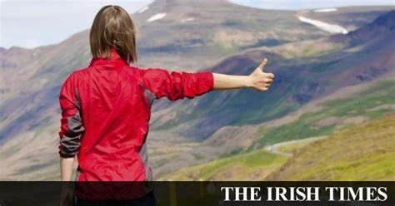
2020.9浙江省名校协作体读后续写

Slide 3
第二节 读后续写 (满分25分)
阅读下面短文，根据所给情节进行续写，使之构成一个完整的故事。
There Are No Vans
To me, what Thanksgiving really means is giving good thanks, not eating turkey.By the time I was 18 I had created my Thanksgiving ritual (惯例).I would go out shopping and buy enough food for one or two families.Then I would dress like a delivery boy, go to the poorest neighborhood and just knock on a door, and would always include a note saying “All that I ask in return is that you take good enough care of yourself so that someday you can do the same thing for someone else.” I have received more from this annual ritual than I have from any amount of money I’ve ever earned, especially one such experience in New York City.
Several years ago I was in New York City with my newly married wife during Thanksgiving.She was sad because we were not with our family.Normally she would be home decorating the house for Christmas, but we were stuck here in

Slide 4
a hotel room.I said, “Honey, look, why don’t we decorate some lives today instead of some trees?” When I told her what I always do on Thanksgiving, she got excited.I said, “Let’s go someplace where we can really appreciate who we are, what we are able to do and what we can really give.Let’s go to the poor neighborhood Harlem and feed some people there in need. We’ll go buy enough food for six or seven families for 30 days.We’ve got enough.Let’s go do it!”
We started by getting a van (货车), but there seemed no vans in all of New York City.The rent-a-car places were all out of vans. My wife was disappointed, and I said, “Look, the bottom line is that if we want something, we can make it happen! All we have to do is take action.There are plenty of vans here in New York City.Look down at the street. Do you see all those vans? Let’s go get one!” My wife agreed and we took action.

Slide 5

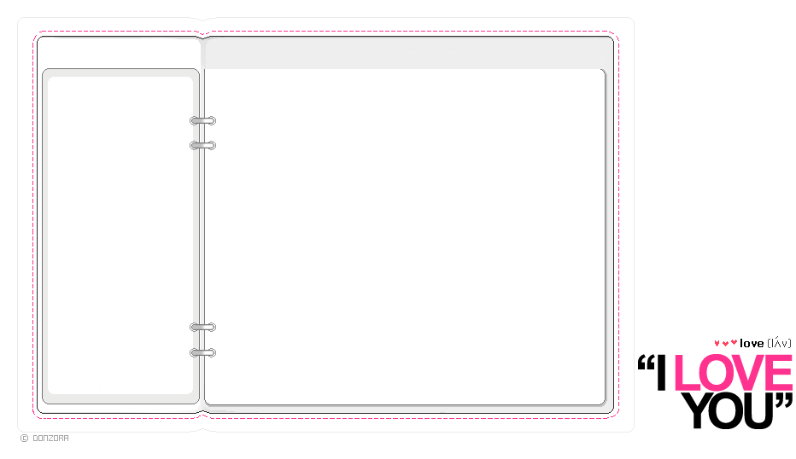
Predict the story
There Are No Vans
What are we looking for?
Do we find what we want? Why?
What do you think the story is about?
To me, what Thanksgiving really means is giving good thanks, not eating turkey.By the time I was 18 I had created my Thanksgiving ritual (惯例).I would go out shopping and buy enough food for one or two families.Then I would dress like a delivery boy, go to the poorest neighborhood and just knock on a door, and would always include a note saying “All that I ask in return is that you take good enough care of yourself so that someday you can do the same thing for someone else.” I have received more from this annual ritual than I have from any amount of money I’ve ever earned, especially one such experience in New York City.
To me, what Thanksgiving really means is giving good thanks, not eating turkey.By the time I was 18 I had created my Thanksgiving ritual (惯例).I would go out shopping and buy enough food for one or two families.Then I would dress like a delivery boy, go to the poorest neighborhood and just knock on a door, and would always include a note saying “All that I ask in return is that you take good enough care of yourself so that someday you can do the same thing for someone else.” I have received more from this annual ritual than I have from any amount of money I’ve ever earned, especially one such experience in New York City.
To me, what Thanksgiving really means is giving good thanks, not eating turkey.By the time I was 18 I had created my Thanksgiving ritual (惯例).I would go out shopping and buy enough food for one or two families.Then I would dress like a delivery boy, go to the poorest neighborhood and just knock on a door, and would always include a note saying “All that I ask in return is that you take good enough care of yourself so that someday you can do the same thing for someone else.” I have received more from this annual ritual than I have from any amount of money I’ve ever earned, especially one such experience in New York City.
To me, what Thanksgiving really means is giving good thanks, not eating turkey.By the time I was 18 I had created my Thanksgiving ritual (惯例).I would go out shopping and buy enough food for one or two families.Then I would dress like a delivery boy, go to the poorest neighborhood and just knock on a door, and would always include a note saying “All that I ask in return is that you take good enough care of yourself so that someday you can do the same thing for someone else.” I have received more from this annual ritual than I have from any amount of money I’ve ever earned, especially one such experience in New York City.
A general point:
I received more from my Thanksgiving ritual
What do I get from my Thanksgiving ritual?
What would I
usual do for my Thanksgiving ritual?
Example:
an experience in New York City

Slide 6

Know the story--elements
Characters
Time
Place
Event | an experience in New York City to search vans.
my wife, I, the driver
during Thanksgiving (the 4th Thursday in Nov.)
New York City
Why were we in need of vans?
What does the writer intend to tell us?
Little people can make a big difference.
A friend in need is a friend indeed.
Nothing is impossible for a willing heart.
One good turn deserves another.
...
kindness

Slide 7

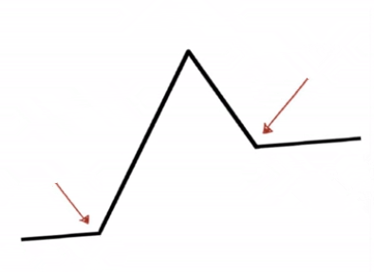
Know the story--plot
overt plot
Climax
Events
A. We needed a van for loading supplies.
B. We tried our chance at the street.
C. We went to the rent-a-car places for
getting a van, but in vain.
D. Stuck in a hotel during Thanksgiving
we decided to help people in Harlem.
B
Falling action
Resolution
C
Rising action
Inciting incident
A
Denouement
Setting
D

Slide 8
Covert plot
Time | Events | Mood
Before we made a plan | My wife and I were _____ in a hotel | She felt ________
When we made a plan | I told her _______________ We decided to _____________ | She got ________
After we made a plan | We started by getting _____, but found ___________________; I advised to ______________ | She was ________
stuck
sad
my Thanksgiving ritual
go to the poor
Harlem and buy food for them
excited
a van
there seemed no vans
available
disappointed
take a chance in the streets

Slide 9
划线词分类
Character | wife
Setting | Thanksgiving; food; experience; Harlem; in need; van
Action | buy; knock
Mood | disappointed
Weave the story
disappointed
Paragraph 1:
We tried stopping vans as they were driving down the street. _______________________________
_______________________________________
_______________________________________
Paragraph 2:
Eventually a van drove up and the driver said yes.
________________________________________________________________________________
started
attempt to get a van---in vain
Event:
Mood:
told
disappointed/hopeless
excited
stuck
sad
Event:
Mood:
succeed in getting a van
delighted/excited

Slide 10
话题词块/表达
表示失望：
叹气
She sighed heavily.
After several fruitless attempts, my wife let out a long sigh.
跺脚
My wife stamped her foot in despair.
皱眉
“Who can we turn help to?” my wife murmured with a fierce frown.紧皱眉头
颤抖
Staring at the vans zooming past us, my wife trembled with rage.
耸肩
My wife gave a miserable shrug. 沮丧地耸了耸肩
目光呆滞
She looked blank in a moment. 目光呆滞
蹒跚
With a dazed look on our face, we staggered away.

Slide 11
表示失望：
苦笑
She smiled a sad smile.
失望地看
My wife darted/cast a frustrated look at me.
I looked my wife in desperation. 绝望地
低头
She bowed her head and said nothing.
摇头
She just shook her head in hopelessness.
哭
Tears of grievance (委屈) /ˈɡriːvəns/ came into her eyes when she saw them left.
心跳加快
My heart thumped fiercely in my chest, tension overwhelming me entirely in its power.

Slide 12
more expressions to show disappointment
无灵主语
The unsuccessful attempts cast a cloud of gloom over our face.
All at once a feeling of hopelessness swept through me.
A strong feeling of failure beat me out of breath.
A sense of disappointment flooded in my heart, and hopelessness frequently echoed my brain.
After a long waiting, disappointment accumulated in our heart.
Disappointment mingled with frustration growing inside me.
Disappointment swallowed my wife. She sat on the ground and didn't utter a single word.
A sense of disappointment crept upon me.

Slide 13
表示高兴：
尖叫
Hearing the words, my wife shrieked with excitement 激动的尖叫
心跳
My heart thumped with excitement. 兴奋地心直跳 (表高兴难以置信)
拥抱
With a shriek of delight, She hugged me.
握手
I took hold of his hands gratefully.
点头
We nodded gratefully.
笑
Her eyes twinkled and her lips broke into a broad smile.
跳起来
Hearing the simple yes, we all jumped with joy.
哭
We shed tears with joy.
松口气
At this moment, we breathed a sigh of relief.

Slide 14
more expressions to show excitement
we were wild with excitement/joy.
we could hardly contain our excitement.
we were delighted beyond description.
we were floating on air.
we were beside ourselves(极度兴奋) with excitement.
we beam with excitement.
Our face lit up.
Our heart was thundering with excitement.
A wave of happiness swept over us.
A surge of excitement flashed into my heart.
A sense of warmth flowed in my body.

Slide 15
表示努力：
用让步状语从句
We kept on struggling forward, even though ___________________
we knew it was hopeless.
While _______________________________________, we never lost hope for another try.
the passing drivers zoomed past us without a stop
_________________________________(as) , we continued to wave at the passing cars stubbornly.
Disappointed and fatigued as we were
however painstaking the task was,
We told ourselves repeatedly ________________________ (however), we wouldn't give in to setbacks.
In spite of ________________________, we still believed in miracles.
countless failures

Slide 16
表示努力：
用非谓语
__________________________________________(be refused), we decided to try one last time.
Having been refused many times
Gritting our teeth
__________________________________(咬紧牙关), we pushed on.
用强调句
__________________________________(妻子的鼓励) gave me an extra burst of energy. 迸发出额外的能量
It was my wife's encouragement that
用倒装结构
Never would we be defeated by the plight
_____________________________________________ (never)

Slide 17
表示努力：
用虚拟语气
We summoned up/collected up/ plucked up/mustered up/gathered our courage and yelled at the top of our voice for the fear that __________
___________
we would
miss a van.
用谚语
Our heart sank at the thought of our failure to get a van, but we told ourselves ________________________________.(绝不半途而废)
never do anything by halves
用“the+比较级， the+比较级”
efforts we put in, the luckier we would be.
We constantly convince ourselves that the more _________________
___________________________________.

Slide 18
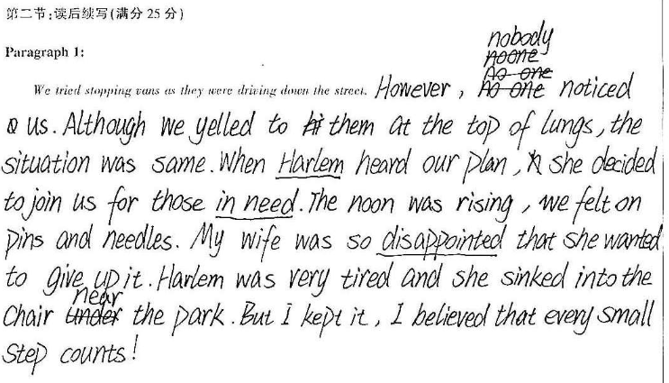

常见问题
未理清人物关系：Harlem 是地点不是人物

Slide 19
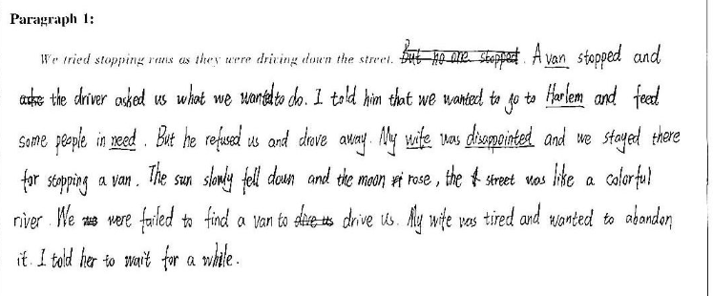
无用的环境描写：colorful与下文故事发展脱节。

Slide 20
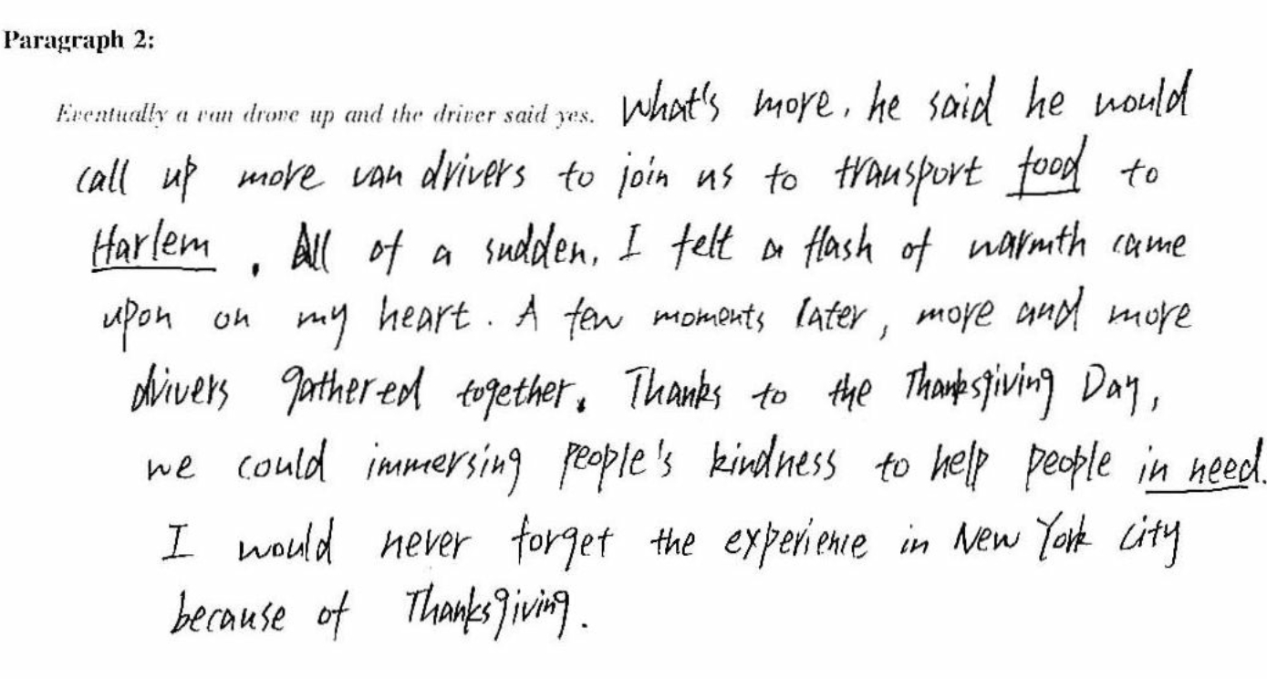
书写较差

Slide 21
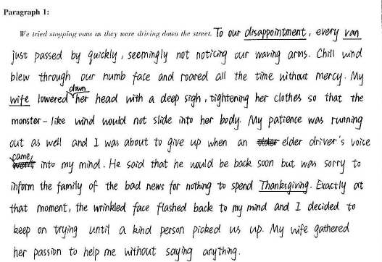
故事太过冗长拖沓

Slide 22
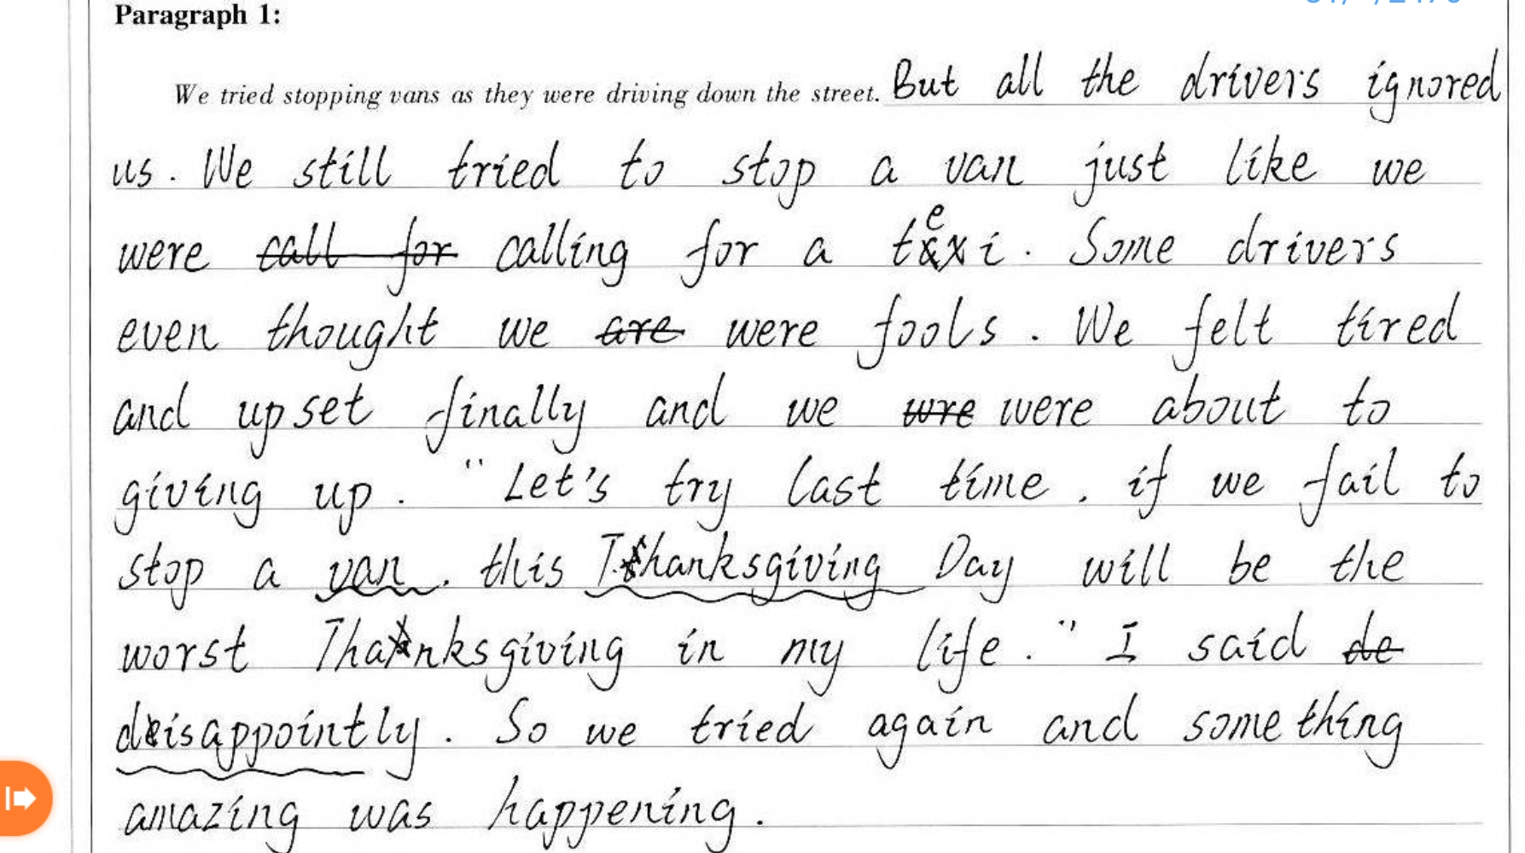
未按要求划线

Slide 23
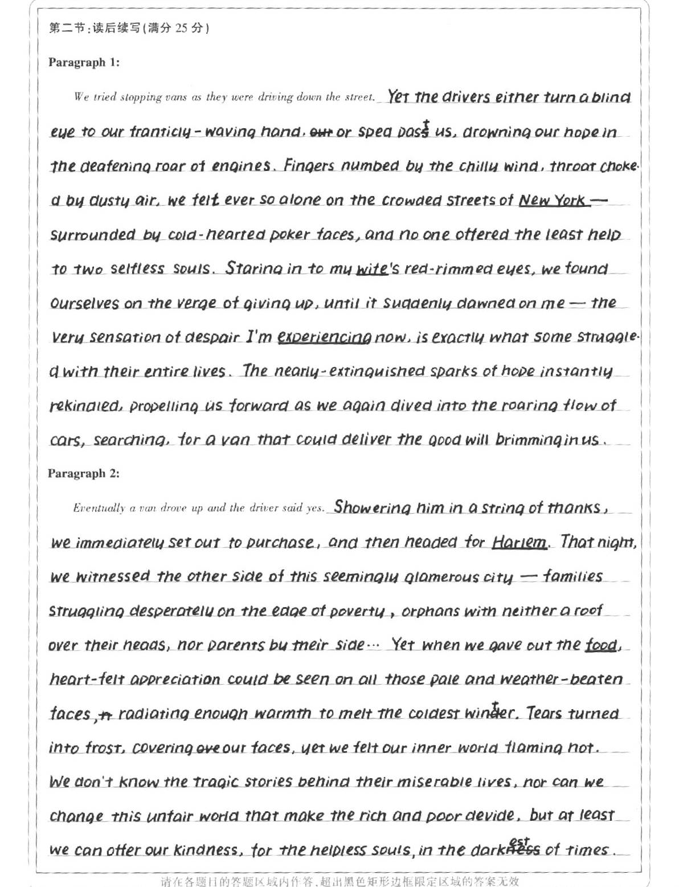
优秀习作
22.5
本文抓住了故事的中心矛盾——我们 的努力和过往车辆的 “无情” (turn a blind eye/sped pass/ drown our hope)构思和推动情节; 用无灵主语和外貌描写(fingers numbed/
throatchocked/red-rimmed )侧面烘托了“我们”的无奈和无助。

Slide 24
结尾段用了时间状语 immediately/
then/that night/ when等有序地推进故事发展；并且用外部寒冷的环境跟内心感到的温暖和炽热作对比深化主题“at least we can offer our kindness”

Slide 25
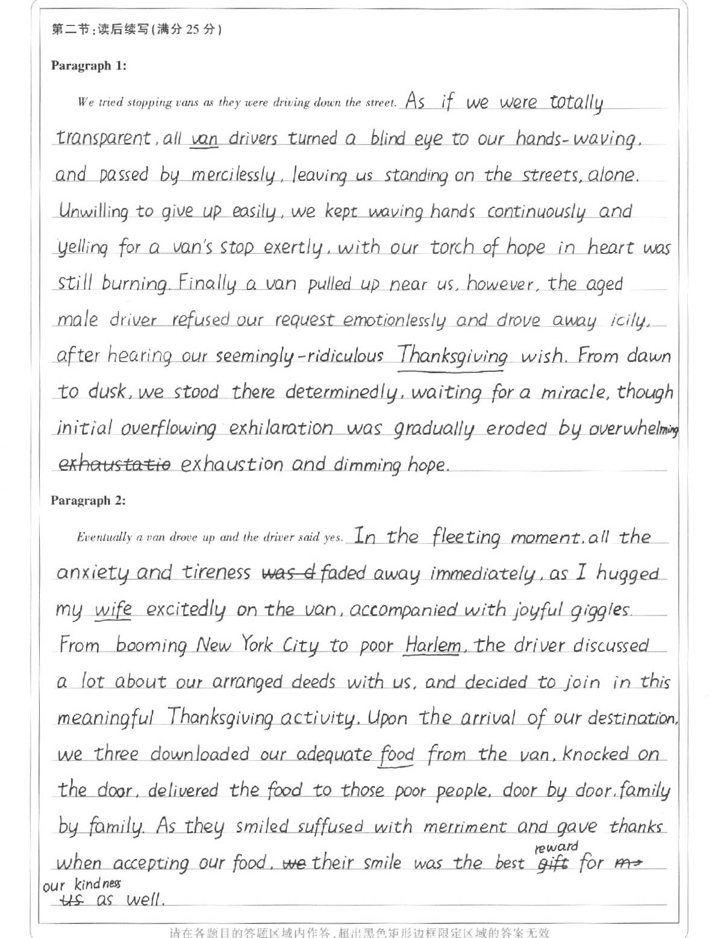
优秀习作
22
该文续写第一段用了非谓语 leaving us
standing on the streets /waiting for a miracle和形容词状语alone/unwilling 生动、形象地勾勒出了 现实的“冷酷” 和 我们的“执着”，描写了故事该有的曲折，合理地推动情节的发展。

Slide 26
该文续写第二段用了形象动词hugged/discussed/ decided/knocked/delivered/smiled等继续推进故事发展；同时用了一系列情绪词anxiety/tiredness/
excitedly/joyful等向读者传递主人公由悲转喜的情景 。

Slide 27
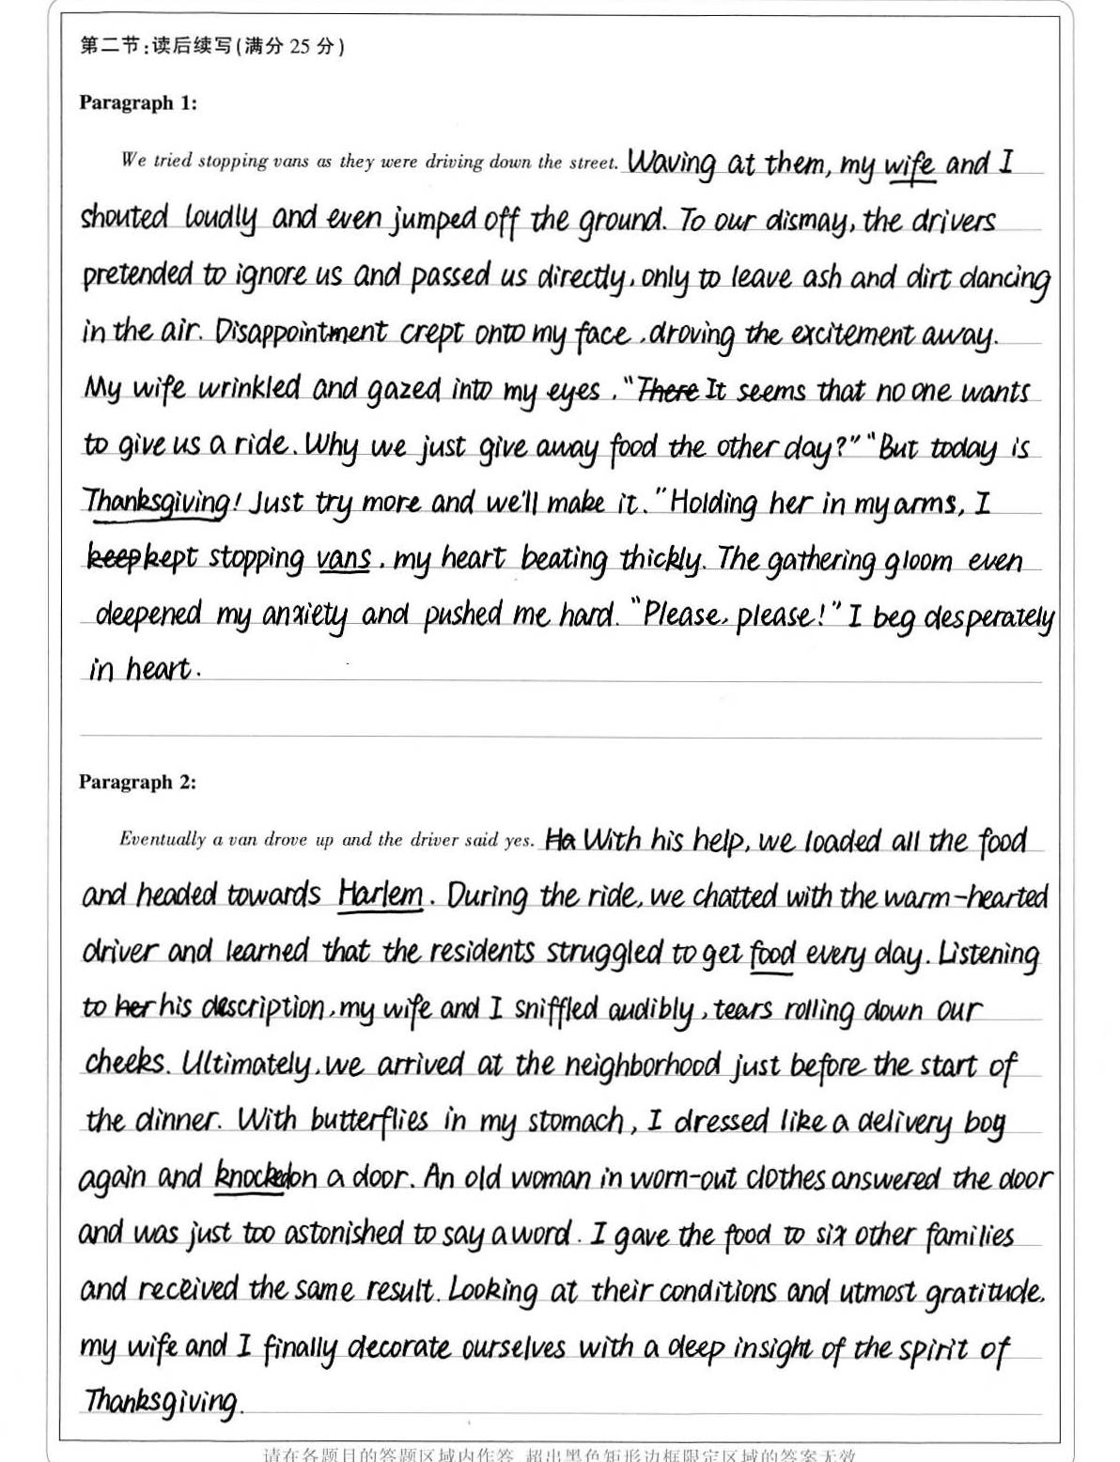
优秀习作
20 郑子欣 高三（1）
该文使用了非谓语（waving at...;）only to...；无灵主语(disappointment crept onto my face; The gathering gloom even deepened my anxiety)
牵动故事发展

Slide 28
文章第二段用了with复合结构 “with butterflies in my stomach” 、非谓语 “Looking at ...”、独立主格结构 “tears rolling down our cheeks” 形象地展示了故事结尾 传递爱心的感人至深的一幕。

Slide 29
A possible version:
Para1：We tried stopping vans as they were driving down the street. I learned something about New York drivers that day: They don’t stop; they speed up. Then we tried waiting by the light. We’d go over, knock on the window and the driver would roll it down, looking at us in alarm, and I’d ask if he would drive us to Harlem so we could help some people. Every time the driver would look away quickly, furiously roll up the window and pull away without saying anything. My wife was ready to give up, but I said, “It’s the law of averages: somebody is going to say yes.”

Slide 30
Para 2: Eventually a van drove up and the driver said yes. We were wild with joy and climbed onto the van. Upon arrival, he led us to a store where we bought lots of food and some baskets. Together we packed them up, carried them onto the van and went to buildings where there were even people living without electricity. It was a truly fulfilling experience to make even a small difference. You see, you can make anything happen if you commit to it and take action. Miracles like this happen every day—even in a city where “there are no vans.”

Slide 31
