Slide 1

感恩遇见，相互成就，本课件资料仅供您个人参考、教学使用，严禁自行在网络传播，违者依知识产权法追究法律责任。
更多教学资源请关注
公众号：溯恩高中英语
知识产权声明

Slide 2
高中英语应用文写作---邀请信1
Letters of Invitations（1）
制作人：杭州二中 许丽君

Slide 3
学习目标： Learning Goals
After learning this lesson, you will
learn about the structure and contents of letters;
apply the format to your writing properly.
write the points completely and clearly.
make your writing more coherent.
use appropriate expressions in your writing and mind your tone.
use some advanced expressions and sentence patterns to write a letter.
know what a good letter of invitation is like.
write an appropriate letter of invitation, especially pay attention to the tone and language.
。

Slide 4
Lead in
Lead in
When do you need to write letters of invitations?
Invite to attend school events
Invite to join in the ceremonies
Invite to take part in the festival activities
Invite to take part in the sports activities

Slide 5
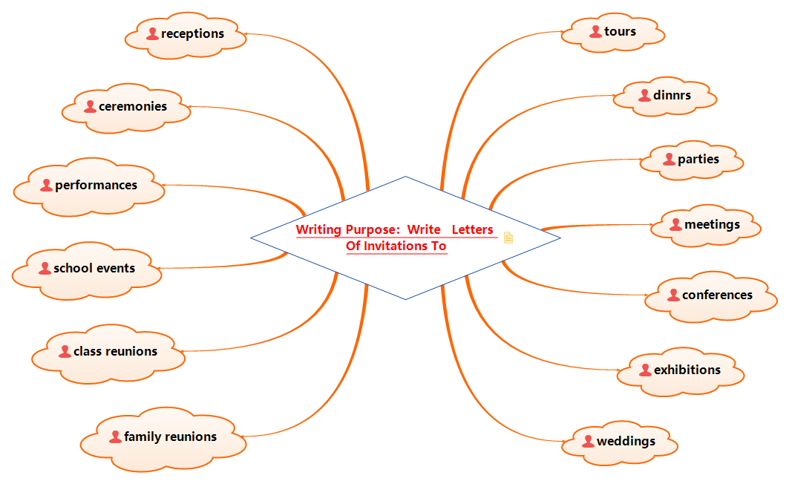
Lead in

Slide 6
Write Letters of Invitations to
Write Letters of Invitations to
tours/dinners/parties
meetings/conferences/exhibitions
school events/ceremonies

Slide 7
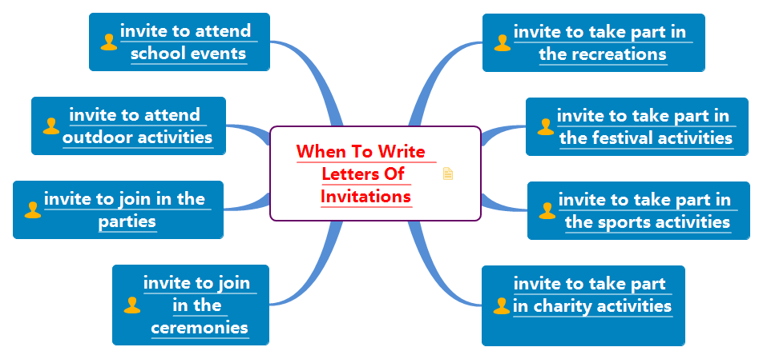
Write Letters of Invitations to

Slide 8
Letters of Invitations
内容完整content
结构清晰Format
语言精确language
交际得体tone
Letters of Invitations

Slide 9

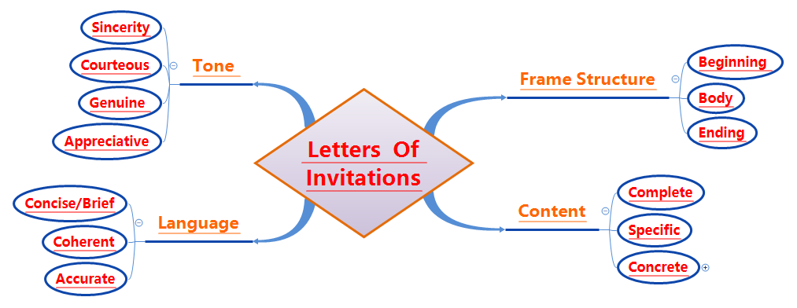
Letters of Invitations

Slide 10
Format/Frame structure邀请信写作框架
Letters of Invitations-Readers-based
Part 1: Beginning - Purpose of writing the letter
Part 2: Body Arrangements
Part 3: Ending

Slide 11
Format/Frame structure邀请信写作框架
邀请信具有简短、热情的特点，信件格式为：
三段式结构Structure:
第一段: 说明与收信人的相关性与写作意图，简要说明活动，并邀请对方；
第二段：介绍活动具体内容，并说明受邀人参加的理由；包括活动的具体时间、地点和内容；
第三段：表示期待对方接受邀请并致谢。

Slide 12
Format/Frame structure邀请信写作框架
Format
What should be included in a letter of invitation?
Dear ______,
Beginning --- Briefly explain the activities and invite them to attend (Introduction and purpose)
Why are you writing the letter?
Body--- Introduce the specific contents of the activity;
--- state the reason for the invitee, including the specific time, place and contents of the activity.
Why do you invite your friends and your relatives?
Ending --- About your wishes for response and being accepted with your gratitude.
Yours faithfully
_________

Slide 13
Writing preparations
Part 1: Purpose of writing the letter
（1）【篇首句】介绍自己(收信人非熟人)，说明写作意图，简要说明活动，并邀请对方。
You have an itch for ……
You have a burning desire for ……
You have an overwhelmingly strong desire for ……
You have a strong /burning passion for ……
You develop a profound love for……
You are exceedingly enthusiastic about……
You are fully fascinated by……
You are surprisingly keen on ……
You are passionately fond of……
You are unusually spellbound with ……
You are incredibly hungry / thirsty for ……
You are deeply hooked on ……

Slide 14


Writing preparations
Part 2: Body Arrangements
（2）【篇中句】篇中介绍活动具体内容，包括受邀请的人，邀请朋友干什么、地点及具体的时间等； Natural transitions
to begin with, as for, In addition , Therefore, as well, to be frank, what’s more, meanwhile, undoubtedly…
The content must be complete and concrete, the language be concise, accurate and coherent, the attitude and tone be courteous and genuine. (描述准确精炼，言简意赅，语气诚恳);
1. 要点2C原则：Complete and concrete
2. 语言3C 原则：conciseness; courtesy; coherence
Suitable Details?
Speak clearly, and in courtesy (语言简洁，有礼貌)
Express your gratitude in an enthusiastic way

Slide 15
Part 3: Ending
（3）【篇尾句】篇尾表达期待朋友的回复，期待对方接受邀请。
1.Let me know...
2.Please drop me a line... (给我留言)
3.Thanks for your favorable consideration.
4.I am looking forward to your favorable reply at your earliest convenience.
5.I would be grateful / thankful / appreciative if you could accept my invitation.

Slide 16
Part 3: Ending
6.It would be highly appreciated if you could come.
7.Looking forward to your earliest reply!
8.We are sincerely looking forward to your coming with great pleasure.
9.We are anticipating your participation in the party.
10.Please confirm your participation/presence at your earliest convenience. (Formal)

Slide 17
Part 3: Ending
11.If you can participate in the visit, we will be more than glad.
12. You are earnestly/surely expected to be present if it is convenient.
13. Hopefully, you won’t decline my invitation if you are available, will you?
14. The favor of your presence is cordially requested at the opening ceremony.
15. Could you spare some time from your busy schedule to share the special moment with us?

Slide 18
Useful words and expressions
01
02
03
breathtaking
celebrate
ceremony
congratulations
cancel
celebration
desire
debut(初次登台，首次亮相)
events
enthusiastic
flavor
fond
funny
friendship
fascinated
goings-on
happy
happiness
activities
affectionately
attend
attendance
announce
acknowledge
balanced
busy
bless

Slide 19
Writing help: Useful phrases
accept with pleasure
as for activities
attend the concert
at 9:00 am next Saturday
at the foot/ top of the hill
be our guest
be scheduled to
be involved in…
bring laughter
bring a guest
chatting casually(随意)
cordially invite you to
drop me a line
during which time
extend my invitation to you to do…
family gathering
well suited for
have the honor of inviting
having a taste of
in celebration of
in honor of
involvement

Slide 20
Writing help: sentences
1. A party is coming. /(With a party approaching / drawing near,) I would like to invite you to participate in it in the flesh. (with+O+C)
2. A grand party will be held/A grand party to be held, I feel it a privilege to extend an invitation to you. (独立主格结构)
3. Knowing /Informed of the exciting news that a party is to be held, (非谓语+同位语) I can’t wait to invite you to participate in it.
4. So meaningful is the party that I am eager to share with you. Therefore, I am inclined to invite you to join. (倒装)
5. You are invited to a special evening showing of our new line. (被动结构)

Slide 21
Writing help: sentences
6. Our school students will present their science projects on that day.
7. As for activities, setting off fireworks and going to the temple fair never fail to bring laughter
8. I suppose the splendid Spring Festival Gala will also be your cup of tea.
9. The projects are graded by our teachers and various awards will be given.
10. It couldn’t be better if you could offer us some valuable advice on learning English at the end of it.

Slide 22
邀请信写作模板1：
Writing Purpose：
Dear ____,
Beginning --- Briefly explain the activities and invite them to attend (Introduction and purpose)
How’s everything with you? I’m writing to tell you that there will be a __________ (活动) at/in __________ (地点) on ________ (时间). I wonder if you’d like to go with me (发出邀请)．
Body--- Introduce the specific contents of the activity;
--- state the reasons for the invitee, including the specific time, place and contents of the activity.
Why do you invite your friends and your relatives?
② It is scheduled that the activity will start at ________ (具体时间). This will be followed by a ________ (进一步的安排). At around ________ (时间), ________ (另一个安排)．
Ending ---About your wishes for response and being accepted with your gratitude.
③ If you are interested in it, let me know. Hope to meet you at the ________./I really hope you can make it (再次邀请). My phone number is ________ (电话号码)．Looking forward to your involvement. Wish you a great success!
Yours Sincerely / Faithfully/ Truly,

Slide 23
Assessment
Purpose | Have you made the purpose clear?
Frame structure | Does the frame structure conform to the requirements?
Language | Are the sentences concise and accurate? Have you used the proper punctuation, words, sentences and paragraphs to convey yourself?
Content | Have you included all the points of view?
Are the details suitable?
Assessment
Work in groups of four. Each student read the article and others comment on your partner’s work. Then select the best one out to show in the class. When you are discussing, you can pay attention to the following hints.

Slide 24
三、参考范文
邀请信范文1：（2017年6月全国卷3高考应用文真题:邀请加入校乒乓球队）
第一节 应用文写作（满分15分）
假定你是李华，你所在的校乒乓球队正在招收新队员，请给你的留学生朋友Eric写封邮件邀请他加入，内容包括：
1. 球队活动；
2. 报名方式及截止日期；
注意：1．词数80左右；
2．可适当增加细节，以使行为连贯。

Slide 25
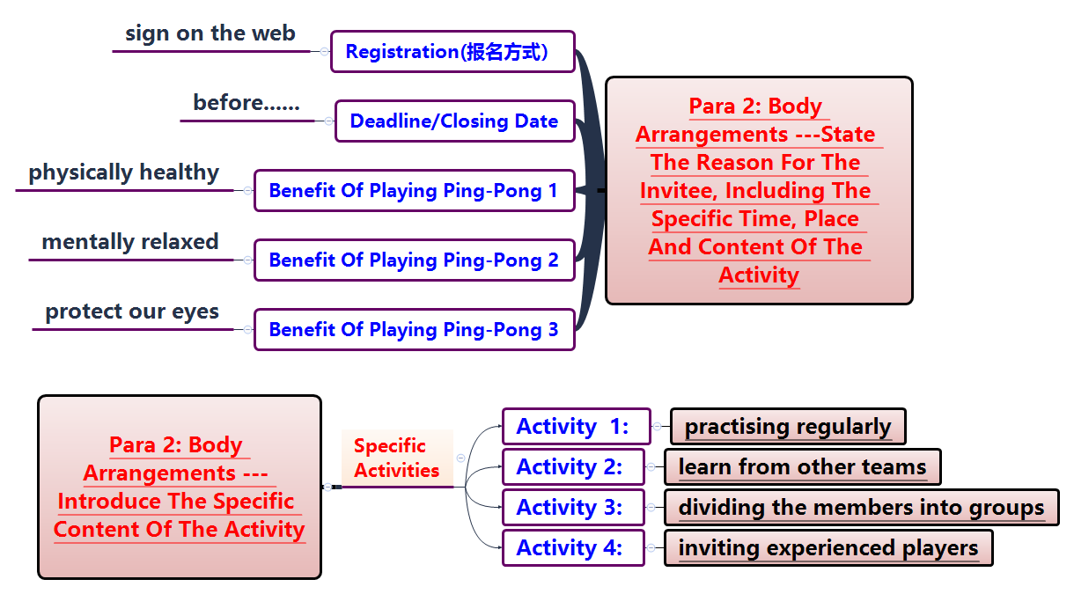
Writing help: structure and content

Slide 26
Writing Sample：
Dear Eric，
How is everything going? I'm Li Hua, I'm happy to invite you to join the Ping-Pong team in our school. I know you are very interested in playing Ping-Pong，which is regarded as the National Ball Sport of China and enjoys great popularity．As for the practice in our school's table tennis team，here is something about it.
Athletes from our team have won many gold medals of the contests in recent years and we benefit a lot from playing Ping-Pong．Members of the team have regular training on every Friday afternoon from 3:30 pm to 5:00 pm．If you want to apply for membership，please sign up on our school website or send an email to pingpong@hotmail. com．The deadline is June 28th．
I'm looking forward to your arrival and joining us in the near future.
Yours faithfully, Li Hua

Slide 27
邀请信范文2: （邀请参加端午节 the Dragon Boat Festival 庆祝活动）
假定你是李华，你们社区将举行端午节 (the Dragon Boat Festival) 庆祝活动，请你给外教Lucy写封信盛情邀请她参加，内容包括：
写信意图；
活动时间和地点；
活动内容。
注意：1．词数80左右；
2．可适当增加细节，以使行为连贯。

Slide 28
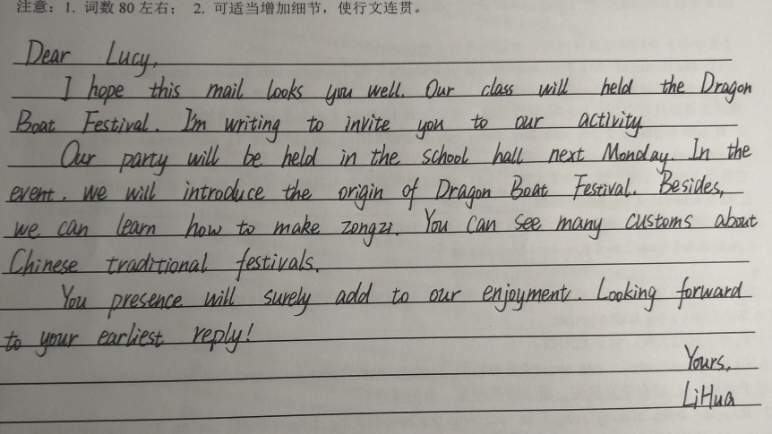
典型的Chinglish
时态和语态运用有误
活动描述过于简单
句与句之间衔接不到位
活动的具体安排不够详尽
句意表达太过简洁
邀请信2:（邀请参加端午节 the Dragon Boat Festival 庆祝活动）
此学生写的应用文首句典型的Chinglish, 时态和语态运用有误，活动描述过于简单，句与句之间衔接不到位，活动的具体安排不够详尽，句意表达太过简洁。

Slide 29
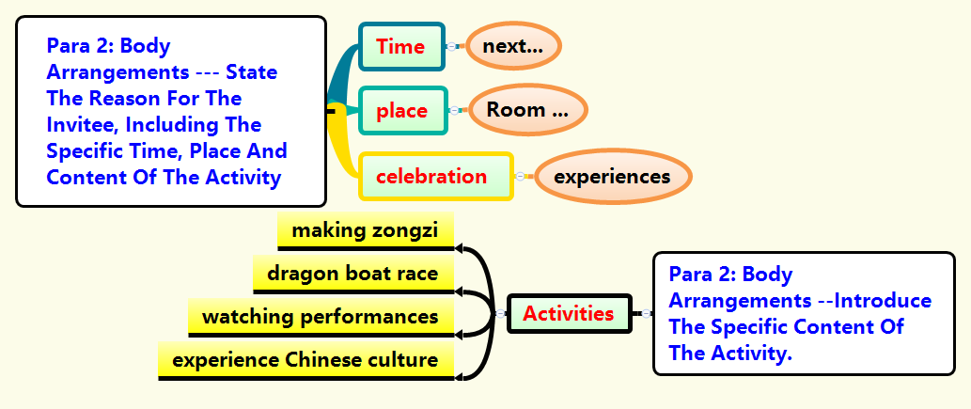
Writing help: structure and content

Slide 30
Writing Sample：
Dear Lucy,
I’m writing to invite you to participate in the celebration of the Dragon Boat Festival in our class.
As is scheduled, the celebration will begin at 2 pm. next Saturday in Room 201, which will be a feast of the Chinese culture. There will be several activities, ranging from making zongzi to watching the stimulating dragon boat race on TV. If you will get actively involved in it, you will surely have a taste of typical Chinese culture and customs. And your arrival will undoubtedly add to our joy.
Your favorable reply at your earliest convenience will be highly appreciated. Looking forward to your involvement.
Yours faithfully, Li Hua

Slide 31
THANK YOU!

