Slide 1


感恩遇见，相互成就，本课件资料仅供您个人参考、教学使用，严禁自行在网络传播，违者依知识产权法追究法律责任。
更多教学资源请关注
公众号：溯恩高中英语
知识产权声明

Slide 2
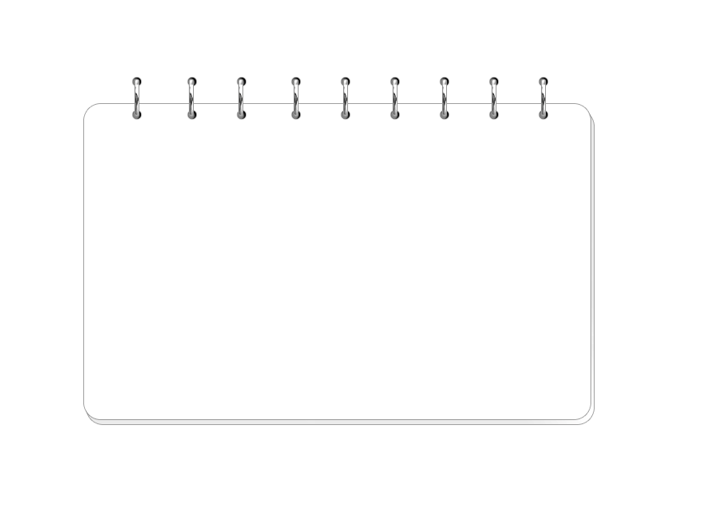





高三英语基测试卷分析及备考建议
--客观题部分
嘉兴四高： 沈洁
2020.9.18

Slide 3

整
本次基础测试的出题思路与近年浙江高考卷基本一致，选材充分体现了《普通高中英语课程标准》精神以及当前英语考试改革的方向，重点考查学生综合运用语言和语法知识的能力，以及用英语获取信息、处理信息、分析问题和解决问题的能力。
体

Slide 4
3.When is the woman’s birthday? A. In May. B. In April. C. In March.
第一部分：听力
Tips：
注意听清时间与事件发生时间之间的关系。尤其要注意时间上的提前和推后，然后再进行正确的换算。
M: How old is your son, Carrie?
W: He just turned two in April. His sister was born the month before, and I was born the month after.
M: That’s a lot of spring birthday.
注意价格的习惯表达：$19.95读成nineteen ninety-five dollars,切勿将其误解为1995美元。
注意时间表达上英美的差异。如1:45可读成a quarter to two或one forty-five.
注意街道、房间、汽车等号码的习惯表达方法。如320读成three twenty或three two zero;电话号码则将数字逐个读出来。

Slide 5
Tips：
36,75%的学生选了C，定位词Los Angeles的迷惑性，属于关键信息的拼凑。
6.Why does the man refuse the woman’s invitation at first? (难度系数0.57）
A. He will have a visitor.
B. He will travel to New York.
C. He will meet his sister in Los Angeles.
W: Will you come round for a meal this Saturday?
M: I’d like to, but my sister is coming from New York. We haven’t seen each other for a long time. She is only staying for two days, and then she is leaving for two days, and then she is leaving for Los Angeles.
W: Then how about next Wednesday?
M: I’ll have lessons. How about next Saturday?
W: Ok. Do as you please.
M: Thank you.

Slide 6
14. Who could be the coach of the competition?
A. A tourist in France.
B. A student from a high school.
C. A teacher working in a school.
Tips：
做听力题目不能“听到什么就选什么”
W: Does our coach have to work in our school?
M: No, but this person does need to be working in a school, for example it could be the French assistant in Woods High School.

Slide 7
12.What happened during the man’last fishing trip? A.He caught no fish. B.He got sunburnt. C.He broke his arm.
Tips：
关键信息的提取和转换能力
Any the only thing I caught was an old boot.
I think it’s going to be hot that day, and I might get a sunburnt.
Listen, let’s try something fun this time! You won’t break your arm or get a sunsurnt.

Slide 8
备考建议:
1.语音知识对听力的影响：在听力理解的过程中，语音是第一位的，听者首先接受的是语音信息(短语和句子) ,使他们在自己的语言图式中“对号入座”，根据已有的知识结构( 图式 ),开始对该信息进行建构，以理解其意义。
连读，音变，省音
2.养成听前做好准备的习惯。提前浏览题干及各个选项，对考点进行大致了解，以便在听录音的时候有的放矢。(关注4W1H的提问以及男女说话人的观点）
3.平时多讲练，而非简单的测试。重视相关话题，场景词汇的积累。注意总结听力中经常出现的词汇及固定搭配，降低听力和理解障碍。（今年7月浙江听力中的available, to-do list；safe and sound）

Slide 9
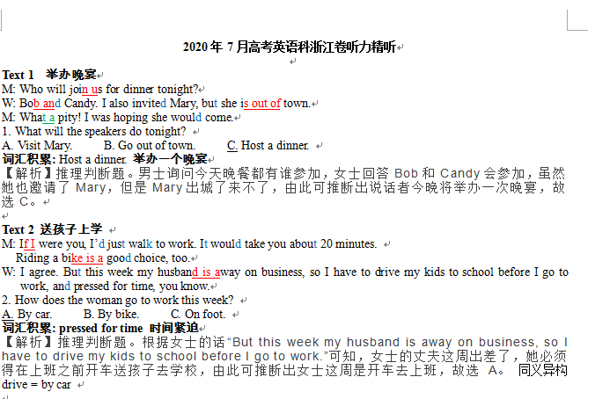

Slide 10
第二部分、阅读理解
题型 | 题号
细节理解题 （包含例证题） | 21,22,24,28,29,30
推理判断题（infer, imply, learn from） | 25,26
词义猜测题（语义题） | 27
主旨大意题（段落大意，文章大意，标题选择，写作意图） | 23

Slide 11
考题特点
1.词汇量增加，需抓住关键细节。
2.长难句多，需化繁为简抓住干。
3.选材广泛，时代性强。

Slide 12
浙江卷的A篇多为故事类的文章，如2020年7月主要讲述了身为主编，作者在编撰该书时的一些初衷和想法。2020年1月介绍作者在Calloway夫人的图书馆读书的经历。2019年6月介绍了Zachariah Fike为“军功章”寻找真正的主人的故事。
本次基测A篇概览:
作者和一个流浪接头的女子同时看到天鹅，听到她对自己生活的评价，感受到她对生活积极乐观的态度。

Slide 13
得分率较低的试题及分析0.67
22.What surprised the author most the day he watched the geese?
A. The bay lady’s remarks on her life.
B. The secret of the survival of the geese.
C. People’s enthusiasm for Christmas gifts.
D. The beautiful sunset and the colorful sky.
Tips：阅读理解做题的黄金法则：定位正确，改写正确
I overheard the lady talking to herself as she walked away. Her words, “Life treats me kindly‘， nearly made my jaw drop.’
made my jaw drop直译为让我的下巴掉下来，中文也有惊掉了下巴，不难推测就是让我惊讶不已的意思。与题干的surprise对应。

Slide 14
平时要积累一些常见的固定表达及谚语。
2020年1月26题四个选项
Bark up the wrong tree
Put the cart before the horse
Rob Peter to pay Paul
Kill two birds with one stone

Slide 15
阅读理解B篇多为说明文。2020年7月主要介绍了美国西雅图贝尔维尤市采用智能信号灯改善了交通状况，但在更拥挤的城市不一定适用。2020年1月介绍了美国威斯康星洲密尔沃基市变废为宝，用cheese brine来除冰。
本次基测B篇概览：
伦敦大都会警察局宣布一个尚有争议的计划，利用实时人脸识别技术提高警察破案能力。

Slide 16
得分率较低的试题及分析
学会分析阅读中关键的长难句
25. What is Elizabeth Denham’s attitude to LFR?
A. cautious B. Favorable C. Ambiguous (31.4%) D Reserved
“Moving very quickly to employ technologies (that can destroy people’s lawful daily lives) might damage trust not only in the technology, but in the fundamental mode of policing,” Elizabeth Denham, the UK ‘s Information Commissioner, said.
Tips：观点态度题要细品人物说的话，同时要积累态度题选项出现的形容词（objective, subjective, skeptical, dissatisfied, supportive, indifferent, unconcerned, negative, sympathetic, critical, doubtful, optimistic, pessimistic等）

Slide 17
长难句
1.生词规避法(Adj. 不读 adv不读 n东西 v.整，做 a of b前后看一个)
2.主干还原法(分割结构指的是把英语句子中原来属于一个整体的句子成分分割开，一部分留在句子的原来位置，另一部分远离原来位置)。
常见结构：主语+【】+谓语+宾语
3.拆分节点法(可以拆分的节点:从句 非谓语动词 介词连词)

Slide 18
认识插入语：插入语：评注性状语和连接性状语 章振邦主编的《新编英语语法》 插入语在句中起副词作用，一般置于句首，也可以置于句中或句末，用逗号或破折号隔开。
Was the lady, this homeless street beggar, being kidding or even mindless. No. I believed the sight of the geese had reminded her of, however briefly, the difficult and unpleasant reality of her own struggle.

Slide 19
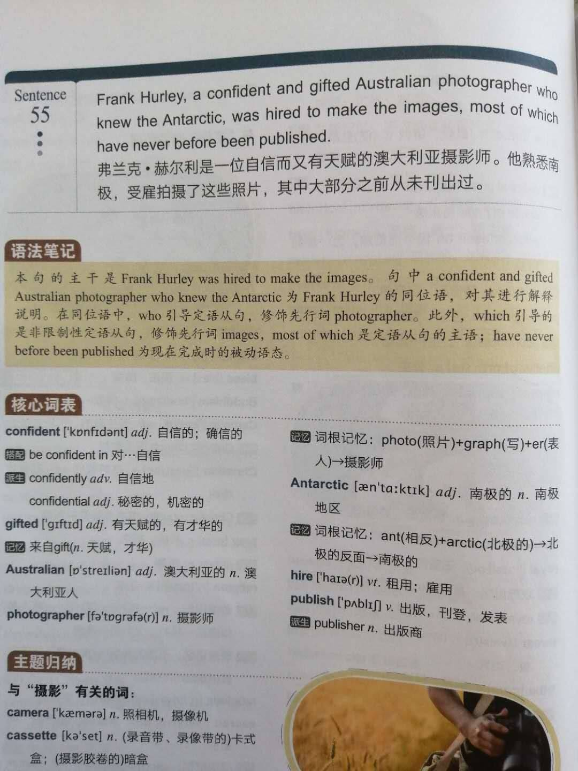
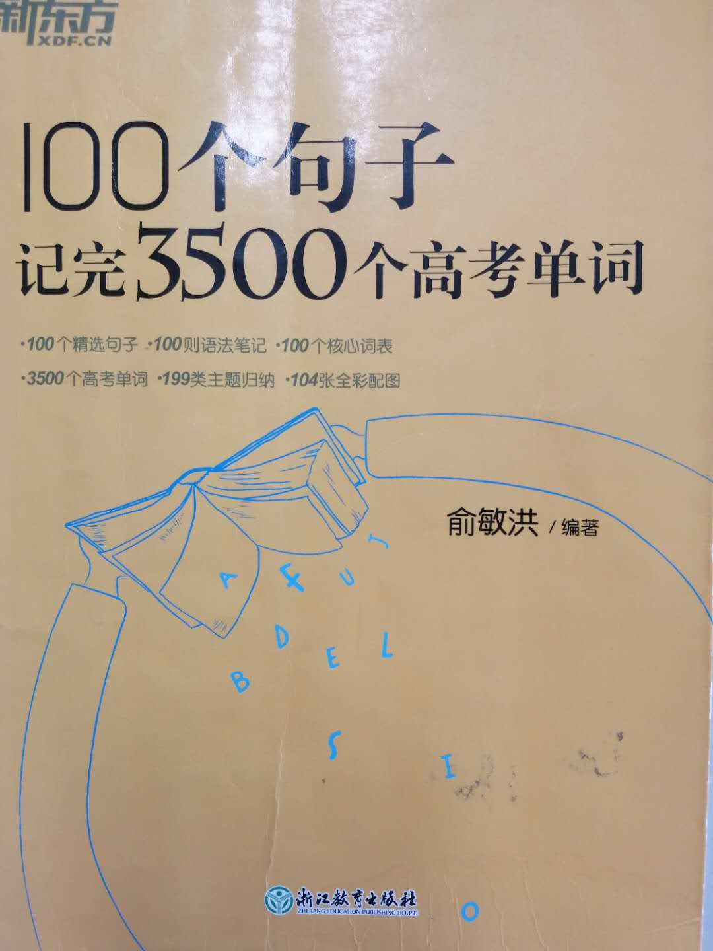

Slide 20
得分率较低的试题及分析 难度系数0.46
推理判断题的标志性词
26.What can we learn about LFR from the last two paragraphs?
A. Benefit from its use is widely recognized.19.3%
(risks of LFR outweigh the benefits)
B. The risks it may bring are hardly known. 11.9%
( taking steps to reduce intrusion and meet the requirements of data protection rules)
C. Laws are being made to support its application. 22,1%
（Danham’s office called on the government to urgently introduce laws to govern LFR.）
D. Improvement on it will be seen in the near future.

Slide 21
阅读理解C篇多为议论文或者科研报告。如2020年7月介绍了一项科学研究：德国的科学家通过实验发现，挑战性工作有助于提升大脑明锐度。2020年1月介绍父亲在子女教育方面的重要作用。
本次基测C篇概览：
老树岌岌可危，有气候原因，更重要的是人们不重视老树的保养，一味追求种植新的树木的数量。

Slide 22
得分率较低的试题及分析 难度系数0.65
One of the costs of being a lover of old trees is the all-too-frequent loss of a beautiful soul you’ve grown fond of.
27. What does the underlined part in paragraph 1 suggest?
A. strong determination to plant trees. 5.37%
B. Real regret at growing old trees. 8.41%
C. Great concern about tree problems. 21.53%
D. Deep love for valuable old trees.

Slide 23
“题目分析
In a recent study, researchers found that Boston would get more benefit from keeping the trees it has alive than from planting new trees. That’s reason to think this finding would apply in other cities, too.
29.The author argues in paragraph 3 by_____.
A. Comparing different cases.
B. Presenting research findings
C. Referring to scientists’ sayings
D. Carrying out some experiments
对写作手法的考查
平时阅读教学需要关注文章写作手法，尤其是最基本的example, cause-effect等
（浙江2020年7月）29. How does Francisca Then explain her findings in paragraph 4?
A. By using an expert's words. B. By making a comparison.
C. By referring to another study. D. By introducing a concept.

Slide 24
Why does the author give the example of nursing babies in the end?
To stress the importance of tree insurance programs.
To show the close connection between trees and babies.
To advocate protecting trees as humans care for babies.
To persuade human beings to pay more attention to babies.
Now, our public and private tree programs often ignore old trees until it is too late. As long as we abandon our trees, planting more is merely to keep pace with growing losses. We want trees to help protect us, but we leave them unprotected. Consider this in the human world: Nobody would send a baby into the world and expect it to just make it ….

Slide 25
题干中出现：example、case、demonstrate、illustrate、mention to show、intend to show、to refute、to explain、to criticize、to discuss、to exemplify、to describe等标志信息时，基本可定性为例证题。 例证题的意义并不在于例子本身内容的理解，而在于考查同学们把握篇章结构加区分论点论据的能力，因此，抓住观点句才是解题的关键。但是，客观来说，对于多数考生而言（尤其是基础薄弱的同学）把握篇章结构，明确定位观点句的难度较大，那么问题来了：如果读不出篇章结构，找不到观点句，还能解决例证题吗？Of course, we can！虽然观点难以定位，篇章结构不易理解，但例子本身的信息在文中却不难发觉。因此，我们需要做的工作就是把例子看懂，然后在选项辨识的过程中坚持所读非所选（将重现例子内容的选项排除）。

Slide 26
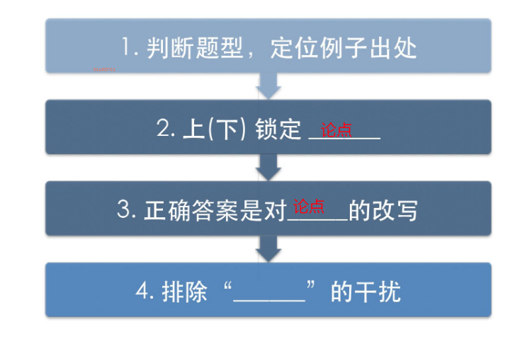
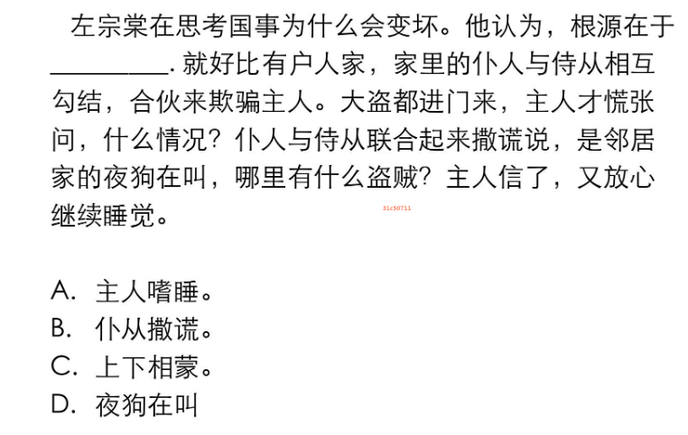
就例论例

Slide 27
例证题：
如何判断例子前后的句子就是观点句？
1.句子本身有抽象性的特征。
2.在句子中提炼实词和选项对应。
（2019,6浙江 25题）What did bridges want to show by mentioning the bride?
（2018,11浙江 22题）What does the author suggest by mentioning “Aunty Nellie” in paragraph 2?
（2018,6浙江 28题）Why is hamburger mentioned in paragraph 2?

Slide 28


备考建议
应试类阅读理解
阅读：目的性（该读的读，无须读的速读或者略读，阅读速读有快有慢，有急有缓。）
理解：空白性（理解作者的观点，不是让你发表自己的看法，一切忠于原文！ ）
应试类阅读是读别人，别人怎么说，你就怎么选。
我不要你觉得，我要作者觉得！

Slide 29
三去除
重新构建阅读思维
“我觉得对” 思维 完全以自己对选项的含义理解做判断（2018基测22题 What the author suggests some people do for the Salvation Army is intended to___ B.show the importance of true kindness）
“他要害我” 思维 在容易词和原文重复的词上不敢选择
“真有道理” 思维 选项讲的是符合认知和客观事实的“有道理”选项

Slide 30
三构建
重新构建阅读思维
有限时间思维：30分钟-20分钟（高山法则）
结构式阅读法：思维 逻辑 题型 选项
复盘总结思维： 熟悉干扰选项特征 了解出题规律

Slide 31

干扰选项特征
1.拼凑细节 容易的词有亲切感 难的词有恐惧感
2.无中生有 真理 放之四海而皆准
3.反客为主 原文是客观 选项是主观
4.大小做题 范围的大小
5.极端错误 极端词汇 一些人-每一个人
6.偷换概念 主语换掉
标题文本
这里可以添加主要内容这里可以添加主要内容这里可以添加主要内容

Slide 32
浙江新高考“七选五”试题特征统计表
时间 | 2017.6 | 2017.11 | 2018.6 | 2018.11 | 2019.6 | 2020.1 | 2020.7
主题 | 人与社会：如何接头随机采访 | 人与自我：怎样记住阅读内容 | 人与社会：怎样赢得邻里关系 | 人与社会：信息时代怎样社交 | 人与社会：披头士乐队 | 人与自然：世界水日 | 人与自我：养成几个生活习惯的原因
体裁 | 说明文 | 说明文 | 说明文 | 议论文 | 说明文 | 说明文 | 记叙文
篇章结构 | 问题解决模式 | 问题解决模式 | 问题解决模式 | 问题解决模式 | 概括具体模式 | 概括具体模式 | 问题解决式
本次基测：
人与自我：坐飞机带上网球减缓疲劳；
问题解决式

Slide 33
Let's just be honest._ 31 _Given the limited space that comes with an economy class seat, you can expect to sit for hours with a stiff(低硬的) neck and back, which has a bad effect on your circelation. While most people know that standing up and walking around during your flight can encourage your blood flow, it's not always possible or convenient to do so. _32_
Confused? Just hear us out. Tennis balls can put any fancy and expensive things to shame when it comes to klling pain, relieving(减轻) tightness, and improving circulation on long fights or road trips. This is why you should always pack a tennis ball for your trip.
_33_It is pratically the on-the-go self-massage(自我按摩) you never knew you needed . Not only are tennis balls tiny enough to fit into a small bag, but also using one during a fight won't bother your neighbors either. And luckily, it's not one of the things most likely to get you flagged in the security line.
There are certain areas you should target when performing a self-massage._34_They are your ankles, wrists, legs, and upper back and shoulders. Apply gentle pressure to each area with the ball as you roll, and use extra care with any spots of tension.
Seems simple enongh, right? _35_Always remember to ly with a tenis ball in your carry-on.
Topic sentence
problem
supporting details
(examples)
solution
注意特殊副词的积累，有助于准备理解文本，如merely, hardly, barely
A. That's where a tennis ball comes in.
B. These days, airplanes can barely fit your own two legs.
C. Some key body parts (与前后文信息的复现） are especially in need of your attention.
D. People are flying with just one piece of carry-on luggage nowadays.
E. But it could make your life so, so much easier and keep you healthier in the air.
F. Just make sure you're not making the airport mistakes before your next flight .
G. Rolling a tennis ball along your body loosens up stiff parts and increases blood flow(与前后文信息的复现）.

Slide 34
题号 | 出现位置 | 难度系数
31 | 段中 | 0.47
32 | 段尾 | 0.53
33 | 段首 | 0.61
34 | 段中 | 0.81
35 | 段中 | 0.56
篇章结构和设题都较为合理，涉及2个主题句。其他为上下文逻辑关系题。

Slide 35
“七选五”阅读文章内设空的位置有三种：段首、段中和段尾，我们可以根据答案所在的位置和功能分别确定解题技巧。
出现位置 | 句子功能 | 解题方法
段首 | 在标题类文章中，该空一般为段落主旨句。在非标题类文章中，该空可能是主旨句或承上启下的过渡句。 | 通读空格后整段的内容，查找同义词或其他相关的词，确定本段主旨，推断出主题句，选择正确的答案。
段尾 | 总结概括，或承上启下。 | 在选项中查找表示总结的信号词或发现前文的同义词句。
段中 | 一般为过渡功能，起到承上启下的作用。也有可能是细节注释。 | 浏览空前及空后的句子来确定句间逻辑关系。也可从主题词语的同词或同义复现进行判断。

Slide 36
第三部分：语言运用
命题特点：
完形填空考查考生在阅读理解的基础上运用词汇的能力。试题要求考生根据文章的主旨和结构以及上下文的逻辑关系选择适合文章内容，语法搭配正确的选项。
高考完型填空题的选材一般为具有一定故事情节的记叙文或者夹叙夹议文 短文长度300词左右，
2. 首句无空格，提供语境。5-10词设一空，人名、 地名、日期、数字不在之列。
3. 选项多为一词，偶会为词组。四选项为同一类词或属同一范畴，或近义或形异义，或与前后配成词组。故干扰性、迷性大。有时单独看一句话语法都是正确的，但根据上下文只有一个正确答案 。

Slide 37
4. 考查单词以实词(v, n, adj, adv, pron.)为主，虚词(conj.,prep.)为辅。实词一般占80%-90%。
5. 以考查学生对文章的整体理解（篇章逻辑题）和词汇的意义（词汇题）把握为主。有些要结合常识才能正确选项；有些甚至要求在通篇理解的基础上，正确把握上下文的逻辑关系，才能正确判断和选择。
6. 有些空格答案由上文决定（前置性设空），有些由后文决定（后置性设空），有些要综合上下文才能得到答案（语篇性设空），以后置性设空为主。

Slide 38
①
When he was 15, Owen Lima got behind the wheel of a car. Soon after, he rolled the car and ＿＿36＿a serious head injury. When he finally woke, he discovered that the injury had brought ＿＿37＿＿ to his brain, which he has continued to ＿＿38＿＿for the past 40 years.
Lima's condition has made it difficult for him to ＿＿39＿＿others, especially when they speak
quickly, and makes him ＿＿40＿＿likely to be affected by anxiety attacks. Therefore, Lima is ＿41
＿by Blue, a service dog that helps keep him＿＿42＿＿.
③ One of the biggest problems Lima has faced is finding ＿＿43＿＿.For years, he has ＿＿44＿
to find a steady job. He has gone to find jobs with his dog but has always been treated ＿＿45＿＿or
given unfair wages, making him feel like a(n) ＿＿46＿＿citizen.
Lima's ＿47＿＿finally turned when he and Blue ＿＿48＿＿a job at a Lowe's home improvement store in Regina. When ＿＿49＿＿what the dog was for, Lima talked about the whole story. The store manager ＿＿50＿＿to give him a chance of success.
Now, Lima and Blue both ＿＿51＿＿in the store. During the store's grand opening, the pair was there to ＿＿52＿＿new customers when the doors opened. Blue has even been dressed in his own custom-made vest to ＿＿53＿＿the other employees‘ uniforms. Lima says he is ＿54＿＿to his new employer, both for the chance to work and for letting Blue come＿＿55＿＿。
②
④
⑤
起因①
经过② ③ ④
结果 ⑤

Slide 39
Clarify the plot of the story
Overt plot (明线)——_______________
Covert plot (暗线)——_______________
Lima’s living condition after the car accident
The change of Lima’s emotions

Slide 40
Overt plot: Lima’s living condition after the car accident
Lima finds it hard to find jobs with the service dog.
Lima’s luck finally turned.
Lima and Blue take delight
in the new job.
Lima has difficulty in understanding others.
Owen Lima suffered a serious head injuries after the car accident.

Slide 41
Covert plot: The change of Lima’s emotions
difficult
feel like a second-class citizen
grateful

Slide 42
考点分布
动词 10 |  | 名词 3 | 形容词 3 | 副词 2 | 词组 3
谓语动词 | 非谓语动词 | Damage, Employment, luck | Calm, Second-class, greatful | Highly, poorly | Live on, Apply for Come along
suffered, Understand, Accompanied, Struggled, Asked, Decided, Work, | Understand, Match, Greet,

Slide 43
试题分析
When he finally woke, he discovered that the injury had brought damage to his brain, which has continued to 38 for the past 40 years.
注意积累单词和词组的一词多义、熟词生义
38.(难度系数0.17）
A. compete against 32.2% B. live in 45.1%
C. look after D. deal with 处理，涉及，应付

Slide 44
Lima’s condition has made it difficult for him to 39 others, especially when they speak quickly, and makes him 40 likely to be affected by anxiety attacks.
40.（难度系数0.43）
A.hardly25.5% B. equally C only D highly
选A的同学没有理解到and连接的是并列关系，hardly与句意矛盾。

Slide 45
He has gone to find jobs with his dogs but has always been treated poorly or given unfair wages, making him feel like a 46 citizen.
经济舱、商务舱bai、头等舱分别为：Economy class, business class, first class
46. 难度系数 0.24
A. ill-educated
B. strange-looking37.5%
C. second-class D middle-status
second-class次要的; 无足轻重的; (质量、标准等) 二流的，次等的; 二等的(车厢、船舱等);

Slide 46

备考策略：
在学习词汇时注意准确把握词义，多积累常用词和高频词，并在此基础上提高在语境中运用这些基本词汇的能力。
倪萍逻辑（前后呼应）：
1996年中央电视台春节联欢晚会由赵忠祥 倪萍 程前 袁鸣主持。倪萍大姐说了“亲爱的观众朋友们，今年的联欢会突出了联欢的主题” 完形填空解题方法之前呼后应法
做完形填空时，要始终抓住文章本身，结合“大语境”（全文中心和基调）和“小语境”（即空格前后所构成的语境）。再根据前有伏笔后又呼应的思路来做题。

Slide 47
Lima says he is ＿54＿＿to his new employer, both for the chance to work and for letting Blue come＿＿55＿＿
55.难度系数0.54
A break in
B.come along come along 陪伴，一起
C.turn up 25.96% 强调出现这个动作
D.move off

Slide 48
英语完形填空解题步骤
≈2mins
速览全文，把握大意。
细读首句，摸清文路。
瞻前顾后，准确选择。
复核全文，调整答案。
≈1mins
≈10mins
≈2mins
做完形填空必须读懂文章，前后逻辑一致；完形填空每个小题的正确答案都是有充分根据的，可以在文章汇总找到具体的突破口也就是信息点。解题时应联系上下文寻找相关线索，如某一个词的原词、指代词、同义词、近义词、上义词、下义词和概括词等。

Slide 49

熵（shāng），热力学中表征物质状态的参量之一，用符号S表示，其物理意义是体系混乱程度的度量。
我们现阶段需要做的一件重要事情就是熵减！
语法体系的思维导图
各类题型的答题思路
Less is more!

Slide 50




感
谢
聆
听

