Slide 1
Continuation Writing
读后续写
读后续写微写作：利用“逆推法”，引导学生合理地推故事情节
Micro-writing: Employ “Backward Pass”, and Guide the Students to Make the Story Develop Logically and Reasonably
余杭区树兰高级中学：郭合英

Slide 2
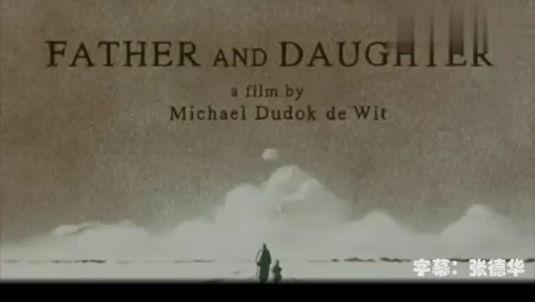
Warming up---- Enjoy “Father and Daughter”

Slide 3
My Dad’s Best Flower
阅读下短文，根据所给情节进行续写，使之构成一个完整的故事。
I remember my first home was a small apartment on the second floor with a lovely and spacious balcony. When my mom was busy in the kitchen, she let me stay on the balcony watching the kids playing in the street. On that balcony I played sometimes with my elder sister, Maria. She was seven years old and when my mom was absent, she was like a mother to me. The balcony was a great hobby place for my father. After his work he used to grow carnations(康乃馨) in flower boxes. His carnations were red，pink and white, and everyone appreciated them for their beauty.
He took care of them with so much love and devotion. He dealt carefully with his flowers like a mother taking care of her baby. Many times I sat on the floor of the balcony for hours observing him and his lovely flowers with patience. He was always doing something on that balcony.He was watering them every day，cleaning the balcony floor，changing the potting soil and when the stems were thick，strong and high enough，he started his improvement operation attentively like a doctor.

Slide 4
My Dad’s Best Flower
My dad took a tiny knife and with his left hand he held the stem of the carnation and measured the height. Then he made a small mark on the stem with his finger. Afterwards he made a sharp cut with the knife，just enough to fit in again of barley(插穗的芽).Then he bandaged the stem with a small bandage. His job was then to water the plants and to take care of them. “No one should touch them，” he said to Mom. Every day，when he came home from work he went straight to the balcony.
Mom used to tell us，“Do not touch Daddy’s flowers.” For us it was a fascinating experience to watch how the small stems were growing and making flowers. When the carnations had grown big enough，my dad enjoyed watching them every day. We the kids did too.

Slide 5

My Dad’s Best Flower
注意：
1.所续写短文的词数应为150左右；
2.应使用5个以上短文中标有下划线的关键词语；
3.续写部分分为两段，每段的开头语已为你写好；
4.续写完成后，请用下划线标出你所使用的关键词语。
Paragraph 1：
One day，my elder sister，who loved Dad very much，had a great idea.
Paragraph 2：
When my dad arrived，he went as usual，straight to the balcony and saw his flowers lying on the floor like dead animals.

Slide 6


Pre-wrting
who
when
What's the style of the passage?
Narration (记叙文)
B. Exposition (说明文)
C. Argumentation (议论文)
where
what
why
how

Slide 7
Pre-writing Task 1: Read for plots.
who
where
What happened
“ I” ，my elder sister, father , mother
on the balcony
Dad planted carnations on the balcony, and he treated them like a mother taking care of her baby, demanding that anyone should not touch them.

Slide 8
Pre-writing Task 2: We can learn about the traits of each character according to what he/she says and does, using some adjectives to describe.
Mom
Father
Maria
“ I ”
My mom was busy in the kitchen.
Mother’s traits:
Loving, patient ,responsible
He took care of them with so much love and devotion.He dealt carefully with his flowers like a mother taking care of her baby
Father’s traits:
Loving, patient, responsible
Sister’s traits:
Loving, patient, responsible
When my mom was absent，she was like a mother to me.
When my mom was busy in the kitchen，she let me stay on the balcony watching the kids playing in the street. On that balcony I played sometimes with my elder sister
“My” traits:
obident, cute

Slide 9

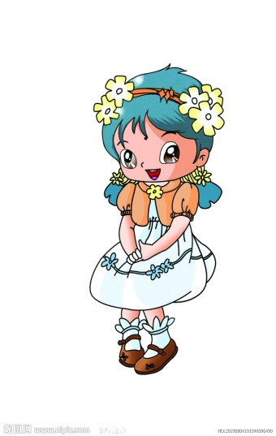
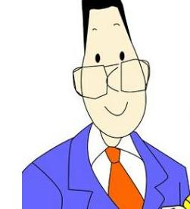
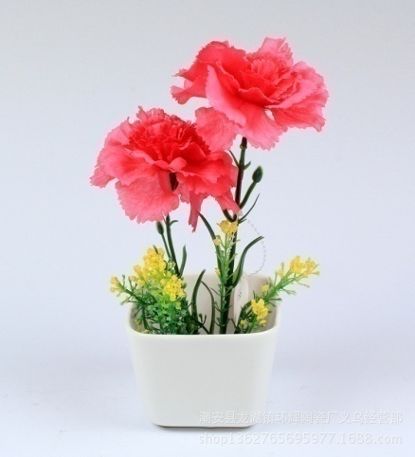

Pre-writing The relationship of the Persons
Maria
Dad
Daughter
Daughter
Mom
Elder Sister
Love and take care of
“I”
Flower

Slide 10
While-writing Analyzing the given sentences:
Paragraph 1：
One day，my elder sister，who loved Dad very much，had a great idea.
Paragraph 2：
When my dad arrived，he went as usual，straight to the balcony and saw his flowers lying on the floor like dead animals.
1.给出句的
作用：
这两段落的给出句起很关键，无论从时间的先后、
情节的发展都要以这两句话作为内在逻辑关系。
2. 衔接原则：要做好三个链接
① 给出句与续写句的衔接
② 续写1段和续写2段之间的衔接
③ 续写段与整篇文章的衔接

Slide 11
3 While-writing three principles 续写三原则
原文一致原则
做好三个衔接，内容上下连贯，语言表达风格一致。
正能量原则
3 续写原则
续写段一定要正能量，弘扬社会主义核心价值观。
曲折性原则
越是跌宕起伏的故事，越能激发读者的兴趣；亦或采用欧·亨利式结尾（通常指短篇小说大师们常常在文章情节结尾时突然让人物的心理情境发生出人意料的变化，或使主人公命运陡然逆转，出现意想不到的结果，既在意料之外，又在情理之中），激发读者的兴趣。

Slide 12

4 Five steps: 五个写作步骤
利用两段给出句的信息，采用逆推法，结合正能量，构思大致框架。
细读文章，弄清主旨大意，理清故事的来龙去脉（主要人物和事件。）
利用心理描写、语言描写、环境描写等各类描写增加细节，烘托人物的内心世界。
斟酌首句
巧妙逆推
读懂大意
理清脉络
细读句
构思框架
2.
巧用描写
点缀细节
细读故事
理清脉络
3.
1.
用地道语言和贴切词语进行润色，辅以语言的丰富性和多样化表达，最后干净整洁地誊写在试卷上。
5.
4.
增加细节
开始写作
修改润色
整洁誊写
言简意赅
升华主题
修改润色
整洁誊写
利用俚语、格言升华主题或巧用环境描写渲染主题

Slide 13
逆推法 (Backward Pass)：
①根据原文已知情节和第二段开头的给出句，找出里面的关键词（关键信息），合理推出第一段发生的故事情节；或先确定结尾段的主题，再结合文章标题，逆推出第一段可能发生的故事情节。
② 利用第一段的给出句，找出里面的关键词（关键信息），提出问题和假设，使故事情节合理发展。
③ 结合①②，根据原文继续提出问题和假设，使故事有序推进。

Slide 14
“逆推法”构思1：利用关键词构思情节
Paragraph 2：
When my dad arrived，he went as usual，straight to the balcony and saw his flowers lying on the floor like dead animals.
根据第二段的关键词 第一段故事的情节：
Paragraph 1：
One day，my elder sister，who loved Dad very much，had a great idea.
“lying”
1. What was the great idea?
（A love story）
第一段的总思路：Go for wool and come home shorn
好心办坏事 (弄巧成拙)
构成第一段的故事情节
2.How did they carry out the great idea?
3. How did the flowers lie on the floor?

Slide 15
推第二段故事情节的注意事项：
第二段故事的总体思路:
a friendly reminder：
Don't forget the basic tone
故事情节发展要和文章基调（basic tone）保持一致，否则情节发展就会偏离主题(off the point)。
注意事项：
以“Love” 为中心展开续写，体现出父亲爱女儿，以女儿为自豪，一家人温馨有爱，其乐融融的场面
由此推出第二段的
故事情节：
得知真相后，父亲转怒为喜，原谅并安慰两个女儿,以他们为豪
提炼出有思想性、体现价值观和传递正能量的元素进行升华，这是故事的点睛之笔

Slide 16
推出第二段可能发生的故事情节：
Paragraph 2：
Supposing your precious goods were destroyed by someone , what would your reaction be?
angry
What was the father’s reaction when seeing the flowers lying on
the floor?
2. Father wanted to know who had done it.
3. What's the sisters' reaction after their father came back?
4. What's Father's attitude to the two sisters after knowing the truth?
Emotional change：
angry
happy
proud
5.Sublimation of the theme.(升华主题)
升华主题时，要以“love”为主线，和文章的基调保持一致

Slide 17




“逆推法”构思2：先确定第二段故事的主题，结合文章标题，去推测第一段可能发生的故事情节
根据 原则 文章的 文章标题
如何确定第二段故事的主题？
正能量
基调
体现社会主义核心价值观
a love story
My Dad’s Best Flower
第二段故事的主题
第二段故事的主题：In Dad’s eyes, “ Do I have a better flower than my lovely daughter ?” It was his daughters who were his best cartations.
陪伴是最真实的爱，因为有你所以快乐

Slide 18

根据第二段确定的故事主题，去推测第一段可能发生的故事情节
可能情节1：
Watching Dad taking care of the flowers painstakingly every day, Maria determined to help dad. She cut the flowers as what Dad did, arranging them on the flowers.
可能情节2：
Realizing Dad loved the flowers so much, Maria made up her mind to buy more carnations for Dad in the flower market. After returning home, she planted them with her sister, upsetting the flowerpot by accident. The flowers lay on the flowers.

Slide 19

根据第二段确定的故事主题，去推测第一段可能发生的故事情节
可能情节3：
Realizing Dad loved the flowers so much, Maria made up her mind to buy more carnations for Dad in the flower market. On the way home, she found a wounded cat, bringing it home and wrapped up the wound. The cat jumped up and down on the balcony, upsetting the flowerpot. The flowers lay on the flowers
Stimulate the brain, and let the students come up with more possible stories

Slide 20
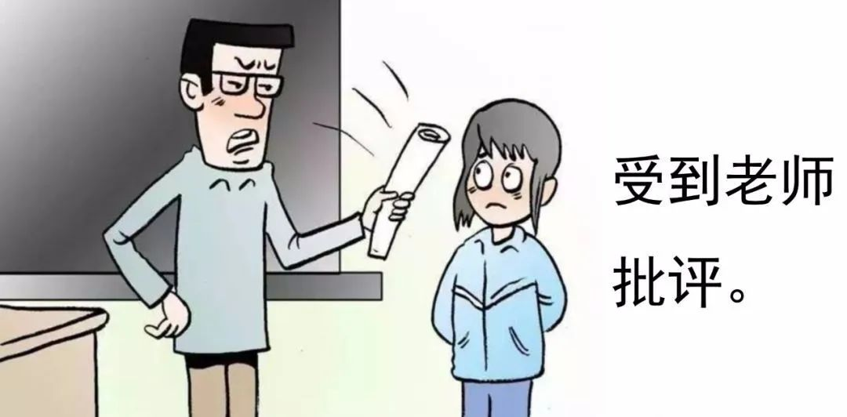
Analysis of the Problem composition
问题范文解读：发现问题，规避问题
（注意：本班学生的基础不好，这是读后续写的第一节课，先告诉他们如何合理地推故事情节，语言描写和语法错误暂时忽略，之后会跟进教学，帮学生提高语言表达能力）

Slide 21
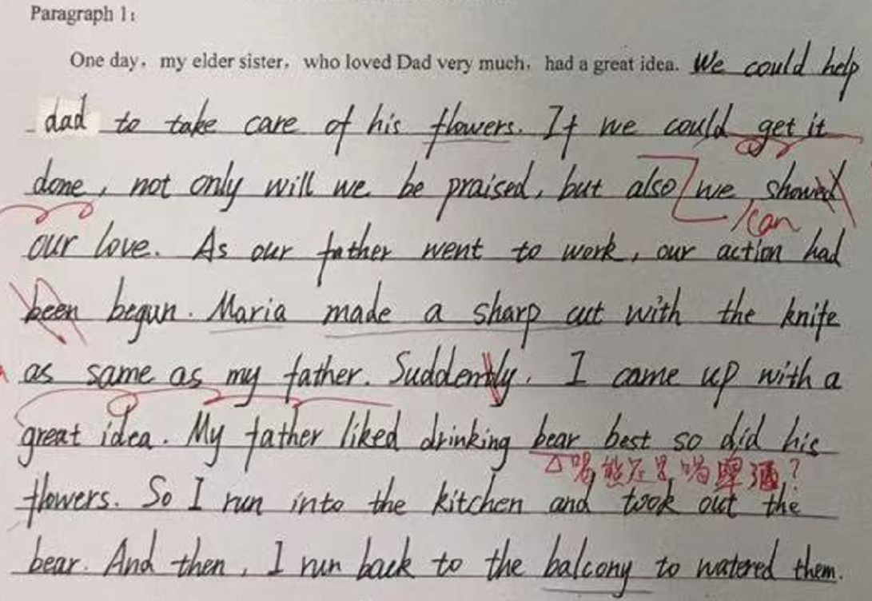
Student's composition 1
？
Problems
in
Plot
Problem：examining the topic unclearly
No “ lying on the floor”
？
？

Slide 22
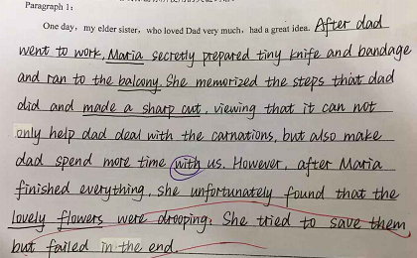
Student's composition 2
？
Problems
in
Plot
Problem：not use the word correctly
droop not lying

Slide 23
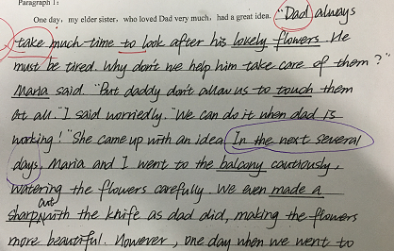

Student's composition 3
？
Problems
in
Plot
Problem：examining the topic unclearly
time disagree
Problem：
no “lying on the floor”

Slide 24
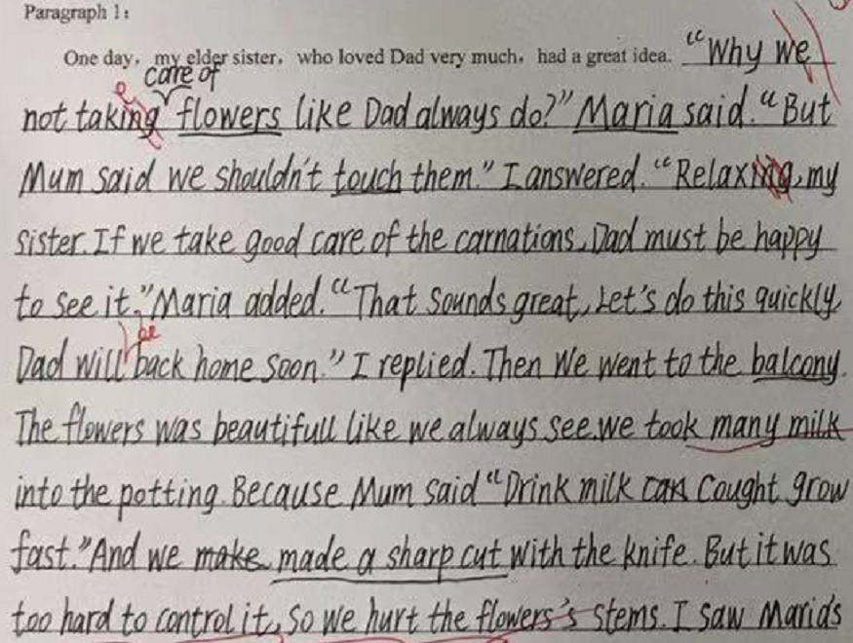
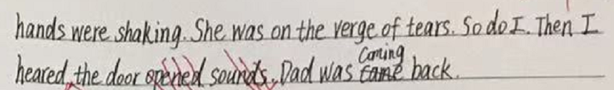
Student's composition 4
？
Problems
in
Plot
Problem：too much talk
“hurt the stem” ，花未必一定会“lying on the floor”
Problem：
“hurt the stem ” 花未必会“lying on the floor”

Slide 25
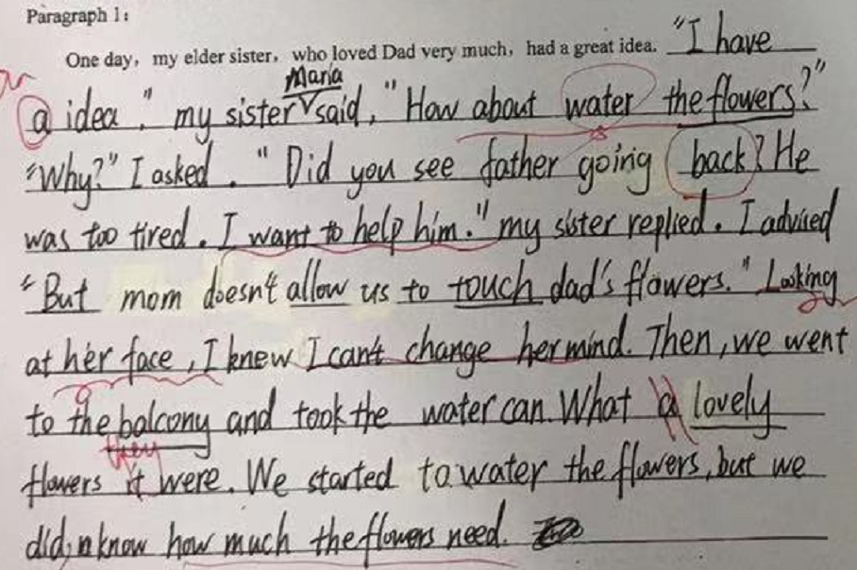
Student's composition 5
？
Problems
in
Plot
Problem：examining the topic unclearly
No “ lying on the floor”
Problem：against the common sense
Watering flowers too much makes them die within a day?
Problem：too much talk

Slide 26
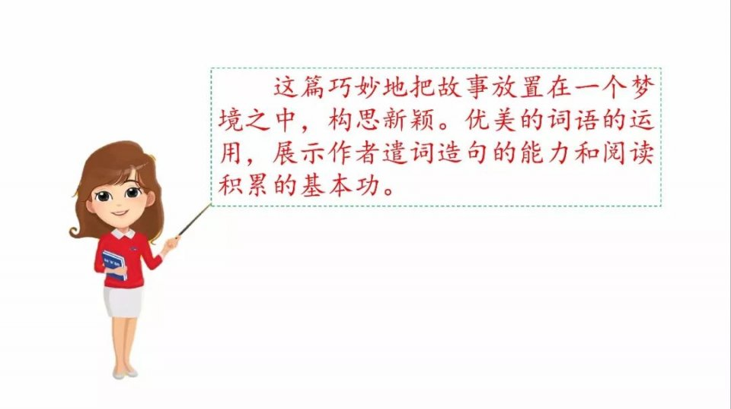

Analisis of the model essay
情节合理范文解读（以第一段为例）
（注意：词汇运用、语言描写和语法错误由于学生基础薄弱暂时忽略，之后会跟进教学，帮学生提高语言表达能力）

Slide 27
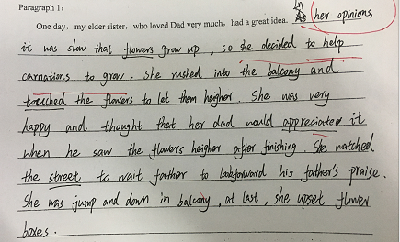
Student's composition 6
有
idea，有process有“lying”,
故事情节发展相对合理

Slide 28
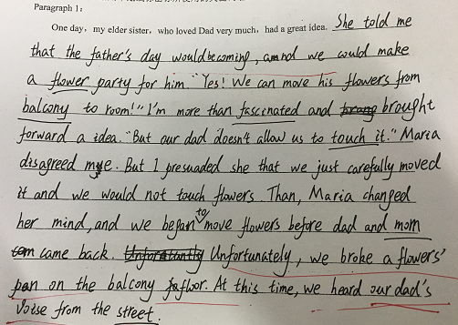
Student's composition 7
故事情节发展相对合理,
但是， “执行”
过程中“对话”
显得累赘，建议改成语言叙述

Slide 29
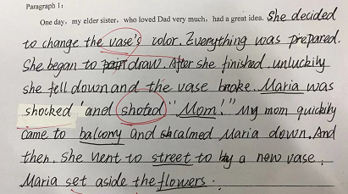
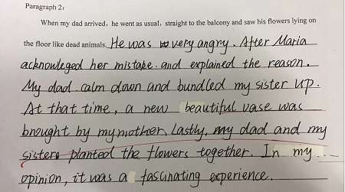
范文解读 6
故事情节发展相对合理,
但是， “执行”
过程语言描述
太少，建议增加细节

Slide 30
Possible version 1
故事情节发展合理有序,
但是，
有2个问题
1.两段发展不均衡
2. 划线词不够5个
One day, my elder sister, who loved dad very much, had a great idea. Wanting to help Dad, she cut the flowers from their stems and arranged them on the floor. She believed that Dad would be very pleased to see them that way. When Mom realized what my sister had done, she didn't say a word. My sister didn’t understand why we were so quiet without a word of appreciation.
When my dad arrived, he went as usual, straight to the balcony and saw his flowers lying on the floor like dead animals. He looked towards the street to see if there was one from the neighbors’ children who could have done it. Then he entered the living room and looked at Mom in silence. We all waited for a punishment. Mom, who always taught us to tell the truth, looked at Dad and said, “We have no bad neighbors in our area.” Then with a nice tone she continued, “No outsider did this great job, only our lovely daughter Linda. Dad’s face changed from tense to a smile and then he said, “Do I have a better flower than my lovely daughter? My sister smiled and gave Dad a big hug.”

Slide 31
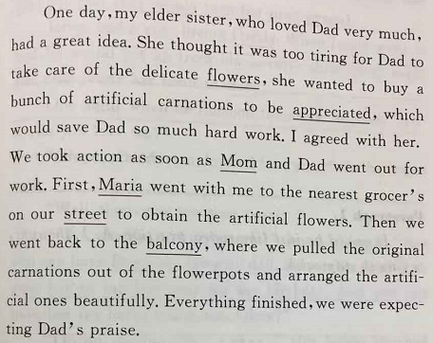
Possible version 2

Slide 32
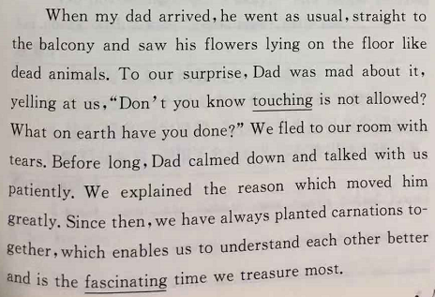
Possible version 2

Slide 33
Post- activity: Induction of common problems 续写常见问题归纳
情节建构方面
① 不注重衔接或衔接不自然：给出句和续写句衔接不连贯; 两段间衔接
不连贯。
② 违背生活真实，情节发展不符合逻辑。（如花浇水过多一天内死掉）
③ 情节发展不符合人设。
④ 续写部分的基调与整篇文章不符合。
⑤ 过多地使用对话，缺少描述性语言。
⑥ 立意不突出、缺少点睛一笔；主题升华牵强或跑偏。
语言运用及语法方面
单词拼错、时态、语态、单复数、各类从句、with的复合结构、非谓语、倒装、虚拟等等

Slide 34
读后续写技巧归纳
1. 利用逆推法，推出合理的故事情节
2. 街接自然：给出句与续写句要巧夺天工地自然融合，让人看不出＂拼接＂
的痕迹。
3. 想象合理：尊重生活，注重实际。故事内容要与事实(真理) 相一致，切不
可胡编乱造，写出 “神剧”。
4. 立意新颖：立意突出，思路独特，与众不同，独树一帜。
5. 运用描写：巧妙运用语言，心里，动作，环境等描写，既可以为文章做铺
垫，又可以烘托文章的气氛。
6. 段落均衡：包括两段字数的均衡和划线词的均衡。
7. 文章基调：文章主要表达了一种什么意愿，渲染了什么样 氛围，是欢快、
愉悦、忧愁、悲凉等
8. 升华主题：通过此事说明了什么／学到了什么／受到了什 么启发等（以
正能量为主，例如珍爱生命，学会合作，学会感恩等)

Slide 35
Summary
利用关键词和给出句，围绕文章的基调展开情节的合理推断, 运用恰当的关联词，巧妙施以一些描写（动作、语言、环境、心理等），辅以地道、贴切、朴实自然的词语（不必追求高大上的词汇），点缀一些长难句，渲染一二个主题升华句(提炼出有思想性、体现价值观和传递正能量的元素），注意给出句和续写句的衔接，即可酝酿成一篇佳作 ，和原文浑然一体，实现无缝对接。

Slide 36





Practice makes perfect!
Thank you

