Slide 1


感恩遇见，相互成就，本课件资料仅供您个人参考、教学使用，严禁自行在网络传播，违者依知识产权法追究法律责任。
更多教学资源请关注
公众号：溯恩高中英语
知识产权声明

Slide 2
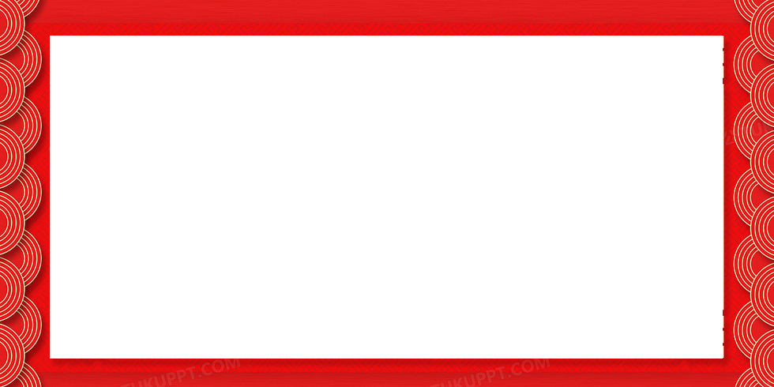
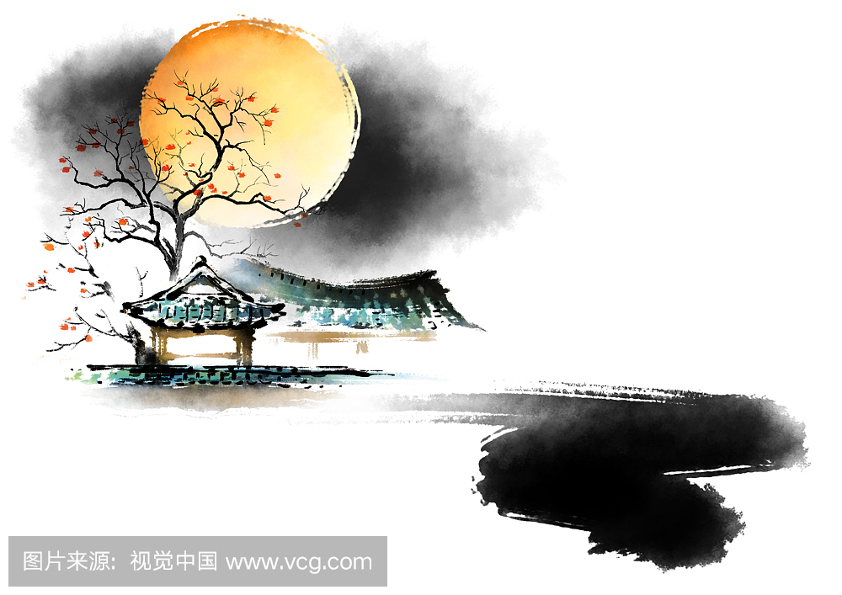
花
好
月
圆
赏
月
从
开
始
余杭区树兰高级中学 郭合英

Slide 3
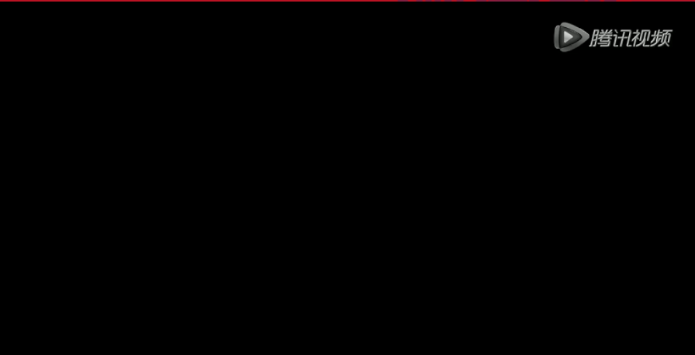
Step 1 lead in: Enjoy a video

Slide 4
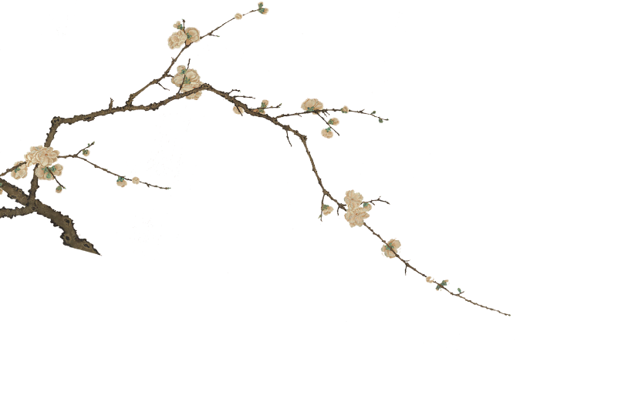

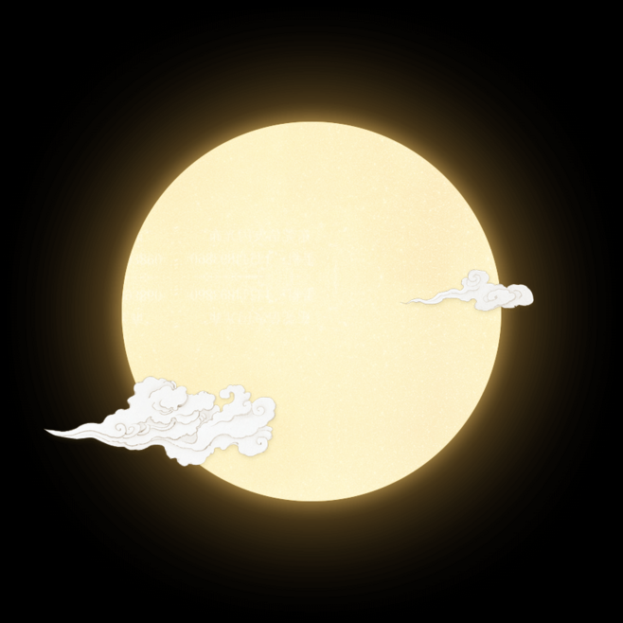

1. The original of Mid-Autumn Festival.
2. The legend of Mid-Autumn Festival.
Learning
Objects
3. The customs of Mid-Autumn Festival.
4. The poems of Mid-Autumn Festival.

Slide 5
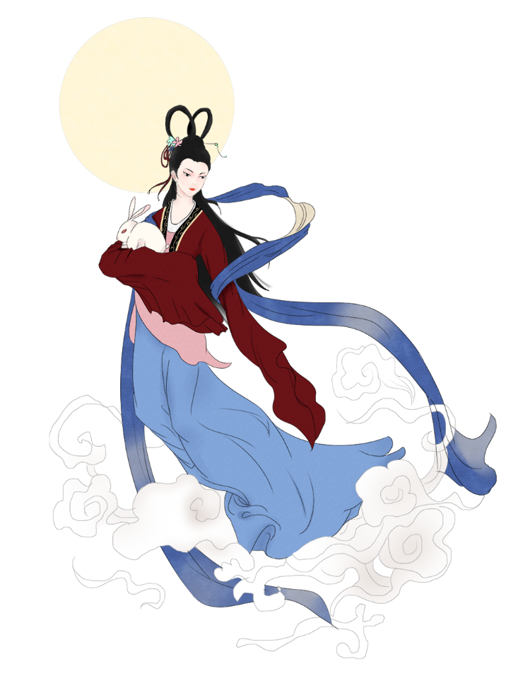
Please answer the questions after watching the video.
1. When is Autumn Festival Day ?
It falls on the 15th day of 8th month in Chinese lunar calendar
2. To the Chinese, What does Mid-Autumn Festival mean?
It means family reunion and peace. The festival is celebrated when the moon is believed to be the biggest and fullest.
3. To the Chinese, what is a full moon’s symbol?
A full moon is a symbol of prosperity, happiness, and family reunion.
4. How the Chinese Celebrate Mid-Autumn？
Many traditional and meaningful celebrations are held in most households in China, and China's neighboring countries. The main traditions and celebrations include eating mooncakes, having dinner with family, gazing at and worshipping the moon, and lighting lanterns.

Slide 6
做好词汇积累，高考蓄势待发
Words:
1. festival [ˈfestəvəl] n.节日;节期;祝贺 a.节日的;欢乐的
2. luner [ˈluːnə] a.月(亮)的;阴历的; 银的
solar['səʊlə(r)] adj. 太阳的；太阳能的
3. view [vjuː] n.看法;见解;景色;视察;想法; vt. 看、观看
view the moon 赏月
4. tradition [trəˈdiʃən] n.传统;传说;惯例
phrases:
fall on ① 发生= happen or take place ② (向某方向）移动；落（在某位置上）
写作佳句1：今年我的生日适逢中秋节。
My birthday falls on the Mid-autumn Day.
The Mid-Autumn festival and National Day fall on the same day this year .
写作佳句2：今年的中秋和国庆恰逢在同一天。
写作佳句3：我突然见到了一样奇怪的东西。
a good quote
My eyes fell on(= I suddenly saw) a curious object.
The moon rose from the sea.
and all the people shared this moment together.
海上生明月，天涯共此时

Slide 7
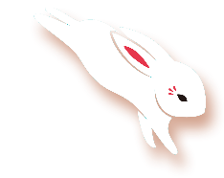
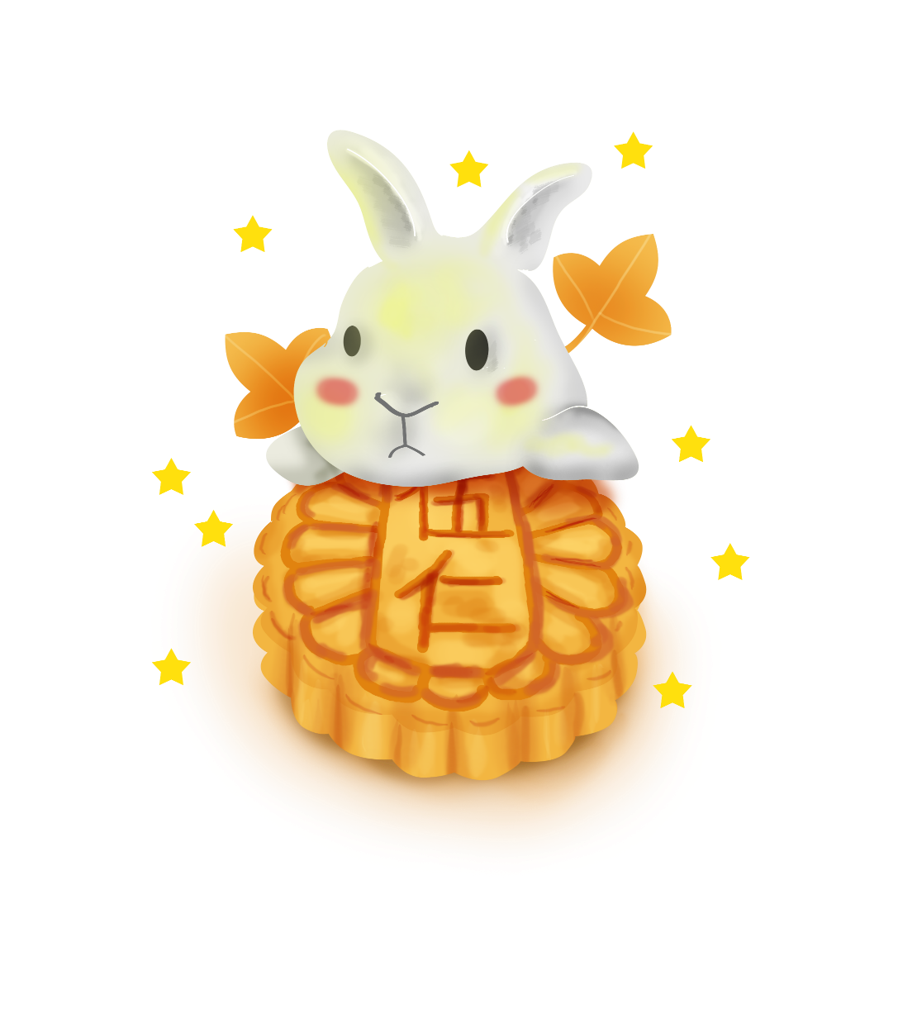
语篇填空: 阅读下面材料，在空白处填入适当的内容（1个单词）或括号内单词的正确形式。
The Mid-Autumn Festival is also called the Moon Festival or the Moon cake Festival. It has a long history 1. (date) back to the Tang Dynasty (618-907). It 2. (traditional) falls on the 15th day of the 3. (eight) month of the lunar calendar. Since ancient times, customs of the Mid-Autumn Festival 4. (include) appreciating the moon, eating moon cakes
5. drinking wine. The full moon on Mid-Autumn night symbolizes family reunion 6. Chinese culture because the moon is round and the 7. (bright) of the year on this day. With the full moon hanging above in 8. sky, people 9. are far away from their 10. (hometown) might miss families while looking at the beautiful moonlight.
dating
traditionally
eighth
have included
and
in
brightest
the
who/that
hometowns

Slide 8

1. The original of Mid-Autumn Festival.
语篇填空：阅读下面材料，在空白处填入适当的内容（1个单词）或括号内单词的正确形式。 ：
Why Mid-Autumn Festival is Celebrated and How it Started？
Mid-Autumn Festival has a history of over 3,000 years, 1. （date）back to moon worship in the Shang Dynasty (1600–1046 BC). It’s 2. an important festival that many poems were written about it, stories and legends about the festival are widespread, and its origins have been guessed at and explained by 3. ____________ (generation) of Chinese.
The term "Mid-Autumn" first appeared in the book Rites of Zhou (周礼), 4. (write) in the Warring States Period (475–221 BC). 5. the term only related to the time and season; the festival didn't exist at that point.
In the Tang Dynasty (618–907 AD), it was popular 6. (appreciate ) the moon. Many poets liked to create poems related to the moon when appreciating it. There is a legend 7. ____________ Emperor Xuanzong of the Tang Dynasty visited the Moon Palace in his dream and heard 8. _____________ wonderful song.
In the Northern Song Dynasty (960–1127 AD), the 15th day of the 8th lunar month was established
9. the "Mid-Autumn Festival". From then on, sacrificing to the moon was very popular,
and 10.______________ (become) a custom ever since.
dating
such
generations
written
But
to appreciate
that
a
as
has become

Slide 9

2. The legend of Mid-Autumn Festival.

Slide 10
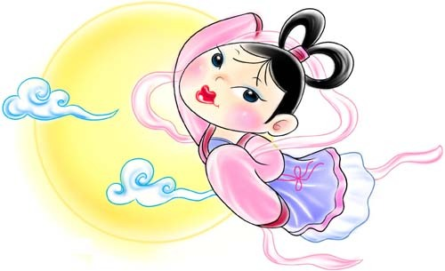
做好词汇积累，高考蓄势待发
Words :
1.scorch [skɔːtʃ] vt.把…烧焦,把…烤焦;严厉批评;vi.变焦,枯萎;烫焦; n.烧焦;焦痕
2. sharpshooter [ˈʃɑːpˌʃuːtə] n.神枪手,狙击手,射击高手
3. excess [ikˈses] n.超过;过量;超额;无节制; a.超额的; vt.不聘任;超过
4.immortal [iˈmɔːtl] a.不朽的;不死的;永世的; n.不死之人;神仙;流芳百世的人
5.reluctant [riˈlʌktənt] a.勉强的;不情愿的;厌恶的;抵抗的;
6.elixir [iˈliksə] n.炼金药液;长生不老药;万灵药;精华
7.archery [ˈɑːtʃəri] n.箭术;射箭用品;弓箭手;弓道,射手队;射箭运动员;射艺
8. disciples [diˈsaipl] n.门徒,信徒,弟子;耶稣之使徒
9. jade [dʒeid] n.玉,翡翠;硬玉;玉雕;瘦马,老马
10. continuously [kənˈtinjuəsli] adv. 连续不断地
11. corresponding [ˌkɔriˈspɔndiŋ] a.一致的;符合的;相应的;对应的;通信的

Slide 11
七选五：根据短文内容，从短文后的选项中选出能填入空白处的最佳选项。选项中有两项为多余选项。
The August Moon Festival or Mid-Autumn Festival (Chinese characters above) is one of the traditional Chinese holidays. 1. Chinese legends say that the moon is at its brightest and roundest on this day.
The Mid-autumn Festival is often called the Women's Festival. The moon (Chinese character on right) symbolizes elegance and beauty. While Westerners worship the sun (yang or male) for its power, people in the Far East admire the moon. The moon is the 'yin' or female principle and it is a trusted friend. Chinese parents often name their daughters after the moon, ____2.___
In fact, many ancient August Moon folktales are about a moon maiden. On the 15th night of the 8th lunar moon, little children on earth can see a lady on the moon.
3. At that time, the earth had ten suns circling it, each taking its turn to illuminate to the earth. But one day all ten suns appeared together, scorching the earth with their heat. The earth was saved by a strong and tyrannical archer named Hou Yi. He succeeded in shooting down nine of the suns. 4 However, his beautiful wife Chang E drank the elixir of life in order to save the people from her husband's
E
B
A
C

Slide 12
tyrannical rule. After drinking it, she found herself floating and flew all they way to the moon. Hou Yi loved his divinely beautiful wife so much, he refused to shoot down the moon.
People believed that the lady was a god who lived in the moon that made the moon shine. 5. And on this magical occasion, children who make wishes to the Lady on the Moon will find their dreams come true.
A. The story about the lady takes place around 2170 B.C.
B. in hope that they will be as lovely as the moon.
C. One day, Hou Yi stole the elixir of life from a goddess.
D. hoping that they will live on the Moon in future.
E. It is held on the 15th day of the 8th lunar month.
F. Long time ago, there was a man named Hou Yi.
G. Girls who wanted to be a beauty and have a handsome husband should worship the
moon.
G

Slide 13
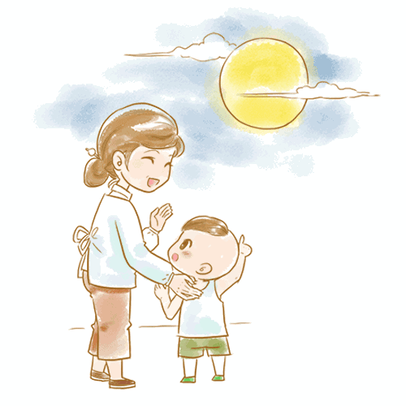
赏月
admire the full moon /
watch the full moon to celebrate the festival
3. The customs of Mid-Autumn Festival.
Admire the full moon
赏月
碧空如洗，圆月如盘。人们在尽情赏月之际，会情不自禁地想念远游在外、客居异乡的亲人。中国人历来把家人团圆、亲友团聚，共享天伦之乐看得极其珍贵，历来有“花好月圆人团聚”之谓。

Slide 14
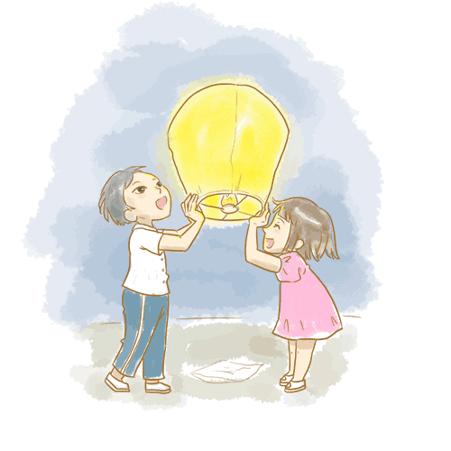
赏月
admire the full moon /
watch the full moon to celebrate the festival
3. The customs of Mid-Autumn Festival.
light lanterns
点灯笼
中秋之夜，天清如水，月明如镜，可谓良辰之美景，然而对此人们并未满足，于是便有燃灯以助月色的风俗。

Slide 15
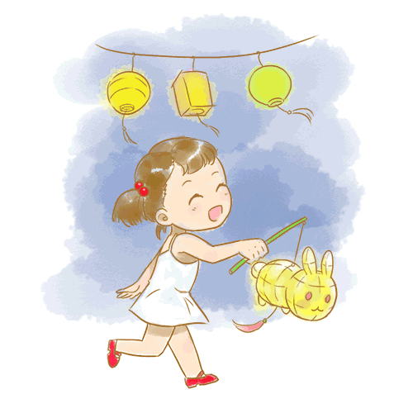
赏月
admire the full moon /
watch the full moon to celebrate the festival
3. The customs of Mid-Autumn Festival.
play with lanterns
玩花灯
中秋玩花灯主要只是在家庭、儿童之间进行的，多集中在南方。

Slide 16
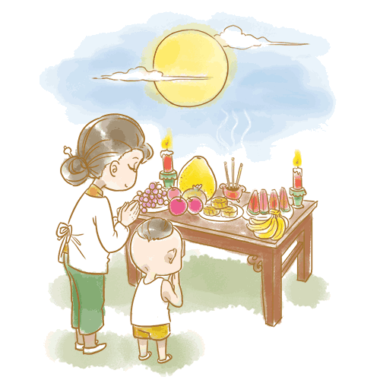
赏月
admire the full moon /
watch the full moon to celebrate the festival
3. The customs of Mid-Autumn Festival.
offering sacrifice
to the moon
祭月
中秋祭月仪式是一种古老的祭祀礼仪，表达人们祈求月神降福人间的一种美好心愿。

Slide 17
翻译下列句子
1. 中秋节的主要庆祝方式为吃月饼，吃团圆饭，赏月和点灯笼。
The main celebrations include eating mooncakes, having dinner with family, gazing at and worshipping the moon, and lighting lanterns.
2. 人们在赏月之际，会情不自禁地想念远游在外、客居异乡的亲人。
Admiring the moon, people cannot resist remembering their relatives who live far away from home .
3.祭月仪式表达人们祈求月神降福人间的一种美好心愿。
The way of sacrificing to the moon expresses a beautiful wish that the god of the moon brings felicity to the earth.
4. 中秋时节，孩子们玩花灯玩得不亦乐乎以至于忘了吃月饼。（倒装）
During the Mid-Autumn Day, so absorbed the children were in playing with lanterns that they forgot to eat mooncakes.

Slide 18
5. 大人们吃着美味的月饼，品着热腾腾的香茗，而孩子们则在一旁拉着灯尽情
玩耍。
Adults will usually indulge in fragrant mooncakes of many varieties with a good cup of piping hot Chinese tea， while the little ones run around with their brightly-lit lanterns.
6. 中秋这天，每个家庭都团聚在一起共同观赏象征丰裕、和谐和幸运的圆月
Mid-autumn Day is a time for every family to congregate and enjoy the full moon - an auspicious symbol of abundance，harmony and luck.
7. 中秋之夜，无数被点亮的灯笼，像天上的星星，点缀着整个世界。
Many lanterns lit in the Mid-Autumn night, just like the stars in the sky, decorate the whole world.
The whole world is decorated with many lanterns in the Mid- Autumn night, just like stars in the sky.

Slide 19

4. The Poems of Mid-Autumn Festival.

Slide 20
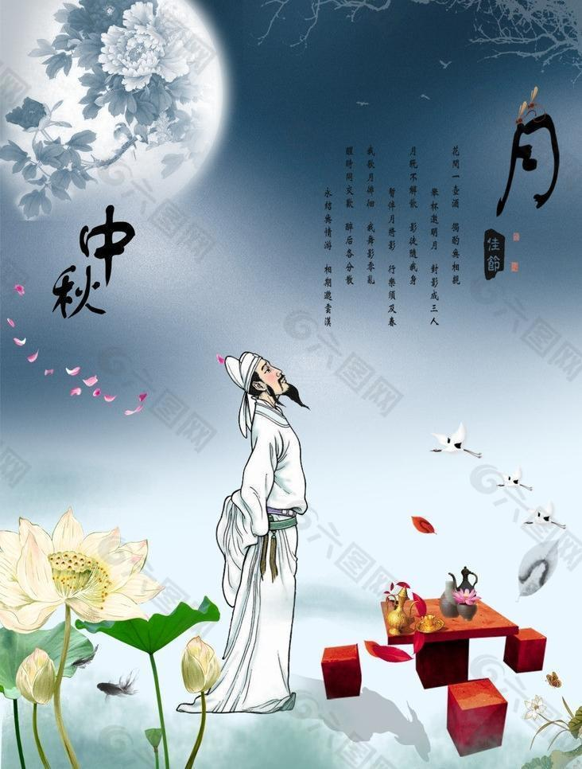
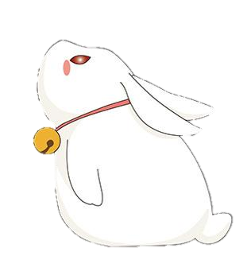
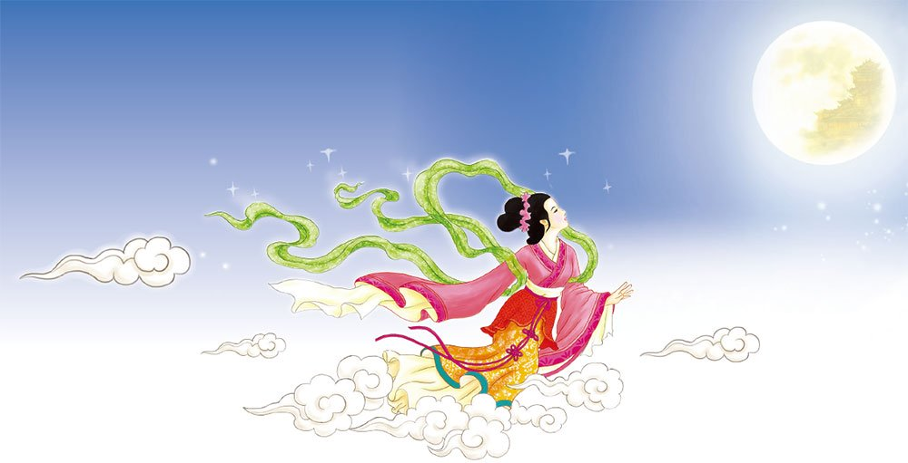
水调歌头·明月几时有
作者：苏轼
When will the moon be clear and bright?
With a cup of wine in my hand,
I ask the blue sky.
I don’t know what season it would be
in the heavens>
明月几时有
把酒问青天
不知天上宫阙
今夕是何年
I’d like to ride the wind to fly home.
Yet I fear the crystal and jade mansions
are much too high and cold for me.
Dancing with my moon-lit shadow,
It does not seem like the human world.
我欲乘风归去
又恐琼楼玉宇
高处不胜寒
起舞弄清影
何似在人间

Slide 21
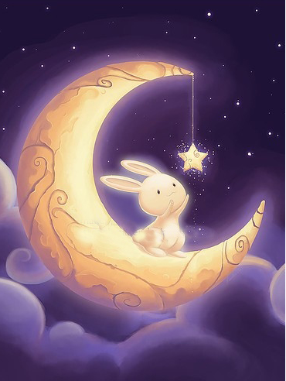
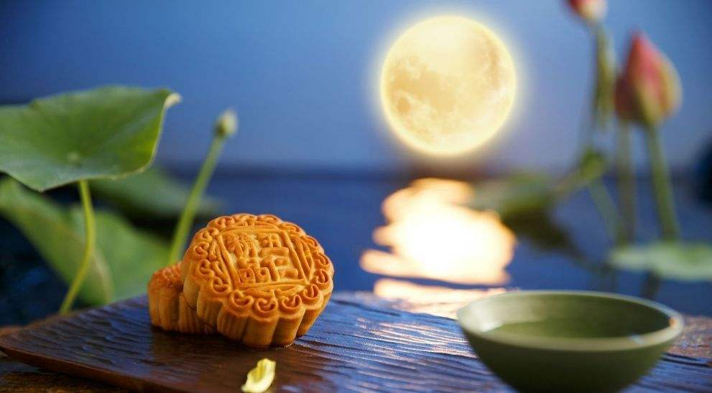
The moon rounds the red mansion
Stoops to silk-pad doors,
Shines upon the sleepless,
Bearing no grudge,
Why does the moon tend to be full
when people are apart?
转朱阁，低绮户，照无眠
不应有恨，何事长向别时圆
People may have sorrow or joy,
be near or far apart,
The moon may be dim or bright,
wax or wane,
This has been going>since the beginning of time.
人有悲欢离合
月有阴晴圆缺
此事古难全
May we all be blessed with longevity
Though far apart,
we are still able to share
the beauty of the moon together.
但愿人长久
千里共婵娟

Slide 22
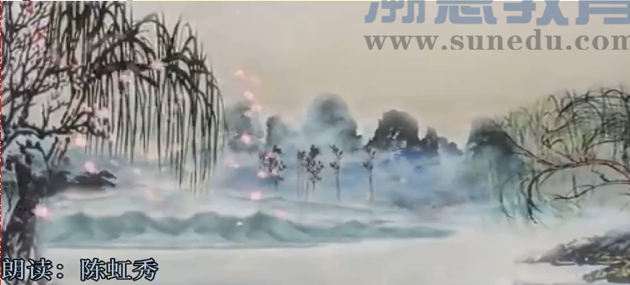
4. The Poems of Mid-Autumn Festival.

Slide 23
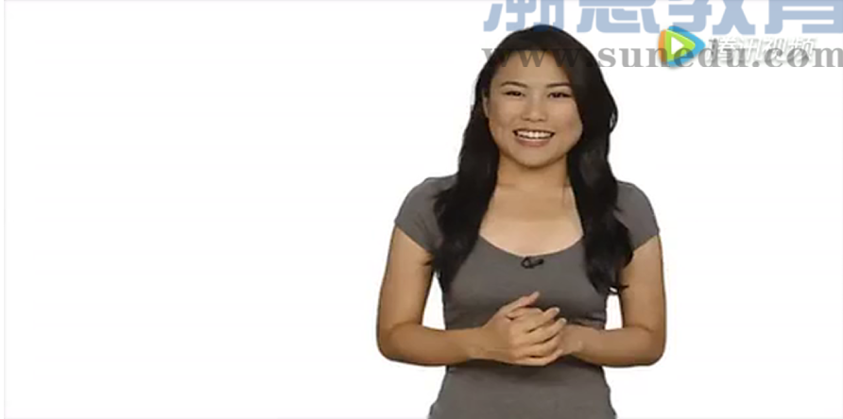
各种月饼的英文表达

Slide 24
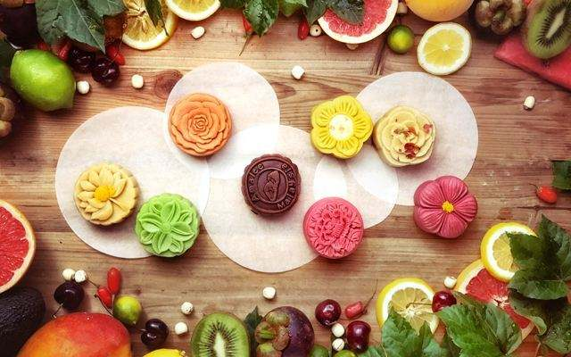
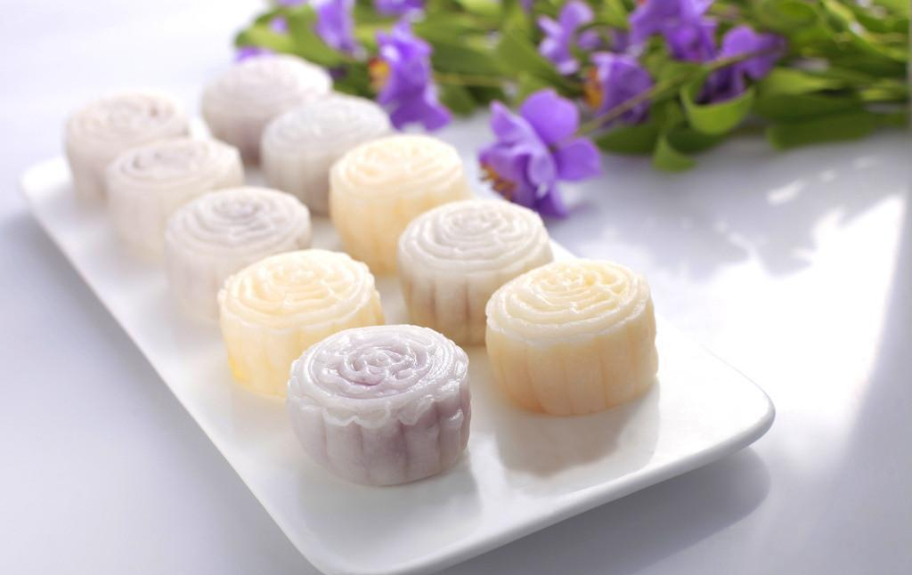
各种月饼的表达
传统月饼：(Traditional styles)
广式月饼：(Cantonese-style mooncake)
苏式月饼：(Suzhou-style mooncake)
京式月饼：(Beijing-style mooncake)
滇式月饼：(Yunnan-style mooncake)
创新月饼：(Contemporary Styles)
低糖月饼：(low-sugar mooncake)
无脂月饼：(fat-free mooncake)
冰皮月饼：(snow skin mooncake)
水果月饼：(fruits mooncake)
月饼口味
Sweet bean paste(豆沙)
Date paste(枣泥)
Mung bean (绿豆)
Black sesame paste (黑芝麻)
Lotus seed paste (莲蓉)
Durian (榴莲)
Five kernel(五仁)
“五仁”是指：
花生(peanut)，
核桃(walnut seed)，
瓜子(watermelon seed)，
杏仁(almond)，
松子(pine nut)

Slide 25
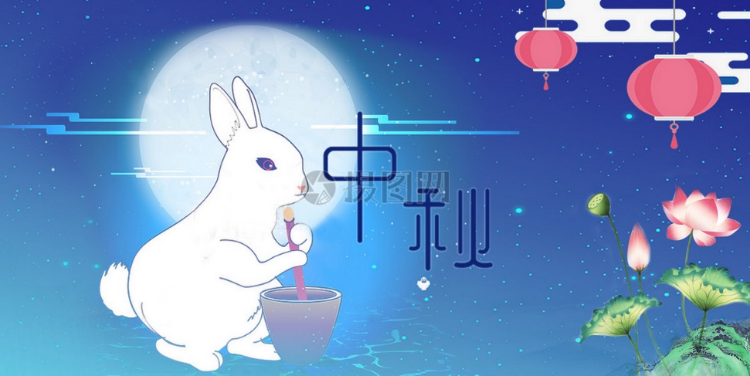
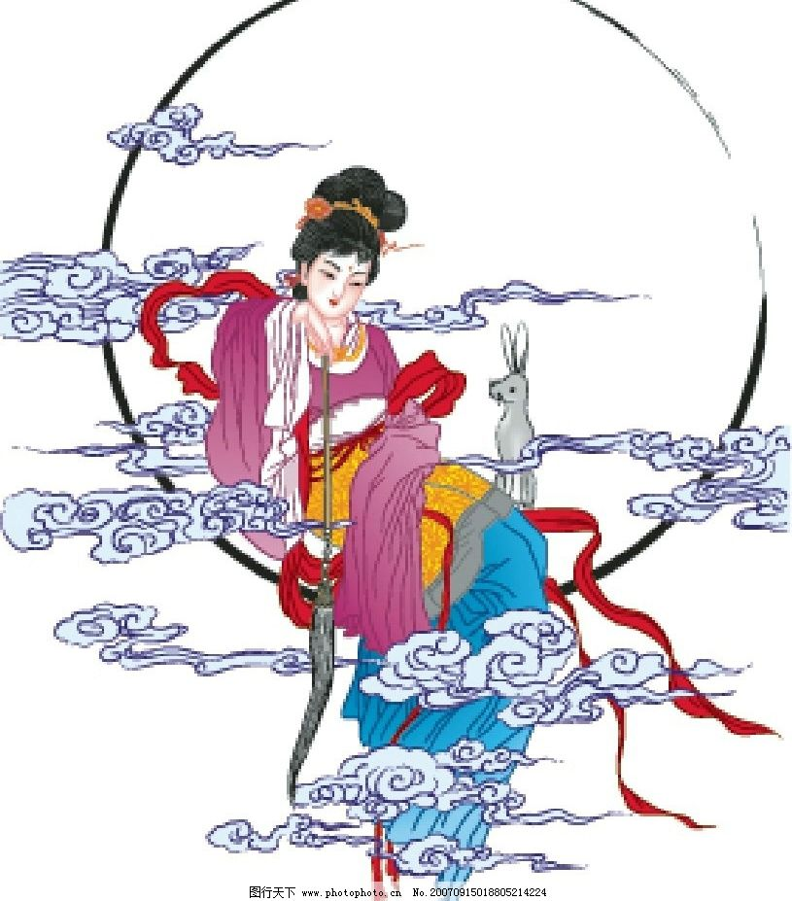
中秋常用祝福语
Happy Mid-Autumn Day! Wish that you go well and have a successful and bright future.
中秋节快乐，万事如意，心想事成!
Wish you a perfect life just like the roundest moon in Mid-Autumn Day.
愿你的生活就象这十五的月亮一样，圆圆满满。
Wishing us a long life to share the graceful moonlight, though thousands of miles apart.
但愿人长久，千里共婵娟
I want to make a toast. I Wish that the round moon take my best blessing to you. May you have a happy family and a bright future.
举杯遥祝：月圆人圆花好，事顺业顺家兴。
The Mid-Autumn Festival 中秋节
Mooncake 月饼
appreciating the moon 赏月
fire dragon dances火龙舞
Chang-E 嫦娥
jade rabbit / hare 玉兔
sky lantern孔明灯
cassia wine 桂花酒
the Chinese lunar calendar 中国农历
lantern riddles 灯谜
中秋常用词汇

Slide 26

中秋话题作文
2014 年高三书面表达
你的美国朋友Mike请你在他们校报上介绍一下中秋节的情况，请你根据下表写一篇短文。
内容：中秋节介绍
字数：80词左右。
提示：阴历： the lunar calendar 果仁：nut
时间 | 每年阴历八月十五日，是中国最重要的传统节日之一。
范围 | 中国及亚洲其它一些国家都会庆祝。
象征 | 人们认为月亮是团圆、运气、财富的象征，在那天会互相表达祝福。
方式 | 在那一天，人们通常回家与家人团聚，共聚晚餐。人们还会吃月饼，那是一种圆圆的饼，里面有肉，果仁、鸡蛋等。

Slide 27
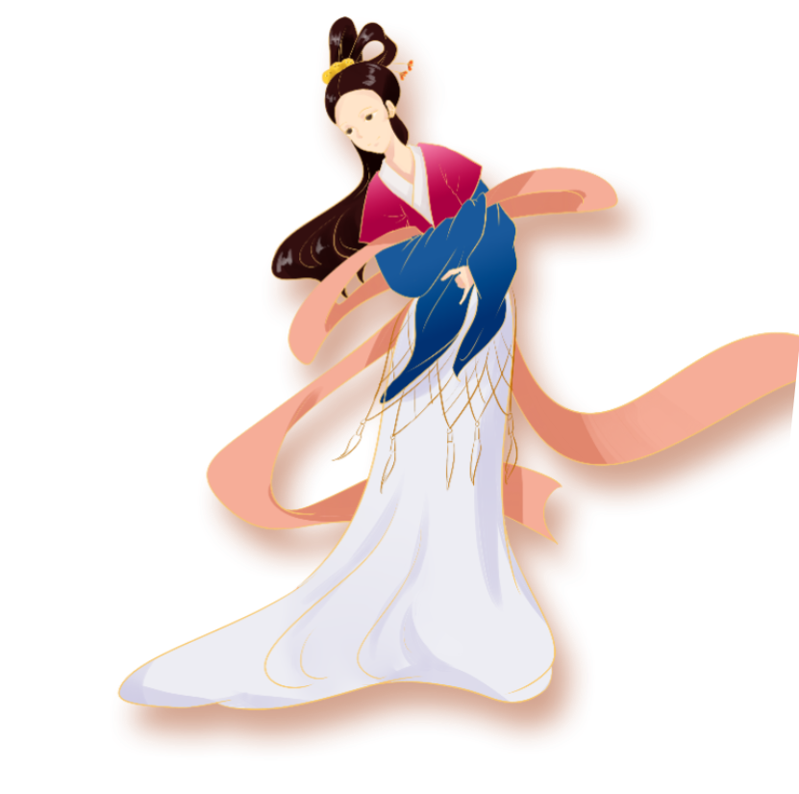
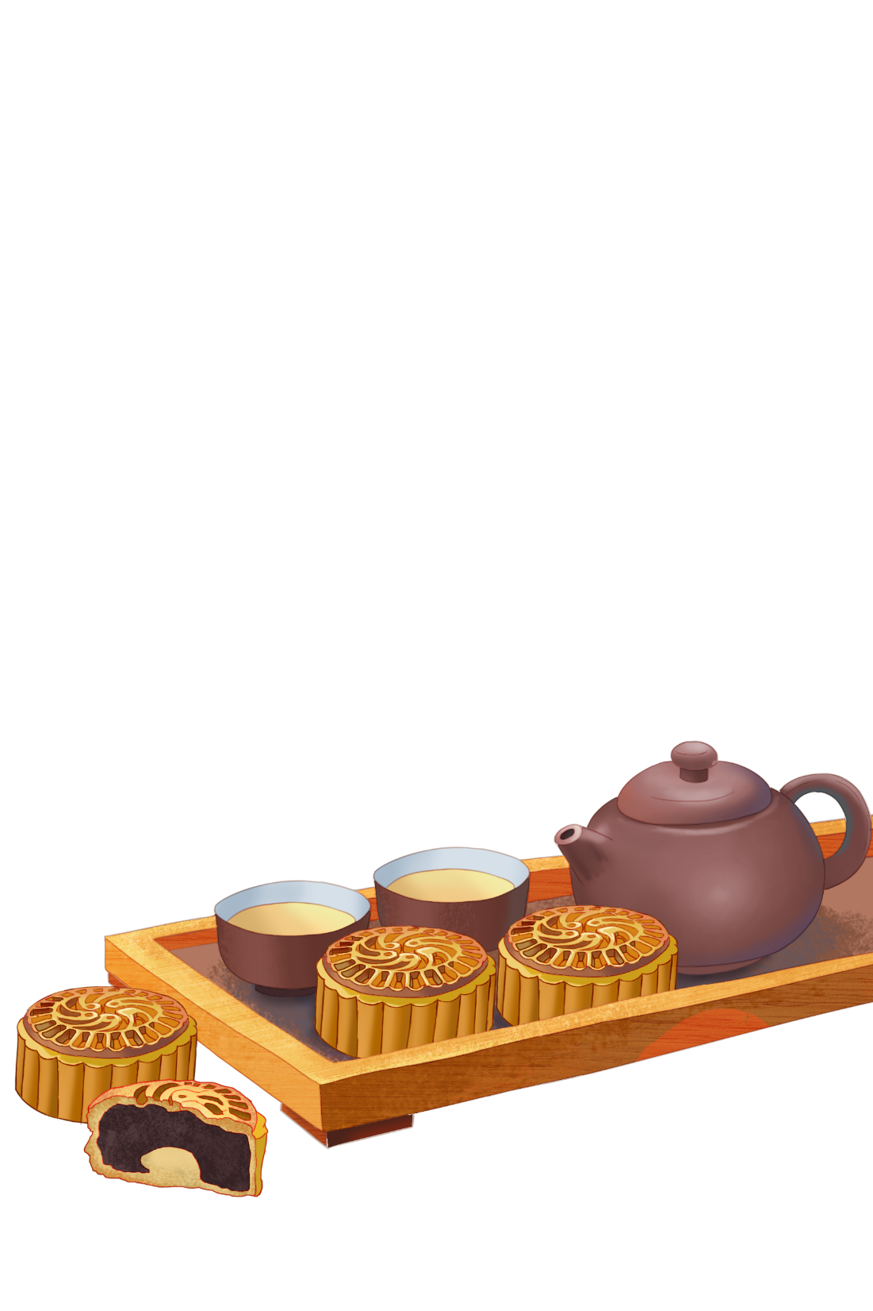
参考范文
The Mid-autumn Festival, which is one of the most important traditional festivals in China, falls on August 15th of the Lunar calendar every year. Not only is it popular in China but it is also celebrated in many other Asian countries. People believe that the moon is a symbol of reunion, luck and fortune, and it is a custom to express best wishes to the beloved ones at this particular time. On that day people usually go back home to have family reunion, enjoying a large meal with their family. They will also eat moon cakes, which are round cakes with meat, eggs, nuts and other things inside.

Slide 28
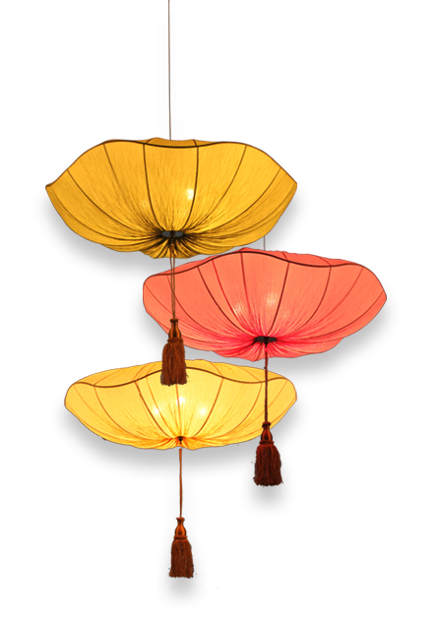
Homework
2019年(辽宁卷)题目:
—个英文网站面向中学生征稿请你写一篇英语稿件，介绍“中秋节”及这个节日里的主要活动。
写作要点:
它是中国的传统节日之一;
家人团聚;
赏月、吃月饼;
还有旅游、访友等其他活动。
注意:1.词数80左右;
2. 可以适当增加细节，以使行文连贯;
参考词汇:
中秋节 the Mid-Autumn Festival
农历 lunar calendar
赏月 enjoy the full moon
月饼 moon cake

Slide 29
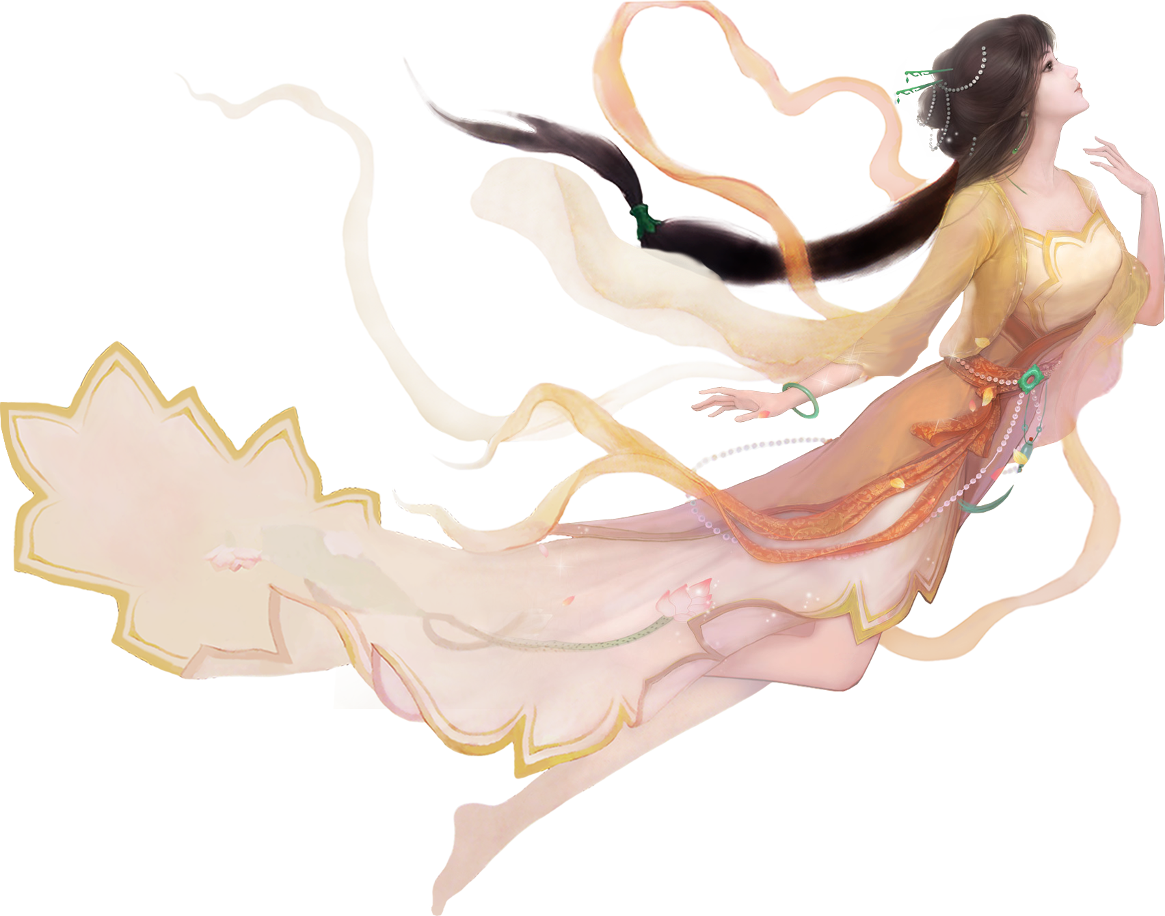
中秋是休闲“假期” 也是同学们提高学习效率的“佳期”。今日若能破茧成蝶，他日必定一飞冲天；时光不负韶华，少年高考必胜！加油！
Thank you!

Slide 30
On the Mid-Autumn Day,
may your life
always filled with happy times and
may your wishes come true. Happy Mid-Autumn Day!

