Slide 1


感恩遇见，相互成就，本课件资料仅供您个人参考、教学使用，严禁自行在网络传播，违者依知识产权法追究法律责任。
更多教学资源请关注
公众号：溯恩高中英语
知识产权声明

Slide 2
Letters of Invitations（2）
高中英语应用文写作---邀请信2
制作人：杭州二中 许丽君

Slide 3

目录 / CONTENTS
01/objectives
03/Format
05/Assessment
02/Lead in
04/ The template
06/Writing Sample

Slide 4
学习目标： Learning Goals
After learning this lesson, you will
learn about the structure and contents of letters;
apply the format to your writing properly.
write the points completely and clearly.
make your writing more coherent.
use appropriate expressions in your writing and mind your tone.
use some advanced expressions and sentence patterns to write a letter.
know what a good letter of invitation is like.
8. write an appropriate letter of invitation, especially pay attention to the tone and language.

Slide 5
Lead in
When do you need to write letters of invitations?
Invite to attend outdoor activities
Invite to join in the parties
Invite to take part in the recreations
Invite to take part in charity activities

Slide 6
Write Letters of Invitations to
class reunions/family reunions
weddings/receptions/performances

Slide 7
邀请信：是邀请好友亲朋或知名人士、专家等参加某项活动时所发的书信。在国际交往及日常的各种社交活动中， 这类书信使用广泛。信文语言简短准确，语气诚恳热情。
Format
What should be included in a letter of invitation?
Dear ______,
Beginning --- Briefly explain the activities and invite them to attend (Introduction and purpose)
Why are you writing the letter?
Body--- Introduce the specific contents of the activity;
--- state the reason for the invitee, including the specific time, place and contents of the activity. Why do you invite your friends and your relatives?
Ending --- About your wishes for response and being accepted with your gratitude.
Yours faithfully

Slide 8
Writing preparations
Part 1: Purpose of writing the letter
（1）【篇首句】介绍自己(收信人非熟人)，说明写作意图，简要说明活动，并邀请对方。
1. Knowing that you are quite fluent in Chinese, I am writing to invite you to participate in the Chinese Speech Contest to be held in our school next Saturday/ on Oct. 6th.
知道你汉语流利，写信来诚邀你参加下周六/10月6号我校主办的普通话演讲比赛。
2. Learning that you have a keen interest in …, I’m writing to extend my invitation to you to…
知道你对……非常有兴趣，写信来诚邀你…….。

Slide 9
Writing preparations
Part 1: Purpose of writing the letter
3. On behalf of the Student Union, I am greatly honored to invite you to be a judge of the English Speech Contest to be held in our school next Friday.
我很荣幸代表学生会邀请你在下周五我校举行的英语演讲比赛中做裁判。
4. It's a pity that you have to go back to America soon. Now I’m writing to invite you to a farewell party to be held for you in the Sun Club this Saturday.
很遗憾你不久要回美国。我写信邀请你参加，这周六，在阳光俱乐部我们会为你举行的一个欢送会。

Slide 10
Writing preparations
Part 2: Body Arrangements
【篇中句】篇中介绍活动具体内容，包括受邀请的人，邀请朋友干什么、地点及具体的时间等；
1. It is my pleasure/honor to invite you to... (Formal)
我非常荣幸邀请你...
2. On the theme of “My First Impression of China”, the contest is scheduled to take place at 6:00 pm (on January 17^{th)} in the school lecture hall.
演讲比赛以我对中国的第一印象为主题，将于(1月17日)晚上6点在学校报告厅举行。
3. It will begin at 2 p.m. and last about two hours, during which time 15 well-prepared competitors will deliver/make their speeches.
将于下午两点钟开始，持续大约2小时，在此期间将会有十五位准备充分的参赛者发表演讲。

Slide 11
Writing preparations
Part 2: Body Arrangements
【篇中句】篇中介绍活动具体内容，包括受邀请的人，邀请朋友干什么、地点及具体的时间等；
4. As is scheduled, the celebration will begin at 4 p.m. in Room 201 next Saturday.
根据安排, 庆祝活动将于下周六下午4点在201房间举行。
5. Scheduled from 2 to 4 p.m. next Saturday in Room 201, the celebration will be a big feast of the Chinese culture.
定于下周六下午2点至4点在201房间举行的庆祝活动将是一场中国文化的盛宴。
6. We’ll have a big feast together, chatting happily.
我们会一起吃大餐，快乐地闲聊。

Slide 12
Writing preparations
Part 2: Body Arrangements
【篇中句】篇中介绍活动具体内容，包括受邀请的人，邀请朋友干什么、地点及具体的时间等；
7. As for the activities, …can never fail to bring laughter/make a deep impression on sb/win applause.
至于活动, ……总会带来欢笑、留下深刻印象、赢得掌声。
8. Ranging from making zongzi to watching the breathtaking dragon boat race on TV, the activities will undoubtedly help you gain a glimpse into/have a taste of the unique Chinese traditions and customs.
从包粽子到在电视上观看激动人心的龙舟比赛，这些活动无疑会帮助你了解独特的中国传统和习俗。

Slide 13
Writing preparations
Part 2: Body Arrangements
【篇中句】篇中介绍活动具体内容，包括受邀请的人，邀请朋友干什么、地点及具体的时间等；
9. Weather permitting, we'll watch the dragon boat race outside，which will surely deepen your insight into the Chinese culture.
如果天气允许，我们将在户外观看龙舟赛，这一定会加深你对中国文化的了解。
10. I’m sure it would be great fun and beneficial to your language learning.
我保证它会很有趣并对你的语言学习有益。
11. We are scheduled to gather at the school gate at 5 pm.
我们计划于…...在学校大门口集合

Slide 14
Part 3: Ending
【篇尾句】期待对方接受邀请并期待对方尽快回复。
1. Your presence / arrival /participation will surely/definitely add to our enjoyment.
你的出席、光临、参加必定会增添我们的欢乐。
2. I would appreciate it if you could accept our invitation.（较正式）
如能接受我的邀请，我将不胜感激。

Slide 15
Part 3: Ending
3. So if you are interested, please sign up for it on the school website before January 12th
如果你对此感兴趣，请在1月12日之前在学校网站上报名。
4. Your favorable reply at your earliest convenience will be highly appreciated.
盼望尽早回复。
5. Looking forward to your participation/involvement. Wish you a great success!
盼望你的参与。祝你成功！

Slide 16

01
Useful words and expressions
healthy
hungry
hooked
honor
itch
installation
joy
keen
loyal
love
motivated
marriage
news
occasion
opportunity
optimistic
participant
pleased
practical
project
promoted
pleasure
proud
postpone
passion

Slide 17
Writing help: Useful phrases
invite you to
join us/the team
kindly respond on or before
looking forward to seeing you
obliged to recall/ cancel/ postpone
on campus
On behalf of
on Sunday morning
on the morning/afternoon of Oct. 1st
on the playground
outstanding presentation
owing to the illness/death of
request the pleasure of your company
sign up for
a whello
keep an interest in
did you know
good to hear from you
have a keen interest
have you ever thought about

Slide 18
Writing help: sentences
01
1. Please confirm by June 6 that you can attend.
2. Please join us for a farewell party in honor of ... , who is leaving ... to pursue other interests.
3. Are you free after work on Friday to join a few of us for dinner?
4. Horseback riding will be available; dress accordingly.
5. I’m pleased to invite you to acquire...
6. It will be so good to see you again.

Slide 19
Writing help: sentences
02
7. Wish you a great success!
8. I urge you to consider this special invitation now.
9. Please join us in celebrating the marriage of sb.
10. The ceremony will take place at 1:30 p.m., and a reception at the house will follow.
11.Hearing/Knowing that you have a keen interest in …,
12. Hearing about sth…, I’m writing to sincerely invite you to…
13. It is my pleasure/honor(荣幸) to invite you to … (Formal)

Slide 20
邀请信写作模板2：
Dear ______, (写信对象)
Writing Purpose：
Dear ____,
Beginning --- Briefly explain the activities and invite them to attend (Introduction and purpose)
①It is our pleasure to inform you that _________ is organizing a ________________(which is) to be held _____________. The fair will be open to sb. from 10:00 am in the gym.
Body--- Introduce the specific contents of the activity;
--- state the reasons for the invitee, including the specific time, place and contents of the activity.
Why do you invite your friends and your relatives?
② With the purpose of promoting ____________, ______________ is the main focus of our ______ fair. Our school students will present _________ that day. The projects will benefit sb. and various awards will be given.
Ending ---About your wishes for response and being accepted with your gratitude.
③ Your gracious presence will be highly appreciated and looking forward to your early reply.
Respectfully yours Li Hua

Slide 21
邀请信范文3：(邀请来访的美国朋友Peterson参加晚会)
假定你是李华，你们学校学生会将为来访的美国朋友Peterson举办一个晚会，邀请他参加，请你写一封邀请信，内容包括：
宗旨：欢迎来访的美国朋友
时间
地点
活动内容
注意：1．词数80左右；
2．可适当增加细节，以使行为连贯。

Slide 22
Assessment
Purpose | Have you made the purpose clear?
Frame structure | Does the frame structure conform to the requirements?
Language | Are the sentences concise and accurate? Have you used the proper punctuation, words, sentences and paragraphs to convey yourself?
Content | Have you included all the points of view?
Are the details suitable?
Assessment
Work in groups of four. Each student read the article and others comment on your partner’s work. Then select the best one out to show in the class. When you are discussing, you can pay attention to the following hints.

Slide 23
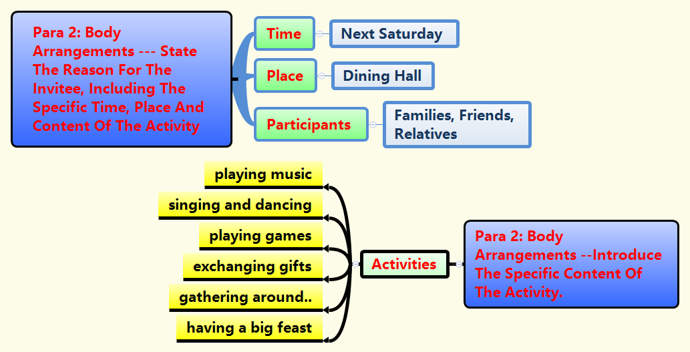

Slide 24
Writing Sample：
Dear Peterson,
I am Li Hua, on behalf of our Students’ Union, I am writing to invite you to attend a big feast together to welcome your arrival. The party scheduled at 7:00 p.m. Saturday evening, Sept 10th will be held in the Dining Hall of our school. There will be music, singing and dancing, games and exchange of gifts, gathering around the table and chatting, which will surely bring us a lot of fun.
It would be highly appreciated, if you considerably accept my invitation, reply to me at your earliest convenience.
Yours faithfully, Li Hua

Slide 25
邀请信范文4 (邀请美国朋友Chris参加中国文化展)
假定你是李华，想邀请美国朋友Chris一起参加中国文化展，请给他写封邀请函，内容包括：
展览时间
展览地点
展览内容
注意：1．词数80左右；
2．可适当增加细节，以使行为连贯。

Slide 26
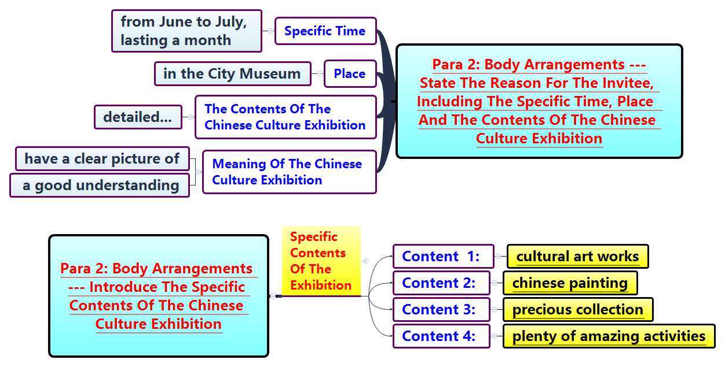

Slide 27
Writing Sample：
Dear Chris，
（提出邀请，说明展览时间、地点）How are you going recently? The Chinese Culture exhibition will be open from June to July in the City Museum lasting a month. As far as I know, you are interested in Chinese Culture, I am delighted to invite you to participate.
（展览内容）Not only will all kinds of cultural art works and precious collection created by famous artist be on show, but plenty of amazing activities will be held, from which you can have a clear picture and a good understanding of Chinese culture.
（殷切希望）Would you please pay a visit to the exhibition with me? I’d appreciate it if you could accept my invitation.
Faithfully yours, Li Hua

Slide 28
THANK YOU!

