Slide 1


感恩遇见，相互成就，本课件资料仅供您个人参考、教学使用，严禁自行在网络传播，违者依知识产权法追究法律责任。
更多教学资源请关注
公众号：溯恩高中英语
知识产权声明

Slide 2
浙南名校联盟第一次联考
英语试卷讲评
浙师大附中外语组 Lynn
2020/10/12

Slide 3
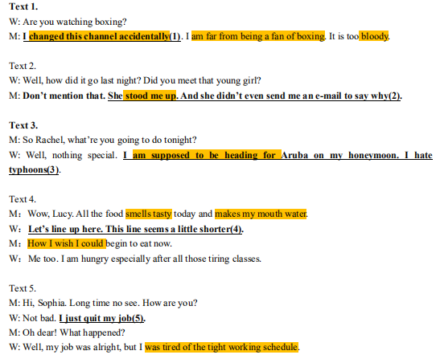
Text 1-5
听力
1. 偶然换到这个频道
远不是拳击迷
血腥的
2. 故意失约使某人
空等
3. 应该正出发前往...
4. 闻起来好吃
让我直流口水
我多么希望我能...
5. 厌倦工作时间排得
满满的

Slide 4
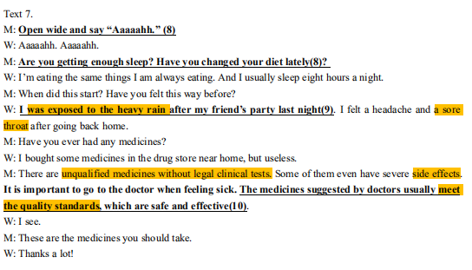
Text 7
1. 淋雨
2. 喉咙痛
3. 未经合法化学
检测的不合格药品
4. 副作用
5. 符合质量标准

Slide 5
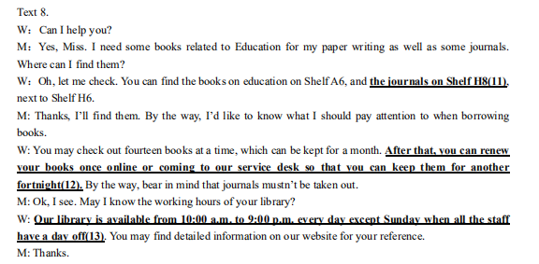
Text 8
第11、12题
The books on education can be found on ________ while the journals are on ________, which is next to ________. You can borrow _____ books at a time for _______ and ______ it for another _________.
Shelf A6
Shelf H8
Shelf H6
14
a month
renew
fortnight

Slide 6
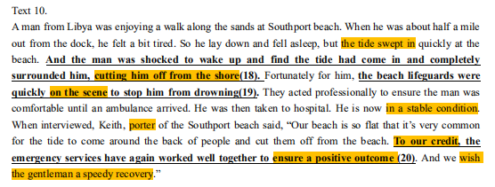
Text 10
1. 潮水涌来
2. 把他从岸上冲走
3. 在现场
4. 情况稳定
5. 护工；搬运工
6. 值得赞扬的是
7. 保证结果好
8. 祝愿这位男士
很快康复

Slide 7
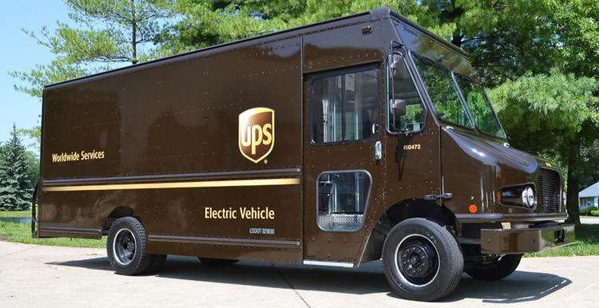
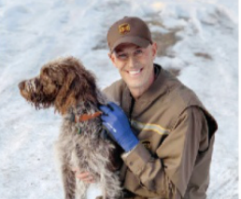
阅读A篇
Narration
: in the order of time
Para.1
Paras.2-4:
Paras.5-6:
before the rescue
during the rescue
第21题
第22题
after the rescue
UPS driver Ryan Arens rescued a dog.
第23题

Slide 8
Language Appreciation:
Ryan Arens was making his rounds near a pond when he heard an strange sound. It came from a brown-and-white hound, struggling to hold on tightly to a thin layer of ice.
Ryan Arens 在一个池塘附近送货时，听到了一个奇怪的声音。这个声音来自于一只棕白色猎犬，挣扎着紧紧抓住一层薄薄的冰面。
Language Imitation:
一队人经过一个洞穴时突然意外地听到了熟悉的声音。这个微弱的声音从洞穴深处传来，拼命叫喊着：“救命啊！”
A group of people were passing a cave when they unexpectedly heard a familiar voice. A weak voice came from the depth of the hole, yelling for help desperately.

Slide 9
Language Appreciation:
Arens ___________ the dog and used the other man's rock to ________ the ice. He lifted the stone too high and ________ the boat, ___________ 16-foot deep cold water. He _________ in time to see the dog going under. Using nervous energy to keep warm, he swam about five feet toward it. He _______________ its collar, and __________ the ice. He then _________________ the boat and ___________ the shore, where anxious bystanders ______ the dog to the home of a retired veterinarian.
Arens滑行到狗身边，用另一个人的石头砸开冰面。他用力一甩，就滑下了船，撞进了16英尺深的冰冷的水中。他重新浮出水面时，正好看见狗沉了下去。他用紧张的能量取暖，向她游了大约五英尺，抓住她的项圈，把她拉到冰上。然后他把狗抬到船上，把船滑回岸边，焦急的旁观者迅速把狗带到一名退休的兽医家中。
slid closer to
smash at
slipped off
crashing into
resurfaced
grabbed hold of
pulled it to
lifted the dog into
slid back to
rushed

Slide 10
Language Appreciation:
The next day, Arens was back working the same neighborhood when the dog's owner came over to thank him for saving it. He opened the door to his pickup, and it sprang out. It leapt on Arens and bathed him in wet kisses.＂That special delivery," says Arens,"was the highlight of my UPS career."
第二天，Arens 又回到原来的社区工作，这时狗的主人过来感谢他救了赛迪。他打开小货车的门，狗冲了过来。她跳到他身上，舔着他全身。Arens说那次特别的快递是他在UPS工作的高光时刻。
Language Imitation:
一队人正在苦苦寻找时他们突然发现了浆果的痕迹。顺着浆果痕迹，他们很快在一个洞穴深处找到了小男孩。“在那里，在那里！”爸爸冲了过去。小男孩跳到爸爸身上，紧紧拥抱着爸爸。那一刻，父子俩被温暖包围。每每回忆起，小男孩都会说：“这次经历我将永生难忘。”

Slide 11
Language Imitation:
一队人正在苦苦寻找时他们突然发现了浆果的痕迹。顺着浆果痕迹，他们很快在一个洞穴深处找到了小男孩。“在那里，在那里！”爸爸冲了过去。小男孩跳到爸爸身上，紧紧拥抱着爸爸。那一刻，父子俩被温暖包围。每每回忆起，小男孩都会说：“这次经历我将永生难忘。”
A group of people were searching desperately when they found the trace of berries. Following the berries, they soon found the little wanderer in the dark corner of a dark cave. “There! There!” the father sprang to his feet and dashed towards the boy. The little boy leapt on his father and hugged him tightly. At that very moment, they were bathed in warmth. Every time he recalls it, he says it is an unforgettable experience that will never fade from his memory.

Slide 12
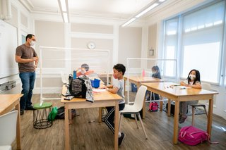

An educational report
第27题
阅读B篇
Paras.1-2: Disruptions to schooling _________________and a new
industry of“Learning Pod”____________________.
Paras.3-5: If not dealt with, educational equality will have long-run
effects on _____________.
increases inequality
第24题
deepens that inequality
第25题
第26题
poor students

Slide 13

Exposition
阅读C篇
What's the difference between “alone” and “lonely”？
Loneliness is most strongly felt with other people, for with others, even with a lover sometimes, we suffer from our differences of tastes, personalities and moods. The fear of hurting or being hurt in a social situation brings us loneliness. Alone, we can afford to be wholly whatever we are, and to feel whatever we feel absolutely. That is a great luxury.
与别人呆在一起时孤独感更为强烈，因为与他人在一起，即使是恋人，我们也会被不同的品味、性格、情绪所困扰。我们因怕在社交场合中伤害他人或被他人伤害而感到孤独。独自一人，我们便可以随心所欲，感受真正的自我。那真是有些奢侈的享受！

Slide 14
Para.1: introduce the topic
Para.2: present the difference
Paras.3-5: my personal experience of being alone and being lonely
第28题
第29题
第30题
Para.3 我已独自生活了二十年，这于我而言变得越来越有益。当早晨醒来，像往常一样看着旭日从海平面上冉冉升起，我知道后面有整整一天。在这一天里， 我可以不受打扰地写几页书，带着我的狗散步，下午长时间地躺着想一些事情，读读书，听听音乐。想到这些，我便沉浸在幸福之中。
Para.4只有在我过度劳累的时候，在我长时间不间断工作时，在我感到内心 空虚需要充实时，我才会感到寂寞。有时，外出演讲回来、见了许多人讲了许多话、心中满是纷乱的体验需要整理，偶而也会觉得孤独。此时我需要一个人静心去找回自我。
Para.5 这需要点时间，但当现实世界逐渐褪去时，自我就会再次从内心深处浮现，最近的种种经历都随之而来，待我慢慢探究领会。

Slide 15
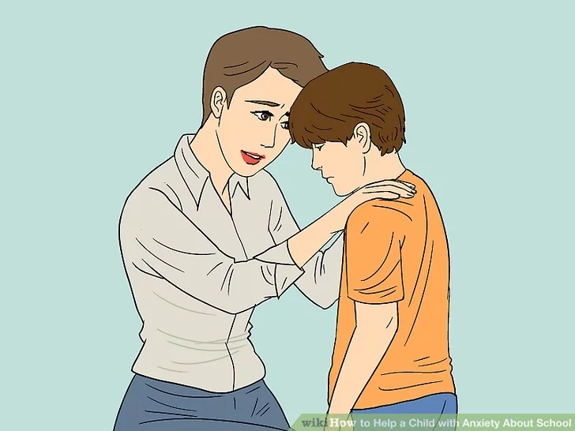
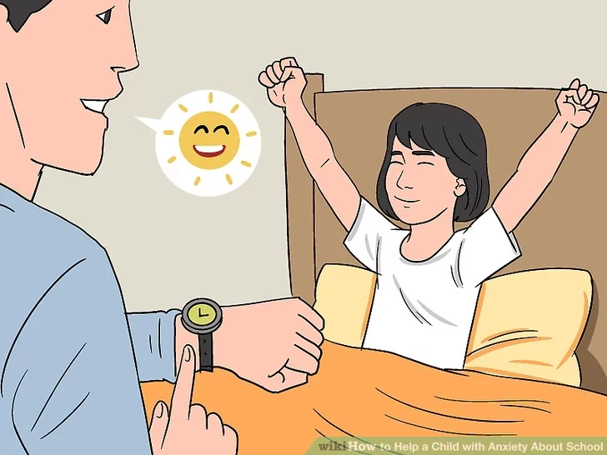
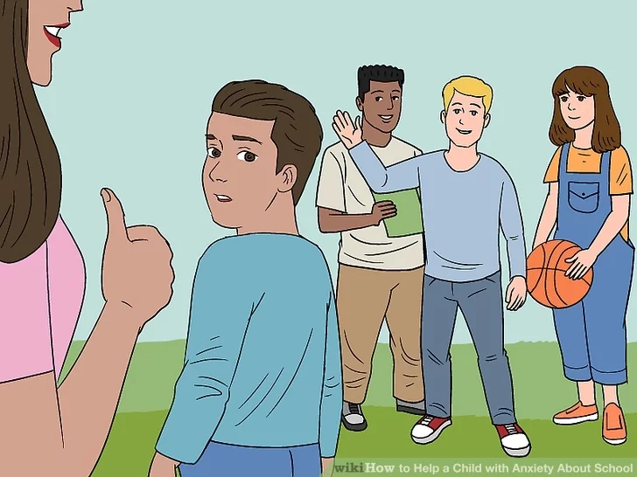
七选五
Exposition
3 tips for parents to help kids overcome anxiety over school
offer
encouragement
promote
self-confidence
identify causes

Slide 16
Para.1: 现象+后果+建议
点拨：典型的问题解决类说明文的开头
Para.2: 31本段小标题+方法1+方法2+32方法3
点拨：与后两个小标题句式一致+关键词why、reason
代词指代
Para.3: 33承上启下+错误的鼓励方法+34正确的鼓励方法
点拨：F选项有迷惑性，抓住it排除
C选项有迷惑性，抓住后文两个the same
Para.4: 有方法+35方法1+ 方法2+这些方法都有用
点拨：抓住下一句关键词a club or activity

Slide 17
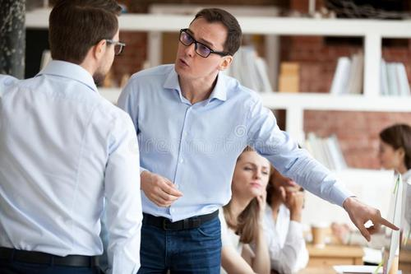
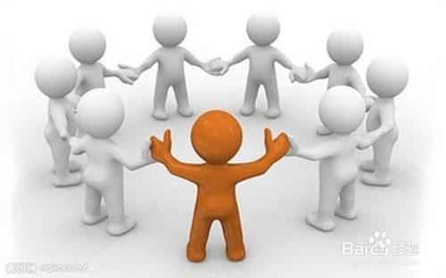
完形
1. How did I feel when another lung infection attacked me? Why? Paras.1-2
2. What did I do when my lung affection calm down? Did I make it? Para.3
3. Did I make a right decision? Why? Para.4

Slide 18
Paras.1-2: 爱八卦爱耍花招(37trick)
心怀恐惧胃也难受(40sick)
Para.3: 递交简历(44submit=hand in)
面试中取得成功(45score an interview)
结果被录用了
Para.4: 这份工作对体力要求更高(47demanding)
打卡下班(49clock out)
瞻前顾后，做事小心翼翼
亲近同事
背叛我(52turn against me)
相互关照(54look out for each other)
把某事谈透

Slide 19
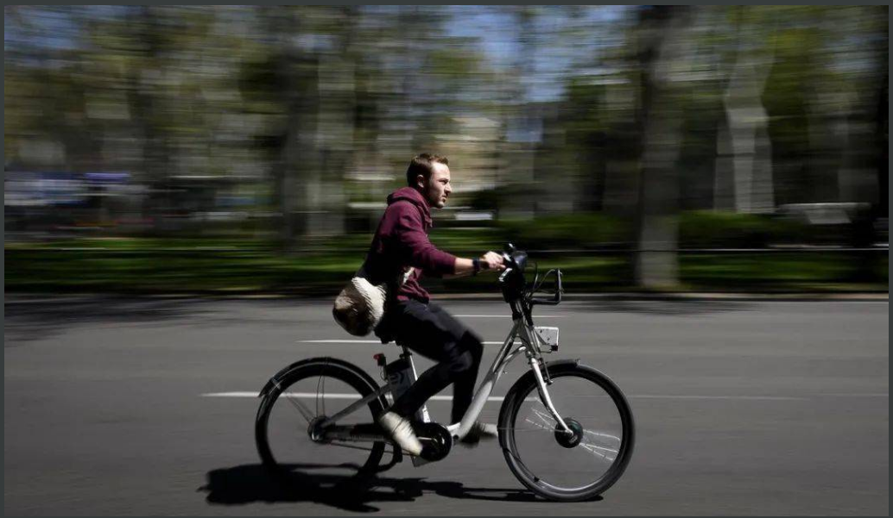
短文填空
The pandemic is giving e-bikes a boost.
新冠疫情正在推动电动自行车的发展。

Slide 20
56. is known 因...而出名 时态语态
57. images 名词复数58. turning 动词ing
59. assisted 电动自行车 过去分词
60. especially 词性转换
61. owns 时态
62. to hit 有望达到 不定式
63. which 定语从句
64. a创新高 冠词
65. to 介词
技巧点拨
1. 读懂全文
2. 留做题痕迹
3. 避免单词拼写错
误和大小写错误
4. 考点不重复

Slide 21
In a television spot for its newest model, 57_____（image) of the evils of car culture---accidents and pollution---are projected onto the skin of an expensive car, which melts, 58____（turn) into one of the company's elegant e-bikes.
In a television spot for its newest model, 57_____（image) of the evils of car culture---accidents and pollution---are projected onto the skin of an expensive car, which melts, 58____（turn) into one of the company's elegant e-bikes.
在其最新车型的电视广告中，将一些汽车文化的罪恶形象，包括交通事故、交通拥堵以及污染，被投射到一辆豪华汽车的外壳上。这辆车的影像渐渐消散，变成了一辆Vanmoof公司精美的电动自行车。

Slide 22
Electrically 59assisted bicycles are not about to replace cars. But they are booming, 60especially in Europe, where sales rose by 23%in 2019, to 3 million units. Now, e-bikes are unlocking even saturated (饱和的）bicycle markets like the Netherlands, where the average person already 61owns 1.3 pushbikes. Last year Deloitte, a company for consultation, estimated the number of e-bikes worldwide at 200 million, and expected it 62to hit 300 million by 2023.
电动自行车不会取代汽车。但是电动自行车的产业正在迅速发展，尤其是在欧洲，2019年，电动自行车的销量增长了23%，达到了300万台。电动自行车甚至正在打开像荷兰这样饱和的自行车市场，荷兰人均拥有1.3辆自行车。去年，咨询公司德勤估计，全球电动自行车的数量为2亿辆，预计2023年将达到3亿辆。

Slide 23
Electrically 59assisted bicycles are not about to replace cars. But they are booming, 60especially in Europe, where sales rose by 23%in 2019, to 3 million units. Now, e-bikes are unlocking even saturated (饱和的）bicycle markets like the Netherlands, where the average person already 61owns 1.3 pushbikes. Last year Deloitte, a company for consultation, estimated the number of e-bikes worldwide at 200 million, and expected it 62to hit 300 million by 2023.
电动自行车不会取代汽车。但是电动自行车的产业正在迅速发展，尤其是在欧洲，2019年，电动自行车的销量增长了23%，达到了300万台。电动自行车甚至正在打开像荷兰这样饱和的自行车市场，荷兰人均拥有1.3辆自行车。去年，咨询公司德勤估计，全球电动自行车的数量为2亿辆，预计2023年将达到3亿辆。

Slide 24
That may prove to be an underestimate now. Sales, 63which stopped in March and April owing to effects of the coronavirus, shifted into 64 a high position when shops opened and supply-chain became stable. In June, Accell, Europe's biggest bicycle manufacturer, earned 53% more than a year ago, largely thanks 65to e-bikes.
这一数据可能被低估了。今年3月和4月，由于新冠疫情，销量一度陷入停滞，但当门店营业、供应链稳定后，销量攀升。6月份，欧洲最大自行车制造商Accell收入比一年前增长了53%，主要得益于电动自行车。

Slide 25
Thank you!

