Slide 1

感恩遇见，相互成就，本课件资料仅供您个人参考、教学使用，严禁自行在网络传播，违者依知识产权法追究法律责任。
更多教学资源请关注
公众号：溯恩高中英语
知识产权声明

Slide 2
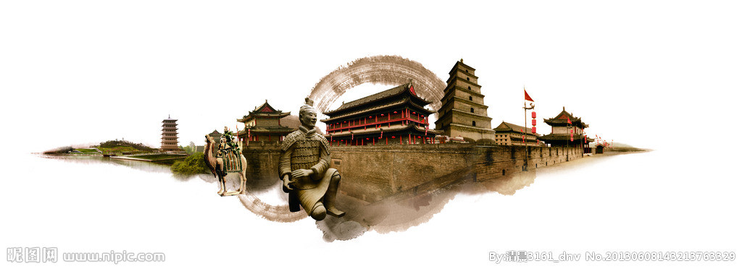
感谢您下载包图网平台上提供的PPT作品，为了您和包图网以及原创作者的利益，请勿复制、传播、销售，否则将承担法律责任！包图网将对作品进行维权，按照传播下载次数进行十倍的索取赔偿！
ibaotu.com
Reading for Writing
Read| outline| draft| assess
Travel, in the younger sort, is a part of education ; in the elder, a part of experience.
Zi Gang High School
Fay

Slide 3
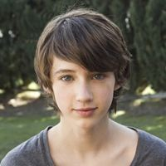

Richard
An email

Slide 4

Richard’s email to his friend
xl@youthlife.com>
Richard

Slide 5
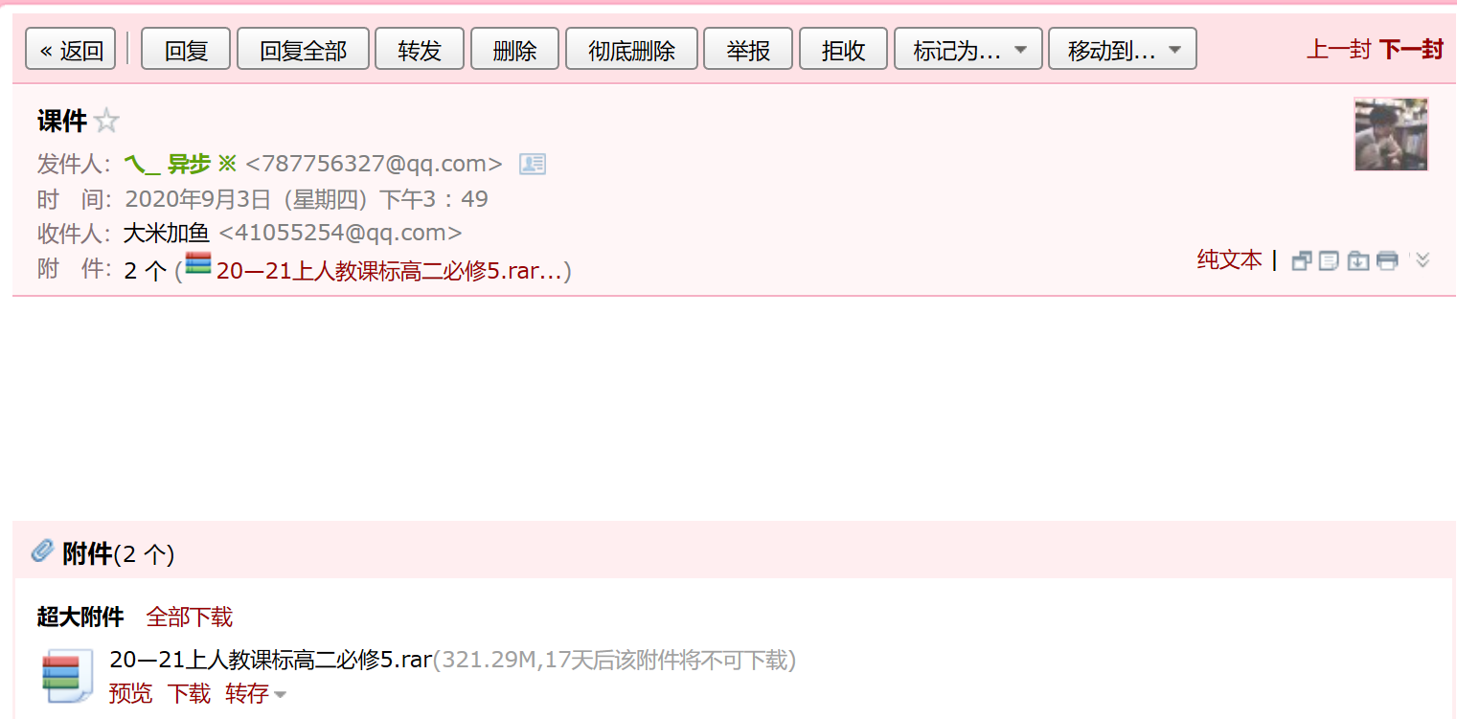
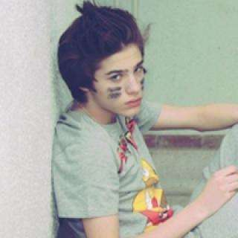


Richard<Richard@youthlife.com>
xl@youthlife.com>
1个
（a brochure about Terracotta Army）
/ˈbrəʊʃə(r)/
Brochure -a thin magazine
with pictures
a brochure about Terracotta Army(17天后该附件将不可下载)

Slide 6

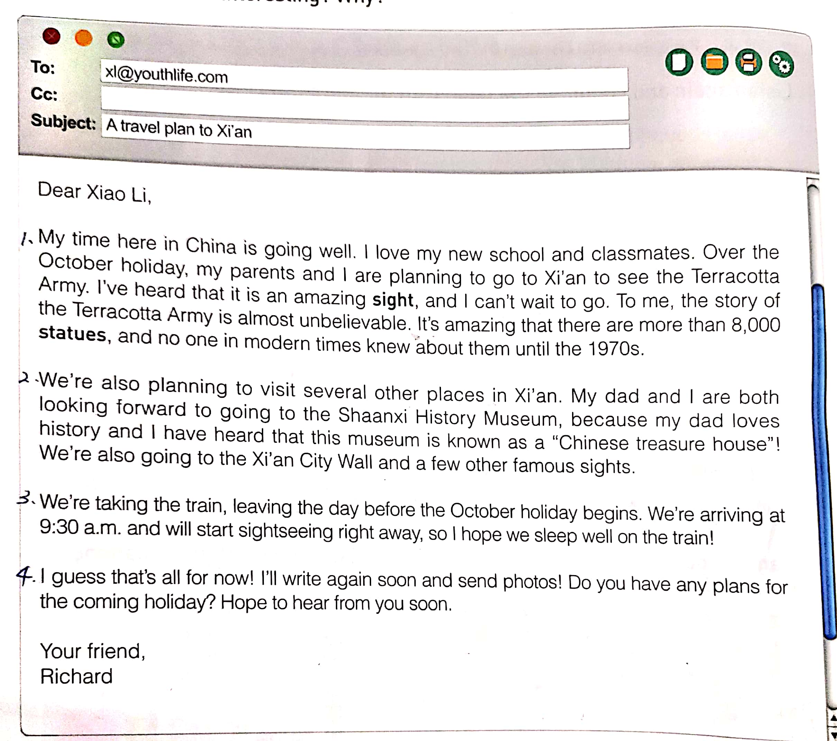

1. Style of writing?
An email of ____________
2. From whom to whom?
3. Relationship?
4. Formal or informal?
A travel plan to Xi’an
A travel plan
Richard to Xiaoli
friends
Informal

Slide 7
format of an email
●Receiver
A travel plan to Xi’an
●Subject/title
●Salutation称谓
●Main body
block form
齐头式
●signature (on the left)

Slide 8
Main purpose for the trip
A travel plan to Xi’an
transport
1
Final thoughts
2
Other plans for the trip
3
Match the main idea of each paragraph
4

Slide 9
A travel plan to Xi’an
1
Main purpose for the trip
2
Other plans for the trip
3
transport
4
Final thoughts

Slide 10
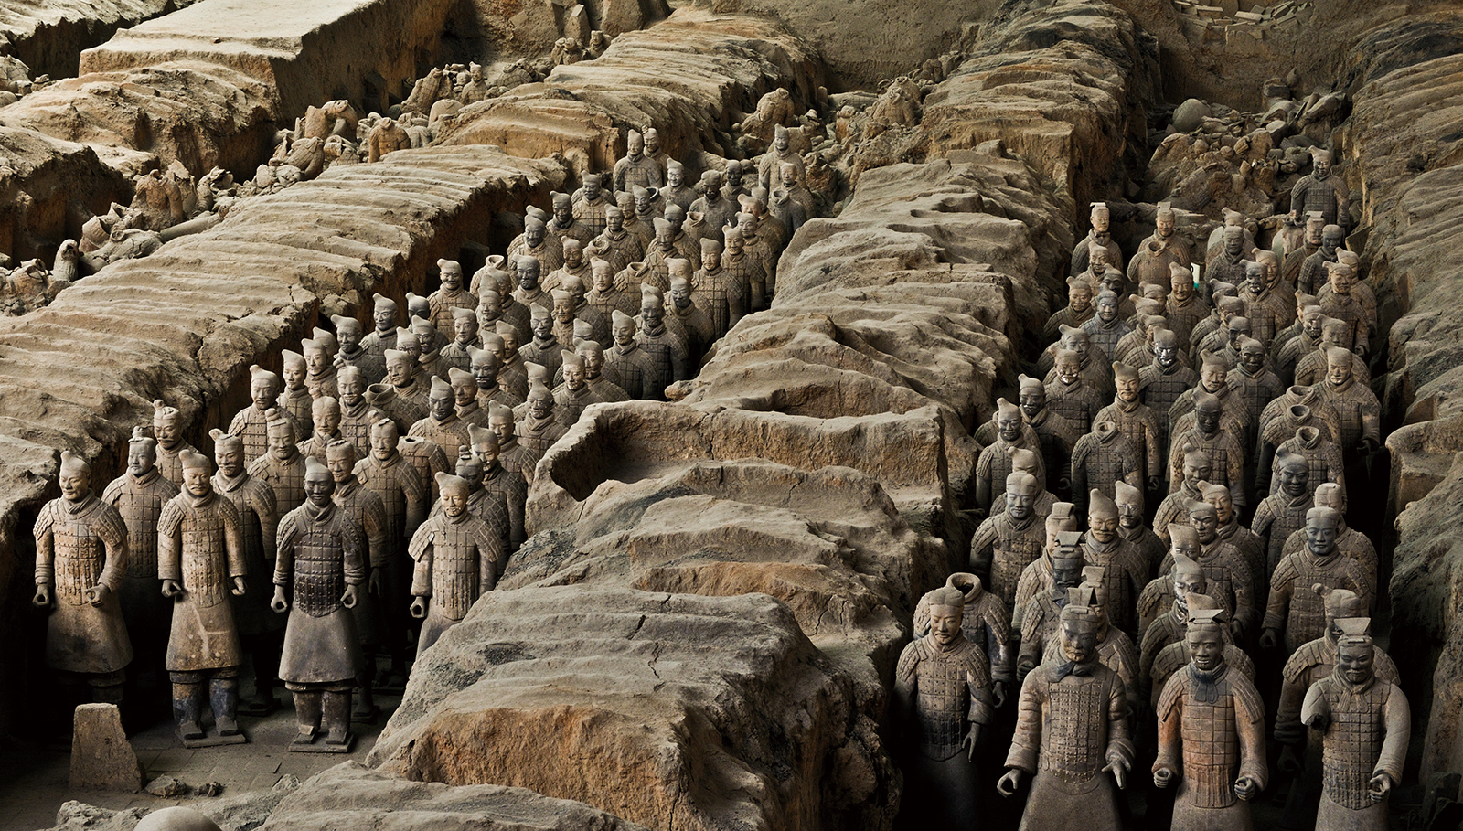
01
Main purpose for the trip

Slide 11
Organization
Main purpose for the trip
Dear Xiao Li，
My time here in China is going well. I love my new school and classmates. Over the October holiday, my parents and I are planning to go to Xi’an to see the Terracotta Army. I’ve heard that it is an amazing sight, and I can’t wait to go. To me, the story of the Terracotta Army is almost unbelievable. It’s amazing that there are more than 8,000 statues, and no one in modern times knew about them until the 1970s.
1
1
Opening greetings
2
Over the October holiday, my parents and I are planning to go to Xi’an to see the Terracotta Army.
2
State your plan clearly : Terracotta Army
I’ve heard that it is an amazing sight, and I can’t wait to go. To me, the story of the Terracotta Army is almost unbelievable. It’s amazing that there are more than 8,000 statues, and no one in modern times knew about them until the 1970s
3
/ˌterəˈkɒtə/
3
The reason for your plan: amazing

Slide 12
language
Main purpose for the trip
►Reply to an email:
I'm very glad to know everything in your new school life goes well.
Thank you for contacting me about your travel plan.
1
Opening greetings
►Write your plan right away:
Time + place +with whom
Use the present continuous tense.
2
State your plan clearly : Terracotta Army
be planning to/be going to…
►Wise choice of expressions:
I’ve heard that... and I can’t wait to go.
It is an amazing sight…
…is almost unbelievable.
3
The reason for your plan: amazing
to believe that
It is ________ (that…)
I’m ________ (at sth)
It’s hard _____________.
It’s an ___________ story.
amazing
amazed
unbelievable

Slide 13
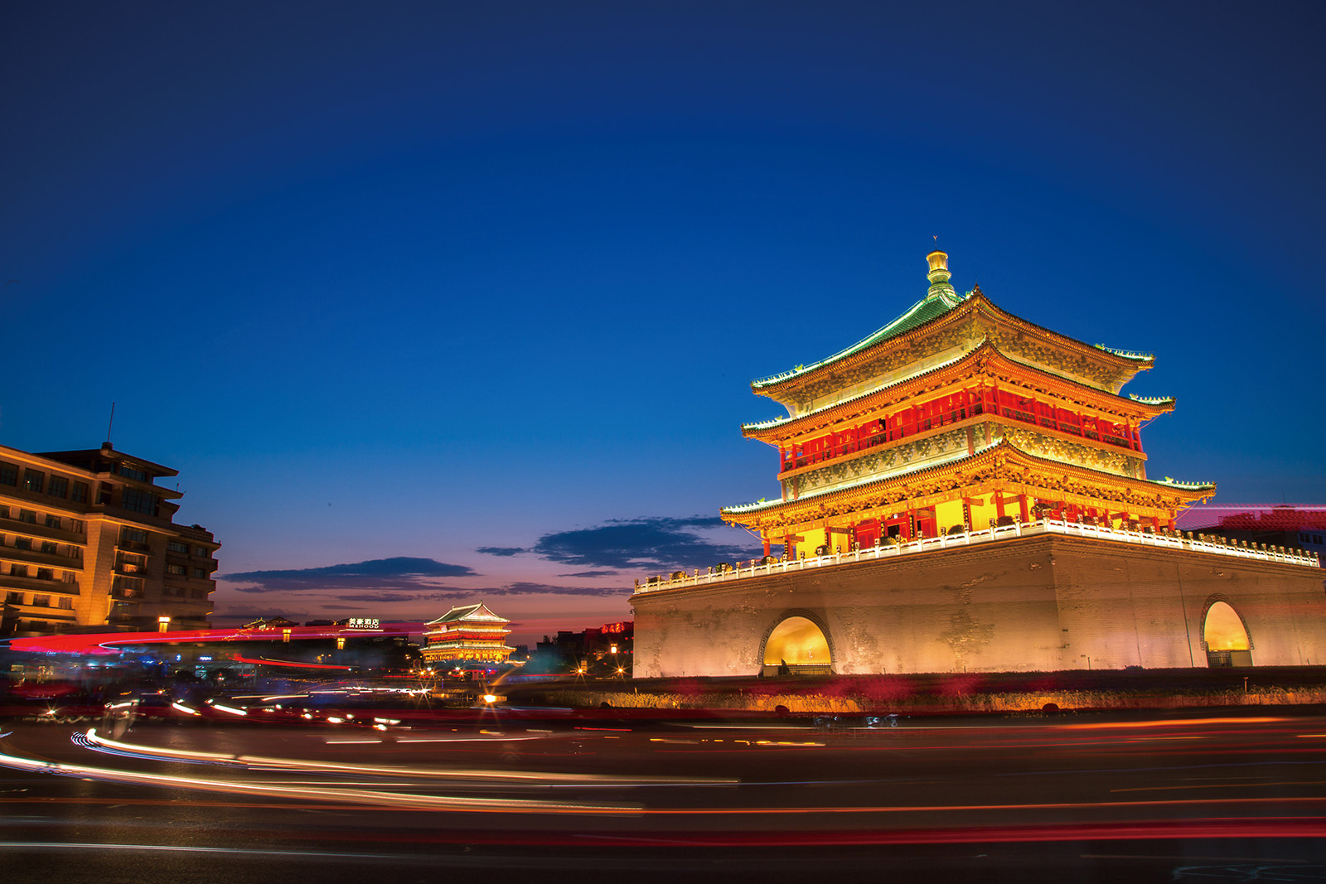
02
Other plans for the trip

Slide 14
Organization
Other plans for the trip
We’re also planning to visit several other places in Xi’an.
My dad and I are both looking forward to going to the Shanxi History Museum , because my dad loves history and I have heard that this museum is known as a “Chinese treasure house”! We’re also going to the Xi’an City Wall and a few other famous sights.
Topic sentence + detailed places
1
1
Plan 1 for Shanxi History Museum and his reason
2
2
Plan 2 for Xi'an City Wall and other famous sights

Slide 15

language
Topic sentence + detailed places
We’re also planning to visit several other places in Xi’an.
My dad and I are both looking forward to going to the Shanxi History Museum , because my dad loves history and I have heard that this museum is known as a “Chinese treasure house”! We’re also going to the Xi’an City Wall and a few other famous sights.
Write your paragraph in the order of place/time:
►the first place/day we are planning to go/visit is ….
►…….
Write your reasons for the places.
►because ; since ; as ; for;
►the reason why…. is that…

Slide 16
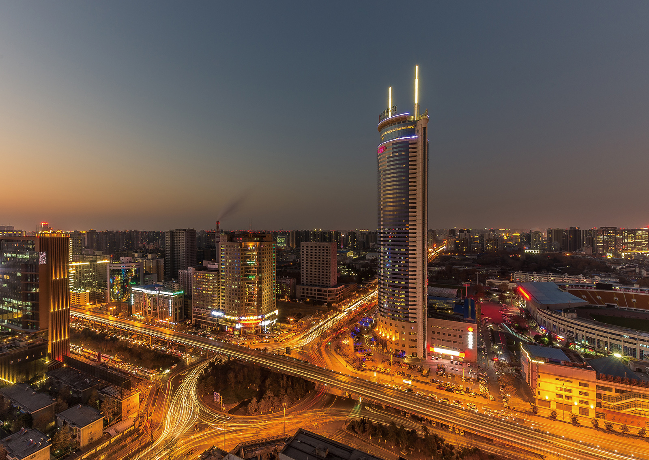
03
transport

Slide 17
transport
We’re taking the train, leaving the day before the October holiday begins. We’re arriving at 9:30 a.m. and will start sightseeing right away, so I hope we sleep well on the train!
Using the present continuous tense to tell about the train, its leaving and arriving time
Arrange your time more specific

Slide 18
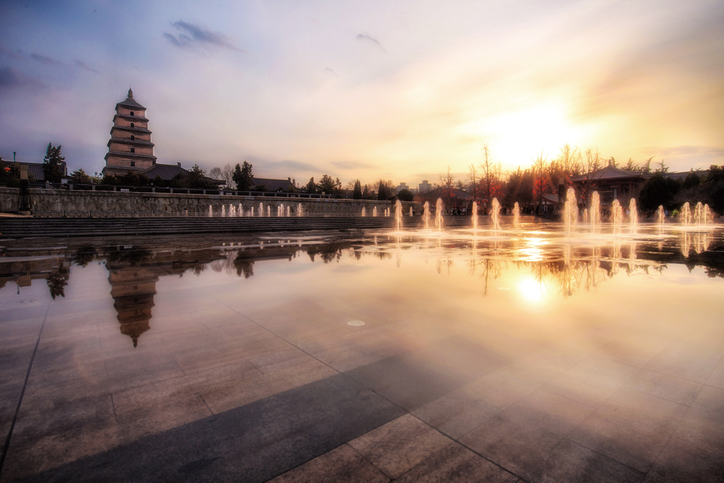
04
Final thoughts

Slide 19
Final thoughts/feelings + wishes
I guess that's all for now. I'll write again and send you photos! Do you have any plans for the coming holiday? Hope to hear from you soon.
Your friend, Xiao Li
►Your ending to reply the email:
Your wish to the receiver:
I believe/guess….
I’m looking forward to your photos.
I wish you enjoy your trip.
Wish you have a good time
……

Slide 20

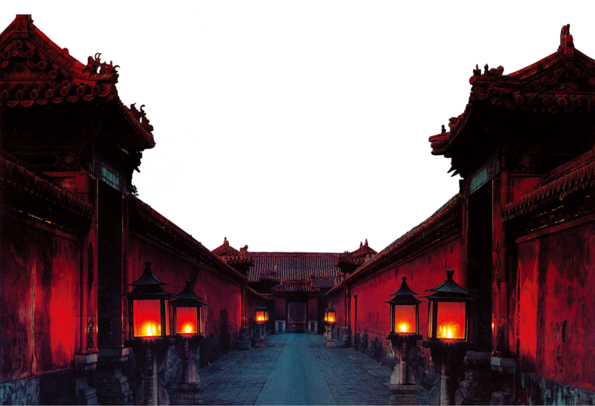
Writing
to

Slide 21
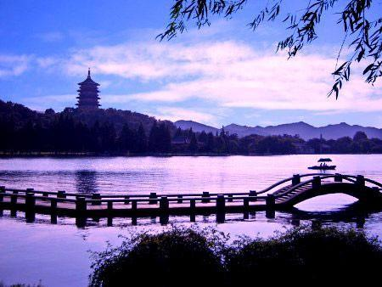
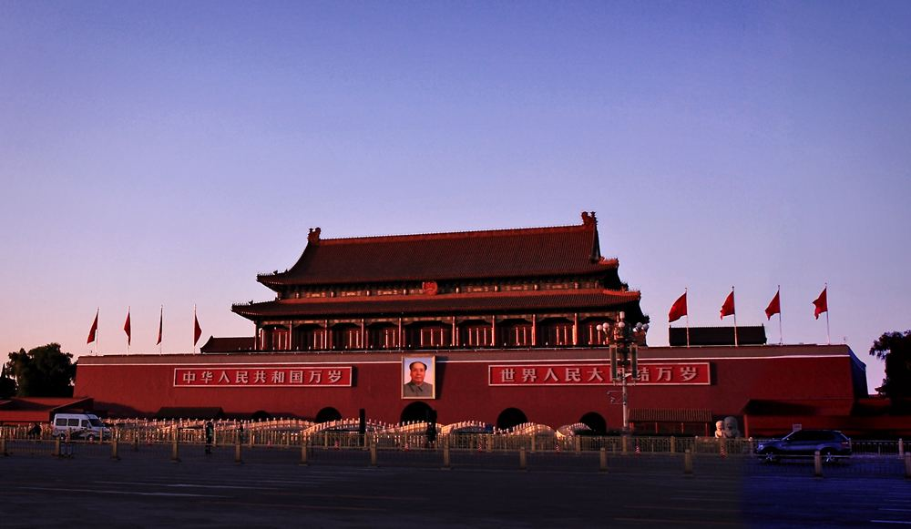
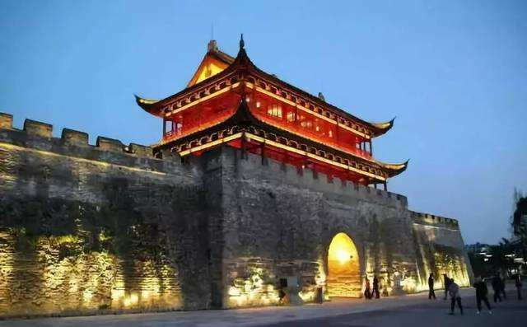
Choose one place to start your email
Bei Jing
Hang Zhou
Qu Zhou
Either reading or traveling , body and soul, there must one on the road!

Slide 22
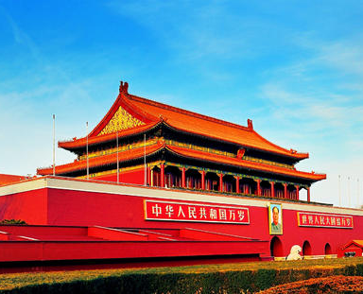

Take Beijing for example.

Slide 23
A travel plan to Bei Jing
1
Main purpose for the trip
The Great Wall
2
1.Tian an men square
2. The forbidden city
Other plans for the trip
3
By train/plane
transport
4
Final thoughts/wishes
Final thoughts

Slide 24
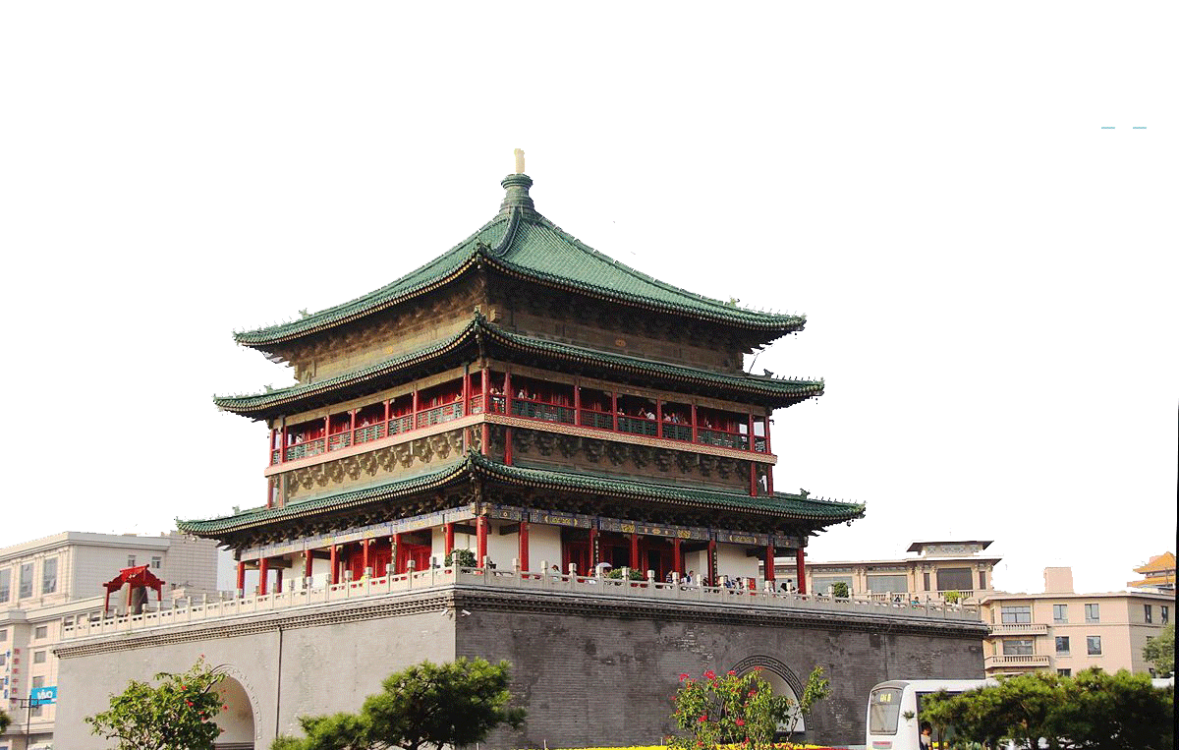
Dear Xiaoli，
My time here in China is going well. I love my new school and classmates.
Over the October holiday, my parents and I are planning to go to Xi’an to see the Terracotta Army. I’ve heard that it is an amazing sight, and I can’t wait to go. To me, the story of the Terracotta Army is almost unbelievable. It’s amazing that there are more than 8,000 statues, and no one in modern times knew about them until the 1970s.
Dear Richard，
I'm very glad to know everything in your new school life goes well.
Opening greetings
Over the October holiday, my _________ and I are planning to go to ________ to ____________
________.I’ve heard that it is an amazing sight, and I can’t wait to go. To me, the story of _______________ is almost unbelievable. ________________________________________________________________________________________________________________________
family
State the plan clearly :
Bei Jing/ the Great Wall
Bei Jing
climb the
Great Wall
construction of
the Great Wall
The reasons
As we all know, Bei Jing is one of four ancient capitals in China and the Great Wall is one of seven wonders in the world.

Slide 25
We are planning to visit the Great Wall first which is one of the Seven Wonders of the World. It's often said that he who has never been to the Great Wall is not a true man. I'm looking forward o visiting it for a long time.
We are also planning to visit the Palace Museum. It is the largest existing palace building in the world. Another place we are visiting is the National Stadium (Bird's Nest), where the opening and closing ceremonies of the Olympic and Paralympic Games were held.
We are going there by plane, leaving on the morning of the first day and arriving in about 4 hours. Upon arriving we are planning to taste roast duck. After unpacking our luggage in the hotel, we will visit Wangfujing, a very famous shopping mall.
I guess that's all for now. I'll write again and sent you photos. Try to share your travel details as much as possible and wish you enjoy your trip.
Your friend, Xiao Li

Slide 26

Is it a well-written email?
Checklist 1
A specific purpose?
A fixed layout(格式)?
Appropriate language?
√
√
√
clear 清晰，correct 正确，concise 简明

Slide 27
Checklist2
Neat handwriting?
Does each paragraph have a clear main idea?
Does the writer use the present continuous tense for future plans?
Are all the words spelt correctly?
Are all the proper nouns capitalized?

Slide 28
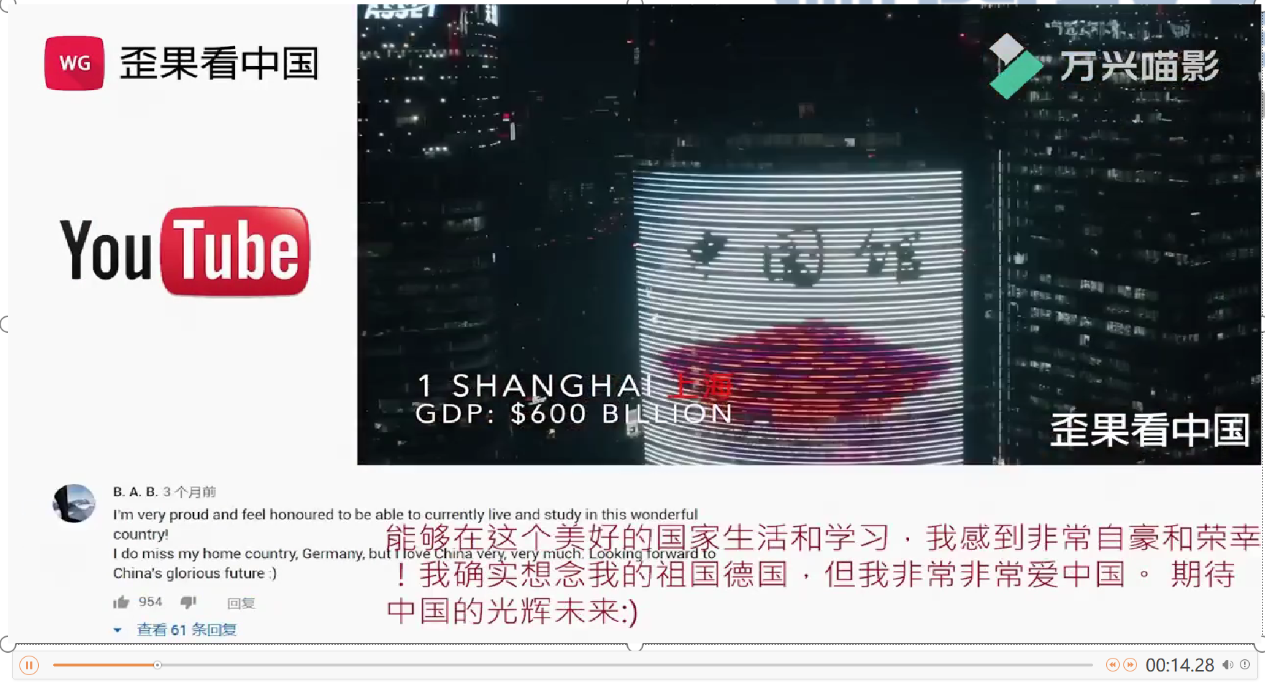

Slide 29


homework
♣Finish your email and check the work according to the checklists

Slide 30
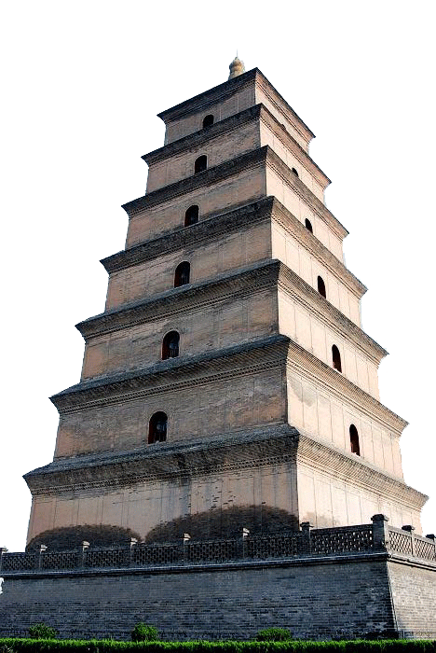
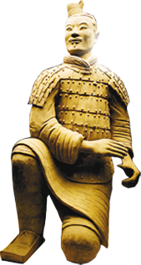
Thank you!

