Slide 1


感恩遇见，相互成就，本课件资料仅供您个人参考、教学使用，严禁自行在网络传播，违者依知识产权法追究法律责任。
更多教学资源请关注
公众号：溯恩高中英语
知识产权声明

Slide 2

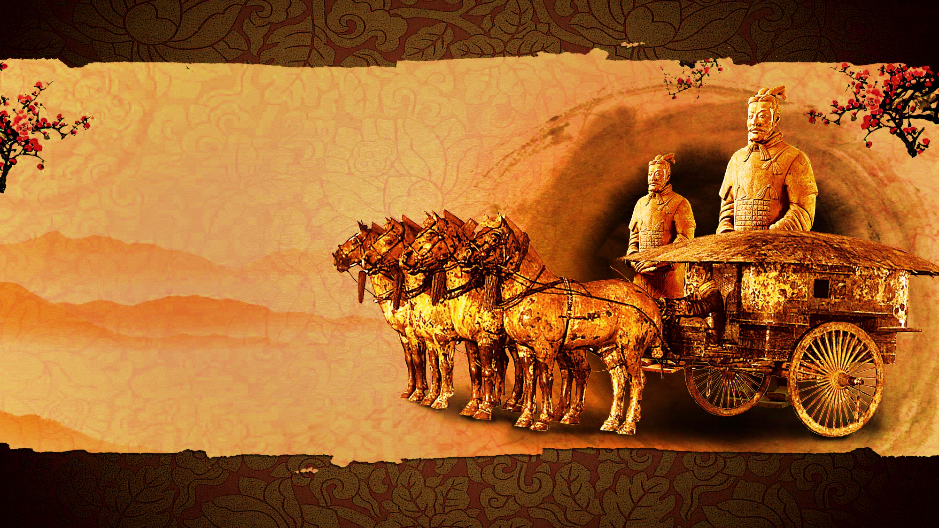
Qin Terra Cotta Army
[‘te rə ‘kɒ tə]
秦兵马俑
秦兵马俑
Come and see the Terracotta Army

Slide 3
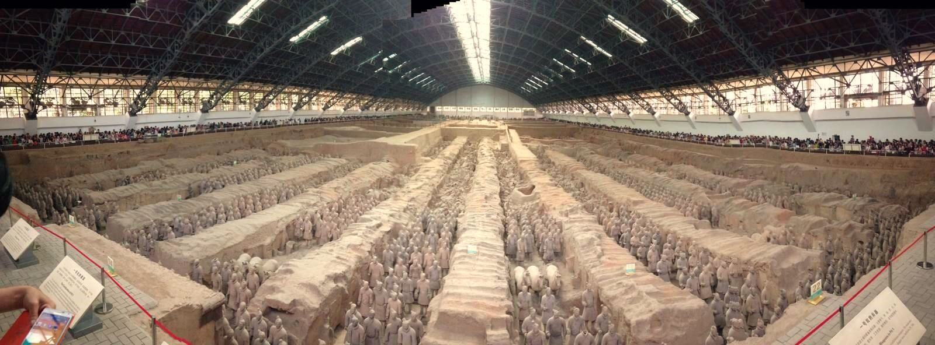
一号坑秦兵马俑
tomb /tuːm/ 坟墓
More than 8,000 statues were made in the third century BCE to guard/protect the tomb of the Chinese Emperor Qinshihuang!
Pit no. 1 qin terra-cotta warriors

Slide 4
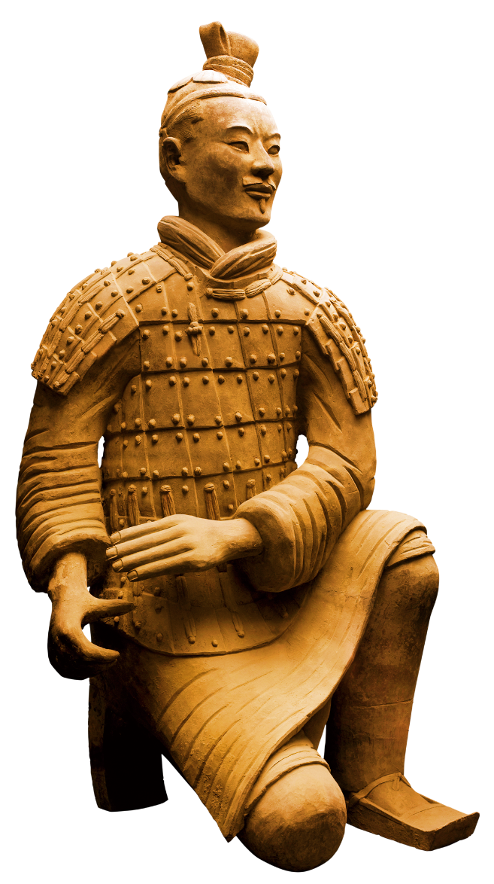
铠甲士兵
Each statue has a different face ,
leading researchers to believe that each one is a copy of a real soldier.
铠甲武士俑，披甲站立，或免冠，或头戴软帽，腿扎行滕，脑后绾六股宽辩行扁髻，个个神情严肃恭谨。
ARMOR SOLDIERS
A statue
is a large sculpture雕塑 of a person or an animal, made of stone or metal.

Slide 5
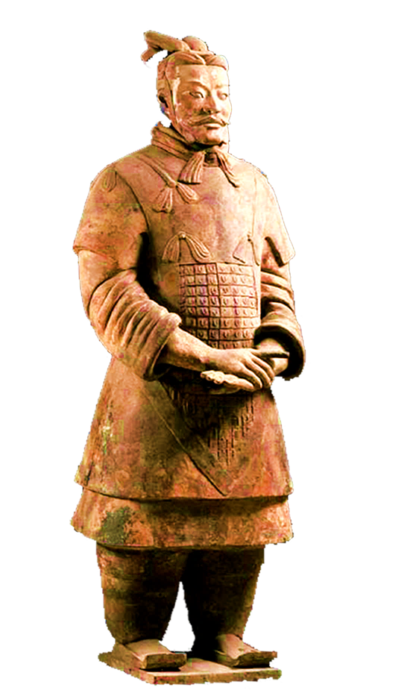
将军俑
The statues fill only one
part of the emperor’s
huge tomb, which still
has not been completely
unearthed.
GENERAL FIGURINES
Be unearthed: be found

Slide 6
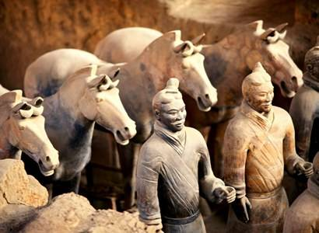
骑兵
鞍马俑
More than 700,000 people worked for nearly 40 years to build this tomb.
Warriors on horseback

Slide 7

战袍武士俑
Terracotta Warriors In Robes
However, no one in modern times knew about the tomb or the terracotta statues until 1974, when some farmers discovered the tomb while they were digging a well.
dig : make a hole in the ground

Slide 8
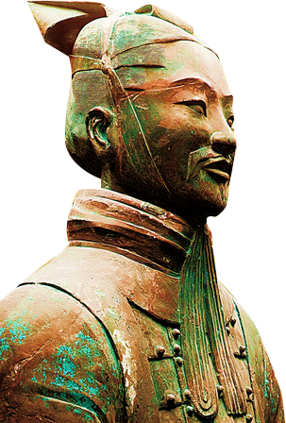
世界各界对兵马俑的赞美
1、新加坡总理李光耀赞美：“世界的奇迹、民族的骄傲；
2、法国总统希拉克说：“秦俑的发现，可以说是世界第八奇迹”；
3、美国总统里根赞扬：“兵马俑制造工艺真好”；
4、英国女王伊丽莎白二世更喜爱秦俑的服饰；
5、印度总理拉吉夫·甘地说：“我完全被感动了”；
6、泰国公主诗琳通认为秦陵兵马俑的“学问很深”；
7、第一个向西方读者详细介紹兵马俑的美国記者托平女士說：“如此伟大的考古发现展示了历经战斗与荣耀的中国历史。……也许就在那巨大的坟墓下面埋藏着帝国最大的秘密以及中国历史上空前绝后的最为瑰丽辉煌的宝藏”。

