Slide 1


感恩遇见，相互成就，本课件资料仅供您个人参考、教学使用，严禁自行在网络传播，违者依知识产权法追究法律责任。
更多教学资源请关注
公众号：溯恩高中英语
知识产权声明

Slide 2
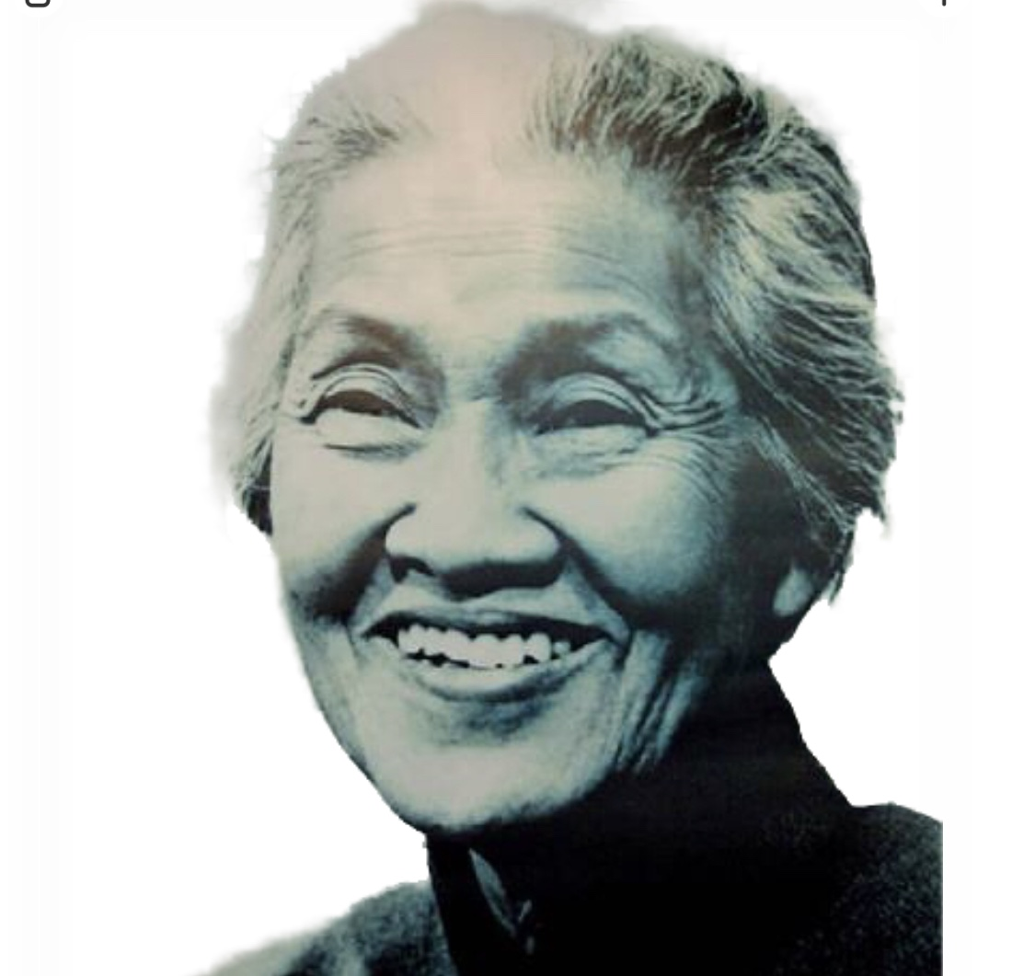
UNIT 2 MORALS AND VIRTUES
Reading and Thinking
桐乡市高级中学 沈凯瑜

Slide 3

What important choices have you ever made in your life?

Slide 4
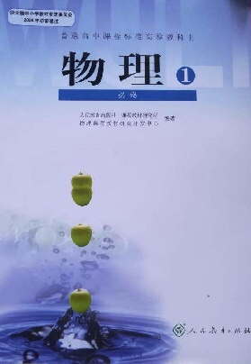





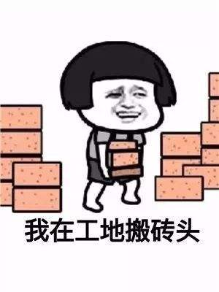
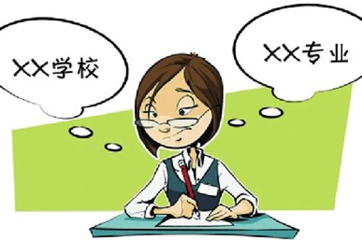

How we can make a better choice without regret?

Slide 5
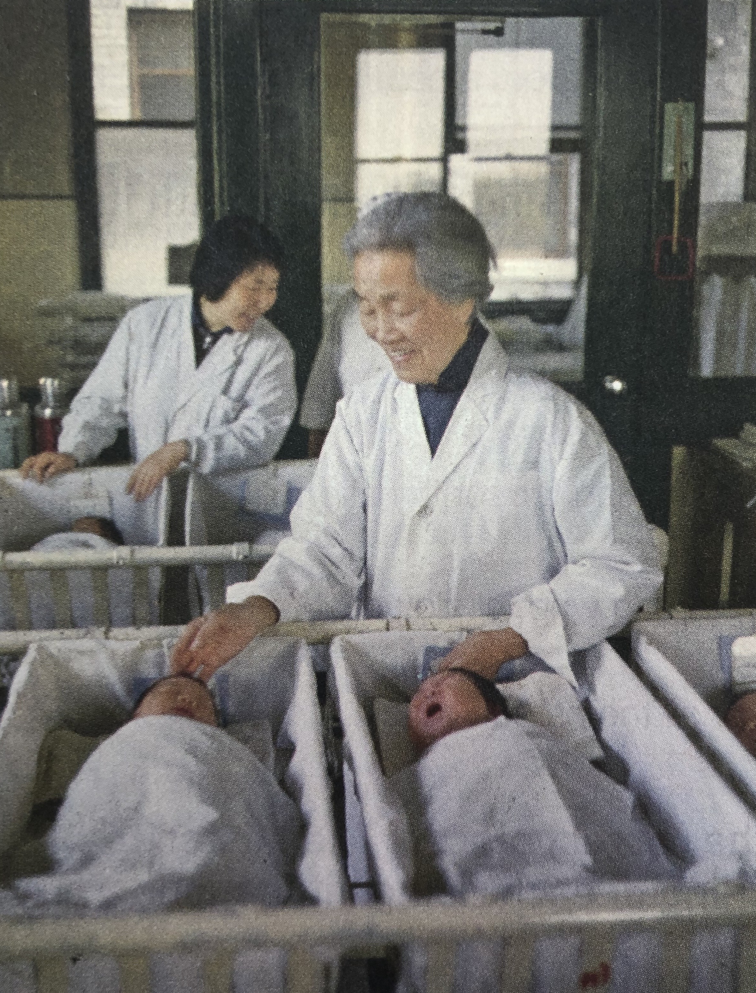
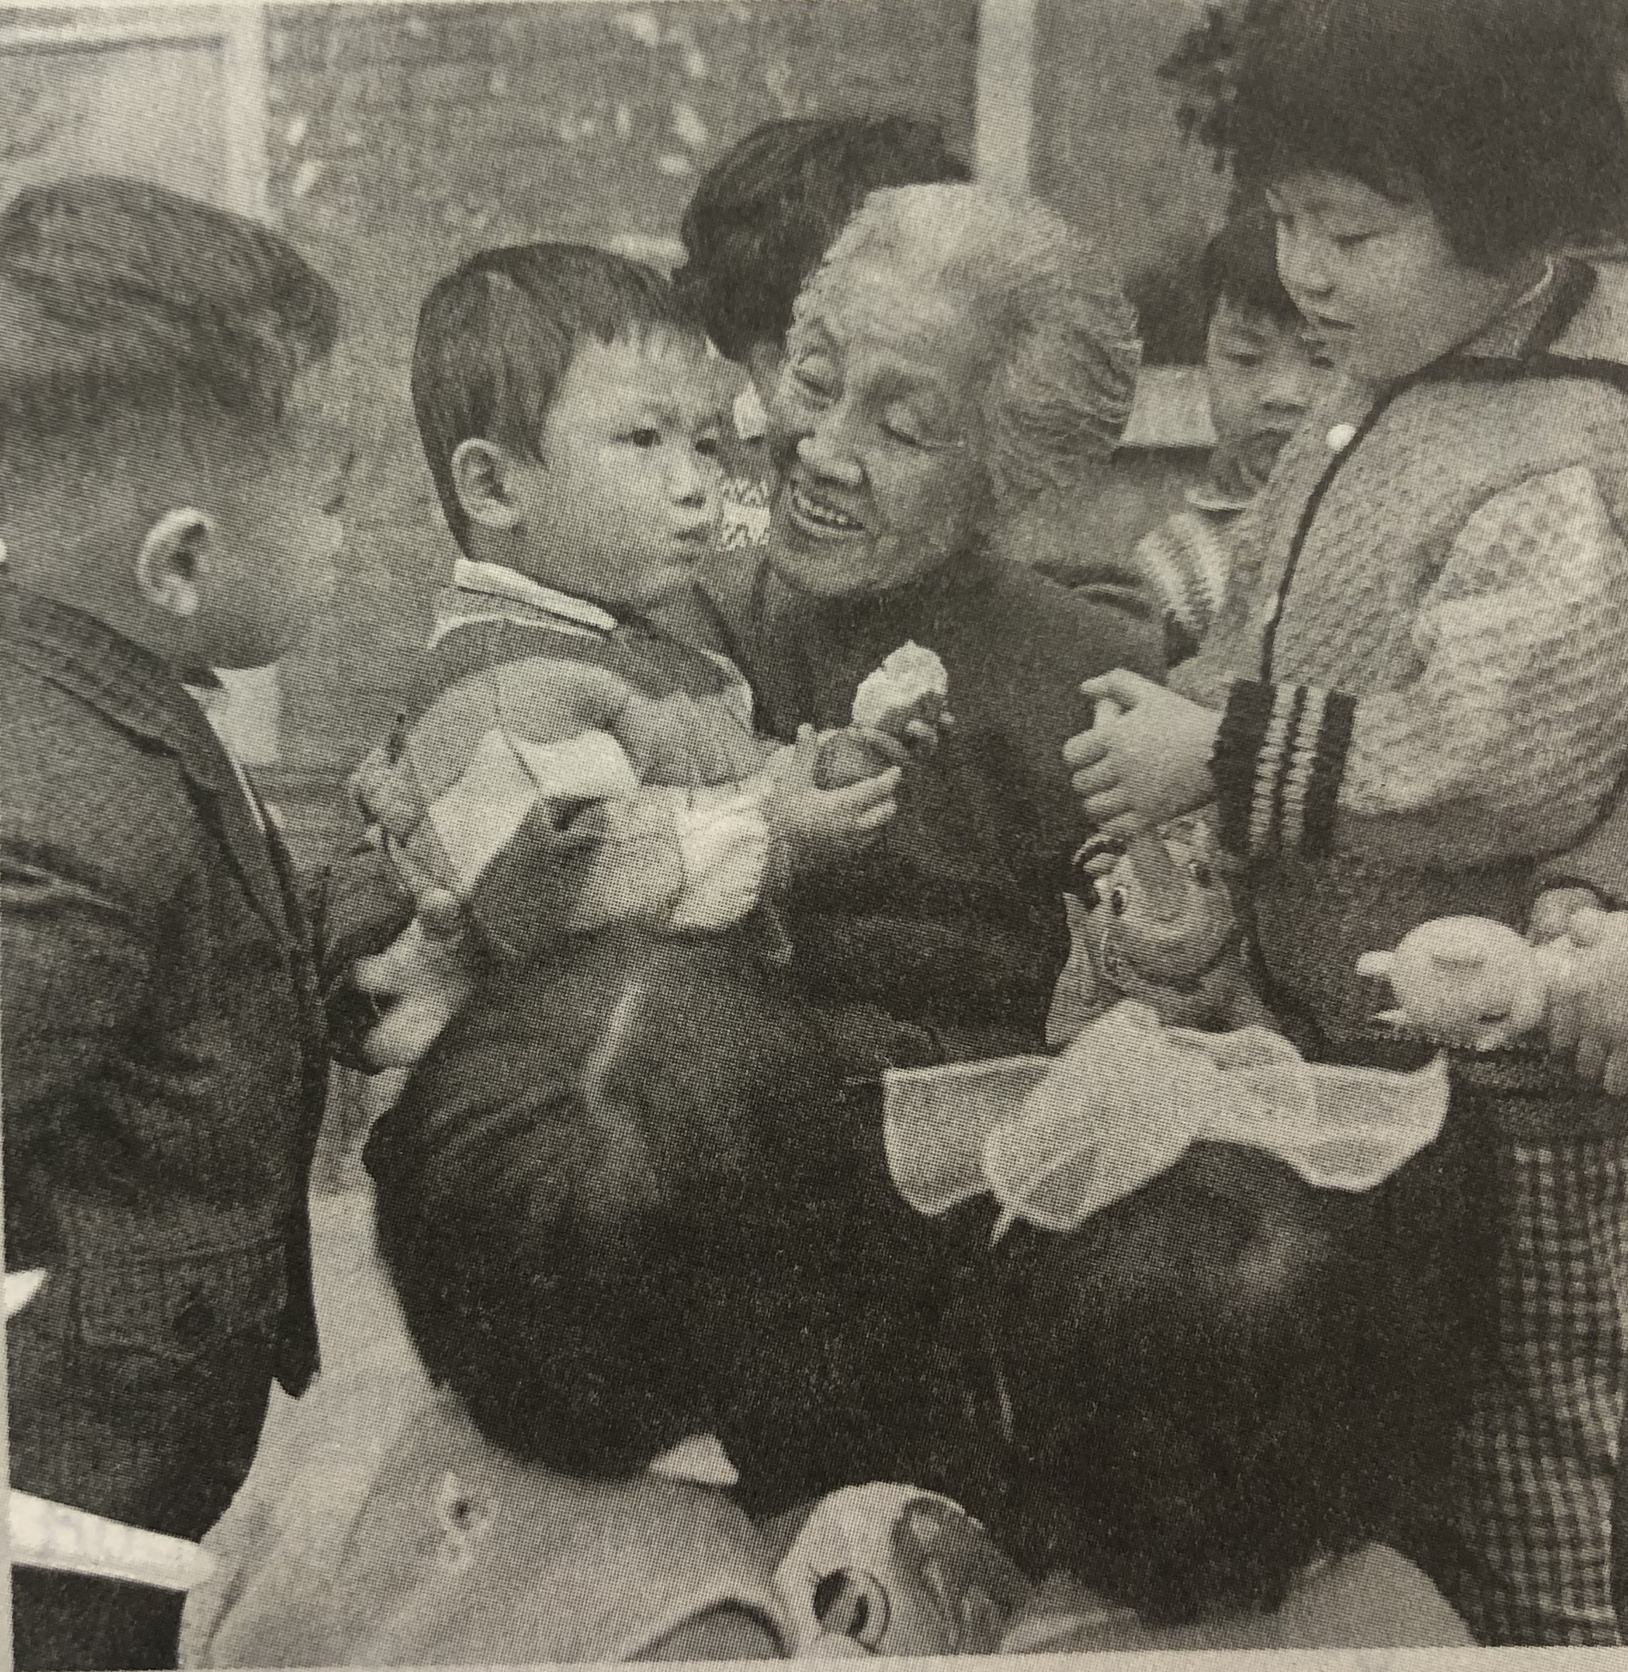
Activity 1
?
Lin Qiaozhi ______________ ten thousand babies.

Slide 6
Activity 2
1). Read and find out:
The text, written in order of __________, is mainly about Lin qiaozhi’s ____________________.
time
life experience
Biography

Slide 7
Activity 2
2). Read and find out:
1983
1954
1941
1931
8 years later
Age 18
Age 5
1901

Slide 8
Activity 2
2). Read and find out:
She died.
She was elected government official.
1983
1954
She studied in the US.
1941
She graduated from PUMC.
1931
She became the first Chinese woman director at PUMC..
8 years later
Her mother died.
She was born.
Age 18
Age 5
1901
She chose to study medicine.

Slide 9
Activity 2
dilemmas
3). Read and find out:
What dilemmas was she faced with? What were her choices?
Para.2
Para.3
Para.4
Para.5
chioces

Slide 10
Activity 2
dilemmas
3). Read and find out:
What dilemmas was she faced with? What were her choices?
to get married; to study medicine
to stay in the US; to serve the children at home
to stop helping people in need; to open a private clinic
to hold positions; to tend patients, publishing...
Para.2
Para.3
Para.4
Para.5
She chose to study medicine.
She chose to serve people at home.
She opened a clinic, helping the poor.
She was interested in tending...
chioces

Slide 11
Activity 3
Read and conclude:
What kind of person Lin Qiaozhi was?
Choice 1
Choice 2
Choice 3
Choice 4
She chose to study medicine.
She chose to serve people at home.
She opened a clinic, helping the poor.
She was interested in tending...

Slide 12
Activity 3
Para.2: “Why should girls learn so much? Finding a good husband should be their final goal!” her brother complained, ...
She responded, ”I'd rather stay single to study all my life!”
determined, strong-willed, persistent, ...
Choice 1
She chose to study medicine.

Slide 13
Activity 3
Para.3: She greatly impressed her American colleagues, who invited her to stay.
What would Lin Qiaozhi get if she had accepted their offer?
She cared little about fame and fortune and was very patriotic(爱国的).
Choice 2
She chose to serve people at home.

Slide 14
Activity 3
Para.4: She charged very low fees to treat patients and reduced costs for poor patients. At times she was even riding a donkey to faraway villages to provide medical care.
kind, empathetic(共情的), and treating people equally...
Choice 3
She opened a clinic, helping the poor.

Slide 15
Activity 3
Para.5: “The OB-GYN department care for two lives,” she told new staff in her department. “As doctors, we should be responsible for the patients and treat them as our sisters.”
Two lives refer to the lives of women and children.
responsible, caring, generous, ...
Choice 4
She was interested in tending patients, publishing medical research and training the next generation of doctors.

Slide 16
Activity 3
Lin Qiaozhi not only helped deliver the babies, but she dedicated her whole life to the mothers and children!

Slide 17
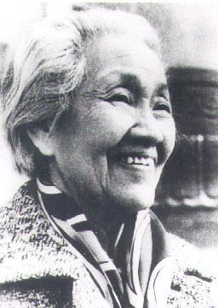
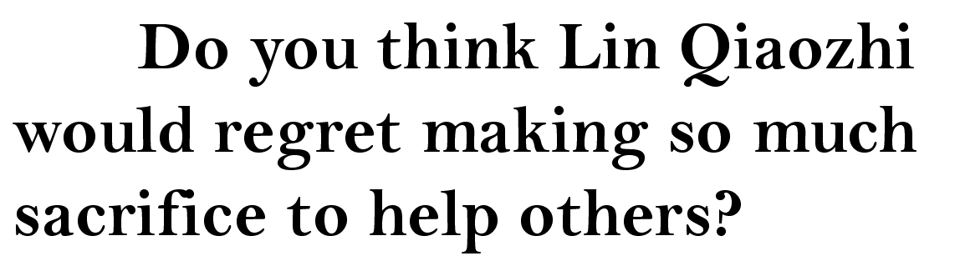
Activity 4
Let's read and think:

Slide 18
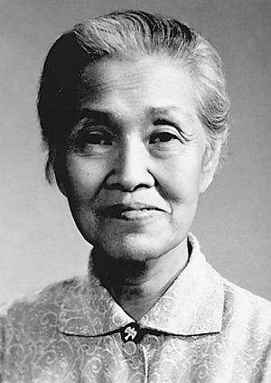
Para.1: “Life is precious. ... To a person nothing is more precious than their life, and if they entrust me with that life, how could I refuse that trust, saying I'm cold, hungry, or tired.”
Para.6: And even as she lay dying, her final thoughts were for others. ...
“As long as I can breathe, I belong to my department. The value of my life lies in treating patients.” --- Lin Qiaozhi
This was her life principle, and this was a great woman who stayed true to her original aspiration(初心).

Slide 19
Further thinking
Have you found your principle to carry through?
Who/What are you going to fight for?
No matter what you choose, stick to your original aspiration!

Slide 20
Homework
Read the dilemma attached. Make your own choice and give your reasons.

Slide 21
THANKS

