Slide 1


感恩遇见，相互成就，本课件资料仅供您个人参考、教学使用，严禁自行在网络传播，违者依知识产权法追究法律责任。
更多教学资源请关注
公众号：溯恩高中英语
知识产权声明

Slide 2
The Face-down Generation
嵊州市高级中学 尹 娟

Slide 3
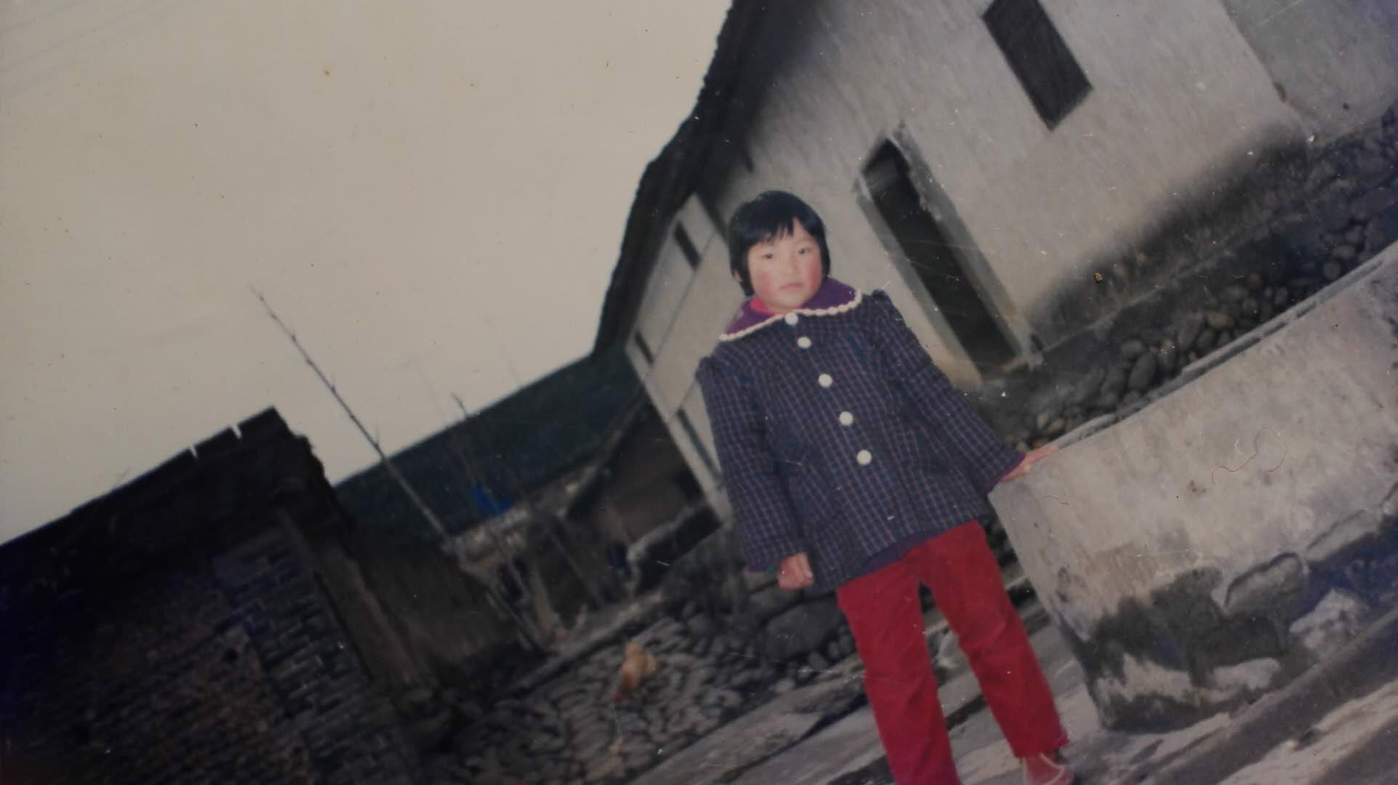
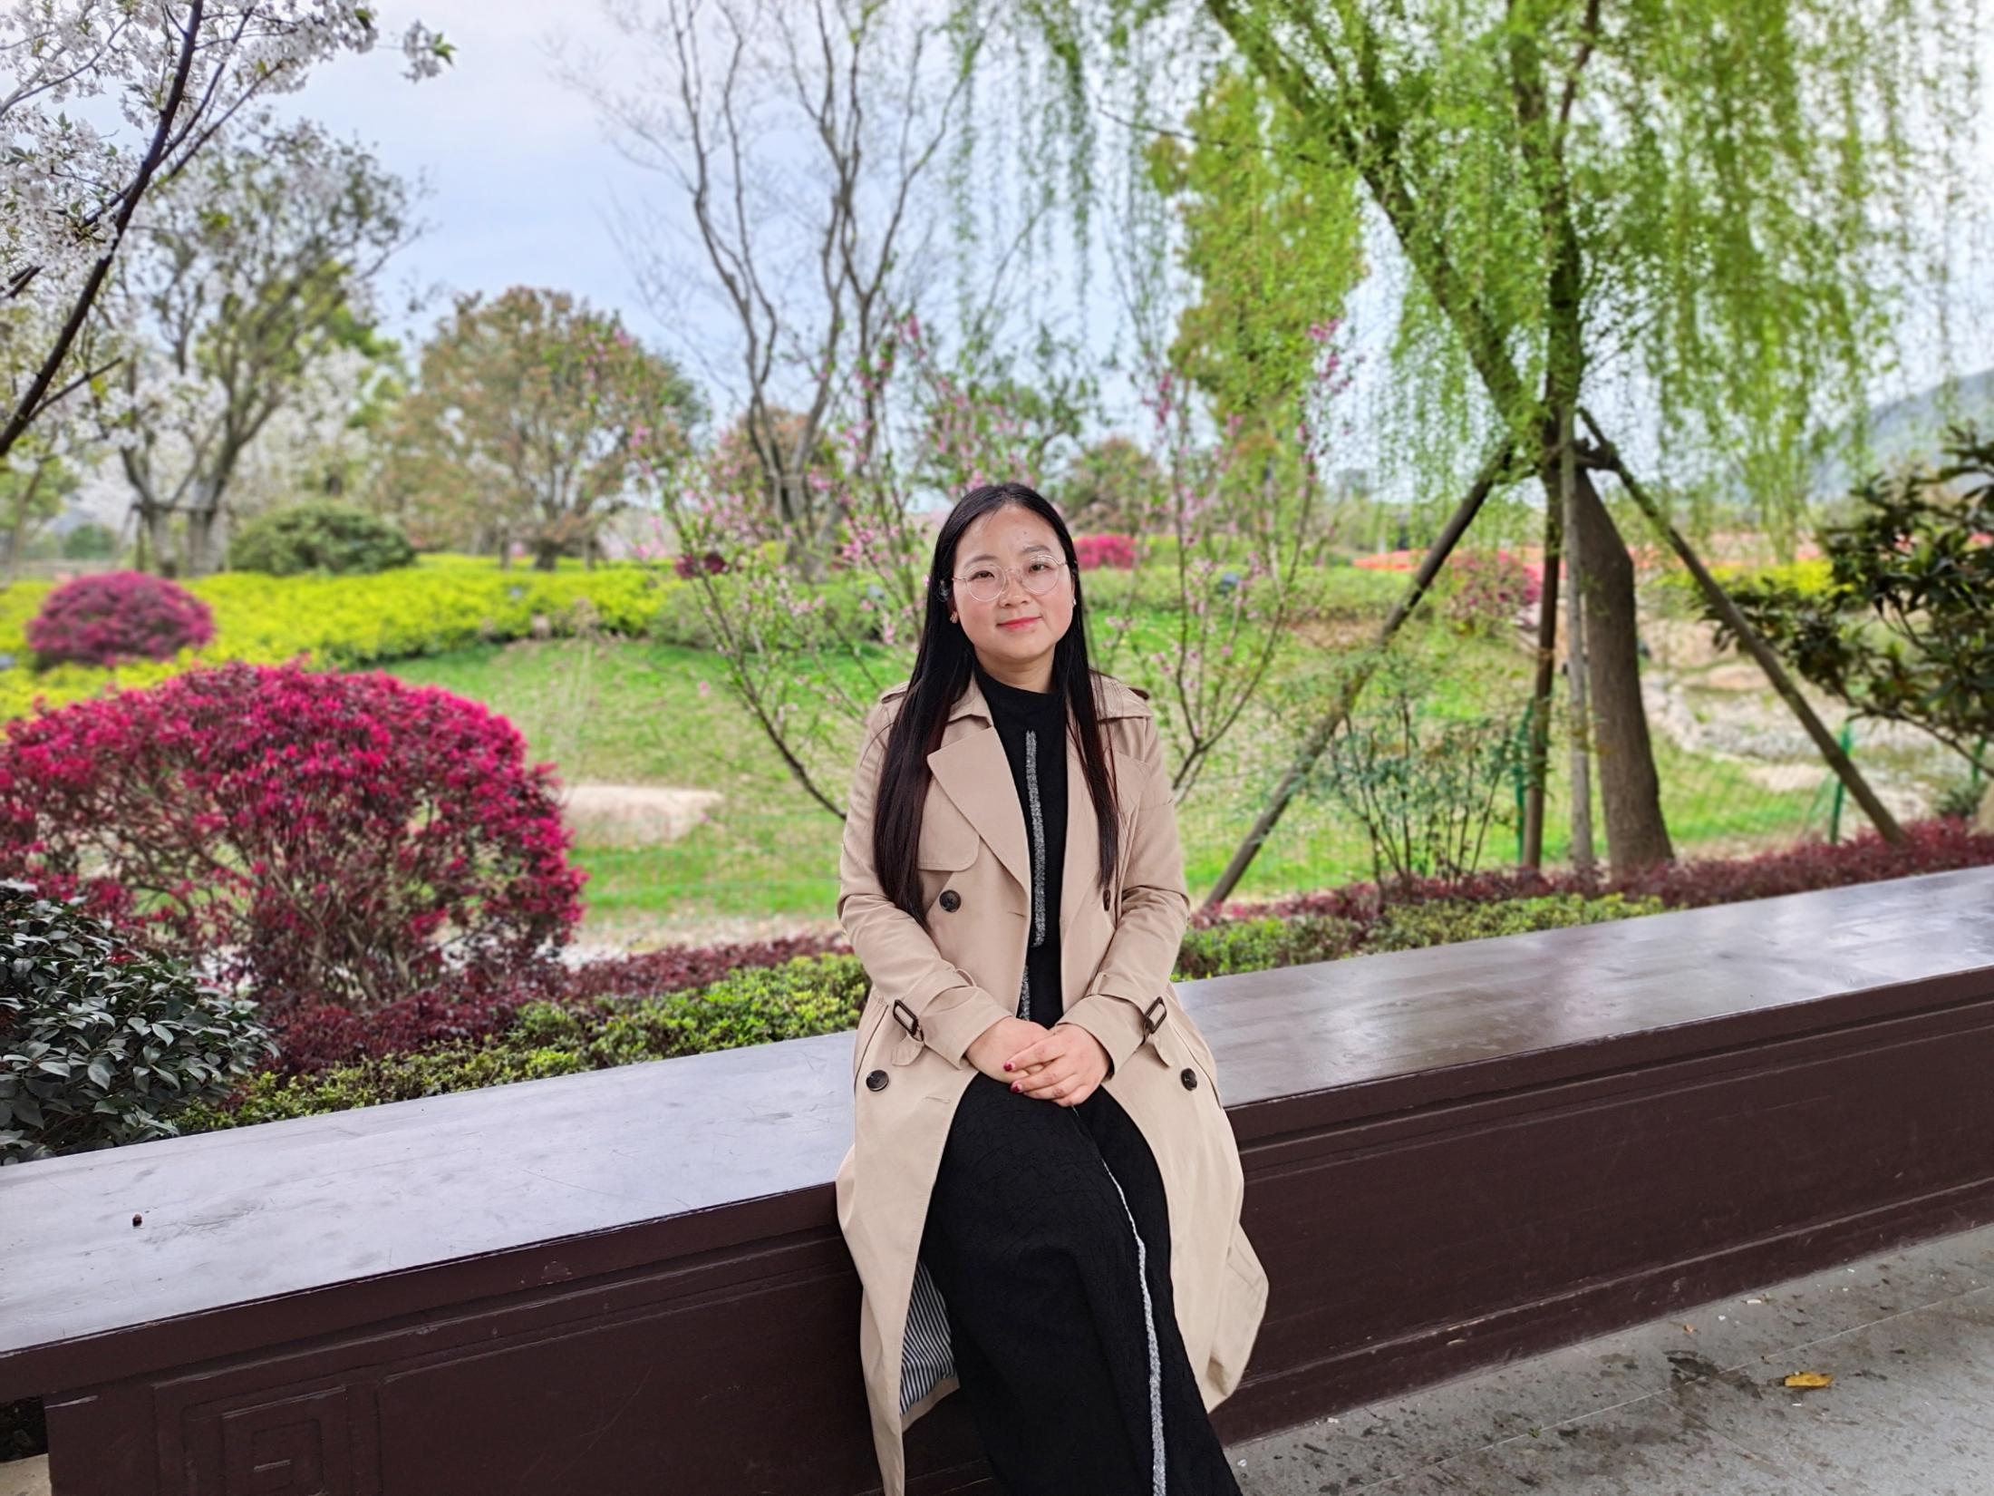
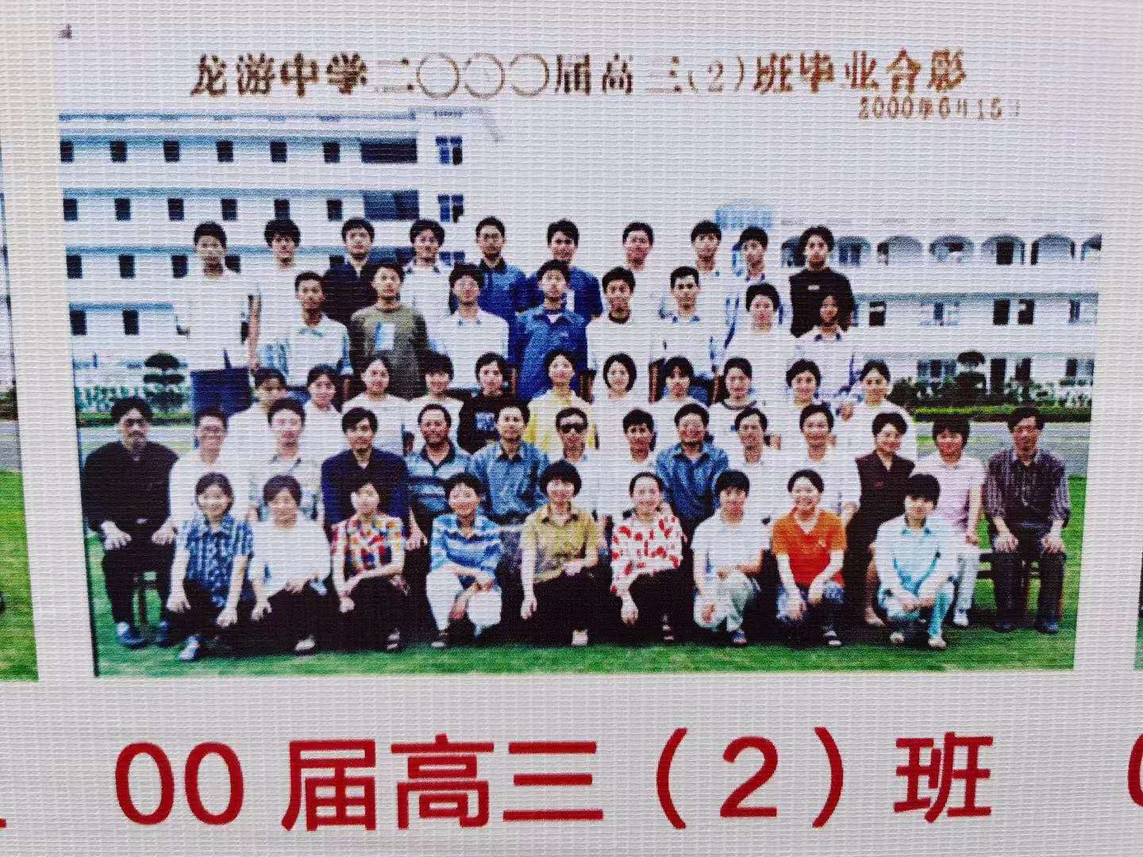
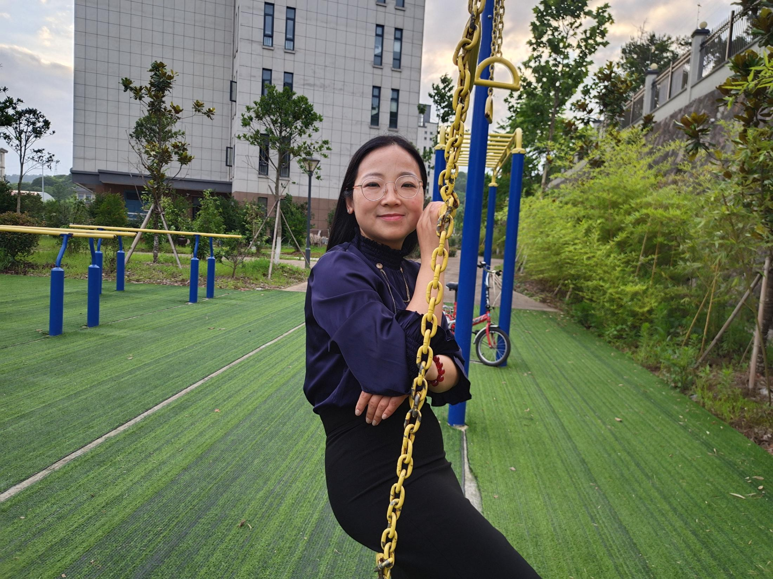

Slide 4

I
You
I was born in the 1980s.
The post-80s generation.
The 20th century.
You were born in the________ .
The __________ generation.
The________ century.
2000s
oh-ohs/00s
21st
enegetic
out-going
young
creative
connected
optimistic
humorous
global
smart
good-looking
What do other people think about your generation?

Slide 5
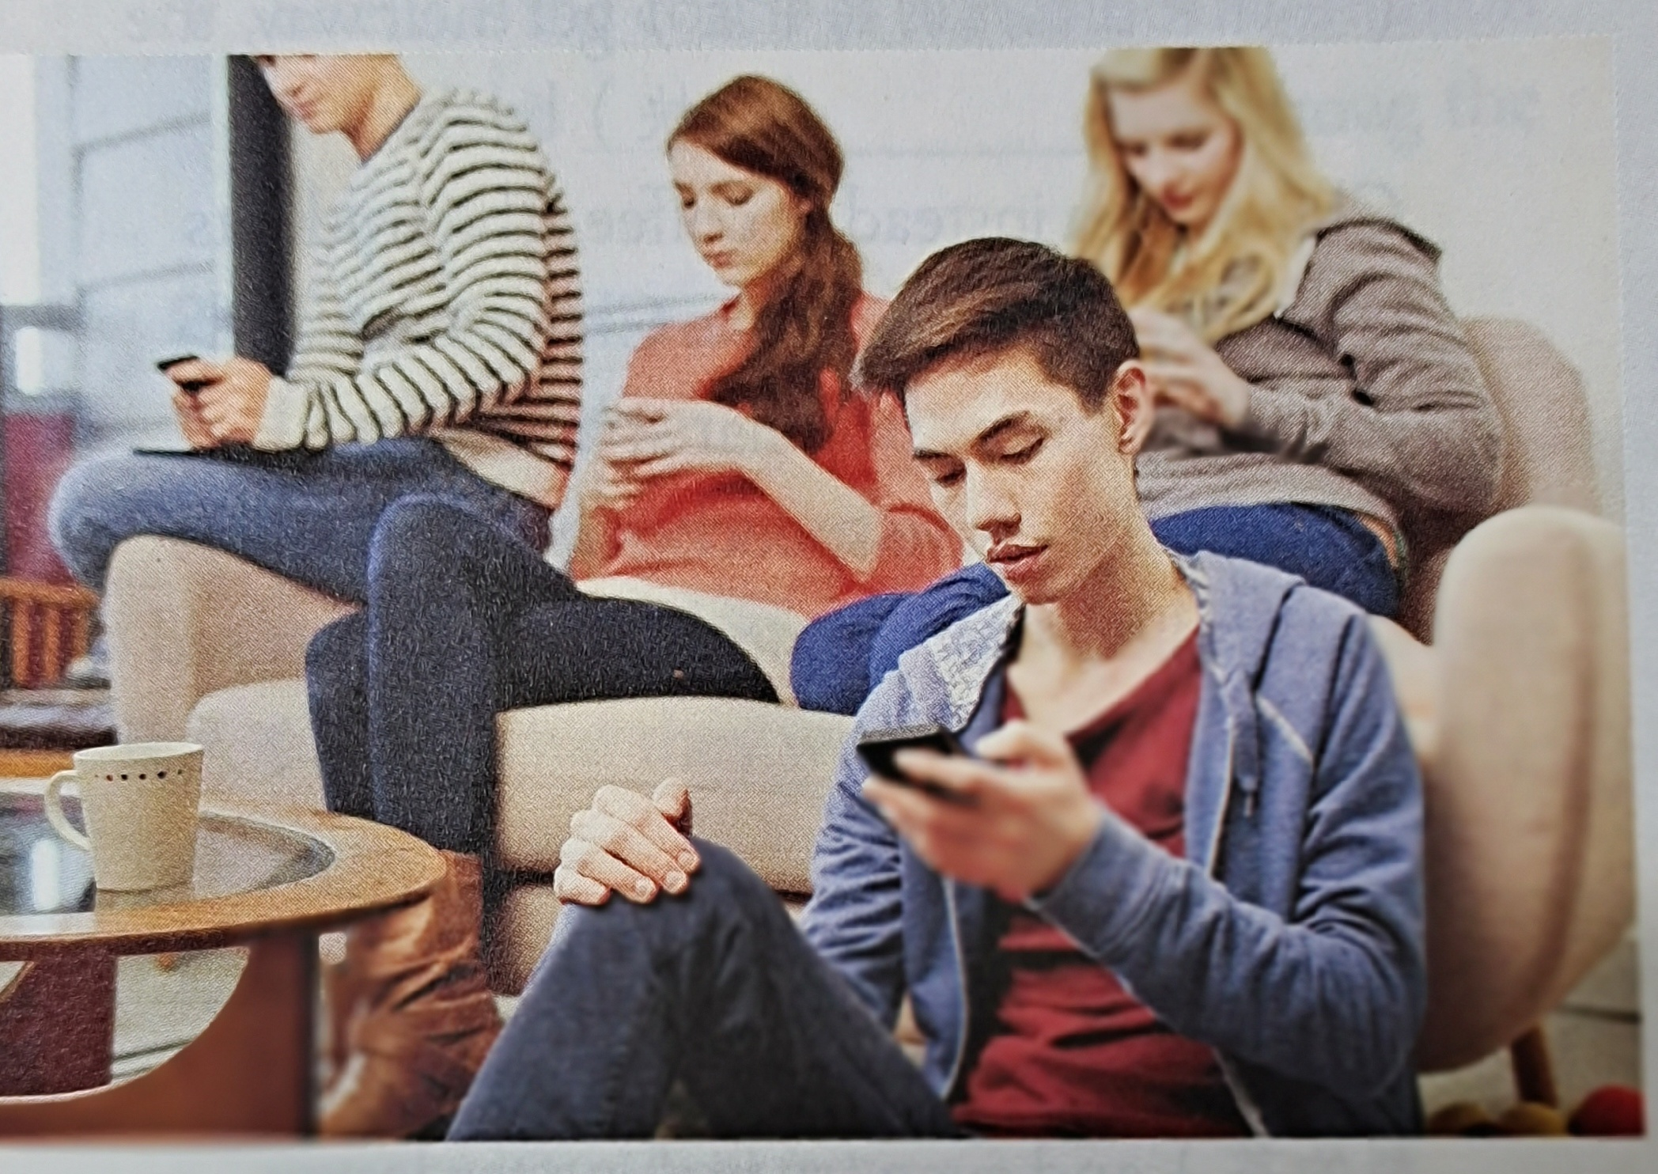
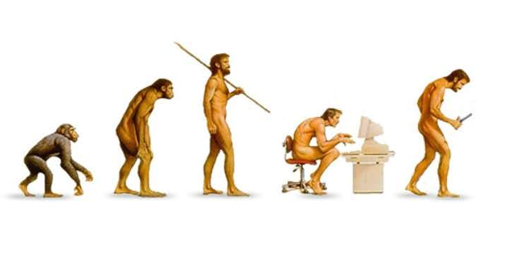
Some adults worry that you’re more interested in the screen in front of you than the world around you. They think of you as the “face-down generation” because you use your phone so much and they wonder how you will deal with school, friends, and family. Are today’s teenagers too busy texting and taking selfies to become successful in real life — or “IRL”, as you would say?
face-down
generation
the face-down generation
Are today’s teenagers too
busy texting and taking selfies to become
successful in real life
What do you think about the question?
worry
be a face-down generation
be isolated from the outside world
Today’s teenagers are too busy texting and taking selfies to become successful in real life.

Slide 6
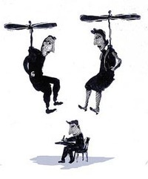
Other adults worry that today’s youth are spoilt (宠坏的) and don’t want to face the challenges of adult life. Many children born in the 1990s and 2000s were raised by “helicopter parents”. They were always there to guide and help them with a busy schedule filled with homework and extra-curricular activities such as dancing, drawing, or sports. With parents who do everything for them, today’s youth seem to prefer to live like teenagers even when they are in their 20s or 30s.
helicopter parents
helicopter parents
be spoilt & refuse to face the challenges of adult life
Today’s youth seem to prefer to live like teenagers even when they are in their 20s or 30s.
worry

Slide 7
What is Helicopter parent?
Helicopter parent is a colloquial(口语体), early 21st-century term for a parent who pays extremely close attention to his or her child’s or children’s experiences and problems, particularly at educational institutions. These parents rush to prevent any harm or failure from befalling them and will not let them learn from their own mistakes, sometimes even contrary to the children’s wishes. They are so named because, like helicopters, they hover closely overhead, rarely out of reach, whether their children need them or not.

Slide 8
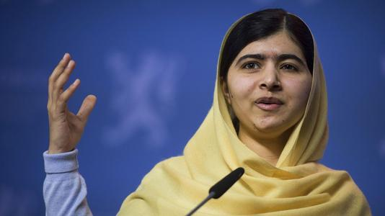
Does the face-down generation need a heads-up?
Does the face-down generation need a heads-up? Well, probably not. The fact is that many of today’s teenagers are better educated and more creative than past generations. They also seem to be enthusiastic (热情的) and willing to become leaders. More young people than ever volunteer to help their communities. There are also brave young people such as Malala Yousafzai, the teenager who won the 2014 Nobel Peace Prize for pushing girls’ rights to go to school.
probably not
face-down generation
Are today’s teenagers too busy texting and taking selfies to become successful in real life?(P2)
helicopter parents
fact
be better educated
be willing to become leaders
be more creative
volunteer to help their communities
be enthusiastic
be brave and young

Slide 9
So if you’re one of the oh-ohs, there’s reason to be hopeful about the future. Things are looking up for the face-down generation. Chances are that you will do GR8 (great) and LOL (laugh out loud).
be hopeful about the future
face-down generation
hope
Things are looking up...
To be a positive, diligent and creative face-down generation.
Chances are that you will...
face-down generation
What can you do when you keep your face down?
concentrate on the homework
be absorbed in reading
focus on the note-taking
keep one's mind on study
devote oneself to inventing something
be lost in thinking
be busy solving the difficult problems in various subjects

Slide 10
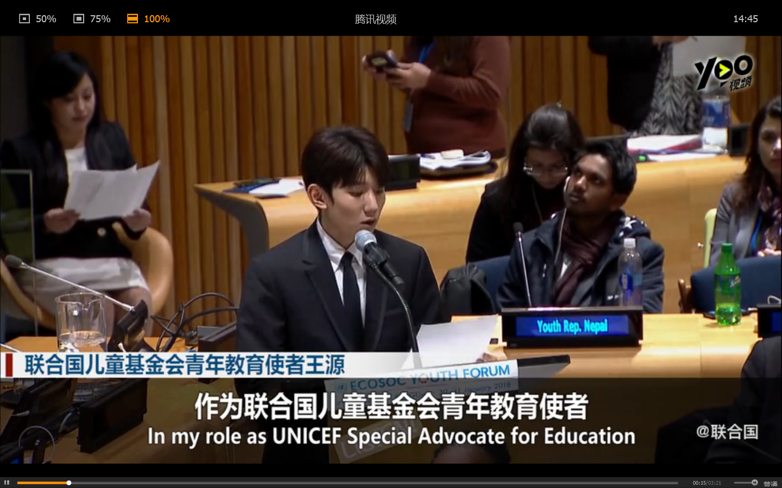
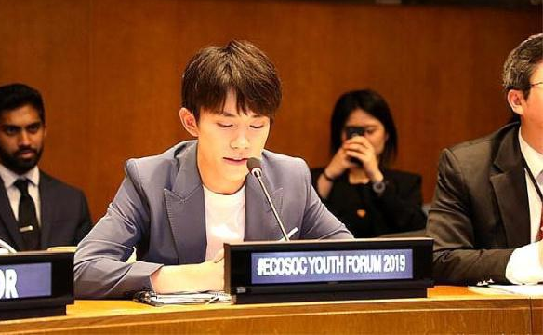
Roy(Wang Yuan)and Jackson Yee(Yi Yangqianxi), members of the Chinese teen idol group TFboys, both made presentations at the United Nations Youth Forum, focusing on the importance of the universal quality education for every child and caring for left-behind children.
They promote the positive energy of youth, and set correct and positive examples for the young generation in China.

Slide 11
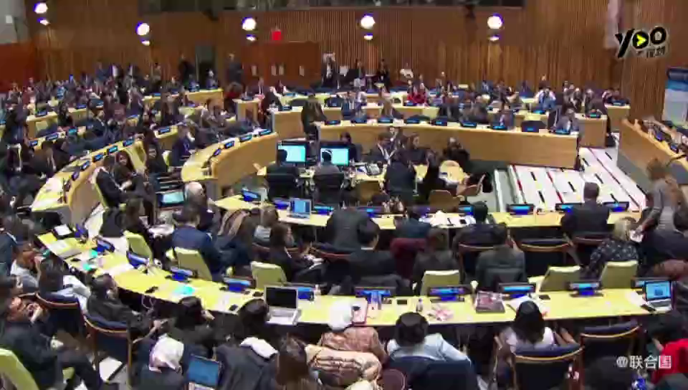

Slide 12
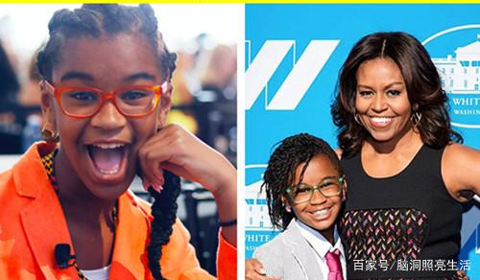
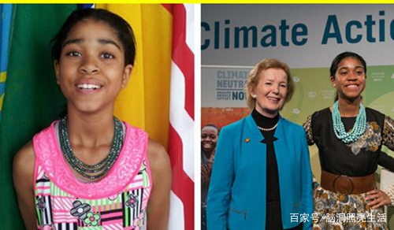
Marley Dias
The 14-year-old founder of #1000BlackGirlBooks, an international movement. Marley was recognized by TIME, as one of the 25 most influential teens in 2018.
Zuriel Oduwole
World’s Youngest Filmmaker She gave a speech to the United Nations last year about the topic of climate change.

Slide 13
As one of the oh-ohs, what will you do at present and in the future?
☆explore the interests
☆make plenty of friends
Individual
☆learn a new language or a new skill
☆enjoy a movie or travel to a distant destination
Surge on, young generations!
☆appreciate diversity in culture and values
Society
☆make contributions to the communities, the cities or even the country
☆turn the traditional into the modern, the classic into the popular, the academic into the public, the national into the international.
☆create a brilliant future for all the poeple in the world
World
The best scenery in a country is its young generation.

Slide 14


Slide 15
Thank you!

