Slide 1

感恩遇见，相互成就，本课件资料仅供您个人参考、教学使用，严禁自行在网络传播，违者依知识产权法追究法律责任。
更多教学资源请关注
公众号：溯恩高中英语
知识产权声明

Slide 2

How to write an appealing ending
-Continuous Writing
浙江省衢州第一中学 徐荣仙

Slide 3
Four Types of Endings

Slide 4
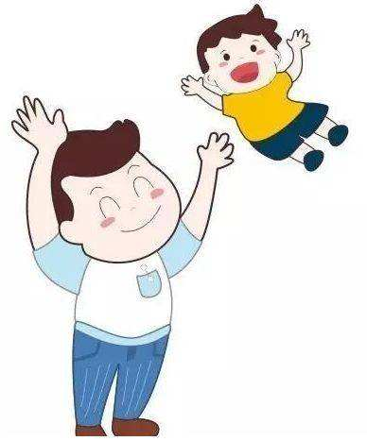
Sample One
浙江省名校新高考研究联盟（Z20联盟）
2020届第三次联考读后续写

Slide 5
“Missy,” I called to my wife, “did you put the banana skin on my desk?” “No, honey. Meghan probably did.” As I’d feared, she had missed my real purpose of the question which was to make it clear to her that she hadn’t done her job: defend my desk against the invader－our naughty girl. I abandoned the conversation.
I sat here at the desk, and stared at the scream. I waited patiently for ideas to come to me, exam questions for a test I would give my English students. My wife was off to a reunion somewhere, but I was not alone. Meghan, our 22-month-old daughter, kept me company. Yet her plans that day seemed to go against mine.
She followed a daily routine that was time-consuming and challenging. It included certain basic tasks: watching the fish, sweeping the carpet in her room, climbing up and down her bed.
At first I could concentrate on designing my test paper. But I was soon sidetracked (分心的). I had not counted on the arrival of the “bib-bibs”(“bib-bibs” were birds). “bib-bibs, bib-bibs!” . Meghan screamed excitedly, her eyes alive with expectation. She insisted that I go with her to the window.
“In a second. Just let me finish this question. ” I said. She pulled me by the hand (two fingers, actually ) toward the window. I saw myself as a fool, being led to watch the bib-bibs. And we did watch them. They chattered and leaped back and forth on the lawn just outside our apartment window. Meghan was absorbed, but as I watched them, I still thought about my work.
Suddenly she rushed out from the room, and I heard her naked feet slapping against the wooden floor outside. She returned with her doll, Dumpty. She held him up to the window, stretching him out by his two arms and whispering into her nonexistent ear, “bib-bibs, Dumpty, bib-bibs! ” Then I left them in conversation and returned to my desk.

Slide 6
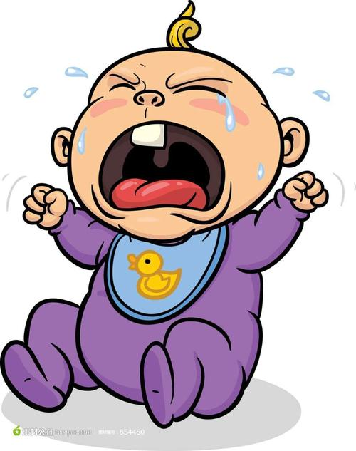
Read for Key Information
What's the main idea of the given passage?
I had to accompany my daughter at home while preparing for a test paper.
When I was with her, I was actually absent-minded.
When her beg for an outing was refused, she began to sob.

Slide 7
What's your ending of the story?
Paragraph1:
Unfortunately, she came again soon, with her shoes in hands and preparing for an outing.__
____________________________________________________________________________
____________________________________________________________________________
Paragraph2:
Out of the corner of my eye I could see the little girl sobbing because I didn’t have time for her._________________________________________________________________________
____________________________________________________________________________

Slide 8
Questions:
Was the father willing to accompany his daughter?
Was the father patient with his daughter?
Could you find some clues(线索) about her father's attitude in the given passage?
Unwilling
Impatient

Slide 9
Analyze the Plots in the given Passage
climax
daughter
Meghan
father
sob
beg for an outing
refuse
P6
doll, Dumpty
left, returned to my desk
P4-5
sidetracked分心的, see myself as a fool
still think about my work
bib-bibs, scream,
P3
time-consuming and challenging
daily routine
P2
keep him company
go against my plan
P1
banana skin
invader, naughty,
accompany my daughter

Slide 10
下水作文
Unfortunately, she came again soon, with her shoes in hands and preparing for an outing. “Daddy, I’d like to …” “Not today, Meghan. I’m pretty busy, you see.” Without even lifting my head from my paper, I interrupted her request impatiently. “Just for a moment, please” she tipped towards my desk and plucked at my sleeves timidly. Somehow, a flood of rage took hold of me, which drove me to yell at her, “ Go and play with your Dumpty! I’m busy with my work. ” She opened her mouth to say something but choked. She inched towards the door quietly.
Out of the corner of my eye I could see the little girl sobbing because I didn’t have time for her. Suddenly, a ripple of guilt touched my heart. I went over, bent down and embraced her tightly. “How about the park now? ” “Really? ” She raised her head, with uncovered childish thrill in her still red eyes. I nodded and picked up her shoes. In a flash, she stood up and flew out cheerfully like a bird. Her twinkling eyes woke me up to the truth that parents’ simple company can warm children’s heart, even lighting up their life.
unwilling , impatient
expectation
excited, happy, unbelievable

Slide 11
Possible Appealing Endings
1. A philosophical ending
Show the main character's growth
No matter how busy we are, don't miss the best time to accompany our children. Parents' company will nourish their hopes and happiness.
Her twinkling eyes woke me up to the truth that parents’ simple company can warm children’s heart, even lighting up their life.
unique, expressive

Slide 12
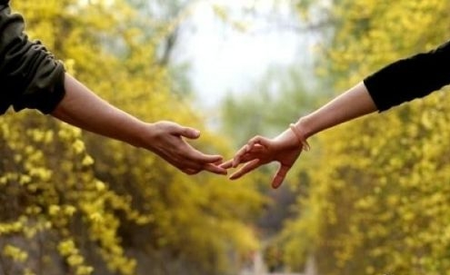
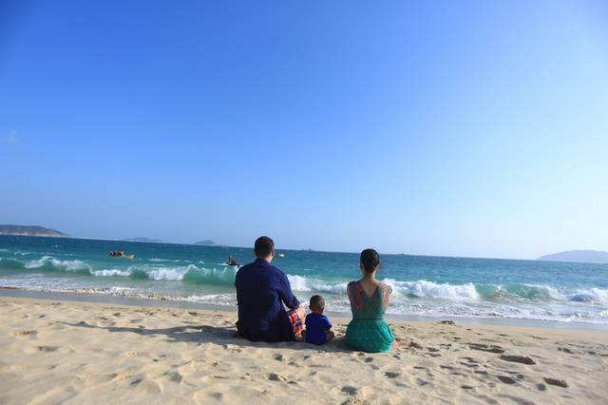
2. A narrative ending
An Ending with what happened later
Now, Meghan has been a mother of two babies. When I looked back to that day, I was still guilty about my rudeness at her expectation for my company.
artistic conception 意境

Slide 13
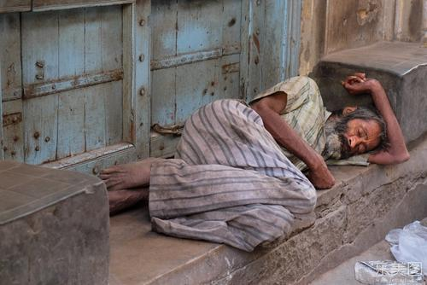
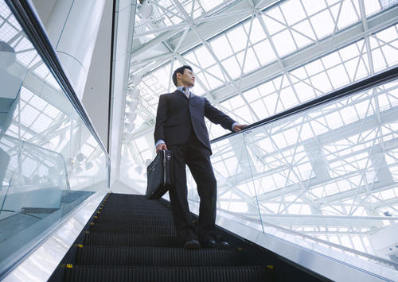
Two men were fired together , but they wrote totally different destinies (命运).

Slide 14
Henry decided to read the report. The hero of the story is a successful man who started his own business after being fired. losing a job is absoultely a shock to everyone who has a family to support and Carl was no exception. However, he picked himself up quickly and moved on instead of complaining. Eventually, his efforts paid off. Admittedly, he was the very man fired together with him. But why did they write totally different destinies (命运)？

Slide 15
Henry started looking back upon his life after he lost his work. To his surprise, he found his life was of nothing but complaints. Had he taken his friends' advice, he wouldn't be homeless now. It dawned on him that it was not the unfair fate but his negative attitude that ruined his life. Then, with the carefully folded newspaper in his pocket, he stood up and walked to the direction of a brand new life.
(From Yanghu, Class14, Grade3)
设置悬念，留白想象空间

Slide 16
3. An echoing ending
Echo an earlier incident or thought
Her gleaming eyes and sunny smile made me realize that it was rewarding to accompany her, even as a “fool”.
“In a second. Just let me finish this question. ” I said. She pulled me by the hand (two fingers, actually ) toward the window. I saw myself as a fool, being led to watch the bib-bibs. And we did watch them.
echo
Her giggle brought every cell of the park to wake up. Surprisingly, I found accompanying her not that time-consuming and challenging, but pretty blessing.
She followed a daily routine that was time-consuming and challenging. It included certain basic tasks: watching the fish, sweeping the carpet in her room, climbing up and down her bed.
echo

Slide 17
4. A scene reproduction ending
Open and close with the same setting
for example, the story starts and ends with a character sitting in a tree house. However, something has happened in between that may change or reveal how the character feels about the house. E.g: The treehouse is no longer a safe place because of the snake she had met there.
Her sunny smile warmed the park. The desk that I was eager to return to a moment ago didn't attract me so much now.

Slide 18
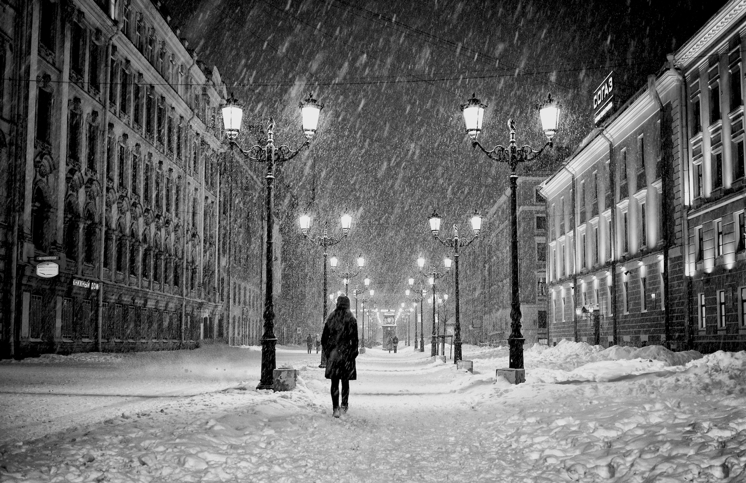
It started snowing just as we were setting out, but I felt warm, my heart melting.

Slide 19
Summary
ending
An
echoing ending
A narrative
ending
A Philosophical
ending
A scene
reproduction
ending

Slide 20
Sample Two
2020年4月衢、湖、丽三地市
读后续写
Fortune Cookie Friends

Slide 21
What initially started as a challenge turned out to be a bonus（意外收获）. Mei Mei couldn't believe it. Wearing a bright smile on her face, she headed towards the kitchen at a brisk pace.
With a sweet smile on her face, she looked around the restaurant confidently. The new city that she disliked before turned out to be a warm one.
Suddenly, she understood it. Sometimes we may be afraid of a new environment, but what matters most is to take the first step bravely rather than curl up in your previous comfortable zone.
A flood of happiness welled up inside. “It may not be a stupid idea to move here, ” murmured Meimei, a secret smile spreading across her face, “What a big day!”
Match
A. An echoing ending
B. A philosophical ending
C. A scene reproduction ending
D. A narrative ending

Slide 22
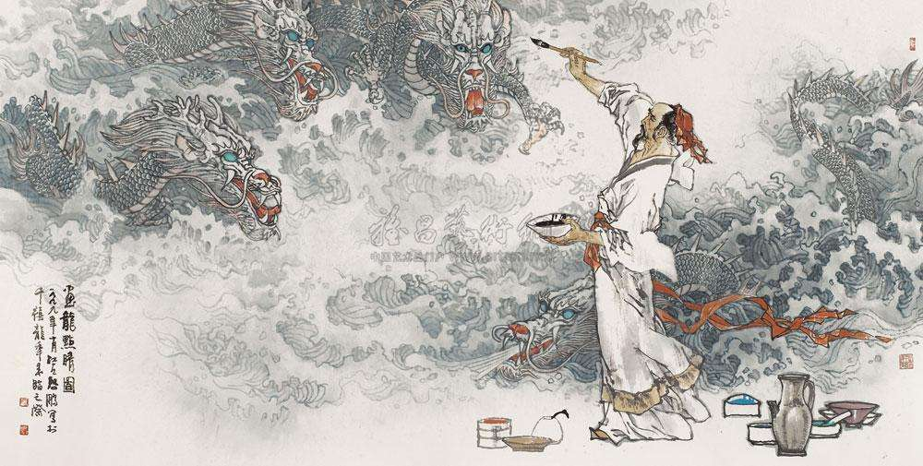
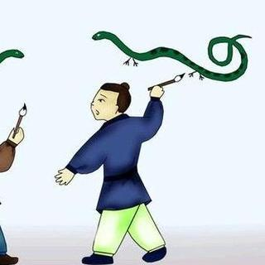
Putting the finishing touch to the picture of a dragon
ending
Adding feet to a snake

Slide 23
Appealing Endings?
reasonable but surprising
合情合理，出人意料
√
situational and emotional
寓情于景，情景交融
√
mysterious by not revealing
设置悬念，留白想象空间
√
improve the idea
合理推断，拔高立意
√
√
arouse resonance
情感真挚，激发共鸣

Slide 24
Enjoy some of your story endings

Slide 25

Assignment
Try to rewrite an ending in a different way

Slide 26


