Slide 1


感恩遇见，相互成就，本课件资料仅供您个人参考、教学使用，严禁自行在网络传播，违者依知识产权法追究法律责任。
更多教学资源请关注
公众号：溯恩高中英语
知识产权声明

Slide 2

Language Focus
in B2U4

Slide 3
Important words
puzzle; surround; defence;charge; approach; generous ;eager;striking（strike）;fascinating
Important expressions
be similar to; be eager to/ for; as well as; keep your eyes open; break away from
Useful sentence patterns
have sth done; doing 做主语； with 复合结构

Slide 4
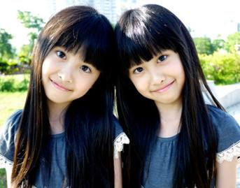
Why do you think William said his hometown was similar to Qufu?
similarity
1. be similar to 与…相似 ___________n. 相似性
①Although the twins are quite different , they _______________ each other in several ways.
②What ____________ can you find between them?
are similar to
similarities

Slide 5

2. Achilles’ heel 希娜神话：阿喀琉斯的脚跟
(比喻)致命的弱点
练：
① Angela is a super scholar, but spoken English is her Achilles’ heel .
② When he gives me advice, I am all ears.
他给我提意见时，我_____________________.
③ Sorry, I’m all thumbs when I cook.
很抱歉我一做饭就_____________________________.
④ My wife bought a mink coat that cost an arm and a leg.
我妻子_____________________买了一件貂皮大衣。
洗耳恭听
笨手笨脚的
花了一大笔钱

Slide 6
Some idioms related to body part
pull one’s leg 开某人的玩笑
be all ears 洗耳恭听
all thumbs 笨手笨脚的
green fingers 园艺技能
cost (sb) an arm and a leg 花了一大笔钱
see eye to eye 看法一致
hit the nail on the head 一针见血

Slide 7
Getting to know a little bit about British history will help you solve this puzzle.
迷惑；使困惑
谜；疑问
puzzle：vt _____________ n _____________
★adj． ______________ ( confused)
★ adj． ______________ (confusing)
puzzled
puzzling
puzzling/confusing
1.The first week was a little ____________________.
2. He wore a expression, maybe the problem was quite __________________.
3. Some people are puzzled ________ the fact that he is still single.
4. _________________（使我困惑的是）is that I don’t know the exact time for the test.
puzzled／confused
puzzling/confusing
about
What puzzles me

Slide 8
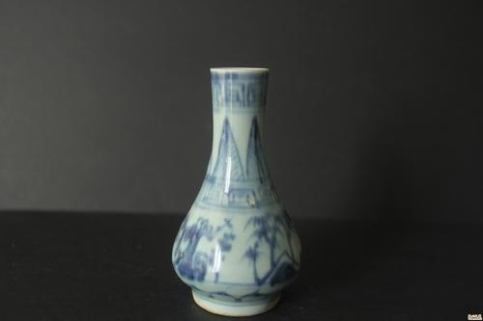
The four countries that belong to the United Kingdom work together in some areas.
belong to 属于（无被动，无进行）
belongings n.所有物，财产，财物
belonging to
★The painting ___________ the gallery dates back to the Ming Dynasty.
★威廉 教授一直告诉他的学生：未来属于受过良好教育的人。
Professor William keeps telling his students that the future belongs to the well-educated.
★Lockers are available to store any ____________ during your visit.
belongings

Slide 9
In the 20th century, the southern part of Ireland broke away from the UK.
挣脱(束缚),脱离,改掉
▲The suspect broke away from the two policemen who were holding him.
▲One of the provinces broke away to form a new state.
break down (机器)出故障；（身体，精神）垮掉;（计划，谈判）失败; (化学)分解
break into 闯入……
break in 闯入；打断；插嘴
break up 结束；放假；破裂；打碎
break out（战争，疾病等）爆发，突然发生

Slide 10
①The First World War _____________ in 1914.
②Yesterday two thieves _____________ his house.
③ As she was talking, he suddenly ____________, saying, "That's a lie".
④The meeting __________ at ten to three.
⑤She's just __________ with her boyfriend.
⑥ Modern music like jazz has _______________ the old traditional rules.
⑦ The elevators(电梯) in that building are always ______________, which makes the residents quite annoyed.
broke out
broke into
broke/cut in
broke up
broken up
broken away from
breaking down

Slide 11
It was hard to approach the painting as there were so many people around.
v. 走近；接近；临近
n. 接近，方法，途径
1. Winter is approaching.
2. With the approach of Christmas the weather turned colder.
3. The approach to the house was a narrow path.
4. The best approach to _________(learn)a foreign language is reading as much as possible.
with the approach of = with….. approaching
learning
an approach to (doing) 做某事的方法

Slide 12


巧 学 活 用
approaches
1. Many _____________ have been adopted to control the spread of COVID-19.
2. _____________ (approach) the city center, we saw a stone statue of about 10 meters in height.
3. _____________________（随着考试的临近）I began to learn English.
Approaching
With the test approaching

Slide 13
Carl and his friends stayed with a generous family.
n. ______________
generosity
be generous to sb 对某人慷慨
be generous with sth 在某方面大方
it's generous of sb to do sth 某人做某事很慷慨
to
★ These volunteers are very generous ________ the old man.
★Everybody likes to get along with someone who is generous ________ his time and money.
★____________________________ (这个小女孩很慷慨) share her toys with the other kids.
with
It is generous of this little girl to

Slide 14
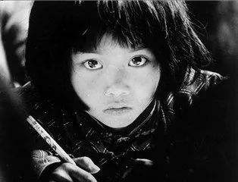
I was eager to see that.... n.eagerness
①
I was eager to succeed.
be eager to do sth
for
②
She is eager _______a present from her parents.
eagerness
③
Her __________ for knowledge is very strong.

Slide 15




be eager for/to do sth
be anxious for/to do sth
be dying for/to do sth
渴望做某事
be desperate for/to do sth
be hungry/ thirsty for/to do sth
have a desire for
long for/to do sth

Slide 16
If you keep your eyes open, you will be surprised to find that you can see both its past and its present.
keep your eyes open (for) 留心；留意
Imitation：make sentence based on the given words.
keep one's eyes open; landscape
If you keep your eyes open, you will be surprised at the landscape as well as the culture of the country.

Slide 17
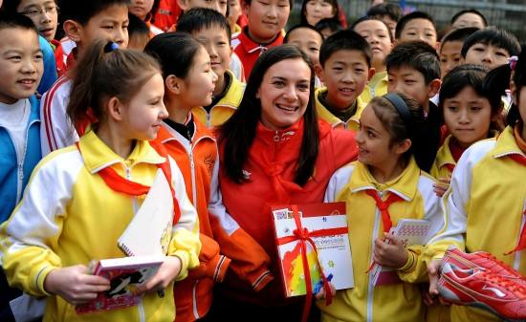
You will be surrounded by evidence of four different groups of people who took over at different times throughout history.
adj. surrounding
n. surroundings (复数) 环境
① The teacher _______________________________(被孩子们包围着)
② _____________ (surround) by lovely Children, the teacher wore a smile on her face.
was surrounded by lovely Children.
Surrounded
[Summary]
surround …with…. 以….包围….
be surrounded with/by …. 被….包围….

Slide 18
巧 学 活 用
①The absolute best way to learn English is to surround yourself ________ it.
② __________(surround) by a lot of green trees and flowers, the village has beautiful ____________.
③They climbed upward along the steep cliffs ____________(surround) the village.
④ All the buildings_______________________
(被灌木包围着)
with
Surrounded
surroundings
surrounding
are surrounded by bushes

Slide 19
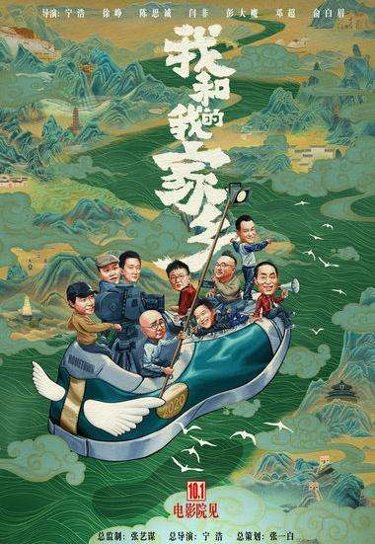
fascinating：adj. extremely interesting and attractive
★adj． ___________ (very interested)
★ vt． ____________ (to interest or attract sb very much)
fascinated
fascinate
The movie My people My homeland is so ___________that everyone who has watched it will be __________ by it.
fascinating
fascinated

Slide 20

charge vt.充电；收费，控告
n. 收费；指控；主管
01
免费
free of charge
02
负责；主管(介词词组)
in charge of
03
负责；主管(动词词组)
take charge of
04
由…负责；主管
in the charge of
05
因…收某人的费用
charge sb for sth
06
charge sb with sth 指控某人某事
Notes:
模板来自于 http://meihua.docer.com/
20

Slide 21
巧 学 活 用
① She takes charge of the day-to-day running of the business.
→ She is ___________ the day-to-day running of the business.
② Our monitor is in charge of our class when our headteacher is out.
→ Our class is ___________________________when our headteacher is out.
③ I'm not going there again, because they charged me 10 pounds for a cup of coffee.
④In the car park we could get our car battery charged
(charge).
⑤ The driver was charged with speeding.
⑥ The ticket is free of charge.
in charge of
in the charge of our monitor

Slide 22
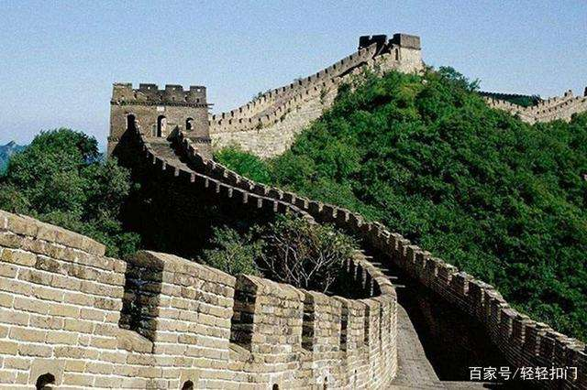
They use the same flag , known as Union Jack, as well as share the same currency and military defence.
defence
1. The Great Wall was our main military __________ against enemies in ancient times.
2.To defend ____________ disease, we should lead a healthy life.
3. She stepped back as if in ________(defend).
from/ against
defence
[Summary]
in defence of 保护/保卫.....
defend from/ against 保护...免受....
defend oneself against 为自己辩解

Slide 23
as well as 同；和，还
★as well as 连接两个并列句子成分，连接两个主语时，谓语动词应与________ 主语保持一致。
★as well 也，又（常放在句尾，相当于too）
前面的
①English , ___________Chinese and maths, is of great importance.
②The famous musician, as well as his students, ____________ (invite) to perform at the opening ceremony last month.
as well as
was invited

Slide 24
▲a striking image
strike---struck---struck--striking(adj.显著的)
打;撞击; 罢工; 侵袭；袭击; 突然想到；（钟）敲响报时; 划(火柴)
1.某人突然想到……
2.被……打动；深受感动
3.趁热打铁。
4.两者兼顾；达到平衡
5.在罢工
6.打击者；罢工者
① It strikes sb.that...
② be struck by...
③ Strike while the iron is hot.
④ strike a balance between A and B
⑤ be/ go on strike
⑥ striker

Slide 25
练：
①Greatly by the beauty of the language，I thought how even today Shakespeare’s writing remains powerful and true.(strike)
②The idea suddenly________ me is that we should go to the City Square to have a look at the ___________ statue.
③The clock has just ________ three.
④The big earthquake struck the area. （袭击）
struck
struck
striking
struck

Slide 26
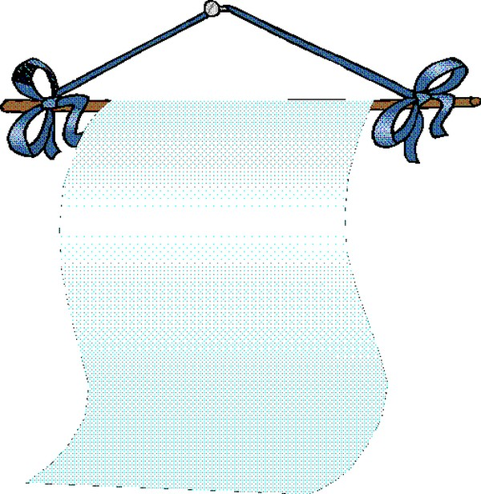
句
型
积
累

Slide 27
1. Getting to know a little bit about British history will help you solve this puzzle.
动名词短语做主语，谓语动词常用_________。
单数
Imitation：
①眼见为实。
_________ is believing.
②在阳光下看书对我们的眼睛有害。
_____________________ is bad for our eyes.
③学习哲学将为我们的生活打开另一扇窗。
_______________________ another window to our lives.
Seeing
Reading in the sun
Studying philosophy will open

Slide 28
2.They had castles built all around England, and made changes to the legal system.
表使役的动词：have, make, get等。
have /get/make + n. /pron. + p.p “使某事被做”
1. Speak a little louder to make yourself ________ by us all. (hear)
2. We should work harder to get the work ___________(recognize).
3. They are going to ______________________ (种些树)
Attention: have ＋宾语＋过去分词”结构中具有以下含义：
1. 主语“请别人做某事”
He wants to have his eyes examined tomorrow.
（“检查”的动作由医生来进行）
2. “遭受某一不愉快、不测的事情”
Be careful, or you'll have your purse stolen.
heard
recognized
have some trees planted

Slide 29
3.The peaceful landscape of the “Emerald Isle” and its many green counties is a true feast for the eyes, with its rolling green hills dotted with sheep and cattle.
with 复合结构
（1）with +n/pron+v-ing: 表示主动或正在进行的动作。
With summer coming near, it's time to buy cool clothes.
（2）with +n/pron+v.-ed: 表示被动或已经完成的动作。
① All the afternoon he worked with the door locked.
（3）with +n/pron+ to do: 表示将要发生的动作。
I can't go out with all these dishes to wash.

Slide 30
（4）with +n/pron+ prep . phrase 表示状态或说明情况。
①His wife came down the stairs, with her 2-year-old son in her arm.
②The boy is smiling with a book and a pencil in his hand.
(5). with + n./pron+ + adj 这里的形容词常表示状态。
He was shocked with his eyes wide open.
(6). with + n./pron+ adv. 副词常表示情况或状态。
①With John away, we've got more room.
②One family lived in a house with tall trees all round.

Slide 31
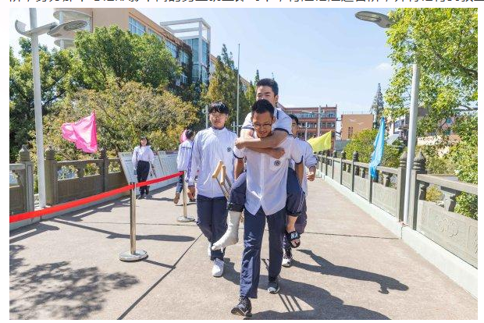

看图说话
With his leg broken
___________________________, he had to come to school with the help of his classmates.
The boy is smiling _______________________________________.
with a book and a pencil in his hand

Slide 32
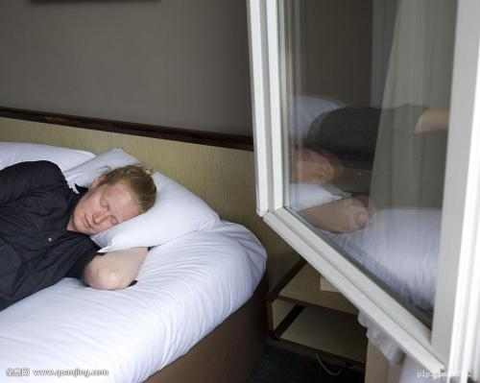
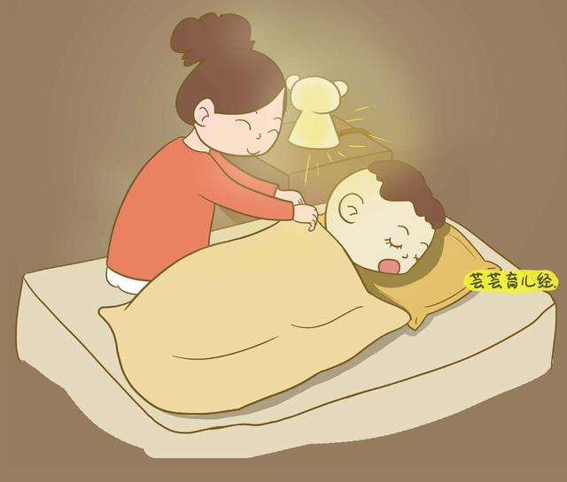
The baby fell asleep __________________.
The man is sleeping ___________________________
with the light burning/on
with the window open.

Slide 33
话题微写作---Learn about a country through its history
（1）许多人都很困惑以下几个名称的意义，联合王国，大不列颠，不列颠和英格兰，为了解决这个困惑，了解一点英国的历史很有帮助。(be puzzled about; solve the puzzle; 动名词作主语)
（2）16世纪，领国威尔士并入英格兰王国；紧接着18世纪也加入进来。（be joined to; followed by）
（3）20世纪爱尔兰南部脱离了联合王国，形成了今天的英国全称。(break away from )
（4）同属于联合王国的这四个国家在某些领域紧密合作，比如说同样的国旗和军事防御。(as well as, military defense)
（5）不管如何，被美丽的风景吸引以及随着对英国的更多了解，我迫不及待地想亲自参观一下。(strike, with结构)

Slide 34

Many people are puzzled about the meanings of the names : the United Kingdom, Great Britain, Britain and England, to solve this puzzle, knowing a little bit about British history will help.
In the 16th century, the nearby country of Wales was joined to the Kingdom of England, followed by Scotland in 18th century.
In the 20th century, the southern part of Ireland broke away from the UK, resulting in the full name we have today.
The four countries belonging to the United Kingdom work together in some areas, such as using the same flag as well as sharing the same military defense.
Anyhow, struck by the picturesque local scenery and with more knowledge of the UK, I can't wait to visit it in person.

Slide 35


Homework
Review what we have learned in this lesson and finish the students' sheet after class.

