Slide 1


感恩遇见，相互成就，本课件资料仅供您个人参考、教学使用，严禁自行在网络传播，违者依知识产权法追究法律责任。
更多教学资源请关注
公众号：溯恩高中英语
知识产权声明

Slide 2
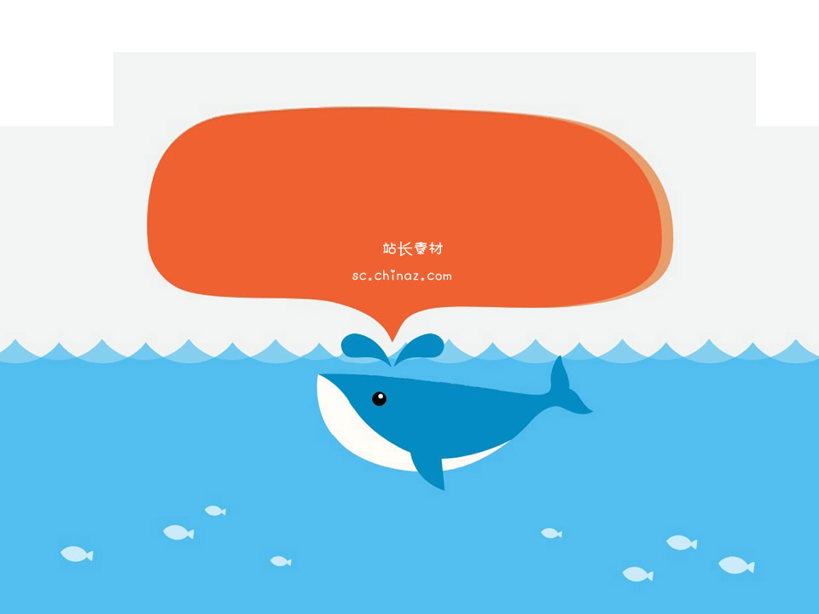
Make reservations
Listening and Talking

Slide 3
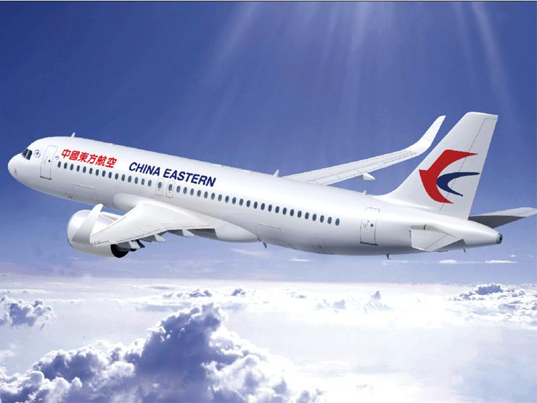
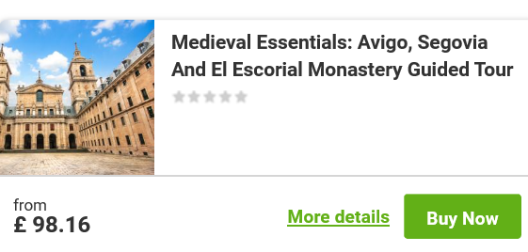
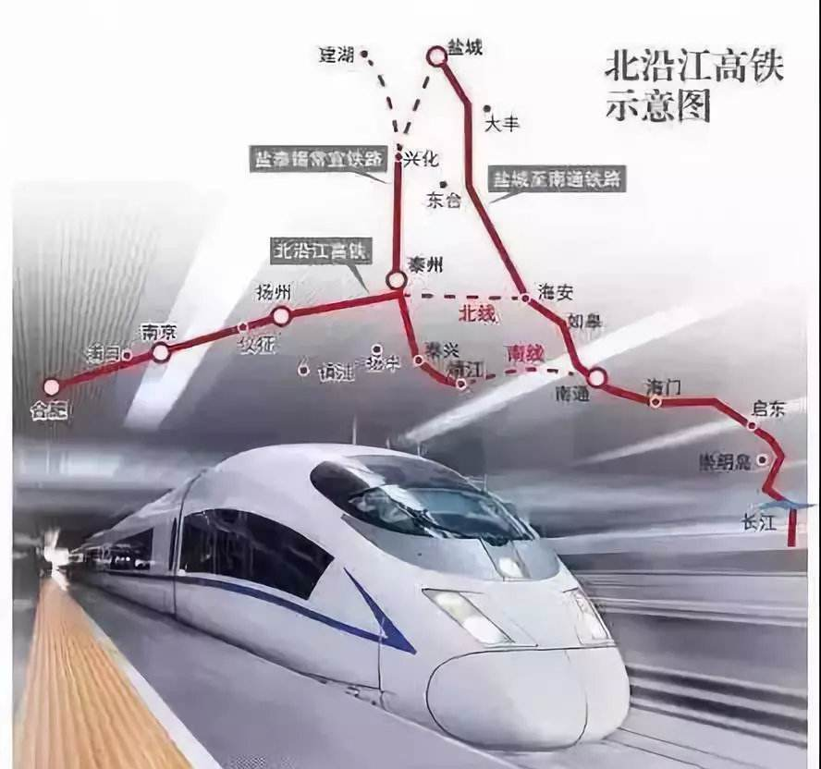
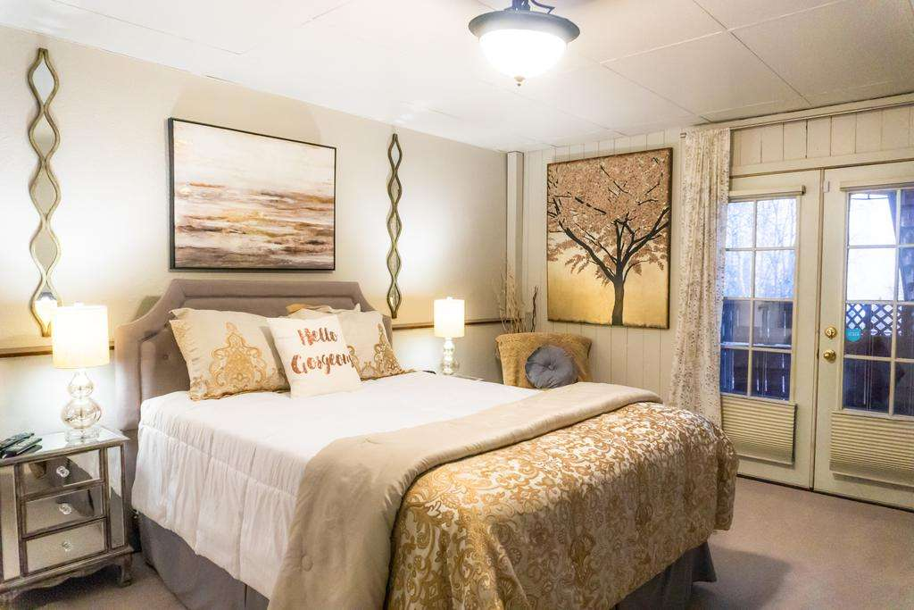
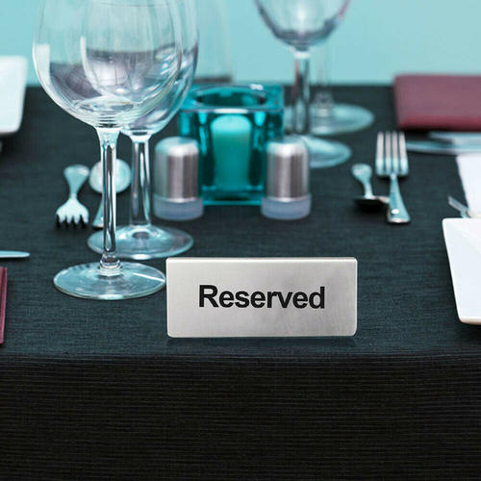
What reservations do we need to make before or when we travel?
book air/train tickets
book attraction tickets
book a hotel room
book a table for dinner

Slide 4
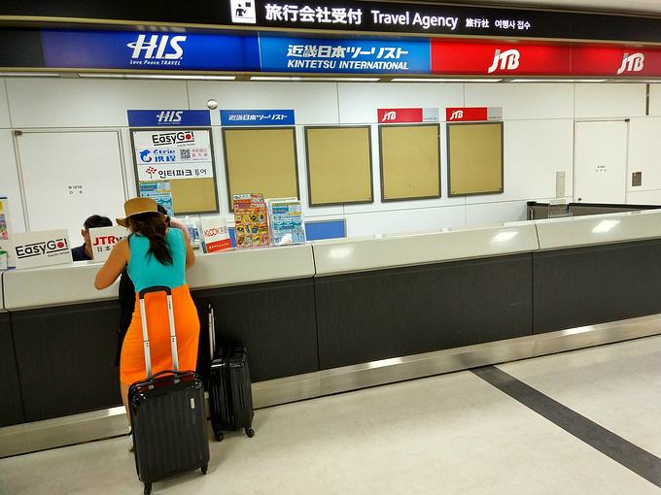
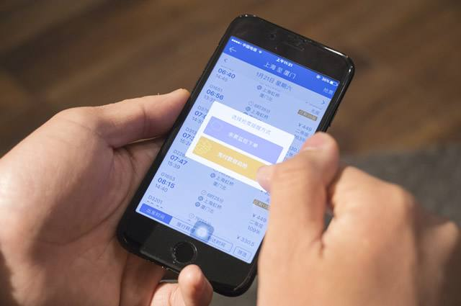



In what ways do people make reservations?
Face to face
Internet
E-mail
fax
Phone

Slide 5

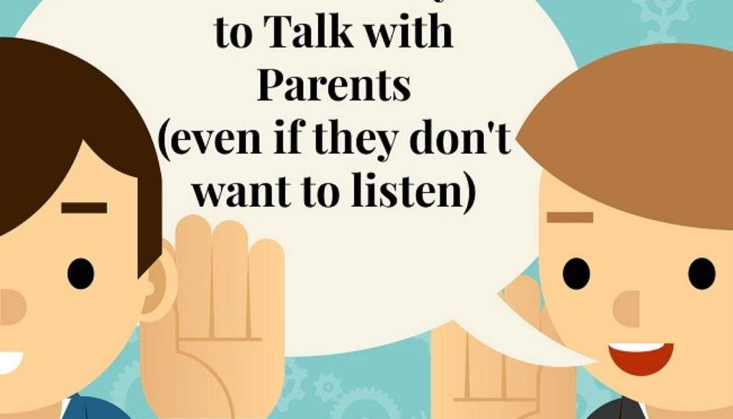
Listen and learn

Slide 6


Make reservations
1. Listen to the phone call and answer the questions.
(1) What are the two speakers talking about?
(2)What is the relationship between the two speakers?
Booking/ Buying a plane ticket
Focus on getting the main idea , not single words.
A. Teacher and student
B. Secretary and Manager
C. Customer and airline reservation agent

Slide 7
2. Listen again and complete the table with the words you hear.
I’d like to
Opening | ______ can I help you? | __________ to buy a plane ticket...
Talking about time | _________________ are you travelling? | On the 23rd of December
Talking about what you prefer | There are two flights... Which ______________? Would _______________ travel business class or economy? _______________ book a return flight this time? | The 9:30 flight, please. _________________ to travel business class. No, _____________. I’m taking the train back.
Other information | ___________ your name, sir? | Robert Williams
Payment | ____________________________ to pay? | By credit card
How
On what date
do you prefer
I’d like
you like to
thank you
Would you like to
May I have
May I ask how you would like

Slide 8
talk and learn

Slide 9
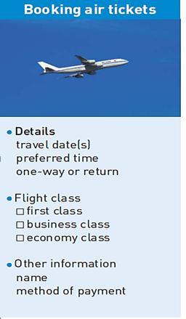
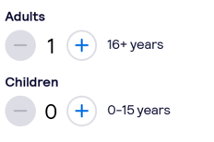
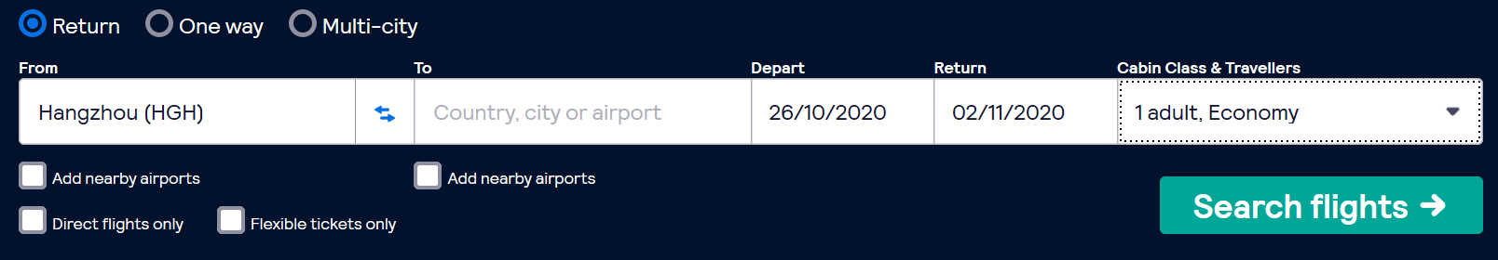
Language bank
Opening:
Closings
How can I help you?
What can I do for you?
Time&place:
On what date are you travelling…
When/where do you want to fly？
Preference:
Which do you prefer?
Would you like to …?
You want to go first class or…?
Other information:
Credit card
Cash
Wechat
Alipay
May I have your name/ tele number..?
How long/much is the flight?
Does the fare include all taxes?
How you would like to pay?

Slide 10
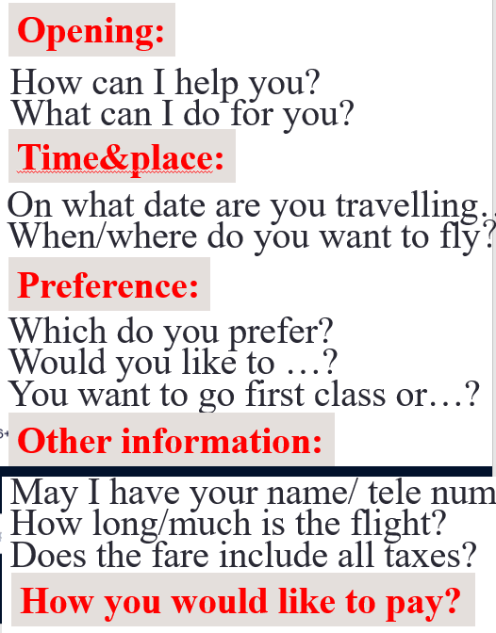
3.Imagine you are making plans for the holiday. Role play a phone call to book air tickets with a partner.
How much does it cost to upgrade to business class?
How many days in advance could I book a plane ticket?
Could I change my ticket now?
Could I cancel the reservation
Thank you for flying with us.
Closings

Slide 11
A:Good morning . The United Airlines . What can I do for you?
B:Yes, I'd like to make a reservation to Boston next week.
A:When do you want to fly?
B:Monday, September
A:We have Flight 802 on Monday .just a moment please. Let me check whether there're seats available. I'm sorry we are all booked up for Flight 802 on that day.
B:Then ,any alternatives?
A:The next available flight is leaving at 9:30 Tuesday morning September
B:er... it is a direct flight, isn't it?
A:Yes it is . You want to go first class or coach?
B:I prefer first class, what the fare?
A:One way is $176.
B:Ok I will take the 9:30 flight on Tuesday.
A:A seat on Flight 807 to Boston 9:30 Tuesday morning. Is it all right,Sir?
B:Right.can you also put me on the waiting list for the 12th?
A:Certainly.may I have your name & telephone number?
B:My name is Fay Fang. You can reach me at 52378651.
A:I will notify you if there is cancellation.
B: Thank you very much.
A:My pleasure.
The present continuous tense can be used to describe future plans and arrangements.
Use formal and polite expressions
A sample

Slide 12
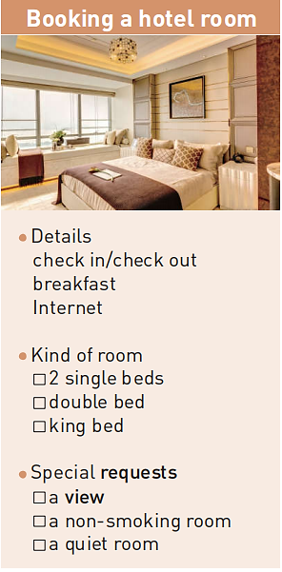
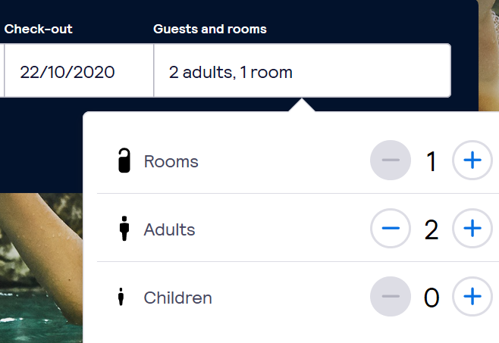
Making a Hotel Reservation
A room with a view风景房
A standard room标间
double rooms and single suites available双人房和单人套间有空房 twin bed 两张单人床
Level of hotel 酒店星级
Hotel facilities酒店设施
Pick-up service接车服务
360RMB per night containing two breakfast tickets

Slide 13

Language bank
I’d like to book a room for next Monday.
I would like to know if you have availability？
How long are you staying?
What kind of room would you like?
What’s the room rate (房价)?
Do you have free Internet service?
Opening
Time
Preference
Other information
Ways of payment
Closing
I’d like to reserve a room for two days.
When are you checking in(入住） and checking out（退房）?
I’d like a room with two single beds.
Is breakfast included?
How would you like to pay?

Slide 14
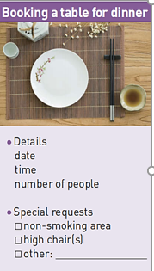
Making a Dinner Reservation
Opening
Time
Preference
Other information
Ways of payment
Closing
I'd like to reserve a table for eight.
Could we sit in the non-smoking area?
I'd like a quiet corner, if possible.
Can we take the small table by the window?
I' m afraid we don't have any tables open at that time.

Slide 15
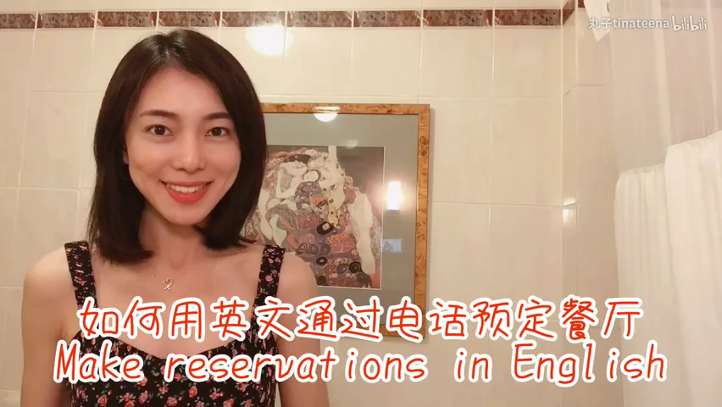
A:Good evening, dragon restaurant. May I help you?
B:Good evening. I’d like to make a dinner reservation for this Friday, the 8th.
A:Alright, just a moment please and I’ll check our reservations book. Okay, how many people are there in your party?
B:There’ll be six, four adults and two children.
A:What time would you like the reservation for?
B:6:30,please.
A:Alright, and what is your name?
B:It’s Shelly Jackson.
A:OK, Ms. Jackson. So, that’s a party reservation for six, Friday, the 8th at 6:30.
B:Yes, that’s right. Thank you very much.
A sample

Slide 16
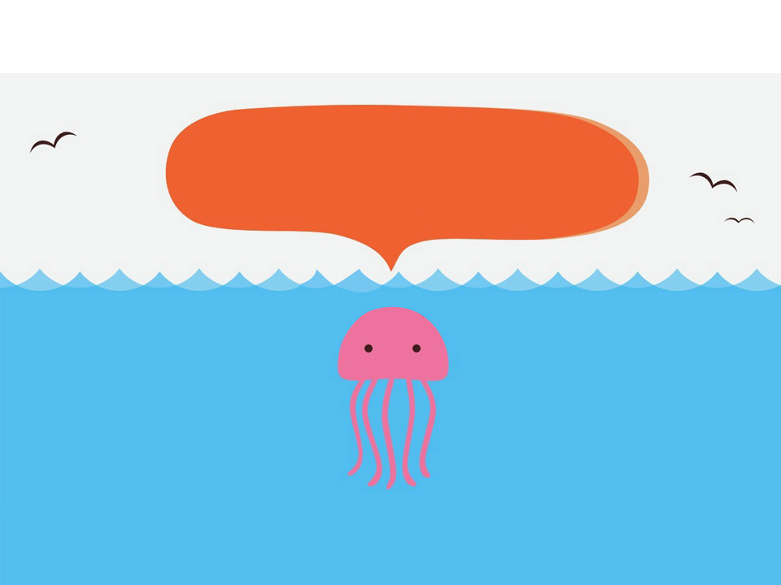
Bye Bye

