Slide 1


感恩遇见，相互成就，本课件资料仅供您个人参考、教学使用，严禁自行在网络传播，违者依知识产权法追究法律责任。
更多教学资源请关注
公众号：溯恩高中英语
知识产权声明

Slide 2
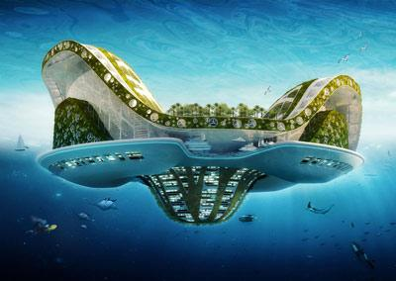
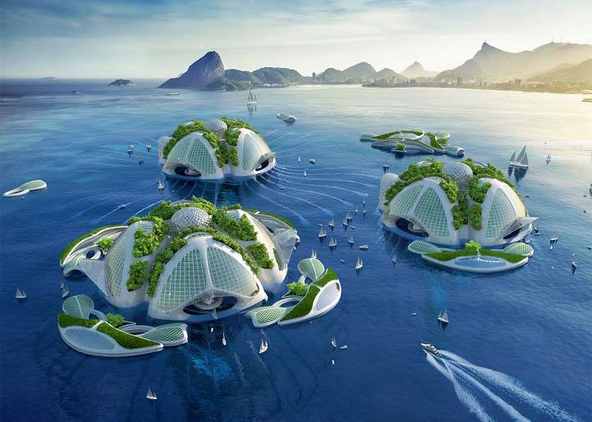
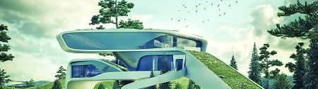
Looking into the future
Unit 2
The best way to predict the future is to create it.
——Peter Drucker

Slide 3
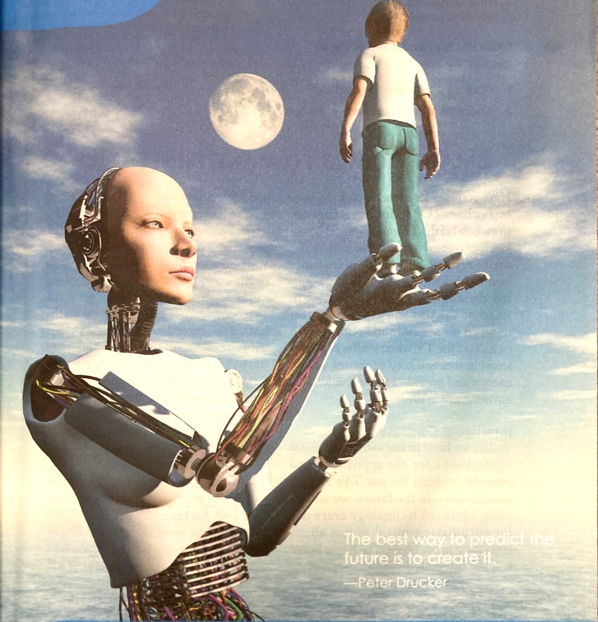
I. Viewing and Speaking
1. What can you see in the picture?
2. What do the boy, the robot and
the universe probably stand for?
3. Based on what the boy is doing,
what message does this picture
intend to convey?
♦the boy: human beings
conquer?
♦the robot: science technology
♦the universe: infinite future ahead
surrender?
live in harmony?
♦the possible future relationship
between man and technology

Slide 4
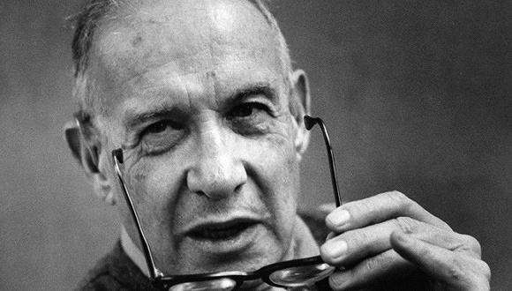
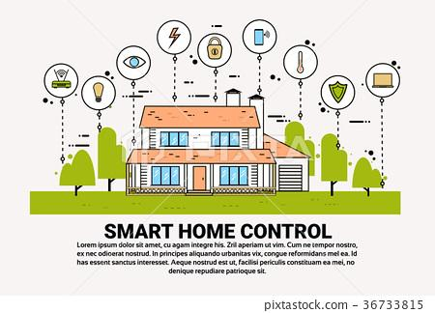
The best way to predict the future is to create it.
——Peter Drucker
How do you understand the quote?
4. Watch a video about Zuckerberg's home and think about the two questions:
1) Use one adjective to describe his home.
2) What changes will technology bring our homes in the future?
♦baby-sitting
Smart homes
make
life Easier
♦entertainment
♦house arrangement
♦...

Slide 5
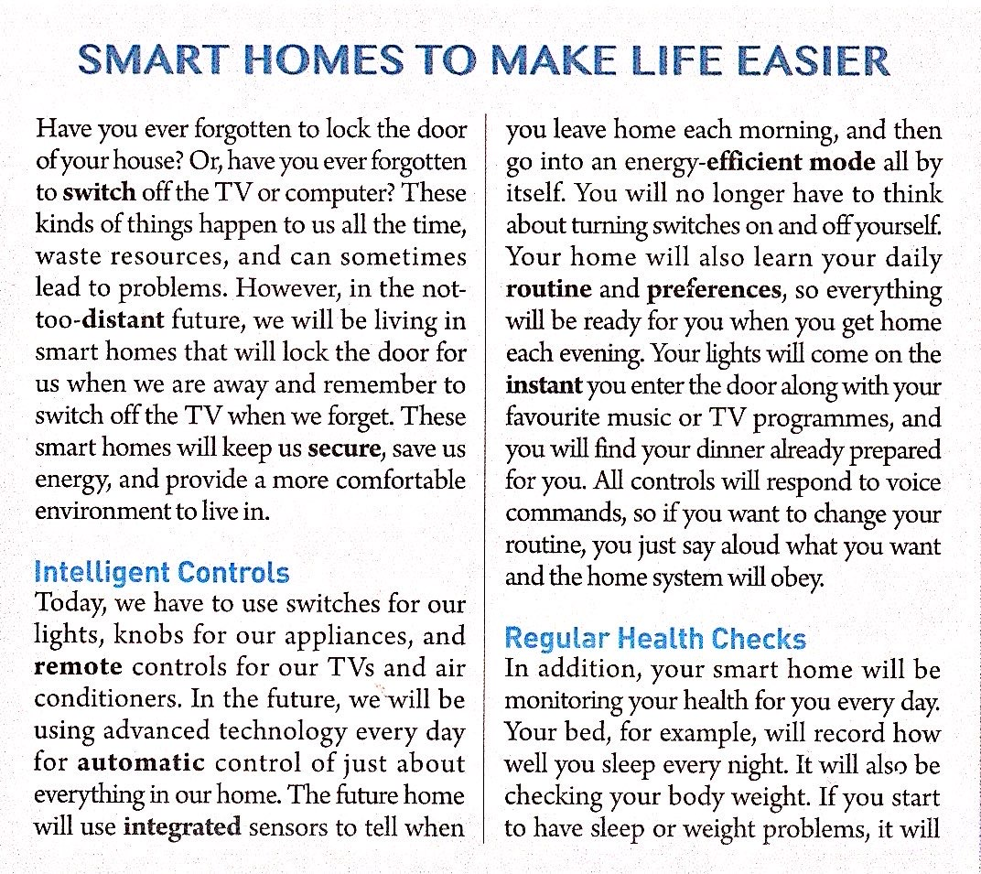
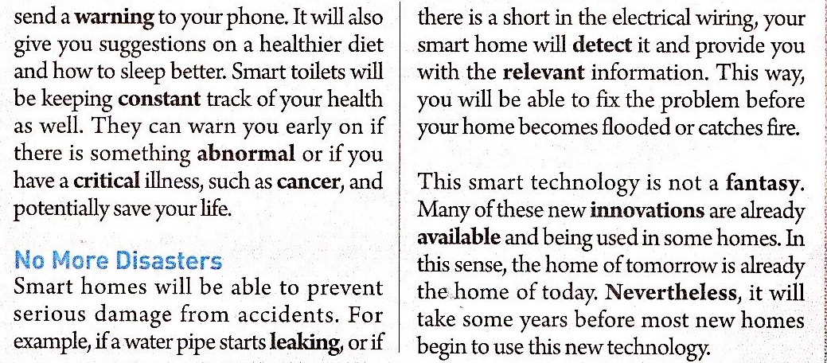
II. Reading and Thinking
1. Skim the text quickly and answer the
following questions:
(1) What's the type of this text?
(2) What's the structure of this text?
(3) What's its purpose?
(4) Who is the intended readers?
Title
Introduction
exposition
Body
subtitle₁
subtitle₂
subtitle₃
To inform readers of smart homes
Home owners who are interested in turning their homes smarter
Conclusion

Slide 6

2. Why does the writer raise two questions in the very beginning?
♦To attract readers' attention
Why could such questions attract readers' attention?
♦To lead to the topic
the shared experience (empathy)
3. What's the following sentences about?
To signal the coming of what the writer emphasizes.
▪ What can smart homes do?
▪ What's smart homes like?
However, in the not-too-distant future, we will be living in smart homes that will lock the door for us when we are away and remember to switch off the TV when we forget. These smart homes ill keep us secure, save us energy, and provide a more ccomfortable environment to live in.
▪ What benefits will smart homes bring us?
▪ What's the benefits of smart homes?

Slide 7
4. Form a Reading Circle in groups of four. Each student plays one of the following
roles to analyze Paragraph 2-4:
Role | Focus | Questions to ask
Content analyst | What's going on? | ♦What's the text about?
 |  | ♦Who does what to whom, how, when and where?
Structure builder | How is the text organized? | ♦How does the text organize the message?
 |  | ♦How are ideas presented and developed?
Language master | What's the language feature? | ♦How does the writer use words and sentences to express ideas?
Paragraph | Role | Name | Questions | Answer
2 | Content analyst | Lucy | What makes all these intelligent controls possible? | ...

Slide 8


▪ Intelligent Controls
5. How will the automatic controls make our homes smarter?
♦using integrated sensors to change the environment into
energy-efficient mode
♦Making everything ready by learning your daily routine and preferences.
6. What makes all these automatic controls possible?
♦advanced technology
7. How could we control the automatic controls?
♦By saying aloud (voice commands)

Slide 9
8. How does the writer show the automatic controls are intelligent?
content: direct description
The future home will use integrated sensors to tell when you leave home each morning...Your home will also learn your daily routine and preferences...
Structure: contrast
Today, we have to use switches for our lights, knots for our applicances...In the future, we will be using advanced technology every day for automatic...
Language:
rhetorical device
(personfication)
The future home will use integrated sensors to tell when you leave home each morning...Your home will also learn your daily routine and preferences...Your lights will come on the instant your...All controls will respond to voice commands, so if ...
...every day for automatic control of just about everything in our home...and the go into an energy-efficient mode all by itself. You will no longer have to think about turning switches on and off yourself...so everything will be ready when you get home each evening. Your lights will come on the instant your enter the door...and you will find your dinner already prepared for you. All controls will respond to voice commands...you just say aloud what you want and the home system will obey.
Language:
adj and adveb
(vivid and strong)

Slide 10
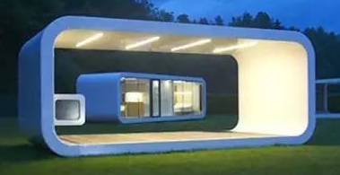
▪ Regular Health Checks
9. What in your smart homes will monitor your health? And what can they do
specifically?
♦smart bed
record sleep quality
check body weight
advise healthy diet
♦smart toliets
send warnings on abnormal physical condition or critical illness
10. Why does the writer use the sentence pattern “Your bed will...It will...it
will...It will...Smart toliets will...”?
♦To create a kind of feeling that smart home could solve all the
problems you meet.
11. How is the paragraph developed? Draw a tree map.
♦By example

Slide 11

▪ No More Disasters
12. How could smart homes prevent your home from serious disasters?
♦By quickly detecting the problem and providing relevant information
13. How is this paragraph developed?
♦By example
14. Why does the writer say “the home of tomorrow is already the home of
today”? How do you understand it?
Not a Fantasy;
a Reality
♦the home of tomorrow: new innovations
♦the home of today: a few new things already available
15. What's the writer's attitude towards smart homes
according to the last paragraph?
♦supportive but rational

Slide 12
16. Draw a mind map to show the content and structure of the text.
integrated sensors to switch mode
How do you understand “smart”?
intelligent controls
prepare everything ready for you
Smart Homes
to Make
Life Easier
record sleep quality
bed
check body weight
regular health check
advise healthy diet
toliet
sned warnings on illness
technologically-intelligent
disaster prevention
detect problems and provide information
user-friendly
benefits
provide security
save energy
provide comfortable environment

Slide 13
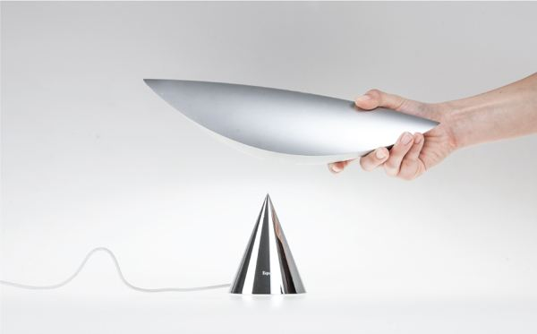
III. Activity
17. Why does the writer begin many sentences with “you”, which seems
inappropriate in writing an exposition?
18. What do you think of smart homes? What are the disadvantages and
disadvantages smart homes have?
19. If you are able top create a smart device for your home, what will you
create? Write about your creation. You are supposed to include:
▪ a name indicating the device;
▪ a general introduction to the new device;
▪ examples illustrating its new function;
▪ the benefits the new device can bring.
(draw a picture to illustrate more clearly
and vividly)

