Slide 1


感恩遇见，相互成就，本课件资料仅供您个人参考、教学使用，严禁自行在网络传播，违者依知识产权法追究法律责任。
更多教学资源请关注
公众号：溯恩高中英语
知识产权声明

Slide 2





Suggestion Letter
月考试卷作文讲评
东阳中学 周英巧 2020.10.15

Slide 3

Original material
假定你是李华，你的英国朋友Peter来信就下周三要参加孔子学院（the Confucius Institute）的面试征询你的意见。请你写封回信，内容包括：
1. 写信目的；
2. 提出建议（至少两条）；
3. 表示祝愿。
注意：1. 词数100左右；
2. 可适当增加细节，以使行文连贯
3. 孔子学院是中外合作建立的非营利性机构，致力于增进世界各国人民对中国语言文化的了解，加强中国与世界各国教育文化交流合作。

Slide 4
假定你是李华，你的英国朋友Peter来信就下周三要参加孔子学院（the Confucius Institute）的面试征询你的意见。请你写封回信，内容包括：
1. 写信目的；
2. 提出建议（至少两条）；
3. 表示祝愿。
注意：1. 词数100左右；
2. 可适当增加细节，以使行文连贯
3. 孔子学院是中外合作建立的非营利性机构，致力于增进世界各国人民对中国语言文化的了解，加强中国与世界各国教育文化交流合作。
interview 面试
interviewer 面试官
interviewee 被面试者
candidate 候选人/考生

Slide 5
假定你是李华，你的英国朋友Peter来信就下周三要参加孔子学院（the Confucius Institute）的面试征询你的意见。请你写封回信，内容包括：
1. 写信目的；
2. 提出建议（至少两条）；
3. 表示祝愿。
注意：1. 词数100左右；
2. 可适当增加细节，以使行文连贯
3. 孔子学院是中外合作建立的非营利性机构，致力于增进世界各国人民对中国语言文化的了解，加强中国与世界各国教育文化交流合作。
1. Writing style文体：
2. Theme 主题：
3. Tense 时态：did? do? will do
4. Content 要点:
letter
suggestions for interview
do
purpose，suggestion，wish

Slide 6
A good understanding of the requirements is half done.
假定你是李华，你的英国朋友Peter来信就下周三要参加孔子学院（the Confucius Institute）的面试征询你的意见。请你写封回信，内容包括：
1. 写信目的；
2. 提出建议（至少两条）；
表示祝愿。
注意：1. 词数100左右；
2. 可适当增加细节，以使行文连贯
3. 孔子学院是中外合作建立的非营利性机构，致力于增进世界各国人民对中国语言文化的了解，加强中国与世界各国教育文化交流合作。
What you write should be closely related to the topic.

Slide 7


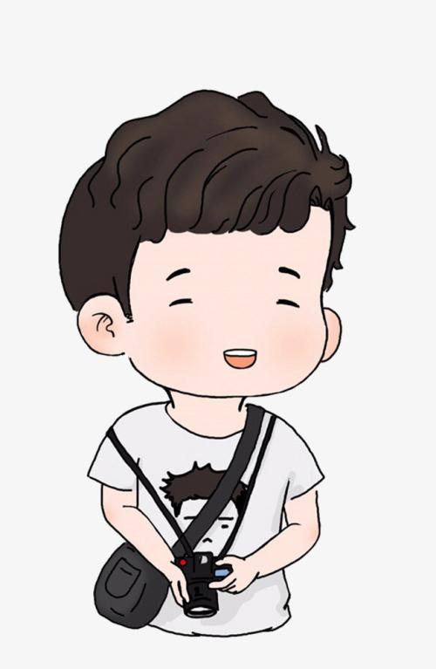
假定你是李华，你的英国朋友Peter来信就下周三要参加孔子学院（the Confucius Institute）的面试征询你的意见。请你写封回信，内容包括：
1. 写信目的；
2. 提出建议（至少两条）；
3. 表示祝愿。
注意：1. 词数100左右；
2. 可适当增加细节，以使行文连贯
3. 孔子学院是中外合作建立的非营利性机构，致力于增进世界各国人民对中国语言文化的了解，加强中国与世界各国教育文化交流合作。
Li Hua
Peter
You
The information here is listed to help you know what kind of suggestions you can make.
Who is the sentence written for?

Slide 8

Format
Dear Peter,
Para. 1 -----background information+ purpose
Para. 2------------suggestions (> 2)
Para. 3---------conclusion + wishes
Yours,
Li Hua

Slide 9
A good beginning is half done.
Para. 1(background information + writing purpose):
Learning that you will have an interview for the Confucius Institute which is to be held next Wednesday, I’m writing to give you some suggestions.
schedule
Glad to receive your letter asking me for some advice on the interview for the Confucius Institute scheduled for this coming Wednesday. I’m writing to remind you of what to prepare for it.

Slide 10
Proper suggestions lead to an excellent version.
Para.2 :Suggestions
What suggestions can we give?
learn a few Chinese greetings
wear Han-style clothing
...
Discuss with your partners to give more suggestions.

Slide 11
●learn a few Chinese greetings
●wear Han-style clothing
●learn Chinese history and culture
●read some books about Confucius
●learn some Chinese manners
◎arrive on time
◎leave a good impression
◎keep smiling
◎be confident, polite and calm
◎good communication skills
◎dress properly
◎be well prepared
◎sleep well
Proper suggestions:

Slide 12
Why not ...;
It's important to do...;
If I were you, I would...;
I would like to suggest you should do...;
It is advisable to ...;
It is a brilliant way to ...;
It is essential for you to ...
It couldn't be better than...;
It should be a good idea to do...;
It will certainly help a lot if you ...;
It would be beneficial if you could ...;
It never fails to be a wise choice to do ...;
...
Useful
sentence patterns:

Slide 13
Proper version:
First, you are advisable to calm yourself down. The confucius Institute was designed to help foreign guests know Chinese culture better. So believe that you are capable of it. Furthermore, I can't emphasize the significance of smiling. It can't be better if a smile is always on your face which will bring others warmth. In addition, preparing well is also a good way to help you stand out in the group. Last but not least, rest well before the interview, which will offer you a clear mind in the interview.

Slide 14
A good ending makes the composition completed.
Para. 3(conclusion + wish):
1. I hope my suggestions will be beneficial. Good luck to you!
More versions:
2. Anyway， I do/sincerely hope that my advice will be of great use/help.
I'm convinced that you will make it!
3. With a sincerce heart, I hope that my advice can be of some value to you. You are bound to (一定) make it finally.
4. I hope my advice can make a big difference. And I'm looking forward to hearing your good news.

Slide 15
Writing sample:
Dear Peter,
Glad to receive your letter asking me for some advice on the interview for the Confucius Institute scheduled for this coming Wednesday. I’m writing to remind you of what to prepare for it.
It would be wise of you to read some books about Confucius, which helps to better understand traditional Chinese cultures. It would also be beneficial to learn a few Chinese greetings. Additionally, wearing Han-style clothing will make you stand out among the candidates and impress the interviewers greatly.
I do hope my proposal could be practical. Wish you good luck!
Yours sincerely,
Li Hua

Slide 16
1. format
2. choice of words
3. sentence patterns
Dear Peter,
Glad to receive your letter asking me for some advice on the interview for the Confucius Institute scheduled for this coming Wednesday. I’m writing to remind you of what to prepare for it.
It would be wise of you to read some books about Confucius, which helps to better understand traditional Chinese cultures. It would also be beneficial to learn a few Chinese greetings. Additionally, wearing Han-style clothing will make you stand out among the candidates and impress the interviewers greatly.
I do hope my proposal could be practical. Wish you good luck!
Yours sincerely,
Li Hua
4. complete information
5. grammatical structure

Slide 17





Evaluation:
01
颜值
Your
comments:
3 sentences
format
handwriting
02
choice of words
言值
03
sentence patterns
04
complete information
05
grammatical structure
06

Slide 18
Homework:
Improve your passage and rewrite your composition.

Slide 19
Thanks for your attention!

