Slide 1
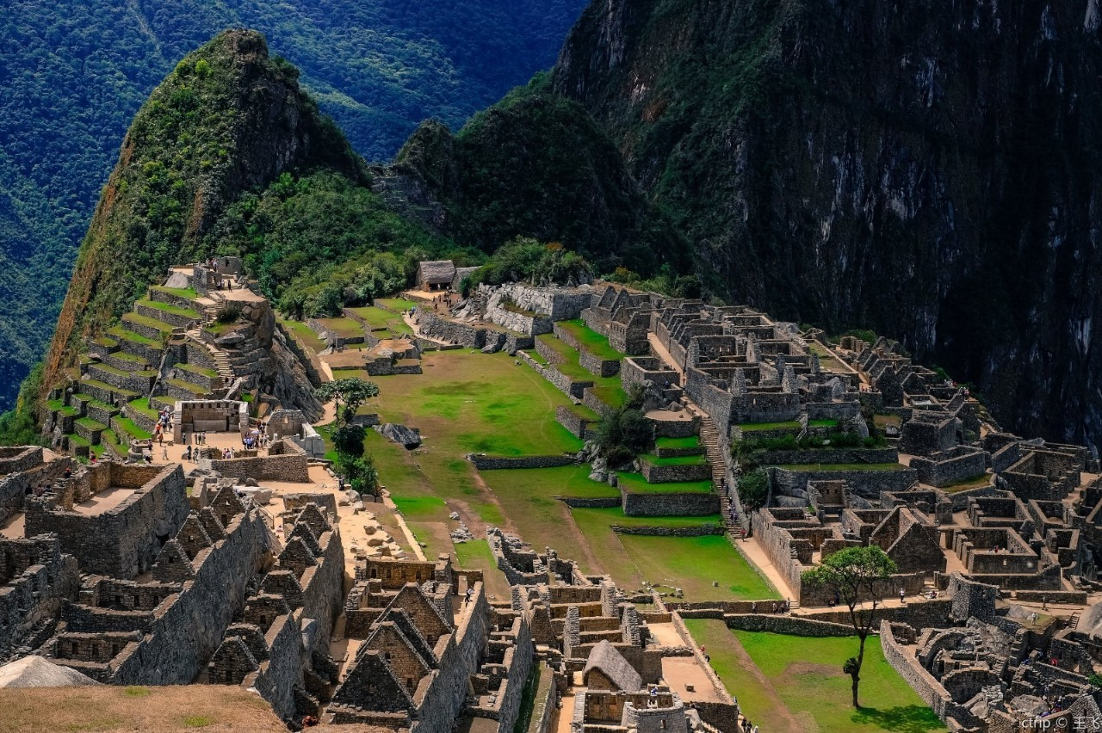
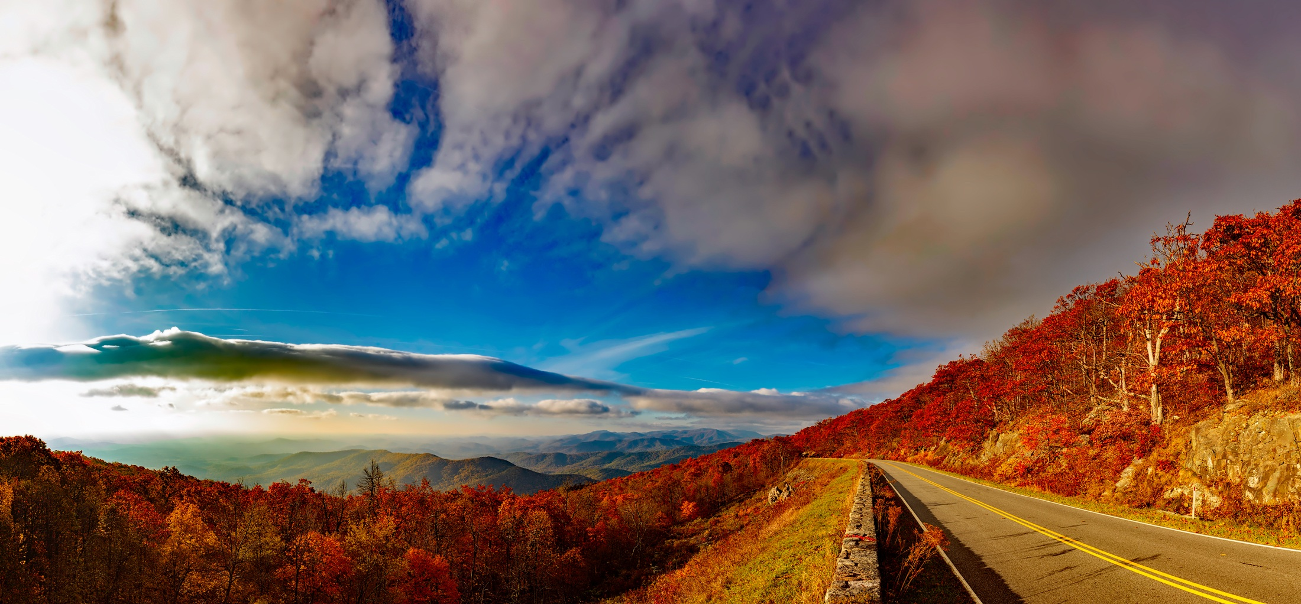

Unit 2 Travelling around
Period 2 Reading and Thinking
By Zhao Yiqun

Slide 2
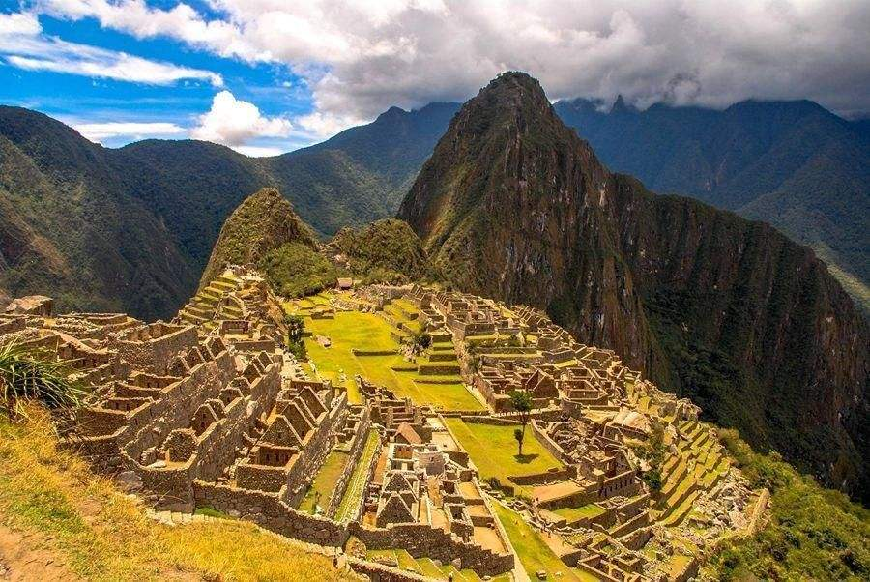
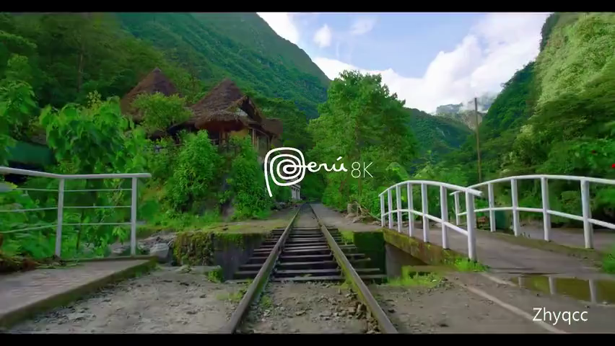
Welcome to Peru
What do you see in the video?
What impresses you most in the video?

Slide 3
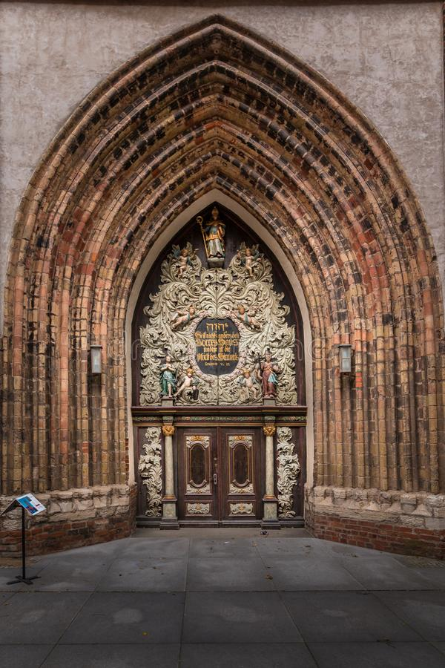
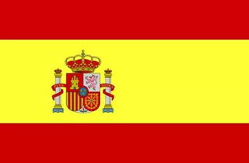

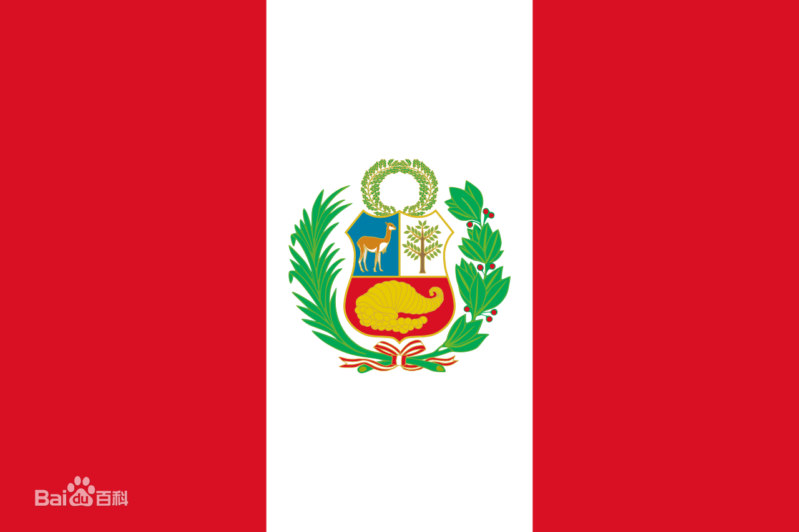
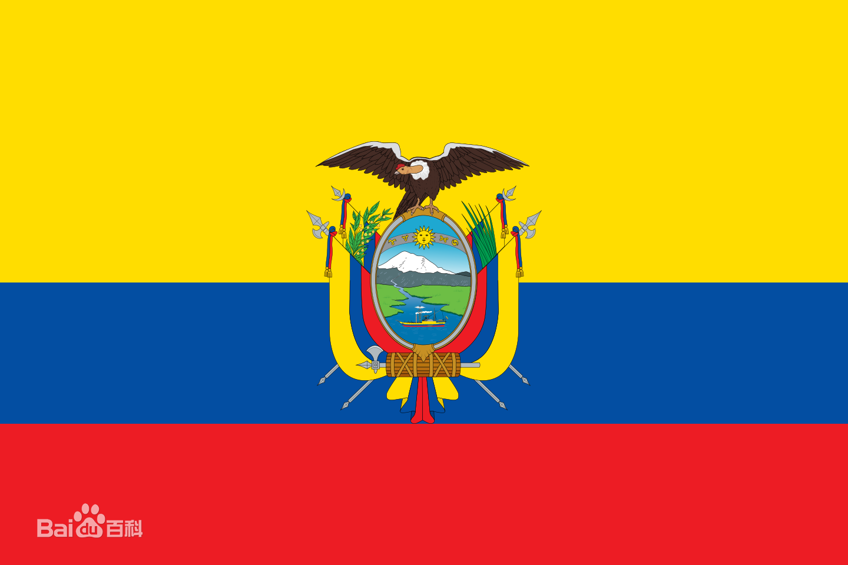
Basic Information of Peru
A
Lima
Capital
B
Spanish
Language
C
Flag
D

Slide 4
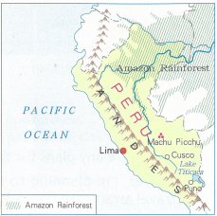

Read the text below. Look through it quickly. What type of text is it: encyclopedia or brochure?
PERU is a country on the Pacific coast of South America with three main areas: narrow, dry, flat land running along the coast, the Andes Mountains, and the Amazon rainforest.
In the 1400s and 1500s, Peru was the centre of the powerful ancient Inca Empire. The Inca emperor lived in the now-famous site Machu Picchu.
Spain took control of Peru in the 16th century and ruled until 1821. It is for this reason that Spanish is the main official language of Peru.
Recognise text type
Before you read, look through the text quickly for titles, headers, pictures, charts, and any other information that might tell you what type of text it is.

Slide 5
Basic Information of Peru
Location
on the _______ coast of _____________
Pacific
South America
___________________ running along the coast, ___________________, and __________________
narrow, dry, flat land
Main areas
the Andes Mountains
the Amazon rainforest
In the1400s and 1500s, _________________________________.
From the 1500s to 1821, _________________________________.
History
Peru was the centre of the Inca Empire
Spain took control of Peru

Slide 6




Read the text below. Look through it quickly. What type of text is it: encyclopedia or brochure?
PERU is a country on the Pacific coast of South America with three main areas: narrow, dry, flat land running along the coast, the Andes Mountains, and the Amazon rainforest.
In the 1400s and 1500s, Peru was the centre of the powerful ancient Inca Empire. The Inca emperor lived in the now-famous site Machu Picchu.
Spain took control of Peru in the 16th century and ruled until 1821. It is for this reason that Spanish is the main official language of Peru.
Location
An encyclopedia(百科全书） is a book or set of books in which facts about many different subjects or about one particular subject are arranged for reference, usually in alphabetical order.
Geographic characteristic
History
Language

Slide 7
Encyclopedia
Brochure
vs
expressive language
brief content
objective language
beautiful design
simple language
vivid pictures
clear structure
Focuses on basic geographic and historical information.
Introduces local travel information

Slide 8
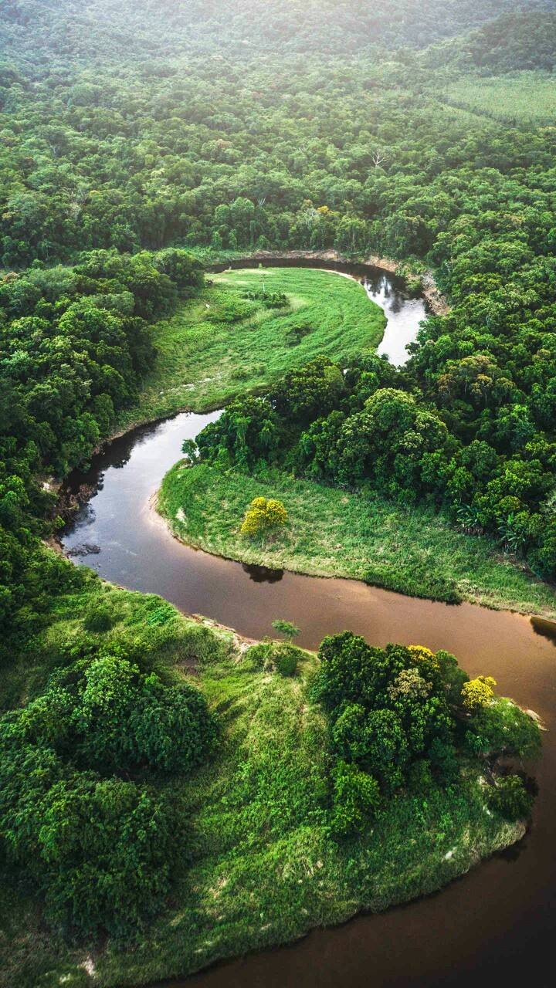
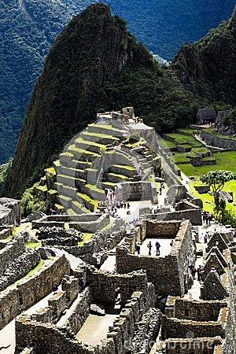
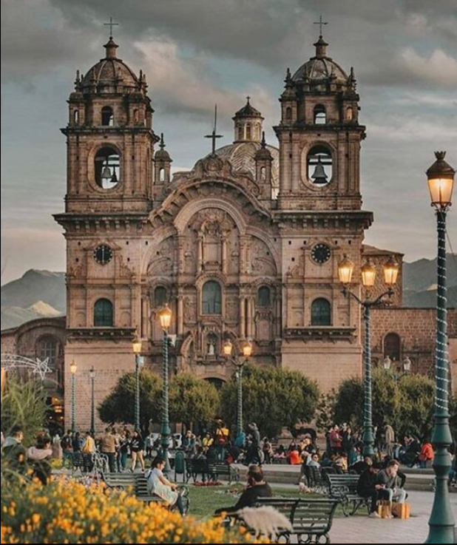
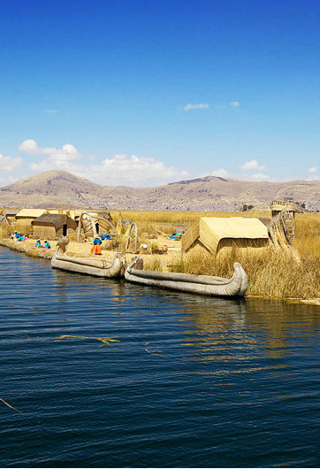
Travel Peru
Amazon Rainforest
Mchu Picchu
Lake Titicaca
Cusco

Slide 9
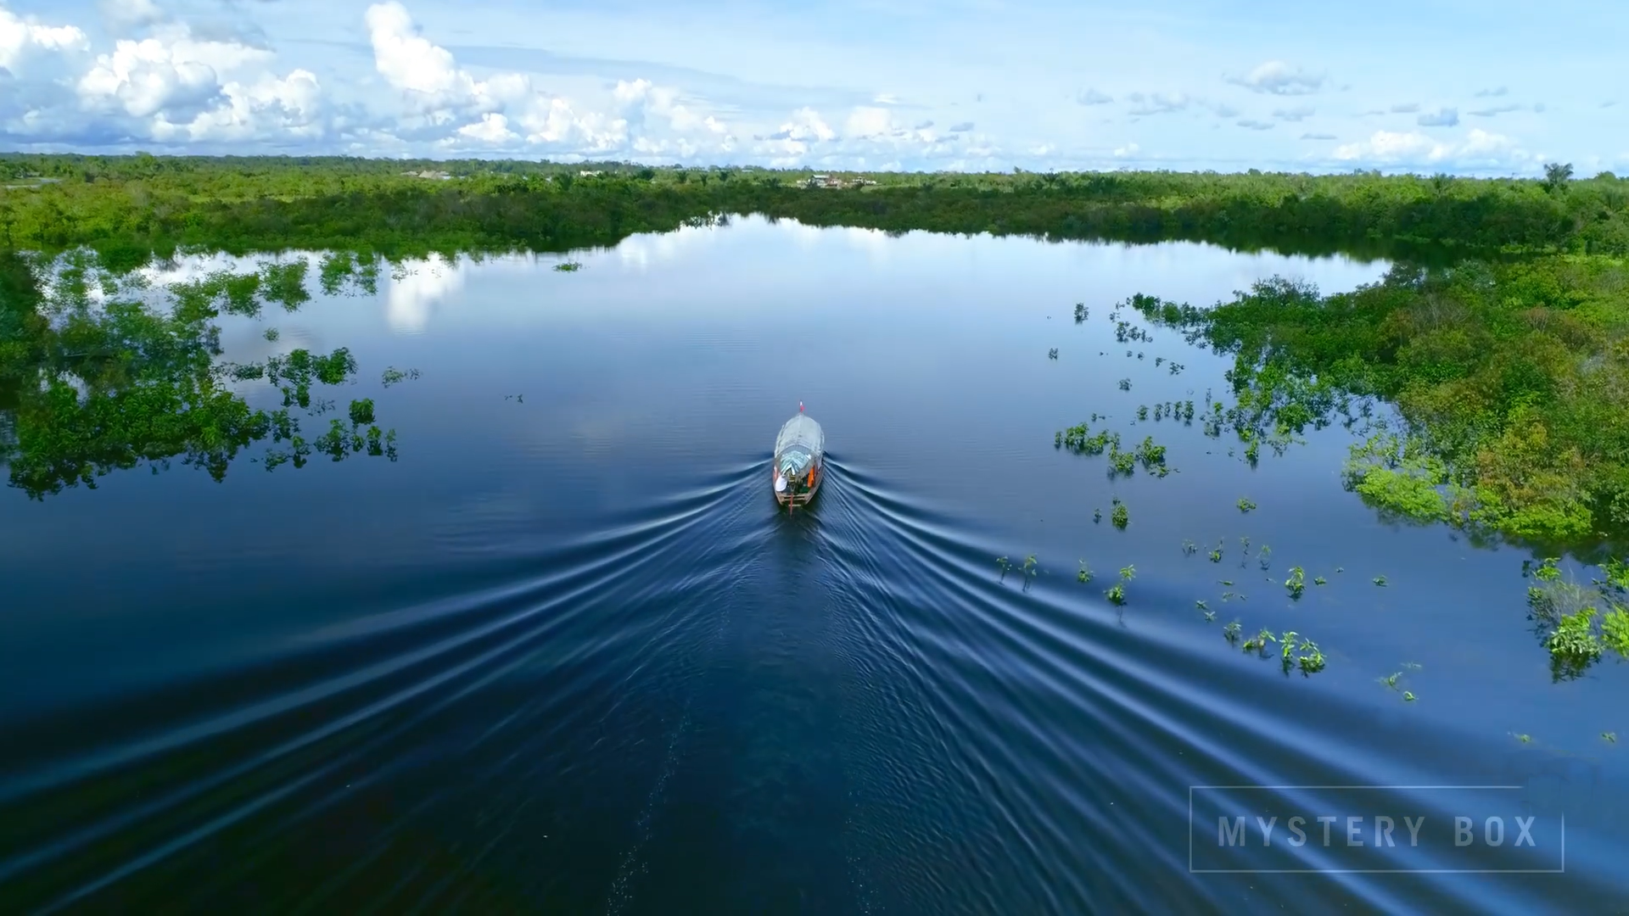
The Largest Rainforest in the World.
Amazon Rainforest Tour

Slide 10
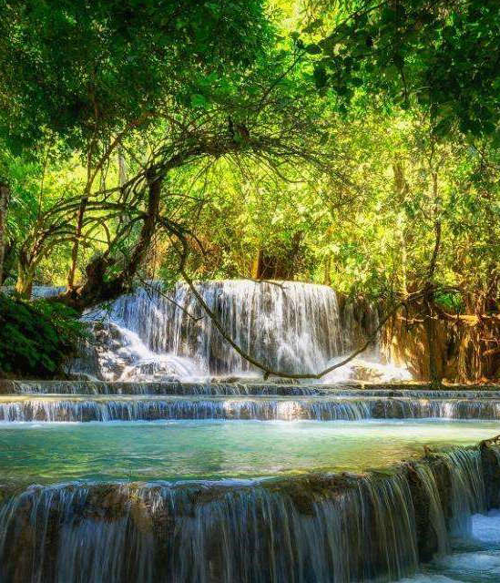
Amazon Rainforest
What kind of transport will you take to travel to Amazon Rainforest？
When travelling in Amazon Rainforest, where will you stay for nights?
How many days will you stay in Amazon Rainforest？
What will you enjoy in this tour?

Slide 11
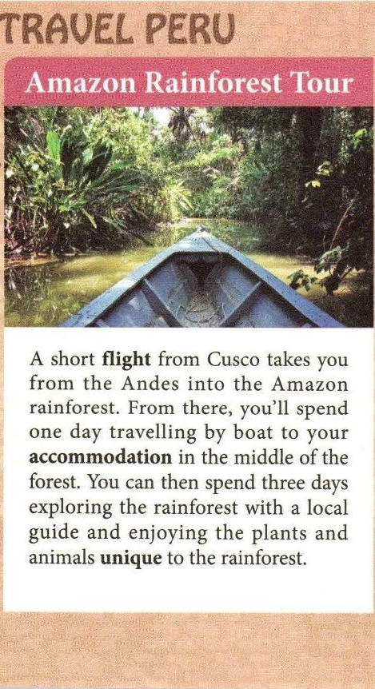
by air & boat
Transport
in the middle of the forest
Accomodation
boating
hiking
exploring the forest
Activity
enjoying the plants and animals
4 days

Slide 12
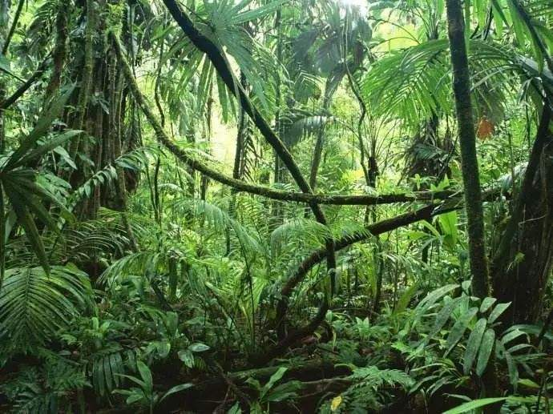
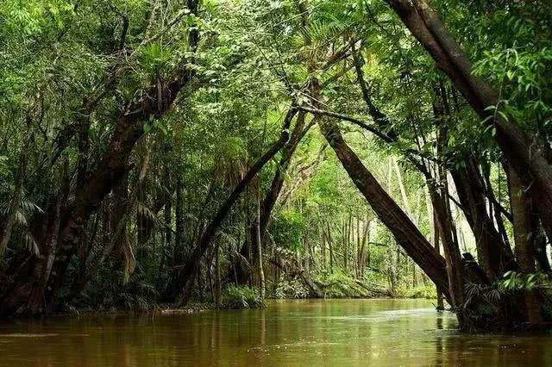
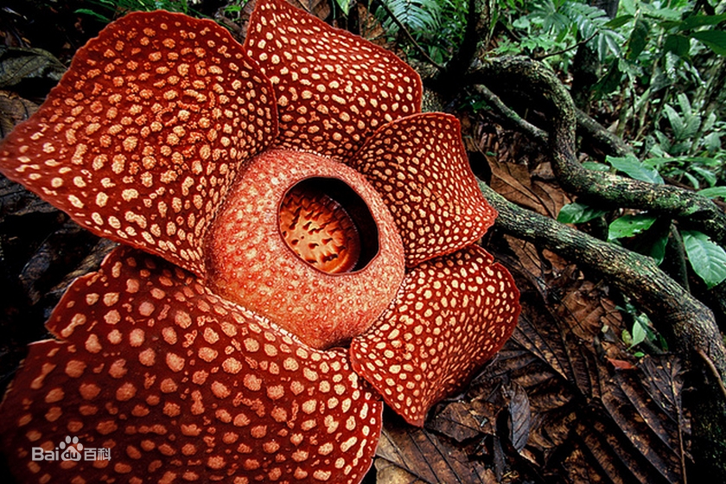
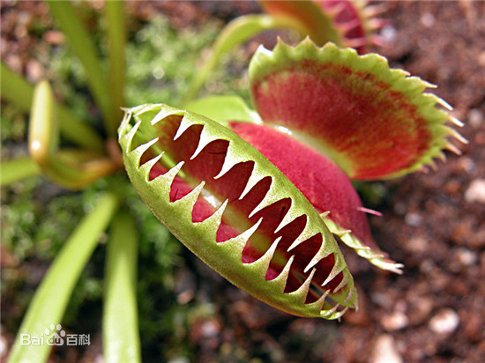
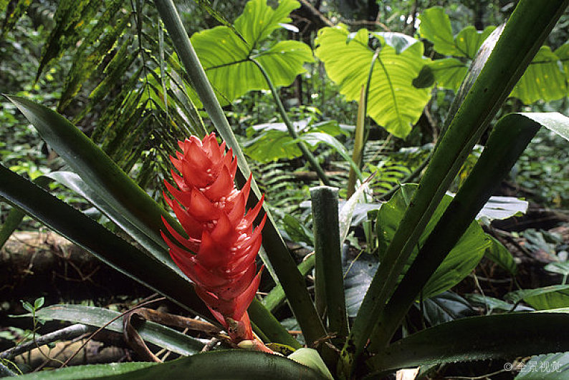
Travel destinations Iceland
11
Plants

Slide 13
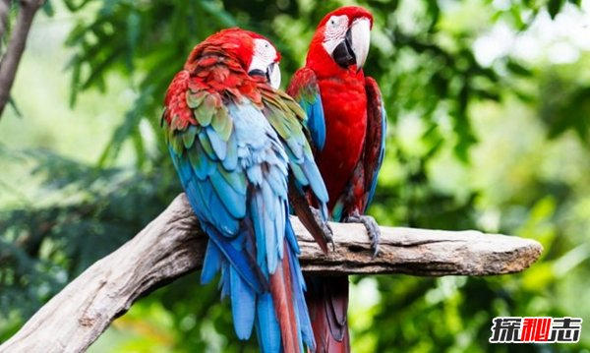
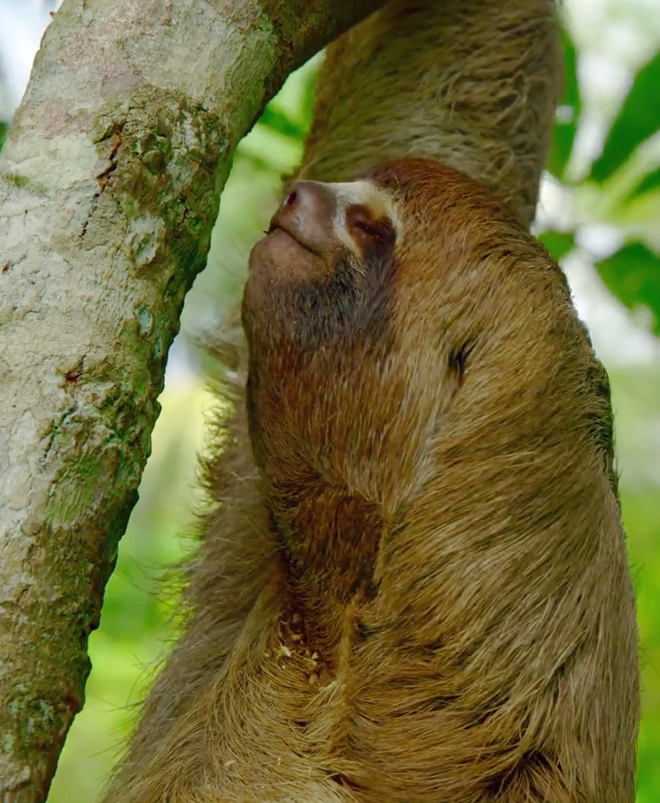
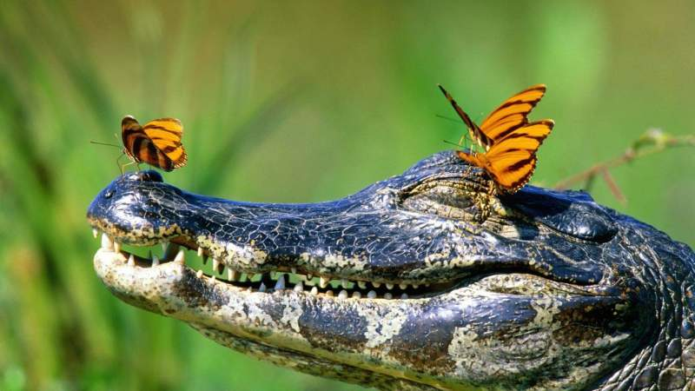
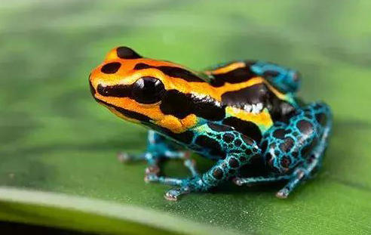
Travel destinations Iceland
11
Animals

Slide 14
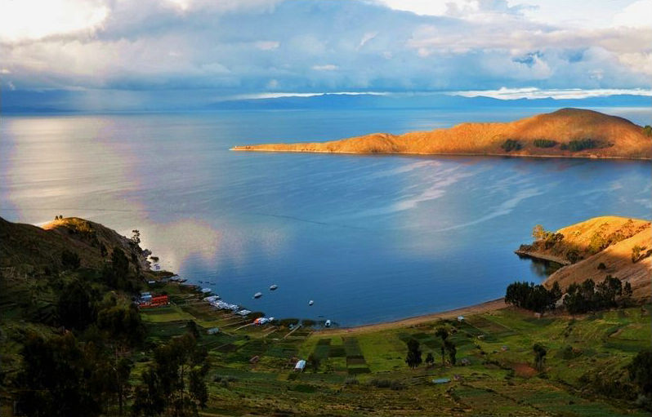
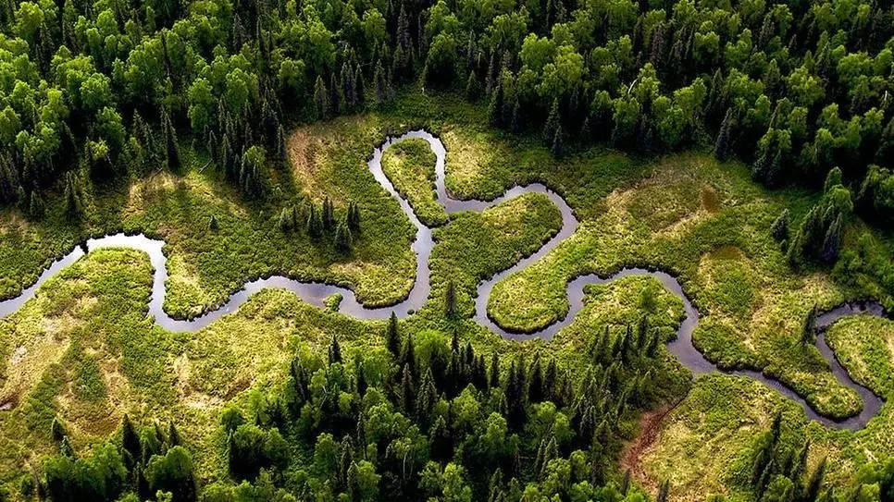
Amazon Rainforest
Unique
Fantastic
Rich/Abundant
Beauty of Nature

Slide 15
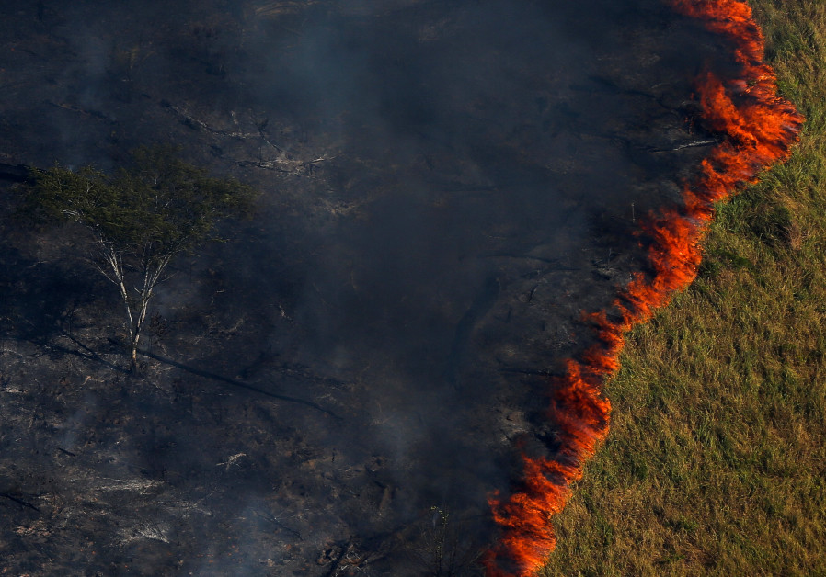
The Amazon Rainforest was on fire .

Slide 16
Machu Picchu Tour
World Heritage Site

Slide 17
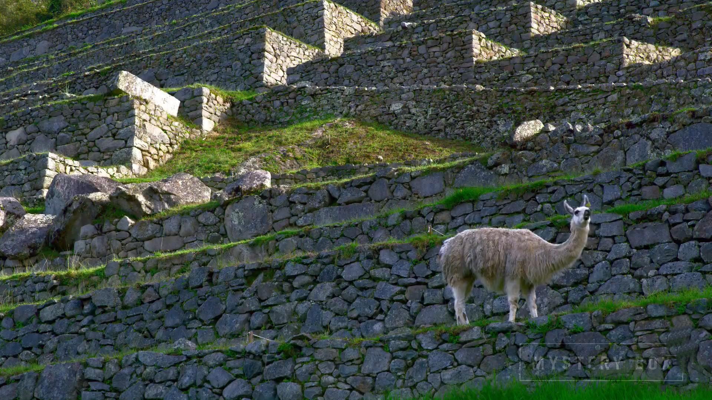
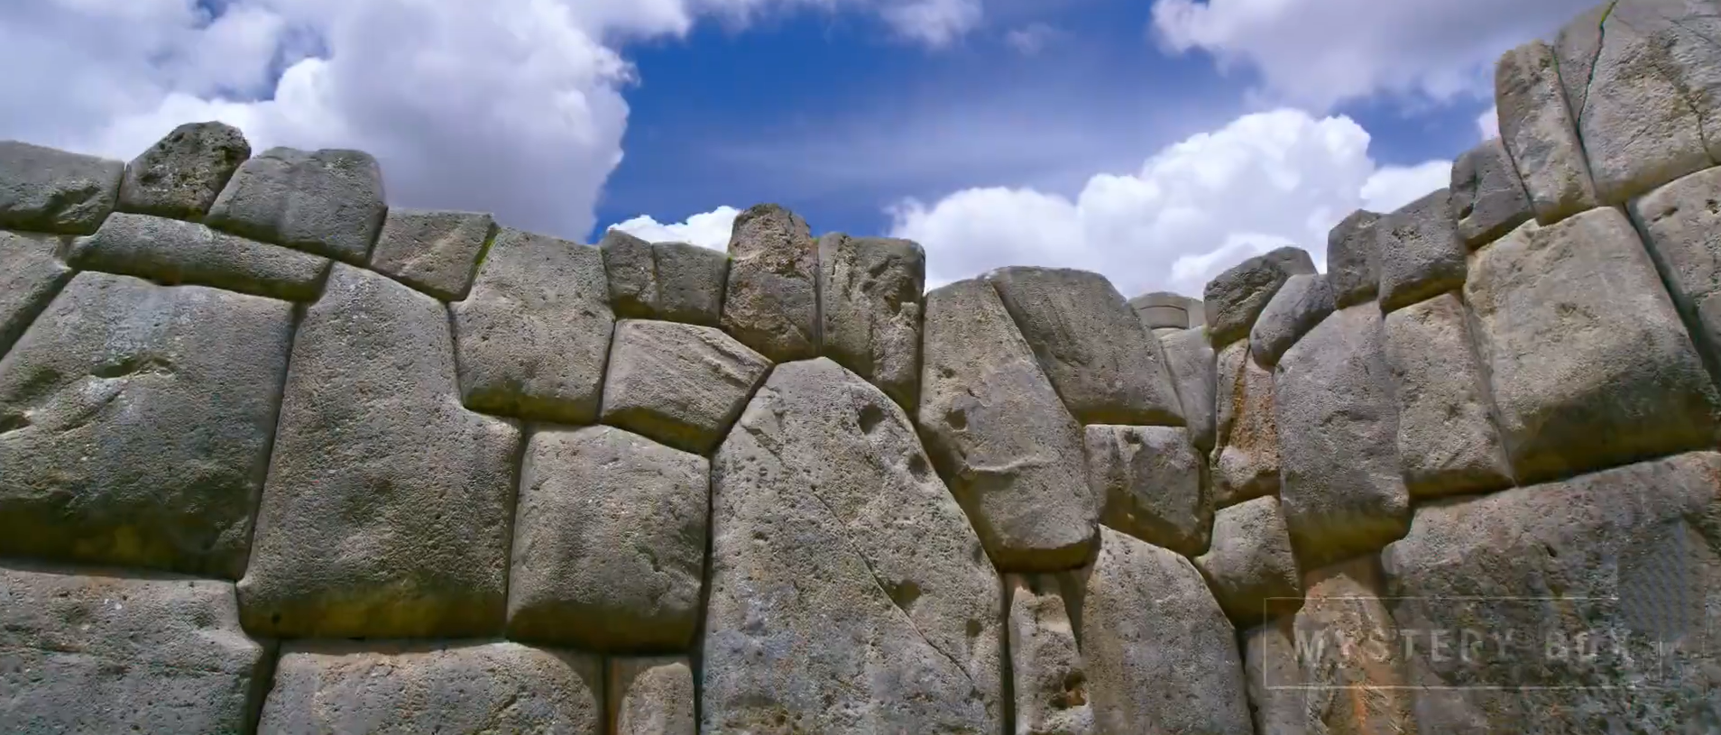
Machu Picchu
What kind of transport will you take to travel to Machu Picchu?
What is the special feature of the stones ?
What do you know about the history of this old city?

Slide 18
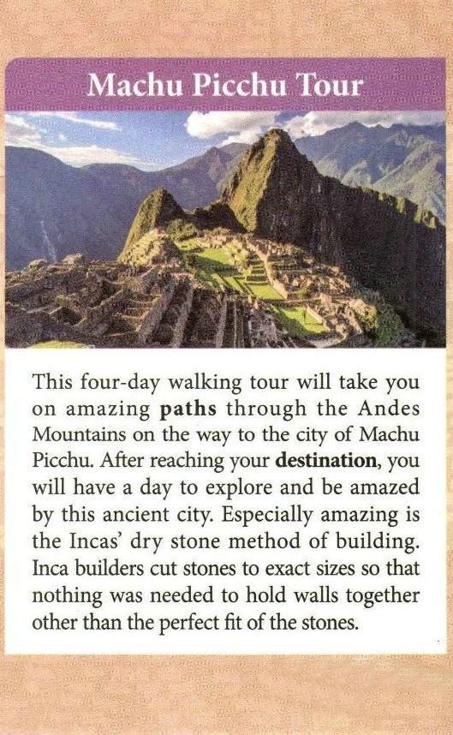
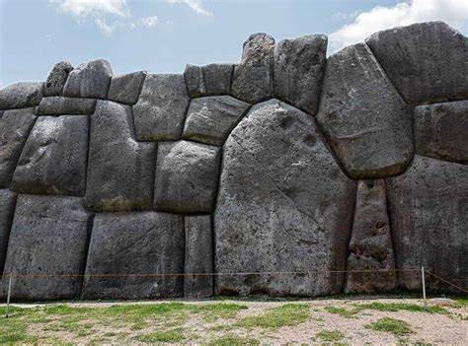
on foot
Transport
5 days
explore the ancient city, especially the dry stone method of building
Activity
Why will you be amazed?

Slide 19
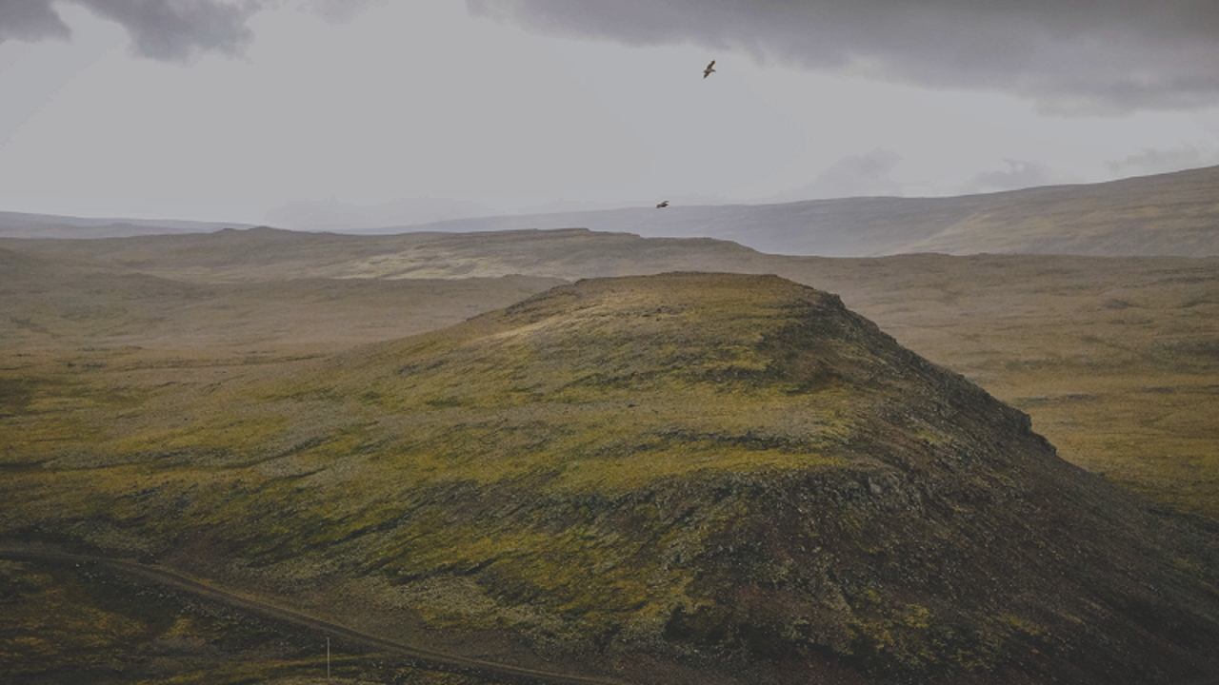
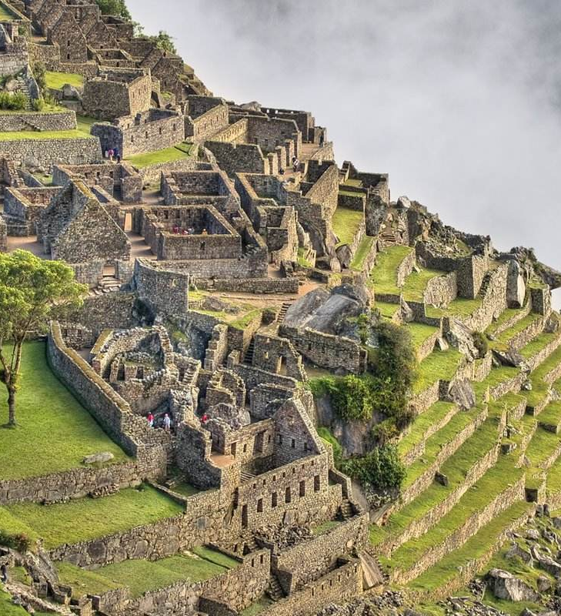
Machu Picchu, which means“Old Mountain”, is an Inca site in the mountains of Peru which is often referred to as the
“Lost city of the Incas”
Machu Picchu was the official home of the Inca rulers in the middle of the 15th century,

Slide 20
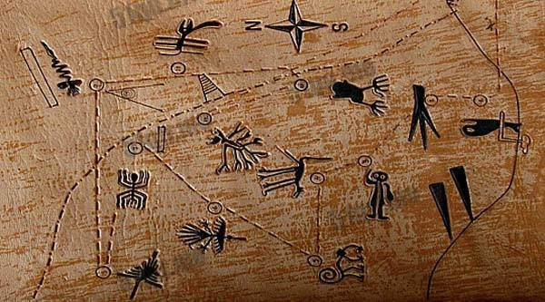
Nazca Lines
Amazing
Ancient
Mysterious
Beauty of History

Slide 21
Lake Titicaca Tour
Mother Lake of South America

Slide 22
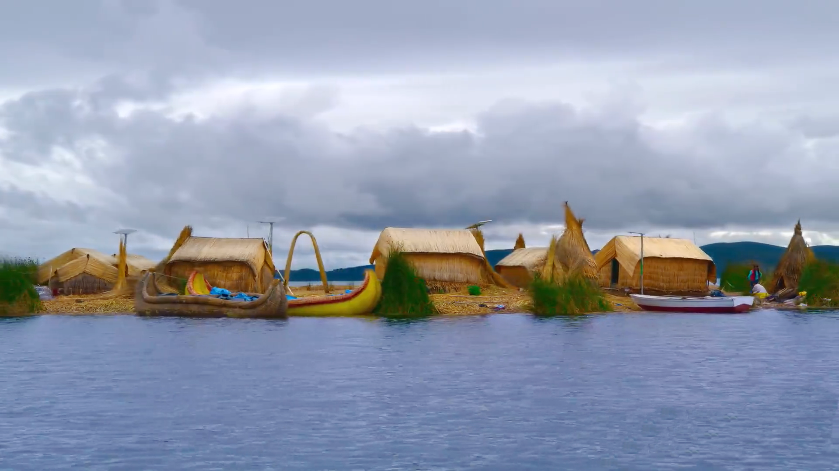
Lago Titicaca
What activities will you experience on this tour?
What is unusual about the islands of Lake Titicaca?
How many days will you stay there?

Slide 23
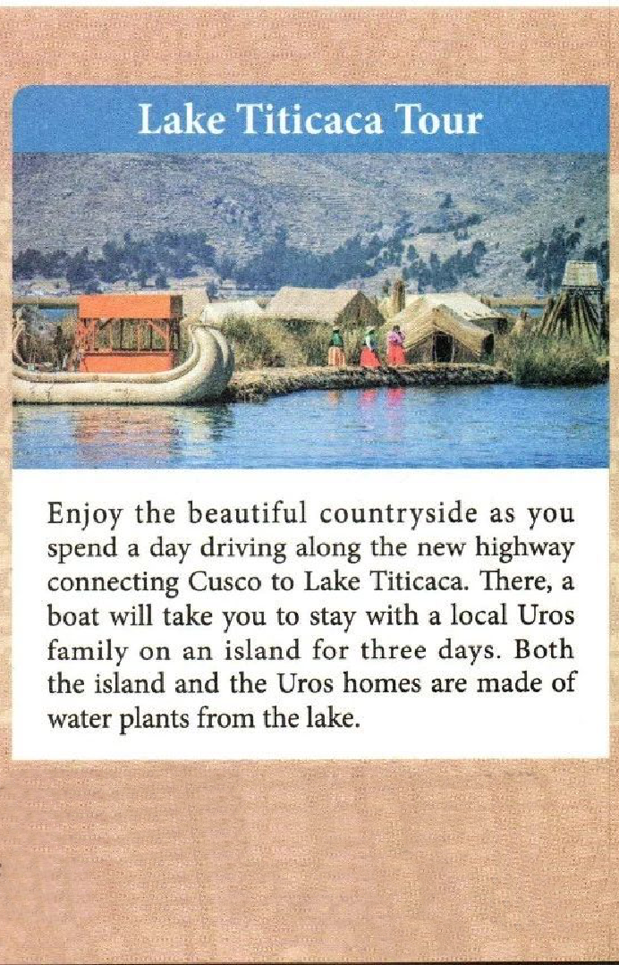
by car & boat
Transport
stay in local houses
Accomodation
experiencing local life
enjoying the beautiful countryside
boating
fishing
Activity
4 days
That's why the islands often float on the lake.

Slide 24
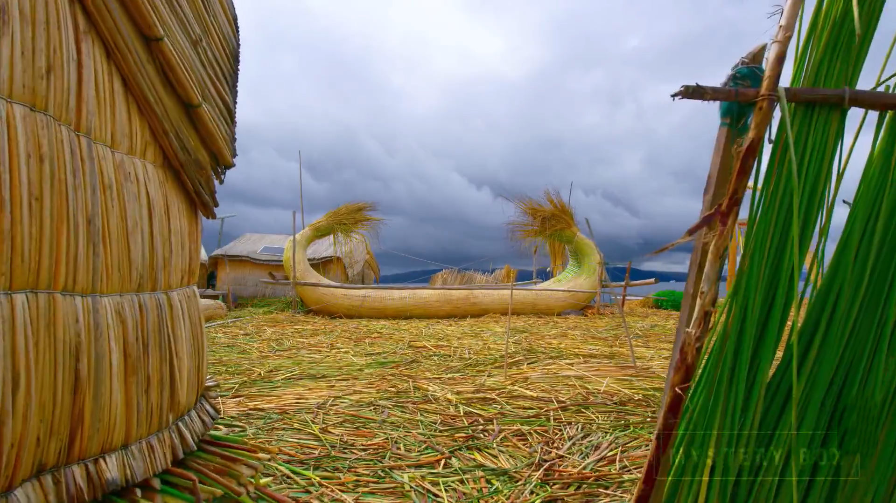
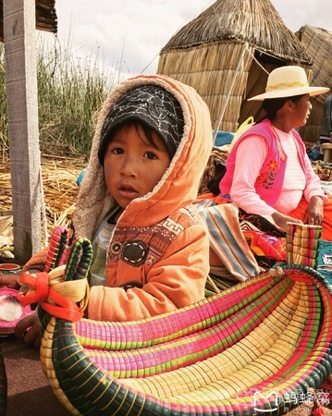
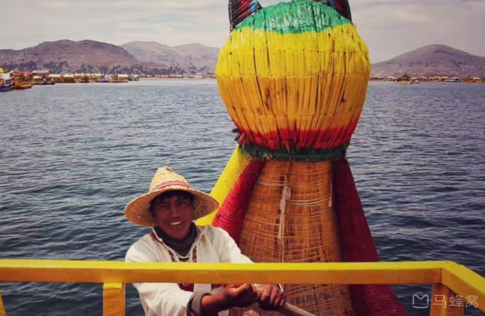
People from the Uros floating
islands and the houses made of reeds(芦苇）

Slide 25
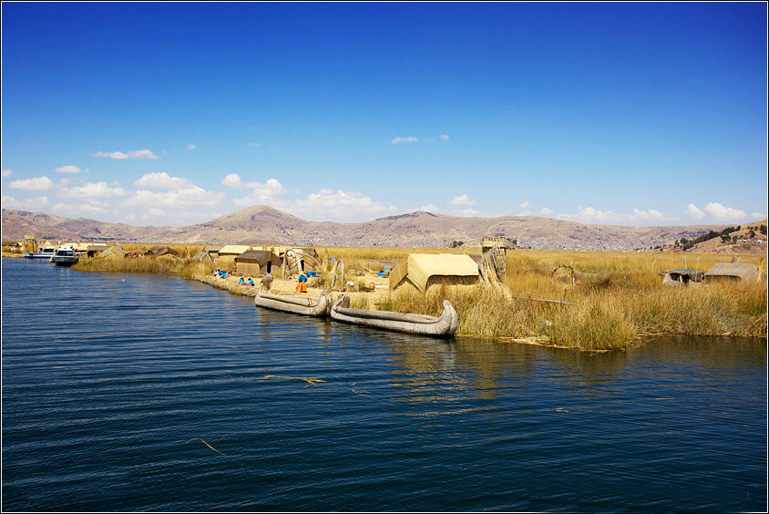
Lake Titicaca
Beautiful
Simple
Harmonious
Beauty of the Countryside

Slide 26
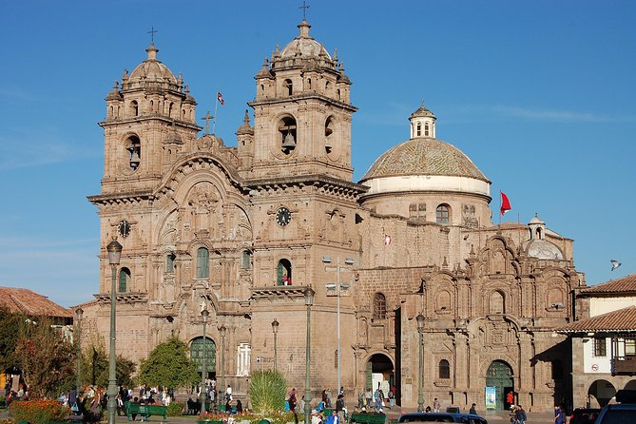
Cusco
World Heritage Site

Slide 27
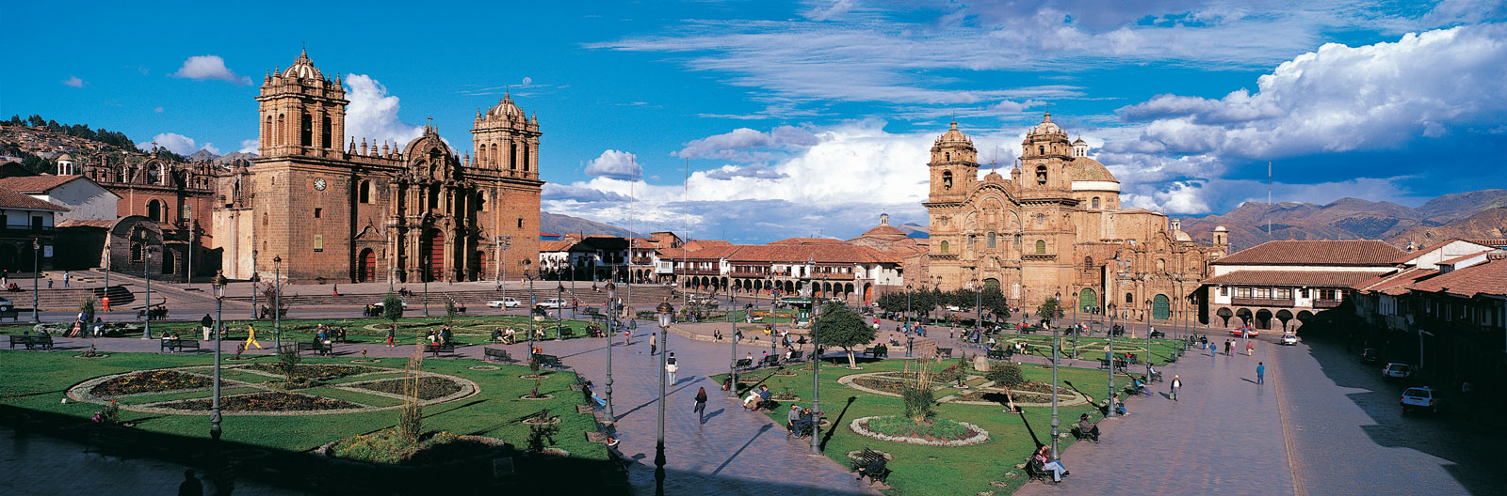
Plaza de Armas
What will you enjoy in Cusco?
What do you know about the history of Cusco?
How many days will you stay there?

Slide 28
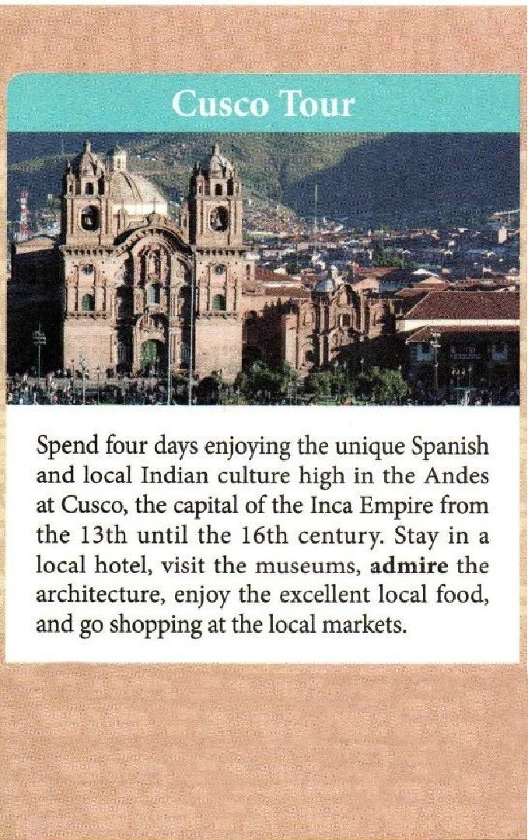
stay in a hotel
Accomodation
visiting museums
admire the architecture
Activity
enjoying local food
shopping at local markets
Historical
Cultural

Slide 29
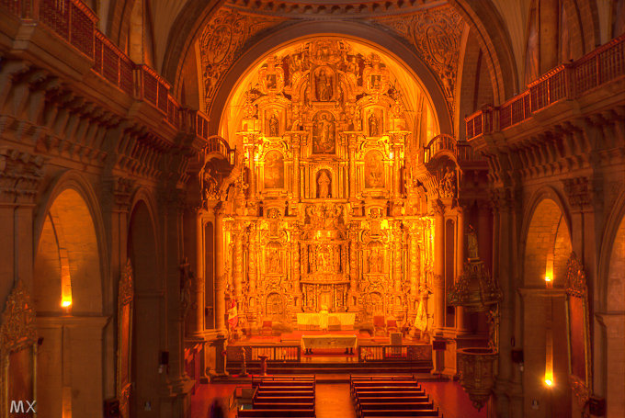
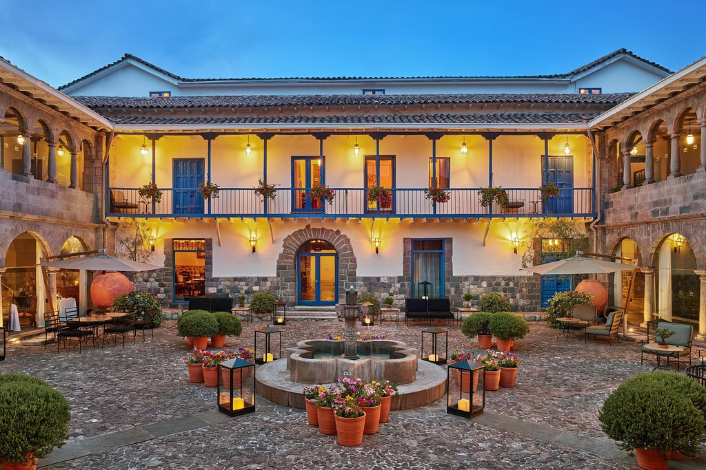
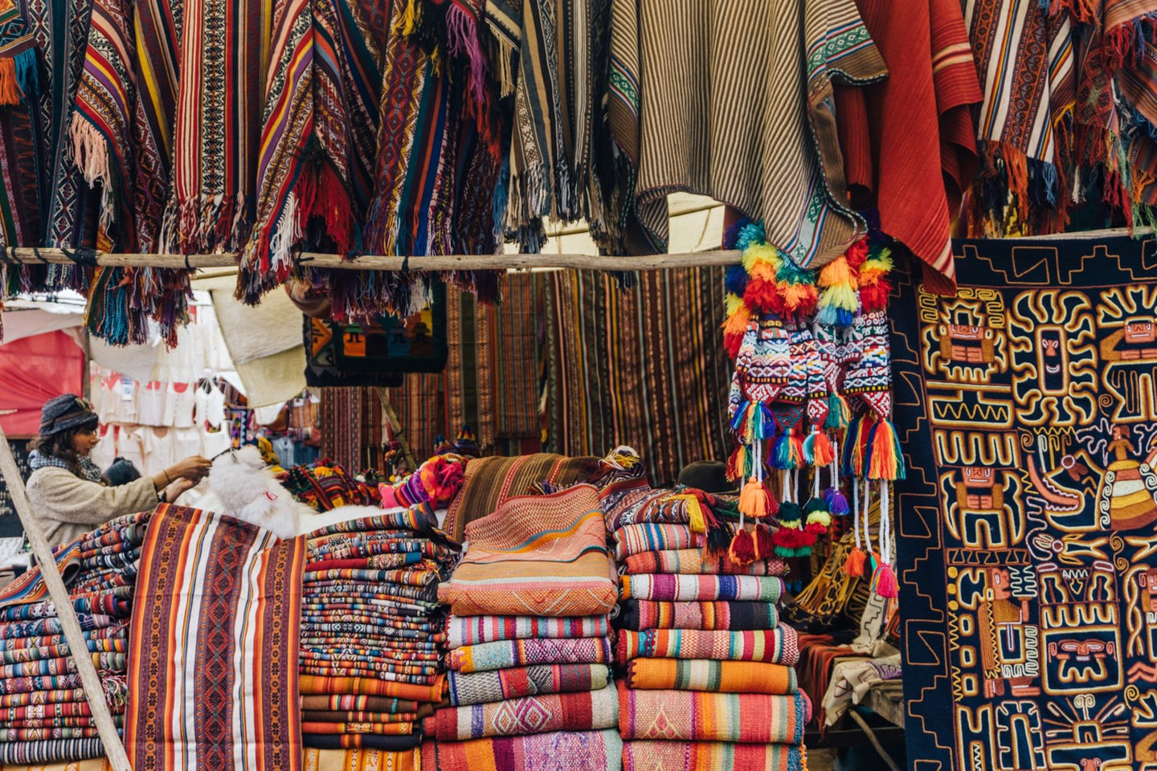
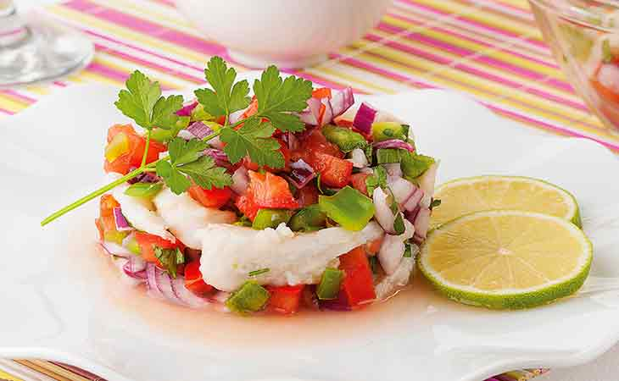
Church
Hotel
Market
Food

Slide 30
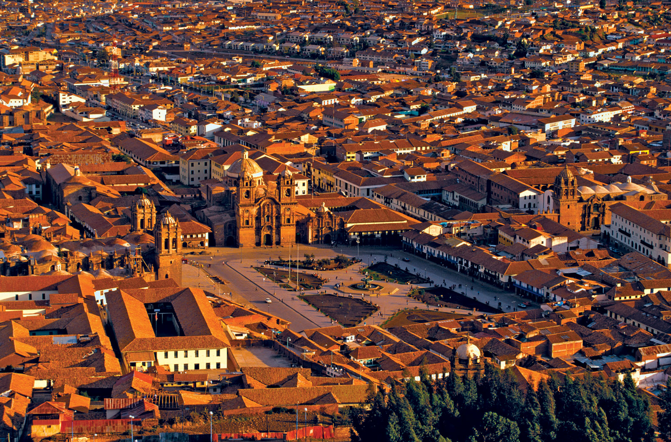
Cusco
Historical
Cultural
Artistic
Beauty of the City

Slide 31

Which tour(s) would you recommend for people who enjoy history and culture?
If you are traveling to Peru, which tour(s) will you choose? Why?

Slide 32
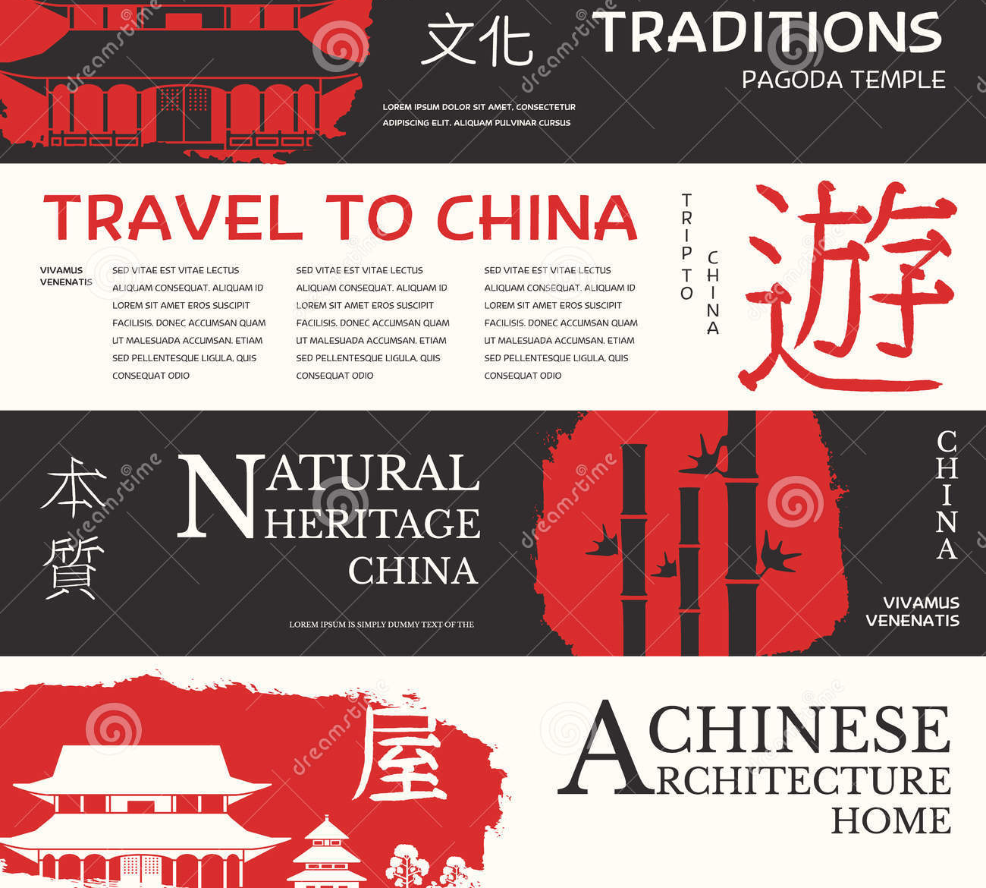
Project:
Design a travel brochure
Your friends are going to visit China. Please recommend a tourist city and design a travel brochure for each of them.

Slide 33



I'm interested in China's history and culture. I'm going to see the Great Wall, but other than that, I'm not sure where to go. Any ideas?
I want to go hiking in China over the summer holiday. I love nature, and I really want to see the beautiful sights there. The mountains, the sky, the lakes are wonderful.
I want to visit a few universities or colleges in China, since I hope to study there next year. I want to experience some Chinese culture and see the natural beauty there.

Slide 34

Tips:
The goal of a travel brochure is to get you interested in their tours. In a travel brochure, you can always ﬁnd some words and expressions which are very powerful, expressive, and impressive.
Number of days,transport, accommodation, activity should be included.

Slide 35

A fight will take you to an amazing city-Huangshan. If time permits, there will be a visit to the Tunxi Old Street on the first day, which is lined with Hui-style buildings along the flagstone lanes. Here you will have a taste of the Huizhou specialties or purchase the Huizhou ink and the local tea as souvenirs. In the following 2 days, your tour will expand to its highlight - Huangshan Scenic Area. Here you will enjoy fantastic pines and rocks, the sea of clouds and hot springs. Along the hiking route, you will encounter a lot of incredible sights including Jade Screen Peak, Guest Greeting Pine, Lotus Peak, One-Line Sky, Bright Summit, and Flying Stone… You will check in a hotel on the mountain to spend the night and watch the fantastic sunrise early next morning.
One possible version

Slide 36

Thank you!

